Slide 1
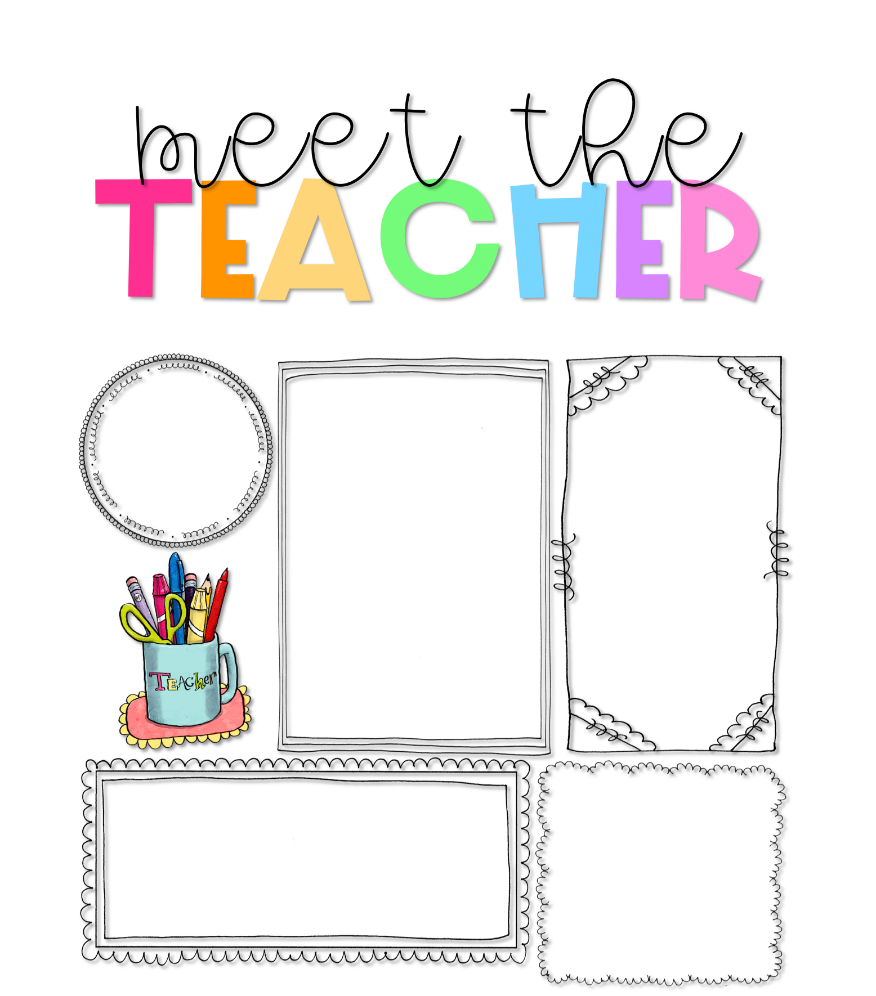
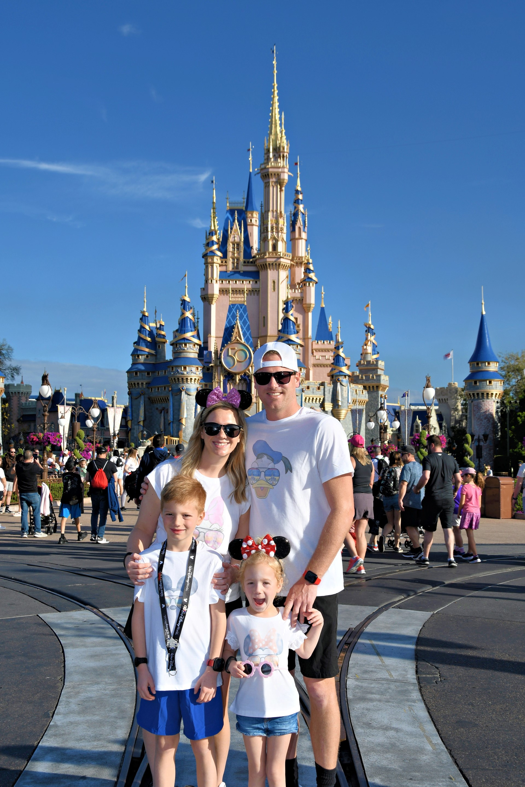




Mrs. Mackenzie Rongey
About Me
Welcome to third grade! This is going to be an amazing year!
Hello! I am Mackenzie Rongey, and I am so excited to be teaching third grade this year! I live in Fenton, MO with my husband and two kids, Oliver (8) and Penelope (5).
I attended UMSL where I received my Bachelors in Early Childhood Education. In 2016, I completed my first Master’s Degree in Gifted Education
I come from a family of teachers. In my family, there are seven people currently in education. They include my two sisters, three cousins and two aunts. My mom and grandfather have also been teachers! I like to say that teaching runs in my blood! I love learning new things and continuing to find ways to master my teaching. This is my 11th year at BWCJA. This is going to be such a fun year!
Contact Me
My Favorites
I welcome and value parent involvement throughout the year. I would love to hear from you, and you are welcome to contact me with any questions, comments, or concerns you may have.
Food:
Tacos
Drink:
Diet Coke & Coffee
314-353-8875
Candy:
Snickers
Mackenzie.Rongey@slps.org
Hobby:
Anything outdoors!
Book:
The Harry Potter Series
Subject:
Reading

