Slide 1
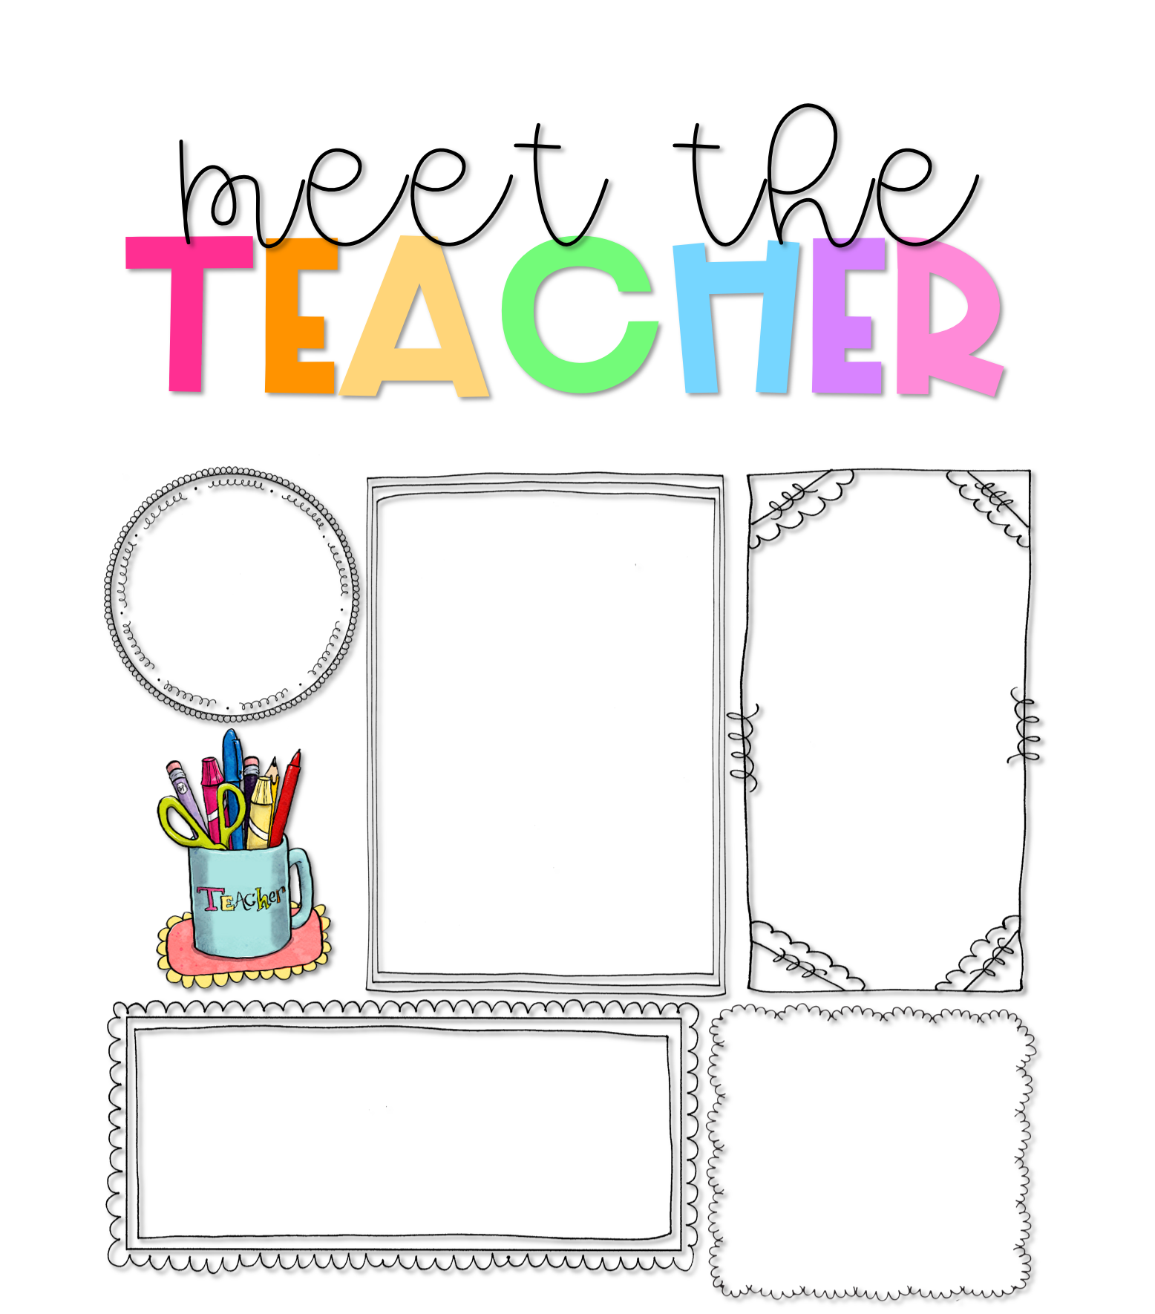
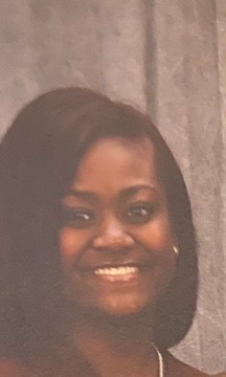
Ms. Kathryn Hayden
About Me
Welcome to 2nd Grade!
I am looking forward to having your child as a student, this year. Second grade is such a fun year with so many wonderful learning opportunities. My most important goal is create a safe and encouraging environment, where students believe they can be anything or anyone they want to be. Parents, you know your child better than anyone. Please help me achieve this goal by communicating with me and letting me know how I can support your child and your family. We will get through this year together. Please reach out to me. I am here for YOU!
Hello! I am Kathryn Hayden and I am your child’s second grade teacher. I have a Bachelor’s Degree in
Elementary Education and a minor in English from Webster University. This is my third year at Gateway. I am going back to school to receive a Master’s Degree in School Counseling. I love my city and the people in it. I am excited for this year!
Contact Me
My Favorites
I welcome and value parent involvement throughout the year. I would love to hear from you. Please contact me with any questions, comments, or concerns you may have.
Food:
Tacos
Drink: Water
Candy: Kit-Kat
*314-441-6546 (cell)
Hobby: Anything Outdoors
Class DOJO
Book: “Oh the Places You’ll Go”-Dr. Seuss
Kathryn.Hayden@slps.org
Subject:
Science

