Slide 1
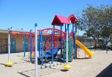
Woodward PK 006
Daily Schedule
9-9:30 Breakfast
9:30-10:00 Morning Meeting
10:00-10:30 Small Groups
10:30-11:00 Recess (Gross Motor)
11:00-11:55 Ancillary
12:00-12:30 Lunch
12:30-2:00 Restroom, rest, restroom
2:00-2:45 Centers/small groups
2:45-3:00 Snack
3:00-3:50 STEAM
3:50-4:00 Dismissal

