Slide 1
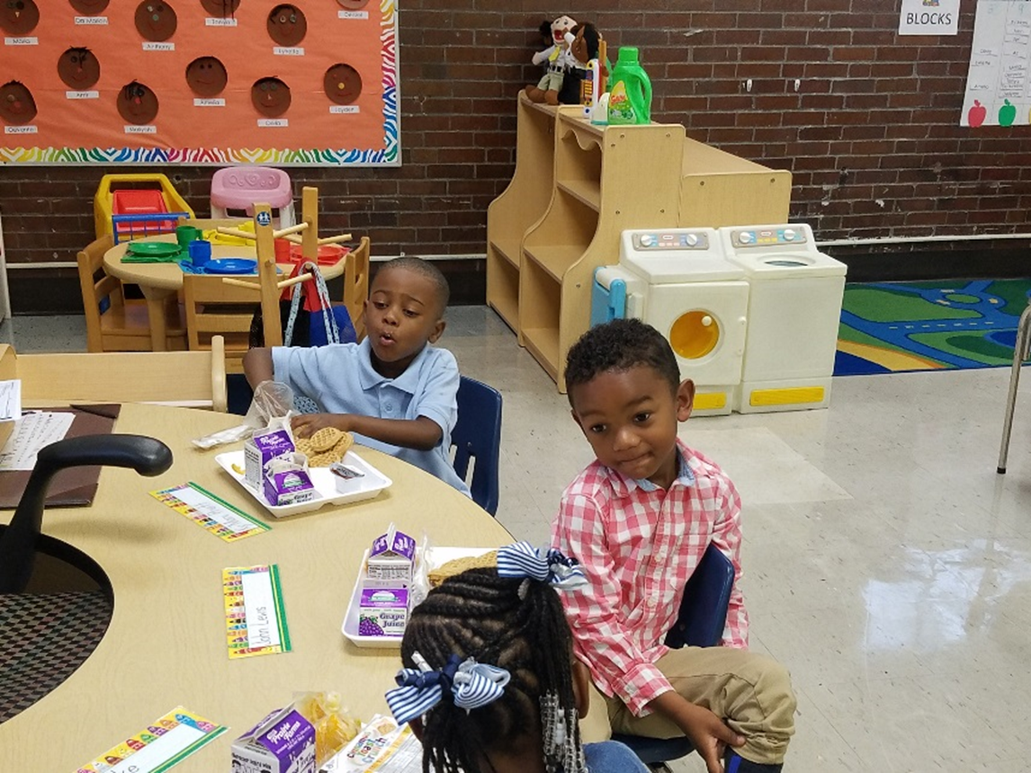
Breakfast in the Classroom
Althea Albert-Santiago,
Director of Food and Nutrition Services
Krystal Simmons, RD,
Nutrition Coordinator
Putting Child Nutrition First

Slide 2
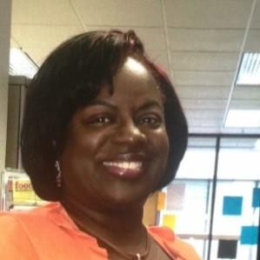
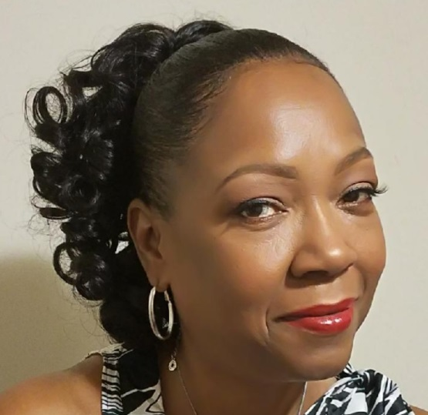
Food & Nutrition Services Management Team
Althea Albert-Santiago
Carolyn Penn
Krystal Simmons, RD
Director of Nutrition Services
General Manager of Foodservice
Nutrition Coordinator

Slide 3
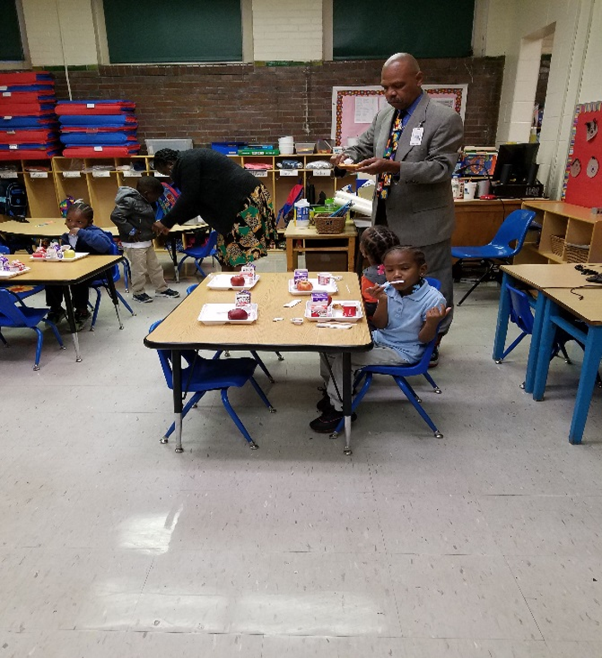
What is Breakfast In The Classroom (BIC)?
Breakfast in the Classroom (BIC ) takes the traditional school breakfast approach and advances it with one key ingredient: The Classroom.
The goals for BIC :
Ensures that students are receiving a healthy breakfast every day
Improves student attendance
Breakfast participation
Improves behavior in classroom
Students will stay focused longer after eating breakfast
Improves academic performance and test scores
Information obtained from: Food Research and Action Center (FRAC)

Slide 4
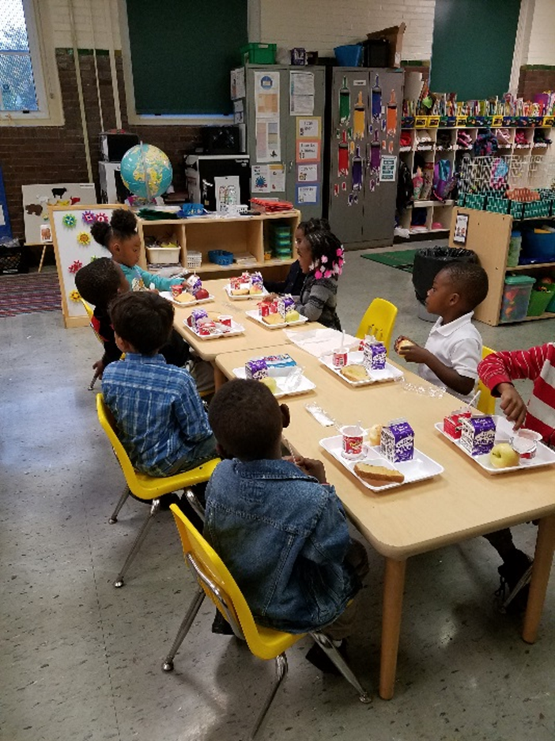
How does Food and Nutrition Services
support teachers?
Collaboration Efforts
The Food and Nutrition Services Department understands the importance of implementing a proper BIC Program
All teachers will receive a free breakfast! Please add your name to the check off roster
Each morning the foodservice team will prepare both hot and/or cold coolers with Grab ‘n’ Go breakfast items that are Easy-to-serve, Easy-to-eat and Easy-to cleanup
One of the greatest concerns expressed is lost instructional time
Often it takes time for children to settle in at the beginning of the day and many teachers find BIC compliments their instructional activities by providing a transitional period
BIC generally takes approximately 10-15 minutes to serve and eat
The coolers are delivered to the classroom 15 minutes prior to the first scheduled bell
Upon completion of BIC, all remaining food items and roster are placed back into the coolers, and at which time a member of the food service team will pickup the cooler

Slide 5
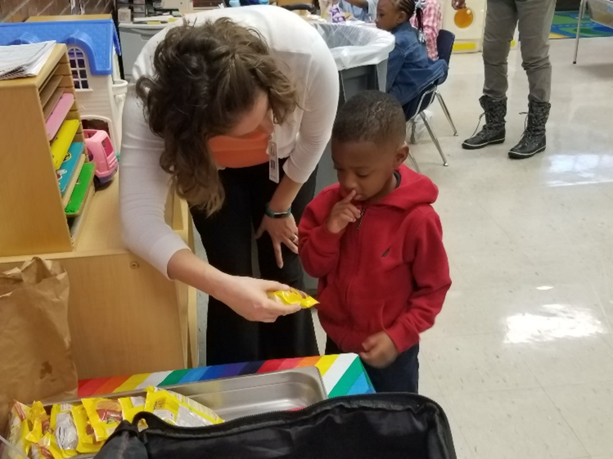
Implementation Process
Process:
Foodservice staff prepares breakfast meal
BIC is a *serve only menu
Hot and/or cold coolers are transported to classrooms (15 minutes prior to the first scheduled bell)
Foodservice staff will place rosters and all needed items in the hot/cold coolers
Teachers will mark off students as students receive a sack breakfast
All teachers will receive a free breakfast! The teacher name should be added to the check off roster
Trash bags and coolers are placed outside the classroom door and a member of the foodservice staff will pick up the breakfast cooler(s) and trash
*Serve only means students have to take all items offered for breakfast

Slide 6
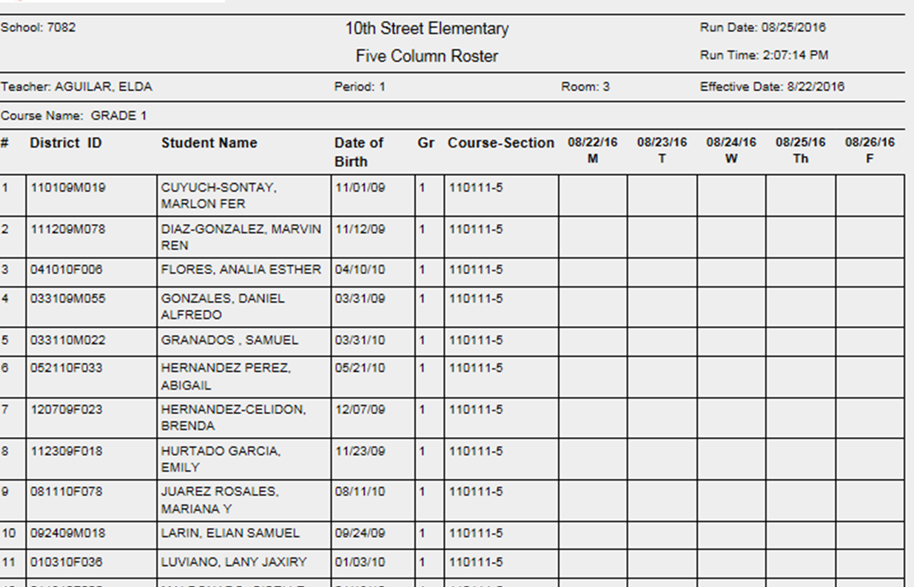
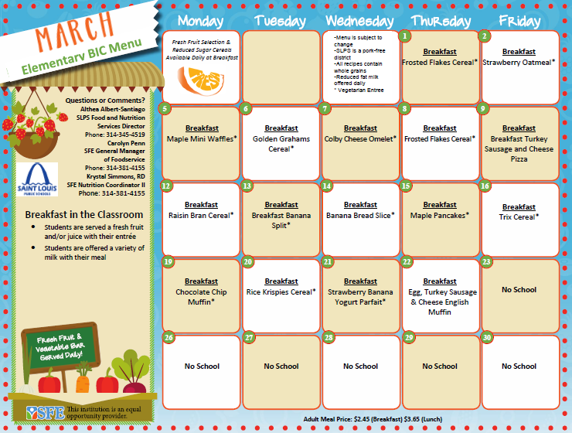
Sample BIC Class Roster and Menu

Slide 7
Second Chance Breakfast
Each school will have a Grab and Go Breakfast Cart
This will be a second chance option for students arriving after the bell
The students will have the option to take breakfast items to the classroom

Slide 8
Share Table Signage

Slide 9
Special Diets
Written documentation form licensed practitioner
Diet order
Signature
Food Service will make accommodations

Slide 10
Contacts
Food and Nutrition Services
Althea Santiago,
Director Food and Nutrition Services
althea.albert-santiago@slps.org
District Cell Number: 314-401-9870
Office Number: 314-345-4519
Tenecia Williams,
Accountability Specialist
Tenecia.williams@slps.org
Office Number: 314-345-2308
Erika Hollinshed,
Catering Services Coordinator
Erika.Hollinshed@slps.org
Number: 314-331-6115
Southwest Foodservice Excellence (SFE)
Carolyn Penn,
General Manger of Foodservice
Carolyn.penn@sfellc.org
District Cell Number: 314-637-4841
Jackie Martin-Baker
Assistant General Manager of Foodservice
Jackie.martin-baker@sfellc.org
District Cell Number: 314-2294746
Krystal Simmons, RD
Assistant Director of Nutrition
Krystal.simmons@sfellc.org
District Cell Number: 636-328-7701
This institution is an equal opportunity provider

