Slide 1
Goal 1 - Fossils
Fossil - Any preserved remains, impression, or trace of any once-living thing from a past geological age.

Slide 2
Types of Fossils

Slide 3
Amber Fossil
When an organism gets trapped and preserved in amber and fossilizes.
Bones
Entire body
Teeth

Slide 4
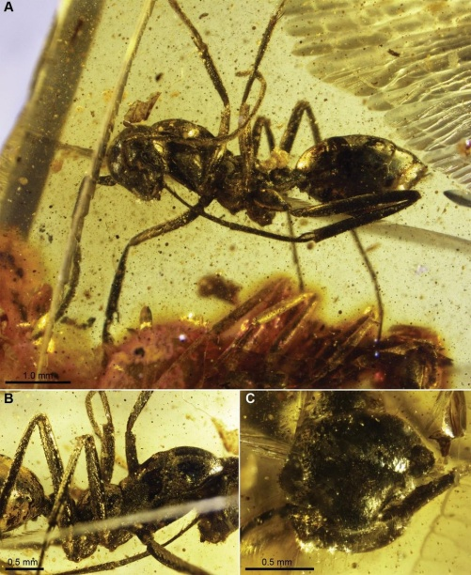
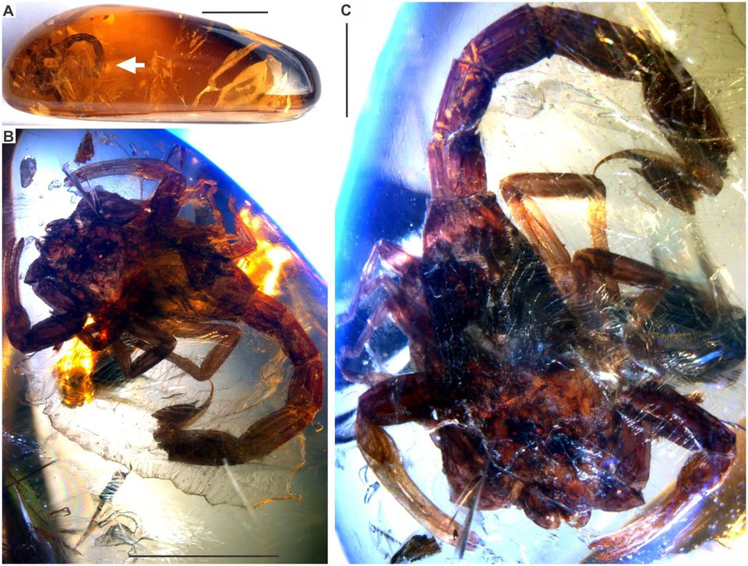
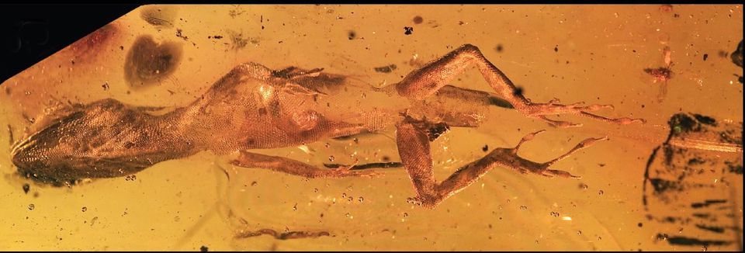
Amber Fossil Examples
99 Million Year Old Ants
15 Million Year Old Scorpion
20 Million Year Old Lizzard

Slide 5
Amber (Def)
Types of Fossils

Slide 6
Carbonized Fossil
All living things are made of Carbon
A Carbon Film is the film of carbon left on a rock by a decaying organism and is preserved as a fossil.

Slide 7
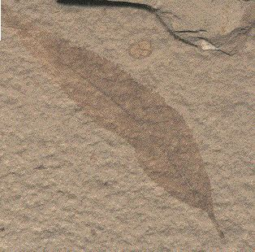
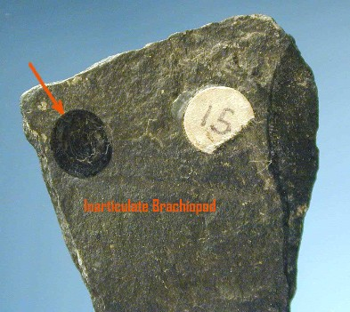
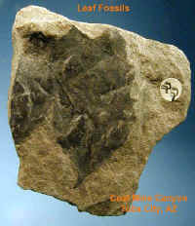
Carbon Film Examples

Slide 8
Amber (Def)
Carbonized (Def)
Types of Fossils

Slide 9
Mold Fossil
Fossil that forms when an organism decays or dissolves and leaves a cavity in the rock.

Slide 10
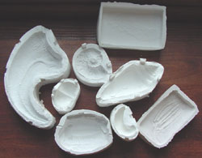
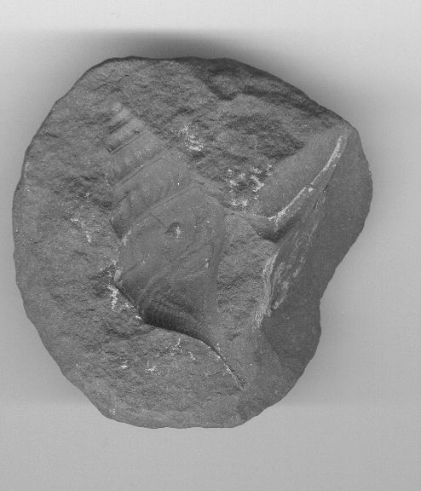
Mold Fossil Examples

Slide 11
Amber (Def)
Carbonized (Def)
Types of Fossils
Mold (Def)

Slide 12
Cast Fossil
Fossil that forms when a mold fills with sediment and then hardens into rock.

Slide 13
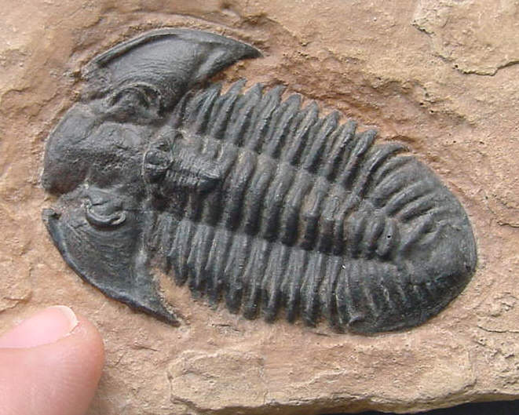
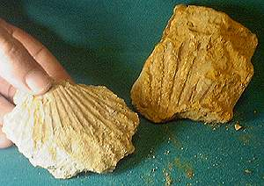
Cast Fossil Examples

Slide 14
Amber (Def)
Trace (Def)
Carbonized (Def)
Tar Pit (Def)
Types of Fossils
Cast (Def)
Mold (Def)

Slide 15
Trace Fossils
Preserved footprints, trails, burrows, or any marks that tell about how things lived.

Slide 16
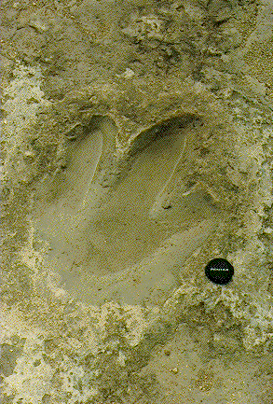
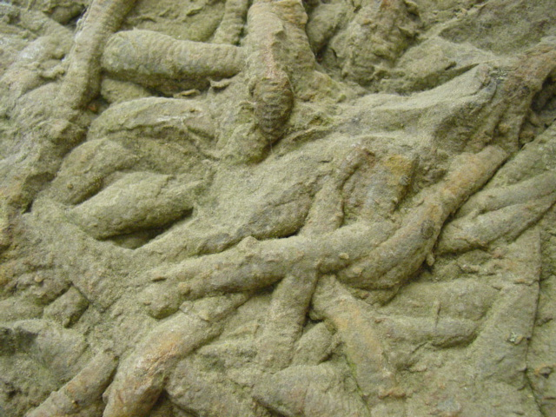
Trace Fossil Examples

Slide 17
Amber (Def)
Trace (Def)
Carbonized (Def)
Types of Fossils
Cast (Def)
Mold (Def)
Permineralized (Def)

Slide 18
Tar Pit Fossils
When an animal gets stuck in asphalt and the soft tissue is decomposed but hard tissue is preserved.

Slide 19
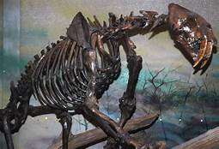
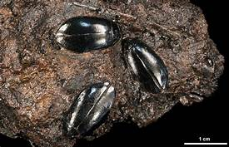
Tar Pit Examples

Slide 20
Amber (Def)
Trace (Def)
Carbonized (Def)
Tar Pit (Def)
Types of Fossils
Cast (Def)
Mold (Def)
Permineralized (Def)

Slide 21
Permineralized Fossils
When an organisms tissues are replaced by minerals from water and turns to stone.

Slide 22
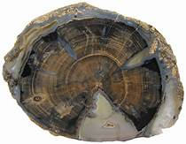
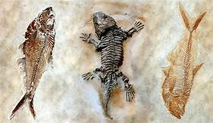
Permineralized Fossil Examples

Slide 23
Amber (Def)
Trace (Def)
Carbonized (Def)
Tar Pit (Def)
Types of Fossils
Cast (Def)
Mold (Def)

Slide 24
Frozen Fossils
When an organisms becomes trapped, dies, and freezes.
The rarest of all fossils.

Slide 25
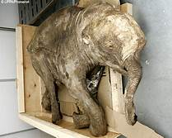
Frozen Fossil Examples

Slide 26
Amber (Def)
Trace (Def)
Carbonized (Def)
Tar Pit (Def)
Types of Fossils
Frozen (Def)
Cast (Def)
Mold (Def)
Permineralized (Def)

Slide 27
Use of Fossils: Indexing
Fossils can be used to date layers of sedimentary rock.
These are the remains of species that lived for a short time and were numerous, and found in many places.

Slide 28
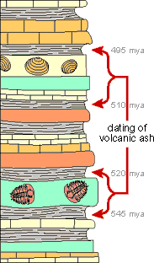
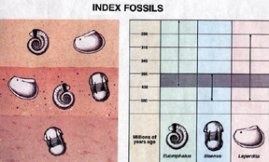
Using Index Fossils

