Slide 1
2019-2022
Strategic Plan
Last revised: June 3, 2021

Slide 2
Purpose of this document
This document represents our preliminary strategic planning to improve our school as we transition into the Consortium Partner Network in July 2019
During the Spring, we’ll continue to update and revise this document based on feedback from stakeholders and as we refine our thinking
We will use aspects of this document to communicate our emerging thinking to various stakeholders (e.g. SLPS, MO DESE, families, teachers, prospective new hires)

Slide 3
Improvement/Accountability Plan
Focus of Plan (check the appropriate box): • LEA • School | Name of LEA: n/a Name of School: Meramec Elementary School School Code: 5500 | Check if appropriate • Comprehensive School ***Requires a Regional School Improvement Team • Targeted School • Title I.A • Autonomous
Date: | June 3, 2021 (revised)
Purpose: To develop a plan for improving the top 3 needs identified in the needs assessment.
School Mission: The mission of Meramec Elementary School is to successfully educate the whole child by building nurturing relationships and providing a sense of belonging and hope, in order to develop life-long learners that become innovative, productive leaders in society.
School Vision: The Meramec Elementary School student will be a goal-driven, problem-solver who leads with integrity in academics and everyday life.
One plan may meet the needs of a number of different programs. Please check all that apply. • Title I.A School Improvement • Title I.C Education of Migratory Children • Title I.D Prevention and Intervention Programs for Children and Youth who are Neglected, Delinquent or At-Risk • Title II.A Language Instruction for English Learners and Immigrant Children • Title IV 21st Century Schools • Title V Flexibility and Accountability • Individuals with Disability Education Act • Rehabilitation Act of 1973 • Carl D. Perkins Career and Technical Education Act • Workforce Innovation and Opportunities Act • Head Start Act • McKinney Vento Homeless Assistance Act • Adult Education and Family Literacy Act • MSIP • Other State and Local Requirements/Needs __________________________________________________________

Slide 4
Who are we?
Who are we?
Where are we now?
Where are we going?
How will we get there?
What will we need to get there?

Slide 5
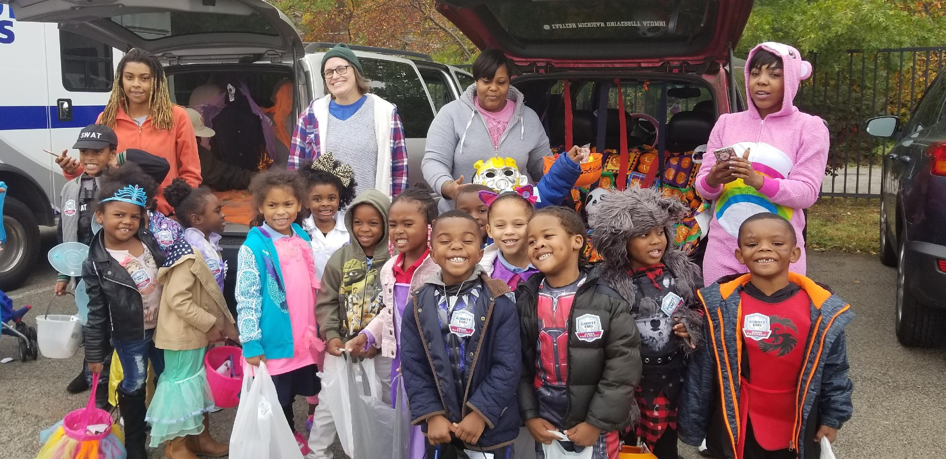
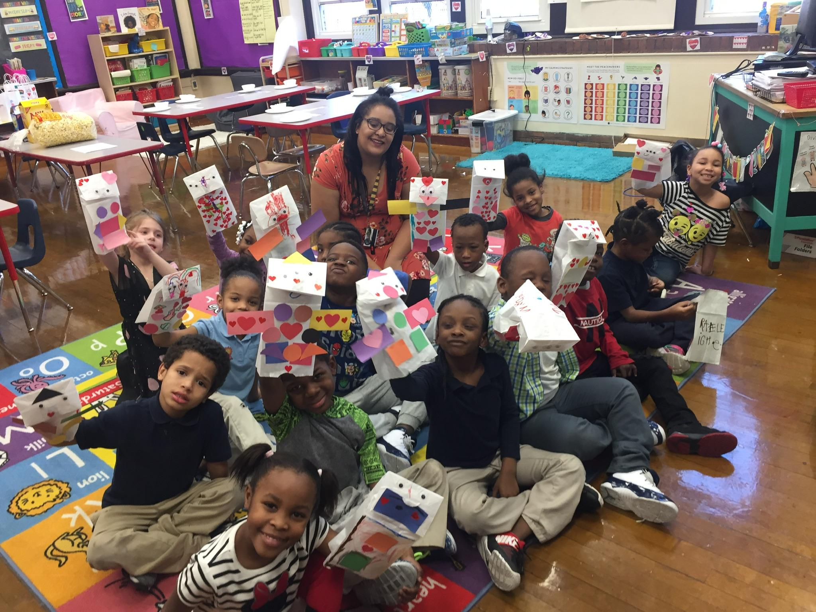
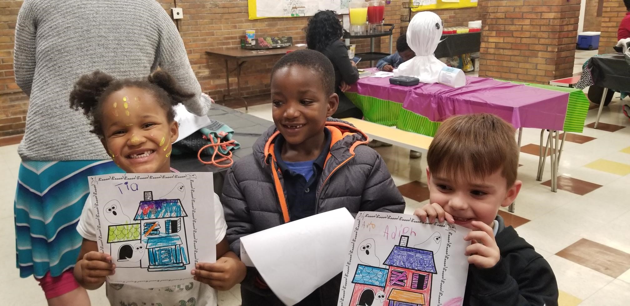
Meramec Elementary is a PK-5 elementary school on the southside of St. Louis

Slide 6
Meramec’s Vision and Mission
Vision
Mission
The Meramec Elementary School student will be a goal-driven, problem-solver who leads with integrity in academics and everyday life.
The mission of Meramec Elementary School is to successfully educate the whole child by building nurturing relationships and providing a sense of belonging and hope, in order to develop lifelong learners that become innovative, productive leaders in society.

Slide 7
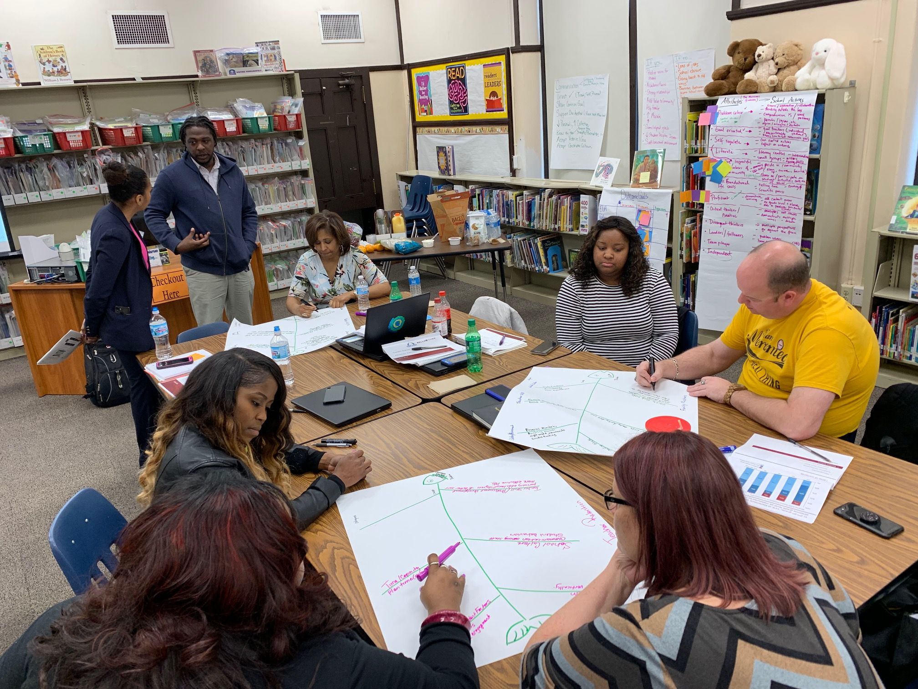
We have a diverse, committed staff of 27, with a representative Teacher Leadership Team to guide plan development
The TLT is leading the development of the plan to improve our school, drawing off years of experience at Meramec
TLT Members:
Name | Title | Years at Meramec
Jonathan Strong | Principal | 4
Brad Besse | 3rd-5th Grade Teacher | 10
Stacy Hearty | K Teacher | 7
Sharissa Ransom | 1st / 2nd Grade Teacher | 7
Tadonya Williams | Secretary | 4
Sherrie McClellan | Counselor | 5
Shannon McMurray | Academic Instructional Coach | 3

Slide 8
Where are we now?
Who are we?
Where are we now?
Where are we going?
How will we get there?
What will we need to get there?

Slide 9
We conducted a Comprehensive Needs Assessment to further assess our current state
Student Demographic
Data Type | Current Information | Reflections
Student Enrollment as of May 28, 2021 | 218 ( up by 9 students from the previous yr) | Our enrollment has declined slightly over the last 3 years
Grade Level Breakdown | PreK - 19; K - 27; 1st - 39; 2nd - 37; 3rd - 43; 4th - 23; 5th - 30 | The majority of the student are in the 1st and 2nd Grade Class
Ethnicity | B -92%; W – 4%; H – 2%; A – 2% | Our student body is predominantly African American
Attendance | 90/90 - 38.3%; ADA –77.23% | Our 90-90 attendance has significant room for improvement
Mobility | 46.80% | The mobility rate is slightly lower than last year, but is still close to 50% and remains a challenge.
Socioeconomic status | 100% | We serve a predominantly low-income student population
Discipline | OSS – 0 ISS - 2 | No out of school suspensions this year; in-school suspensions down 9.6% from last year.
Limited English Proficiency | 2.3% | Our students are predominantly African American with a small population of students with limited English proficiency
Special Education | 10.96% | 5% of our students have disabilities and we must serve these students well
Notes:
UPDATED JUNE 10, 2021

Slide 10
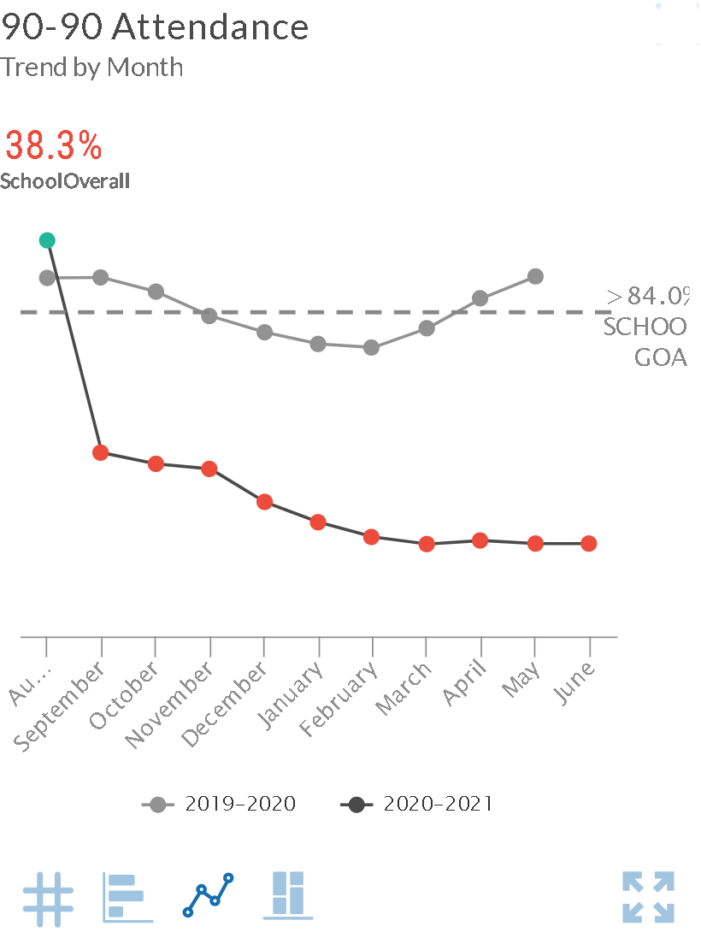
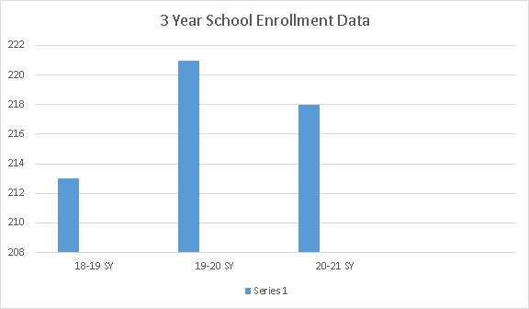
Student enrollment and attendance at Meramec has increased from 2019-2020 to the 2020 - 2021 school year
Meramec student enrollment over time
Meramec % 90-90 Attendance by Year (2019 – 2020 & 2020 - 2021)
Source: MO DESE School Comparison Tool
Notes:
Opportunity to drill down and diagnose by grade level.
PLEASE include district formative data in this section and not just summative data. Thank you.

Slide 11
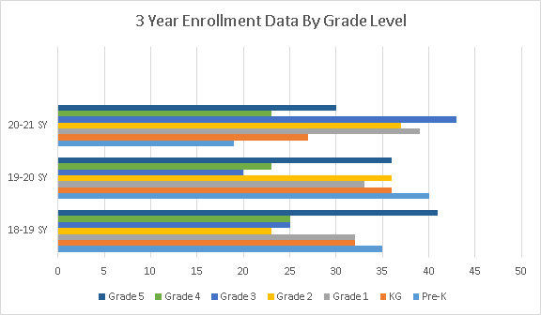
Student enrollment at Meramec from the 2018 - 2021 school years

Slide 12
Based on the Needs Assessment, we have identified strengths, weaknesses, and needs related to student demographics
Strengths | Weaknesses | Needs
● We have decreased suspensions this school year ● We are seen as a community school drawing the students from our community ● We serve all students—regardless of income, race, or whether they have disabilities | ● Our 90-90 student attendance results are too low; we wish to improve this through this plan ● Though student mobility is mostly out of our control, the mobility rate experienced by our school is very high | ● Support increasing student attendance and decreasing student mobility—two major challenges facing our school and community ● Foster an environment that encourages greater student attendance

Slide 13
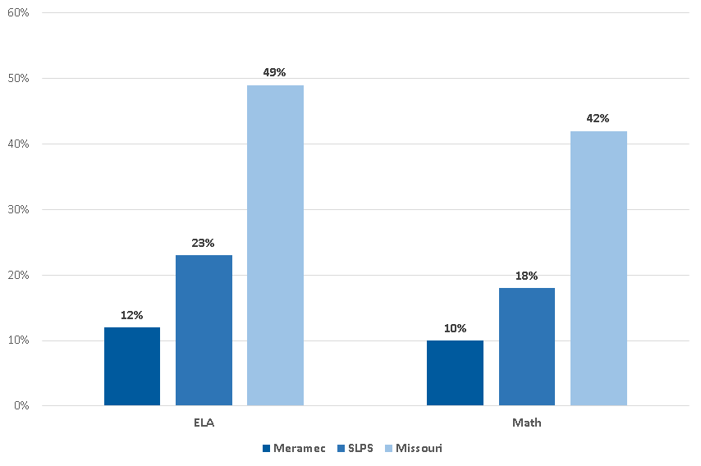
Today at Meramec, fewer students are proficient / advanced in ELA and Math than the district or state
% Students Proficient or Advanced on ELA and Math at Meramec, SLPS, and MO in 2019
Source: MO DESE School Comparison Tool
Note: Proficiency data displayed here are slightly higher than Meramec’s internal data; we share the state-reported data to compare against SLPS and MO
Notes:
UPDATED JUNE 10, 2021

Slide 14
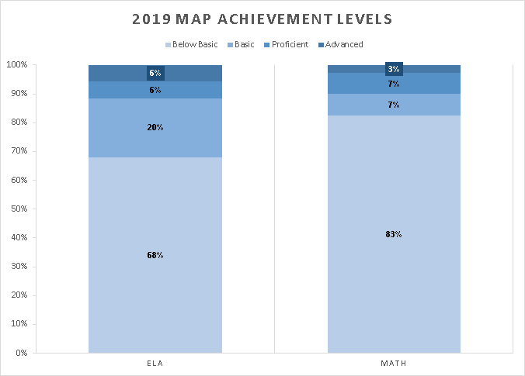
At Meramec, 68% of students are below basic in ELA and 83% are below basic in Math
Notes:
UPDATED JUNE 10, 2021

Slide 15
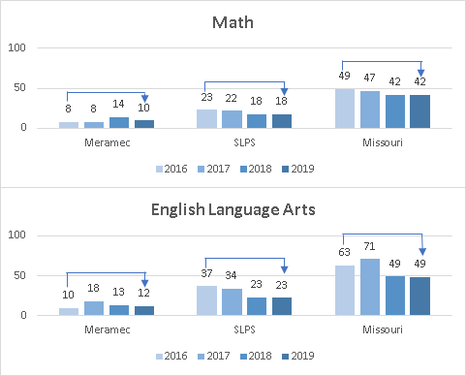
Percent of Students Proficient/Advanced on MAP Over Time
Source: MO DESE School Comparison Tool
Notes:
UPDATED JUNE 10, 2021

Slide 16
In our Comprehensive Needs Assessment, we reflected upon our current achievement data for 18-19 Data unavailable for 19-20
Goal Areas | 18-19 performance | 20-21 Goal | Current Performance | Explanation/Rationale for Current Performance
ELA | 2183 | 180 MPI | 150 MPI | ● High mobility and low attendance have decreased the amount of instructional time we have with a significant portion of our students ● Our ELA curriculum is not scaffolded across PK-5 ● We need to improve data monitoring and responsive interventions in ELA ● We must better develop teacher skill in ELA instruction
Reading | 2143 | 175 MPI | 145 MPI | ● High mobility and low attendance have decreased the amount of instructional time we have with a significant portion of our students ● Our Reading curriculum is not scaffolded across PK-5 ● We need to improve data monitoring and responsive interventions in Reading ● We must better develop teacher skill in Reading instruction
Math | 2172 | 185 MPI | 150 MPI | ● High mobility and low attendance have decreased the amount of instructional time we have with a significant portion of our students ● We need to improve data monitoring and responsive interventions in Math ● We must better develop teacher skill in Math instruction
Science | 2247 | 190 MPI | 160 MPI | ● High mobility and low attendance have decreased the amount of instructional time we have with a significant portion our students ● We have prioritized ELA and reading achievement over Science ● We must better develop teacher skill in Science instruction ● We would like to increase hands-on materials and resources in Science

Slide 17
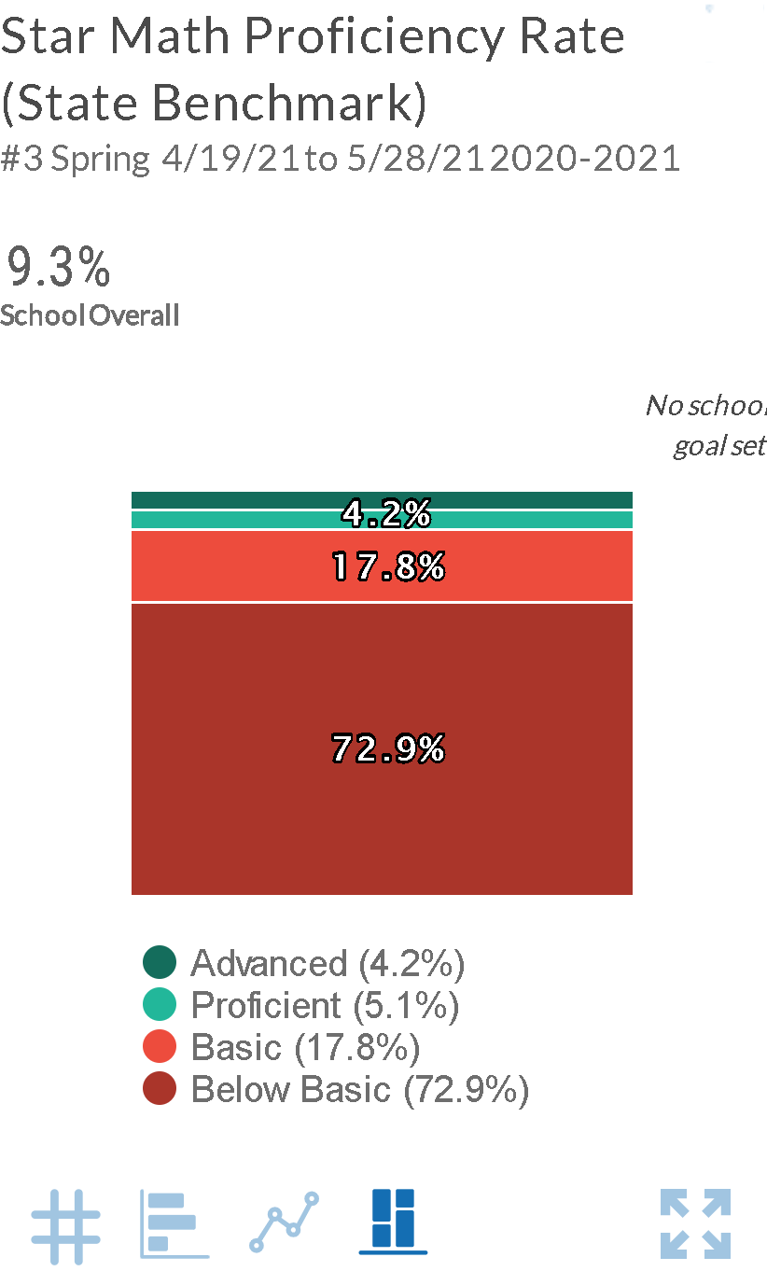
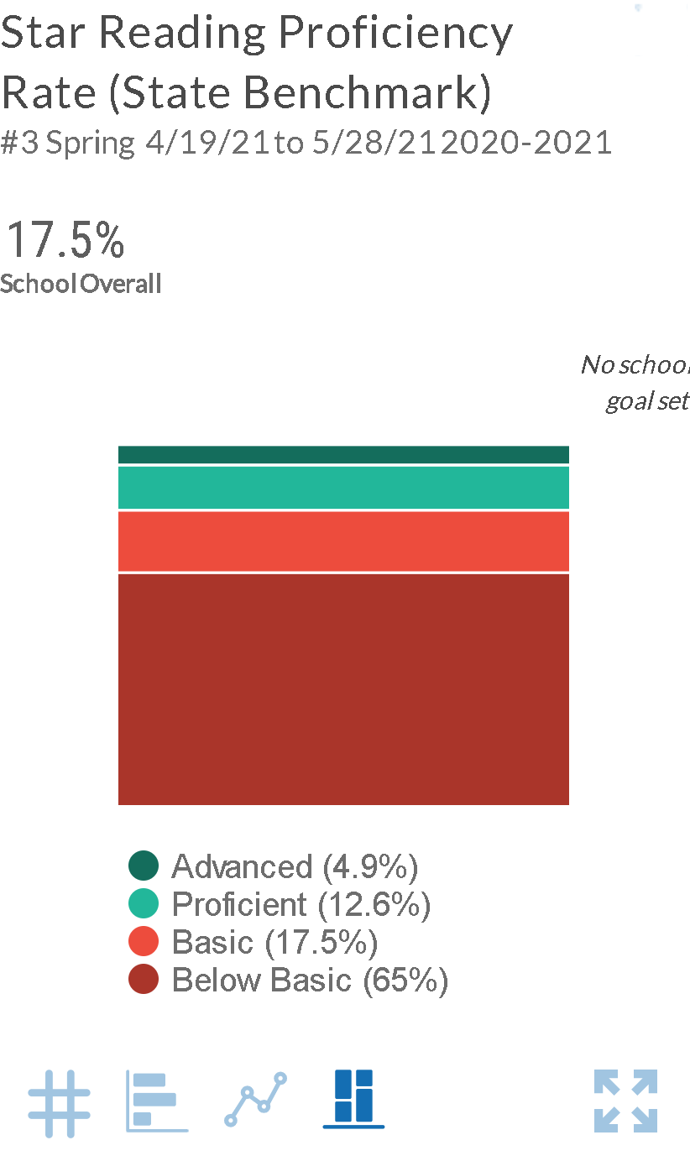
Star Assessment Reading and Math ProFormance Indicator

Slide 18
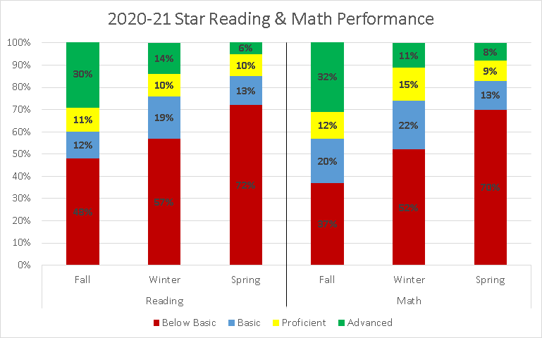
Star Assessment Reading and Math Performance from Fall 2020 to Spring 2021
Notes:
UPDATED JUNE 11, 2021

Slide 19
Based on the Needs Assessment, we have identified strengths, weaknesses, and needs related to academic proficiency
Strengths | Weaknesses | Needs
● Via the CPN process, we are forming a high-performing TLT and putting together an effective plan to improve student achievement | ● In all subject areas, our projected 18-19 performance falls below our 18-19 goals ● Our student proficiency needs to improve ● Due to COVID-19, we struggled with consistent student attendance and in-class participation | ● Continued time w/ our TLT to create our plan for school improvement ● Improved teacher skill across content areas ● Improved progress monitoring and interventions for students in all subject areas ● Additional intervention capacity to tailor supports to student needs ● Strong professional development opportunities

Slide 20
In our Comprehensive Needs Assessment, we analyzed our current supports for curriculum and instruction
Curriculum and Instruction (Please use the boxes below to describe how your school supports the following factors of curriculum and instruction)
Data Type | Current Information | Reflections
Learning Expectations | Each Wednesday, we host Data Team and PLC meetings to review standards and student data Weekly teacher walkthroughs Creation of an instruction team Parent conferences twice a year. | ● We would benefit from additional PD time to support our teachers’ content and standards knowledge ● Would also benefit from a strong school to home virtual learning system.
Instructional Programs | Building-level PD cohorts on instructional methods District-level PD cohorts on instructional methods STAR and Scantron used as benchmark assessments | ● We need a data "warehouse" platform that includes accurate and current student data.
Instructional Materials | For Reading, we use CKLA For Writing we use Being a Writer with no formal writing process For Math, we use Envision We supplement in Math using IXL We supplement in Reading w/ EPIC, STAR Reading | ● We are confident in the strength of our Envision curriculum as a strong foundation to work from in Math ● CKA has proven to be highly engaging for the students. ● We need a formal writing process and school rubric
Technology | In grades PreK-5, we have 1:1 student to iPad ratio To support parent communications and classroom management, we use Class Dojo | ● Strong technology investments across the school We need to allow the 1 t01 technology to travel home with the students. And better virtual classroom distance learning streaming capabilities.
Support personnel | Support personnel: ● Restorative Practice Monitor ● Full-time counselor ● Part-time social worker ● Full-time Academic Instructional Coach ● Math and Reading interventionist ● STEAM specialist | ● We have a strong and robust team in place to support students along with math and reading interventionist.

Slide 21
Based on the Needs Assessment, we have identified strengths, weaknesses, and needs related to curriculum & instruction
Strengths | Weaknesses | Needs
● Strong teacher fidelity to our instructional program ● Strong technology foundation across the school ● Curricular resources available to teachers | ● After Covid we struggle meeting the needs of the students and families virtually. ● Insufficient progress monitoring data and capacity to structure interventions based on this data | ● More systematic time for teacher collaboration ● More opportunity for building-led and outside high -quality professional development ●Technology to provide more streaming and virtual classrooms. Include online subscriptions and tech hardware. ● A scope and sequence that provides real-world application with classroom lesson. ● Real-world application and exposure to go deeper with content knowledge

Slide 22
In our Comprehensive Needs Assessment, we analyzed our current approach to supporting our staff
High Quality Professional Staff (How are you ensuring that all students are taught by a high-quality teacher?)
Data Type | Current Information | Reflections
Staff Preparation | All new teachers receive classroom mentors and participate in district-led new teacher PD as well as building-specific PD that is tailored to the new teacher’s needs Before the school year starts, we have 1 week of teacher PD We have 5 days of during the school-year PD for teachers Each Wednesday, we host PLC and Data Team meetings | ● Additional PD time with our teachers throughout the year would greatly impact our ability to develop teachers ● We have strong teacher on-boarding procedures
Staff Certification | 100% of our staff are certified. We have 1 teacher who will receive her permanent certification pending the completion of coursework in May During our hiring process, we target highly-qualified, certified teachers | ● Staff certification is a strength we’ll continue to leverage
Staff Specialist and other support staff | Staff specialist positions: ● Full-time PE teacher ● Part-time Art teacher ● Part-time Music teacher ● Restorative Practice Monitor ● Full-time counselor ● Full-time social worker | ● We have a strong support team in place ● Will continue to utilize the additional intervention capacity from ELA / Math interventionists
Staff Demographics | 6 Males, 21 Females 7 White, 20 African American | ● We have a diverse team so that all students can find an adult who shares their identity
School Administrators | Principal and Academic Instructional Coach | ● In 2020 - 2021 school yr we benefited from additional teacher coaching capacity, and support in freeing up additional coaching capacity for our principal and AIC will continue this plan for the current year. ● Creation of a Teacher Leader Instructional team.

Slide 23
Based on the Needs Assessment, we have identified strengths, weaknesses, and needs related to supporting staff
Strengths | Weaknesses | Needs
● Highly-qualified staff of certified teachers ● Strong staff diversity ● Strength in on-boarding new teachers | ● PD is often “one size fits all” and not differentiated to teacher need ● Insufficient PD time ● Insufficient intervention capacity | ● Additional intervention capacity to tailor our interventions to the needs of our students ● Additional PD time to build teacher skill and content knowledge ● Strong academic-based PD for support staff

Slide 24
We are encouraged by a number of “bright spots” in our work that will serve as a foundation to build upon in our plan
Effective leaders who have built trust and credibility with the team, model positive relationships with students, and are reflective and eager to grow
Structures in place to coach and develop teachers with evidence of helpful school-based PD for teachers from the Academic Instructional Coach
Positive community partnerships leading to frequent tutoring opportunities for students
Many positive relationships between adults, students, and families leading to increased trust across the school

Slide 25
Where are we going?
Who are we?
Where are we now?
Where are we going?
How will we get there?
What will we need to get there?

Slide 26
Drawing on our St. Louis pride, we’ve articulated three critical skills for all Meramec graduates
All Meramec graduates will be able to…
During the school day, this will look like…
S
olve complex problems
Students engaging each other in thoughtful discussion
Teachers designing challenging projects and opportunities for student collaboration
Teachers and students practicing restorative practices to resolve differences
T
ackle rigorous content
Students demonstrating proficiency across grades and content areas
Teachers providing differentiated instruction to meet each students’ needs
Students developing passion for and expertise in academic content
L
ead our community
Students, teachers, and families collaborating together on important issues
Students participating in leadership opportunities (e.g., student government)
Students participating in community service

Slide 27
In order to assess our progress towards this ambitious long-term vision, we’ve set 1 year goals for 2021-22 [Due to COVID-19, we will continue with the goals below.]
ELA Goal
Math Goal
Leadership Development Goal
Student Attendance Goal
7%
Increase in the % of students proficient / advanced on the MAP exam
10%
Decrease in the % of students scoring below basic
7%
Increase in the % of students proficient / advanced on the MAP exam
7%
Decrease in the % of students scoring below basic
85%
Percentage of teachers* we’ll retain from 20-21 to 21-22
*rated proficient or distinguished on the PBTE
80%
90-90 attendance (an increase of 9% from 71% in 2019)
This years data was inconclusive due to Covid
Pending the selection of an interim assessment calendar and system, interim assessments will be used to set BOY, MOY and EOY student indicators of success during the school year.
Notes:
SMART goals should include/reflect district formative assessments and not just MAP/summative assessment.

Slide 28
In order to assess our progress towards this ambitious long-term vision, we’ve set 1.5 years growth goals for 2021-2022 in star.
ELA Goal
Math Goal
Star interim assessment system, interim assessments will be used to set BOY, MOY and EOY student indicators of success during the school year. Targets will be set in Sept 2021 to set baseline, dependent on the final assessment selection in May 2022.
Notes:
SMART goals should include/reflect district formative assessments and not just MAP/summative assessment.

Slide 29
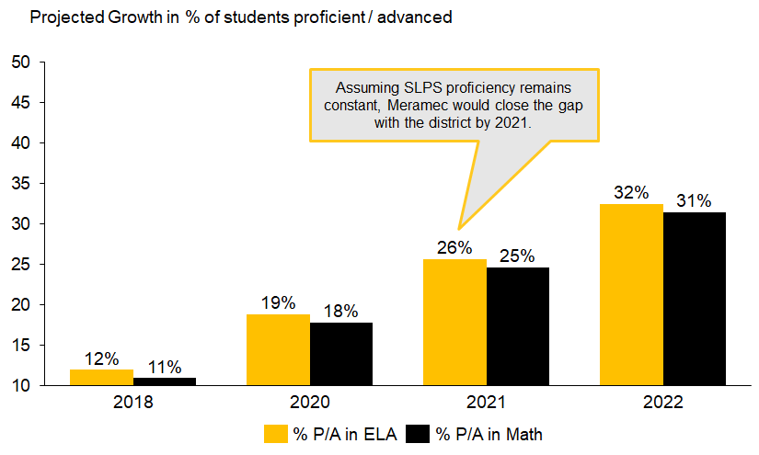
By 2022, 32% of Meramec students will be proficient or advanced in ELA and 31% proficient or advanced in Math

Slide 30
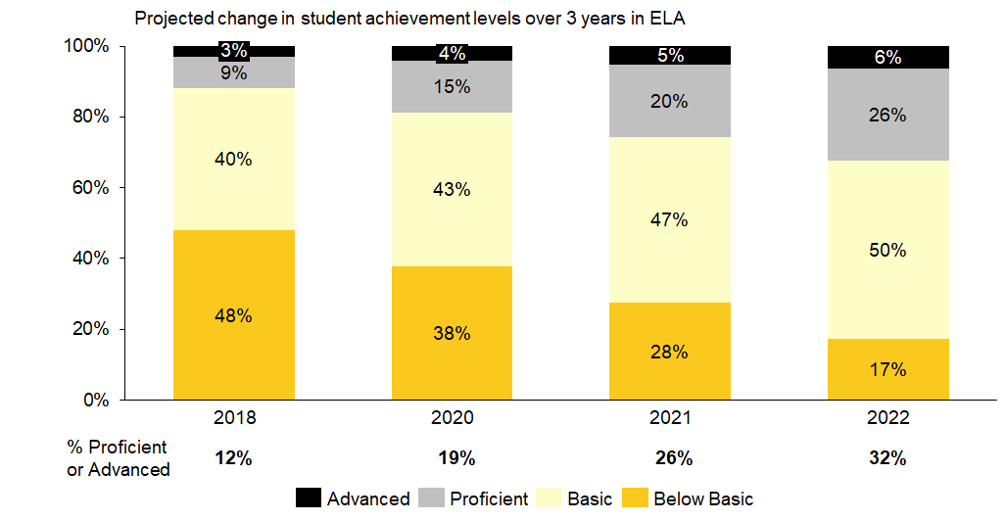
In ELA, the percent of students at the below basic level would decrease from 48% to 17% by 2022
Note: * These projections assume Meramec can achieve its goals around moving students to proficient / advanced and decreasing the number of below basic students over the next 3 years

Slide 31
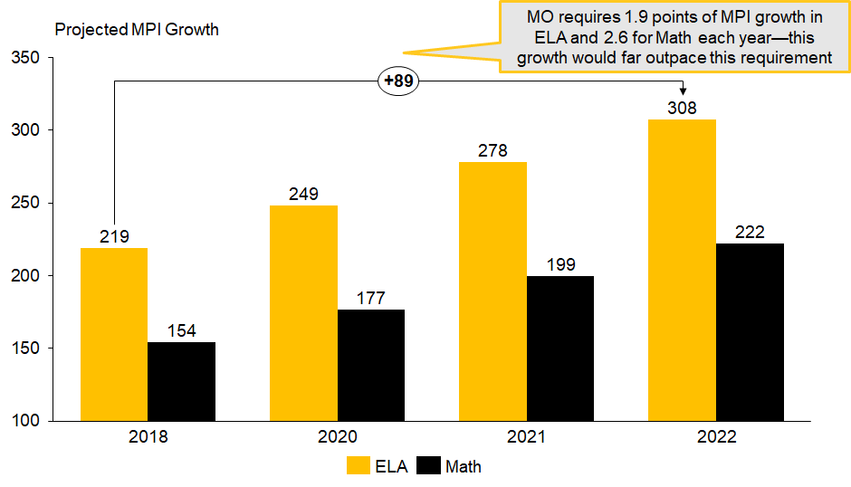
If we sustain this progress over 3 years, we’ll far exceed the state’s minimum requirements for MPI growth
Note: * MPI growth targets are projections based on assumptions of how students will move between levels (e.g., how many proficient students move to advanced).

Slide 32
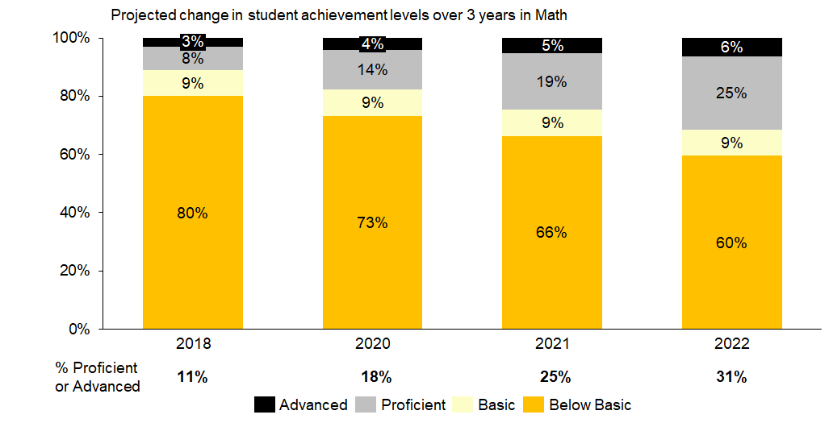
In Math, the percent of students at the below basic level would decrease from 80% to 60% by 2022
Note: * These projections assume Meramec can achieve its goals around moving students to proficient / advanced and decreasing the number of below basic students over the next 3 years

Slide 33
How will we get there?
Who are we?
Where are we now?
Where are we going?
How will we get there?
What will we need to get there?

Slide 34
Working back from our 1-year ELA goal, we’ve analyzed root causes and identified focused priorities
Root Causes
Priorities
Curriculum:
Curriculum is scaffolded PK-5- but needs to focus on increasing students background knowledge and real world application
1-year goal*
Increase ELA Proficiency
7%
Increase in the % of students proficient / advanced on the MAP exam
10%
Decrease in the % of students scoring below basic
Data & Assessment
Need for consistent progress monitoring
Need for more frequent usage of data to modify instruction
Revise the implementation of the KG – 5 ELA curriculum.
Implement an RTI system in ELA that progress monitors student growth and provides students with tailored supports.
Implement high-quality professional development for teachers and support staff running records, and phonics to strengthen teachers’ literacy content knowledge.
Develop a literacy-STEM lab that connects our ELA content with science and math.
Teacher Skill:
Teachers are not adequately trained in guided reading, running records, and phonics
Student Factors:
High student mobility
Students enter Meramec with significant gaps in ELA skill
School Culture:
Low student attendance
Frequent interruptions to learning
*Pending the selection of an interim assessment system, interim assessments will be used to set BOY, MOY and EOY student indicators of success during the school year. Final targets will be set in August 2021 dependent on the final assessment selection in May 2022.

Slide 35
We’ve also analyzed root causes and identified focused priorities to achieve our Math goal
Root Causes
Priorities
Curriculum:
Curriculum is not scaffolded PK-5- needs to focus on increasing students background knowledge and real world application
1-year goal*
Increase Math Proficiency
7%
Increase in the % of students proficient / advanced on the MAP exam
7%
Decrease in the % of students scoring below basic
Data & Assessment
Need for consistent progress monitoring
Need for more frequent usage of data to modify instruction
Implement an RTI system in Math that progress monitors student growth and provides students with tailored supports.
Ensure teachers and support staff have access to high quality professional development.
Teacher Skill:
Teachers are not adequately trained in guided reading, running records, and phonics
Student Factors:
High student mobility
Students enter Meramec with significant gaps in Math skills
School Culture:
Low student attendance
Frequent interruptions to learning
*Pending the selection of an interim assessment system and calendar, interim assessments will be used to set BOY, MOY and EOY student indicators of success during the school year. Final targets will be set in August 2021, dependent on the final assessment selection in May 2022.

Slide 36
We’ve performed this same analysis for teacher retention
Root Causes
Priorities
Adult Climate:
Lack of trust/strong relationships across staff
Improve teacher retention
Goal
Communications
Need for stronger communication systems to ensure teachers are informed
Improve the quality and clarity of communications by streamlining structures.
Using committees, data, and staff meetings, build team trust and morale.
Align resources and incentives so staff are adequately supported.
80%
Percentage of teachers* we’ll retain from 20-21 to 21 - 22
*rated proficient or distinguished on the PBTE
Resources:
Inadequate resources/rewards to support teachers in this challenging work
Student Factors:
Emotionally challenging work supporting students suffering from trauma and poverty
Data and Assessment:
Need for a means of assessing the health of the team’s culture to course correct
School Culture:
Emotional stress caused by student misbehavior challenges

Slide 37
Finally, we’ve performed this same analysis for student attendance
Root Causes
Priorities
Student Factors
Disconnect with staff
Lack of feeling successful academically
Improve school culture
Goal
Improve student attendance
Strengthen family engagement
School Factors
Lack of deep relationships between staff and students’ families
Lack of engagement in lessons
Need for more regularly recognizing/ celebrating students
80%
Attendance Rate (90-90)
*An increase of 9% from current state
Home Factors
Basic needs not met (e.g., hunger, dirty clothing, bathing)
Homelessness or insecure housing
Lack of routine
Emotional stress, trauma, abuse
Students’ responsibilities beyond school

Slide 38
As a result, we have highlighted the following priorities to focus on for next year
Meramec graduates who solve complex problems, tackle rigorous content, and lead our community
Goals in ELA, Math, and Leadership Development
Increase ELA Proficiency
Increase Math Proficiency
Improve teacher retention
Improve school culture
Improve currant RTI system in ELA & Math that progress monitors student growth and provides students with tailored supports.
Implement high-quality professional development for teachers in E LA & Math (the Science of Learning and Writing across all context)
Implement high-quality professional development for support staff.
Improve the quality and clarity of communications by streamlining structures.
Using committees, data, and staff meetings, build team trust and morale.
Provide more building leadership opportunities for staff
Improve student attendance
Increase student celebration and incentives
Disciplining with dignity practices
Implement revised implementation of comprehensive PK-5 ELA curriculum to reflect place-based learning. .

Slide 39
After developing strategies from our root cause analysis, we narrowed to 1-2 highest-leverage strategies per priority
Priorities | Strategies
1. Implement a comprehensive PK-5 curriculum in Reading and Writing | Continue to use CKLA as core curriculum. Overlay Curriculum with deeper writing component that address writing structure Overlay curriculum with real word experiences and applications that enhances student knowledge base through project base learning.
2. Implement an RTI system in ELA & Math that progress monitors student growth and provides students with tailored supports | Adjust data dashboard to monitor specific skills along with overall growth Create year-long assessment scope and sequence with prioritized standards to cover before assessments, and ensure instructional minutes support Create a data base of skill-specific activities, lesson, and inks.
3. Implement high-quality professional development for teachers in ELA & Math | Identify high-impact PD opportunities (internal or external) and create year-long PD scope and sequence, including vertically-aligned PLCs Align weekly / monthly schedule to provide additional opportunities for coaching and professional development.
1. Improve the quality and clarity of communications by streamlining structures | Create systems and structures to share information (memos, calendars, etc.) and designate teacher leaders to help disseminate to the team
2. Using committees, data, and staff meetings, build team trust and morale | Form staff and student morale committees to lead celebrations/birthdays, etc./own staff morale efforts Research, plan and execute PD opportunities to increase staff trust and build socioemotional skills for adults and develop building leaders Attend Building Leader Professional Development Visit schools with similar demographic.
1. Improve student attendance | Build a stronger school-home connection(including technology) Create shared responsibility for student attendance monitoring
ELA and Math
Leadership / Retention
School culture
.
Notes:
These are to be evidence-based (research based) strategies. Don’t have to line up a EBS for every priority. Less is more. Identify 1-2 ELA evidence-based strategies,1 for MA and 1 for climate/culture (to address attendance

Slide 40
Funding
For ELA/Math strategies, funds will be needed for:
Place-based learning implementation $10,000
Development of new data tracker $5,000
Funding math interventionist and Literacy-STEM teacher for add’l capacity to support RTI $120,000
Cost of teacher PD (focusing on a train the train approach) $25,000
Online supplemental programming $10,000
Funding for expedition experience tied to curriculum $10,000
Funiture for to support flexible and creative literacy spaces $20,000
Technology needs to support math and Literacy-STEM library $20,000
For teacher retention strategies, funds will be needed for:
Budgets for committees
Team retreat
PD and team building activities
Staff incentives
Additional staff resources identified by staff morale committees
Funding to design a inquiry-based learning environment (future and materials)
Social emotional environments
These action items can be supported from the GOB
*Pending the selection of an interim assessment system, interim assessments will be used to set BOY, MOY and EOY student indicators of success during the school year. Final targets will be set by August 2019, dependent on the final assessment selection in May 2019.
Notes:
Must be cite specific costs and funding source(s) for every item listed.

Slide 41
We have assigned the following teams and owners:
Priorities | Strategies | Owners
1. Implement a comprehensive PK-5 curriculum in Reading and Writing | Overlay Curriculum with deeper writing component that address writing structure Overlay curriculum with real word experiences and applications that enhances student knowledge base through project base learning/ inquiry learning. | Mr. Besse (3-5), Ms. Ransom (1-2), Dr. Mac [Support]
2. Implement an RTI system in ELA & Math that progress monitors student growth and provides students with tailored supports | Overlay state standards with current pacing guide Create year-long assessment scope and sequence with prioritized standards to cover before assessments, and ensure instructional minutes support Create a data base to monitor and address skills with specific activities, lesson, and inks. | Dr. Mac, Mrs. Rogers Mrs. Ransom
3. Implement high-quality professional development for teachers in ELA & Math | Identify high-impact PD opportunities (internal or external) and create year-long PD scope and sequence, including vertically-aligned PLCs Align weekly / monthly schedule to provide additional opportunities for coaching and professional development. | Mr. Strong, Mrs. Rodgers Dr. Mac Jay Hartman [co-leadership]
4. Creation of a literacy-STEM library. | Analyze ELA curriculum and to see interdisciplinary opportunities. Repurpose the school library to support literacy and STEM learning. Purchase needed materials for the literacy-STEM library. | Dr. Mac, Strong, Ramos, Hartman
1. Improve the quality and clarity of communications by streamlining structures | Create systems and structures to share information (memos, calendars, etc.) and designate teacher leaders to help disseminate to the team | Mr. Strong, Ms. Williams [co-leadership]
2. Using committees, data, and staff meetings, build team trust and morale | Redesign staff and student morale committees to lead celebrations/birthdays, etc./own staff morale efforts Research, plan and execute PD opportunities to increase staff trust and build socioemotional skills for adults and develop building leaders Attend Building Leader Professional Development Partnership with outside agency provide social emotional needs for staff. | Teacher Leadership Team
1. Improve student attendance | Build a stronger school-home connection (including technology) Create shared responsibility for student attendance monitoring | Ms. Williams, Ms. McClellan Ms. White Mr. Jackson
ELA and Math
Teacher Retention
School Culture

Slide 42
For each Year 2 strategy, we have also developed a set of working action plans to enable our success, which follow this slide. We will continue with these strategies due to COVID.

Slide 43
ELA/Math Strategy 1.1 Overlay Curriculum with deeper writing component that address writing structure and all components.
Action Step | Owner/Performers | Timing
1. Identify and procure writing professional development for teachers. | Strong, Instructional Team | May-June 2022
2. Align on unified vision for literacy and Math instruction in Writing Workshop. | Strong Rodgers Dr. Mac | June 2022
3. Revise master schedule to ensure ample number of instructional minutes dedicated for use of writing | Strong, UHL, Dr. Mac | June 2022
4. Create comprehensive PK-5 pacing guides/ rubric ; create master document (with exemplars) showing vertical alignment and the progression of learning outcomes and writing skills across all contents PK-5. | Instructional Team, Besse | June 2022 (can we sequence the work of creating pacing and rubric guides so it doesn’t all happen in June)
5. Deliver professional development on selected Reading and Writing Workshop | External Facilitator Strong | July 2022; August-May
6. Support teachers on implementation via monthly coaching, observations, and planning meetings. | McMurray Strong Rodgers | August/September 2022
7. Analyze student data and disseminate teacher surveys throughout year to gauge effectiveness of new curriculum. | Staff | August 2021, December 2021, February 2022, May 2022

Slide 44
ELA/Math Strategy 1.2 Overlay curriculum with real word experiences and applications that enhances student knowledge base through project base learning/ inquiry learning.
Action Step | Owner/Performers | Timing
1. Develop subcommittee to review the CKLA and Math curriculum and provide resources for deeper learning experiences (ie…-fieldtrips, web quest reading list) | Jay Hartman May-Dec Instructional Team Dec-May | May 8-29, 2021 On-going
2. Identify and procure project base learning professional development for teachers. | Dr.Mac Rodgers Strong Jay | June 2021 (complete)
3. Create a calendar for deeper learning based on the units and topics in current curriculum including expeditionary and virtual fieldtrips | Instructional Team | June-August 2021 (in-progress) Finalize by end of July/August
4. Develop a schedule of release time for teacher to work on project based planning with supports | Strong, Dr.Mac | September, October, November, February, April
5. Implement curriculum and provide real time feedback and coaching on teaching fidelity | Dr. Mac, Mr. Strong, | , December, March, May

Slide 45
ELA/Math Strategy 2.1-2.2 Implement data dashboard for collecting and analyzing assessment data
Action Step | Owner/Performers | Timing
1. Develop subcommittee to review state standard alongside current pacing guide | Mac Rodger Strong | May-August 2021(in-progress)
2. Import standards into current data tacker. | Mac Rodger Strong | Jun-Jul 2021(in-progress)
3. Determine the mastery cutoff points you will use to flag students or concepts for re-teaching | Mac Rodger Strong | July 2021 (in-progress)
4. Develop coaching protocol to support teachers in using dashboard to inform daily instruction | Mac Rodger Strong | July 2021 (in-progress)
5. Provide PD for staff on using the data dashboard tool (uploading classroom data, reading class and school wide reports, etc.) | Mac Rodger Strong | Aug-Sep 2021
6. Ensure teachers have a weekly deadline for uploading their student data -- make clear that this isn’t weekly standards, but weekly formative assessments. (Potentially this can be automated depending on system purchased) | Mac Rodger Strong | Aug 2021 (create calendar; show during summer & BOY PD)
7. Develop weekly report that analyzes classroom data and pulls out trends (** if using excel, then a template needs to be created in July for data analysis) | Mac Rodger Strong | Aug 2021
8. Plan and facilitate data days to analyze data and develop re-teach plans | Mac Rodger Strong | Aug-Sep 2021 (plan); Sep 2020-May 2021 (facilitate)

Slide 46
ELA/Math Strategy 2.3 Create year-long assessment scope and sequence with prioritized standards to cover before assessments and ensure instructional minutes support
Action Step | Owner/Performers | Timing
0. Poll teachers to identify who is available to work during the summer. | Hearty | Complete [Teachers will work August 2 – 6, 2021]
1. Develop subcommittee to work on scope and sequence (or hire an external consultant to develop guides); allocate funds for this work | Hearty | May-Jun 2021
2. Create a template/calendar onto which each grade and content area will be mapped; divide template/calendar into units, each of which will be roughly aligned to grading periods. | Ransom Mac Rodgers Strong | By Jun 1, 2021
3. Enter all assessments onto the template (state, district, Meramec-specific) | Ransom Mac Rodgers Strong | Jun-Jul 2021
4. Working backwards, prioritize content based on state standards, district requirements, MAP assessed learning outcomes, critical/foundational skills, etc. | Ransom Mac Rodgers Strong | Jun-Jul 2021
5. Sort prioritized content standards into preliminary units, ensuring student learning is scaffolded and concepts build upon one another. Leverage tools to support coherent mapping (e.g. Fountas and Pinnell Literacy Continuum) | Ransom Mac Rodgers Strong | Jun-Jul 2021
6. Overlay curricular resources onto this template/calendar, explicitly naming which lessons/materials will be used in each unit. Build in time for reteaching and differentiation. Adjust unit lengths/ shift content standards accordingly. | Ransom Mac Rodgers Strong | Jul-Aug 2021
7. Publish finalized scope and sequence for each grade and subject area. | Ransom Mac Rodgers Strong | Aug 2021
8. Regularly leverage the scope and sequence in weekly grade-level planning meetings. | Ransom Mac Rodgers Strong | Ongoing throughout school year

Slide 47
ELA/Math 3.1 Identify high-impact PD opportunities (internal or external), create year-long PD scope and sequence and decide which teachers to attend; vertically-align PLCs
Action Step | Owner/Performers | Timing
1. Develop subcommittee to create a prioritized list and survey teachers on their PD need and development goals. Ensure specialists (music, PE, etc.) can still go to the district PDs when it makes sense. | Strong | May 2021
2. Use student assessment data to gather information on grade-level and content-specific needs that exist across the school. | Strong | June 2021
3. Based on needs, research and develop a list of potential PD sessions that would meet those needs, along with cost of PD, travel considerations, and times/days offered. | Strong | June 2021
4. Based on list of PD sessions to cover, prioritize the highest-leverage PD sessions that would meet the most individual needs of teachers to create a scope and sequence; add participants. |  | June 2021
5.. Overlay this PD scope and sequence onto the master staff calendar of events, to ensure adequate classroom coverage for staff who would be traveling off-site or participating on-site. |  | June 2021
6.. Work with school leader to sequence and calendar the PD sessions that are most relevant for subsets of teachers, and to set up coverage for those teachers participating in PDs. | Hearty | Jul-Aug 2021
7. Form mixed grade professional learning communities (PLCs) based on content-specific and/or professional development needs. Ensure a diversity of grade-level and content level perspectives within each group. | McMurray
8.. Schedule PLC convenings. Identify topics and materials for each convening. Add PLC meetings to PD scope and sequence. Ensure there are quarterly meetings of PK-5 teachers to discuss content and vertical progression-- throughout the year -- and determine protocol for these meetings.
9.. Solicit feedback from participating teachers on effectiveness of PDs to inform next year’s scope and sequence. |  | Year-round, after each PD session

Slide 48
Teacher Retention 1.1 Refine systems and structures to share information (memos & calendars) and designate teacher leaders to help disseminate to the team
Action Step | Owner/Performers | Timing
1. Develop subcommittee to make a list of all the touchpoints to: staff, parents, students (e.g., printed parent newsletters, daily email digest, website announcements, grade-level letters, website), and decide on ideal cadence for each touchpoint (e.g., daily, quarterly, weekly) | Ms. Williams, Mr. Strong, | Early Aug 2021 (on-going)
2. Place them all on a calendar (shared if possible, like Google), with one “event” per touchpoint | Ms. Williams, Mr. Strong, | End of Aug 2021 (on-going)
3. Distribute link to calendar/website; AND post calendar up in visible location (e.g., bulletin board in teacher’s lounge) | Ms. Williams, Mr. Strong, | Aug (on-going)
4. Designate teacher leads who will be appointed to disseminate information and decide on the mode and frequency of communication | Ms. Williams, Mr. Strong, | Aug 2021 (on-going)
5. Create protocol for adding to the master calendar -- e.g., if you would like to submit an event to be added to the daily digest, email xxxx@gmail.com at least 24h in advance. *If possible, automate this system as much as possible so someone isn’t having to manually check this account and update the calendar every time a request is submitted. | Ms. Williams, Mr. Strong, | Early Aug 2021 (on-going)
6. Update master communications calendar monthly | Ms. Williams, Mr. Strong, | Throughout school year (on-going)

Slide 49
Teacher Retention 2.1 Form staff morale and student morale committees to lead celebrations/birthdays, etc./own staff morale efforts
Action Step | Owner | Timing
1. Create 2 committees (1 for staff, 1 for students) by having sign up sheets at BOY events. Select a leader of each committee, and calendar regular (bi-monthly?) times and places to meet. | Williams/McClellan | May 2021 (on-going)
2. Committee creates a survey (e.g., Google Form) to a) pulse check on morale and b) obtain ideas for ideas for celebrations and resource requests for classroom needs. | Ms. McClellan | May 2021 (on-going)
3. Staff and student committees submit a year-long calendar with dates, ideas, and budget requests to the school leader for approval. | Williams/ Strong? Mclellan | August 2021 (on-going)
4. Once requests are approved, plan celebrations on master calendar. | McClellan | August 2021 (on-going)
5. Staff and student committees submit budget request to school leader for approval to purchase these resources on a monthly basis. | Strong/Williams | August 2021 (on-going)
6. “Ensure regular meeting cadence to plan events, etc”: Beginning of each quarter / prior to each meeting, assigning an owner to gather everyone, and check in that the meetings are happening. | Strong | On-going

Slide 50
Teacher Retention 2.2 Research, plan and execute PD opportunities to increase staff trust and build socioemotional skills for adults/outside facilitation of team building activities
Action Step | Owner/Performers | Timing
1. Develop sub-committee to research and identify options for PD focused on trust-building and developing socio-emotional skills for educators, targeted specifically for our staff (e.g., emotional regulation, restorative justice circles); including planning for staff retreat | Hearty | May-June 2021
2. Bring option set to TLTs (or subset of staff and leadership) to vote on options to include for Meramec PDs and retreat plan | Strong | July
3. Sync with school and existing PD calendar to identify implementation windows for selected PD (at least 2-3 sessions throughout year) |  | July 2021(prior to school)
4. Secure outside facilitator for retreat/events/PD sessions as relevant | Strong, Williams | June- July
5. Hold team retreat | Strong | Aug 2021 (prior to school)
6. Create and distribute staff survey to get feedback on PDs, adjust PD plan based on feedback | Shannon | Ongoing after PD sessions
7. Adjust PD plan for next year (both retreat and year-long PD) | Ransom Strong Shannon | (Dec 2020 as midpoint; May 2021)

Slide 51
Student Attendance 1.2 Refine shared responsibility for student attendance monitoring
Action Step | Owner/Performers | Timing
1. Starting with 2018-2019 school year (SY) attendance data, identify which KG – 4th grade students did not meet the 90-90 attendance benchmark. Assign staff members who will be responsible for monitoring identified students’ attendance during the 2021-2022 SY. | Student Support Team (SST) | June/July 2021
2. Develop and mail an “Attendance Contract” and an attendance survey to all parents (of identified students) to complete. Survey will include questions regarding why identified parents say their child’s attendance was low during the 2020-2021 school year. | SST | July/August 2021
3. Develop a list of consequences and incentives for the parents & students identified in Action Step 1 relative to attendance. | SST | July 2021
4. Develop a year-long calendar that includes: dates when staff (from Action Step 1) will meet with their assigned students (one-on-one) in order to “check-in” regarding attendance. dates when staff (from will call parents (of identified students) in order to discuss, congratulate, and/or warn parents about attendance rate to date. dates when staff (from Action Step 1) will meet as a team to discuss the attendance status of identified students, add (new) students to the identified list. dates when parents and students will be recognized/celebrated/congratulated for maintaining 90-90 attendance. | Teachers/SST | July/August 2021

Slide 52
This is our roadmap for 3 years:
Priorities | Year 1 Strategies | Year 2 Strategies | Year 3 Strategies
1. Implement a comprehensive PK-5 curriculum in Reading and Writing | 1.1 Identify, evaluate and implement EngageNY and/or other research-based, RTI-aligned ELA support models (e.g., balanced literacy, phonics, SIPPS) as a comprehensive PK-5 curriculum | Continue to use CKLA as core curriculum. Overlay Curriculum with deeper writing component that address writing structure Overlay curriculum with real word experiences and applications that enhances student knowledge base through project base learning. | Fine-tune and differentiate Redesign the schedule to ensure the allotted minutes Create a systematic schedule for professional development and peer walk-throughs; additional data-team meetings, as needed Structure more teacher and teacher-peer professional development
2. Implement an RTI system in ELA & Math that progress monitors student growth and provides students with tailored supports | 2.1 Procure and implement Fountas & Pinnell Benchmark Assessment System (BAS) quarterly 2.2 Implement data dashboard for collecting and analyzing assessment data 2.3 Create year-long assessment scope and sequence with prioritized standards to cover before assessments, and ensure instructional minutes support | Adjust data dashboard to monitor specific skills along with overall growth Create year-long assessment scope and sequence with prioritized standards to cover before assessments, and ensure instructional minutes support Create a data base od skill specific activities, lesson, and inks. | Continue 2.1 2.2: Consider idea of shifting to different data platform or purchase a data warehouse system (e.g., Schoolzilla) Continue 2.3
3. Implement high-quality professional development for teachers in ELA & Math | 3.1 Identify high-impact PD opportunities (internal or external) and create year-long PD scope and sequence, including vertically-aligned PLCs | Identify high-impact PD opportunities (internal or external) and create year-long PD scope and sequence, including vertically-aligned PLCs Align weekly / monthly schedule to provide additional opportunities for coaching and professional development. | Continue
4. Effective integration of productivity and collaboration tools to promote literacy through an inquiry-based literacy-STEM learning environment for all students and to provide 21st century skills and platforms for students to demonstrate competency, present content knowledge, publish work, and promote speaking and listening. | 1, Partnerships Gateway Green, MySci | Partnership with TLI, developed inquiry-based and place-based learning curriculum. All faculty and staff participated in virtual learning professional development and every teacher taught virtual & hybrid courses. Partnership with Washington University. | 1. Embedding transformational technology strategies into instruction as needed to support learning for content standards/projects, to support complex thinking, to promote discussion and collaboration, and enable new learning not possible without technology. 2. All students will participate in a technology-based literacy and STEAM course for a total of 100 instructional minutes weekly.
ELA and Math
Notes:
Again, evidence based strategy is different than action steps and what you have listed are mostly action steps.

Slide 53
This is our roadmap for 3 years:
Priorities | Year 1 Strategies | Year 2 Strategies | Year 3 Strategies
1. Improve the quality and clarity of communications by streamlining structures | 1.1 Create systems and structures to share information (memos, calendars, etc.) and designate teacher leaders to help disseminate to the team | Form staff and student morale committees to lead celebrations/birthdays, etc./own staff morale efforts Research, plan and execute PD opportunities to increase staff trust and build socioemotional skills for adults and develop building leaders Attend Building Leader Professional Development Visit schools with similar demographic. | Complete
2. Using committees, data, and staff meetings, build team trust and morale | 2.1 Form staff and student morale committees to lead celebrations/birthdays, etc./own staff morale efforts 2.2 Research, plan and execute PD opportunities to increase staff trust and build socioemotional skills for adults | Build a stronger school-home connection(including technology) Create shared responsibility for student attendance monitoring | Continue with committees; reflect on practices and course-correct Reflect on and refine peer-to-peer and upward feedback practices; expand leadership opportunities
1. Improve student attendance | 1.1 Build a stronger school-home connection 1.2 Create shared responsibility for student attendance monitoring | Continue to use CKLA as core curriculum. Overlay Curriculum with deeper writing component that address writing structure Overlay curriculum with real word experiences and applications that enhances student knowledge base through project base learning. | Continue
Teacher Retention
School Culture
Notes:
Again, evidence based strategy is different than action steps and what you have listed are mostly action steps.

Slide 54
We will also engage parents and families to enable the success of our plan
Program Evaluation Results
How does your school seek and obtain the agreement of parents to the parent and family engagement policy? | We have 2 Title I meetings with parents each year to address current practices and make adjustments. During these meetings, we solicit family input on the parent and family engagement policy. In addition to these meetings, we conduct home visits to solicit family input, including to families with disabilities who require an alternative location.
What are the strengths of family and community engagement? | Developed strong relationships between teachers and families and opened up various lines of productive communication. Utilize our website, Class Dojo, social media platforms, and other resources to communicate to families Developed parent support systems including eye care, dental care, and access to other social support services (e.g., housing support, food pantries, and mental health supports) Developed a partnership with the local power company to provide utility assistance for families. Using this, we were able to reduce / eliminate $3,000 in utility bills for the school
What are the weaknesses of family and community engagement? | Turnout of our families to school events is an area we’d like to improve; we’ve been unsuccessful at generating large turnout for events
What are the needs identified pertaining to family and community engagement? | We would like to provide additional assistance to families in getting access to fresh produce, utility support, community college and/or technical education, and access to various social services (e.g., housing programs, counseling, theorpy)

Slide 55
We will also engage parents and families to enable the success of our plan
Policy Involvement
How are parents involved in the planning, review, and improvement of the Schoolwide plan? | During our 2 Title I meetings each year, families receive an update on school performance, provide input on the schoolwide plan, and provide feedback to the staff
How are parents involved in the planning, review, and improvement of the school parent and family engagement policy? | During our Title I meetings, parents also provide input on the school parent and family engagement policy
How is timely information about the Title I.A program provided to parents and families? | We utilize a Robo-call, flyers, and Class Dojo to communicate information to families about our Title I program.
What are the methods and plans to provide an explanation of curriculum, assessments and MAP achievement levels to parents and families? | During our Title I meetings, we share information on curriculum, assessments, and MAP achievement Through the HomeWorks program, we have family nights where we share information on curriculum, assessments, and MAP achievement. In order to drive attendance for these events, we provide dinner to attendees. We do our best to share MAP data during parent-teacher conferences (as possible based on the state’s release of MAP data)

Slide 56
We will also engage parents and families to enable the success of our plan
Shared Responsibility for Student Achievement – School Parent Compact
Purpose: The school-parent compact outlines how parents, the entire school staff, and students will share the responsibility for improved student academic achievement and the means by which the school and parents will build and develop a partnership to help children achieve the state’s high standards.
What are the ways in which all parents will be responsible for supporting their children’s learning? | Parents are asked to attend our family events, Title I meetings, and parent-teacher nights. We also ask that families allow a home visit as part of the HomeWorks program
Describe the school’s responsibility to provide high quality curriculum and instruction in a supportive and effective learning environment. | During our family events, we share our goals and explain our strategies for achieving these goals. We call these meetings the “State of Meramec” to explain where we are and what we’re doing to improve
Please provide assurance that the school is: ✔ Conducting parent-teacher conferences at least annually, during which the compact shall be discussed ✔ Issuing frequent reports to parents on their children’s progress ✔ Providing reasonable access to staff, opportunities to volunteer, and observation of classroom activities ✔ Ensuring regular two-way, meaningful communication between family members and school staff and, in a language that family members understand. | We conduct parent-teacher conferences twice per year We use Class Dojo, robo-calls, social media platforms, and flyers to share important information. We provide interpreters at parent-teacher conferences to ensure all families can participate The principal has an open door policy for all parents wishing to meet We also bring families in to volunteer (e.g., tutoring) We have a Family Community Specialist who is in charge of ensuring effective communications with families.

Slide 57
We will also engage parents and families to enable the success of our plan
School Capacity for Involvement
How does the school provide assistance to parents in understanding the following items? - Missouri Learning Standards - Missouri Assessment Program - Local Assessments - How to monitor a child’s progress - How to work with educators to improve the achievement of their children | We present information at our Title I meetings, family nights, home visits, and via regular communications to families
How does your school educate school personnel (teachers, specialized instructional support personnel, principals, and other school leaders, and other staff) in the value and utility of contributions of parents, and in how to reach out to, communicate with, and work with parents as equal partners? | We do not have a systematic way of training staff on this but wish to improve that as part of this planning process.
How does your school implement and coordinate parent programs, and build ties between parents and the school? | We have a Family Community Specialist whose role is to gain parent input on our school, to maintain avenues of communication with families, and address parent concerns / needs
Describe plans to coordinate and integrate, to the extent feasible and appropriate, parental involvement programs and activities with other programs, such as parent resource centers that encourage and support parents in more fully participation in the education of their children. | In addition to the HomeWorks program, we provide access to various social support services (e.g., housing support, utility support, mental health support, dental and eye care) to ensure families receive the support they need

Slide 58
We will also engage parents and families to enable the success of our plan
Accessibility Assurance
In carrying out the parent and family engagement requirements, the school, to the extent practicable, provides opportunities for the informed participation of parents and families including: Parents and family members who have limited English proficiency Parents and family members with disabilities Parents and family members of migratory children Provides information and school reports in a format and language parents understand
We provide interpreters in the language of need We are able to adjust the location of meetings to meet the needs of families with disabilities

Slide 59
Summary statements:
Summary of the strengths and weaknesses relative to Family and Community Engagement.
Developed strong relationships between teachers and families Utilize numerous modes of communication including our website, Class Dojo, robo-calls, social media platforms, and flyers Developed access for parents to support systems including eye care, dental care, and other social support services (e.g., housing support, food pantries, and mental health supports) Developed partnerships to provide assistance for families. Using this, we were able to reduce / eliminate $3,000 in utility bills for the school in the 2018 – 2019 school year
Summary of the strengths and weaknesses relative to the school context and organization.
We need to increase the portion of our family population that is able to take advantage of our family resources and increase participation during family events
Summary of Needs Assessment and Priorities for 2019-2020
Summarize your current progress as a school, what is going well, where there is room for growth. Outline your 2 priority areas of focus/programmatic shifts you will make to ensure success during the 2020-21 school year. Please see slide 26 for our draft goals for 20-21 (goals to be refined throughout the school year) Please see slides 35 and 36 for a description of our draft priorities and areas of focus/programmatic shifts (priorities and strategies to be refined throughout the school year) Please see slide 37 for draft funding needs required to execute on these priorities (exact funding needs to be refined throughout the school year)

Slide 60
What will we need to get there?
Who are we?
Where are we now?
Where are we going?
How will we get there?
What will we need to get there?

Slide 61
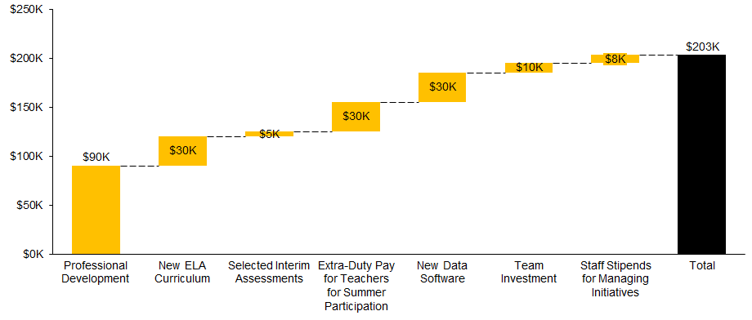
Implementation of these priorities and strategies next year requires an investment of $203K in non-personnel resources
Of this total investment, $123K represents one-time investments (e.g., new curriculum, data systems) whereas $80K represents annual, on-going investments (e.g., team investment)¹.
¹See next 2 slides for additional detail.
Notes:
$200K total -- $150 annual recurring, $50K upfront

Slide 62
To support new strategies and school needs, we request the following resources (ordered by priority): (1 of 2)
Ask & Description | With incremental funding |  |  | Without incremental funding
 | Related Priority | Rationale | Cost
Professional development on: Continue support ELA curriculum New data tool ELA and Math (e.g., Reading and Writing Workshop; Math Workshop) Selected interim assessment (e.g., BAS) | All priorities | Ongoing professional development is critical to successful implementation of new programming. By providing embedded professional development, we have the opportunity to build staff skill and capacity throughout the year. We will ensure quality facilitation of PDs and implement PDs to help deepen staff’s ELA and Math content knowledge and expertise, to improve student academic performance as a result. Implementing place-based learning via our CKLA curriculum. | $50,000* some on-going, some one-time | Continue to use current materials
Purchase of curriculum and materials for PK-5 Reading and Writing | Implement a comprehensive PK-5 curriculum in Reading and Writing | Current reading and writing curriculum materials are not comprehensively scaffolded across grades PK-5 nor, match the rigor expected of students on the MAP. | $30,000 one-time | Use free supports from online research and school visits
Predictive interim assessment tools for ELA (BAS) and Math (e.g., NWEA MAP) | Implement an RTI system in ELA & Math that progress monitors student growth and provides students with tailored supports | Prior interim assessments (e.g. Scantron) have not been useful in predicting student performance on MAP. Funding would allow for the use of interim assessment tools commonly leveraged by excellent schools to inform instruction and predict student proficiency. | $5,000 one-time | Continue to use STAR; BW can advise on setting interim benchmarks
Extra-duty pay for teacher participation in summer training | All priorities | Teachers must be trained, prepared, and coached prior to implementation of new curriculum, data- driven instruction practices, and classroom management to improve both student achievement and school culture. | $30,000 on-going | Mr. Strong and other administration takes this on
*Note: Ashland and Meramec have expressed an interest in sharing PD, to reduce costs across schools. This will be adjusted against the existing PD budget from the district.
Notes:
Appreciate the collaboration between the two CSI/Consortium Schools! Also helpful to have a summary page including this information. However, missing the column Evidence-based Strategy. That must be featured. Some of what is listed in Related Priority column is actually the Evidence-based Strategy.

Slide 63
To support new strategies and school needs, we request the following resources (ordered by priority): (2 of 3)
Ask & Description | With incremental funding |  |  | Without incremental funding
 | Related Priority | Rationale | Cost
Team investment for: Staff-wide retreat Activities to promote morale and team-building Culture initiatives (e.g., parent nights, home visits) | Using committees, data, and staff meetings, build team trust and morale | School culture and team trust is an on-going investment, and requires staff to learn how to collaborate in order to execute on new initiatives and feel invested in change. In addition, this budget will cover school culture incentives such as awards, incentive trips, home visits, and parent engagement nights, to promote improved attendance, and positive school culture. | $10,000 on-going | Use free supports and ideas from online research and school visits
Staff stipends for: Managing and rolling out new data tool Building out PD modules/ calendar Building out communications protocol and managing information flow to students, staff, and families Excellent school visits (e.g., sub coverage, travel) School Leadership Team School Instructional Team Various building supports | All priorities | Teachers must be supported and provided compensation for leading these new strategic initiatives. | $18,000 one-time | Mr. Strong or administration takes this on
Notes:
Same comment as in the previous page.

Slide 64
To support new strategies and school needs, we request the following resources (ordered by priority): (3 of 3)
Ask & Description | With incremental funding |  |  | Without incremental funding
 | Related Priority | Rationale | Cost
STEM-Literacy Library | Reading and math Priority 4 Effective integration of literacy and technology. | Effective integration of productivity and collaboration tools to promote literacy through an inquiry-based STEAM learning environmen.t This includes book furniture, and tech resources | $25,000 one-time | Students missed out on valuable literacy across content.
Furniture to support flexible Seating | Reading and math Priorities 1 – 4 . | Create an environment that supports inquiry-based learning. | $25,000 one-time | Puts students in factory-style seating.
Inquiry-based Technology Resources | Reading and math Priority 4 Effective integration of literacy and technology. | Effective integration of productivity and collaboration tools to promote literacy through an inquiry-based STEAM learning environment | $30,000 (an additional $15,000 over two years) | Students missed out on valuable literacy across content.
Total |  |  | $223,000
Notes:
Same comment as in the previous page.

Slide 65
To support new strategies and school needs, we also request 3 additional FTEs (ordered by priority)
Personnel Role and Description (# FTE) |  | With incremental funding |  | Without incremental funding
 |  | Rationale | Total Cost (incl. benefits)
Interventionist (Math) | 1.0 | One of our key priorities this year is to create an aligned RTI model to provide targeted math interventions; we will need additional capacity to implement and manage this priority | $75,000 | AIC will take on this initiative
Interventionist (Reading) | 1.0 | One of our key priorities this year is to create an aligned RTI model to provide targeted reading interventions and implement a BAS system quarterly; we will need additional capacity to implement and manage this priority | $0 | District Allocated position
Building-wide TA -- floats between K-2 | 1.0 | Additional support from a TA would allow for coverage for teachers to do RTI, push in, F&P benchmark assessment, and attend professional development | $45,000 | Peer coverage from existing teaching staff
Literacy-STEM Specialist | 1.0 | Support students as they utilize a variety of resources using digital tools to construct knowledge, produce creative artifacts and make meaningful learning experiences for themselves and others. | $75,000 | Technology integration falls to the classroom teacher.
Total |  | $195,000

Slide 66
To support new strategies and school needs, we request the following autonomies (ordered by priority): (1 of 2)
Priority | Autonomy requested | Description | Rationale
Implement a comprehensive PK-5 curriculum in Reading and Writing Implement an RTI system in ELA & Math that progress monitors student growth and provides students with tailored supports | Curriculum and assessments | We request the flexibility to opt in or out of current district assessments and curriculum scope and sequences according to program needs. | Our current Reading and Writing curriculum is not scaffolded PK-5, nor does it represent the best support for students in meeting the demands of MAP. In addition, current assessments (e.g., Scantron) are not sufficiently predicting year-end student performance on MAP.
Implement high-quality professional development for teachers in ELA & Math | Professional development | We request that school administration and their staff have the option but will not be required to attend all district professional development and to supplement with external professional development of their choosing as needed. | As a CPN school, we have unique needs that may or may not be met by attending district-offered professional development. By providing staff the option to choose what professional development they attend with the guidance of their school leaders, teachers and staff retain flexibility to choose best-fit learning opportunities to line up to individual and school-specific needs.
All | Budget | We request to the maximum extent possible that Meramec’s budgeted funds be used flexibly to support the needs of the school, to include funds allocated for staffing. | In order to meet the unique needs of the school, our instructional program and ultimately our students, we request maximum autonomy of campus funds in order to pay for programming, consider how to maximize the impact of staff, and think creatively about how we partner with our community.
Notes:
Insert a column for Evidence-based strategy (vs Priority? or in addition to).

Slide 67
To support new strategies and school needs, we request the following autonomies (ordered by priority): (2 of 2)
Priority | Autonomy requested | Description | Rationale
All | Staffing | We request flexibility to make hiring and staffing decisions across the school to support student needs. We request no forced placement or forced transfer of teaching and administrative staff into the school. | In order to meet the unique needs of the school and implement our priorities and strategies, we need the ability to make hiring decisions flexibly. This should include off-boarding or transfers of existing staff based on performance and/or being able to flexibly staff across the school to meet instructional needs.
Implement high-quality professional development for teachers in ELA & Math | School schedule and calendar | We request the ability to modify the school calendar and school day based on the needs of our school and staff PDs. | To implement the strategies outlined to reach our ELA/Math and teacher retention goals, we request early release days for students, so that staff can have regular time for PLCs and PD. This is a best practice that “excellent schools” implement, and allows for staff to be aligned on instruction and school culture, as well as increasing teacher retention by providing teachers the time and space to get better at their practice and receive formative feedback and coaching.

Slide 68
Appendix

