Slide 1
Microsoft Teams Tutorial
Student Tutorial

Slide 2
Getting Logged In

Slide 3

First, go to the Teams app on your iPad.

Slide 4
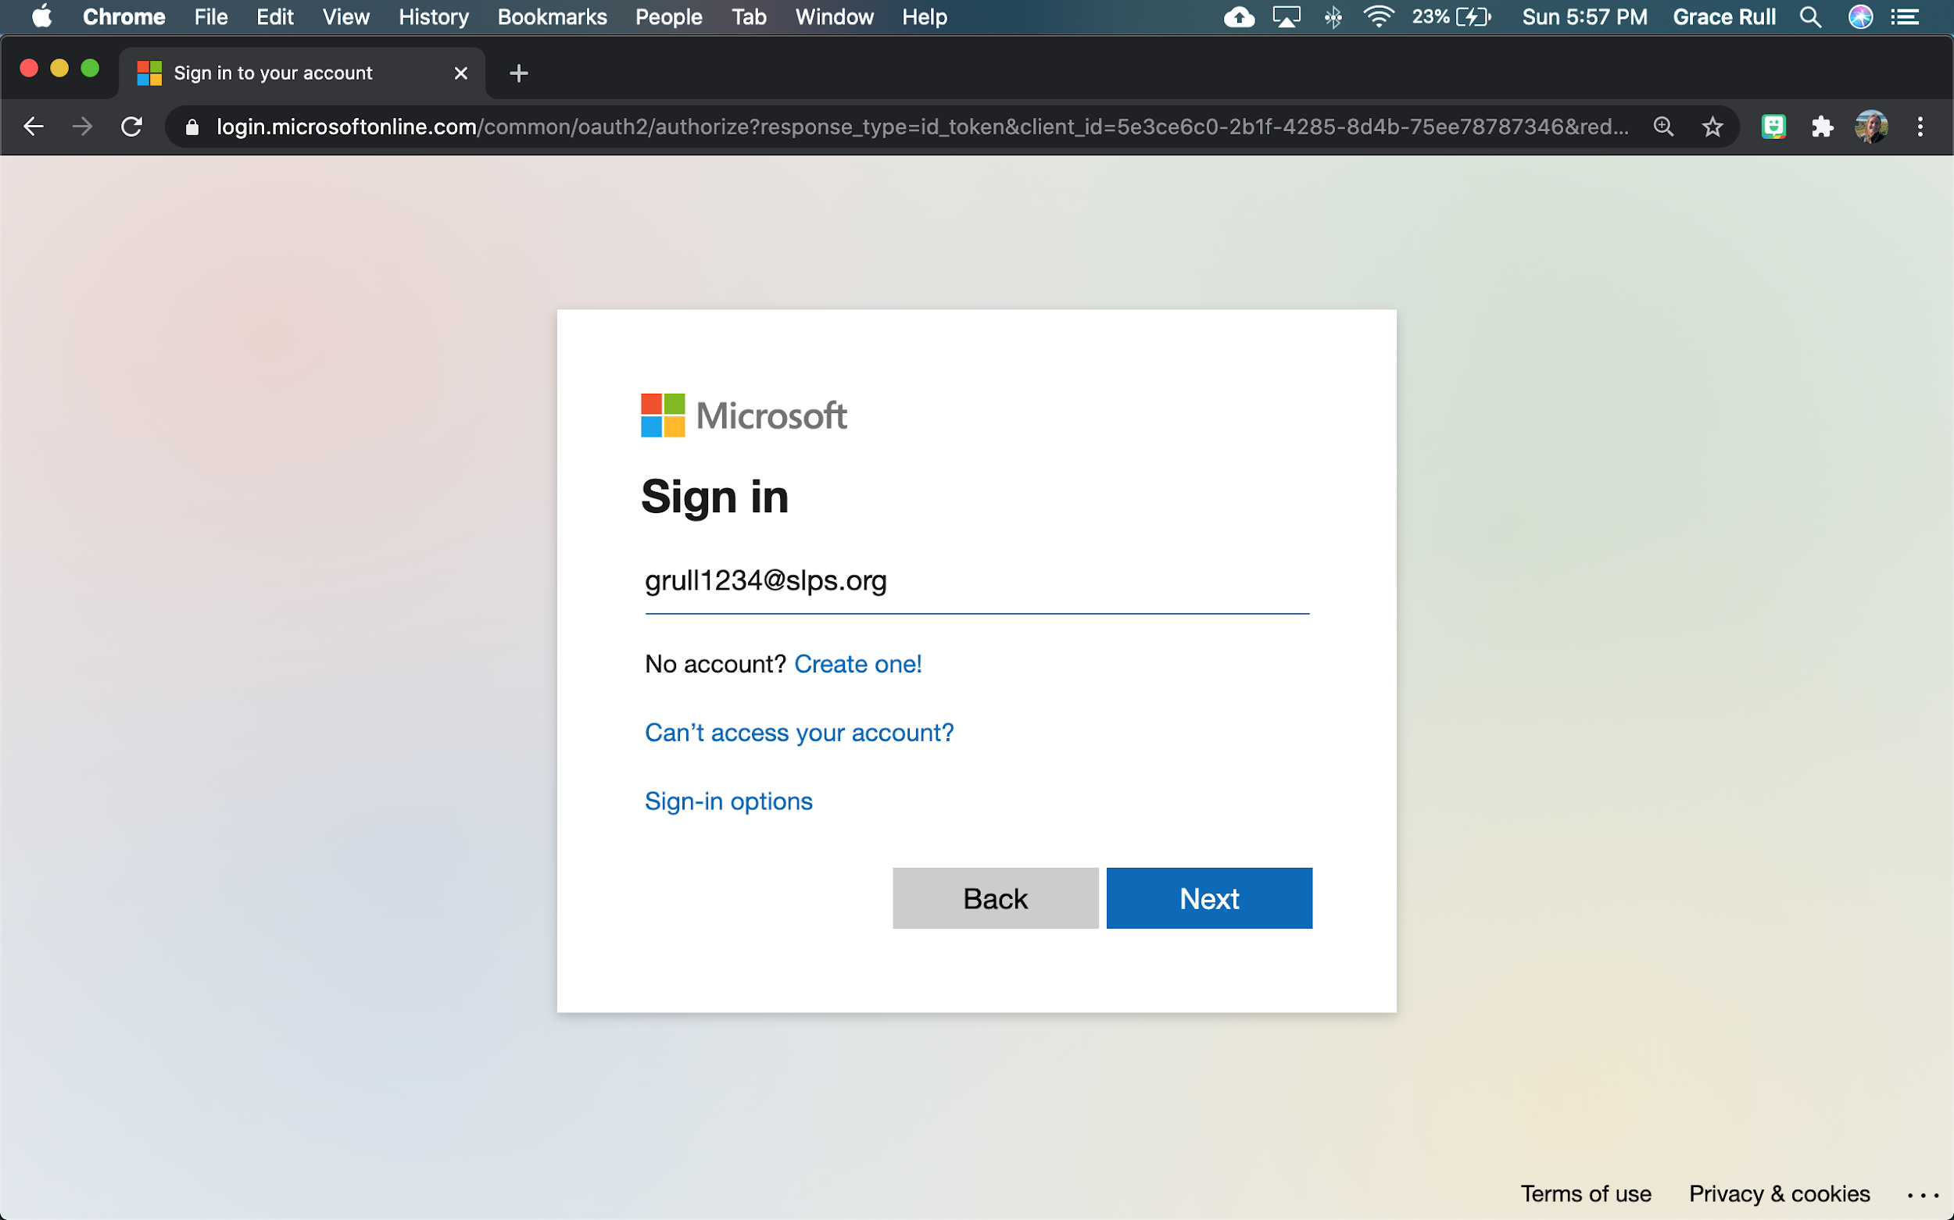
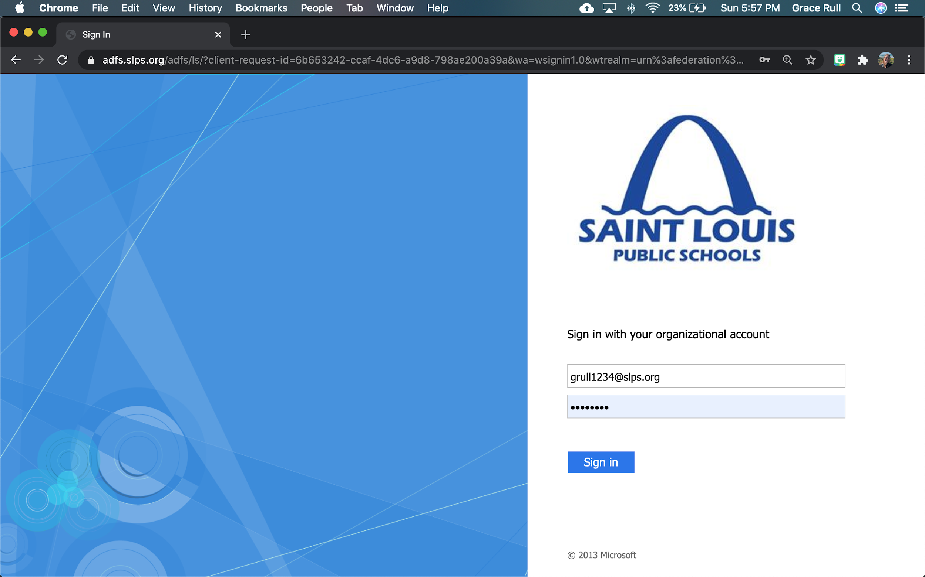
Getting logged in:
On the first page:
You will type in your first initial of your first name, your last name, and four digits
Example: grull1234@slps.org
On the second page:
You will type the SAME email address
Example: grull1234@slps.org
Password:
This will be given to you by your teacher

Slide 5
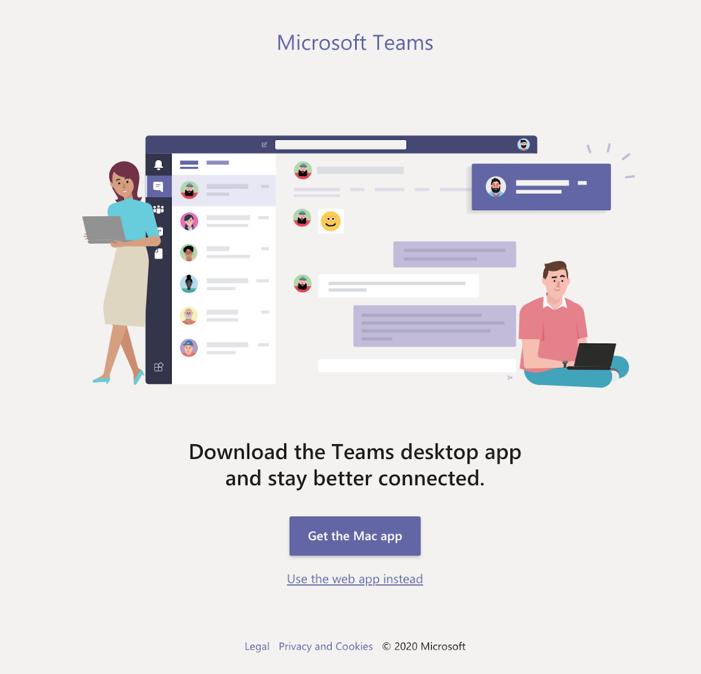
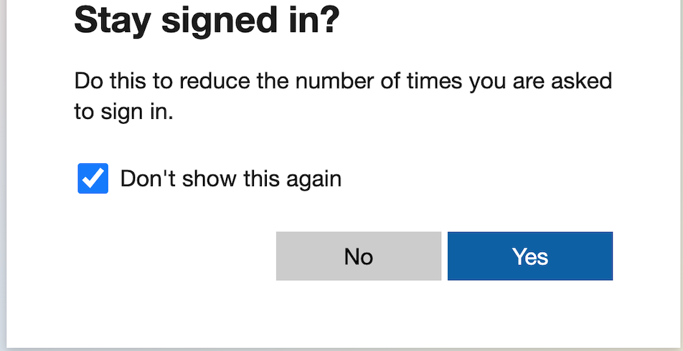
Getting logged in (Part 2):
If you are on an iPad, the message below will not show,
If you are on a computer, click “Use the web app instead”
When message below pops up, you can choose either option, but it is easier to click “Don’t show this again” and Yes (to stay signed in).
Click this
Click this
Click this

Slide 6
General Teams
Overview

Slide 7
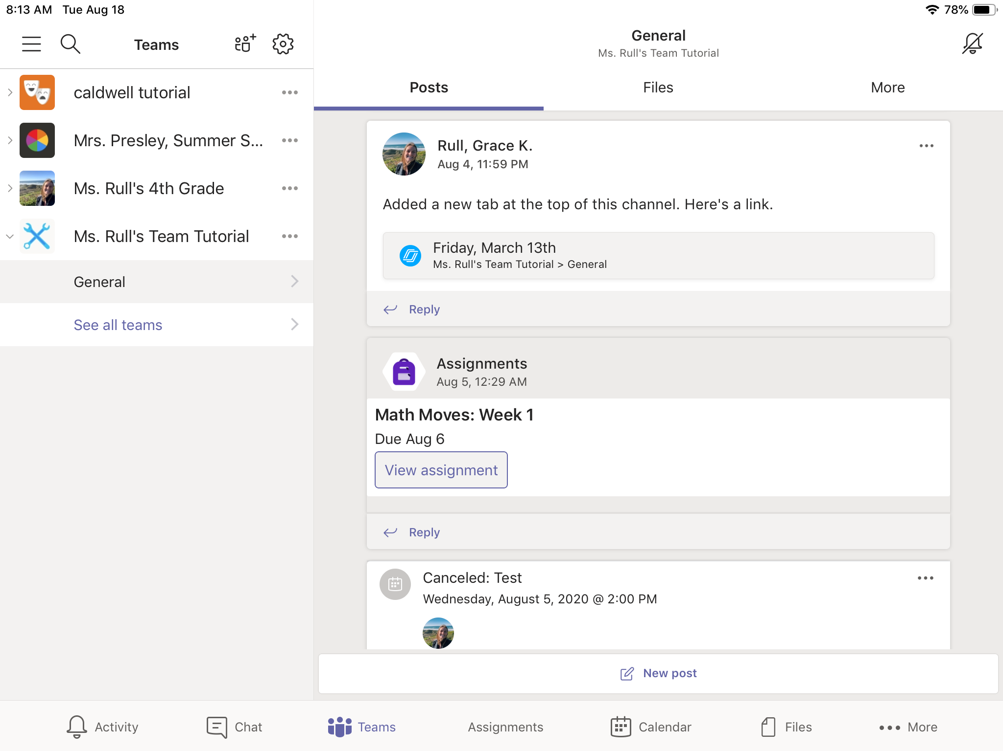
Finding your team:
[
When you first log onto Microsoft Teams, you will want to go to click the Teams icon in the bottom middle.
This will show you all of your teams that you are a part of.

Slide 8
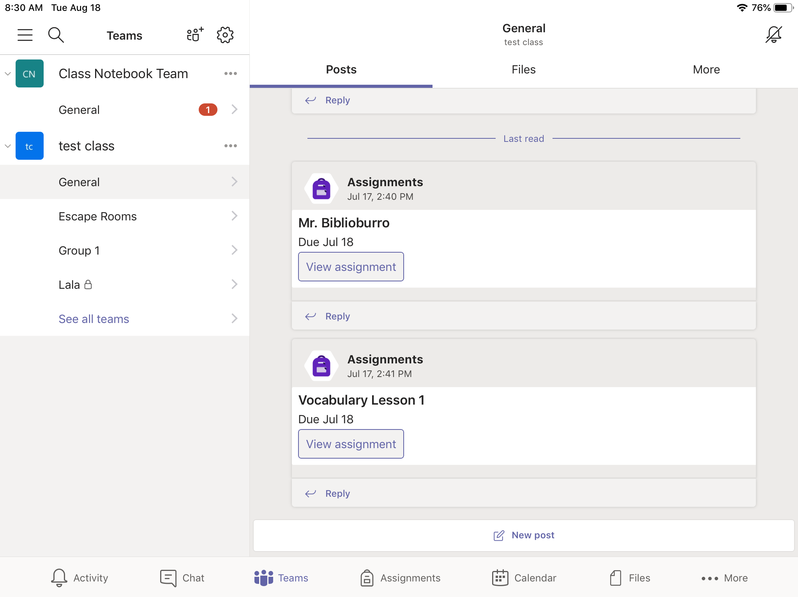
General Channel:
After you click on your team, you will see the General Channel.
[
ELA
Math
Science
You will also have subject area channels.

Slide 9
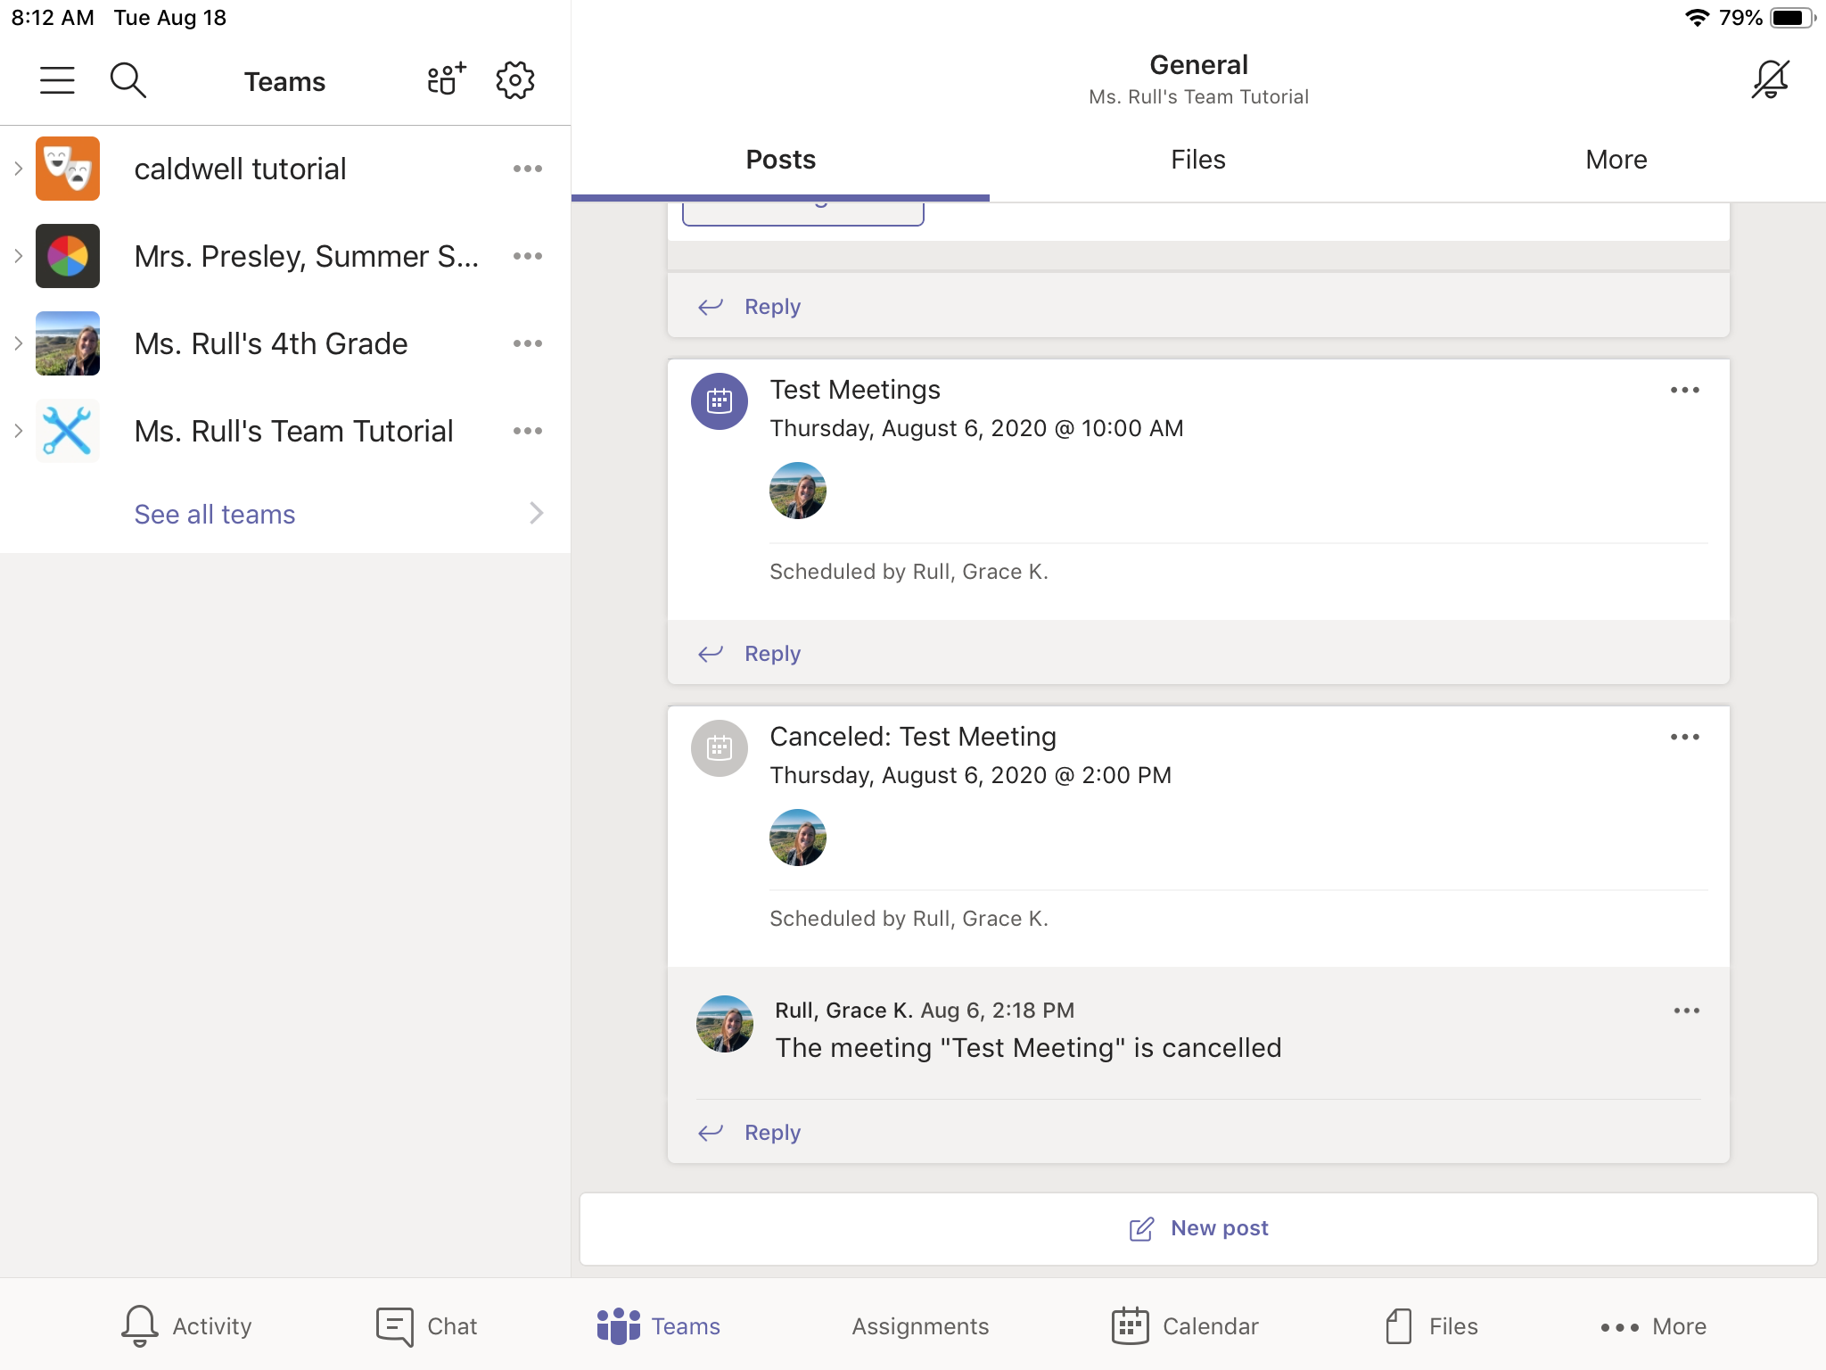
Posts Tab:
Post Tab has:
Reminders
General information
Assignments
Links to resources

Slide 10
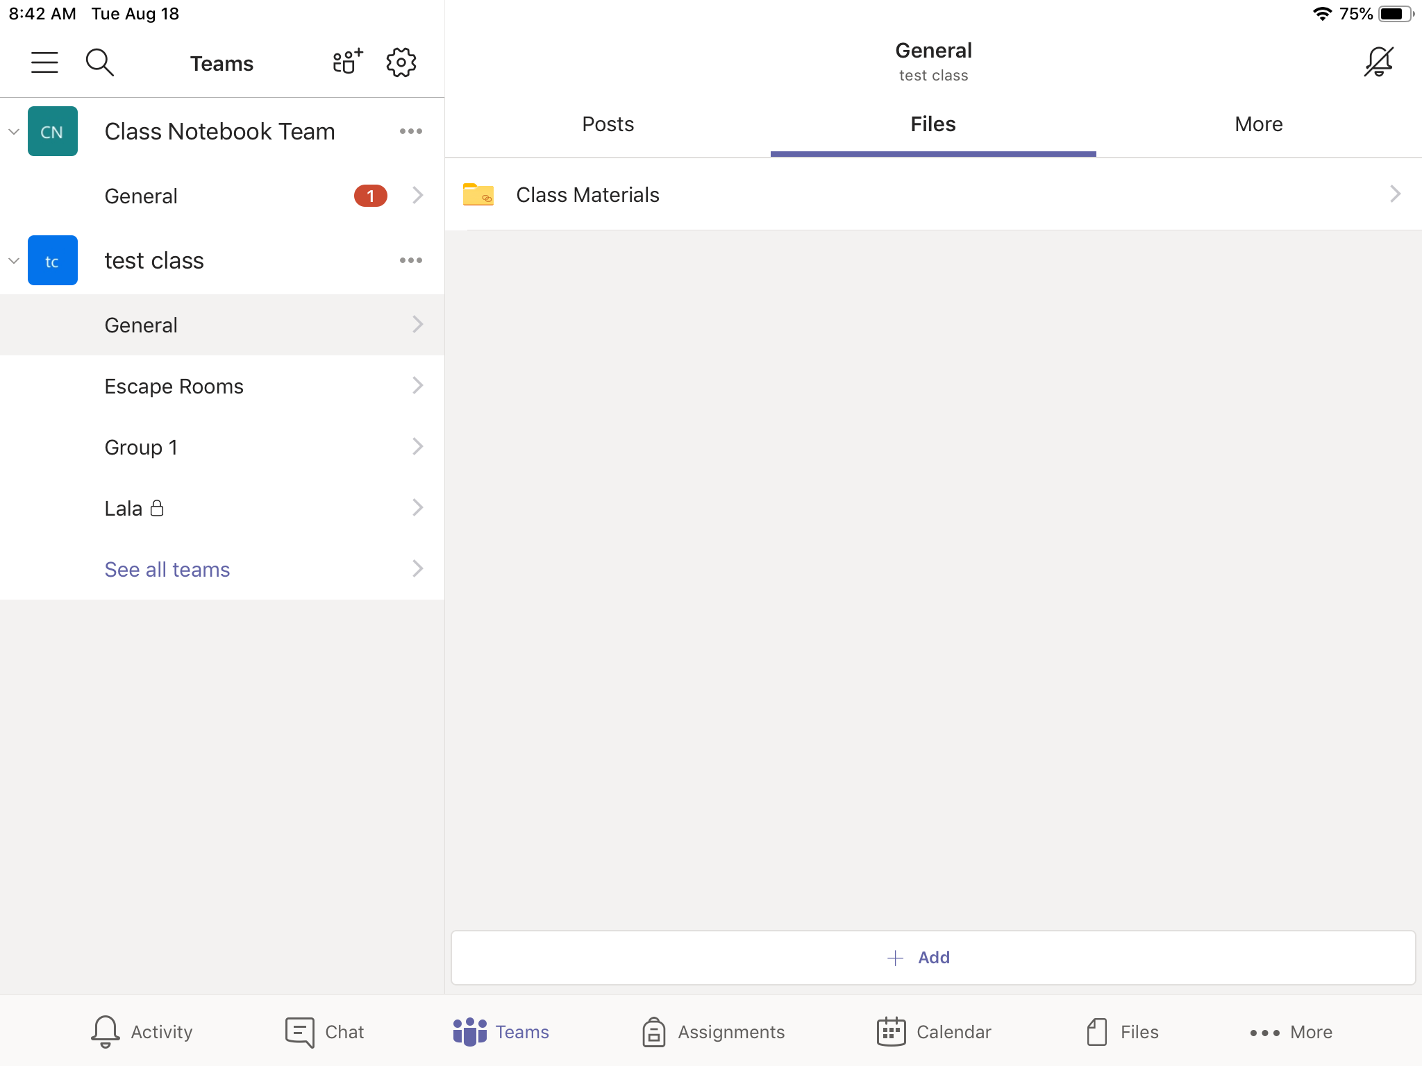
Files Tab:
In the Files tab of the General channel, you can see the Class Materials folder:
This will have more folders. Inside these folders, you can find documents and presentations.

Slide 11
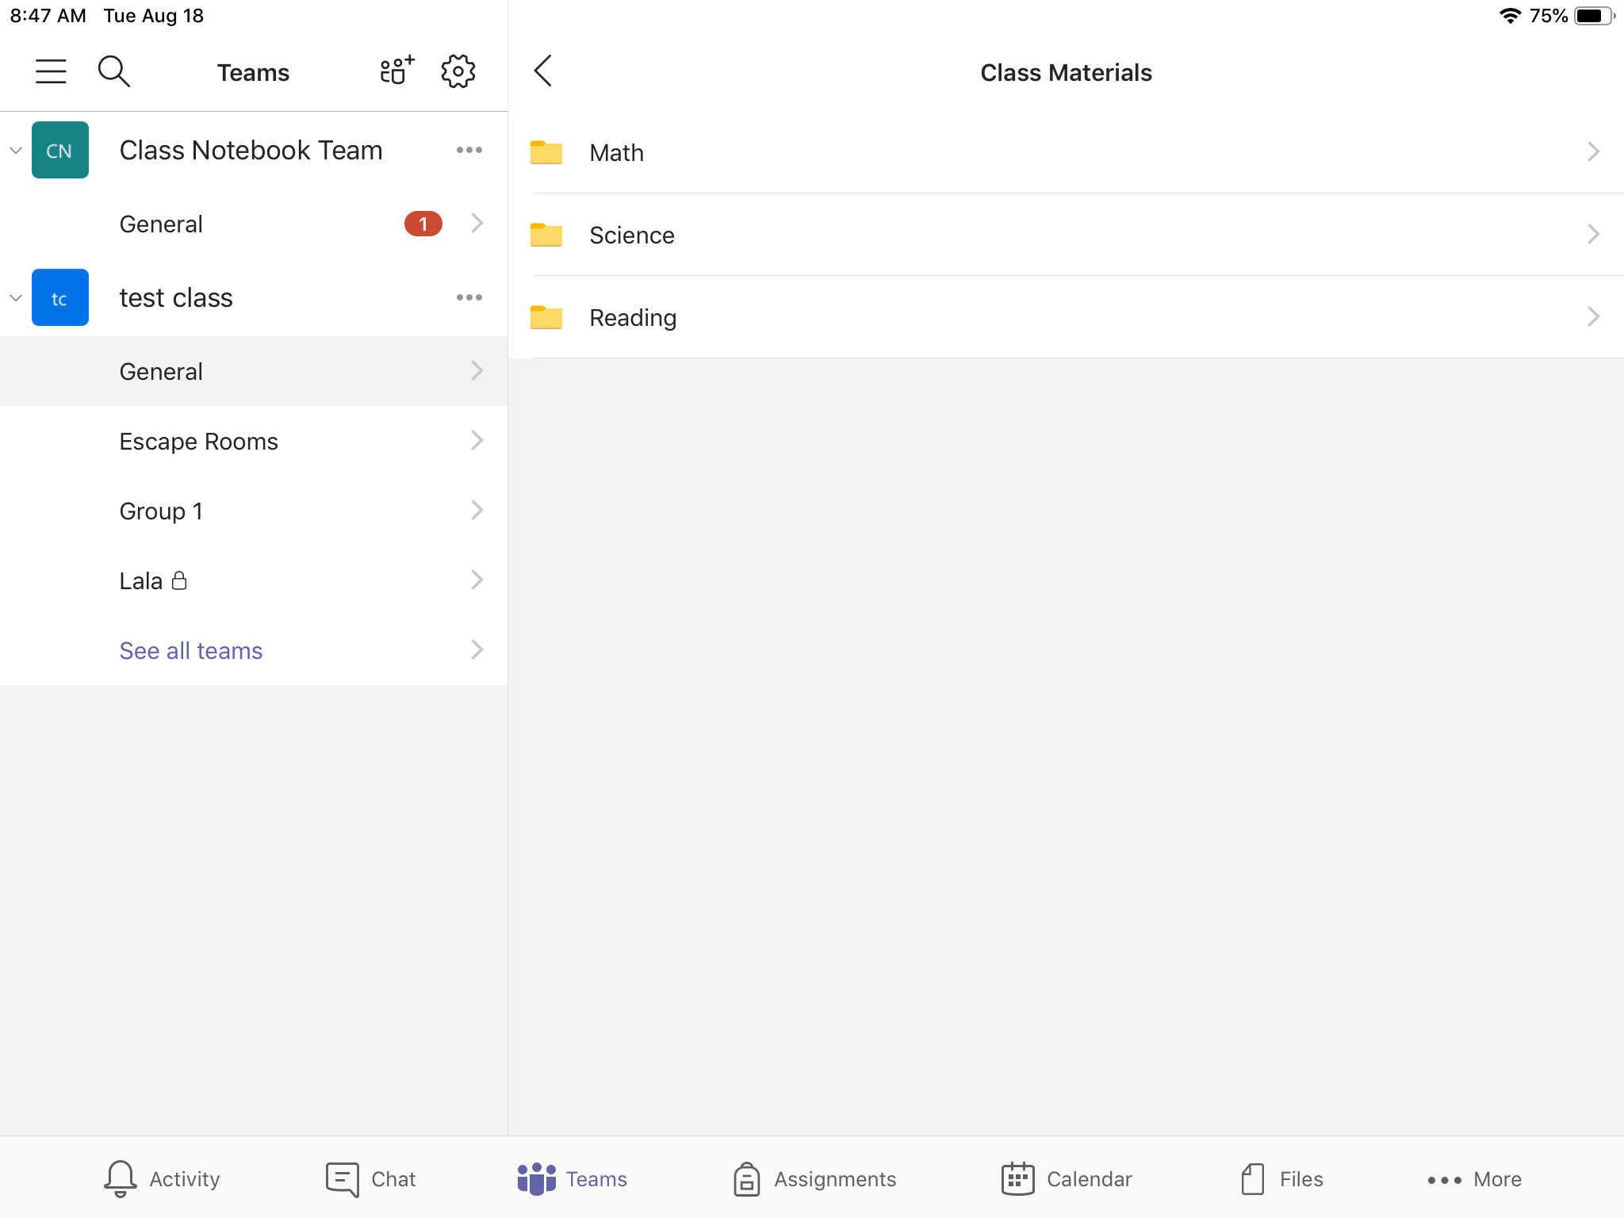
Files Tab: In Class Materials Folder:
[
After clicking on “Class Materials,” you will be taken to this page.
Choose your subject.

Slide 12
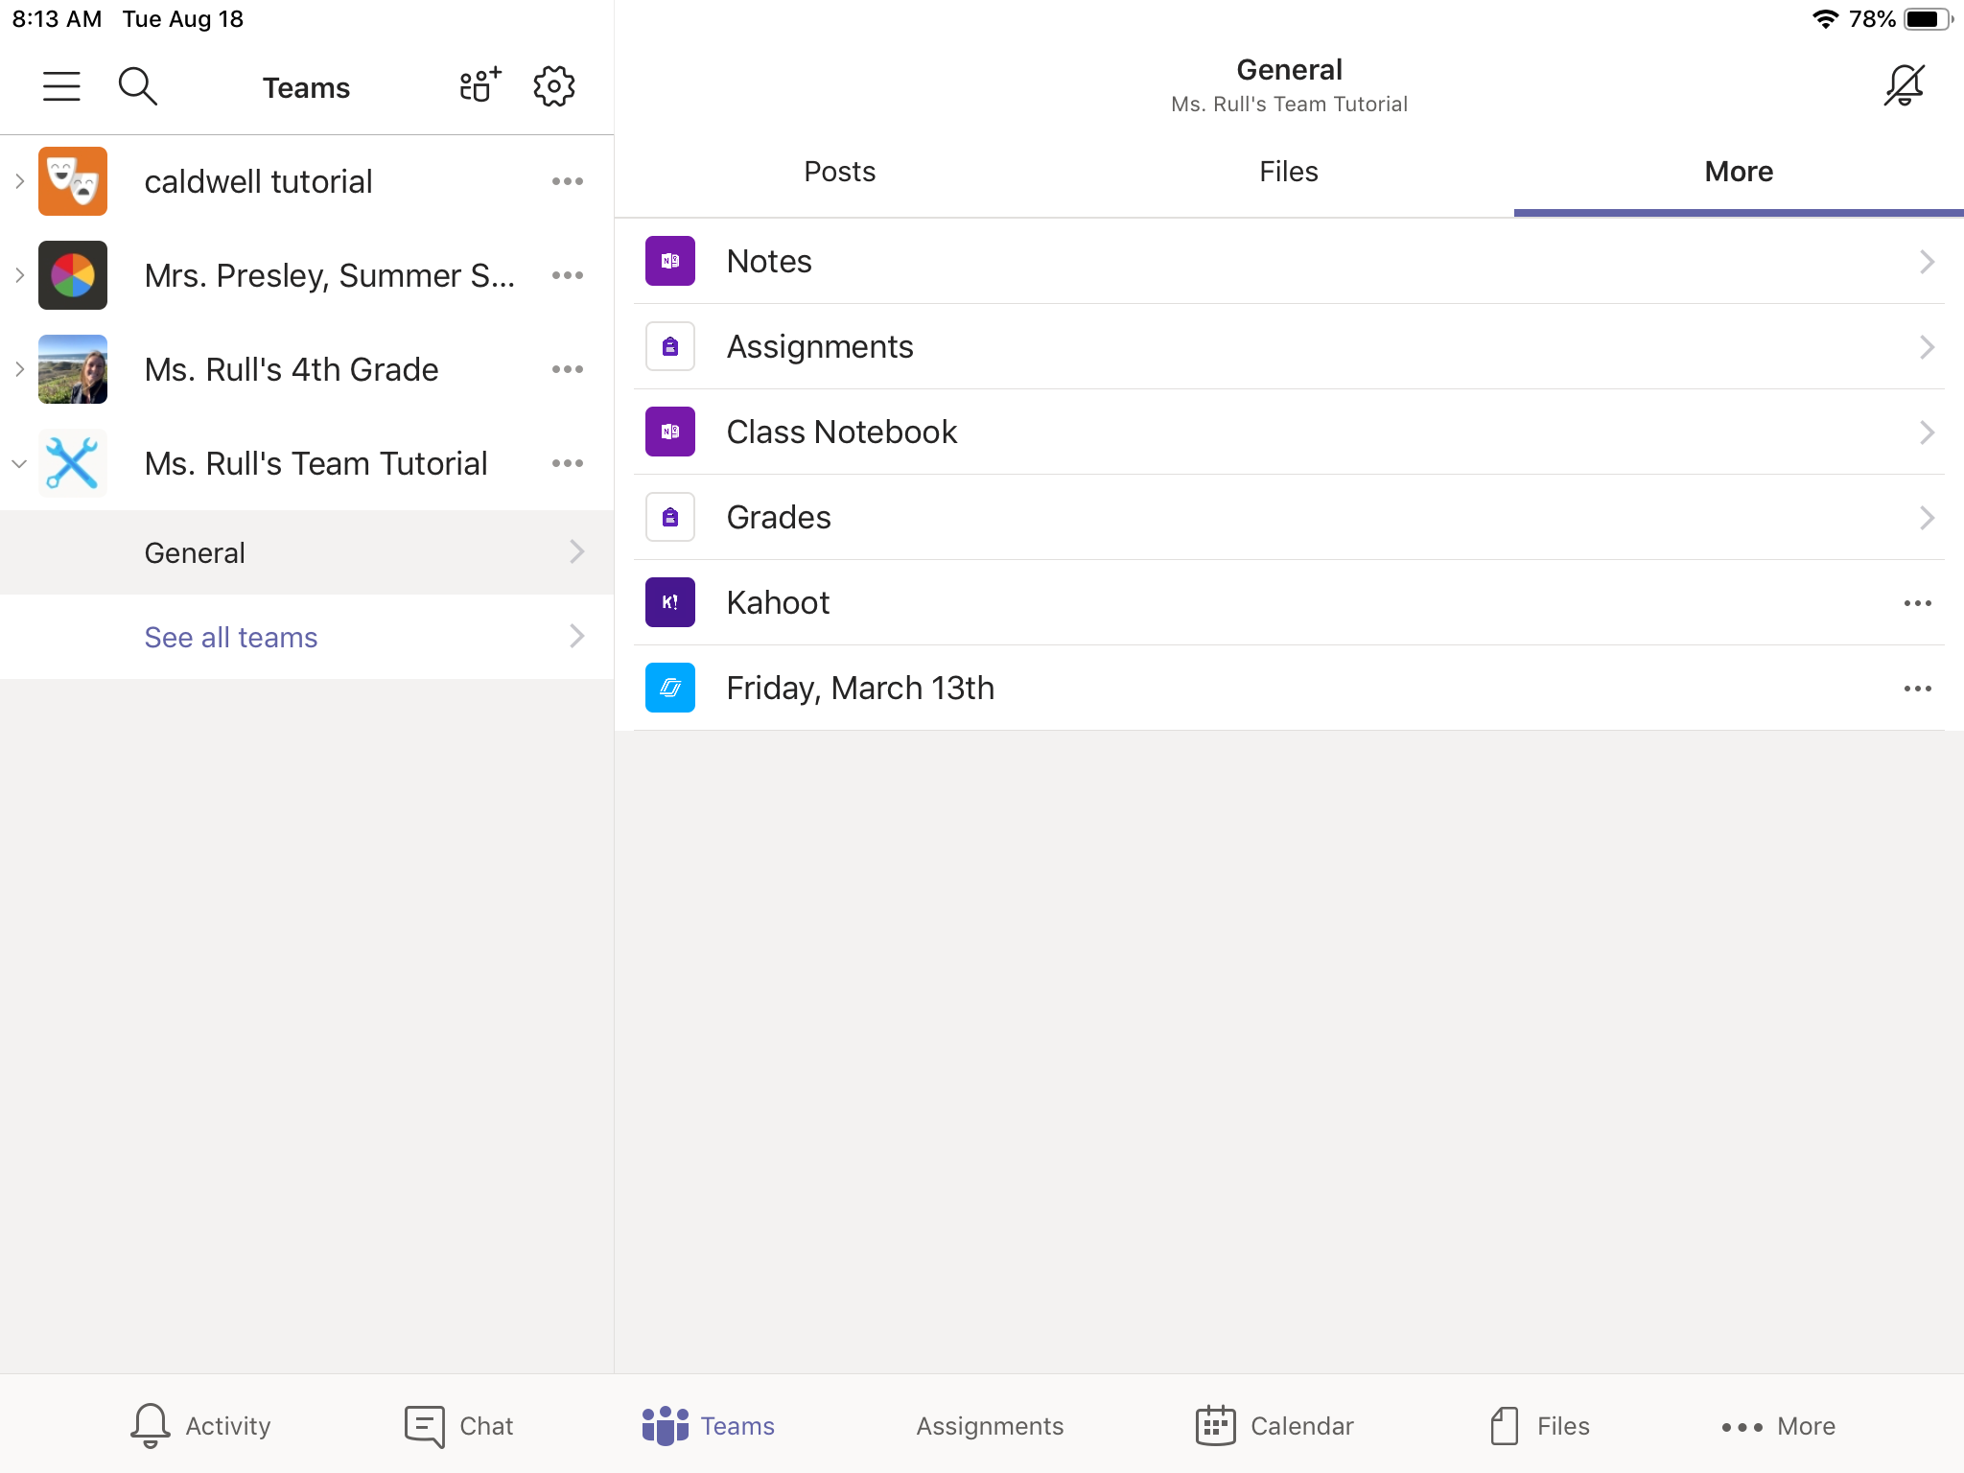
More Tab:
In the “More” Tab has more apps that you may need, including Class Notebook.

Slide 13
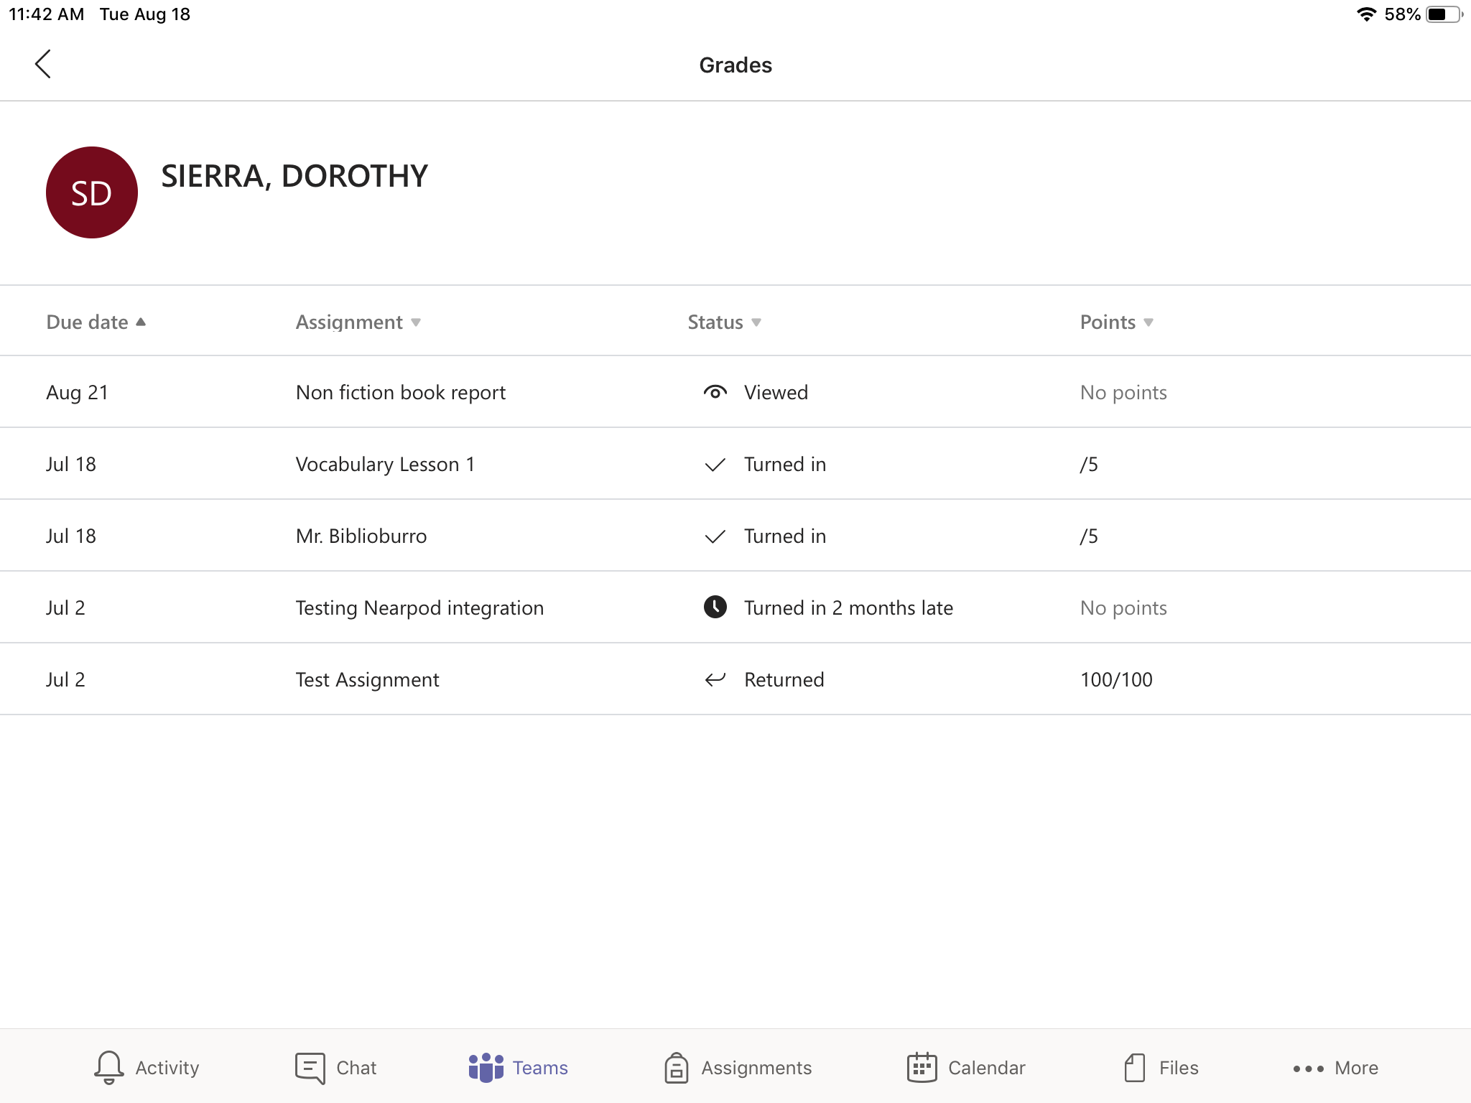
More tab: Grades
Status:
Viewed: This means you have looked at the assignment, but you have not turned it in yet.
Turned in: You have turned in your assignment.
  If it says “Turn in late,” you turned in the assignment after the due date
Returned: The teacher has seen, graded, and/or given feedback on your assignment.
Student 1

Slide 14
Class Notebook

Slide 15
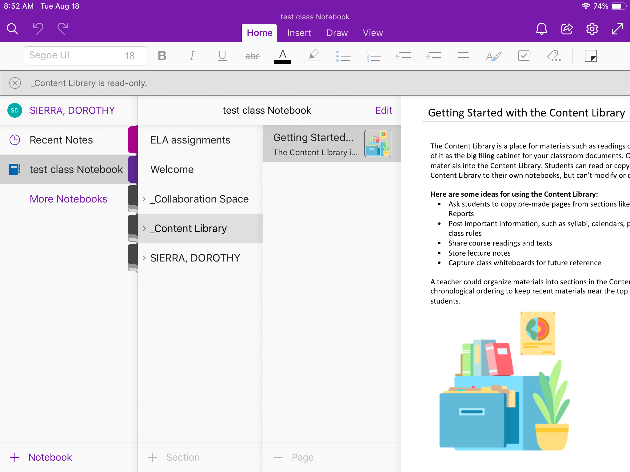
More Tab: Class Notebook: First Look
When you first open Class Notebook, this will be what you see.
Student 1
Student 1

Slide 16
Class Notebook: First Look Continued
[
By clicking on any of these sections, you can open them to see more.
Student 1
Student 1

Slide 17
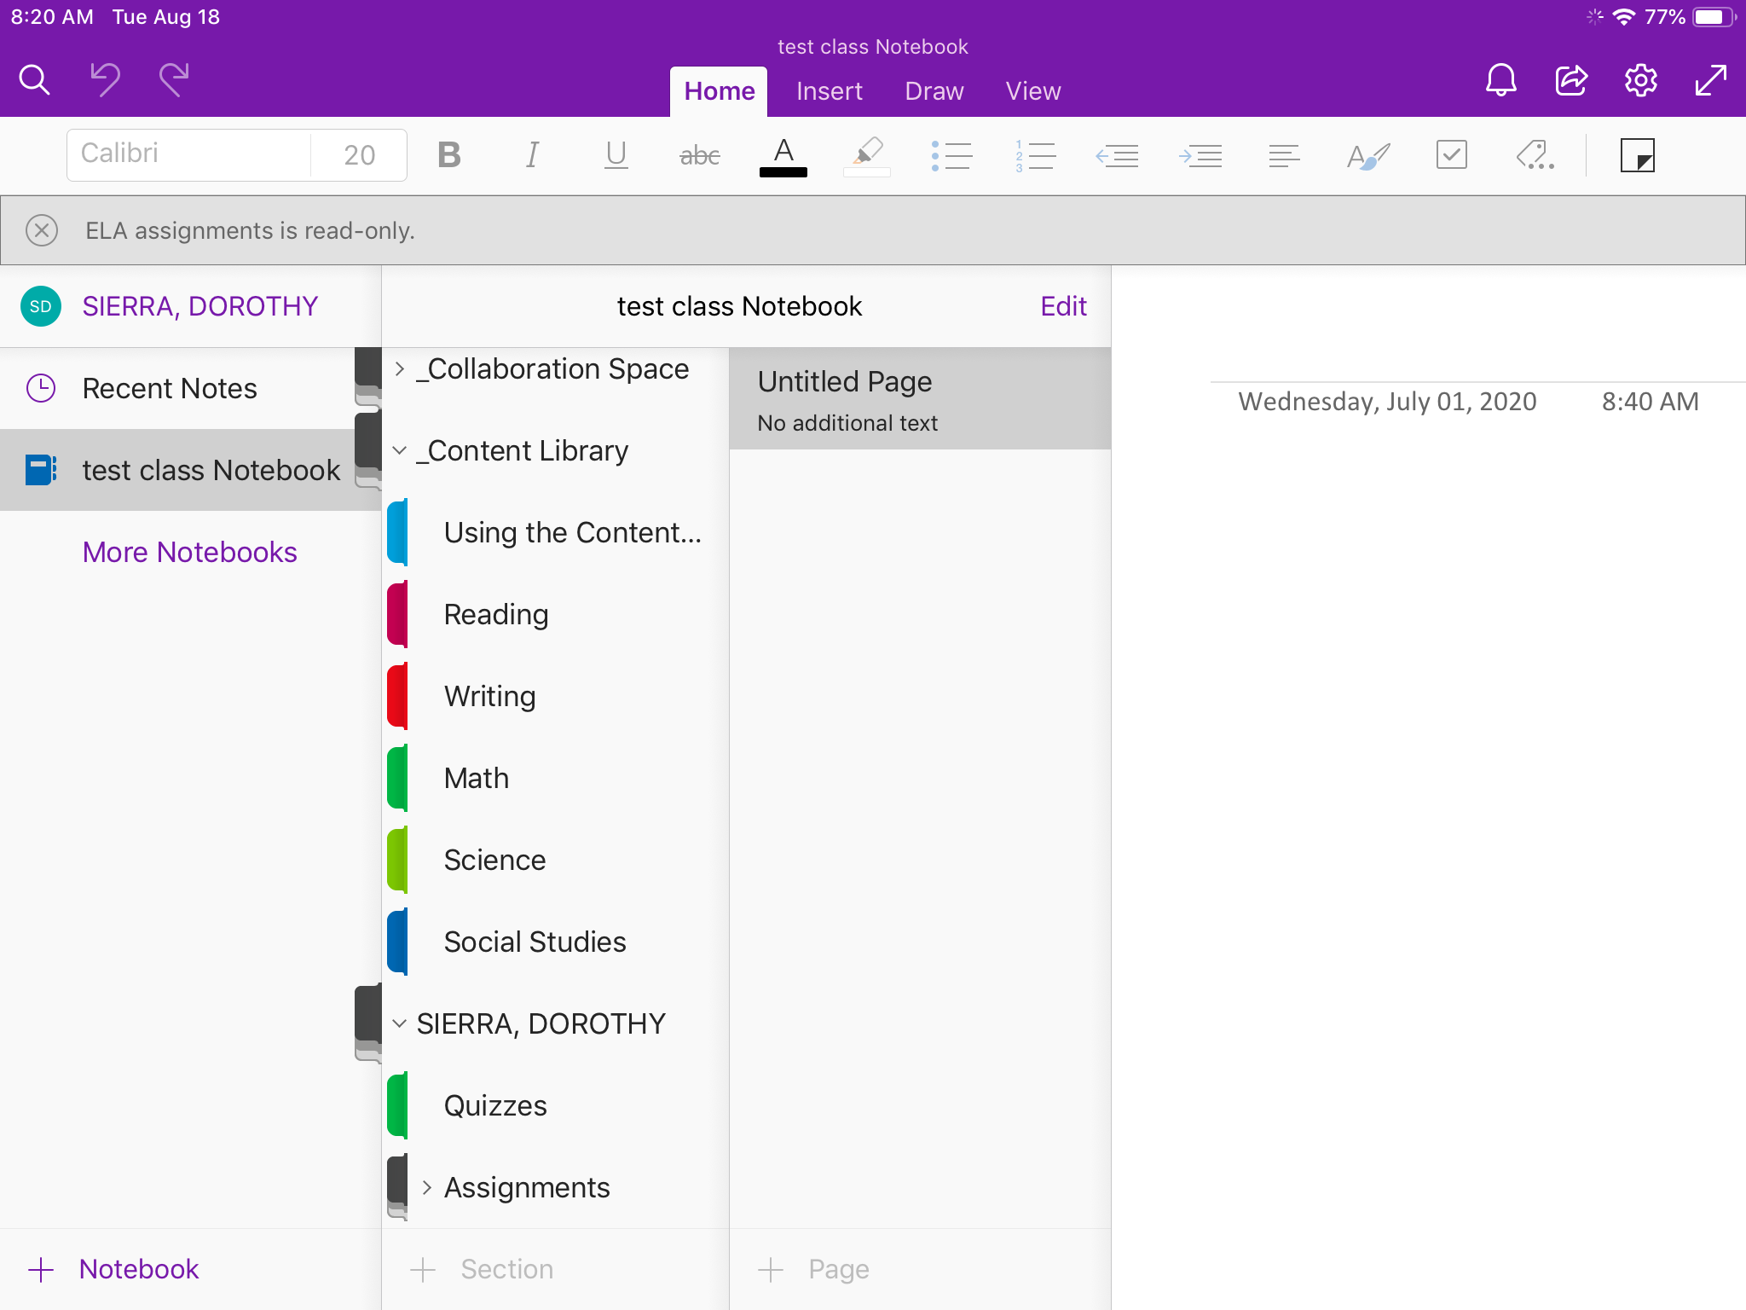
Class Notebook: Section Groups and Colored Tabs
This is an example of what you might see, when you open a section.
When the tab of the section is shades of gray, that is a section group. Section groups have more tabs (such as: ELA, Math, etc.)
Student 1
Student 1
The colored tabs which include pages.

Slide 18
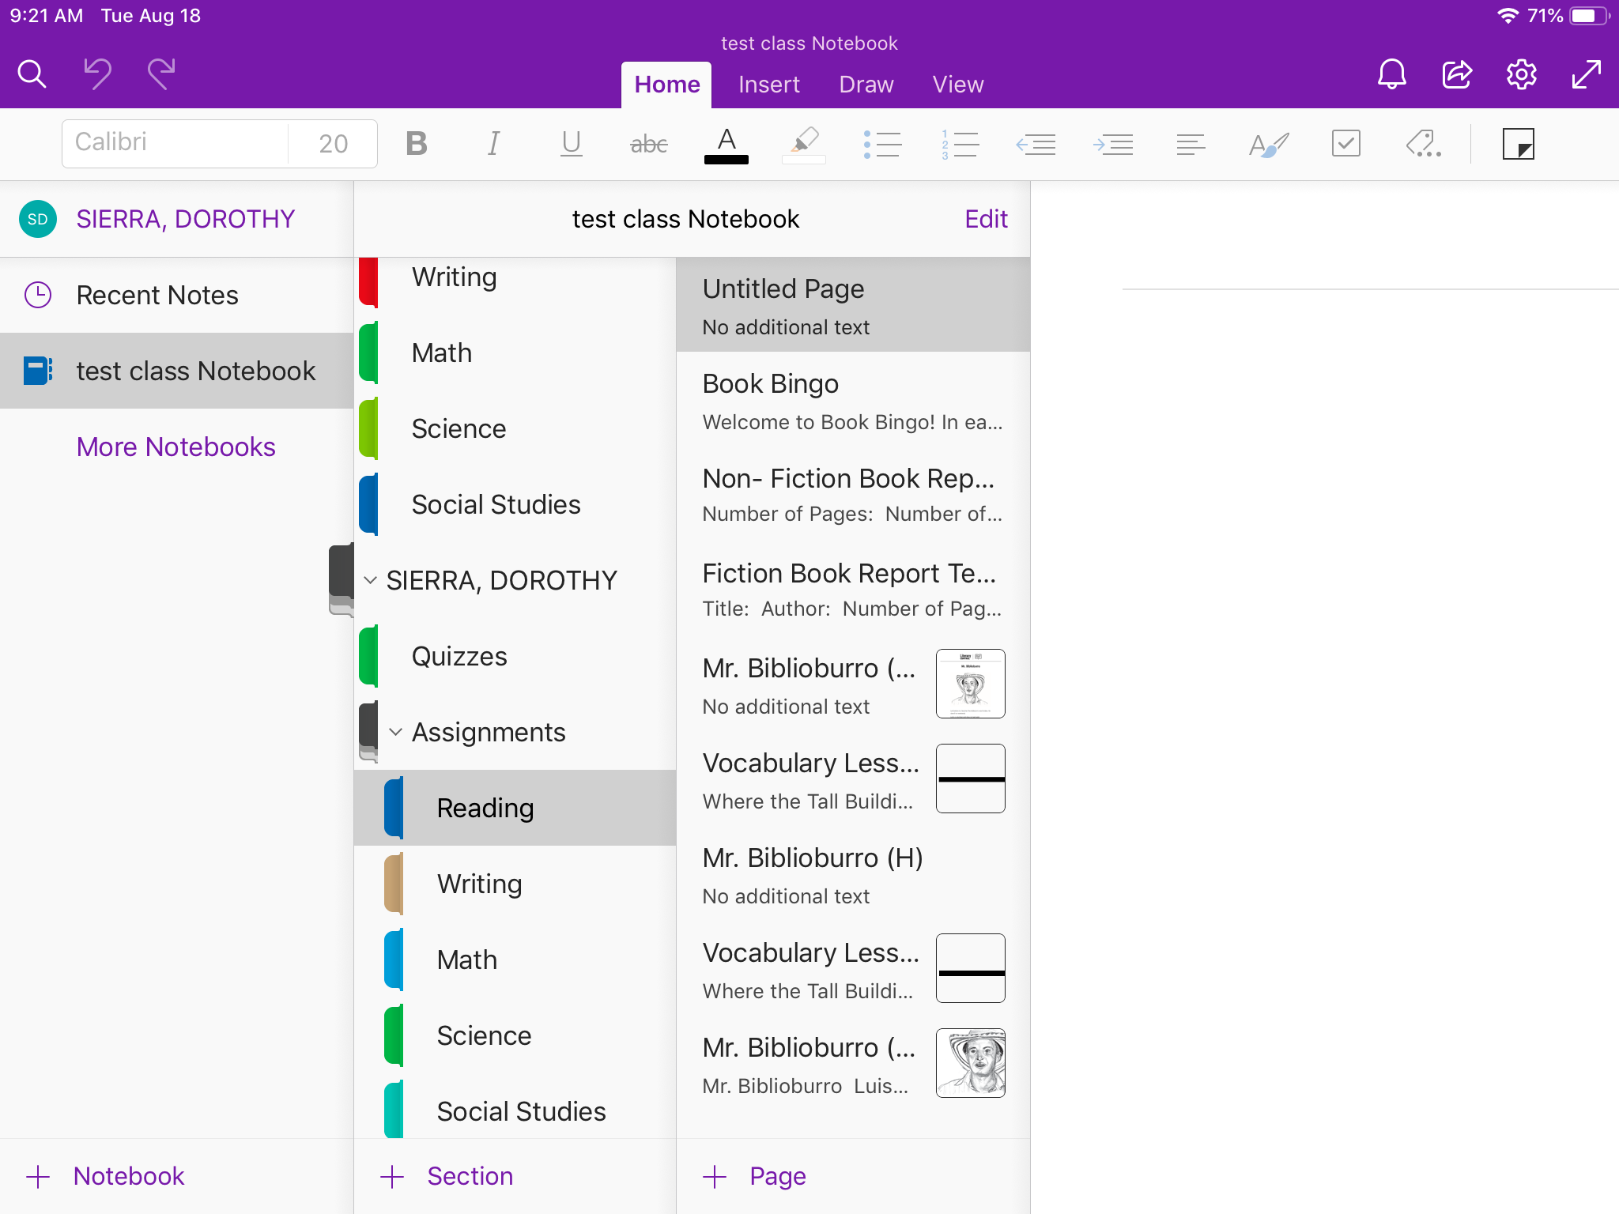
Class Notebook: Pages within Colored Tabs
Student 1
This an example of what your pages in a colored tab will look like.
Student 1

Slide 19
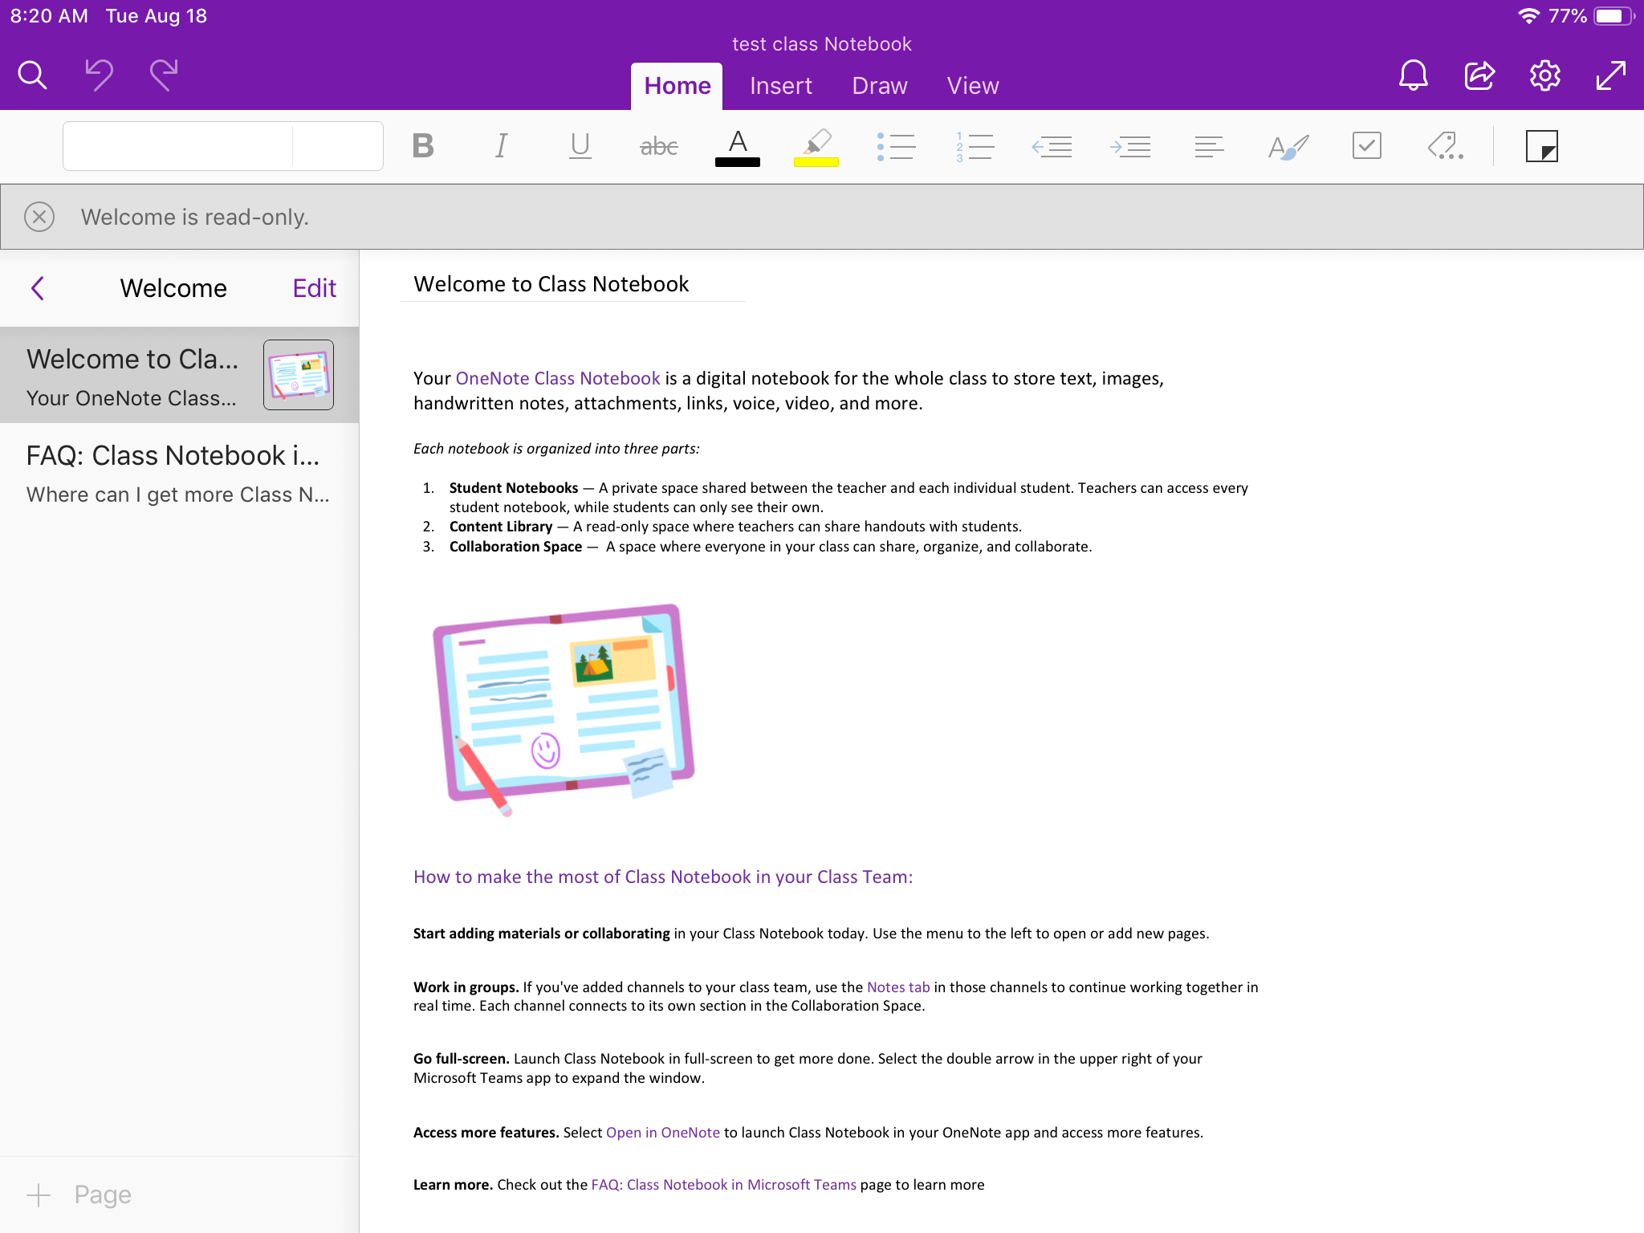
Welcome Tab in Class Notebook:
Welcome Section:
This tells you an overview of Class Notebook.

Slide 20
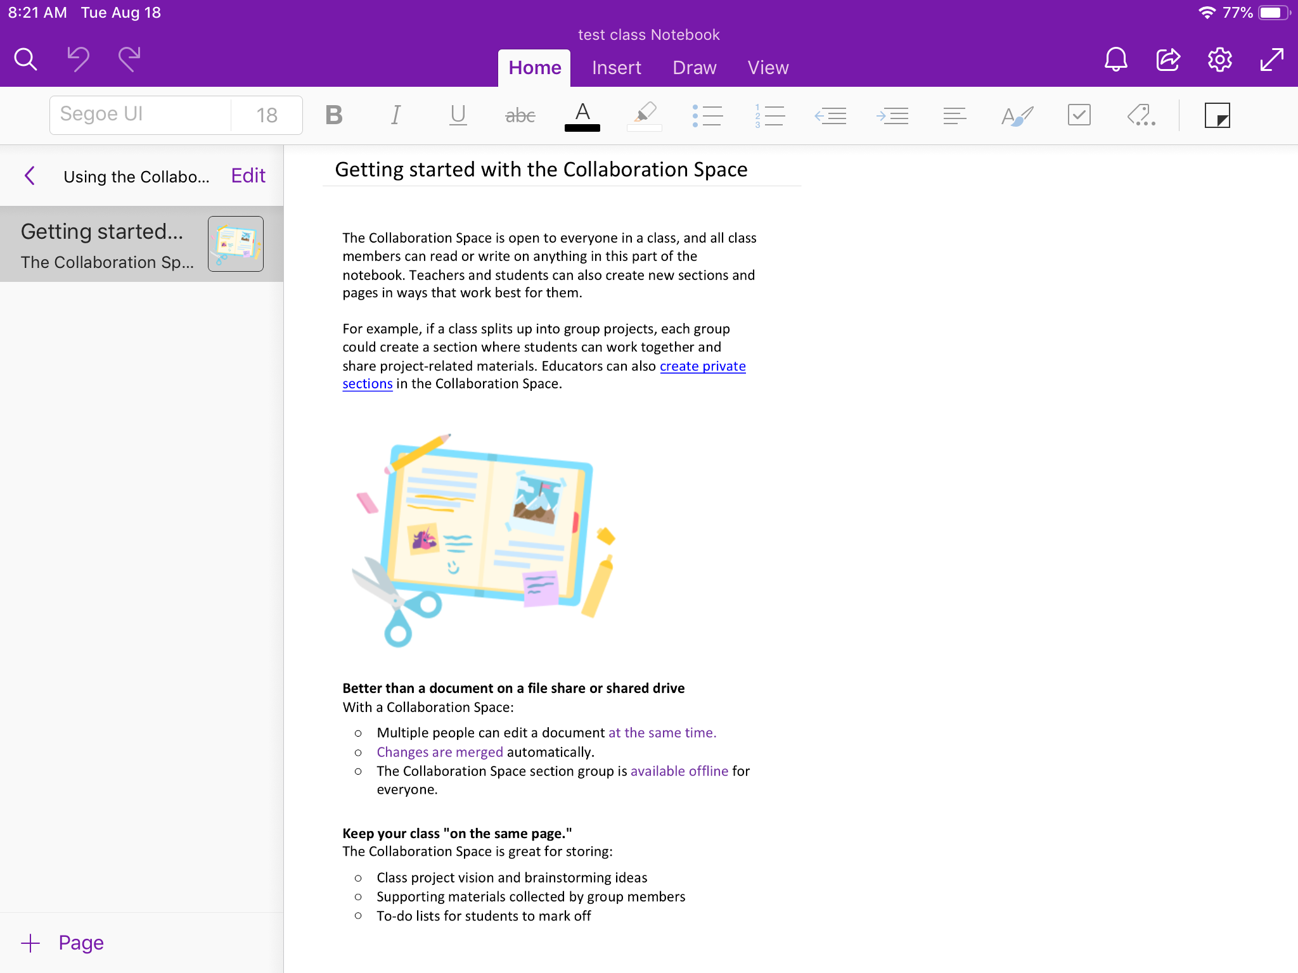
Collaboration Space in Class Notebook:
Collaboration Space Section:
This is a place where students can be put into small groups.
They can edit the same document and communicate with one another in here.

Slide 21
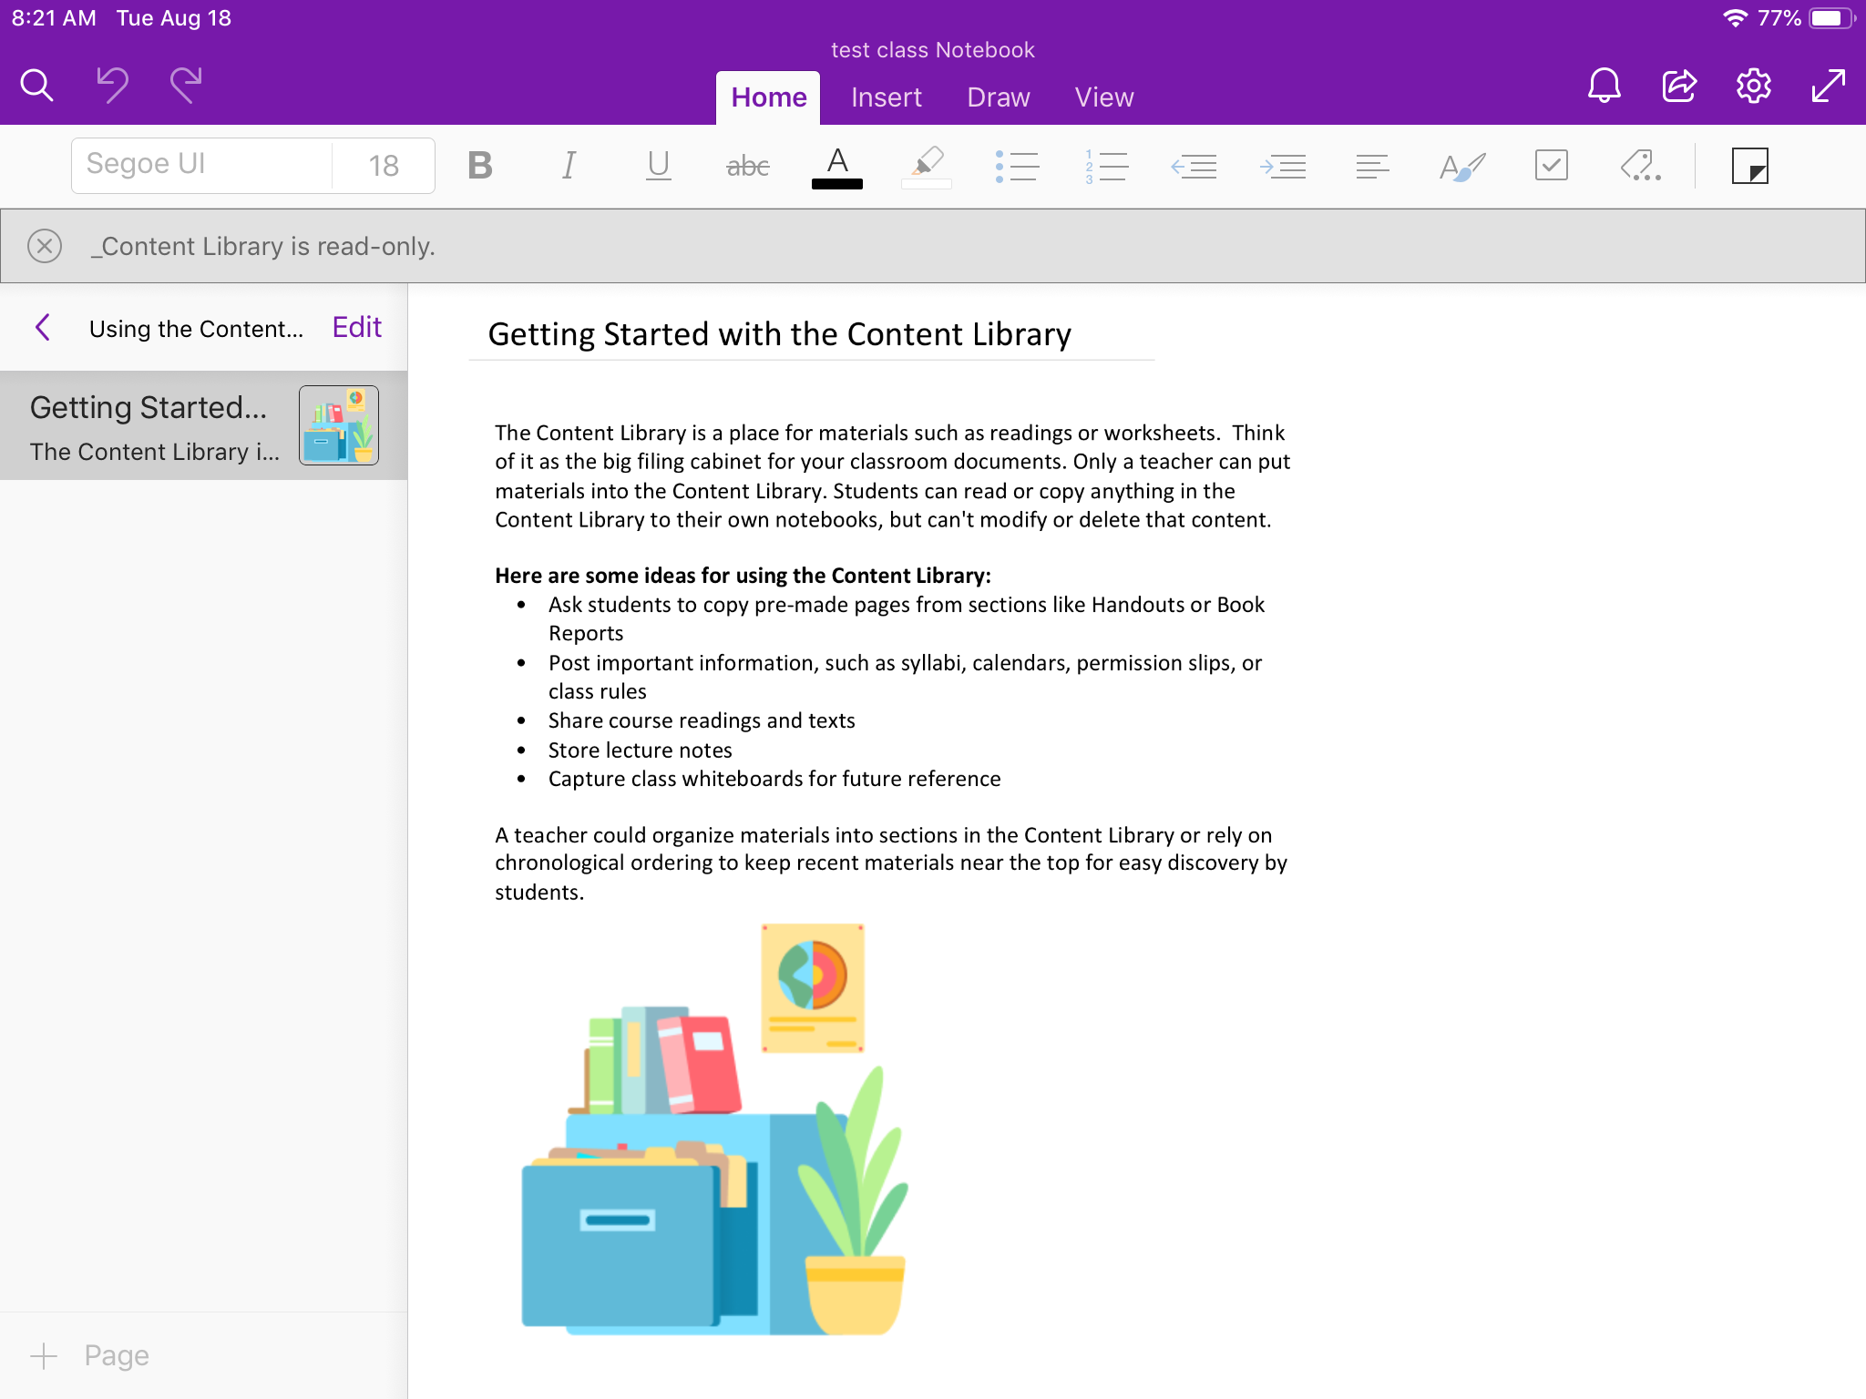
Content Library in Class Notebook:
Content Library Section:
This will be where students will spend most of their time.
Teachers will post worksheets and handouts here.
Students can see everything in the Content Library, but must make their copy to edit these documents.

Slide 22
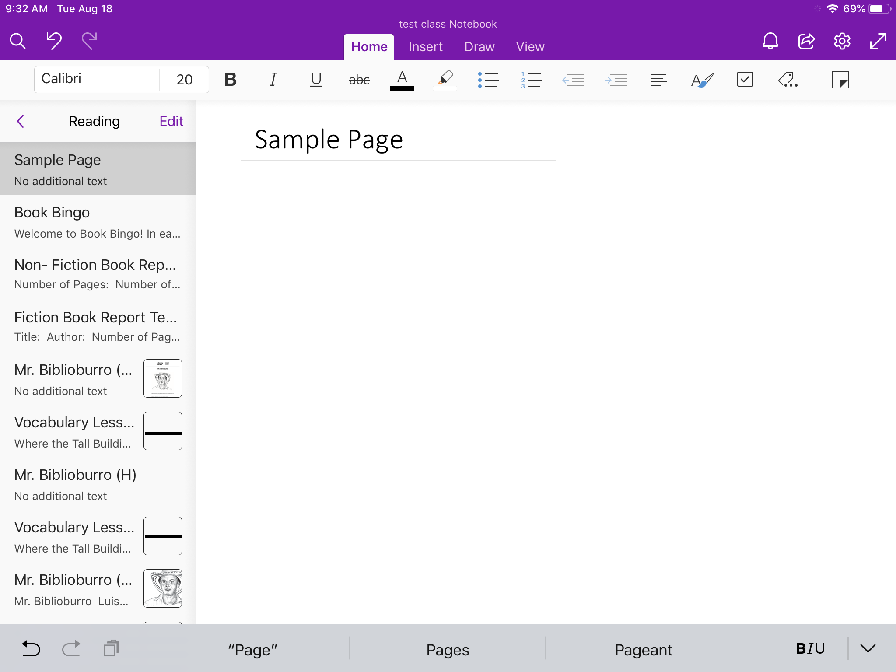
Class Notebook Tools: Home
Home Tab:
You can:
Change font style, size, color, etc.
Highlight
Bullet points
Numbering

Slide 23
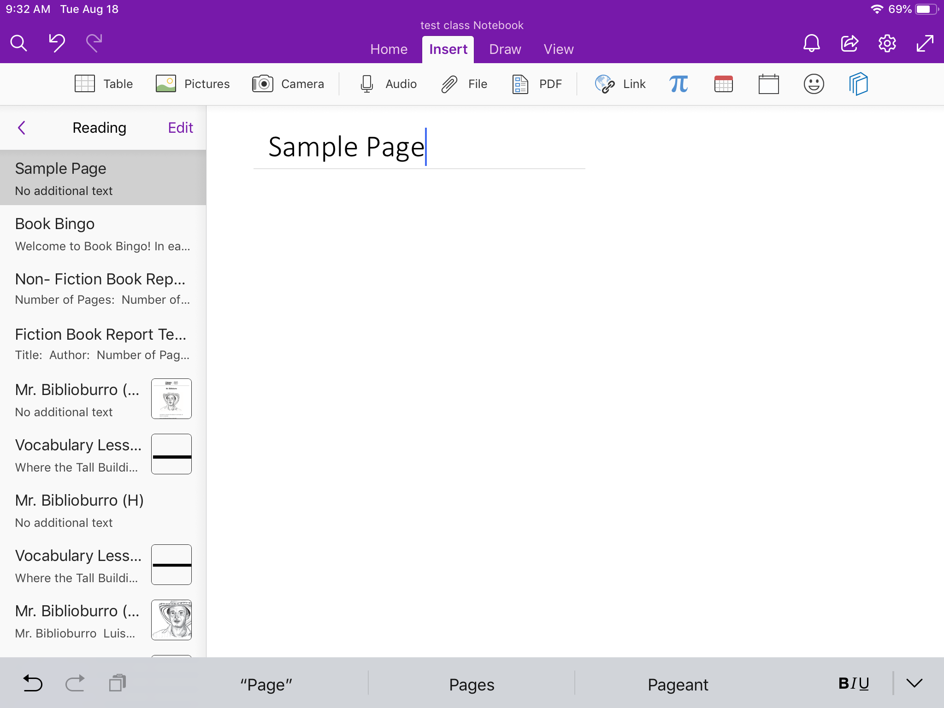
Class Notebook Tools: Insert
Insert Tab:
You can add:
tables
pictures
Recordings
Files (PDF are a type of file)
Links to websites

Slide 24
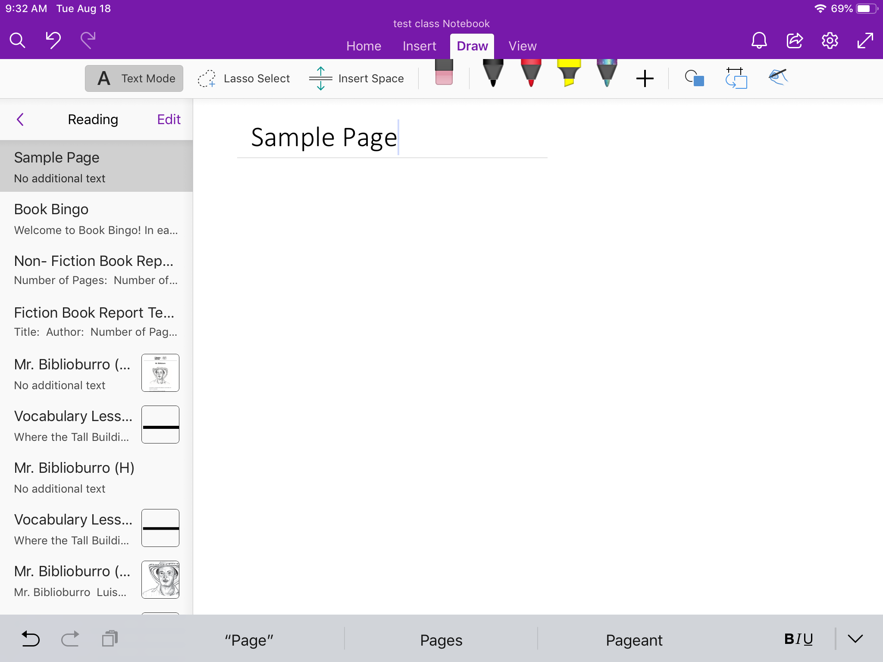
Class Notebook Tools: Draw
Draw Tab:
You can:
Add text boxes
Add spaces
Use pen and marker tools to write and draw on your page
Shapes

Slide 25
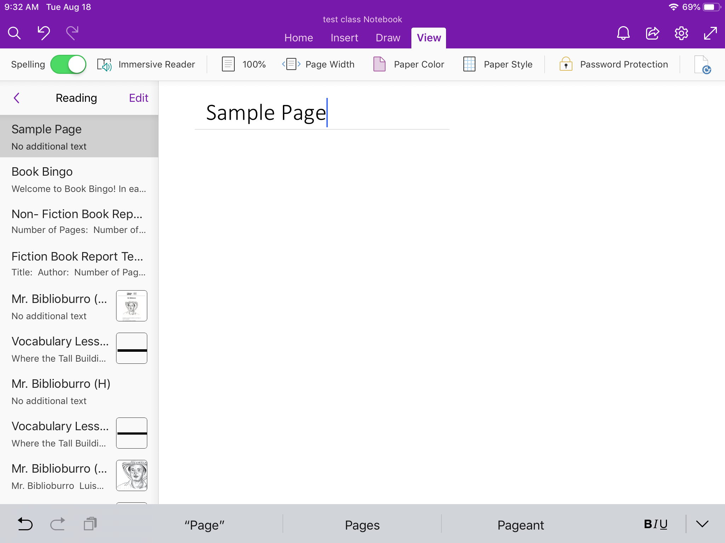
Class Notebook Tools: View
View Tab:
You can:
Turn on and off spell check
Immersive Reader (see next slide for more information)
Zoom in and out on the page
Change color of page
Change paper style (blank, lined notebook paper, or graph paper)

Slide 26
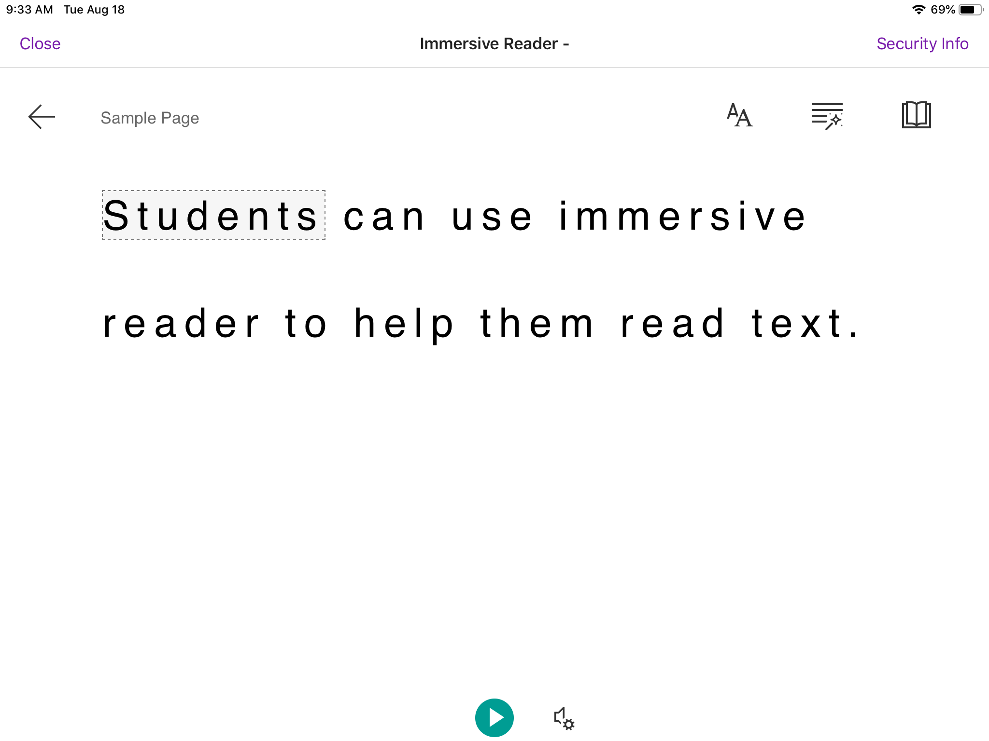
Class Notebook View Tab: Immersive Reader
Immersive Reader can:
Read text to you

Slide 27
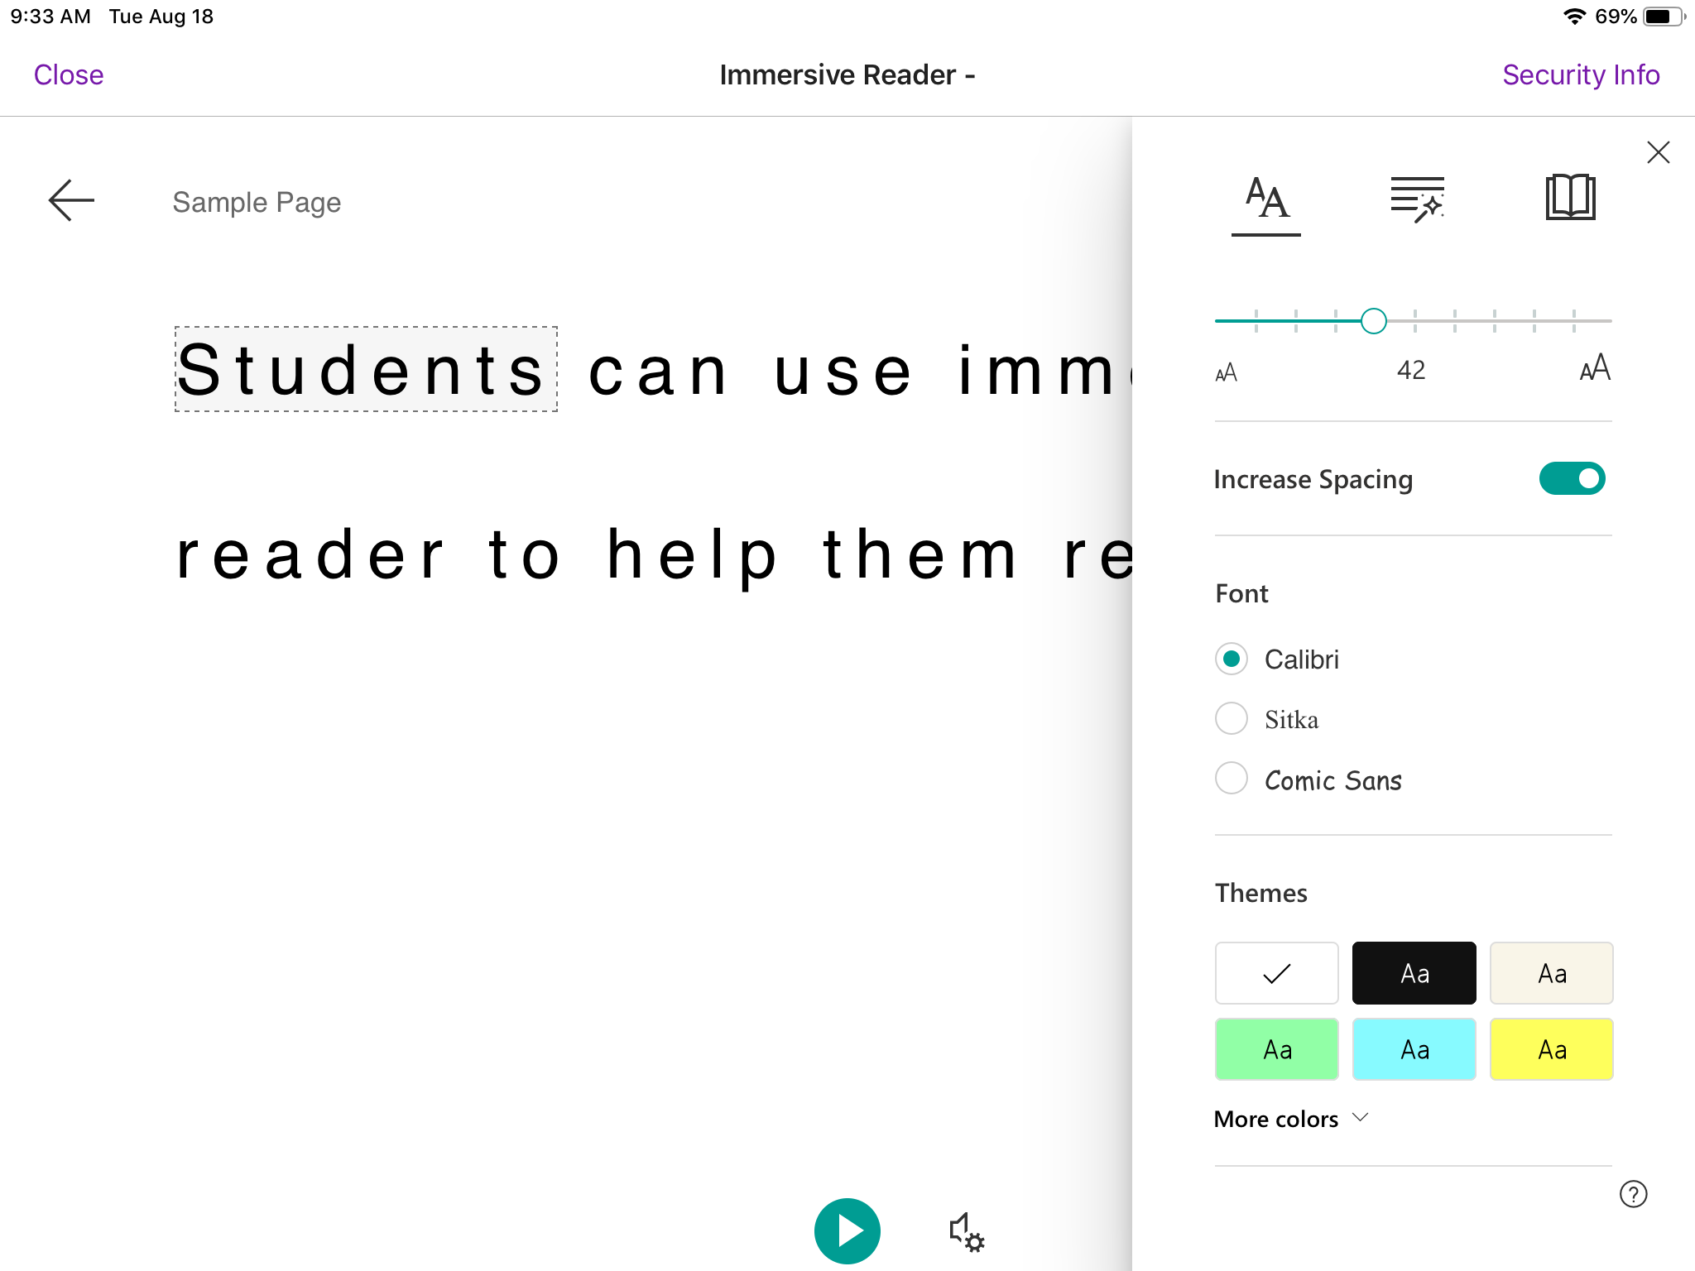
Class Notebook View Tab: Immersive Reader
Double A icon:
You can:
Make text bigger
Make spaces between letter bigger
Change font
Change background color

Slide 28
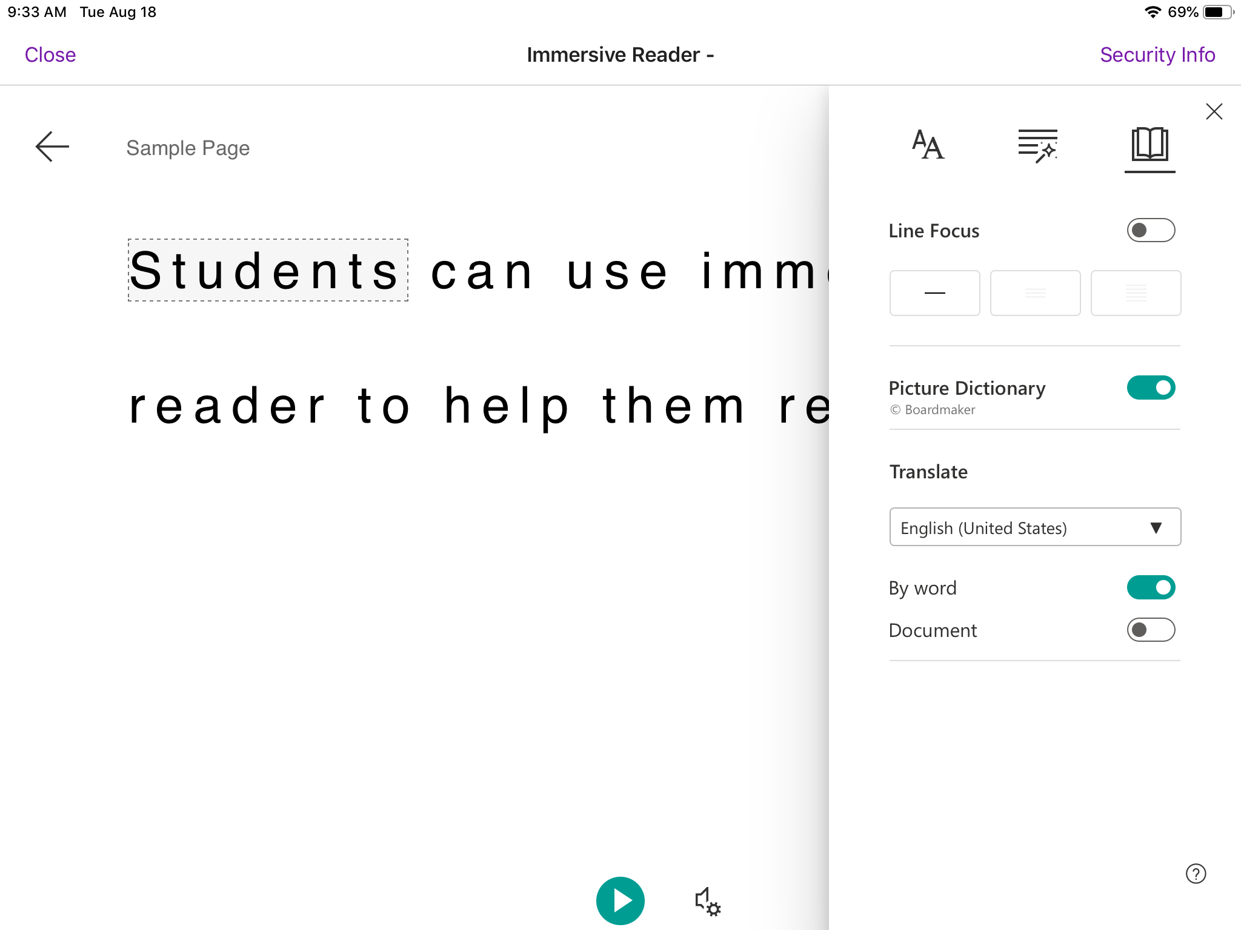
Class Notebook View Tab: Immersive Reader
Book icon:
You can:
Highlight the line you’re reading
Picture dictionary
Translate
  Just one word
  Or the whole document

Slide 29
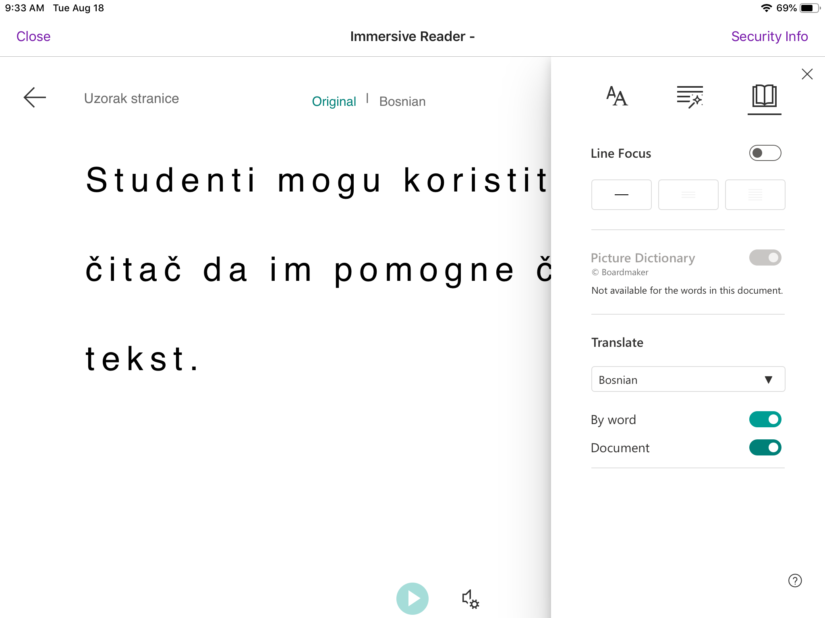
Class Notebook View Tab: Immersive Reader
Book icon:
This is what the document will look like when it is completely translated.

Slide 30
Assignments

Slide 31
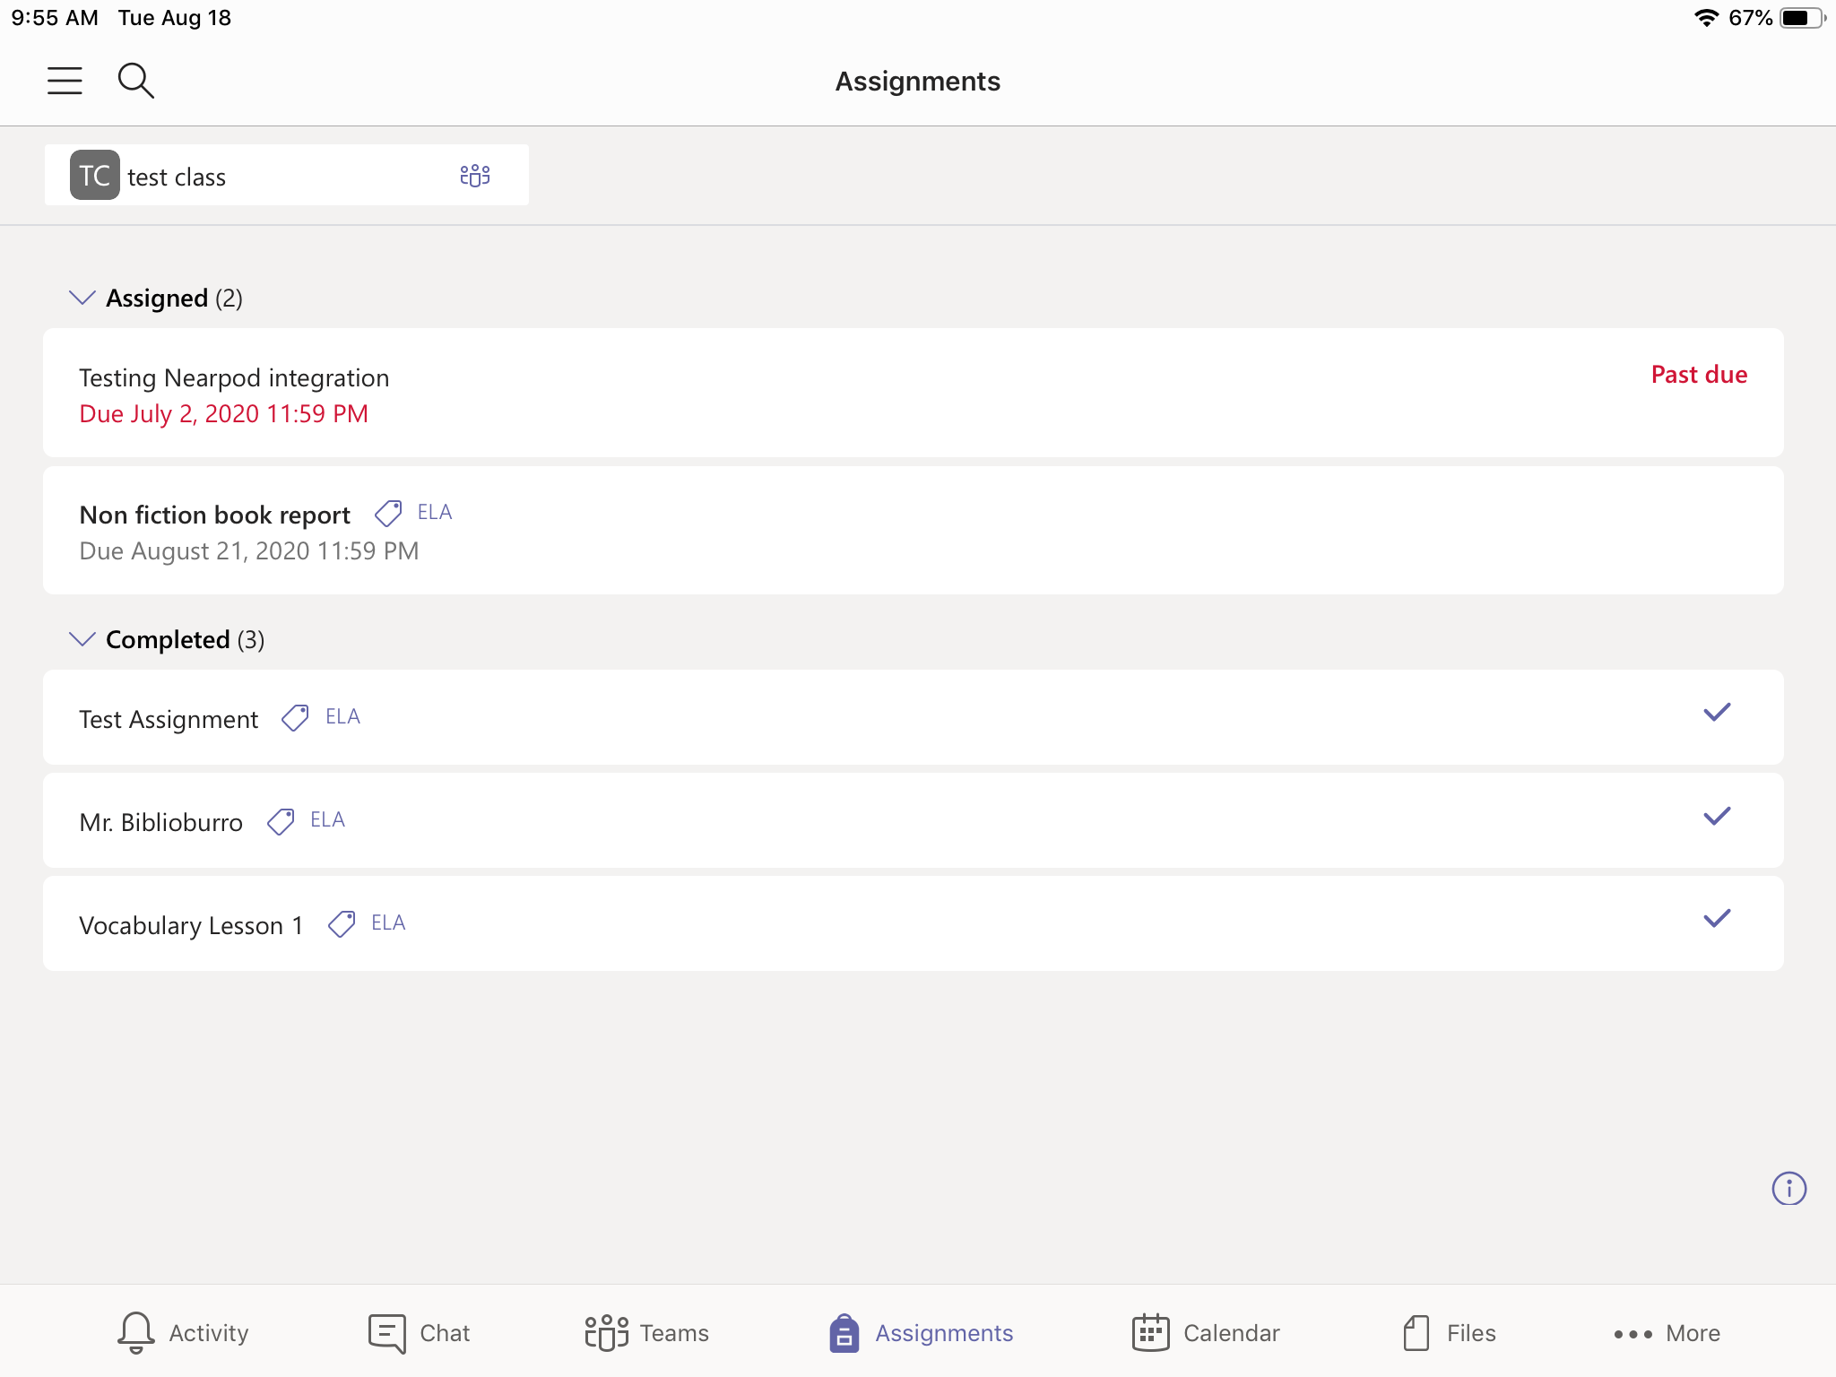
Assignments Tab:
This is the team the assignments are from
You can see assignments:
you still need to do
the ones you have already finished.
You can get to your assignments by clicking the assignments icon.
[
[

Slide 32
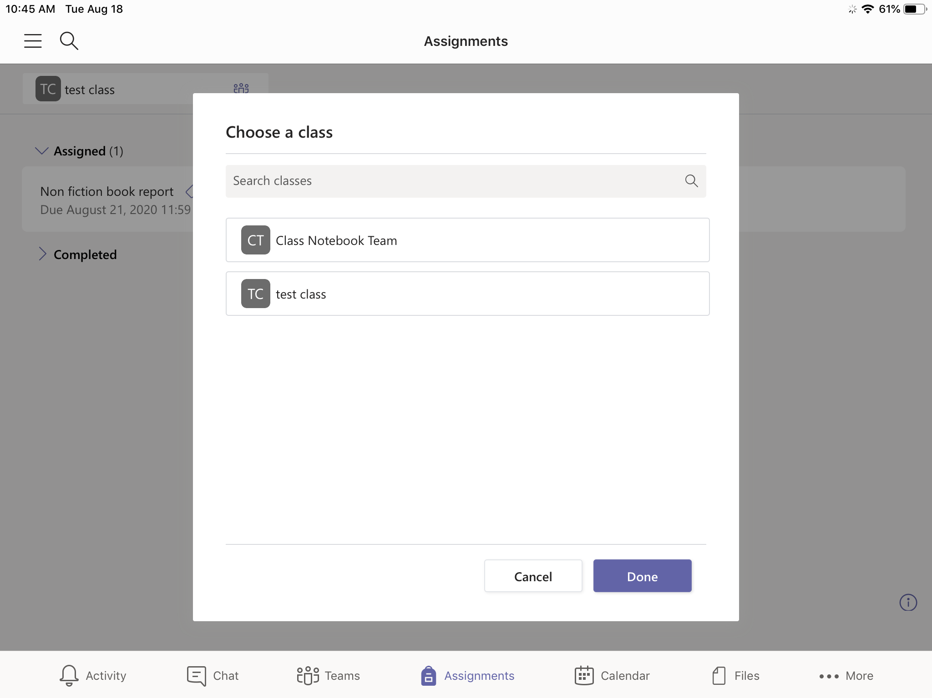
Being in more than one Team:
You will click on this box to choose the team.
If you receive services outside of the classroom (Speech, OT, PT, Resource), you will be in more than one Team.
You will need to click on each team to see your assignments for that class.

Slide 33
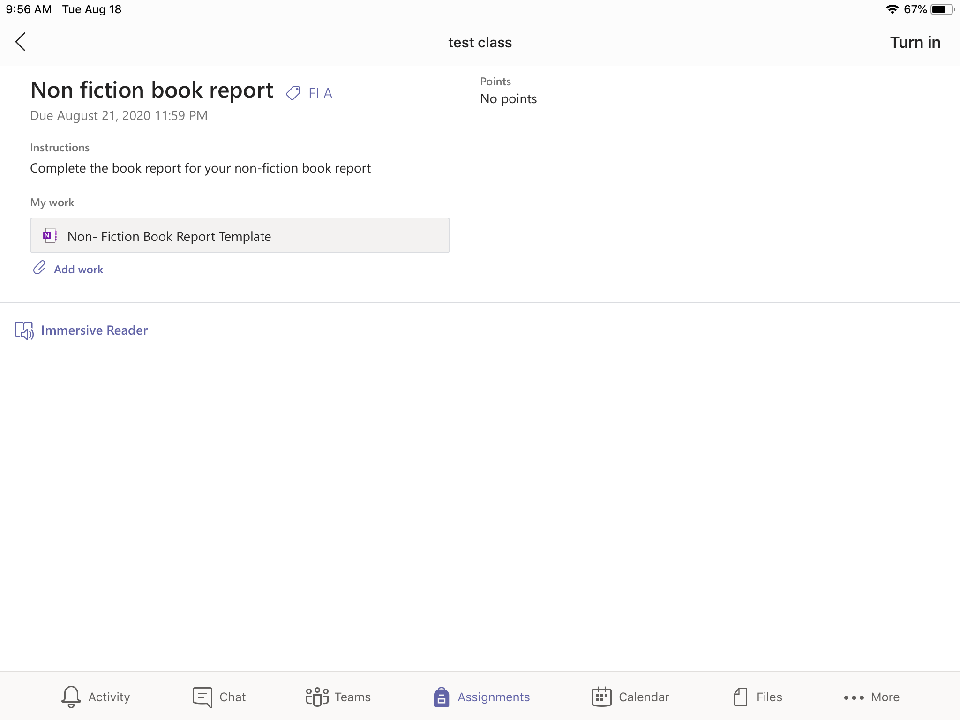
Assignments Tab:
Turn in button
Assignment Title
Subject Tag
This is what your screen looks like when you open an assignment.
Due date
Blank worksheet
This how you attach documents and pictures as your work.

Slide 34
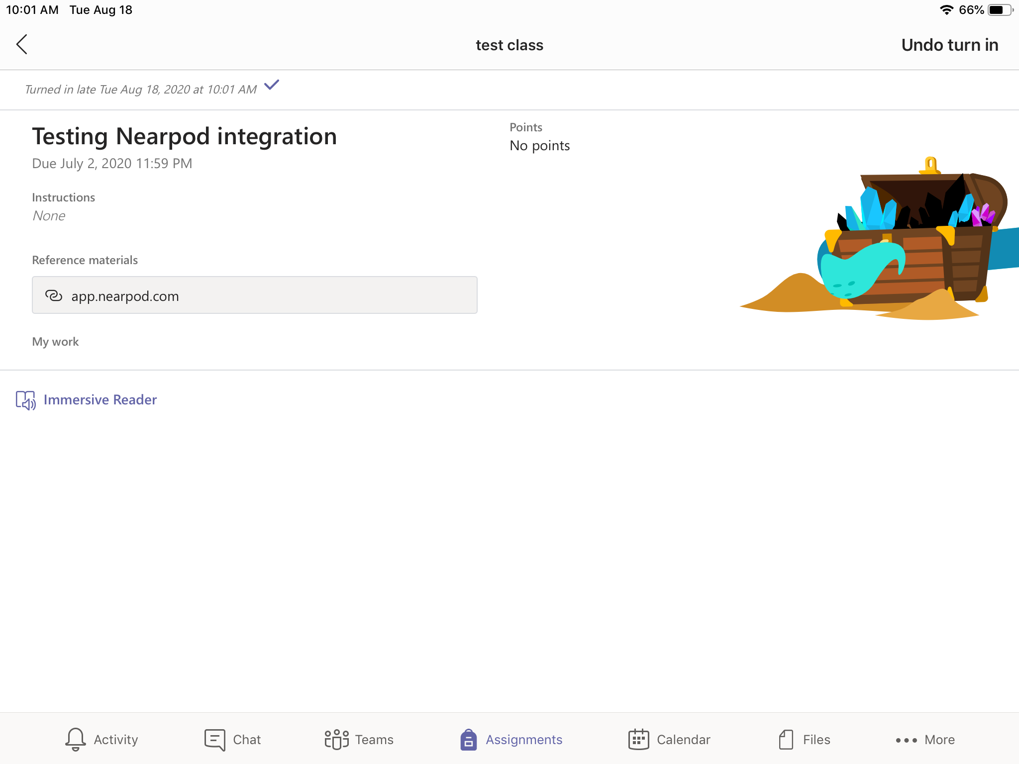
Assignment Tab: When you turn in an assignment
This is what your screen looks like when you’ve turned in an assignment.

Slide 35
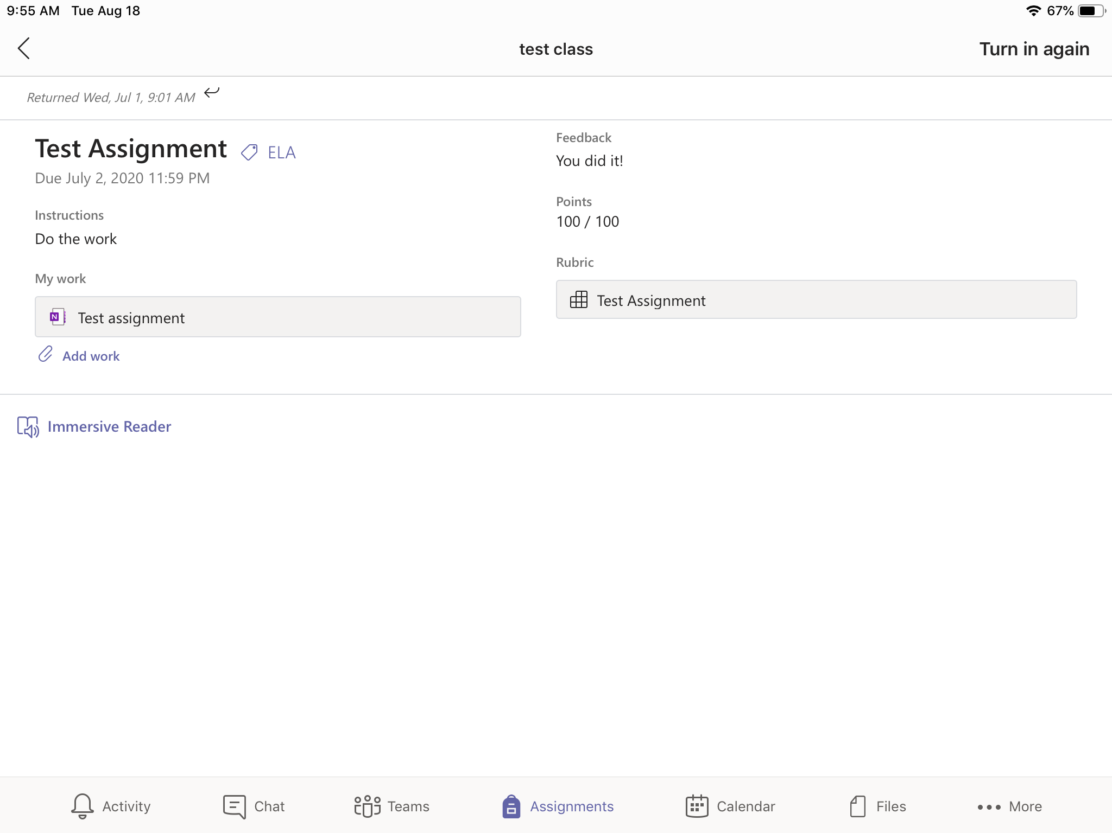
Assignment Tab: Graded Assignments
You can resubmit an assignment, even if it has already been graded.
Teacher feedback
Score on assignment
Graded rubric
This shows you when your teacher graded your assignment.

Slide 36
Teams Meetings

Slide 37
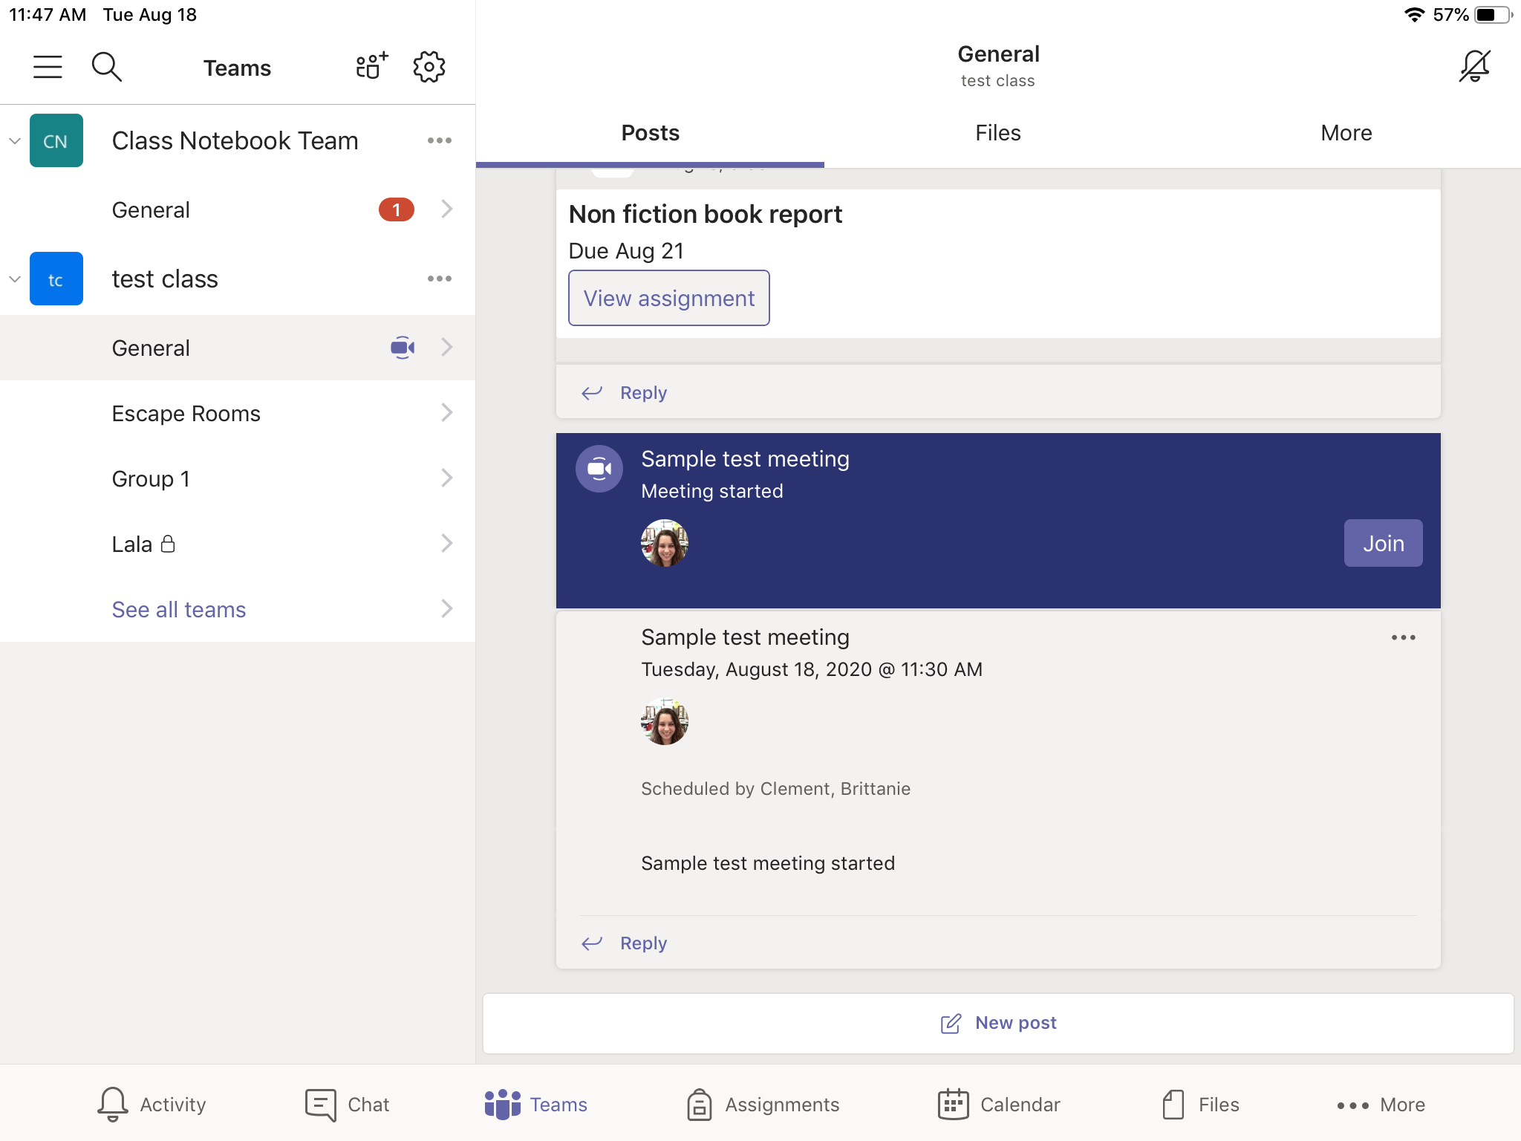
How to use the features in Teams Meet:
You will join the meeting by clicking on the Join button, which will be under the Posts tab.

Slide 38
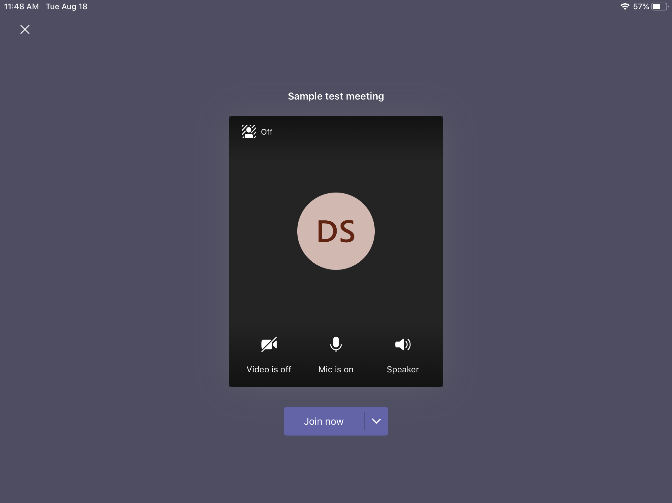
Teams Meeting:
This is the screen that will pop up when you join a meeting.
Make sure the following are turned on:
Video
Mic
Speaker
Click the "Join Now" button

Slide 39
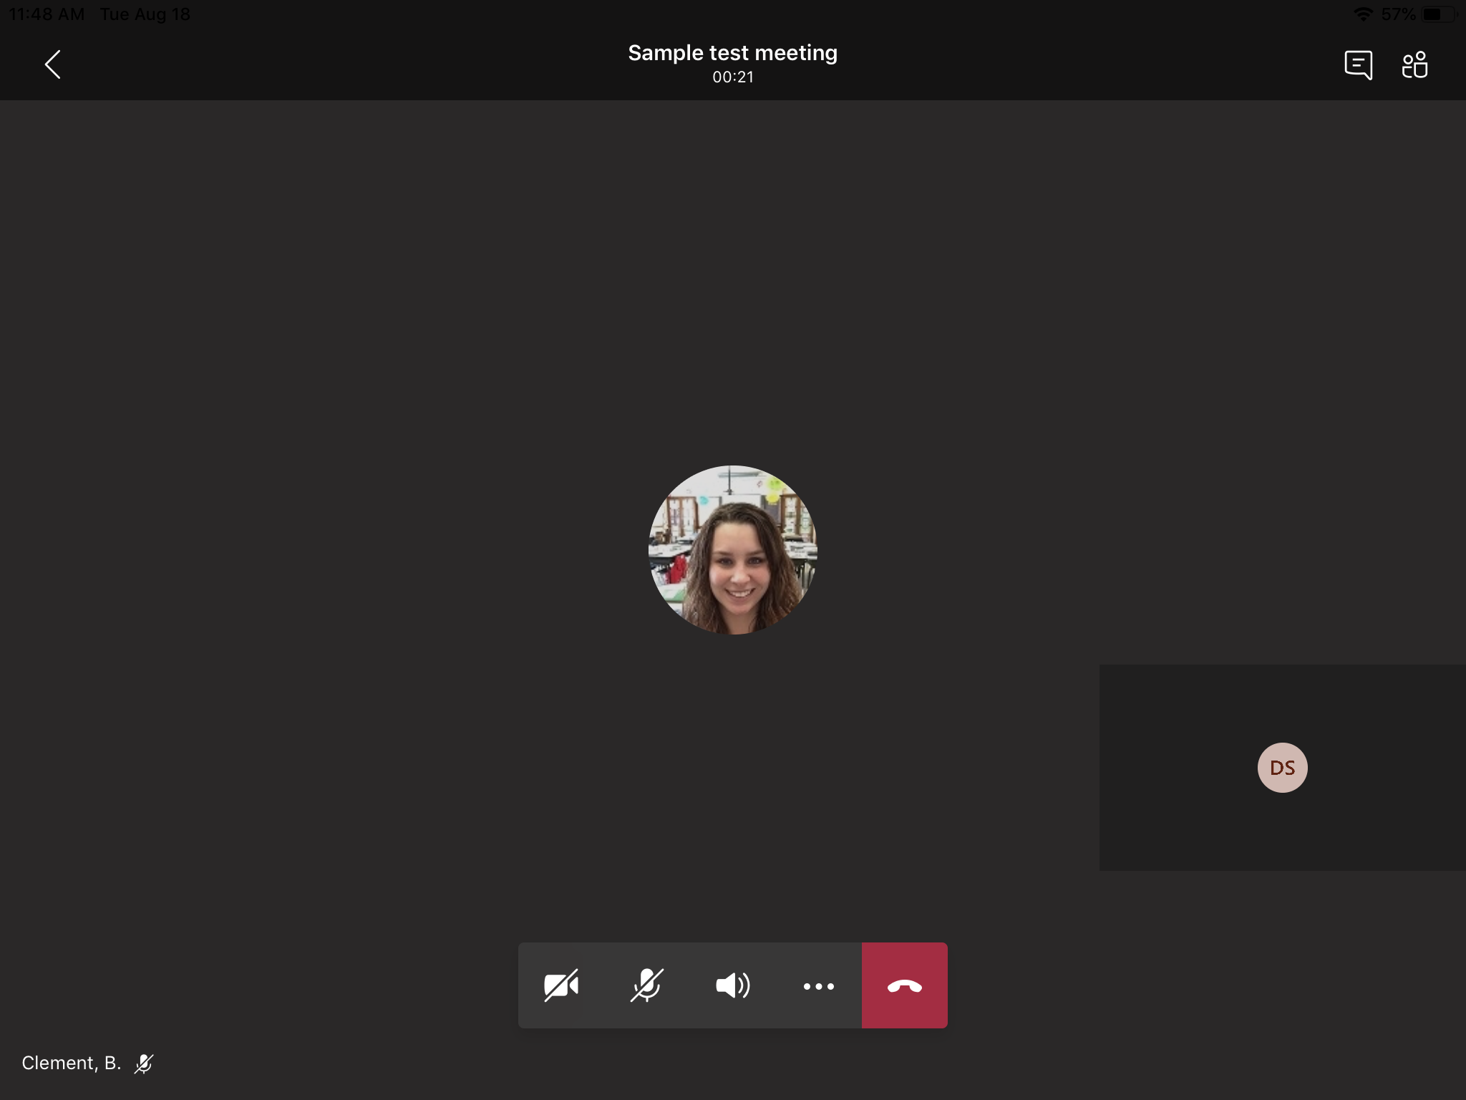
Team Meetings:
This screen is what it will look like when you are in a meeting.
You should see other members in meeting and yourself.
Meeting Chat
Mic On/Off
Speaker On/Off
More Options
Video On/Off
End Call

Slide 40
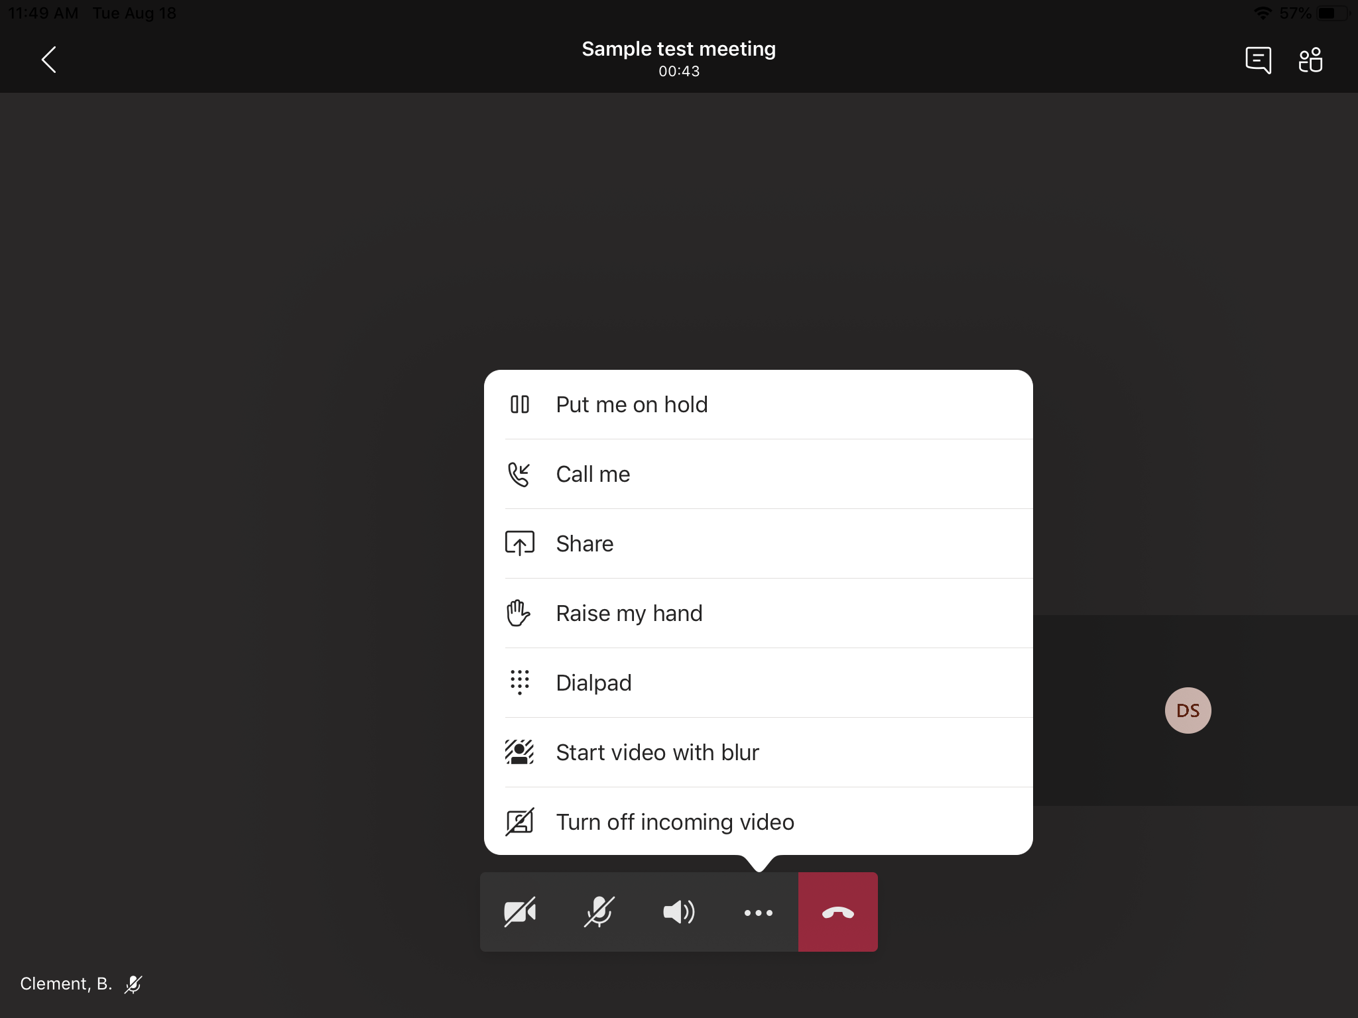
Team Meeting: More Options
This is what is shown when you click on the more options button during a meeting.

Slide 41
Using Add-ins

Slide 42
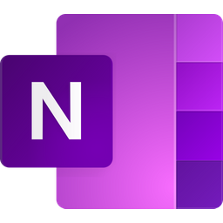












Recommended Apps for Teams:
Stream
Powerpoint
Word
Excel
Planner
One Drive
Forms
Youtube
Microsoft
FlipGrid
Quizlet
Nearpod
Kahoot
*Click on any of the pictures to be taken to that application and website.

Slide 43
Nearpod:
Nearpod will be used for lesson presentations.
Students need to participate in lessons to continue going through the presentation.
You will get a code to your teacher’s lesson presentation.
You do not need to make an account.

Slide 44
Microsoft Stream:
Microsoft Stream is the app that teachers will use for video lessons.
Students will get to this app using a link given by teacher.
When you first click a link for Microsoft Stream, you will need to use your Teams login.

Slide 45
Microsoft Forms:
Microsoft Forms is the app that is used for surveys, quizzes, and check ins.
Students will get to this app using a link given by teacher.
When you first click a link for Microsoft Stream, you will need to use your Teams login.

