Slide 1
2019-2022
Strategic Plan
Last revised: June 4, 2021

Slide 2
Improvement/Accountability Plan
Focus of Plan (check the appropriate box): • LEA • School | Name of LEA: n/a Name of School: Ashland Elementary School School Code: 4060 | Check if appropriate • Comprehensive School ***Requires a Regional School Improvement Team • Targeted School • Title I.A • Autonomous
Date: | May 21,2020
Purpose: To develop a plan for improving the top 3 needs identified in the needs assessment.
School Mission: Ashland Scholars will be equipped to attend the school of their choice without remediation. Well-rounded in academics, social/emotional development and moral character
School Vision: Ashland Elementary is a hub where every member of the community belongs and finds hope. At Ashland, students grow academically, socially, emotionally and morally. Ashland students will be the problem-solvers of a generation.
One plan may meet the needs of a number of different programs. Please check all that apply. • Title I.A School Improvement • Title I.C Education of Migratory Children • Title I.D Prevention and Intervention Programs for Children and Youth who are Neglected, Delinquent or At-Risk • Title II.A Language Instruction for English Learners and Immigrant Children • Title IV 21st Century Schools • Title V Flexibility and Accountability • Individuals with Disability Education Act • Rehabilitation Act of 1973 • Carl D. Perkins Career and Technical Education Act • Workforce Innovation and Opportunities Act • Head Start Act • McKinney Vento Homeless Assistance Act • Adult Education and Family Literacy Act • MSIP • Other State and Local Requirements/Needs __________________________________________________________

Slide 3
Who are we?
Who are we?
Where are we now?
Where are we going?
How will we get there?
What will we need to get there?

Slide 4
Ashland Elementary is a PK-6 elementary school on the northwest side of St. Louis

Slide 5
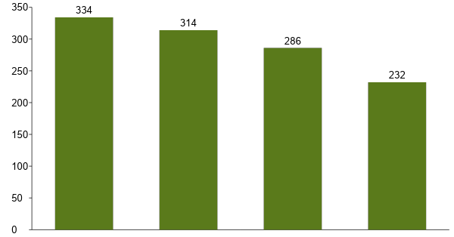
Today, Ashland enrolls 232 students; over the last 4 years, student enrollment has declined
Ashland Enrollment by Year (2016-2019)
2016
2017
2018
2019
Sources: Enrollment Report for Little Bit Foundation and : MO DESE School Comparison Tool; Projections

Slide 6
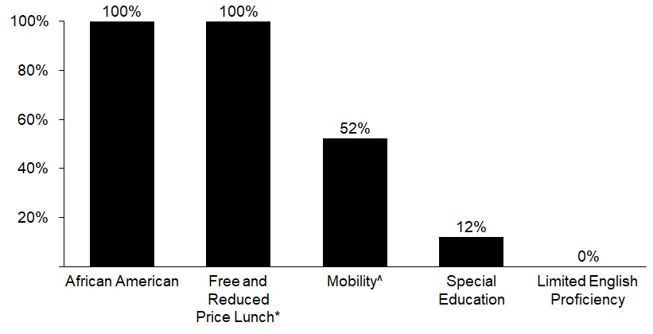
At Ashland,100% of students qualify for free/reduced price lunch and 52% have changed schools during the current year
% Ashland students by special population (SY 18-19)
Note: * Free and reduced price lunch denotes the % of students who receive free or reduced price lunch based on family income ^ Mobility % denotes the % of students who changed schools during the year
Sources: 3.20.19 Student Demographic Email and MO DESE School Comparison Tool

Slide 7
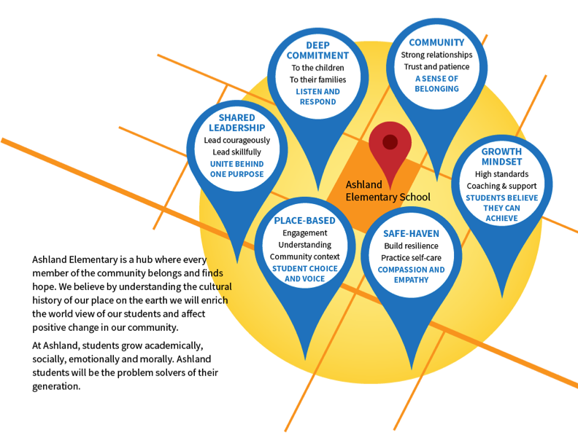

Slide 8
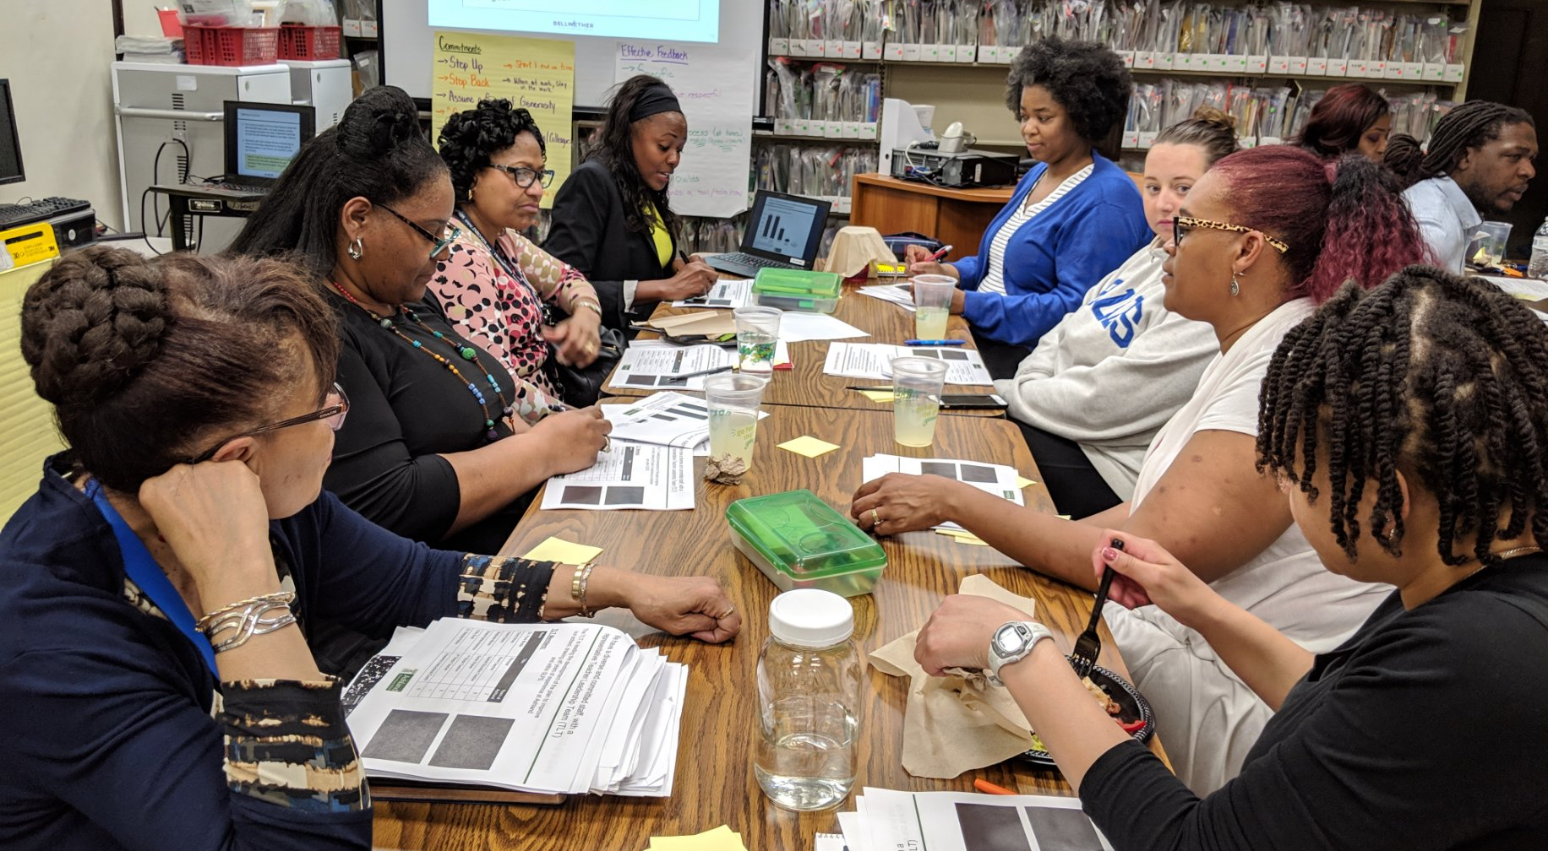
Ashland has a diverse, committed staff, with a representative Teacher Leadership Team (TLT) to guide plan development
The TLT is leading the development of the plan to improve our school, drawing off years of experience at Ashland and within St. Louis Public Schools.
TLT Members:
Name | Title | Years @ Ashland | Years @ SLPS
Dr. Paula Boddie | Principal | 3 | 30
Cicely Brown | Pre-K Teacher | 9 | 20
Karen Eason | Specialist | 13 | 17
Stephanie Moore | Social Worker | 6 | 5
Andrew Eason (interim) | 5th Grade Teacher | 2 | 2
Marjorie Patton | Academic Instructional Coach | 6 | 44

Slide 9
Where are we now?
Who are we?
Where are we now?
Where are we going?
How will we get there?
What will we need to get there?

Slide 10
We conducted a Comprehensive Needs Assessment to further assess our current state
Student Demographic
Data Type | Current Information | Reflections
Student Enrollment as of 3/1 | 212 | Our enrollment has declined over the last 3 years.
Grade Level Breakdown | PreK - 41; K - 32; 1st - 27; 2nd - 25; 3rd - 28; 4th - 23; 5th – 26; 6th- 10 | Traditionally, there is a significant decline in the size of the 6th grade class (as compared to 5th grade). Many of our students are recruited to attend another district middle schools after 5th grade.
Ethnicity | B - 100%; W - 0%; H - 0%; A - 0% | Our student body is predominantly African American.
Attendance | 90/90 Attendance- 70% ADA - 91.3% | Our 90-90 attendance has room for improvement.
Mobility | 52% | Our mobility rate is very high and is a significant factor in student outcomes.
Socioeconomic status | 100% | We serve a predominantly low-income student population
Discipline | OSS – 0; ISS- 0 | We have significantly decreased the number of OSS and ISS this school year (from 7 and 30 respectively in the previous year).
Limited English Proficiency | 0% | Currently, there are no students who are formally identified as having limited English proficiency.
Special Education | 12% | We serve a large portion of students with disabilities and are committed to serving all students well.

Slide 11
In our Needs Assessment, we identified our strengths, weaknesses, and needs related to student demographics
Strengths | Weaknesses | Needs
● We have strong community partnerships and provide wrap around resources to students and families. ● We have significantly decreased suspensions this school year. We have seen progress in student’s reading scores across grades in the 2019/2020 year. | ● Our 90-90 student attendance results can be improved. ● Though student mobility is mostly out of our control, the mobility rate experienced by our school is very high | ● Support needed to increase student attendance and decrease student mobility—two major challenges facing our school and community

Slide 12
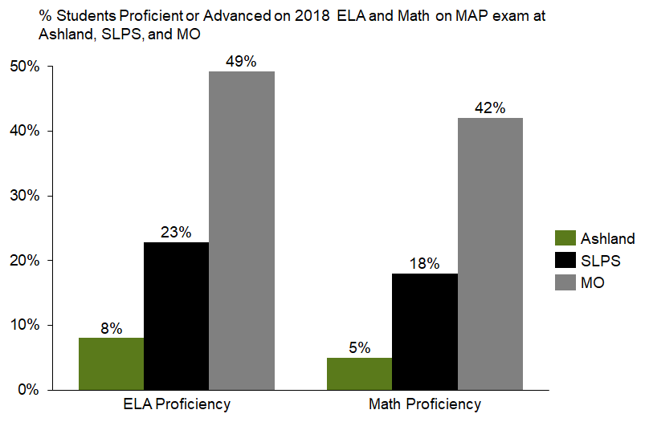
Today at Ashland, fewer students are proficient / advanced in ELA and Math than the district or state
Source: MO DESE School Comparison Tool
Note: Ashland’s internal numbers submitted for review trend lower than the state reported data
Notes:
In Plan, also include SLPS formative data.

Slide 13
STAR DATA
16-17 |  |  | 17-18 |  |  | 18-19 |  |  | 19-20
BOY | EOY | CHG | BOY | EOY | CHG | BOY | EOY | CHG | BOY
2.34 | 2.76 | .42 | 2.27 | 2.86 | .59 | 2.23 | 2.72 | .49 | 2.76

Slide 14
Scantron Math Data
Scantron New 2018-2019 school year
Scantron Math Percentile 10.3%
9 of 87 students met or exceeded the 50th percentile
2019/20 Data
Math Percentile 41%
31 OF 75 students met or exceeded the 50th percentile
Location | Grade | Student Count | Mean Math SS | SE of Mean Math SS | Number & Operations Scaled Score | Number & Operations SEM | Algebra Scaled Score | Algebra SEM | Geometry Scaled Score | Geometry SEM | Measurement Scaled Score | Measurement SEM | Data Analysis & Probability Scaled Score | Data Analysis & Probability SEM
Ashland Elementary - Sept/Oct | Overall | 96 | 2148
 | Grade 3 | 25 | 1997 | 30 | 1984 | 30 | 2019 | 47 | 1931 | 45 | 2030 | 38 | 2024 | 45
 | Grade 4 | 31 | 2109 | 39 | 2131 | 39 | 2103 | 47 | 2120 | 38 | 2103 | 50 | 2083 | 64
 | Grade 5 | 29 | 2246 | 46 | 2279 | 45 | 2303 | 50 | 2229 | 47 | 2186 | 57 | 2223 | 66
 | Grade 6 | 11 | 2345 | 63 | 2327 | 57 | 2362 | 95 | 2364 | 75 | 2312 | 73 | 2370 | 64
Ashland Elementary - Feb/March | Overall | 97 | 2164
 | Grade 3 | 25 | 2031 | 40 | 2060 | 44 | 2103 | 43 | 2017 | 44 | 1978 | 58 | 1994 | 55
 | Grade 4 | 33 | 2125 | 34 | 2178 | 43 | 2142 | 47 | 2102 | 36 | 2089 | 41 | 2090 | 48
 | Grade 5 | 29 | 2260 | 44 | 2260 | 51 | 2269 | 48 | 2281 | 40 | 2288 | 60 | 2200 | 62
 | Grade 6 | 10 | 2340 | 67 | 2369 | 92 | 2382 | 79 | 2349 | 93 | 2271 | 91 | 2337 | 57

Slide 15
Schoolzilla - Attendance
90-90 Attendance 2018-2019
Goal 91.2%
Current 79.2%
9.8 percentage points down from this time last year
90-90 Attendance 2019-2020
Goal 93.5%
COVID-19 Impact data incomplete

Slide 16
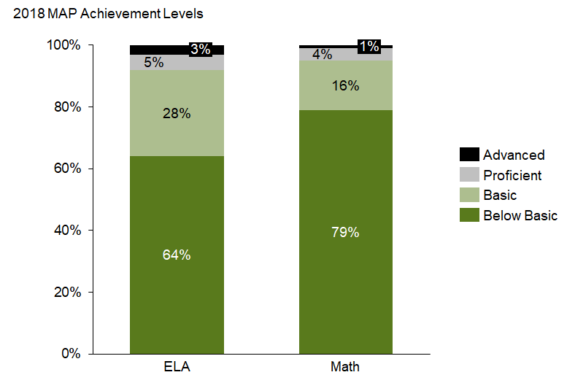
At Ashland, 64% of students are below basic in ELA and 79% are below basic in Math
Source: Ashland 2017-18 MAP GLA_EOC Appeals
Note: Ashland’s internal numbers submitted for review trend lower than the state reported data
Notes:
No 2019 MAP due to COVID-19

Slide 17
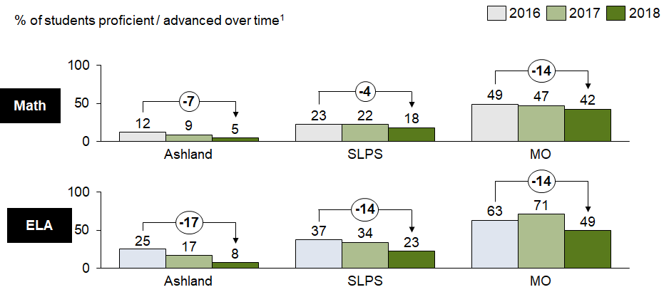
Relative to 3 years ago, proficiency scores have declined; district and state scores have also declined during this time
Source: MO DESE School Comparison Tool
Notes:
No new data

Slide 18
In our Comprehensive Needs Assessment, we reflected upon our current achievement data for SY18-19
Goal Areas | 18-19 performance | 19-20 Goal | Current Performance | Explanation/Rationale for Current Performance
ELA | 2220 (Below Basic Quartile) | 180 MPI | 150 MPI | ● There exists a need to improve data and progress monitoring practices related to ELA and Reading instruction. ● There exists a need to deepen teachers’ ELA and Reading content knowledge and expertise. ● High mobility and low attendance have decreased the amount of instructional time we have with our students
Reading | 2268 (Below Basic Quartile) | 190 MPI | 160 MPI
Math | 2189 (Below Basic Quartile) | 175 MPI | 145 MPI | ● There exists a need to employ an aligned RTI model to provide targeted Math interventions. ● There exists a need to improve data and progress monitoring practices related to Math. ● There exists a need to deepen teachers’ Math content knowledge and expertise. ● High mobility and low attendance have decreased the amount of instructional time we have with our students
Science | 2208 (Below Basic Quartile) | 180 MPI | 150 MPI | ● Given the heavy dependence on literacy proficiency to achieve success on the Science exam, we have prioritized a focus on ELA and Reading. ● Nonetheless, we must better develop teacher skill in Science instruction and identify resources for students to have inquiry-based, hands-on experiences in Science.

Slide 19
In our Needs Assessment, we identified our strengths, weaknesses, and needs related to academic proficiency
Strengths | Weaknesses | Needs
● Via the CPN process, we are forming a high-performing TLT and putting together an effective plan to improve student achievement TLT participation in the Transformational Leadership Initiative began late Spring 2020 | ● In all subject areas, our projected 20-21 performance falls below our 20-21 goals ● Our student proficiency needs to improve | ● Continued time w/ our TLT to create our plan for school improvement ● A scaffolded, comprehensive curriculum in,Tier 2 Reading Intervention and Math ● * Improved teacher skill across content areas ● * Improved progress monitoring and interventions for students in all subject areas ● Additional intervention capacity to tailor supports to student needs, qualified specialist in content areas of reading and math.
* Denotes tool identified

Slide 20
In our Comprehensive Needs Assessment, we analyzed and reflected upon our approach to curriculum and instruction
Curriculum and Instruction
Data Type | Current Information | Reflections
Learning Expectations | ● We have targeted 1.5 years of growth in ELA and Math each year ● Teacher are expected to submit pre- and post- test data each Monday ● Teachers are expected to develop reteach plan based on data, leadership team reviews plans and provides feedback, teachers adjust plan ● Reteaching occurs during intervention block beginning Tuesday | We identified the need to set the goal of 1.5 years of growth per year, because data from two years ago suggest the majority of our students were 3 years behind.
Instructional Programs | ● For ELA, We have adopted Core Knowledge as our curriculum Pre-K thru 6th ● For Math, we use Savvis(K-6) | We provided focus implementation of Tier 1 instruction using a flipped classroom and HOTS
Instructional Materials | ● Envision Math manipulative kits ● Guided Reading leveled libraries | Supplements used at grade 5 DreamBox
Technology | ● In grades Pre-K thru 6th, we have purchased 1:1 student to iPad ratio (Khan Academy, Raz Kids, Envision Interactive Lessons, STAR, Scantron) ● All classrooms have Smart Boards (Flipped Classroom, Videos) | Two weeks of PD on new technology tools to answer the need for virtual instruction provided insight on increasing outcomes
Support personnel | Support personnel: ● Full-time Reading specialist ● Full-time counselor ● Full-time social worker ● Full-time Academic Instructional Coach ● Nurse ● ISS Monitor ● Family Community Specialist ● Special Education teacher | We have a strong and robust team in place to support students in 2020 we added a full-time supplemental reading teacher

Slide 21
Based on the Needs Assessment, we have identified strengths, weaknesses, and needs related to curriculum
Strengths | Weaknesses | Needs
● Ability to focus on academics with the staff (prior year focus was student culture). ● Teachers’ willingness to learn and grow (however learning curve is steep). ● Teachers’ willingness to seek support from the DCI and other veterans in the district. ● Proactive management of student behaviors. ● Some improvement to teacher culture and cohesion (unified front). ● Teacher ownership/ adopting a school-wide lens. | ● Current support structures ineffective. ● Lack of subject area content knowledge and understanding of instructional pacing, particularly in math. ● Teacher attrition; 2 long-term subs covering classrooms. ● Students are not being referred in a timely fashion despite significant learning gaps. Surface level teaching of writing and expectation of application in daily work. ● Insufficient funding for instructional programs (e.g. Words Their Way). | ● More highly-effective teachers ● Intervention specialist in reading and in math ● Increase autonomies in hiring ● We need more systematic time for teacher collaboration ● Need more opportunity for building-led professional development
Notes:
Due to budget constraints we continue to struggle finding specialist in reading and math.

Slide 22
In our Comprehensive Needs Assessment, we analyzed our current approach to supporting our staff
High Quality Professional Staff
Data Type | Current Information | Reflections
Staff Preparation | ● At the beginning of the year, there are 2 district-based PD days, 2 school-based PD days, and 2 days dedicated to classroom set up/organization. ● We have 2 staff meetings per month. They begin 10 minutes after staff duty ends and are 90 minutes in length. ● All new teachers receive support from a consultant teacher. Length of support varies (1 year if successful, 1.5 years if struggling). The consultant teacher works with the new teacher on planning, organization, classroom management, and instruction. ● Additionally, new teachers receive a mentor teacher. | We would benefit from increased PD time with our teachers throughout the year.
Staff Certification | ● During our hiring process, we attempt to attract highly-qualified, certified teachers. ● Currently, 16 staff members are certified while 14 are non-certified. ● Two classrooms are staffed with long-term substitute teachers. ● | Access to exceptional teaching talent has impacted student outcomes.
Staff Specialist and other support staff | ● Full-time PE teacher ● Full-time Music teacher ● Part-time Art teacher ● Full-time Counselor ● Full-time Academic Instructional Coach ● Full-time Social Worker ● Nurse ● ISS Monitor ● Family Community Specialist | We have a strong support team in place but would benefit from additional intervention capacity.
Staff Demographics | ● 3 Males, 27 Females ● 5 White, 25 African American | We have a representative team which enables students to daily see positive adults who share aspects of their identity.
School Administrators | ● Principal – Dr. Paula Boddie ● Academic Instructional Coach (AIC) - Marjorie Patton | We would benefit from additional capacity on the leadership team.

Slide 23
In our Needs Assessment, we have identified strengths, weaknesses, and needs related to supporting staff
Strengths | Weaknesses | Needs
● Committed, dedicated staff. ● Staff diversity. | ● A wide range of disparate tasks fall within the scope of the AIC, creating competing interests for instructional coaching and data analysis (e.g. library inventory, interventionist, instructional coaching, lesson plan review, curriculum curation). ● Principal owns responsibility of professional development and does not have capacity for management of the full range of operational tasks. Attendance is currently managed by a part-time staff member. ● Insufficient PD time. ● Insufficient intervention capacity; insufficient capacity for data analysis. | ● Expand leadership team to include an additional instructional leader and an operations director who would manage data systems, attendance, budget, etc. ● Additional intervention capacity to tailor interventions to the needs of students. ● Additional PD time to build teacher skill and content knowledge. ● Flexibility to incorporate 2 hours of PD every Wednesday after school. (tethered by capacity to compensate)

Slide 24
There are “bright spots” in our work that will serve as a foundation for our plan
Experienced instructional leaders and educators who believe in students and who are committed to continuous improvement. Ashland boasts three former Pettus Award winners for Teacher of the Year.
A host of tools, resources, and expertise to help guide this process.
Positive energy and momentum around collaborative decision making and the TLT process
Strong community and university partnerships with Little Bit Foundation, St. Louis University, Oasis- Hopewell, Care STL, and other local faith-based organizations to provide wrap around services and supports.

Slide 25
Where are we going?
Who are we?
Where are we now?
Where are we going?
How will we get there?
What will we need to get there?

Slide 26
Drawing on our Ashland Bear pride, we have articulated four critical skills for all graduates
All Ashland graduates
will be…
During the school day,
this will look like…
B
alanced academically and socially
Students demonstrate proficiency across grade levels and content areas
Students able to build and maintain positive peer and adult relationships.
E
mpowered innovative learners
Students able to name their strengths and growth areas, and able to set goals.
Students engaged in creative pursuits (art, music, STEM, etc.)
A
dvocates for self and others
Students positively use their voice to access resources needed
Teachers serve as facilitators, designing lessons to give students agency, voice, and choice
R
espectfully invested in community
Teacher and student show pride and ownership of the Ashland school community (e.g. beautification projects)
Student participate in service learning (or community service).
Notes:
B- formerly well-rounded (socially and academically sound)
E- combined empowered/dedicated learners with innovative and creative

Slide 27
In order to assess our progress towards this ambitious long-term vision, we’ve set the following goals for 2020-21
ELA Goal
Math Goal
Leadership Development Goal
Student Attendance Goal
8%
Increase in the % of students proficient / advanced on the MAP exam
9%
Decrease in the % of students scoring below basic
8%
Increase in the % of students proficient / advanced on the MAP exam
9%
Decrease in the % of students scoring below basic
75%
Percentage of teachers* retained from 2019-20 to
2020-21
*rated proficient or distinguished on the PBTE
87%
90-90 attendance (an increase of 17% from 70% in 2019)
Pending the selection of an interim assessment system, interim assessments will be used to set BOY, MOY and EOY student indicators of success during the school year.
Notes:
All goals will depend upon continuing impact of COVID-19 virtual learning vs brick and mortar. Full time vs. part-time etc.
Recommendation: SMART Goal include formative assessment in addition or in place of summative MAP test.
Ashland will move 8 kids to P/A each year. (1 A, 7 P)
This will take place by moving 4 kids from B and 4 kids from BB (-4 B, -4 BB)
In addition, Ashland has committed to moving a total of 9 kids from the BB category (which for our purposes is an addition -5 students from the BB category, and a +5 students to the B category.
Therefore the total year by year net additions/subtractions are as follows
+1 Advanced
+7 Proficient
+1 Basic (-4 +5)
-9 Below Basic

Slide 28
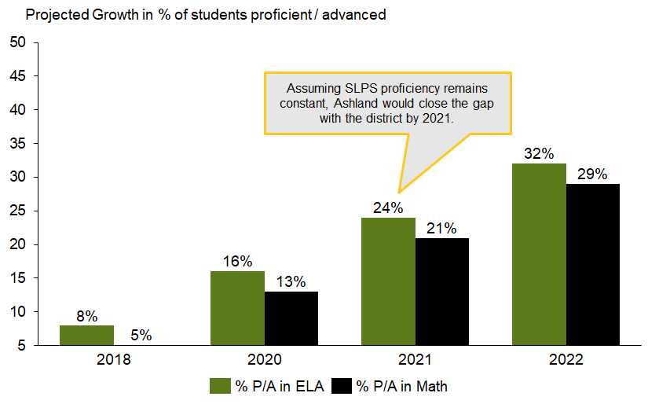
By 2022, 32% of Ashland students will be proficient or advanced in ELA and 29% proficient or advanced in Math

Slide 29
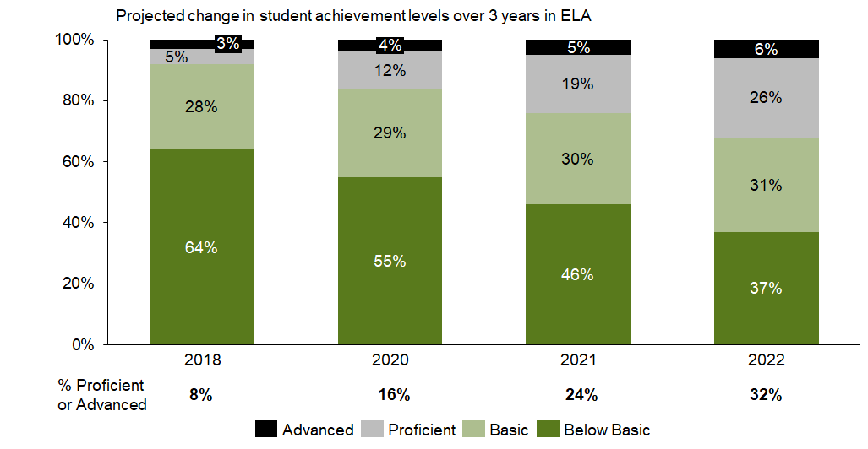
In ELA, the percent of students at the below basic level would decrease from 64% to 37% by 2022
Note: * These projections assume Ashland can achieve its goals around moving students to proficient / advanced and decreasing the number of below basic students over the next 3 years

Slide 30
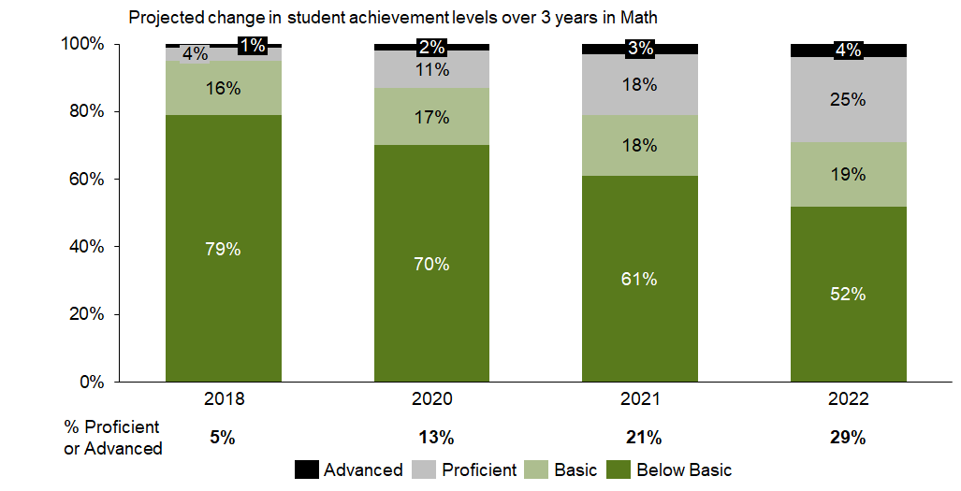
In Math, the percent of students at the below basic level would decrease from 79% to 52% by 2022
Note: * These projections assume Ashland can achieve its goals around moving students to proficient / advanced and decreasing the number of below basic students over the next 3 years

Slide 31
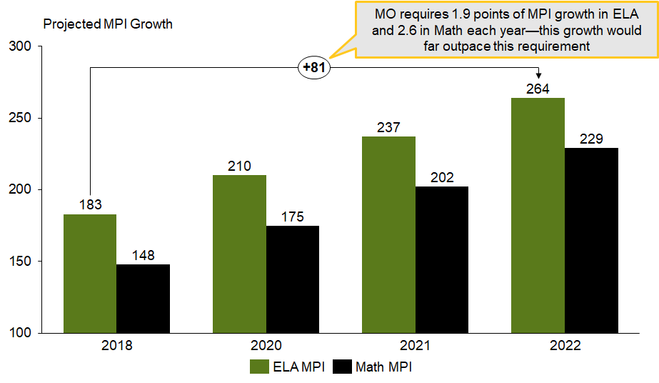
If we sustain this progress over 3 years, we’ll far exceed the state’s minimum requirements for MPI growth
Note: * MPI growth targets are projections based on assumptions of how students will move between levels (e.g., how many proficient students move to advanced).

Slide 32
How will we get there?
Who are we?
Where are we now?
Where are we going?
How will we get there?
What will we need to get there?

Slide 33
Working back from our 1-year ELA goal, we’ve analyzed root causes and identified focused priorities
Root Causes
Priorities
Curriculum
Curriculum is not scaffolded PK-6 or culturally responsive
Need for stronger curriculum for reading and writing instruction
Increase ELA Proficiency
1-year goal*
Implement a scaffolded PK-6 curriculum in Reading and Writing and ensure dedicated time for instruction.
Consistently leverage a system to collect data and progress monitor student growth and proficiency in ELA.
Ensure teachers have access to high quality professional development to deepen ELA content knowledge & expertise.
Data & Assessment
Need for consistent use of progress monitoring systems, tools, and structures
Need for more frequent use of data to inform instruction
8%
Increase in the % of students proficient / advanced on the MAP exam
9%
Decrease in the % of students scoring below basic
Teacher Skill
Lack of subject area expertise
Need for expanded/improved PD offerings
Student/Family Factors
High student mobility
Students lack foundational skills (literacy)
Families need tools for at-home support
Time/Capacity
Schedule does not include writing instruction
Frequent behavioral interruptions
*SCANTRON was selected results 35% Proficient and Advanced goal MET.
Notes:
*based on increasing levels of proficiency on F/P

Slide 34
Working back from our 1- year Math goal, we’ve analyzed root causes and identified focused priorities
Root Causes
Priorities
Curriculum
Curriculum is not scaffolded across PK-6
Need for tools to help develop students’ conceptual understanding (vs. calculations)
Illogical pacing of scope and sequence
Increase Math Proficiency
1-year goal*
Employ an aligned RTI model to provide targeted Math Interventions.
Consistently leverage a system to collect data and progress monitor student growth and proficiency in Math.
Ensure teachers have access to high quality professional development to deepen Math content knowledge and expertise.
8%
Increase in the % of students proficient / advanced on the MAP exam
9%
Decrease in the % of students scoring below basic
Data & Assessment
Misaligned classroom assessments
Need for consistent progress monitoring
Need for more frequent use of data to inform instruction
Teacher Skill
Lack of subject area expertise
Need for expanded/improved PD offerings
Student/Family Factors
High student mobility
Students lack foundational skills (numeracy)
Families need tools for at-home support
Time/Capacity
Limited time for math instruction in schedule
Critical need for math interventions
*SCRANTON selected as tool 41% Proficient and Advanced Goal MET.

Slide 35
We’ve performed this same root cause analysis for teacher retention and developed a 1-year goal
Root Causes
Priorities
Trust/Relationships
Pockets of negative staff morale
Perceived lack of respect for teachers’ time
Limited PD/staff time to build trust
Increase Teacher Retention
1-year goal
Actively plan and implement regular opportunities to build and strengthen trust, cohesion, and relationships across the Ashland team.
Ensure leadership team communication is balanced, thorough, proactive, and timely.
Build teacher toolkit around trauma and self care.
Communication
Unclear, overwhelming (high volume), and late information (internal and external/district)
75%
By May 2020, 100% of the administrators and teachers will be trained in guiding principles for cultural proficiency and model intentional behaviors to foster an inclusive learning environment to include Pre/Post surveys, action steps (following walk-throughs) focused on specific instructional strategies use of culturally inclusive resources and additional evidence.
Coaching/Development
Need for more individualized coaching
Support/ Resources
Need for additional teachers/aides to relieve overcrowded classes
Burnout of experienced teachers supporting newcomers
Hiring
Salary lower than other districts
Restricted by SLPS process
Shallow candidate pool/Ashland reputation

Slide 36
Finally, we’ve performed this same root cause analysis for improving school culture and developed a 1-year goal
Root Causes
Priorities
1-year goal
Student Factors
Illnesses, lack of access to quality healthcare
Avoidant behavior due to students not feeling successful at school
Students lacking basic needs
Improve School Culture
87%
90-90 Attendance
*An increase of 17% from current state
Improve student attendance
Strengthen family engagement
School Factors
Poor rapport / relationships between teachers and students
Academic challenges
Social issues (with peers, social media)
Negative peer relationships
Socio-emotional issues
Transportation Factors
Inclement weather
Distance from Ashland (e.g., out of district, too far away to walk)
Neighborhood violence
Lack of access to reliable transport
Home Factors
Highly transient student population
Lack of parental monitoring / accountability
Parents undervaluing education

Slide 37
We narrowed to focus on 1-2 priorities in each category for next year
Ashland graduates who are balanced, empowered advocates for self and community
1-year goals in ELA, Math, Leadership Development, and School Culture
Increase ELA Proficiency
Increase Math Proficiency
Improve teacher retention
Improve school culture
Increase depth of content knowledge, scaffolded PK-6 curriculum in Reading and Writing and ensure dedicated time for instruction.
Employ an aligned RTI model to provide targeted Math Interventions.
Actively plan and implement regular opportunities to build and strengthen trust, cohesion, and relationships across the Ashland team.
Build teacher toolkit around trauma and self care.
Improve student attendance
Priorities
Consistently leverage a system to collect data and progress monitor student growth and proficiency in Math.
Ensure teachers have access to high quality professional development to deepen Math content knowledge and expertise.
Notes:
Year one goals continue as school year was disrupted and new staff must be on-boarded.

Slide 38
We have also highlighted 1-2 strategies to focus on for each priority, and determined funding and benchmark indicators of success to monitor our progress (1 of 2)
Priorities | Strategies
1. Implement a comprehensive, scaffolded PK-6 Reading and Writing curriculum and ensure dedicated time for instruction. | 1.1 Research, select and implement a comprehensive, scaffolded PK-6 curriculum for reading and writing (Complete)
2. Employ an aligned RTI model to provide targeted Math Interventions | 2.1 Research and implement evidence-based approaches to flexible, differentiated, small group instruction in math 2.2 Create individualized learning plans for Tier 3 students and struggling populations
3. Consistently leverage a system to collect data and progress monitor student growth and proficiency in ELA & Math | 3.1 Analyze school-wide data trends using universal data tool to track student mastery of standards on a six-week cycle
4. Ensure teachers have access to high quality professional development to deepen ELA & Math content knowledge and expertise | 4.1 Secure/deliver robust PD in ELA (e.g. Reading and Writing Workshop, Daily 5, Strategies That Work, Fountas and Pinnell Literacy Continuum, Spalding, Words Their Way) & Math (Math Workshop, small group instruction, centers, increasing rigor, number talks, Understanding by Design, etc.) 4.2 Redesign planning meetings to focus on unpacking standards and aligning instruction
1. Actively plan and implement regular opportunities to build and strengthen trust, cohesion, and relationships across the Ashland team and staff. | 1.1 Leverage TLT to disseminate survey and facilitate activities, trainings, and culture step backs with the staff
2. Build teacher toolkit around trauma and self care. | 2.1 Design / select and deliver PD on classroom management, trauma-informed classroom practices, and self-care and sustainability for teachers
1. Improve student attendance | 1.1 Strengthen school-family connection (e.g., home visits, walking school bus) 1.2 Raise teacher involvement in attendance
ELA and Math
Teacher Retention
School Culture
*Depending on autonomies granted, would want to replace this with “Diagnostic MAP assessment” **Depending on autonomies granted for selecting different assessments, would want to change this to “Select and implement predictive, MAP-aligned assessments” ***Pending the selection of an interim assessment system, interim assessments will be used to set BOY, MOY and EOY student indicators of success during the school year. Final targets will be set by August 2019, dependent on the final assessment selection in May 2019.
Notes:
Evidence-based/Research-based strategy not clear/evident
Recommendation: Select and focus on 1-2 ELA and MA strategies that your team believes will have greatest impact.

Slide 39
Evidence based STRATEGIES FOR ELA & MATH
ELA – GUIDED READING
MATH – GUIDED MATH
Notes:
Reading instruction in leveled groups with grade level materials.

Slide 40
We have also highlighted 1-2 strategies to focus on for each priority, and determined funding and benchmark indicators of success to monitor our progress (2 of 2)
Funding
Teacher Indicators of Success
Data warehouse
Predictive ELA & Math assessments
PD and materials
Extra-duty pay for summer training
Add’l FTEs for Math intervention support
Activities for trauma/self-care toolkit development
For ELA/Math:
By August
PD held on curriculum implementation
*Diagnostic assessment/ data analysis completed
At least 30% of staff implementing instruction with fidelity
By December
**Administer STAR/Scantron assessments: data analysis
Teacher practicum
PD on curriculum and assessment
PD on small group instruction
Data tracking system implemented;
Benchmark/ MAP assessment taken
At least 50% of staff implementing instruction with fidelity
By February
PD on curriculum & assessment
By May
100% of staff implementing instruction with fidelity
For teacher retention:
By August
Survey distributed
Public calendar created
Together Teacher, classroom mgmt / trauma-informed training held
By December
Step back done
Survey distributed,
Classroom mgmt/ trauma-informed training held
By February
Survey distributed
Classroom mgmt/ trauma-informed training held
By May
Step back done
Survey distributed
Classroom mgmt/ trauma-informed training held
Student Indicators of Success
By December, February/March, and May
Increase ELA / Math proficiency by determined % (pending selection of interim assessment)***
*Depending on autonomies granted, would want to replace this with “Diagnostic MAP assessment”
**Depending on autonomies granted for selecting different assessments, would want to change this to “Select and implement predictive, MAP-aligned assessments”
***Pending the selection of an interim assessment system, interim assessments will be used to set BOY, MOY and EOY student indicators of success during the school year. Final targets will be set by August 2019, dependent on the final assessment selection in May 2019.
Notes:
Continued for year 2 with COVID-19 disruption and new staff that will need to be trained in curriculum.

Slide 41
We sequenced the strategies for each priority along a monthly timeline for next year
 | May 2019 | Jun 2019 | July 2019 | Aug 2019 | Sept 2019 | Oct 2019 | Nov 2019 | Dec 2019 | Jan 2020 | Feb 2020 | Mar 2020 | Apr 2020 | May 2020
1. Implement a comprehensive, scaffolded PK-6 Reading and Writing curriculum and ensure dedicated time for instruction. |  |  |  |  |  |  |  |  |  |  | Pandemic Hit
2. Employ an aligned RTI model to provide targeted Math Interventions
3. Consistently leverage a system to collect data and progress monitor student growth and proficiency in ELA & Math
4. Ensure teachers have access to high quality professional development to deepen ELA & Math content knowledge and expertise
1. Actively plan and implement regular opportunities to build and strengthen trust, cohesion, and relationships across the Ashland team and staff.
2. Build teacher toolkit around trauma and self care.
1. Improve student attendance
1.1: curriculum (research/select)
2.1: small group inst. research
2.2 plans for Tier 3
2.2 plans for Tier 3 (implement, monitor)
3.1 data tool (create)
3.1 data tool (use on 6-wk cycle)
4.1 PD (select)
4.1 PD (implement, monitor)
4.2 redesign planning meetings
4.2 redesign planning meetings (implement, monitor)
1.2 TLT planning/surveys
1.2 TLT plans and executes on activities throughout year
2.1 TI (research)
2.1 TI (PDs)
2.1 TI (support / implementation)
2.1 teacher self-care (research)
2.1 teacher self-care (PDs, activities)
1.1 school-family connection (e.g., home visits, walking school bus) 1.2 teachers attendance tracking

Slide 42
We have assigned the following priority owners
Priorities | Strategies | Priority Owner
1. Implement a comprehensive, scaffolded PK-6 Reading and Writing curriculum and ensure dedicated time for instruction. | 1.1 Research, select and implement a comprehensive, scaffolded PK-6 curriculum for reading and writing | Ms. Patton
2. Employ an aligned RTI model to provide targeted Math Interventions | 2.1 Research and implement evidence-based approaches to flexible, differentiated, small group instruction in math 2.2 Create individualized learning plans for Tier 3 students and struggling populations | Ms. Eason
3. Consistently leverage a system to collect data and progress monitor student growth and proficiency in ELA & Math | 3.1 Analyze school-wide data trends using universal data tool to track student mastery of standards on a six-week cycle | Mr. Eason
4. Ensure teachers have access to high quality professional development to deepen ELA & Math content knowledge and expertise | 4.1 Secure/deliver robust PD in ELA (e.g. Reading and Writing Workshop, Daily 5, Strategies That Work, Fountas and Pinnell Literacy Continuum, Spalding, Words Their Way) & Math (Math Workshop, small group instruction, centers, increasing rigor, number talks, Understanding by Design, etc.) 4.2 Redesign planning meetings to focus on unpacking standards and aligning instruction | Dr. Boddie
1. Actively plan and implement regular opportunities to build and strengthen trust, cohesion, and relationships across the Ashland team and staff. | 1.2 Leverage TLT to facilitate activities, trainings, and culture step backs with the staff | Ms. Moore
2. Build teacher toolkit around trauma and self care. | 2.1 Design / select and deliver PD on classroom management, trauma-informed classroom practices, and self-care and sustainability for teachers | Ms. Moore, Ms. Brown
1. Improve student attendance | 1.1 Strengthen school-family connection (e.g., home visits, walking school bus) 1.2 Raise teacher involvement in attendance | Ms. Moore, Ms. Brown
ELA and Math
Teacher Retention
School Culture
Notes:
Sherri to work with Ms. Patton
Eleisha to work with Dr. Boddie

Slide 43
For each Year 1 strategy, we have also developed a set of working action plans to enable our success, which follow this slide.

Slide 44
ELA/Math Strategy 1.1 Research, select and implement a comprehensive, scaffolded PK-6 curriculum for reading and writing
See next page for detail
Action Step | Owner | Timing
1. Develop subcommittee to research evidence-based ELA curriculum options; narrow options for TLT vote. | Dr. Boddie | May 8-29, 2019 completed
2. Select/ purchase a unified ELA curriculum | Dr. Boddie | June 2019 completed
3. Secure PD provider who can provide modeling, + sufficient practice (possible ongoing engagement) |  | June 2019 completed
4. Revise master schedule to ensure ample number of instructional minutes for use of newly adopted ELA curriculum | Dr. Boddie | June 2019 completed
5. Create comprehensive PK-6 pacing guides | Ms. Patton | June 2019 completed
6. Create master document showing ELA vertical alignment and the progression of learning outcomes and skills PK-6 | TBD | June 2019 completed
7. Deliver professional development on new ELA curriculum | External Facilitator | July 2019 + ongoing
8. Deploy resources and implement use of new ELA curriculum school-wide. | TBD | August/September 2019
9. Support teachers on implementation through monthly coaching, observations, and planning meetings. | TBD | August/September 2019 + ongoing
10. Collect student data results and disseminate teacher surveys throughout year to gauge effectiveness of new curriculum. | TBD | Aug/September 2019, December 2019, February 2020, May 2020

Slide 45
ELA/Math Strategy 1.1 Research, select and implement a comprehensive, scaffolded PK-6 curriculum for reading and writing
Priority Owner: Ms. Patton
Action Step | Owner/Performers | Timing
1. Develop subcommittee to research evidence-based ELA curriculum options; narrow options for TLT vote. Identify who will be on the subcommittee and gather (ask them to join; find a meeting time that works for everyone, etc.) Brainstorm the qualifications the new ELA curriculum must meet -- content alignment, well-reviewed, pricing, etc., and what “research” you need. Split up research duties. Choose date to come back together (in 2-3 weeks) to choose 2-3 options to present to TLT. | Owner: Ms. Patton Subcommittee members: Dr. Boddie Ms. Patton Ms. Eason | May 8-29, 2020 completed
2. Select/ purchase a unified ELA curriculum Subcommittee presents the narrowed 2-3 options and related research to TLT. TLT votes on 1 option. Submit via district procurement process or call vendor directly to purchase the curriculum. | Owner: Ms. Patton | June 2020 completed
3. Secure PD provider who can provide modeling, + sufficient practice (possible ongoing engagement) Contact program curriculum representative to schedule PD training on ELA curriculum program Secure funding for PD Train the trainer for internal support | Owner: Boddie Patton | June 2020 completed
4. Revise master schedule to ensure ample number of instructional minutes for use of newly adopted ELA curriculum Allot appropriate minutes to ELA block that accommodations the implementation of the curriculum program as designated to implement with fidelity Schedule whole group and small group ELA instructional minutes in schedule (teacher modeling & guided instruction/student independent practice/guided reading/stations/centers) Schedule ELA intervention minutes into schedule | Owner: Boddie Patton | June 2020 completed
5. Create comprehensive PK-6 pacing guides Identify and plan year long scope and sequence by grade level and cross curricular Quarterly learning targets and objectives aligned with identified state standards 6 week standard objective/ benchmark checkpoints /assessments Resources to support curriculum Textbooks and materials to implement curriculum Teacher guides and resources to implement curriculum | Owner: Instructional Partners Group | June 2021 completed
6. Create master document showing ELA vertical alignment and the progression of learning outcomes and skills PK-6 Identify and plan year long scope and sequence by grade level Micro action step Identify and plan year long scope and sequence scaffold across grade levels Prk- 6 Align learning targets, skills, and state standards | Owner: Patton Boddie Hartman | July 2020
7. Deliver professional development on new ELA curriculum PD scheduled prior to school to introduce ELA curriculum to teachers Schedule PD sessions for the year Feedback survey for understanding, implementation, and further support Internal training and support - planning sessions, weekly PLC or Data team meeting Modeling in classroom/ Teaming co-teaching in classroom | External Facilitator | July 2019 + ongoing Complerted
8. Deploy resources and implement use of new ELA curriculum school-wide. Classroom library to support reading curriculum Supplemental reading materials to support program - secure funding Order additional leveled books for leveled library to support guided instruction | Owner: | August/September 2019
9. Support teachers on implementation through monthly coaching, observations, and planning meetings. Support teachers in weekly planning meeting providing additional supports - plan, model, practice Participate in one weekly team grade level team meeting to provide support Scheduled observation, real time feedback, modeling, follow, reflective conference Additional supports in bi-weekly faculty meeting | Owner: | August/September 2019 + ongoing
10. Collect student data results and disseminate teacher surveys throughout year to gauge effectiveness of new curriculum. Collect benchmark assessment data/ analyze/ plan instruction Track student progress - set goals Running records tracker STAR assessment data - growth data- baseline reading data and subsequent scores throughout the year | Owner: | Aug/September 2019, December 2019, February 2020, May 2020

Slide 46
ELA/Math Strategy 2.1 Research and implement evidence-based approaches to flexible, differentiated, small group instruction in math
See next page for detail
Action Step | Owner | Timing
1. Develop subcommittee to research evidence-based small group approaches and instructional tools for math | Deleo – Math Specialist | May 2020 con’t
2. Narrow to three and select one; purchase small group tools and intervention program. | TBD | June 2021
3. Revise master schedule to include time for small group math interventions; allocate staffing and budget accordingly | Patton/Boddie | June2021 complete
4. Deploy the tool for Tier 1, Tier 2, and Tier 3 support. | TBD | June 2021 con’t
5. Hire math interventionist/math specialist for Tier 3 interventions | Boddie/CPN | by July 2021
6. Deliver teacher professional development on new math small group program | Deleo | July 2019 (ongoing)
7. Deploy use of math intervention program | Tier 1 and 2- Classroom Teachers; Tier 3- Math Specialist/Interventionist | September 2021
8. Support teachers on implementation through monthly coaching, observations, and planning meetings. | Boddie/Patton/Deleo | August/September 2021
9. Collect student data results and disseminate teacher surveys throughout year to gauge effectiveness of new math program. | Childress | Aug/Sept 2021, December 2021, February 2022, May 2022

Slide 47
ELA/Math Strategy 2.1 Research and implement evidence-based approaches to flexible, differentiated, small group instruction in math
Priority Owner: Karen Eason
Action Step | Owner/Perfomers | Timing
1. Develop subcommittee to research evidence-based small group approaches and instructional tools for math Identify tools within Savvis Review data from Dreambox trial micro action step | Nikki Deleo Contact math curriculum provider to further discuss program attributes TLT will meet to check to see if math curriculum includes all math pieces. Check for Professional Development providers for training | June 2021
2. Narrow to three and select/purchase small group tools and intervention program. Savvis Dreambox IXL | Dr. Boddie Schedule on-going Professional training for staff with curriculum Set up scheduled math block times Set up small group and intervention schedules for students | July 2020
3. Revise master schedule to include time for small group math interventions; allocate staffing and budget accordingly micro action step micro action step micro action step | Marjorie Patton/Dr. Boddie Meet to set up revised schedule according to staff and budget Secure 2 Interventionalist to provide small group interventions | June 2019
4. Determine how the tool will be used for Tier 1, Tier 2, and Tier 3 support. micro action step micro action step micro action step | Marjorie Patton
5. Hire math interventionist/math specialist for Tier 3 interventions micro action step micro action step micro action step | Dr. Boddie | by July 2019
6. Deliver teacher professional development on new math small group program micro action step micro action step micro action step | TLT or Program Prof Developers | July 2019 (ongoing)
7. Deploy use of math intervention program micro action step micro action step micro action step | Tier 1 and 2- Classroom Teachers;Tier 3- Math Specialist/Interventionist | September 2019
8. Support teachers on implementation through monthly coaching, observations, and planning meetings. micro action step micro action step micro action step | TLT Team | August/September 2019
9. Collect student data results and disseminate teacher surveys throughout year to gauge effectiveness of new math program. micro action step micro action step micro action step | TBD | Aug/Sept 2019, December 2019, February 2020, May 2020

Slide 48
ELA/Math Strategy 2.2 Create individualized learning plans for Tier 3 students and struggling populations
See next page for detail
Action Step | Owner | Timing
1. Identify a guide that informs the Individualized Learning Plan (ILP) templates. Revise/update (ILP) template and tracking tools; ensure presence of data infrastructure (see 3.1) | Patton | July 2021
2. Determine which universal screener/assessment; determine qualifying score for Tier 3 support. Ensure data tool is compatible with assessment for ease of upload. | CKLA Team | June 2021
3. Administer screener. |  | August 2021
4. Analyze student data to identify students in need of Tier 3 interventions. | Patton, Eason, Boddie | August 2021
5. Articulate time-bound learning goals for all Tier 3 students; create a targeted support plan and document within ILP | Boddie, Patton | August 2021
6. Determine Math assessment; leverage an evidenced-based academic intervention tool for instruction. | Eason A., Eason K. | September 2021 -May 2022
7. Flexibly group students for small group instruction. | Staff | September 2021 -May 2022
8. Monitor and track student progress towards learning goals. Adjust groups if needed throughout year. | Math Interventionist | October 2021 -May 2022

Slide 49
ELA/Math Strategy 3.1 Analyze school-wide data trends using universal data tool to track student mastery of standards on a six-week cycle
See next page for detail
Action Step | Owner | Timing
1. Develop sub committee to research data platforms or systems that already exist to help track standards mastery; if not, create a simple tool (e.g., an Excel spreadsheet) | TBD | May-June 2019
2. Secure tool | TBD | June-July 2019
3. Import instructional standards into tool (if not already imported) Note: ensure it is connected to the curriculum. | TBD | June-July 2019
4. Determine the mastery cutoff points you will use to flag students or concepts for re-teaching | TBD | July 2019
5. Provide PD for staff on using the data tool (uploading classroom data, reading class and school wide reports, etc.) | TBD | Aug-Sep 2019 (possibly ongoing)
6. Ensure teachers have a weekly deadline for uploading their student assessment data | TBD | Aug 2019 (create calendar; show during summer & BOY PD)
7. Develop coaching protocol to support teachers in using data results to inform daily instruction | TBD | Aug 2019 + on-going
8. Develop weekly report that analyzes classroom data and pulls out trends | TBD | Aug 2019 + on-going
9. Plan and facilitate 6 weeks data days to analyze data and develop re-teach plans | TBD | Aug-Sep 2019 (plan); Sep 2019-May 2020 (facilitate in 6-wk cycles)

Slide 50
ELA/Math Strategy 3.1 Analyze school-wide data trends using universal data tool to track student mastery of standards on a six-week cycle
Priority Owner: Deanna Childress
Action Step | Owner/Performers | Timing
1. Develop sub committee to research data platforms or systems that already exist to help track standards mastery; if not, create a simple tool (e.g., an Excel spreadsheet) Identify needs of what we’re looking for in the tool. Present options to TLT Vote on tool. | TLT | May-June 2021
2. Secure tool Provide payment TLT familiarizes themselves with tool in order to support students | Dr. Boddie | June-July 2021
3. Import instructional standards into tool (if not already imported) Note: ensure it is connected to the curriculum. create a sub-committee of staff who could import instructional standards into tool | Childress | June-July 2021
4. Determine the mastery cutoff points you will use to flag students or concepts for re-teaching Create a re-teach or intervention plan for students at every grade level. | Mrs. Patton | July 2021
5. Provide PD for staff on using the data tool (uploading classroom data, reading class and school wide reports, etc.) Identify trainer of tool Introduce tool to staff Allow time for staff to practice and familiarize themselves with the tool. | A. Eason | Aug-Sep 2021(possibly ongoing)
6. Ensure teachers have a deadline for uploading their student assessment data Determine a date Create an accountability plan for entering data (who will check to see that data is entered and entered correctly? What will we do if it isn’t entered? etc) Employ accountability plan | Mrs. Patton | Aug 2021 (create calendar; show during summer & BOY PD)
7. Develop coaching protocol to support teachers in using data results to inform daily instruction Develop a coaching plan Create a calendar Create a checklist/ how will we know staff have mastered using the tool. Create a remediation plan for staff that don’t understand the tool. Execute coaching | TBD | Protocol complete
8. Develop weekly report that analyzes classroom data and pulls out trends review data with teachers and students | TBD | Aug 2019 + on-going
9. Plan and facilitate 6 weeks data days to analyze data and develop re-teach plans Create data meeting goals and agendas for 6 week cycles. Develop plans Execute plans | Mrs. Patton | Aug-Sep 2019 (plan); Sep 2019-May 2020 (facilitate in 6-wk cycles)

Slide 51
ELA/Math Strategy 4.1 Secure/deliver robust PD in ELA & Math (1 of 2) - ELA
See next page for detail
Action Step | Owner | Timing
1. List and prioritize all ELA and Math sessions desired. | TLT | May 2021
2. Create a master PD calendar including the following: externally facilitated PD, internally facilitated PD, walk through windows, data days, 6-week coaching focus | Instructional Partners | June 2021
3. Secure facilitator and schedule dates for ongoing professional development related to new ELA curriculum implementation | Boddie | June 2021
5. Assign owners/facilitators to internal sessions with deadlines for final session development | Boddie | July 2021
6. Develop materials list (books, food, etc.) for internal sessions monthly and give to purchaser to secure materials. | Boddie | July 2021 (ongoing)
7. Facilitate ongoing professional development | TLT | August-May 2022
8. Monitor effectiveness of PD and adjust calendar scope as needed based on findings (teacher surveys, student data). | TLT | August-May 2022

Slide 52
ELA/Math Strategy 4.1 Secure/deliver robust PD in ELA & Math (2 of 2) - Math
Priority Owner: Dr. Boddie
Action Step | Owner/Performers | Timing
1. Develop subcommittee to list all Math sessions/PD opportunities that you wish to have (internal and external), can include input from staff. (ie: Number Talks, Small group, TT, etc.) Name tools Order resources Submitt for calendar | Eason, A. | May 2021
2. Group sessions by topic and map out ideal order on year long calendar, staying on a topic for 6-8 weeks. Create math team Assign Chair Develop PD | Instructional Partners | July 2021
3. For external opportunities, conduct outreach to solicit cost & availability. IPG District specialist micro action step | Hartman | July 2021
4. Make decisions on external sessions given cost + availability and add to/adjust calendar scope as needed based on decisions. micro action step micro action step micro action step | CPN | June 2021 completed
5. Assign owners/facilitators to internal sessions with deadlines for final session development. Meet with math coach set priorities Train the trainers Schedule run-thru’s | Eason ,CPN | July 2019

Slide 53
ELA/Math Strategy 4.2 Redesign planning meetings to focus on unpacking standards and aligning instruction
See next page for detail
Action Step | Owner | Timing
1. Develop subcommittee to Identify standards for ELA and Math to be covered throughout the year. | TLI Team | June 2021
2. Prioritize standards and build a scope and sequence of instruction that includes the standard identified weekly for instruction aligned with curriculum | TLI Team | June-July 2021
3. Create a schedule that allows for planning meetings. Develop a cycle for meetings: standards break down>lesson plan review> review assessment data. Add a recurring meeting appointment to teacher’s calendars | TLI | June-July 2021
4. Create/revise a protocol for planning meetings that includes the break down of time for the meeting and the process for breaking down a standard (know -- noun -- what is being taught-skill; show -- verb -- how skill is applied.) | TLI | June-July 2021
5. Create/revise a protocol for lesson plan internalization/review during planning meetings. | TLI | June-July 2021
6. Create/revise a protocol for data analysis by standards mastery during planning meetings. Daily -- exit tickets; Weekly -- assessments Analysis of standard mastery: 75%-80%: mastery; 75% or below: reteach | TLI | June-July 2021
7. Plan and conduct school-wide PD on how to break down standards (using the same standard). | TLI | August 2021
8. Implement, monitor, analyze and redesign (continuous cycle) | TLI | Ongoing

Slide 54
ELA/Math Strategy 4.2 Redesign planning meetings to focus on unpacking standards and aligning instruction
Priority Owner: Dr. Boddie
Action Step | Owner/Performers | Timing
1. Develop subcommittee to Identify standards for ELA and Math to be covered throughout the year. Identify state standards for ELA & Math | Dr. Boddie/TLT | June 2021
2. Prioritize standards and build a scope and sequence of instruction that includes the standard identified weekly for instruction aligned with curriculum Contact vendor to verify if scope and sequence come with program micro action step | Dr. Boddie/TLT | June-July 2021 completed
3. Create a schedule that allows for planning meetings. Develop a cycle for meetings: standards break down>lesson plan review> review assessment data. Add a recurring meeting appointment to teacher’s calendars Meet with executive coach SAM | Dr. Boddie | June-July 2021
4. Create/revise a protocol for planning meetings that includes the break down of time for the meeting and the process for breaking down a standard (know -- noun -- what is being taught-skill; show -- verb -- how skill is applied.) Use protocol developed in TLI Know/Show tool | Patton | July 2021
5. Create/revise a protocol for lesson plan internalization/review during planning meetings. Coaching cycle uses internalization Relay tool | Patton | July 2021
6. Create/revise a protocol for data analysis by standards mastery during planning meetings. Daily -- exit tickets; Weekly -- assessments Analysis of standard mastery: 75%-80%: mastery; 75% or below: | Childress | July 2021

Slide 55
TR Strategy 1.2 Leverage TLT to disseminate survey and facilitate activities, trainings, and culture step backs with the staff
See next page for detail
Action Step | Owner | Timing
1. Develop TLT subcommittee to create survey to assess team needs & interests using Google forms. Dissemination, collect and analyze data. | Childress | August 2021
2. Share findings with staff (meeting + email) and prioritize list of activities based on staff input. | Moore | August 2021
3. Calendar quarterly staff survey and step back to collect regular feedback from the team | Childress | August 2021
4. Calendar activities and assign owners to each activity. Owners are responsible for ensuring the following: Contact necessary people for any external activities Verify scheduling Inform staff via email, public calendar A process/survey is sent after activity to get feedback from the team | TLT | August 2021
5. Calendar regular TLT meetings to discuss execution of activities and ensure proper planning 4-5 weeks in advance of each. | Boddie | BiWeekly

Slide 56
TR Strategy 1.2 Leverage TLT to disseminate survey and facilitate activities, trainings, and culture step backs with the staff
Priority Owner: Ms. Moore
Action Step | Owner/Performers | Timing
1. Develop TLT subcommittee to create survey to assess team needs & interests using Google forms. Dissemination, collect and analyze data. micro action step micro action step micro action step | TBD | June-August 2019
2. Share findings with staff (meeting + email) and prioritize list of activities based on staff input. micro action step micro action step micro action step | TBD | August 2019
3. Calendar quarterly staff survey and step back to collect regular feedback from the team micro action step micro action step micro action step | TBD | August 2019
4. Calendar activities and assign owners to each activity. Owners are responsible for ensuring the following: Contact necessary people for any external activities Verify scheduling Inform staff via email, public calendar A process/survey is sent after activity to get feedback from the team micro action step micro action step micro action step | TBD | August 2019
5. Calendar regular TLT meetings to discuss execution of activities and ensure proper planning 4-5 weeks in advance of each. micro action step micro action step micro action step | TBD | August 2019

Slide 57
TR Strategy 2.1 Design / select and deliver PD on classroom management, trauma-informed classroom practices, and self-care and sustainability for teachers
See next page for detail
DRAFT
Action Step | Owner | Timing
1. Develop subcommittee to research trauma-informed care (TI classrooms; working in urban schools with high poverty; intersectionality) and decide on list of PD sessions to cover topic over the year. | TBD | May-June 2019
2. Research and select key classroom management strategies to be leveraged at Ashland and list PD sessions to cover. | TBD | June-July 2019
3. Research/create PD topics about self-care for teachers | TBD | June-July 2019
4. Register all teachers for Together Teacher PD for time management | TBD | June-July 2019
5. Prioritize sessions on trauma, classroom management and self care to be covered, add to PD calendar. | TBD | June-July 2019
6. Contact any external trainers and schedule. | TBD | June-July 2019
7. Assign owners/facilitators for each session who ensure content is created and/or details are planned with deadlines for updates before the session date. | TBD | June-July 2019
8. Develop materials list (books, food, etc.) for internal sessions monthly and give to purchaser to secure materials. | TBD | July 2019 (ongoing)
9. Leadership decide on coaching and accountability practices to support and hold teachers accountable for implementation of strategies | TBD | July 2019

Slide 58
TR Strategy 2.1 Design / select and deliver PD on classroom management, trauma-informed classroom practices, and self-care and sustainability for teachers
Priority Owner: Ms. Brown/Ms. Moore
Action Step | Owner/Performers | Timing
1. Develop subcommittee to research trauma-informed care (TI classrooms; working in urban schools with high poverty; intersectionality) and decide on list of PD sessions to cover topic over the year. Research trauma informed practices Get in touch w/community resources (e.g. Shut it Down, Live & Well STL, TIPS) Create Calendar Call & Confirm a facilitator through community resources | TBD | May-June 2019
2. Research and select key classroom management strategies to be leveraged at Ashland and list PD sessions to cover. Research effective classroom management strategies View My Learning Plan for any district or state PD’s related to classroom management strategies Communicate to staff about PD sessions Create Calendar | TBD | June-July 2019
3. Research/create PD topics about self-care for teachers Research or survey topics about self-care Decide on Topics Contact and Confirm a facilitator | TBD | June-July 2019
4. Register all teachers for Together Teacher PD for time management Communicate steps on how to register for Together Teacher PD to all staff members | TBD | June-July 2019
5. Prioritize sessions on trauma, classroom management and self care to be covered, add to PD calendar. Create criteria for prioritizing Decide who will be responsible for prioritizing micro action step micro action step | TBD | June-July 2019
6. Contact any external trainers and schedule. Research and decide on trainers Call to see how to secure trainers | TBD | June-July 2019
7. Assign owners/facilitators for each session who ensure content is created and/or details are planned with deadlines for updates before the session date. micro action step micro action step micro action step | TBD | June-July 2019
8. Develop materials list (books, food, etc.) for internal sessions monthly and give to purchaser to secure materials. micro action step micro action step micro action step | TBD | July 2019 (ongoing)
9. Leadership decide on coaching and accountability practices to support and hold teachers accountable for implementation of strategies micro action step micro action step micro action step | TBD | July 2019

Slide 59
This is our roadmap for the next 3 years:
Priorities | Year 1 Strategies | Year 2 Strategies | Year 3 Strategies
1. Implement a comprehensive, scaffolded PK-6 Reading and Writing curriculum and ensure dedicated time for instruction. | 1.1 Research, select and implement a comprehensive, scaffolded PK-6 curriculum for reading and writing | 1. Provide teachers opportunities to explore how to release learning to students 2. Automate routines for all parts of lit. block | 1. Build teacher skill to implement student-led, teacher-facilitated ELA instruction
2. Employ an aligned RTI model to provide targeted Math Interventions | 2.1 Research and implement evidence-based approaches to flexible, differentiated, small group instruction in math 2.2 Create individualized learning plans for Tier 3 students and struggling populations | 1. Create on-going benchmark assessments, individual math goals, and flexible groupings for teacher-guided instruction 2. Deepen content knowledge of teachers | 1. Introduce student-driven, teacher-facilitated math instruction that is connected to real-world problem solving and application
3. Consistently leverage a system to collect data and progress monitor student growth and proficiency in ELA & Math | 3.1 Analyze school-wide data trends using universal data tool to track student mastery of standards on a six-week cycle | Continue as is | Continue as is
4. Ensure teachers have access to high quality professional development to deepen ELA & Math content knowledge and expertise | 4.1 Secure/deliver robust PD in ELA (e.g. Reading and Writing Workshop, Daily 5, Strategies That Work, Fountas and Pinnell Literacy Continuum, Spalding, Words Their Way) & Math (Math Workshop, small group instruction, centers, increasing rigor, number talks, Understanding by Design, etc.) 4.2 Redesign planning meetings to focus on unpacking standards and aligning instruction | 1. Ensure choice in PD for teachers, aligned to: grade-level, content area, tenure/experience | 1. Ensure teachers have opportunities to lead PDs and drive professional learning experiences (e.g., teacher-led book clubs, peer coaching)
1. Actively plan and implement regular opportunities to build and strengthen trust, cohesion, and relationships across the Ashland team and staff. | 1.1 Leverage TLT to disseminate survey and facilitate activities, trainings, and culture step backs with the staff | 1. Implement peer-to-peer feedback and coaching model | 1. Implement a teacher-led system for conflict resolution with colleagues 2. Leverage teachers to create and lead team-building and “Ashland pride” initiatives
2. Build teacher toolkit around trauma and self care. | 1.2 Design / select and deliver PD on classroom management, trauma-informed classroom practices, and self-care and sustainability for teachers | Complete | Complete
*NEW* Year 2: Create internal teacher training pipeline for new talent |  | 1. Research examples of residency programs to gather best practices and lessons learned 2. Deepen relationships with local teacher prep programs | 1. Implement a teacher residency program at Ashland
1. Improve student attendance | 1.1 Strengthen school-family connection (e.g., home visits, walking school bus) 1.2 Raise teacher involvement in attendance | TBD | Mobile campaign with door hangers, pda and open house with bbq

Slide 60
We will engage parents and families to enable the success of our plan
Program Evaluation Results
How does your school seek and obtain the agreement of parents to the parent and family engagement policy? | We host Title I meetings during the school year. During these meetings we introduce the student / parent compact, invite parent input, align on language, and adjust language accordingly. This process takes place annually
What are the strengths of family and community engagement? | There are four major events that take place each year focused on parent engagement: - Family Math Night - Family Reading Night - Family Science Night - Family Game Night Additionally, Ashland has strong community and university partnerships with Little Bit Foundation, St. Louis University, Oasis-Hopewell, Care STL, and other local faith-based organizations. These organizations provide a wide-range of resource including wrap-around services and supports. We will host a live feed face book in the 2021-22 school year.
What are the weaknesses of family and community engagement? | Parent participation has been an ongoing challenge. There is no one event we can count on all parents (or a majority of parents) to show up for. Currently, we do not have a PTO given insufficient parent demand driven by competing priorities.
What are the needs identified pertaining to family and community engagement? | We could use additional capacity from our social worker and from our family community specialist (or other staff) to do additional family engagement. More proactive collaboration and positive communication (vs. reactive and negative messaging when a student is in trouble) with families would shift the dynamic in the partnership. Given our high mobility, it could also be helpful to consider expanding partnerships with the housing/social services to determine how Ashland could provide additional support to parents and connect them with other needed resources.

Slide 61
We will engage parents and families to enable the success of our plan
Policy Involvement
How are parents involved in the planning, review, and improvement of the Schoolwide plan? | Parents are invited to two meetings annually where they are invited to review school-level data. We engage them in table talks and solicit their input.
How are parents involved in the planning, review, and improvement of the school parent and family engagement policy? | During our Title I meetings, parents engage on the parent/student compact and provide input.
How is timely information about the Title I.A program provided to parents and families? | Information is sent out with the school report card and through monthly parent letters.
What are the methods and plans to provide an explanation of curriculum, assessments and MAP achievement levels to parents and families? | Information is sent out with the school report card and through monthly parent letters.

Slide 62
We will engage parents and families to enable the success of our plan
Shared Responsibility for Student Achievement – School Parent Compact
Purpose: The school-parent compact outlines how parents, the entire school staff, and students will share the responsibility for improved student academic achievement and the means by which the school and parents will build and develop a partnership to help children achieve the state’s high standards.
What are the ways in which all parents will be responsible for supporting their children’s learning? | All parents receive parent / student compact as well as parent / student handbook. All parents sign the handbook agreeing to the school’s policies
Describe the school’s responsibility to provide high quality curriculum and instruction in a supportive and effective learning environment. | Through the use of highly qualified staff and a system of gradual release of responsibility, the school assesses and meets the needs of all learners against the expectations of all stakeholders.
Please provide assurance that the school is: ✔ Conducting parent-teacher conferences at least annually, during which the compact shall be discussed ✔ Issuing frequent reports to parents on their children’s progress ✔ Providing reasonable access to staff, opportunities to volunteer, and observation of classroom activities ✔ Ensuring regular two-way, meaningful communication between family members and school staff and, in a language that family members understand. | ● Ashland hosts a fall and spring parent-teacher conference at which point the compact is reviewed a well as current test data. Student learning goals are set during this meeting. ● Report cards are sent to parents every 10 weeks. Every 5 weeks progress reports are sent to parents for all students, regardless of performance. Additional data sets are provided for students who have special needs and who have individualized plans. ● All teaches have opportunities to serve on walk through teams where they are able to observe colleagues in their work. ● Evidence of two-way communication between the school and families include communication logs, meeting agendas, sign in sheets, etc. Additionally, teachers are explicitly trained in using accessible language for parent conferences (vs. use of education jargon).

Slide 63
We will engage parents and families to enable the success of our plan
School Capacity for Involvement
How does the school provide assistance to parents in understanding the following items? - Missouri Learning Standards - Missouri Assessment Program - Local Assessments - How to monitor a child’s progress - How to work with educators to improve the achievement of their children | Information about state learning standards and assessments is presented during Title I meetings and family nights. A state produced report explaining the results is universally distributed. Additionally, if parents have questions about the DESE, staff members are available to schedule a 1-1 meeting to discuss student performance and progress.
How does your school provide materials and trainings to help parents work with their children to improve achievement? | During Family Reading, Math, and Science Night, staff members train parents to utilize strategies and techniques leveraged during instruction. Parents are taught strategies used during the school days and have the opportunity to practice this side by side with their children.
How does your school educate school personnel (teachers, specialized instructional support personnel, principals, and other school leaders, and other staff) in the value and utility of contributions of parents, and in how to reach out to, communicate with, and work with parents as equal partners? | During PD, we discuss the value of stakeholders (of which parents are the most important). We ask teachers to identify the “resident expert”-- parents who have special certain expertise that could be shared with students or that could add to the Ashland community (e.g., parent who makes oatmeal cookies, parent who showed the kids how to use basic household tools like rubber hammers, screwdrivers, wrenches)
How does your school implement and coordinate parent programs, and build ties between parents and the school? | All of our performances and programs include a parent invitation which serves as an opportunity to partner with parents. In addition to the activities listed above, we host a Grandparents’ Day and invite grandparents and other special elders to engage with our students. We focus on teaching students how our roots run deep.
Describe plans to coordinate and integrate, to the extent feasible and appropriate, parental involvement programs and activities with other programs, such as parent resource centers that encourage and support parents in more fully participation in the education of their children. | ● We partner with Little Bit Foundation that provides resources and materials for children ● The Dream Center that collaborates with the family community specialist to support families (e.g., applying for jobs, reviewing resume) ● Rental office a mile down the road who does surveys with our children about how to improve the neighborhood. We support parents in using that rental center to secure permanent housing ● We connect parents with the local alderman to meet the families’ needs

Slide 64
We will engage parents and families to enable the success of our plan
Accessibility Assurance
In carrying out the parent and family engagement requirements, the school, to the extent practicable, provides opportunities for the informed participation of parents and families including: Parents and family members who have limited English proficiency Parents and family members with disabilities Parents and family members of migratory children Provides information and school reports in a format and language parents understand
● Our family and community specialist works with our families who need additional support ● Documents provided are available in multiple languages so they are in the families’ home language ● For important issues, we create an audio recording and share that over the phone so that families who are unable to read are able to access information

Slide 65
Summary statements:
Summary of the strengths and weaknesses relative to Family and Community Engagement.
Strengths ● At times, attendance at school based events has been positive with as many as 170 parents attending school based events. ● Accurate contact information for families and ability to contact them easily and in a timely fashion. Weaknesses ● We have parents who hold trauma around (and/or are stigmatized by) their own school experience. There is some anxiety about coming into the building and being asked to do school-related tasks. ● The background check process is sometimes prohibitive of parent volunteerism. Many of our parents are not able to pass the background check in order to participate fully in the life of the school ● Desired parent participation from a larger subset of parents
Summary of the strengths and weaknesses relative to the school context and organization.
Strengths ● We have 15 local community partners who are frequently involved with the school (e.g., tutoring, painting, after-school services for reading, hot meals, after-care for students who need it, local PD, fire department, local churches, Little Bits Foundation, Science program) Weaknesses ● Blight in our community—limited parks, recreational facilities, outdoor spaces, summer programming, etc. Narrative and fear regarding the community where Ashland is located. (Proximity to Natural Bridge which was once touted as the most dangerous street in the world.)
Summary of Needs Assessment and Priorities for 2021-2022
Summarize your current progress as a school, what is going well, where there is room for growth. Outline your 2 priority areas of focus/programmatic shifts you will make to ensure success during the 2019-20 school year. Priority #1 Implement place-based learning using the community as classroom Priority # 2 Build pride in students/families through historical study and research of the community

Slide 66
What will we need to get there?
Who are we?
Where are we now?
Where are we going?
How will we get there?
What will we need to get there?

Slide 67
Teachers need guidance to assess and teach students through differentiated instruction, given the varying levels of student progress due to COVID-19.
Logging On Understanding why students are not logging on will help schools prepare for the potential return to COVID-19 or any remote learning need | TECH Training Technology provides opportunities to innovate on instructional practices but training is required to adopt best practices and prevent frustration amongst teachers. Teachers require ongoing training at different levels of mastery. | Rebuild Trust Trust between the district and teachers has diminished. Rebuild trust by: Designing robust communication systems Listening to parent and teacher needs Prepaing emergency plans to maximize clarity and speed | Instruction Teachers need guidance to assess And teach students through differentiated instruction, given the varying levels of student progress under COVID-19 & Social Injustice | Support To foster learning and growth in students, parents need support in using technology Developing skills to reinforce learning Basic Needs

Slide 68
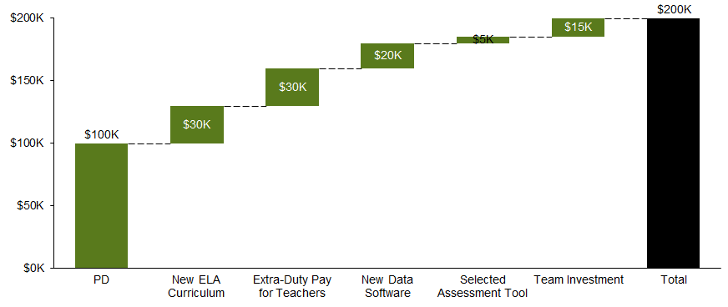
Implementation of these priorities and strategies next year requires an investment of $200K in non-personnel resources
Of this total investment, $120K represents one-time investments (e.g., new curriculum, data systems) whereas $80K represents annual, on-going investments (e.g., team investment)¹.
¹See next 2 slides for additional detail.

Slide 69
To support new strategies and school needs, we request the following resources (ordered by priority): (1 of 2)
Ask & Description | With incremental funding |  |  | Without incremental funding
 | Related Priority | Rationale | Cost
Professional development, including: New data tool Trauma-informed care ELA and Math (e.g., Reading and Writing Workshop; Math Workshop) Selected interim assessment | All priorities | Ongoing professional development is critical to successful implementation of new programming. By providing embedded professional development, we have the opportunity to build staff skill and capacity throughout the year. We will ensure quality facilitation of PDs and implement PDs to help deepen staff’s ELA and Math content knowledge and expertise, to improve student academic performance as a result. In addition, teachers must be equipped with the tools to guide themselves and their students through socio-emotional challenges. | $100,000* some on-going, some one-time | Continue to use current materials Dr. Boddie has taken on workshop, we are developing an interim assessment and outside funding for trauma.
Purchase of new curriculum and materials for PK-6 Reading and Writing | Implement a comprehensive, scaffolded PK-6 Reading and Writing curriculum and ensure dedicated time for instruction. | Current reading and writing curriculum materials are not comprehensively scaffolded across grades PK-6 nor, match the rigor expected of students on the MAP. | $30,000 one-time | Use free supports from online research and school visits
Extra-duty pay for teachers (e.g., participation in summer training, leadership of initiatives) | All priorities | Teachers must be trained, prepared, and coached prior to implementation of new curriculum, data-driven instruction practices, trauma-informed classroom practices, and classroom management to improve both student achievement and school culture. Teachers must also be supported and provided compensation for leading these new strategic initiatives. | $30,000 on-going | Dr. Boddie and other admin. takes this on
*Note: Ashland and Meramec have expressed an interest in sharing PD, to reduce costs across schools. This cost will be adjusted against the existing PD budget from the district.
Notes:
Funding source(s) need to be identified as aligned to SMART Goals, Evidence-based strategies and implementation timeline. Important to also cross reference with other plans (ie. Title I, etc.)

Slide 70
To support new strategies and school needs, we request the following resources (ordered by priority): (2 of 2)
Ask & Description | With incremental funding |  |  | Without incremental funding
 | Related Priority | Rationale | Cost
New data software (e.g., Tableau, Schoolzilla, Illuminate) Building our own currently | Consistently leverage a system to collect data and progress monitor student growth and proficiency in ELA & Math | A data tool that is user-friendly, real-time, and allows for aggregate trend analysis as well as individual and classroom reporting is critical to enable data-driven instruction. This tool would make data management less burdensome for schools and enable them to spend more time responding to the data versus manipulating it. | $20,000 one-time | Create Excel-based tool, and start earlier in the summer to populate with all standards
Predictive, aligned interim assessment tools for Math and ELA (e.g., NWEA MAP) Building our own currently | Consistently leverage a system to collect data and progress monitor student growth and proficiency in ELA & Math | Prior interim assessments (e.g. Scantron) have not been useful in predicting student performance on MAP. Funding would allow for the use of interim assessment tools commonly leveraged by excellent schools to inform instruction and predict student proficiency. | $5,000 one-time | Continue to use STAR; BW can advise on setting interim benchmarks
Team investment for: Staff-wide retreat Activities to promote morale, team-building, and self-care Culture initiatives (e.g., parent nights, home visits) Unfunded | Actively plan and implement regular opportunities to build and strengthen trust, cohesion, and relationships across the Ashland team and staff | School culture is an on-going investment and requires staff to continue to build trust and learn how to collaborate in order to execute on new initiatives and feel invested in change. In addition, this budget will cover school culture incentives such as awards, incentive trips, home visits, and parent engagement nights, to promote improved attendance, and positive school culture. | $15,000 on-going | Use free supports and ideas from online research and school visits
Total |  |  | $200,000

Slide 71
To support new strategies and school needs, we also request 2.5 additional FTEs (ordered by priority)
Personnel Role and Description (# FTE) |  | With incremental funding |  | Without incremental funding
 |  | Rationale | Total Cost (incl. benefits)
Operations Manager Rejected | 1.0 | One of our key priorities this year is a focus on academics. However, instructional leaders currently hold a multitude of operations responsibilities. Having an operations manager allows school leadership to drive instruction and academic initiatives. The operations manager will build, streamline and manage school systems (operational, culture) and data systems. The operations manager will also manage systems to allow a focus on attendance. | $50,000 | School leader would continue to manage both school operations and instruction
Social Worker Complete | 0.5 | This would allow for the current part-time social worker to become full-time. Students require a social work team with capacity to support their social-emotional needs and ensure their wellness. | $35,000 | Current social work team will take on additional duties
Interventionist (Math) Hiring cureently | 1.0 | One of our key priorities this year is to create an aligned RTI model to provide targeted math interventions; we will need additional capacity to lead and implement this initiative. | $75,000 | Current RTI team will take lead on this initiative, and drop lower-priority items
Total |  | $160,000
Notes:
Operations manager-identify funding source (not likely to meet allowable expense out of Title I(a).

Slide 72
To support new strategies and school needs, we request the following autonomies (ordered by priority): (1 of 2)
Priority | Autonomy requested | Description | Rationale
All | Budget | We request to the maximum extent possible that Ashland’s budgeted funds be used flexibly to support the needs of the school, to include funds allocated for staffing. | In order to meet the unique needs of the school, our instructional program and ultimately our students, we request maximum autonomy of campus funds in order to pay for programming, consider how to maximize the impact of staff, and think creatively about how we partner with our community.
Ensure teachers have access to high quality professional development to deepen ELA & Math content knowledge and expertise | Professional development | We request that school administration and their staff have the option but will not be required to attend all district professional development and to supplement with external professional development of their choosing as needed. | As a CPN school, we have unique needs that may or may not be met by attending district-offered professional development. By providing staff the option to choose what professional development they attend with the guidance of their school leaders, teachers and staff retain flexibility to choose best-fit learning opportunities to line up to individual and school-specific needs.
All | Staffing | We request flexibility to make hiring and staffing decisions across the school to support student needs. We request no forced placement or forced transfer of teaching and administrative staff into the school. | In order to meet the unique needs of the school and implement our priorities and strategies, we need the ability to make hiring decisions flexibly. This should include off-boarding or transfers of existing staff based on performance and/or being able to flexibly staff across the school to meet instructional needs. We also request that, given the current hiring needs of the school, Ashland be given priority in the district hiring process (e.g., access to top candidates with our competition with other schools, additional recruitment team attention, etc.)

Slide 73
To support new strategies and school needs, we request the following autonomies (ordered by priority): (2 of 2)
Priority | Autonomy requested | Description | Rationale
Implement a comprehensive, scaffolded PK-6 Reading and Writing curriculum and ensure dedicated time for instruction. Consistently leverage a system to collect data and progress monitor student growth and proficiency in ELA & Math | Curriculum and assessments | We request the flexibility to opt in or out of current district assessments and curriculum scope and sequences according to program needs. | Our current Reading and Writing curriculum is not scaffolded PK-6, nor does it represent the best support for students in meeting the demands of MAP. In addition, current assessments (STAR Reading and STAR Math) are not sufficient to predict year-end student performance on MAP.
Ensure teachers have access to high quality professional development to deepen ELA & Math content knowledge and expertise | School schedule and calendar | We request the ability to modify the school calendar and school day based on the needs of our school and staff PDs. | To implement the strategies outlined to reach our ELA/Math and teacher retention goals, we request early release days for students, so that staff can have regular time for PLCs and PD. This is a best practice that “excellent schools” implement, and allows for staff to be aligned on instruction and school culture, as well as increasing teacher retention by providing teachers the time and space to get better at their practice and receive formative feedback and coaching.

Slide 74
Appendix
Professional Development Year 3 2021/2022
LETRS Training (Reading) | $25,000 – On-going
Instructional Partners (Lesson Plan and Writing) Train the Trainer | $15,000 – On-going
CT-3 (No nonsense nurturer Program and Coaches Training) | $40,000 - Postponed

Slide 75
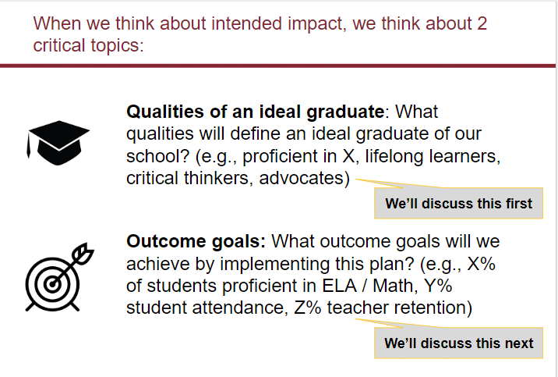
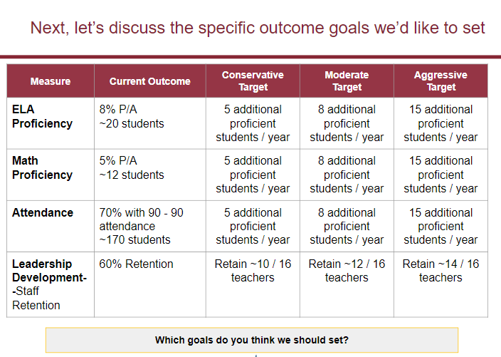
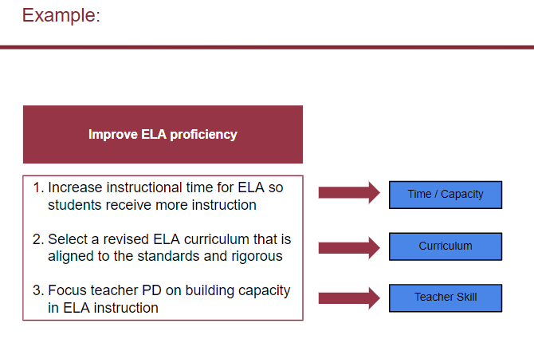
Here is a review of our process:
A review of our process...
What We Have Done...
1. Create a vision and set goals 2. Identify root causes 3. Determine priorities 4. Brainstorm strategies, milestones, and funding needs to bring our priorities to life 5. Lay out action steps related to our primary strategies

Slide 76
We have aligned resource requests to priorities and strategies
Priorities | Strategies | Resource Request
1. Implement a comprehensive, scaffolded PK-6 Reading and Writing curriculum and ensure dedicated time for instruction. | 1.1 Research, select and implement a comprehensive, scaffolded PK-6 curriculum for reading and writing | PK-6 curriculum for Reading and Writing and related PD
2. Employ an aligned RTI model to provide targeted Math Interventions | 2.1 Research and implement evidence-based approaches to flexible, differentiated, small group instruction in math 2.2 Create individualized learning plans for Tier 3 students and struggling populations | Interventionist (math)
3. Consistently leverage a system to collect data and progress monitor student growth and proficiency in ELA & Math | 3.1 Analyze school-wide data trends using universal data tool to track student mastery of standards on a six-week cycle | Data software for tracking mastery of standards and related PD Data collection devices (e.g., iPad/Chromebook) Predictive, aligned ELA/ Math interim assessment tool (e.g., NWEA MAP, STAR) and related PD
4. Ensure teachers have access to high quality professional development to deepen ELA & Math content knowledge and expertise | 4.1 Secure/deliver robust PD in ELA (e.g. Reading and Writing Workshop, Daily 5, Strategies That Work, Fountas and Pinnell Literacy Continuum, Spalding, Words Their Way) & Math (Math Workshop, small group instruction, centers, increasing rigor, number talks, Understanding by Design, etc.) 4.2 Redesign planning meetings to focus on unpacking standards and aligning instruction | PDs in ELA PDs in Math Extra-duty pay for teacher participation in summer PD Staff stipends to build out PD modules and calendar
1. Actively plan and implement regular opportunities to build and strengthen trust, cohesion, and relationships across the Ashland team and staff. | 1.2 Leverage TLT to facilitate activities, trainings, and culture step backs with the staff | Team retreat budget Cost of on-going incentives and activities Cost of additional staff resources identified through staff needs survey Staff stipends to build out PD modules and calendar
2. Build teacher toolkit around trauma and self care. | 2.1 Design / select and deliver PD on classroom management, trauma-informed classroom practices, and self-care and sustainability for teachers | External PD facilitator Extra-duty pay for teacher participation in summer PD Staff stipends to build out PD modules and calendar
1. Improve student attendance | 1.1 Strengthen school-family connection (e.g., home visits, walking school bus) 1.2 Raise teacher involvement in attendance | Budget for culture initiatives (e.g., parent nights, home visits, awards, incentive trips)
General implementation |  | Stipends to support excellent school visits for 5-6 staff
ELA and Math
Teacher Retention
Notes:
We have aligned resource requests to priorities and strategies.
Goal of today: 1) propose any additional must-haves, 2) understand top asks and vote on 6-8.

Slide 77
Priority | Ask & Description | With incremental funding |  | Without incremental funding
 |  | Rationale | Total Cost
Implement a comprehensive + scaffolded PK-6 Reading and Writing curriculum and ensure dedicated time for instruction. | Purchase of PK-6 Reading and Writing curriculum materials | Current reading and writing curriculum materials are not vertically aligned for PK-6 | $30,000 if new | Continue to use current materials
 | PD for new PK-6 Reading and Writing curriculum | Ongoing professional development is critical to successful implementation of new programming.. | $40,000 | Use online, free resources
Consistently leverage a system to collect data and progress monitor student growth and proficiency in ELA & Math | Data system for tracking student mastery, classroom and school-wide trends and generates data reports | A data tool that is user-friendly, real-time, and allows for aggregate trend analysis as well as individual and classroom reporting is critical to enable data-driven instruction New data software (e.g., Tableau, Schoolzilla, Illuminate, etc.) Related PD | $20,000 $10,000 | Creation of Excel-based tool, and starting earlier in the summer to populate with all standards
 | Predictive, aligned ELA/Math interim assessments (e.g., Practice Buddy Envision) | Prior interim assessments (e.g. Scantron) have not been useful in predicting student performance on MAP. Funding would allow for the use of interim assessment tools commonly leveraged by excellent schools to inform instruction and predict student proficiency. | $5,000 | Continue to use STAR; BW can advise on setting interim benchmarks
 | PD for new ELA/Math interim assessments (e.g., “Getting Started” package with MAP) | Ongoing professional development is critical to successful implementation of new programming. By providing embedded professional development, Ashland has the opportunity to sustain momentum throughout the year. | $5,000 | Continue to use STAR; BW can advise on setting interim benchmarks
Ensure teachers have access to high quality professional development to deepen ELA & Math content knowledge and expertise | Build out or acquire PD in ELA (e.g., Reading and Writing Workshop, Daily 5, Strategies That Work, F/P, Spalding, Words Their Way, UnboundEd Standards Institute) | These PDs have been used by other schools to help deepen staff’s ELA content knowledge and expertise, and these schools have improved student academic performance | $20,000 | Use free supports from online research and school visits
Notes:
Vote: do you like this proposal? Not purchase core curriculum but need funds for all supplemental thinking 30,000
Debate about any others
https://ohsblt.files.wordpress.com/2015/12/nwea-product-and-services-pricing-sheet.pdf
We’re not going into weeds on this call on rationale + cost + contingency. Highest-leverage place to spend on this call is to make sure we have all hte appropriate asks aligned to this proirity. This is the priority. #1: Implementing preK-6 ...two asks: 1) purchase curriculum, and 2) secure PD. Are there any other asks that you think are required with htat?
Next priority: 3 asks that go with that. Data system / platform + interim assessments + PD.

Slide 78
Priority | Ask & Description | With incremental funding |  | Without incremental funding
 |  | Rationale | Total Cost
Ensure teachers have access to high quality professional development to deepen ELA & Math content knowledge and expertise | Build out or acquire PD in Math (Math Workshop, small group instruction, centers, number talks, Understanding by Design) | These PDs have been used by other schools to help deepen staff’s Math content knowledge and expertise, and these schools have improved student academic performance | $15,000 | Use free supports from online research and school visits
 | Extra-duty pay for teacher participation in summer PD, build out of PD module and calendar | Teachers must be trained, prepared, and coached prior to implementation of new curriculum, data-driven instruction practices, trauma-informed classroom practices, and classroom management to improve both student achievement and school culture | $30,000 | Slot into school-year PD calendar
Actively plan and implement regular opportunities to build and strengthen trust, cohesion, and relationships across the Ashland team and staff. | Team retreat budget | Staff must go into the school year invested in the changes related to the strategic planning process, and trusting each other as a team, in order to execute on these priorities. | $5,000 | On-site retreat during a regular PD time
 | Cost of on-going incentives and activities to support culture and team-building (including add’l staff resources) | School culture is an on-going investment and requires staff to continue to build trust and learn how to collaborate in order to execute on new initiatives and feel invested in change. (Part of building morale and strengthening staff culture is to support staff through being responsive in providing materials and resources they need to execute on strategic priorities, and to help maximize student achievement.) | $5,000 | Existing budget for staff activities
Build teacher toolkit around trauma and self care. | External PD facilitator for trauma-informed practice and self-care PD | Teachers must be supported and provided the tools and skills to deal with socio-emotional stress both within themselves and in their classrooms with students. | $10,000 | Social work team to create resources for teachers
School culture priority | School culture initiatives | This budget will cover incentives (e.g., awards, incentive trips), home visits, parent engagement nights, etc. that will allow for improved attendance, and positive school culture. | $5,000 | Use free incentives
 | Total | $200,000
Notes:
https://ohsblt.files.wordpress.com/2015/12/nwea-product-and-services-pricing-sheet.pdf
The district promised us to visit other schools therefore it’s not an ask from us. We have secured an external PD provider for trauma informed practices and self care

Slide 79
Smart Goal - ELA
By June 2022 all of my students will demonstrate growth in reading by increasing their score on the STAR Reading assessment (which assesses multiple CCSS reading standards) in the following manner: Subgroup (A) Students who demonstrated they are at/above benchmark as indicated on the STAR reading assessment in the fall will increase their percentile rank to at least 50 percentile or improve on their personal percentile rank (whichever is greater) in the spring. Subgroup (B): Students who scored in the “on watch” category (between 26-39 percentile rank) will grow by at least one level towards meeting the standard to the “at/above benchmark category (above 40 percentile rank). Subgroup (C) Students who scored in the "intervention" category(between 11-24 percentile rank) on STAR in the fall will grow by at least one level towards meeting the standard to the “on watch” category (between 26-39 percentile rank) Subgroup (D) Students who scored in the "urgent intervention” category (below 10 percentile rank) on STAR in the fall will grow by at least one level towards meeting the standard to the intervention category 11-24 percentile rank
Notes:
COVID negatively impacted the ability to meet this goal thru lack in engagement, virtual or hybrid instruction and technology issues.

Slide 80
Smart Goal - Math
By June 2022, students in the following subgroups will demonstrate growth in extending understanding of math on the conceptual level. Subgroups were decided upon based on the STAR Math state standards report which breaks students into the following categories based on their performance Subgroup (A) Students who scored in the "below" category in the fall STAR Math will increase their score by 30% Subgroup (B) Students who scored in the “within” category in the fall on STAR Math will increase scores by 20% Subgroup (C): Students who scored in the “above” category in the fall on STAR Math will increase their score by 10%
Notes:
COVID – negatively impacted students academic achievement with 30% or more student failing to log into class for instruction

Slide 81
Strategy Cost and Funding Source
Strategies
Amplify CKLA grades Pre-K thru 6^{th – Research-Based - complete}
Math Specialist
Cost Funding Source
Amplify - $40,000 -complete Comprehensive Dollars
Math - $75,000 GOB
PD - $10,000 Comprehensive Dollars

