Slide 1
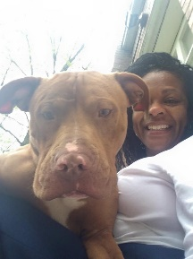
Ms. Sherron P. Walker RN
The Basics!
Hi! My name is Ms. Sherron Patrice Walker. I am 55 years old and live in University City, MO with my son Chris (an artist) and our two dogs, Leonard Nimoy and Snoot Atticus Finch. I love live theater, traveling and shopping for bargains at thrift store. I have been a nurse for 35 years and school nurse for 20 years. I LOVE being a school nurse & look forward to the 2017-2018 school year and taking care of your child
MY CHILDHOOD!
I grew up in Saint Louis, Missouri where I attended Metro High School, graduating in 1979. I am the oldest of 4 children
MY FAVORITES!
MY EDUCATION!
Food: Pasta
Movie: Cat On A Hot Tin Roof
Book: “Trinity by Leon Uris”
Color: Black
Drink: Coffee & Pure Leaf Tea
Season: Fall
Sports: Cardinals Baseball Singer: Phyllis Hyman
Hobby: Reading
Subject: History
Store: Goodwill
Dessert: Sweet Potato Pie
Candy: Milky Way
Restaurant: Olive Garden
Flower: Tulip
In June 1982, I graduated from Deaconess Hospital School of Nursing
CONTACT ME!
Email: Sherron.walker@slps.org
Secondary Email: octobersky1961@aol.com
Class Webpage: www.slps.org
Phone Number: (314) 481-8585 Fax: 314-244-1935
You can always stop by my office !

Slide 3
Kg Summer Storm
Kg Miss Kindergarten
Sweet Pea

