Slide 1


Presented to School Nurses
School Year 2022-2023
Althea Albert-Santiago, MPH, CCNP, CMP, Director of Food and Nutrition
Faith Fude MS, RD, Nutrition Coordinator III
This institution is an equal opportunity provider

Slide 2
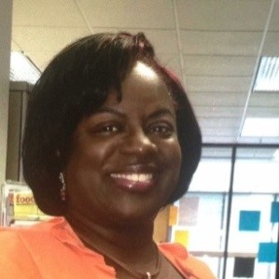

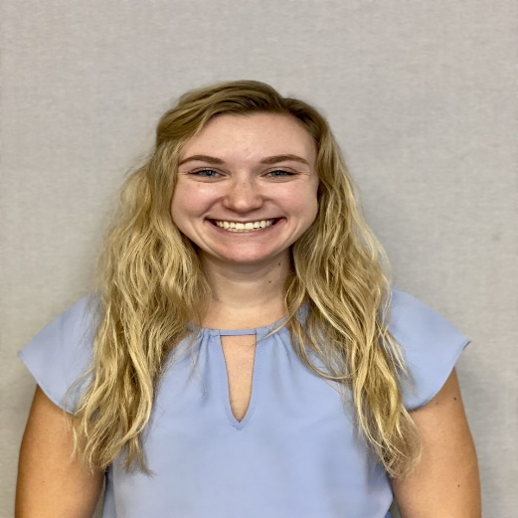

Food and Nutrition Services Leadership Team
Althea Albert-Santiago, MPH, CCNP, CMP
Director of Nutrition Services
Carolyn Penn
General Manager of Foodservice
Faith Fude, MS, RD
Nutrition Coordinator III

Slide 3

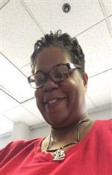
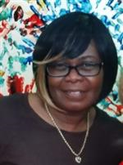
Food and Nutrition Services Leadership Team
Tenecia Williams
Accountability Specialist
Erika Hollinshed
Catering Services Specialist
Jackie Martin-Baker
Assistant to the General Manager

Slide 4
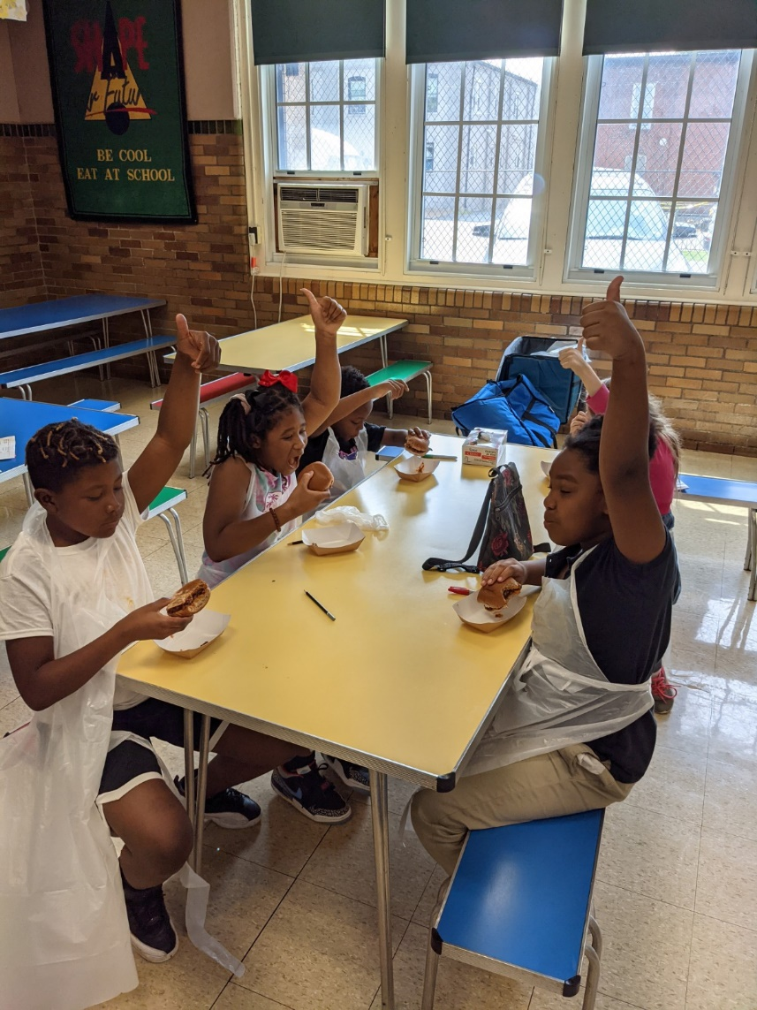
Community Eligibility Provision
Saint Louis Public Schools (SLPS) continues to operate the Community Eligibility Provision (CEP) Program under the United States Department of Agriculture Department (USDA) and Missouri Department of Elementary and Secondary Education (DESE).
The District will offer both free breakfast and lunch to all St. Louis Public Schools students.
All food programs are required to have written approval by Althea Albert-Santiago, Director of Food and Nutrition Services.

Slide 5

Talking Points
Is the student eligible to receive accommodation?
Is the dietary need considered a disability?
Possible Modifications
Allergen and Carbohydrate Reports
What we need from you

Slide 6
Student Allergy Information
Student Allergy Intervention & Response
Policy #P5142
The St. Louis Public School District (SLPS) has created this policy to describe an organized system for preventing and responding to allergic reactions.
This policy is not a guarantee of an allergen-free environment; instead, it is designed to increase awareness, provide education and training, reduce the chance of exposure and outline responses to allergic reactions. The best form of prevention for life-threatening allergies is avoidance of the allergen.

Slide 7
Student Allergy Information
Student Allergy Prevention & Response Procedure
Policy #R5142
In the St. Louis Public School District (SLPS) the School Nurse shall oversee the administration of these procedures in consultation with the Director of Food and Nutrition Services, the School Health Advisory Council (SHAC), the District Health and Wellness Council, Executive/Building Commissioner for Operations and Facilities Management, Executive Director of the Transportation Division, the school district Medical Director, Executive Director of Special Education, local health authorities and, where appropriate, the special education director or Section 504 coordinator.

Slide 8
Examples of Special Diet Needs Considered a Disability:
Celiac disease
Diabetes
Food allergies that are life threatening; anaphylactic reaction
PKU (Phenylketonuria)
Dysphasia

Slide 9
Possible Modifications
Food restrictions (milk, milk products, gluten, eggs …)
Calorie increase
Texture Changes (pureed, ground, chopped, thickened liquids ...)
Tube feeding
Weight managment (calorie –controlled)

Slide 10

Special Diet Form
Special Diet Form: (OHS-18)
This form must be signed by a recognized medical authority and include the following;
  Identification of the medical or other special dietary condition which restricts the student’s diet
  The food or foods omitted from the student’s diet
  The food or choice of foods to be substituted
  Documentation needs to be updated on a yearly basis
Notes:
Hyperlink

Slide 11
Special Diet Form OHS-18
Notes:
Hyperlink

Slide 12
Our Process
The parent gives the proper signed documentation (Special Diet Form: OHS-18) to the School Nurse
  The School Nurse turns this documentation to Faith Fude, MS, RD- faith.fude@sfellc.org (Nutrition Coordinator III) AND Althea Albert- Santiago,MPH , CCNP, CMP -althea.albert-Santiago@slps.org (Director of Food and Nutrition Services)
    The Health and Nutrition (H&N) team receives the info, and creates a specialized menu for the student
      Once the menu is completed, the H&N team turns the menu over to the manager assigned to the school
      From there, the manager communicates with the cafeteria lead at the school to prepare the meal
      The turnaround time for a student to receive their specialized meal from when Faith and Althea receive the documentation is less than 3 days

Slide 13
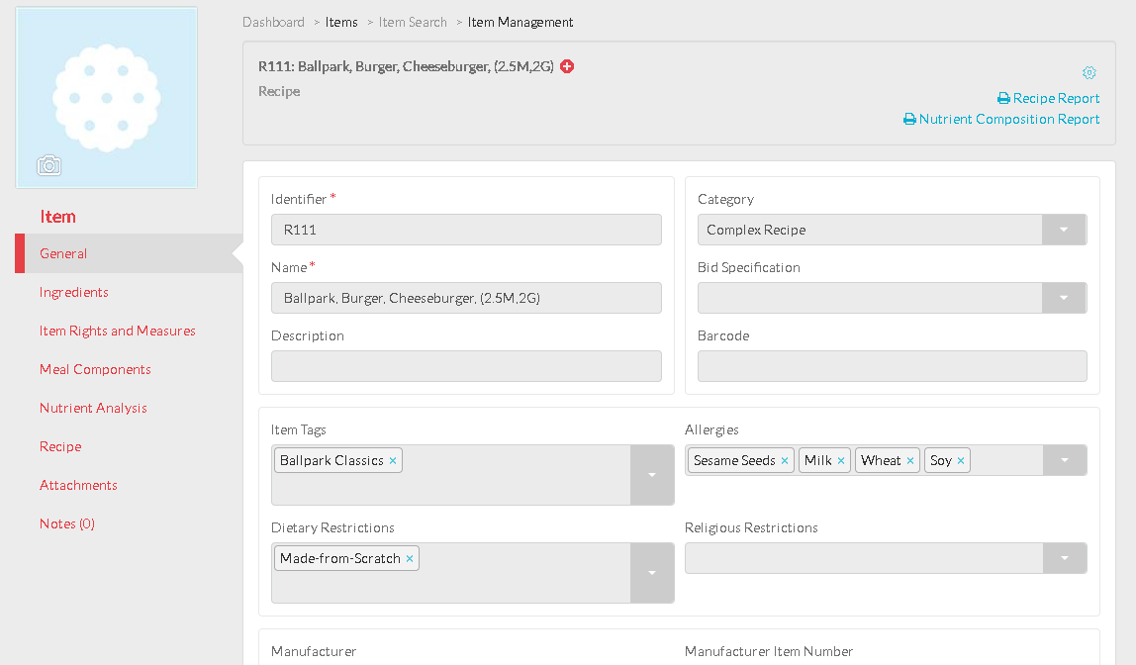
Titan Allergen Report

Slide 14
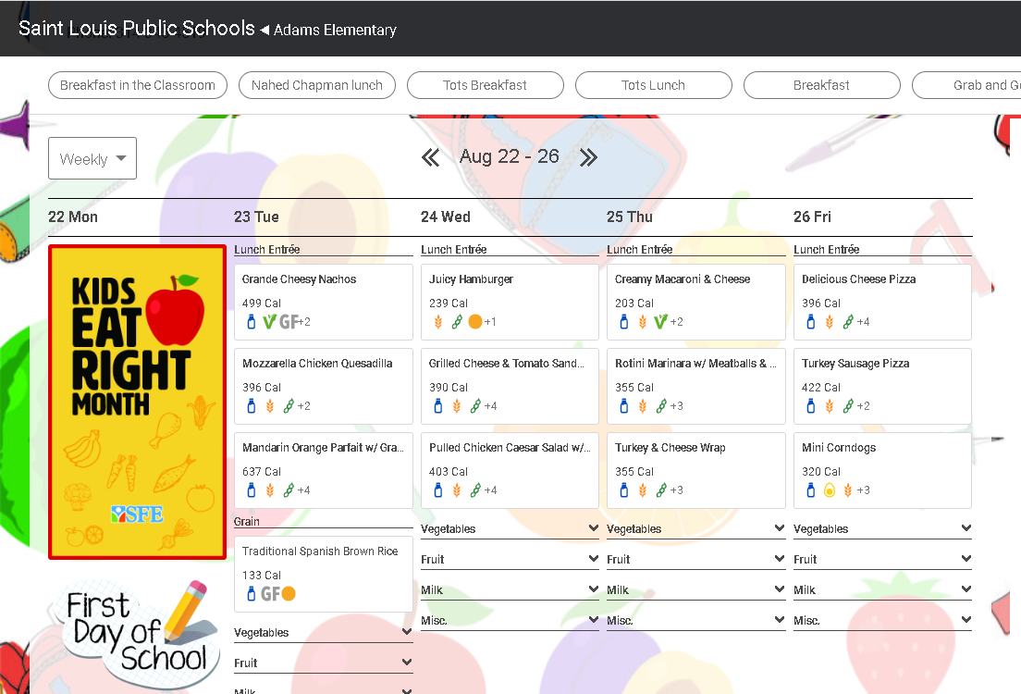
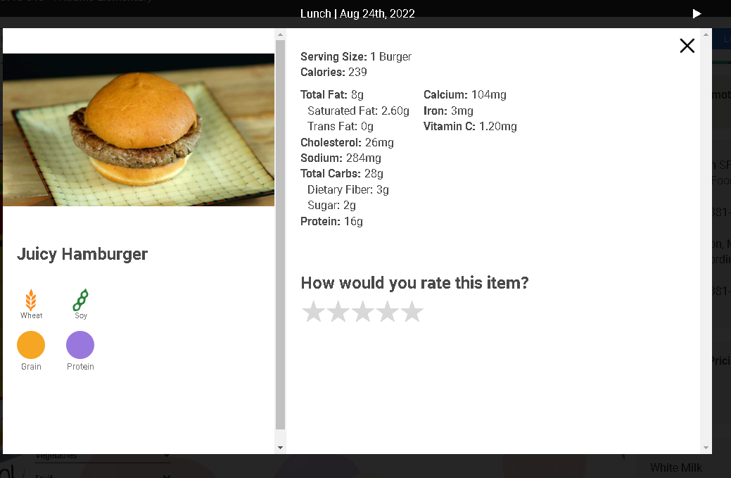
Nutrislice Allergen Reports

Slide 15
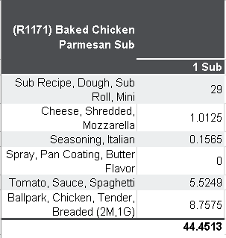
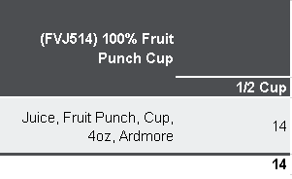
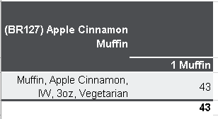
Carbohydrate Count Reports
    Reports sent monthly in an excel format to the lead nurses
      Sent ~ the 15th of the preceding month
Notes:
Sent to the nurses every month

Slide 16
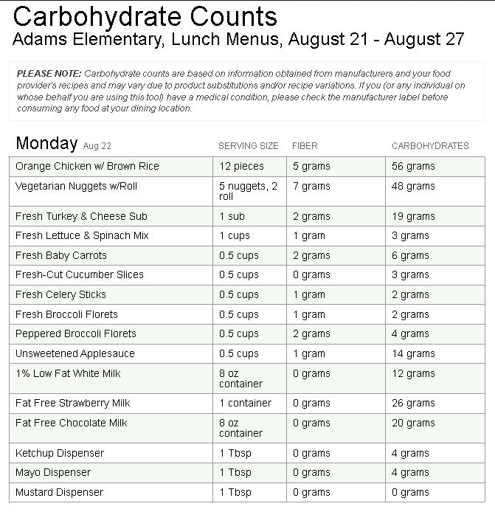
Nutrislice Carbohydrate Report

Slide 17
What we need from you
    Send us your list of students with allergies or special diets ASAP
      Both documented, and undocumented
    Remember, this process is updated annually. Allergies can change, and so should the documentation
    Continue to communicate with us as you receive new and updated allergy or special diet information
Notes:
Diet forms have to be renewed every year!

Slide 18

Questions
    What special diets do you have at your schools?
Notes:
Diet forms don’t have to be renewed every year, but it’s best practice to have the most up to date form.

Slide 19
Contact Information
Southwest Foodservice Excellence
Carolyn Penn, General Manager
Carolyn.penn@sfellc.org
District Cell Number: 314-637-4841
Southwest Office Number: 314-381-4155
Jackie Martin-Baker, Asst. to the General Manager
Jackie.martin-baker@sfellc.org
District Cell Number: 314-229-4746
Southwest Office Number: 314-381-4155
*Faith Fude, MS, RD Nutrition Coordinator II
Faith.fude@sfellc.org
Cell Number: 630-632-5408
Food and Nutrition Services Department
*Althea Santiago MPH, Director of Food and Nutrition Services
althea.albert-santiago@slps.org
District Cell Number: 314-401-9870
Office Number: 314-345-4519
Tenecia Williams, Accountability Specialist
Tenecia.williams@slps.org
Office Number: 314-345-2308
Erika Hollinshed, Catering Services Coordinator
Erika.Hollinshed@slps.org
Number: 314-331-6115
*don't hesitate to get in touch with Faith and Althea if you have questions about the menu and special diets.

