Slide 1
Chapter 6:
The Presidency
As head of the executive branch of the United States, the president fills both informal and formal roles and wields power that affects our government at every level.

Slide 2
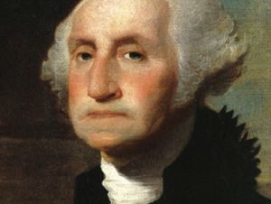
Section 1: The President
The Constitution gives only a brief description of the president’s qualifications and powers. Yet the job is vast and complex, as the president must fulfill many roles.

Slide 3
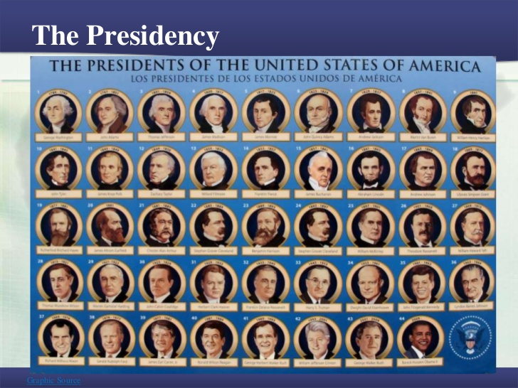
Do Now
What do you think a president of the United States actually does?

Slide 4
Learning Goals
Learning Objectives
Essential Question
Roles of the president.
Formal characteristics of the presidency.
Informal qualifications for the presidency.
What are the formal and informal powers of the presidency?

Slide 5
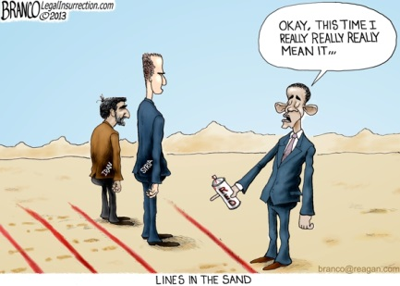

Slide 6

I. Roles of the President
Official Roles
  Chief Executive: Laws implemented
  Commander in Chief: Order troops into action.
  Foreign Policy: Plans relations with other countries.
    Diplomacy: Art of negotiating.
Unofficial Roles
  Chief of State: Symbolic figurehead
  Party Leader: Shapes party platform
  Chief Citizen: Models of good citizenship

Slide 7
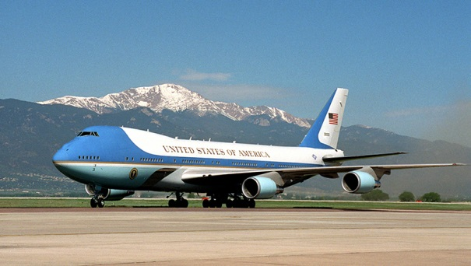
II. Formal Characteristics of the Presidency
Written Qualifications
  35 yrs. Old
  Lived in U.S. for 14 yrs.
  Natural-born U.S. citizen
Term of Office
  2 four-year terms
  22nd Amendment 1951
Election to Office
  Electoral College (538)
Succession
  Process of who comes after
  Vice Prez, Speaker, Pro tempore, Sec. State
Salary & Benefits
  $400,000/yr & travel, staff, insurance

Slide 8
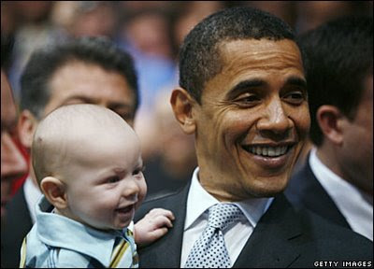
III. Unwritten Qualifications
Presidential Backgrounds
  Well-educated, Christian
  White, upper-class
  75% military background
Personal Qualities
  Communicator
  Confident, poised, charismatic
  Calm, controlled

Slide 9
IV. Exit Slip
The official roles of the president are outlined by
Which of the following is an unofficial role of the president?
The Framers originally set the term of office for president at
Which of the following ay behind the creation of the electoral college?
Who is first in line of succession to the presidency?

Slide 10
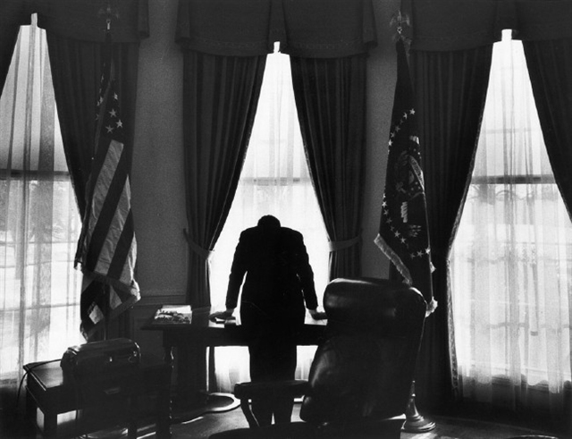
Section 2: The Powers of the Presidency
The powers of the presidency, outlined in Article II of the Constitution, are vast and have grown throughout the history of the United States. They are, however, checked by the other branches of government.

Slide 11
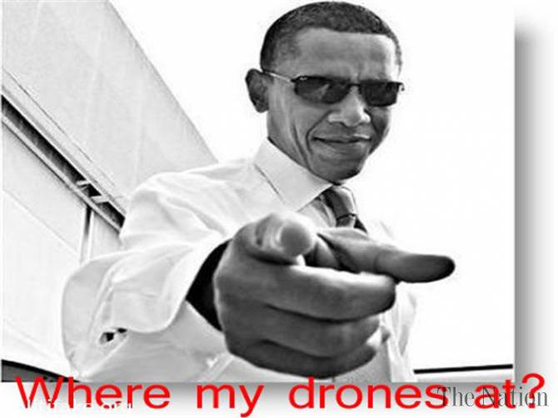
Do Now
If you were president, what is one power that you would want? Why would you want this specific power and what could you do with it?

Slide 12
Learning Goals
Learning Objectives
Essential Question
Executive powers of the president.
Diplomatic and military powers of the president.
Presidential exercise of legislative & judicial powers.
Informal powers of the president.
Who has the power to declare war and send troops into combat?

Slide 13
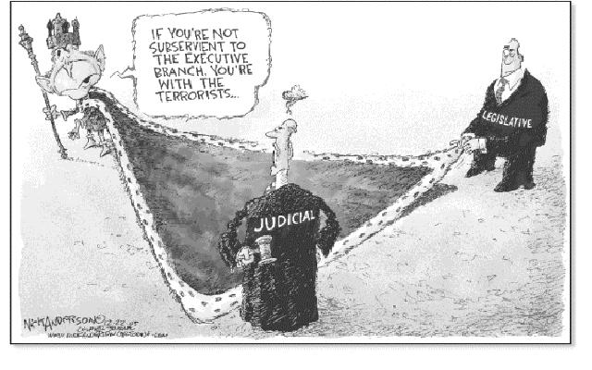

Slide 14
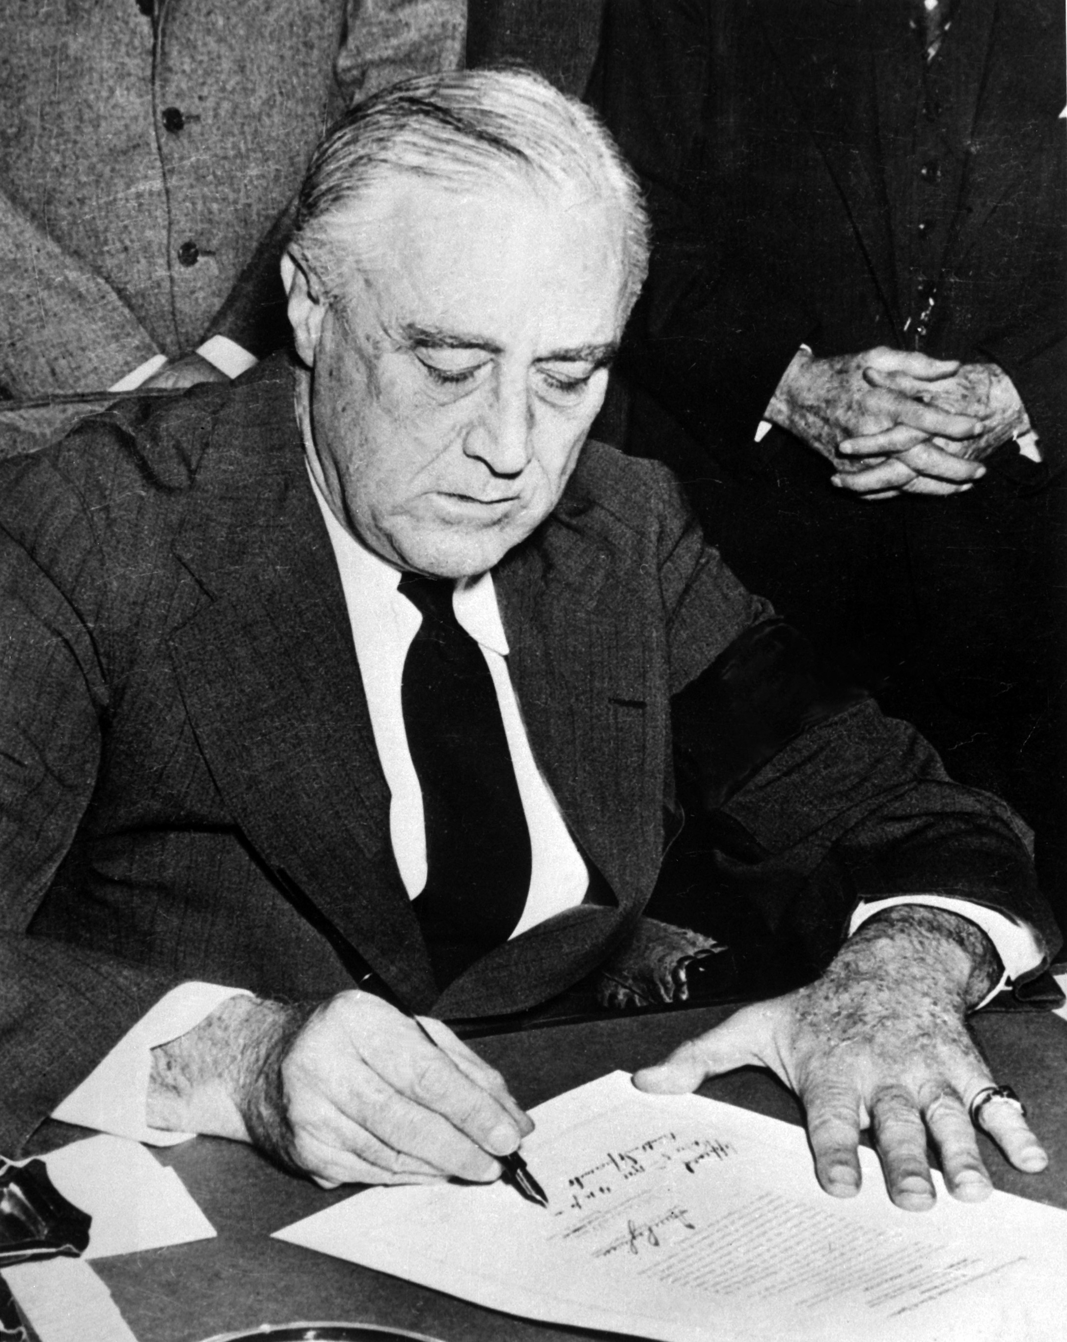
I. Executive Powers
Appointment & Removal
  Appoints over 3,000 people & can remove them
Executive Orders
  Formal rule or regulation instructing executive branch officials on how to carry out their jobs.
Executive Privilege
  Refuse to release info to Congress or a court.
Diplomatic Powers
  Diplomatic Recognition: Formally recognize the legitimacy of a foreign gov’t.
Military Powers
  Send troops for 60-90 days w/out Congressional consent.
  Troops sent over 200 times but only 5 wars.

Slide 15
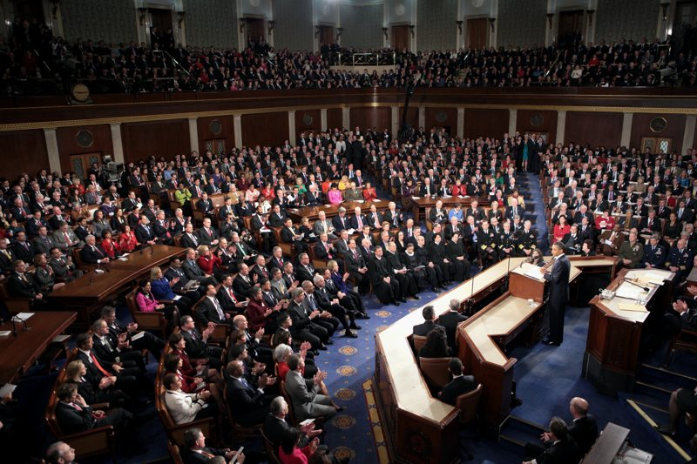
II. Legislative & Judicial Powers
Legislative Powers
  Proposes budget & legislation
Judicial Powers: Nominate judges & alter sentences.
  Reprieve: Postpones the carrying out of a sentence.
  Pardon: Releases a convicted criminal from having to fulfill a sentence.
  Amnesty: Grants a group of offenders a general pardon.
  Commute: Reduce a person’s sentence.

Slide 16
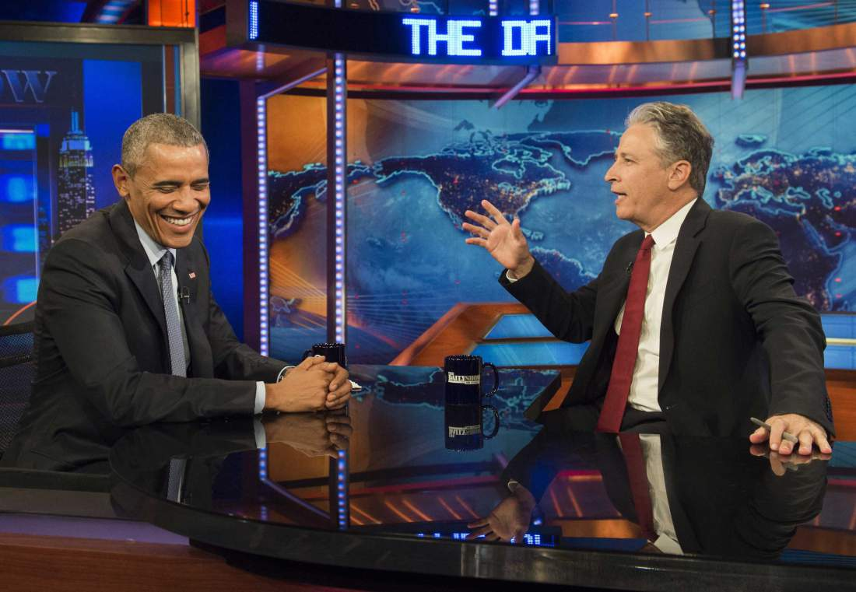
III. Informal & Change
Informal Powers
  Public Attention
  Party leadership
Checks
  Judicial Review
  Veto override
  Public Opinion
First 100 Years
  Congress was powerful and Prez accepted.
Prez. Power Expands
  Civil War, Great Depression, 1960s.

Slide 17
As chief executive, the president can issue __________________________, formal rules that tell officials in the executive branch how to carry out their jobs. (pardons/executive orders)
The president may refuse to disclose information to Congress or a court by claiming the right of __________________________. (executive privilege/executive immunity)
The president’s treaty-making power is limited by __________________________. (the Supreme Court/Congress)
__________________________ refers to the president’s power to formally recognize the legitimacy of another nation. (Executive privilege/ Diplomatic recognition)
The president’s main legislative power, the power to refuse to sign bills into law, is known as the __________________________. (check/veto)

Slide 18
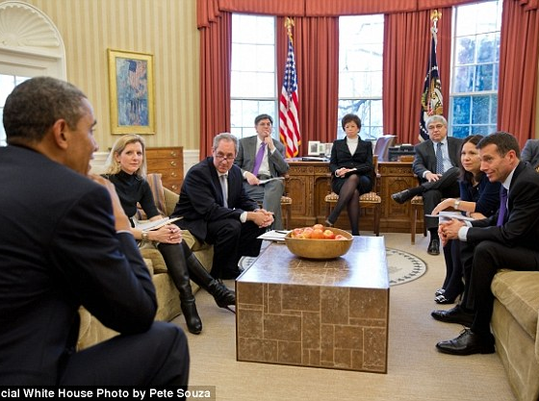
Sec. 3: The President’s Administration
The president leads a large team of people who help carry out the duties of the office. This team includes a staff of advisers, the vice president, and members of the cabinet.

Slide 19
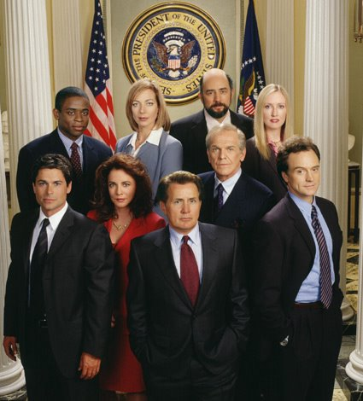
Do Now
What do you think the president’s staff does? What job would you like if you worked for the president?

Slide 20
Learning Goal
Essential Question
Learning Objectives
Duties of the Executive Office of the President.
The changing role of the Vice President.
How the cabinet works with the President.
What do you think would be the most important quality to have in a cabinet member?

Slide 21
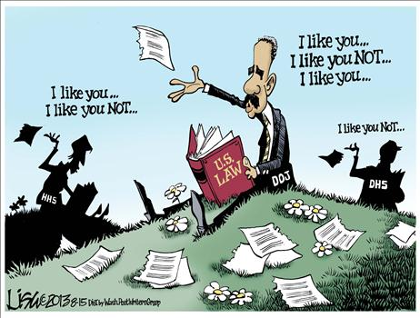

Slide 22
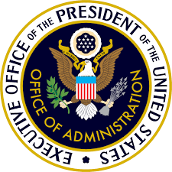
I. Executive office of the President
Administration: All the people who work for the executive branch.
Executive Office of the President: Offices that help the president formulate policy.
White House Office: President’s key personal & political staff.
  Chief of Staff: Manages the everyday operations of the White House.
National Security Council: Top military, foreign affairs, & intelligence officials.
Council of Economic Advisers: Expert analysis of the economy.
Office of Management & Budget: Help develop the federal budget & its execution.

Slide 23
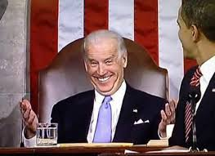
II. The Vice President
Official Duties
  Presides over the Senate
  Counting electoral college votes
  Assume presidency if needed.
12th Amendment
  Separate ballots for vice president elections
Modern Vice Presidents
  Make policy
  Carry out programs

Slide 24
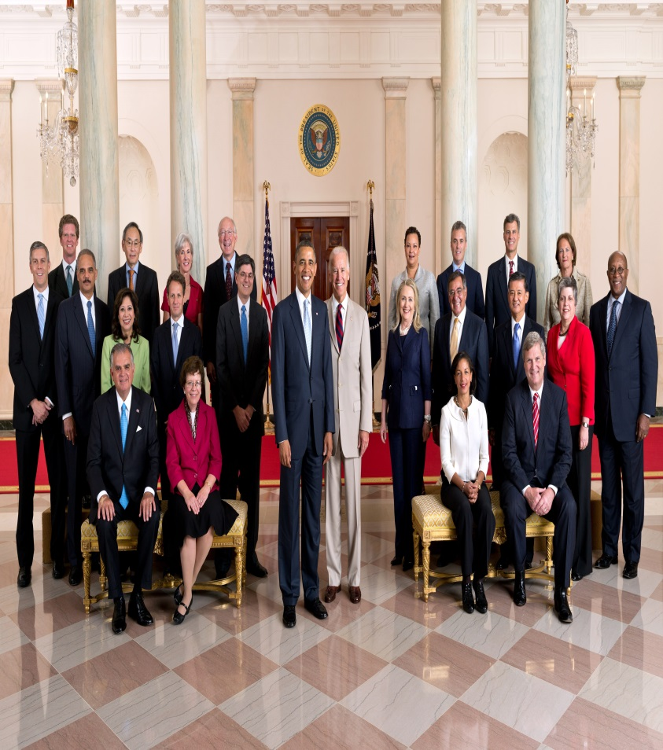
III. The Cabinet
Heads of the executive departments that advise the president.
Executive Departments: Carry out laws, administer programs, & make regulations.
Not mentioned in the Constitution
  Washington had Depts. Of State, War, Treasury, and Attorney General.
  16 Official positions today.

Slide 25
1. Person who manages the everyday operations of the White House Office
2. Advisory committee made up of heads of the executive departments
3. All of the people who work for the executive branch
4. Group that provides the president with expert analysis of the economy
5. Organization that helps develop the federal budget
6. Serves as president if the president cannot do the job

