Slide 1
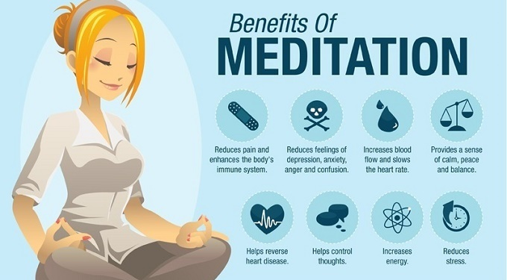

Slide 2

Do Now
What makes you who you are?
How much impact have your genes had on making you who you are?
What impact has your environment had on you?

Slide 3

Nature vs. Nurture
Back corner is “Nature” & doorway is “Nurture.”
Stand on the line where you think the influence level is between nature and nurture in determining people’s behavior.
Why did you stand where you did?

Slide 4
What is "Nature vs. Nurture"
Nature versus nurture" is a psychology term related to whether heredity or the environment most impacts human psychological development (behavior, habits, intelligence, personality, sexuality, aggressive tendencies, and so on).

Slide 5
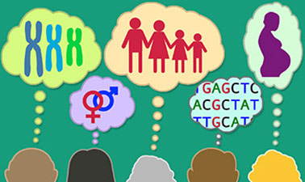
Genetics
Inherited Traits
  Draw a straight horizontal line on a sheet of paper. When the tip of your ring finger is placed on the line, does the tip of your forefinger also reach the line?
    Short forefingers are determined by a recessive trait in females, whereas in males it is dominant.
  Interlock your fingers. Do you place your left or right thumb on top?
    Certain behavior are genetically controlled.

Slide 6
Nature
In the "nature vs nurture" debate, nature refers to an individual's innate qualities (nativism).
Example: Nature is your genes. The physical and Personality traits determined by your genes stay the same irrespective of where you were born and raised.
Factors: Biological and Family

Slide 7
Nurture
In the "nature vs nurture" debate, nurture refers to personal experiences (i.e. empiricism or behaviorism).
Example: Nurture refers to your childhood, or how you were brought up. Someone could be born with genes to give them a normal height, but be malnourished in childhood, resulting in stunted growth and a failure to develop as expected.
Factors : Environmental and Social

Slide 8
Individual Assignment
Work on the Nature vs. Nurture check sheet and the terms handout. Utilize the dictionary under your desk to find the definitions for each of the 13 listed terms.
You will have around 25 minutes to complete the assignment.

Slide 9
Discussion Questions
Do you think personality traits are primarily inherited or influenced by environment? What is your evidence?
Why do you think nature versus nurture is debated? Do you think it is possible to answer this question definitively? Why or why not?
Who might be most interested in resolving the nature versus nurture debate? What effect might a resolution have on our society?
If you were raising identical twins, what might you do to make sure that they were unique individuals? Explain your answer
Based on what you have learned, do you think it is possible to change your personality? Why or why not? If so, how would you go about making changes?

Slide 10
Class Debate
You will form into groups of 4 (two groups will have 5) and you will have to decide if you want to debate on the side of Nature or Nurture.
Use the computers in the back to look up more information and evidence for your side.
You should be able to present information and prepared to ask questions of your opponents and answer questions from your opponents.
We will begin the debate at the beginning of class on Friday.

