Slide 1
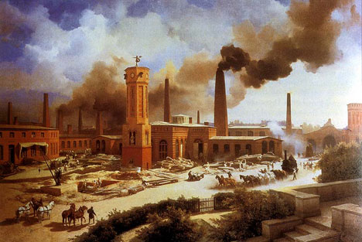
The Industrial Revolution
Industrialization: When a society transitions from being based on agriculture (farming) to industry (factories)

Slide 2
Introduction
After the Civil War:
  Reconstruction was going on in the South
  Population was moving into the West
  At the same time, the cities were also undergoing a major change.
  Rise of industry
  New inventions made this possible

Slide 3
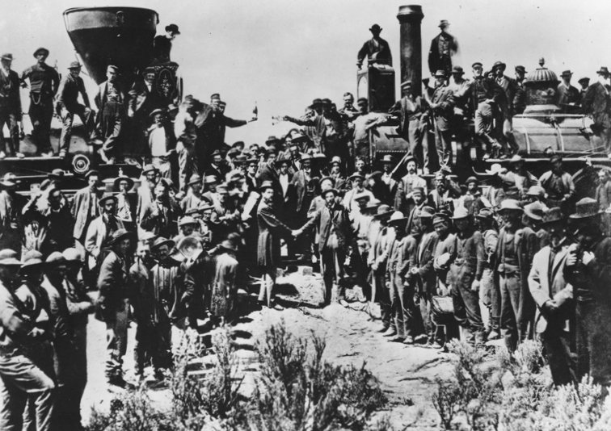
Transcontinental Railroad
The railway completed in 1869 between Omaha, Nebraska and Sacramento, California
It was built in large part by Chinese immigrants

Slide 4
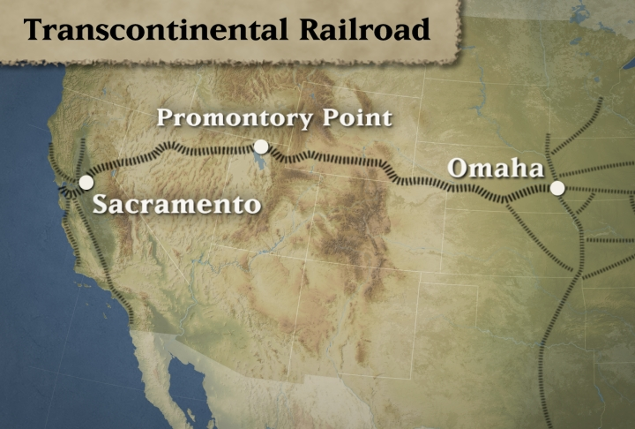
Transcontinental Railroad

Slide 6
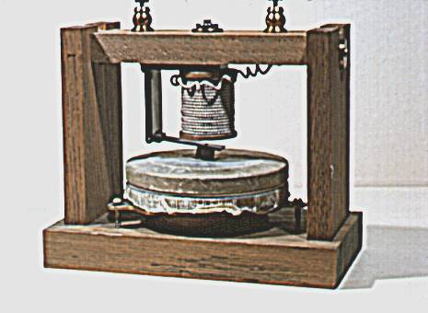
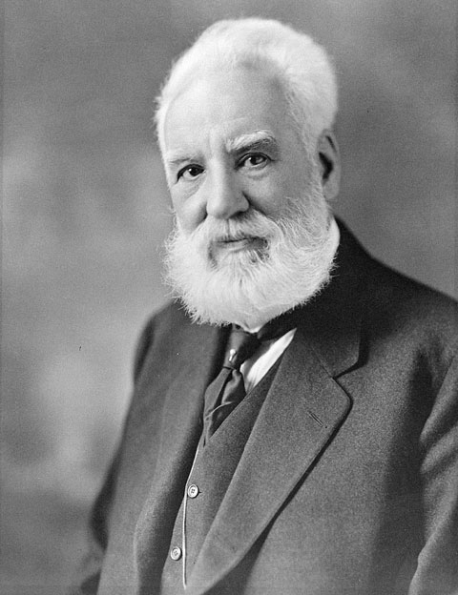
Bell develops telephone
One of the most dramatic inventions of the late 1800s was in the field of communications.
In 1876, Alexander Graham Bell developed the first telephone, which revolutionized communication by increasing the scale and speed of nationwide communications.
"Mr. Watson -- come here -- I want to see you."

Slide 7
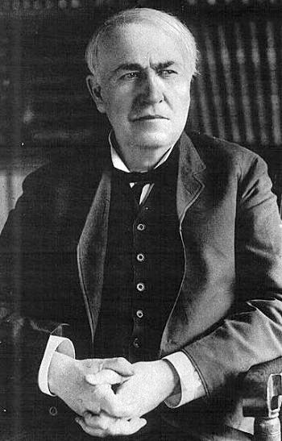
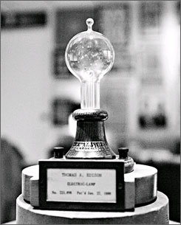
Edison and the Light Bulb
In 1879, American inventor Thomas Edison developed the first commercial viable light bulb. The invention led to the wide spread use of electrical power and factories being able to run at night.
Edison is considered one of the most prolific inventors in history, holding 1,093 U.S. patents in his name.

Slide 8
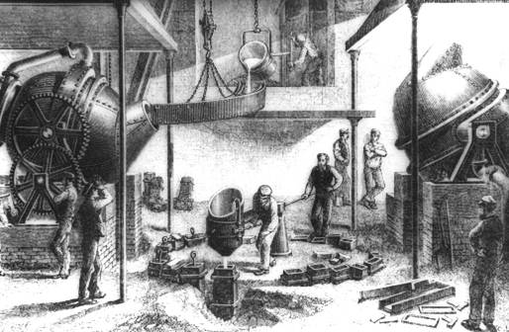
The Bessemer Process
The Bessemer process was the first inexpensive industrial process for the mass-production of steel.
By the late 1880s an immigrant by the name of Andrew Carnegie used this process to become a millionaire

Slide 9
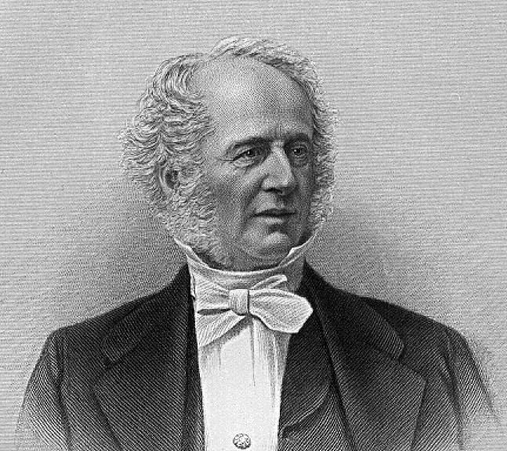
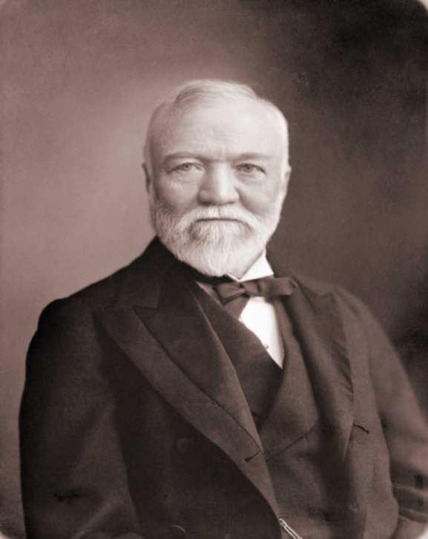
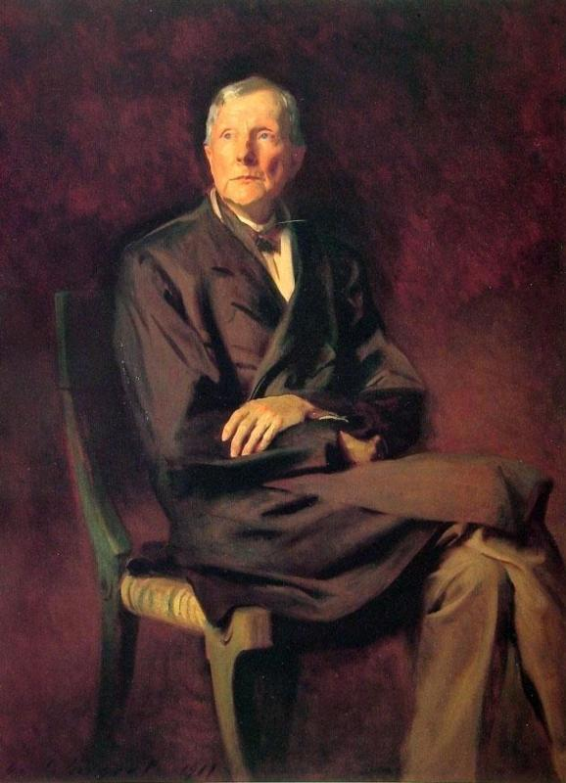
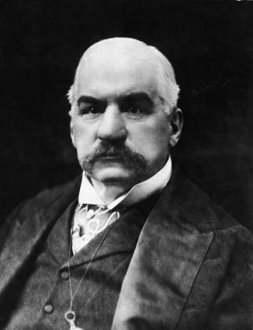
Captains of Industry
Entrepreneurs & Industrialists like Cornelius Vanderbilt, Andrew Carnegie, John D. Rockefeller and J.P. Morgan were able to build great fortunes during the Gilded Age
Railroads
Steel
Oil
Banking
Cornelius Vanderbilt
Andrew Carnegie
John D. Rockefeller
J.P. Morgan
The government created policies to support the industrialists
High tariffs led to lower prices for American made goods
There were very few government regulations on big business
Government supported owners over workers in labor disputes

Slide 10
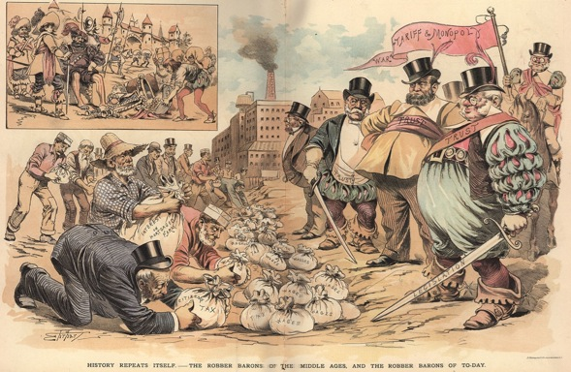
Captains of Industry …
…or Robber Barons?

Slide 11
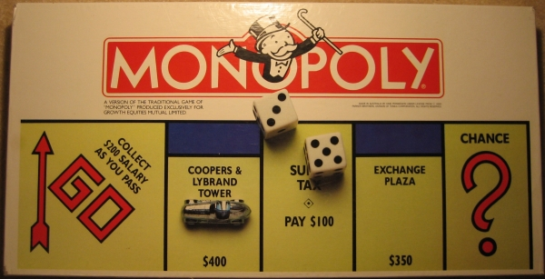
Monopolies
A monopoly is having exclusive control of a commodity or service in a particular market.

Slide 12
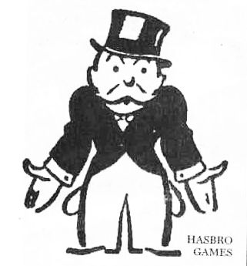
Social Darwinism
The belief that people and businesses who that cannot adapt to their environment will eventually “die out”
“Survival of the fittest”

Slide 13
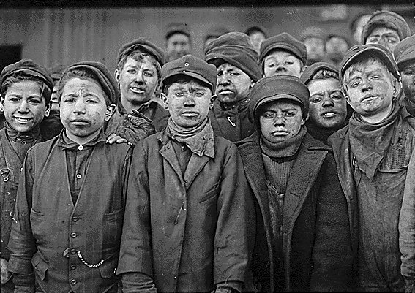
Child Labor
Child labor included factory work, agriculture, or doing odd jobs.

Slide 14
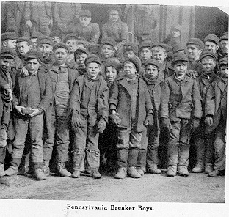
Child Labor
Immigrant children were put to work in sweatshops – jobs with harsh working conditions

Slide 15
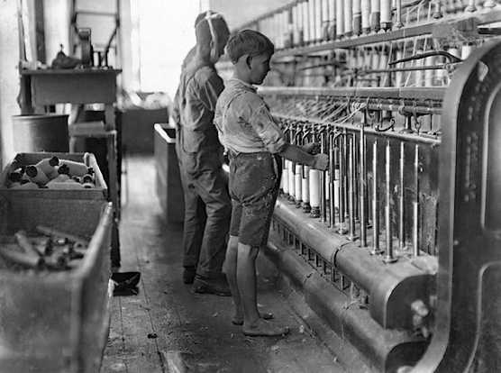
Child Labor
Businesses wanted to hire children because they were a cheap source of labor.

Slide 16
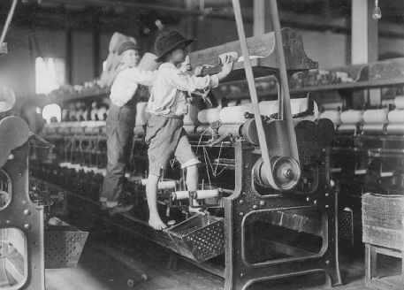
Child Labor
Children often worked in dangerous factory jobs…

Slide 17
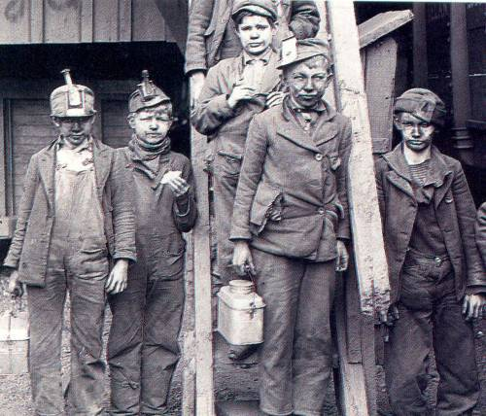
Child Labor
...or dangerous jobs in mines because of their size

Slide 18
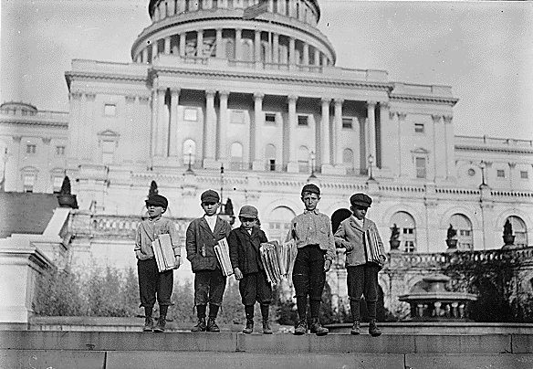
Child Labor
Newspaper carriers were known as “Newsies”

Slide 19
Triangle Shirtwaist Fire
-146 women died in the factory fire, which was caused by unsafe conditions.
-Led to NYC govt. investigation which led to improved safety conditions in factories.

Slide 20
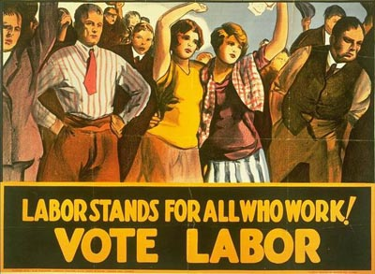
Labor Unions
A labor union is an organization of workers who unite to protect the rights of the workers from abusive practices of the employer

Slide 21
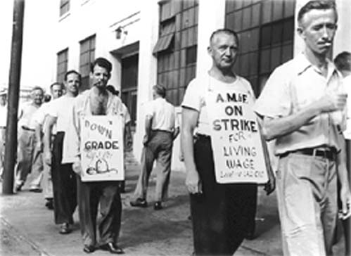
What is a Labor Strike?
A labor strike is when a labor union refuses to go to work in order to shut down a business because of poor working conditions or poor pay

Slide 22
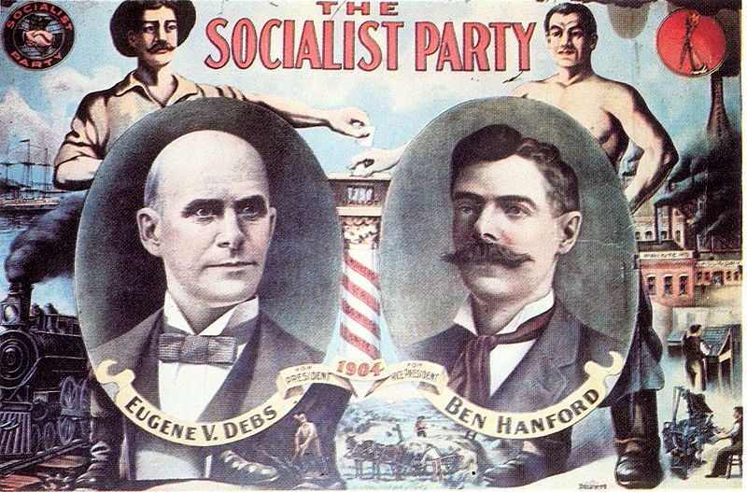
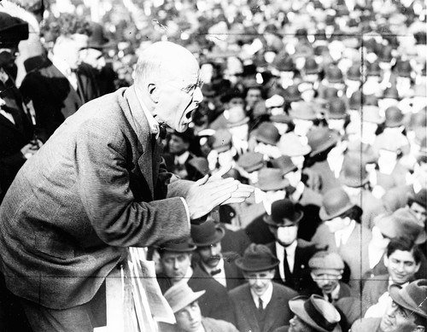
Eugene V. Debs
Eugene V. Debs was the powerful leader of the American Railway Union.
Debs would run for president four times as a candidate for the Socialist Party, backed by unions

Slide 23
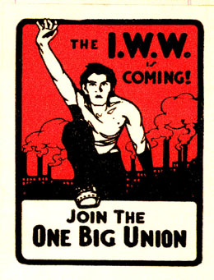

IWW (Wobblies)
The International Workers of the World (IWW) called for all workers to be united as a class and demand better working conditions.
The IWW, created in Chicago in 1905, was made up primarily of socialists and anarchists

