Slide 1
Do NOW
1) What does consciousness mean?
2) Give some examples of consciousness? What about unconsciousness?
3)What are some ways where we can alter our consciousness?

Slide 2
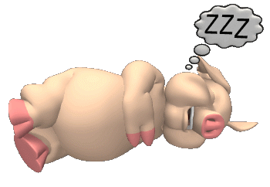
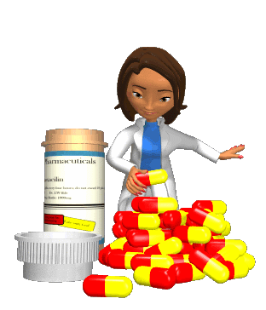
Chapter 4: Consciousness: Sleep, Dreams Hypnosis and Drugs

Slide 3
States of Consciousness (2–4%)
Understanding consciousness and what it encompasses is critical to an appreciation
of what is meant by a given state of consciousness. The study of variations in
consciousness includes an examination of the sleep cycle, dreams, hypnosis, circadian
rhythms, and the effects of psychoactive drugs.
AP students in psychology should be able to do the following:
• Describe various states of consciousness and their impact on behavior.
• Discuss aspects of sleep and dreaming:
— stages and characteristics of the sleep cycle;
— theories of sleep and dreaming;
— symptoms and treatments of sleep disorders.
• Describe historic and contemporary uses of hypnosis (e.g., pain control,
psychotherapy).
• Explain hypnotic phenomena (e.g., suggestibility, dissociation).
• Identify the major psychoactive drug categories (e.g., depressants, stimulants)
and classify specific drugs, including their psychological and physiological
effects.
• Discuss drug dependence, addiction, tolerance, and withdrawal.
• Identify the major figures in consciousness research (e.g., William James,
Sigmund Freud, Ernest Hilgard).

Slide 4
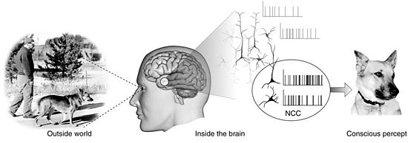
Chapter 4-1: What Is Consciousness?
What does it mean to be conscious, and are there different levels of consciousness?

Slide 5
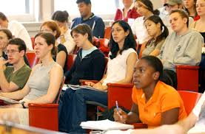
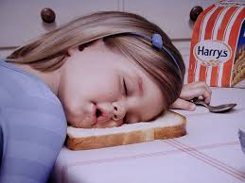
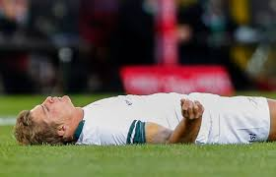
What is Consciousness?
Consciousness: The process underlying the mental model we create of the world of which we are aware. Used to organize human behavior
Walking Consciousness: State in which thoughts, feelings, and sensations are clear, organized and the person feels alert.
It is also a part of the mind from which we can potentially retrieve a fact, an idea, an emotion, or a memory and combine it with critical thinking.

Slide 6
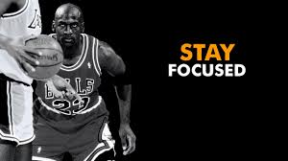
What Does Your Conscious Do?
Our consciousness has 3 main functions:
1. Consciousness restricts our attention.
It keeps our brain from being overwhelmed by stimulation by processing things serially and limiting what we notice and think about-this is called selective attention.
2. Consciousness provides us with a mental “meeting place.”
Where sensation combines with memory, emotions and motives-this is the binding problem.
Ex: We know we see an Italian restaurant, taste pizza, and smell pasta. However, we do not know how all of these senses come together to create the one perception of "our" reality

Slide 7
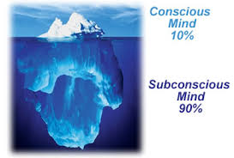
What does your Conscious Do? (Continued)
3. Consciousness allows us to create a mental model of the world that we can manipulate.
Unlike other, simpler organisms, we are not prisoners of the moment: We don’t just act reflexively to stimulation.
Humans are the only animal with the ability to set goals

Slide 8
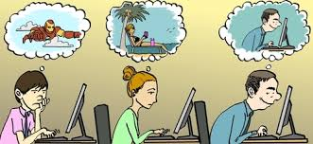
Altered States of Consciousness
Altered State of Consciousness: State in which there is a shift in the quality or pattern of your mental activity.
Ex: When you are sleep deprived so your thoughts and actions are hazy and disorganized
Divided Conscious awareness: ex talking on your cell phone and driving.

Slide 9
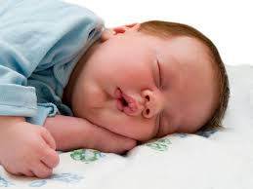
4.2: Altered States of Consciousness: Sleep
Why do people need to sleep and how does sleep work?

Slide 10
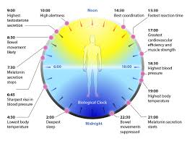
The Biology of Sleep
Q: Why do people need to sleep?
A: The human body has “Biological Rhythms” or natural cycles that it most go through, including a sleep-wake cycle which helps the body restore natural properties (as well as consciousness)
Circadian Rhythms: A cycle of bodily rhythm that occurs over a 24 hour period.
For most of us this means we will sleep once during every 24 period
Our circadian rhythm (i.e. sleep cycle) is controlled by the brain

Slide 11
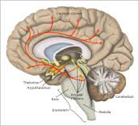
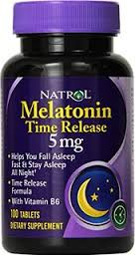
Sleep and the Hypothalamus: The Mighty Mite
Melatonin: a hormone released by the hypothalamus that helps regulate the human sleep cycle
Superchiasmatic Nucleus: Inside the hypothalamus, sensitive to changes in light
Body Temperature: Higher temp=more alert, lower temp=less alert

Slide 12
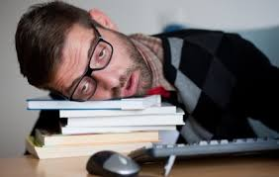
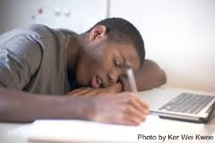
The Price of Not Sleeping
Micro sleeps: Brief sidesteps into sleep lasting only a few seconds
Sleep Deprivation: A significant loss of sleep, resulting in problems in concentration and irritability
Effects of missing sleep:
concentration problems, memory retention problems inability to do simple tasks.
Symptoms of Sleep Deprivation:
trembling hands, inattention, staring off into space, droopy eyelids and general discomfort

Slide 13
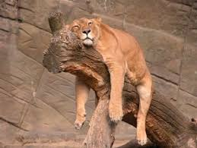
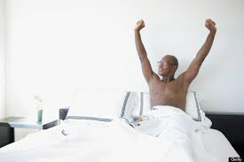
Sleep Theories
Adaptive Theory of Sleep: Proposes that animals and humans evolved sleep patterns to avoid predators by sleeping when predators are the most active
Ex: Lions sleep 14 hours per day (Few predators) and gazelles sleep 4 hours per day (Many predators)
Restorative Theory of Sleep: Proposes that sleep is necessary to the physical health of the body and serves to replenish chemicals and repair cellular damage
Ex: Children who are growing need more sleep and children with sleep disruption problems suffer from delays in growth
Ex: Lions sleep 14 hours per day (Few predators) and gazelles sleep 4 hours per day (Many predators)

Slide 14
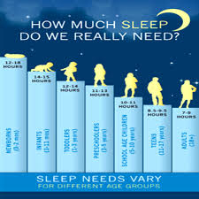
How Much Sleep do We Need?
Amount of sleep needed varies with age and inherited sleep needs
Most adults need about 7-9 hours in a 24 hour period
Children need about 8-12 hours and teenagers need around 8-10

Slide 15
Ted Talk: Why do we sleep? Questions
1) How much time do “average” people spend sleeping in their lifetimes?
2) Describe the three of the ideas that the narrator poses to answer the question. Why do we need sleep?
Restoration:
Conservation:
Processing and Memory Consolidation:
3) Of these 3 which do you think is the most likely? Explain.
4) What are some common problems caused by sleep deprivation?
5) Debunk one “sleep myth”.
6) Describe the connection between sleep and mental illness.

Slide 16
Brain Games: Sleep
While watching the following episode of Brain Games, record the following in your notebook
1) What is the importance of sleep
2) Describe at least two “Brain Games” or “Experiments” that the hosts did and explain their relevance to the study of sleep.

Slide 17
Homework
Notes: Finish 4-2 (If not finished in class) Chapter 4-3 Stages of Sleep
Vocabulary: 4-1-4-3
TED Talk Summary/Questions (In Notebook): Why do we sleep? (Ted Talk link on Website)

Slide 18
Ted Talks Questions: How do you explain Consciousness?
1) Describe the movie analogy that Mr. Chalmers uses to explain consciousness
2) How does Mr. Chalmers suggest that we “bring consciousness into science”?
3) Describe his two “crazy” ideas: The fundamental one and the Universal one
4) Based on his ideas and research on consciousness, create your own definition of consciousness? How could we test for your idea? Be prepared to share out these ideas

Slide 19
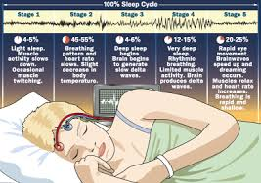
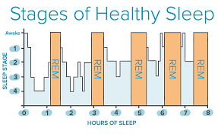
Chapter 4-3: Stages of Sleep

Slide 20
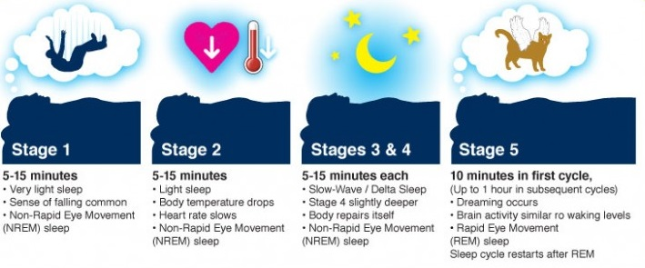
The Stages of Sleep

Slide 21
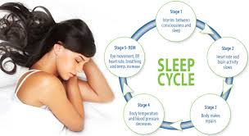
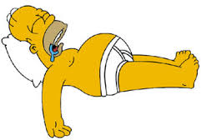
Types of Sleep
There are two kinds of sleep:
REM (Rapid Eye Movement) Sleep: stage of sleep in which the eyes move rapidly under the eyelids and the person is typically experiencing a dream
During REM sleep our voluntary muscles are inhibited and we experiences very little movement
Non-REM Sleep: any stages of sleep that do not include REM sleep
Non-REM sleep is deeper and person is free to move around

Slide 22
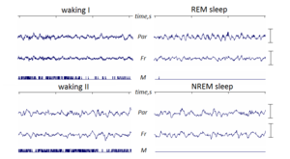
Stages of Sleep: Brain Waves
Beta Waves: Small, fast waves that indicate alertness and mental activity
Alpha Waves: Larger, Slower brain waves that indicate relaxation or light sleep
Theta Waves: Very large, very slow waves that indicate the early stages of sleep
Delta Waves: Long, Slow Brain waves that indicate the deepest stages of sleep

Slide 23
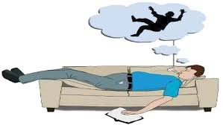
Stages of Sleep: Stage One
Non-REM stage one: Light Sleep:
If awakened often don’t believe you were actually asleep
May experience vivid visual events called hypnagogic images
Hypnic Jerk: Sudden “jerk” of the extremities or falling sensation

Slide 24
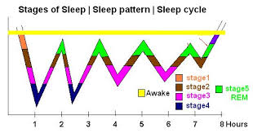
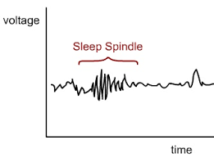
Stages of Sleep: Stage Two
Non-REM Stage 2: Drifting into deeper sleep
Conditions of stage two sleep
Body temperature drops
Heart rate slows
Breathing shallows
Sleep Spindles: Brief bursts of activity lasting for a few seconds
Dominated by theta waves

Slide 25
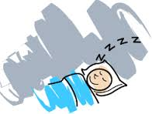
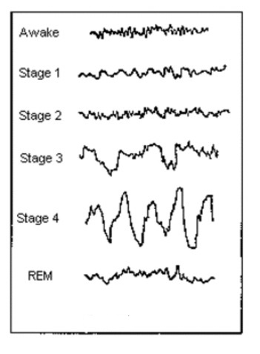
Stages three and four
Non REM stages 3 &4: Deep Sleep
Stage three is made up of 20%-50% Delta Waves
Stage four is over 50% Delta waves
Stage 3 & 4 Conditions
Growth hormones activated
Lowest functional level of body
Hard to awaken

Slide 26
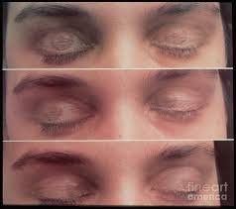
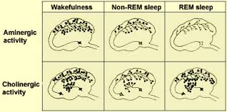
REM Sleep
Reached at the top of sleep cycle (1,2,3,4,3,2,1REM, 1, 2, 3, 4)
Conditions of REM Sleep
Body temperature near waking levels
Eyes move rapidly under the eyelids
Heart beats faster
Most dreams occur in REM stage
REM Paralysis: The inability of the voluntary muscles to move during REM sleep

Slide 27
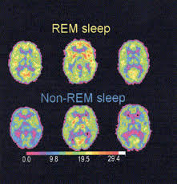
The need for REM Sleep
REM and NREM sleep serve different purposes
Physically demanding day=more NREM sleep
Emotionally demanding day= more REM sleep
REM Rebound: Increased amounts of REM sleep after being deprived of REM sleep on earlier nights

Slide 28
Do Now
Give a short definition/explanation of each stage of sleep
Stage 1
Stage 2
Stage 3
Stage 4
REM Sleep
2. What does the sleep cycle look like? What order do the stages go in?

Slide 29
Video Questions: Top 10 Sleep bizarre sleep Disorders
1) Describe each of the disorders as they are described in the video.
2) Which Sleep Disorder do you find craziest or most bizarre? Explain your answer

Slide 30
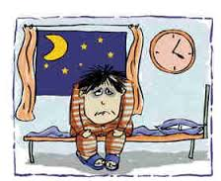
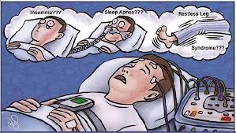
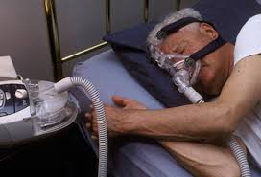
4.4: Sleep Disorders
How do sleep disorders interfere with normal sleep?

Slide 31
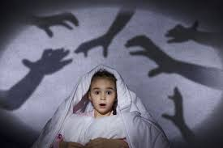
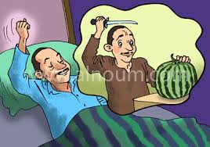
Nightmares and REM Behavior Disorder
Nightmares: Bad dreams occurring during sleep
More common in children than adults
REM Behavior Disorder: A rare disorder in which the mechanism that blocks the movement of the voluntary muscles fails, allowing the person to thrash around and even get up and act out nightmares
Usually seen in men over 60

Slide 32
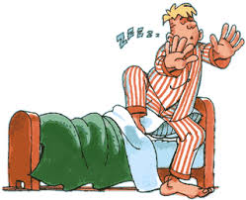
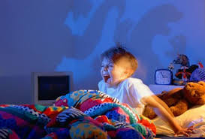
Stage four sleep Disorders
Sleepwalking (Somnambulism): Occurs during deep sleep, an episode of moving around or walking in one’s sleep
More common in childhood than adulthood.
Night Terrors: Disorder in which the person experiences extreme fear and screams or runs around during sleep without waking fully.
More likely in children than adults
Tend to disappear as children age

Slide 33
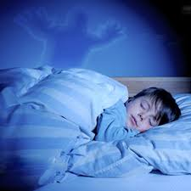
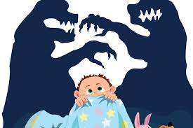
Nightmare vs night terrors: What’s the difference?
Nightmare
Night Terrors
Remembered immediately upon waking
Will be able to wake immediately and talk about the dream
No crying or movement
Occurs in REM sleep
Will not remember when awoken
Will not be able to wake suddenly or talk about the dream
Crying and Increased respiration
Occurs in deep sleep

Slide 34
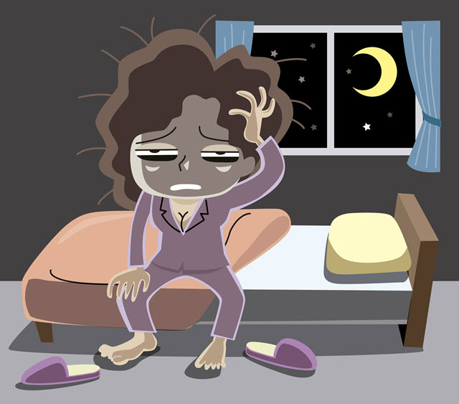
Insomnia
Insomnia: The inability to get sleep, stay asleep or get a good quality of sleep
Common Causes of Insomnia:
Psychological: worrying, trying to hard to sleep, anxiety
Physiological: Too much caffeine, indigestion, general aches and pains.
What are some simple tips to deal with insomnia?

Slide 35
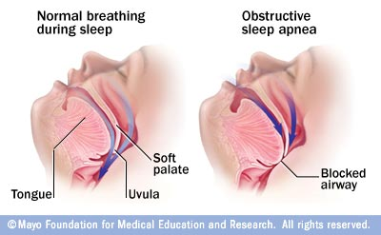
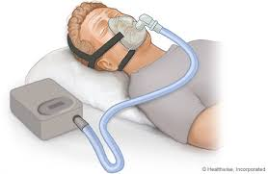
Sleep Apnea
Sleep Apnea: Disorder in which a person stops breathing for nearly half a minute or more. Generalized by loud, non-rhythmic snoring, followed by silence and gasping for air.
Causes sleep deprivation and heart problems
Treatment:
Continuous Positive Airway Pressure (CPAP) device
Surgery to open the Uvula

Slide 36
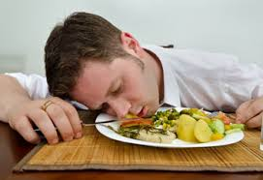
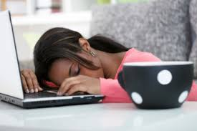
Narcolepsy
Narcolepsy: Sleep disorder in which a person falls immediately into REM sleep during the day without warning.
Often onset by a stressful event or series of strong emotions
Excessive daytime sleepiness occurring at inappropriate times and places
Cataplexy: Sudden loss of muscle tone
Also may have hypnogogic images

Slide 37
Sleep disorders Chart
Name of Disorder | Primary Symptoms
Somnambulism (Sleepwalking) | Sitting, walking, or performing complex behaviors while asleep
Night Terrors | Extreme fear, agitation, screaming while asleep
Restless Leg Syndrome | Uncomfortable sensations in legs causing movement and loss of sleep
Nocturnal Leg Cramps | Painful cramps in calf or foot muscles
Hypersomnia | Excessive daytime sleepiness
Circadian Rhythm Disorders | Disturbances of the sleep-wake cycle such as jet lag and shift work
Enuresis | Urinating while asleep in bed

Slide 38
IS it real? Extreme Sleepwalking and Sleep Homicide?
We are going to be watching a Documentary that looks at cases of “extreme sleepwalking”.
In your notebook your job is to write down “Evidence” to answer the essential question:
Extreme Sleepwalking and Sleep Homicide, is it real?
Your evidence should be organized into a table or chart that proves

Slide 39
Example Evidence Chart: Is sleep homicide real?
 | Affirmative YES | Negative NO
Evidence #1
Evidence #2
Evidence #3
Evidence #4

Slide 40
Homework
Finish Essential Question in notebook if not completed in class?
Read: Psychology in the News (pg. 144) and answer questions (In notebook)
Vocabulary 4-4
Dream Journal (Due December 14th and/or 15th)

Slide 41
Do Now
1) Why do you think humans dream?
2) What do you think effects what/how we dream?

Slide 42
Video Questions: Why do we dream?
The video will give a list of “reasons” why we dream. Record each reason and give a short description of each:

Slide 43
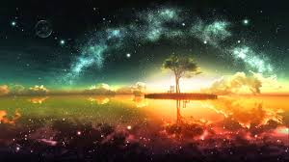
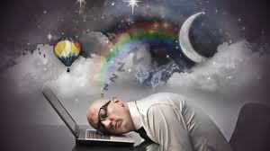
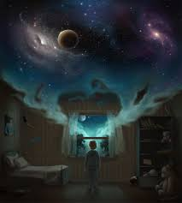
4.5: Dreams
Why do people dream and what do they dream about?

Slide 44
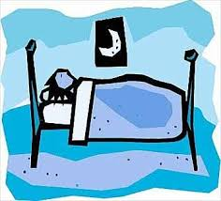
Why do we dream?: theories
There are several theories about why humans (and animals) experience dreams:
Freuds theory of wish fulfillment
Information Process Theory
Physiological Function
Activation Synthesis Theory
Cognitive Development Theory

Slide 45
Freud’s interpretation: Dreams as wish fulfillment
Freud believed that problems stem from the unconscious mind (repressed events, traumas)
Freud used symbolism to interpret how dreams were linked to unconscious
Manifest Content: The actual content of the dream
Example: Chad dreams he is trying to climb out of a bathtub. Manifest content is Chad trying to climb out of a bathtub
Latent Content: The hidden meaning of the dream
Example: The bathtub symbolizes birth, the water symbolizes the womb of his mother. Chad is trying to escape his mother’s womb in the dream (repressed unconscious memory)

Slide 46
Dreams: Information Processing
Some researchers theorize that dreams are the brains way of sifting, sorting and fixes our daily experiences in our memory.
This could explain why REM sleep and memory retention are so linked
Problems with Information Processing theory:
Why do humans dream about things they have never seen or experiences?

Slide 47
Activation-synthesis Hypothesis
PET scans show that dreams are a product of the pons:
Inhibits the neurotransmitters that allow movement
Send other random signals to the areas of the cortex that interpret sensory information
Brain synthesizes an explanation of these random signals using memories and other stored information in the brain: this is the Activation-Synthesis Hypothesis
Activation-Information-Mode Model: Revised version of the Activation Synthesis Explanation of dreams in which information that is accessed during waking hours can have an influence on synthesis of dreams

Slide 48
What do people dream about?
Most dreams reflect everyday life
Most dreams are in color
Those born before color TV will dream in B&W
Cultural differences:
US: High levels of aggression vs Netherlands: Low levels of aggression

Slide 49
Gender differences in dreams
Females
Males
Tend to dream about males and females equally
Rarely physically aggressive , but often victims of aggression
Common dream themes: People they know, personal appearance concerns, family and home
More romantic dreams: usually with someone they know.
Tend to dream more commonly about males
Higher levels of physical aggression as the aggressor
Common dream themes: outdoor, unfamiliar setting, involve weapons, tools, cars and roads
More sexual dreams: usually with unknown and attractive partners

Slide 50
Most Common Dreams and meanings
The video is going to give you the top 10 most common dreams and their meanings. You should make a chart or list of each dream and a short explanation of the dream meaning. You will need this information for the next activity.

Slide 51
In Class: Dream Interpretation
You have been given a case study, outlining 4 dreams that Debbie, a high school senior, has recorded in her dream journal. Read the information about Debbie to get a better feel for her background
You have been hired as Debbie’s psychologist who needs to help Debbie interpret her dreams (using the concepts/theories discussed today in class.
You need to answer the following 3 questions for your dream analysis:
1) What themes can you identify in Debbie’s Dreams? How can you relate the themes to Debbie’s life?
2)Identify the Latent and Manifest Content of each dream.
3) Explain why Debbie might be having these dreams? These don’t need to be scientific (It’s okay to guess, just use evidence). Base your analysis off the themes from your notes, videos or past knowledge/experiences

Slide 52
Homework
Finish Dream Case Study (In notebook)
Read and take notes on chapter 4-6: Hypnosis
Vocabulary 4-5 and 4-6
Work on Dream Journals

Slide 53
4.6: Altered States: Hypnosis
How does hypnosis affect consciousness?

Slide 54
Steps in Hypnotic induction
Hypnosis while it varies in style, will always use the 4 following steps
1. The hypnotist tells the person to focus on what is being said
2. The person is told to relax and feel tired
3. The hypnotist tells the person to “let go” and accept suggestions easily
4. The person is told to use vivid imagination
The key to hypnosis seems to be a heightened state of suggestibility
Only 80% of people can be hypnotized and only 40% make “good hypnotic subjects

Slide 55
hypnotic Susceptibility
The key to hypnosis seems to be a heightened state of suggestibility
Only 80% of people can be hypnotized and only 40% make “good hypnotic subjects
Usually people who fantasize a lot, daydream and have vivid imaginations are more susceptible to hypnosis than others
To test hypnotic susceptibility, hypnotists use a list of ordered suggestions
The more suggestions that the person responds to the more susceptible they are.

Slide 56
Stanford Hypnotic susceptibility scale (Form A)

Slide 57
Fact or myth: What can Hypnosis really do?
Despite popular belief, people can not be hypnotized against their will
Basic suggestion Effect: The tendency for hypnotized people to act as though their behavior is automatic and is out of their control.
Controversial when used in therapy to “recover” repressed memories.
Most successful at helping people to relax and control pain.

Slide 58
Theories of Hypnosis
Hypnosis as dissociation: The hidden observer
Hypnosis as social role playing: The social-cognitive explanation
Ernest Hilgard( 1991)
Hypnosis works only on the immediate conscious mind of a person
Part of the mind remains aware of what is going on (hidden observer)
Similar disassociation when you drive somewhere familiar and forgot how you got there.
Sarbin and Coe (1972)
Assumes that people who are hypnotized are not in an altered state but are merely playing the role expected of them in the situation.
Sometimes the subjects are unaware that they are role playing

Slide 59
Do Now
1) What is addiction?
2) What types of things can people be addicted to?
3) How can someone become addicted? Is addiction biological? Psychological? Or Both?

Slide 60
Video questions: TED talk Everything you think you know about addiction is wrong
Why did the narrator decide to begin studying addiction?
What does the author “think” that we know about addiction?
Describe Bruce Alexander’s experiment with rats and drug water? How does this experiment describe the relationship between addiction and environment?
Why does the narrator suggest we should call addiction “bonding”?
How does our public policy on drugs in the United States effect people suffering from addiction?
How can we use this information about drugs and addiction in the field of psychology (or education or public policy) to better address problems of addiction in our society?

Slide 61
4.7: Altered States- Psychoactive Drugs
What are psychoactive drugs? What is the difference between a psychological and a physical drug dependency?

Slide 62
Psychoactive Drugs: AN Overview
Psychoactive Drugs: Drugs that alter thinking, perception and memory
Some psychoactive drugs allow for sedation (operations), others deal with pain from injuries and disease, or help control conditions such as sleep and attention deficit disorders
Misuse/ or “pleasure” use of these drugs pose serious health risks including physical and psychological dependence, drug abuse and/or drug overdose

Slide 63
Physical vs psychological dependencies
Physical Dependence
Psychological Dependence
Condition occurring when a person’s body becomes unable to function normally without at particular drug
Signs of Physical Dependence:
Drug Tolerance: As a person continues to use a drug, a larger and larger dose of the drug are needed to achieve the same initial effects of the drug
Withdrawal: Physical symptoms when a body is denied access to an addictive drug it has been dependent on. Symptoms may include nausea, pain, tremors, crankiness, and high blood pressure.
Negative Reinforcement: the tendency to continue a behavior that leads to the removal or escape from unpleasant circumstances or sensations
A feeling that a drug is needed to continue a feeling of emotional or psychological well-being.
Rather than a physical need for the drug, the person will continue to use it because they think or feel like they need it
Positive Reinforcement: tendency of a behavior to strengthen when followed by pleasurable consequences
Not all drugs can cause a physical dependence, but any drug can cause a psychological dependence

Slide 64
Withdrawal Symptoms Video
As you watch the short video on withdrawal symptoms, describe what you see in your notebook

Slide 65
Major drug categories
Stimulants: Drugs that increase the functioning of the nervous system
Depressants: Drugs that decrease the functioning of the nervous system
Narcotics: Painkilling depressant drugs derived from the opium poppy
Hallucinogens: Drugs that alter perception and may cause hallucinations

Slide 66
4.8: Stimulants and depressants
How do stimulants and depressants affect consciousness and what are the dangers associated with them?

Slide 67
Stimulants: Amphetamines
Type of Drug | Definition | Examples | Effects | Popular Uses
Amphetamines | Stimulants that are synthesized (made) in laboratories rather than being found in nature | Methamphetamine (Crystal Meth), Benzedrine, Methedrine, Dexedrine, | Cause sympathetic nervous system to go into overdrive. Extra energy, Suppress appetite, energy “crash” when drug leaves system. Easy to develop physical dependence | Treat narcolepsy, sleep disorders, ADHD, Diet pills

Slide 68
Stimulants: Cocaine
Type of Drug | Definition | Examples | Effects | Popular Uses
Cocaine | A natural drug found in coca plant leaves. | Cocaine, Crack Cocaine | Feeling of euphoria, energy, power and pleasure. Kills pain, suppresses appetite, highly addictive, convulsions. In pregnant women: causes learning disabilities, delayed language development, tremors and drug dependency in child | Commonly used in 19th century to treat aches and pains, in Coca-Cola (until 1929). Popular Recreational drug

Slide 69
Signs of physical dependency: Cocaine
1. Compulsive Use: If cocaine is available, the person has to use it. He or she can’t say no to it
2. Loss of Control: Once people start using it they can’t stop until it is all gone or until they have exhausted themselves to the point where they can no longer function
3. Disregard for the consequences of use: Cocaine addicts will lie, cheat, steal, lose jobs, damage, break up relationships, use rent money to buy cocaine

Slide 70
Stimulants: Nicotine and Caffeine
Type of Drug | Definition | Examples | Effects | Popular Uses
Nicotine | A relatively mild but toxic stimulant (The active ingredient in tobacco) | Chewing Tobacco, Cigarettes | Slight “rush” or sense of arousal, raises blood pressure and heart rate, provides rush of sugar into bloodstream, releases adrenaline, highly addictive | Cigarettes/chewing tobacco, nicotine gum and patches (to help quit smoking)
Caffeine | A mild stimulant found in coffee, tea, and other plant based substances | Coffee, Tea, Soda, OTC pain killers, energy drinks, energy pills/shots | Helps maintain alertness, increases the effectiveness of pain killers | Pain killers, to stay awake/focused.

Slide 71
Depressants: Barbiturates and benzodiazepines
Type of Drug | Definition | Examples | Effects | Uses
Barbiturates or Major Tranquilizers | Depressant drugs that have a sedative effect | Sleeping pills, tranquilizers (Amobarbital, Butabarbital) Street names: Yellowjackets or Blue Devils | Mild sedation, General anesthesia nausea, drowsiness, unconsciousness, slowing of breathing and heart, | To treat severe sleeping disorders, general anesthesia
Benzodiazepines or Minor Tranquilizers | Drugs that lower anxiety and reduce stress | Valium, Xanax, Halcion, Ativan and Librium | Relatively mild depressant, induces sleep, reduces anxiety | Treat sleep problems, nervousness and anxiety

Slide 72
Depressants: Alcohol
Type of Drug | Definition | Examples | Effects | Uses
Alcohol | The chemical resulting from fermentation or distillation of various kinds of vegetable matter | Beer, wine, Liquors, Liqueurs, | Impaired judgement, lowered alertness and coordination, serious risks to liver, heart and brain | Most commonly used and abused depressant
Alcohol Effects and Disorders
Binge Drinking: Drinking a large amount (more than 4-5 drinks) within a limited period of time
Alcoholism: an addiction to the consumption of alcoholic liquor or the mental illness and compulsive behavior resulting from alcohol dependency
Korsakoff’s Syndrome: a form of dementia brought about by a severe vitamin B1 deficiency (when you drink instead of eating)

Slide 73
Blood Alcohol level and behaviors
Average Number of Drinks | Blood Alcohol Level | Behavior
1-2 | .05% | Feeling of Well Being, Release of inhibitions, impaired judgement, lowered coordination and alertness, increased risk of collision while driving
3-5 | .10% | Significantly slowed reaction time, Muscle control and speech impaired, limited vision, loss of self control, crash risk greatly increased
6-7 | .15% | Consistent and major decreases in reaction time
8-10 | .20% | Loss of equilibrium and technical skills, depressed sensory and motor capabilities, double vision and legal blindness (20/200), unfit to drive for up to 10 hours

Slide 74
Blood alcohol levels and behaviors (Continued)
Average Number of Drinks | Blood Alcohol Level | Behavior
10-14 | .20-.35% | Staggering, Severe motor disturbances, unaware of surroundings, surgical anesthesia, lethal dosage for a small percentage of people
14-20 | .40% | Lethal dosage for 50% of people, severe circulatory/respiratory depression, Alcohol poisoning or overdose
One Drink=1/2 ounce of alcohol
I can of beer (12 oz.=4-5% alcohol)
1 glass of wine (4 oz.= 12% alcohol)
1 shot of most liquors (1 oz.=40-50% alcohol)

Slide 75
Homework
Finish Stimulants and Depressants case study if not completed in class .
Mouse Party Webquest (Due next class)
Vocabulary 4-8 and 4-9
Reminders:
Vocab cards due Monday 12/13 (A Day) and Tuesday 12/14 (B Day)
Dream Journal and Reflection due 12/15 (A Day) and 12/16 (B Day)
Notebooks due and Final Exam due 12/20 (B Day) and 12/21 (A Day)

Slide 76
Stimulants and depressants: Case study questions
Read through the list of case studies provided all involving use of stimulant and/or depressant drugs discussed in class today. Your job today is to play the role of a drug/addiction counselor or psychologist and use your knowledge of psychoactive drugs, stimulants and depressants to best answer the questions you have been provided.
Use your common knowledge about drug dependancies, as well common uses and effects of different drugs to help answer the questions in your notebook.
Be prepared to discuss your answers (either at the end of class or beginning of class depending on time)

Slide 77
Do now
1) Describe the difference between a stimulant and a depressant.
2) Why do you think that people can feel the same effects from opposite drugs? (IE: saying that alcohol makes you happy and uninhibited and getting the same feeling from cocaine)?

Slide 78
Graphic Organizer: Your Brain on Drugs
Depressants: Alcohol
Stimulants: Caffeine

Slide 79
Why are opiods so addicting?
Drugs derived from the poppy seed or opiates (ocycontin, heroin, morphine) are considered to be the most addicting and also most deadly drugs that exist.
What makes opiates so addicting? As you watch the one minute video, write a short summary of the reasoning.

Slide 80
4.9: Narcotics and hallucinogens
What are some of the effects and dangers of using narcotics and hallucinogens?

Slide 81
Narcotics and opium
Narcotics: A class of drugs that suppress the sensation of pain by binding to and stimulating the nervous system’s natural receptor sites for endorphins. Narcotics slow the action of the nervous system.
Combining narcotics with depressants can be deadly
Opium: A substance derived from the opium poppy from which all narcotic drugs are derived. Often these drugs are referred to as opiates.

Slide 82
Narcotics: Morphine and Heroin
Type of Drug | Definition | Examples | Effects | Possible Uses
Morphine | Narcotic derived from opium, used to treat severe pain | Liquid (IV) or solid (pill) forms | Relieves extreme levels of pain, feelings of numbness and euphoria, nausea, respiratory suppression | Short term pain relief after surgery
Heroin | Narcotic drug derived from opium that is extremely addictive | Solid forms (can be smoked or ingested through the nasal cavity) and Liquid forms (IV) | Sensations of pleasure “rush”, flushing of skin, nausea, vomiting and itching. Clouded mental function, slowed heart and breathing. Very severe withdrawal | Was used as a replacement for morphine, but found too highly addictive to be used medically

Slide 83
A day in the life of a heroin addict: Video
Using the video, describe the symptoms and conditions of the Heroin addict.
What might be some signs to look for of someone suffering from a heroin addiction? What are some possible reasons that someone would succumb to a heroin addiction.

Slide 84
Hallucinogens:
Hallucinogens: Drugs that alter the interpretation of sensations and perceptions of reality
Hallucinations: False sensory perceptions that are experienced
Two types of Hallucinogens: Laboratory Drugs and Natural Drugs

Slide 85
Manufactured Hallucinogens: LSD and PCP
Type of Drug | Definition | Examples | Effects | Possible Uses
Lysergic Acid Diethylamide (LSD) | A powerful synthetic hallucinogenic drug | Mainly found in solid (pill or sticker) form and can be ingested nasally or orally | Heightened level of consciousness or awareness, lucid imagination, “tripping”, inability to recognize real life hazards | Recreational drug
Phencyclidine (PCP) | A synthesized drug now used as an animal tranquilizer that can cause stimulant, depressant, narcotic or hallucinogenic effects | Liquid (IV) and | Hallucinations, distorted sensations, acts of violence, suicidal thoughts, absence of pain sensations (often leading to self-harm) | Recreational Drug also used as an animal tranquilizer

Slide 86
Manufactured Hallucinogens: MDMA (Ecstasy)
Type of Drug | Definition | Examples | Effects | Possible Uses
MDMA (Ecstasy or X) | Designer drug that can have both stimulant and hallucinatory effects | Mainly found in solid form (pill/tablet) and ingested orally | Increase in energy levels, distorted perceptions, higher pleasure from and desire for physical touch, Dehydrates the body, raises body temperature, brain damage, muscle cramping | Recreational drug

Slide 87
Non manufactured Hallucinogens: Mescaline and Psilocybin
Type of Drug | Definition | Examples | Effects | Possible Uses
Mescaline (Peyote) | A natural hallucinogen derived from peyote cactus buttons | Natural and synthetic versions of the drug exist. Both are solid form to be ingested orally (by smoking) | Visual hallucinations, “Out of Body” sensations, visualizations, feelings of euphoria | Recreational Drug Used in Native American religious and spiritual rituals, meditation and psychedelic therapy
Psilocybin (Mushrooms) | A natural hallucinogen found in certain mushrooms | Natural form as well as synthetic forms available | Heightened suggestibility, disorientation, lethargy, joy and depression, increased heart rate and blood pressure | Recreational drug, Also used in Native American rituals

Slide 88
Non-manufactured Hallucinogen: Marijuana
Type of Drug | Definition | Example | Effects | Possible Uses
Marijuana | Mild hallucinogen derived from the leaves and flowers of a particular type of hemp plant | Solid form. Normally smoked but can also be baked into foods | Euphoria or relaxation, increased appetite, altered sense of time, mild visual distortions, delusions, paranoia, irritability, memory loss, sleep difficulties | Recreational Drug. Medical uses including pain relief for diseases such as cancer and glaucoma

Slide 89
Your brain on drugs pt II
Hallucinogens: MDMA and Marijuana
Opiates: Heroin

Slide 90
Activity: The psychology of drugs and disorders
The handout you have been provided gives a list of 12 hypothetical scenarios involving the use of psychoactive drugs.
Your job is to use your knowledge from chapters 4-7-4.9 to answer questions and help to diagnose the drug disorders and problems faced by the case studies provided. Answer these in your notebook and we will discuss the answers in class on Monday.
It is possible that there will be more than one way to answer the question, so what is most important is that you can JUSTIFY your answers with facts and information from the notes and videos.

Slide 91
States of consciousness Charades!
Game Time!!!!!: Time to put your Chapter 4 Knowledge to the test (and compete for bonus points)
The class will be divided into two teams. Each team will send one representative at a time to the front of the class. The representative will pick a vocabulary term that they will need to act out and give clues. The representative may act out, give examples, clues or suggestions to help their team guess the vocabulary term. They may not spell the term or use the word in their description.
If the team does not guess after 90 seconds the second team will have the opportunity to steal.
The team with the most points at the end of the period win 5 bonus points applied towards the final exam.

Slide 92
Homework
Notes on Chapter 4-10 (Sleep Deprivation)
Finish Drugs and Disorders Assignment if not completed in class.
Vocab 4-9 and 4-10
Vocab cards Ch 3 and 4 due next class
Dream Journal/Reflections
Due 12/15 (A) and 12/16 (B)

Slide 93
4.10: Sleep Deprivation
How serious is the problem of sleep deprivation?

Slide 94
Signs of Sleep Deprivation
You may be sleep deprived if:
You actually need your alarm clock to wake up
Find getting out of bed in the morning as a struggle
Feel tired, irritable or stressed out for much of the day
Struggle to concentrate or remember things
Fall asleep watching TC, in meetings, lectures or warm rooms
Fall asleep after heavy meals or a low dose of alcohol
Fall asleep within 5 minutes of getting into bed

Slide 95
Causes of Sleep Deprivation
Sleep disorders (sleep apnea, narcolepsy, night terrors etc…)
Refusing to go to sleep at a reasonable time so you can get 8+ hours of sleep
Worry, Stress, anxiety
Some medications interfere with sleep (ex: Decongestants,

Slide 96
How widespread is sleep deprivation?
55% of drowsy driving fatalities occur under the age of 25
56% of the adult population reports that daytime drowsiness is a problem
In a study of 1,000 people who reported daytime drowsiness, 34% were found to be dangerously sleepy
30-40% of heavy truck accidents are linked to driver fatigue
Sleep deprivation was one of the main factors in such disasters such as: The Challenger Explosion, The Exxon Valdez Oil Spill and the Chernobyl explosion

