Slide 1
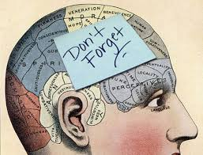
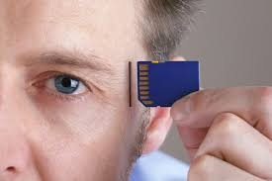
Chapter 6: Memory
WHY STUDY Memory?

Slide 2
How Does Your Memory Work? Video Questions
1. What part of your brain springs to action when your memory “network” is activated?
2. Describe these 3 major functions of memory as described in the video:
Encoding:
Consolidaton:
Retreival
3. What are some tips the video gives for improving your memory

Slide 3
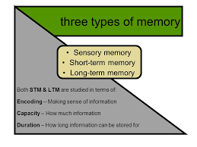

Chapter 6.1: Memory
What are the three processes of memory and the different models of how memory works?

Slide 4
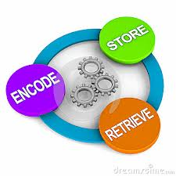
Memory and Its Processes
Memory: an active system that receives information from the senses, organizes and alters it as it stores it away, and then retrieves the information from storage.
There are many “models” of memory, but they all deal with the same three processes:
Processes of Memory:
      Encoding - the set of mental operations that people perform on sensory information to convert that information into a form that is usable in the brain’s storage systems.
      Storage - holding onto information for some period of time.
      Retrieval - getting information that is in storage into a form that can be used.

Slide 5
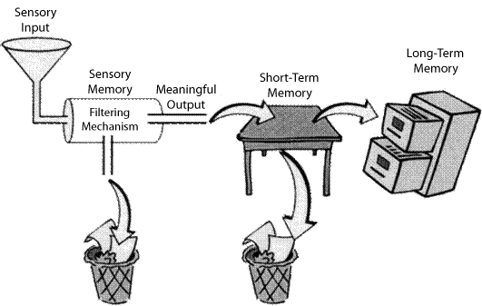
Models of Memory: Information Processing Model
Information-processing model - model of memory that assumes the processing of information for memory storage is similar to the way a computer processes memory in a series of three stages.
This model focuses on the way that information is processed or “handled” through the three different stages of memory.
Information Processing assumes that how long a memory is remembered and/or retained depends on the stage of memory in which it is stored
Often known as the “Computer” or “Flash Drive” theory of memory.

Slide 6
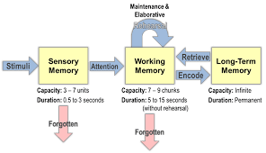
Models of Memory: Information Processing Model

Slide 7
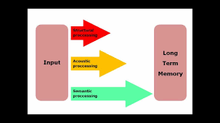
Models of Memory: Levels of Processing Model
Levels-of-processing model - model of memory that assumes information that is more “deeply processed,” or processed according to its meaning rather than just the sound or physical characteristics of the word or words, will be remembered more efficiently and for a longer period of time.
This model suggests that how long a memory will be retained depends of the depth (i/e the effort made to understand the meaning) to which the memory was processed
Example: Asking someone to recall a word that was flashed across a screen vs asking someone how to use the same word in a sentence

Slide 8
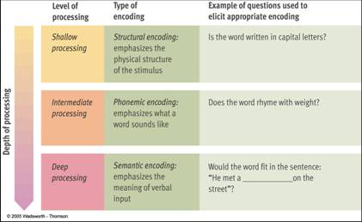
Memory Models: Levels of Processing Model

Slide 9
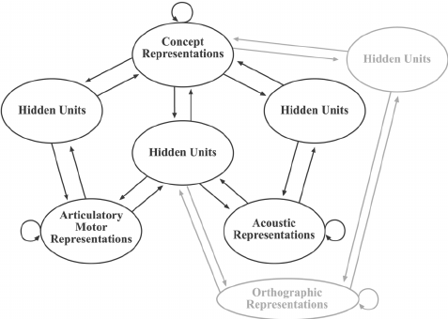
Models of Memory: Parallel Distributed Processing (PDP) Model
Parallel distributed processing (PDP) model - a model of memory in which memory processes are proposed to take place at the same time over a large network of neural connections
Supporters of this model base their viewpoint on the way neural processing actually takes place in the brain.
In this model, instead of processing information in a simple series of steps, it suggests that the brain performs several processes all at the same time, spreading the information across an entire neural network.
The PDP model is the model used from constructing artificial intelligence

Slide 10
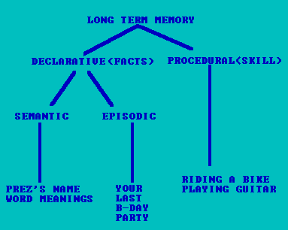
Memory Models: Parallel Distributed Processing Model

Slide 11
Brain Games: Memory
We are going to be watching an episode of the popular show Brain Games that deals with the concept of “Memory” in the simplest terms. Your job is to use the information from your notes as well as the show to answer the following questions/
1) According to Brain Games, how does memory work?
2) Why do we have memory?
3) Describe one experiment or game that was used in the show and explain what concept of memory the game/ experiment was used to illustrate.
4) Based on this episode, which of the 3 memory models do you feel is the most realistic? Explain

Slide 12
Homework
Chapter 6-3 Notes (Sensory Memory) Quiz Next Class
  Hint: Make sure you understand the difference between Iconic and Echoic Sensory Memory
Ace Vocab 6-1 – 6-3
Begin working on Memory Map Project due January 27th

Slide 13

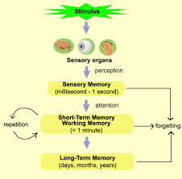
Chapter 6.2: Sensory Memory
How does sensory memory work?

Slide 14
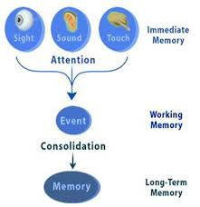
Sensory Memory
Sensory memory - the very first stage of memory, the point at which information enters the nervous system through the sensory systems.
Information is encoded into sensory memory as neural messages are traveling through the system.
There are two types of sensory memory that have been studied extensively: Iconic (Visual) and Echoic (Hearing)

Slide 15
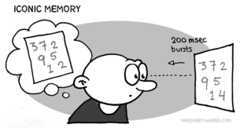
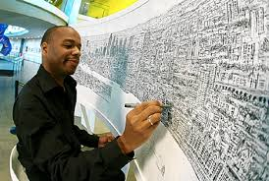
Iconic Sensory Memory
Iconic memory - visual sensory memory, lasting only a fraction of a second.
    Capacity – everything that can be seen at one time.
    Duration - information that has just entered iconic memory will be pushed out very quickly by new information, a process called masking.
    Eidetic imagery - the rare ability to access a visual memory for 30 seconds or more. (Sometimes called a photographic memory)
    Function – Helps the visual system to view its surroundings as continuous and stable and allows time for the brain stem to decide if information is important enough to be brought into consciousness.

Slide 16
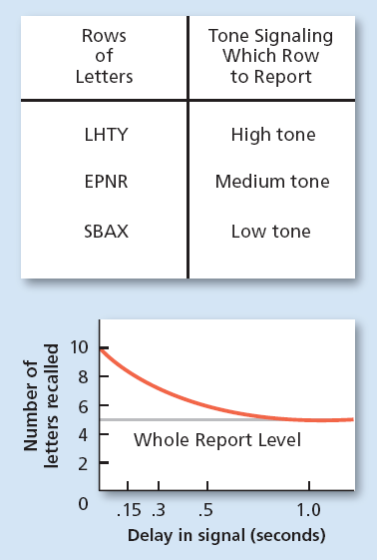
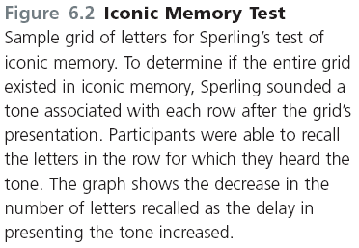

Slide 17
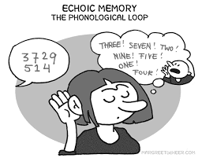

Echoic Sensory Memory
  Echoic memory - the brief memory of something a person has just heard.
    Capacity - limited to what can be heard at any one moment and is smaller than the capacity of iconic memory
    Duration – lasts longer that iconic — about 2 to 4 seconds
    Function --- Allows people to remember words and convert them into meaning and hold onto auditory information long enough for lower brain centers to decide if the information is important enough to become conscious

Slide 18
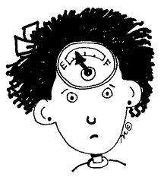
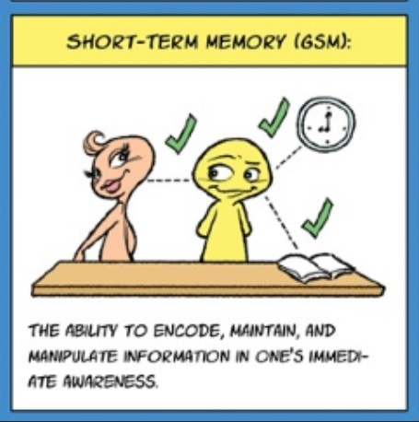
Chapter 6.3: Short Term and Working Memory
What is short term memory, and how does it differ from working memory?

Slide 19
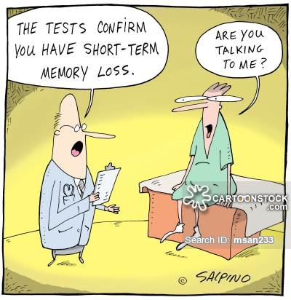

Short Term Memory
Short-term memory (STM) (working memory) - the memory system in which information is held for brief periods of time while being used.
Working Memory: An active system that processes the information in short term memory.
  Selective attention – the ability to focus on only one stimulus from among all sensory input.
  Example: A mother of a new baby can sleep through a passing train but immediately awakens at the sound of her baby crying (even if the train is much louder)
  Divided attention: When focus is divided or split between multiple tasks. Negatively affects memory.
  Example: Listening to music while trying to memorize lines for a play
It is easier to form memories around things we have selective attention focus on

Slide 20
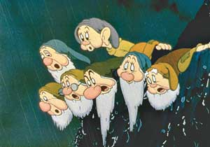

Short Term Memory
Digit-span test – memory test in which a series of numbers is read to subjects in the experiment who are then asked to recall the numbers in order.
  Conclusions are that the capacity of STM is about seven items or pieces of information, plus or minus two items, or from five to nine bits of information.
      “magical number” = 7
Chunking – bits of information are combined into meaningful units, or chunks, so that more information can be held in
Short term memory lasts from about 12-30 seconds without rehearsal
Maintenance Rehearsal: Practice of saying some information to be remembered over and over in one’s head in order to maintain it in short term memory.

Slide 21
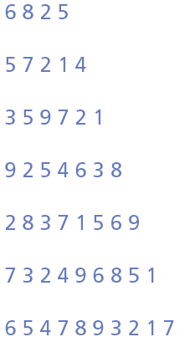
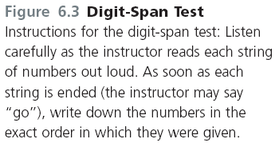
Example: Digit Span Test

Slide 22
Example: Chunking

Slide 23
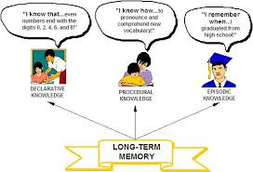
Chapter 6.4: Long Term Memory
How is long-term memory different from other types of memory?

Slide 24
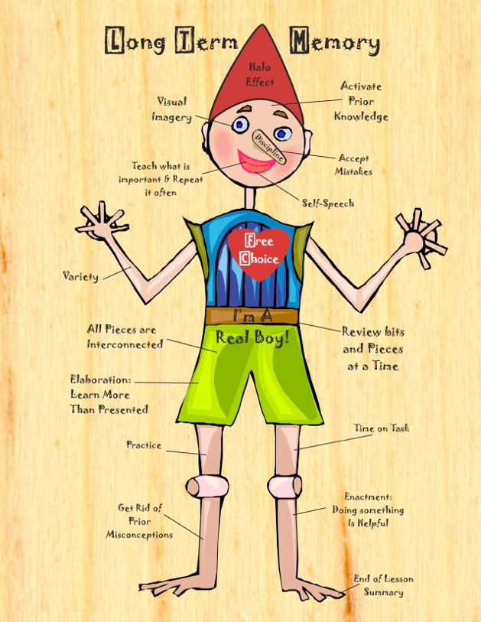
Long Term Memory
Long-term memory (LTM) - the system of memory into which all the information is placed to be kept more or less permanently.
LTM seems to be unlimited and forms permanent physical changes in the brain.
While LTM memories are always available, they are not always accessible (retrieval!).
LTM includes not only “Visual” memories, but sounds, smells and tastes and also combinations of these memories
  LTM is like your brain’s filing cabinet. You store things in it that you may or may not need and retrieve from it “When needed”
Elaborative Rehearsal: a method of transferring information from STM into LTM by making that information meaningful in some way

Slide 25
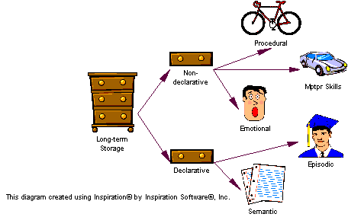
Chapter 6.5: Types of Long-Term Information
What are the various types of Long-term memory, and how is information stored in long-term memory organized?

Slide 26
Types of Long-Term Information
Long term information can be sorted into 2 categories:
  Procedural Memory (Non-declarative): Involving series of steps or procedures
  Declarative Memory: Facts that can be stated outright

Slide 27
Procedural (Nondeclarative) LTM
Procedural (Nondeclarative) Memory: A type of long term memory including memory for skills, procedures, habits and conditioned responses. These memories are not conscious, but are implied to exist because they affect conscious behavior.
  Procedural memories also include emotionally associated memories
  Example: Tying your shoes, Riding a Bike, Driving a car are all procedural memories
Anterograde Amnesia: Loss of memory from the point of injury or trauma forward, or the inability to form new long-term message.
  Famous case study H.M suffered from anterograde amnesia
Implicit Memory: Memory that is not easiey broght into conscious awareness. Memory that is IMPLIED (i.e. tying shoes , fear of dogs, etc….)

Slide 28
Declarative LTM
Declarative Memory: Type of long term memory containing information that is conscious and known. These are the facts and information that we learn, rather than the skills we learn
  Example: Information that you learn such as, how many planets are in the solar system, addition, grammar rules.
  Example: Things that have happened personally such as what you ate for breakfast, something you saw on your way to school

Slide 29
Types of Declarative LTM
1. Semantic Memory: Type of declarative memory containing general knowledge such as knowledge of language and information learned in formal education
  Example: Word meanings, math skills, names for objects, “Trivia” or “Game Show” knowledge
2. Episodic Memory: Type of declarative memory containing personal information not readily available to others such as daily information and events
  Example: Recent things in your life (what you ate for breakfast or saw on your way to school), Meaningful events in your life (first date, first day of school, wedding day)
  These memories are not always completely accurate
Semantic and Episodic Memories are both forms of Explicit Memory: Memory that is consciously known, such as declarative memory

Slide 30
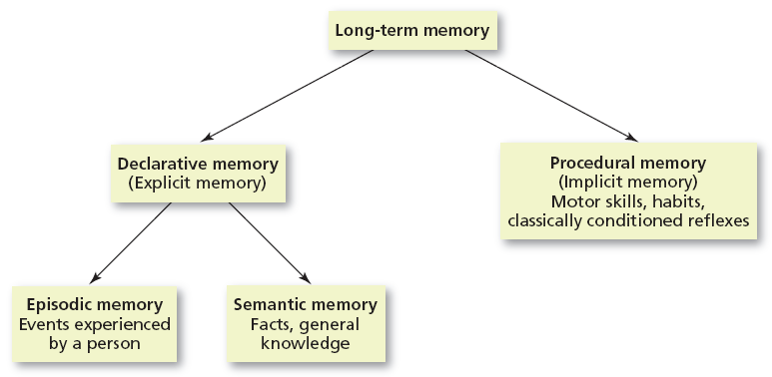
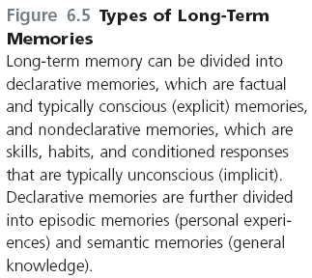

Slide 31
Organization of Long Term Memory
LTM needs to be well organized in order for memory retrieval to be so fast.
Research (Collins & Loftus 1975) suggests that LTM is organized according to related meanings and concepts.
This models is known as The Semantic Network Model: Model of memory organization that assumes information is storied in the brain in a connected fashion, with concepts that are related stored physically closer to each other than concepts that are not highly related

Slide 32
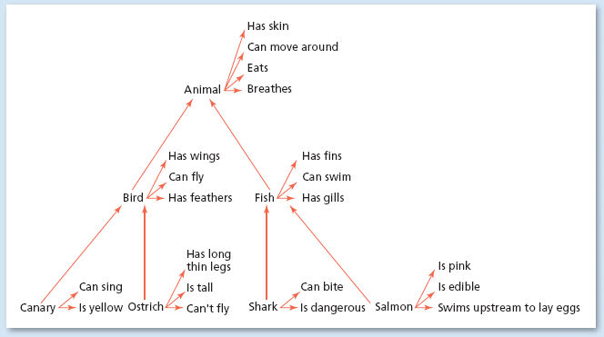
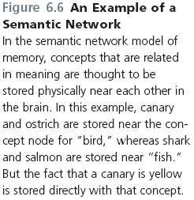
An Example of a Semantic Network

Slide 33
Chapter 6.6: Retrieval of Long-Term Memories
What kinds of cues help people remember?

Slide 34
Retrieval Cues
A retrieval cue is a stimulus for remembering
  The more cues stored with a piece of information the easier the retrieval of that information will be
  Some memories are easily remembered, while others are much harder to bring up. For example, if you draw a blank on a test, it may be a result of the wording on the test not being the same as the wording you used while studying
  Example: A song you hear reminds you of a specific moment (First Dance, a date, Senior Prom). The song acts as a retrieval cue for the event

Slide 35
Encoding Specificity and State Dependent Learning
Encoding specificity - the tendency for memory of information to be improved if related information (such as surroundings or physiological state) available when the memory is first formed is also available when the memory is being retrieved.
  Example: Take a test in a classroom different from the one where the material was learned and normally your performance will be slightly worse.
State Dependent Learning: Memories formed in a specific psychological or physiological state will be easier to remember while in a similar state
  Example: When you are fighting with someone it is easier to remember all the bad things that person has done rather than the good things
  Example: Listening to happy music while studying psychology can put you in a good mood everytime you study for psychology.

Slide 36
Chapter 6.7: Recall (Hmm…Let Me Think)
How do the retrieval processes of recall and recognition differ, and how reliable are our memories of events?

Slide 37
Recall vs Recognition
Recall: Type of memory retrieval in which the information to be retrieved must be “pulled” from memory with very few external cues.
  Example: Filling in the blanks on an application form, taking an essay test
Recognition: The ability to match a piece of information or a stimulus to a stored image or fact
  Example: Completing a word search or fill in the blank puzzle, taking a multiple choice test

Slide 38
Issues with Recall
Retrieval Failure: Known as the “Tip of your Tongue” phenomenon. When you can recall names or letters associated with the word/concept but not the word/concept itself
  Best way to overcome TOT phenomena is to “forget about it” and allow the word to surface naturally or through retrieval cues
Serial Position Effect: Tendency of information at the beginning and end of a body of information be remembered more accurately than information in the middle of the body of information
  Primacy Effect: Tendency to remember things at the beginning of a body of information better than the information that follows
  Recency Effect: Tendency to remember things at the end of a body of information better than the information at the beginning of it.

Slide 39
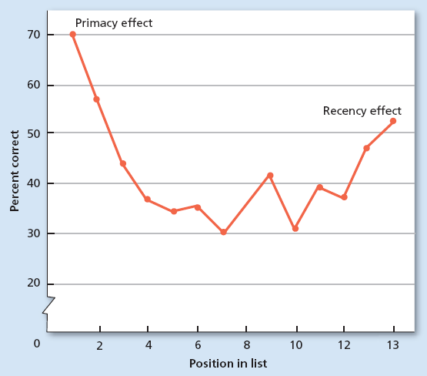
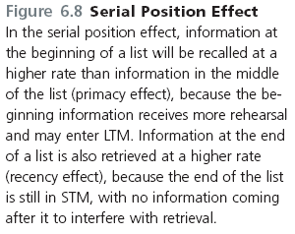
Serial Position Effect

Slide 40
Issues with Recognition
Recognition is generally easier and more accurate than recall, however it is not without issues
False Positives: Error of recognition in which people think that they recognize some stimulus that is not actually in negative.
  Can be especially dangerous and damaging when dealing with criminal justice (lineups, eyewitness statements)

Slide 41
Automatic Encoding and Flashbulb Memories
While some memories need extensive maintenance and rehearsal (Think: Studying for your AP Psychology test), other LTM seem to enter permanent storage with little to no effort at all. This is known as Automatic Encoding.
Flashbulb Memories: Type of automatic encoding that occurs because of an unexpected event has strong emotional associations for the person remembering it.
  Example: People can remember exactly where they were during traumatic national events (9/11, JFK Assassination) or even major emotional events (wedding, first date, embarrassing event)
  These memories are generally more vivid because they are enhanced by emotions and hormones

Slide 42
Chapter 6.8: Constructive Processing of Memories
How are long-term memories formed, and what kinds of problems do people experience as a result?

Slide 43
How LTM’s Are Formed
While people often describe their memories as an “instant replay” of an event, more often, our memories are a blend of knowledge and inference.
Constructive Processing: Referring to the retrieval of memories in which those memories are altered, revised or influenced by newer information
  This view describes memories as being “built” from the pieces stored away in our LTM.
  Each time a memory is retrieved, it may be altered or revised in some way to include new information or details that were there at encoding but left out at retrieval.
Hindsight Bias: The Tendency to falsely believe, through revision of older memories to include newer information, that one could have correctly predicted the outcome of an event

Slide 44
Memory Retrieval Problems: The Misinformation Effect
Misinformation Effect: The tendency of misleading information presented after an event to alter the memories of the event itself.
  This problem is the reason that police investigators try to keep eye witnesses to crimes or accidents from talking with each other.

Slide 45
Chapter 6.9: Reliability of Memory Retrieval
What is false memory syndrome?

Slide 46
False Memory Syndrome
If memory is edited and changed when people are in a state of waking consciousness, how much more might memory be changed when in an altered state of consciousness?
False memory syndrome - the creation of inaccurate or false memories through the suggestion of others, often while the person is under hypnosis.
  Evidence suggests that false memories cannot be created for just any kind of memory.
  The memories must at least be plausible

Slide 47
Chapter 6.10: Forgetting
Why do we forget?

Slide 48
Ebbinghaus and the Forgetting Curve
Hermann Ebbinghaus was one of the first researchers to study forgetting in 1913
He used a list of “nonsense syllables” (GEX, WOL, CHA) and memorized the list, waiting for a specific period of time and then tried to retrieve the list, making a graph of the results each time.
Curve of Forgetting: a graph showing a distinct pattern in which forgetting is very fast within the first hour after learning a list and then tapers off gradually.
  The graph shows that forgetting happens quickly (within the first hour after learning) and tapers off gradually
  Meaningful material is forgotten more slowly and less completely than the standard curve.

Slide 49
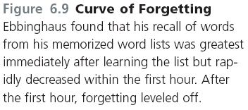
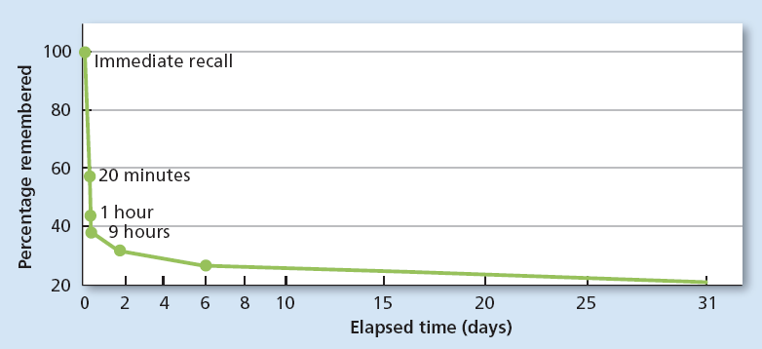

Slide 50
Distributed Practice
Ebbinghaus also discovered that “cramming” information was not an effective strategy for remembereing.
Distributed Practice: Spacing the study of material to be remembered by including breaks between study periods
  Example: Studying psychology for 30 minutes to an hour and taking several breaks over several hours in preparation for a test.
Massed Practice: The attempt to study a body of material all at once
  Example: Studying psychology for 3 hours right before the test

Slide 51
Encoding Failure
One of the common reasons people forget things, is that they never were properly encoded in the first place.
Encoding Failure: Failure to process information into memory.
  Example: Your mom says something as you are walking out of the door, you heard her but you weren’t paying attention to what she said. In this case the content never gets past sensory memory.

Slide 52
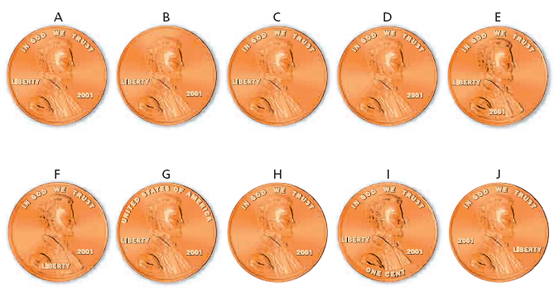
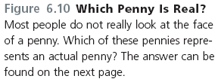
Encoding Failure: Which is the correct penny?

Slide 53
Forgetting: Memory Trace Decay Theory
Memory Trace: Physical change in the brain that occurs when a memory is formed.
  Decay: Loss of memory due to the passage of time, during which the memory trace is not used
    Decay is used to explain forgetting in sensory and short term memory
  Disuse: Another name for decay, assuming that memories that are not used will eventually decay and disappear. “Use it or lose it”
    Disuse is used to explain forgetting in LTM

Slide 54
Forgetting: Interference Theory
Another explanation of forgetting LTM is that memories not always be accessible to attempted retrieval because other information interferes with it. There are 2 different types of interference in LTM.
Proactive Interference: Memory retrieval problem that occurs when older information prevents or interferes with the retrieval of newer information.
  Example: When you switch from a sport you’ve been playing for years to a newer sport (soccer to field hockey) and have trouble picking up new skills or breaking old habits.
Retroactive Interference: Memory retrieval problem that occurs when newer information prevents or interferes with the retrieval of older information
  Example: Switching back from field hockey to soccer and having trouble recalling old soccer skills in favor of newly acquired field hockey skills.

