Slide 1
Do Now: FRQ Practice (Learning)
1. Renee is interested in trying out for the soccer team. Explain how each of the following learning concepts could positively or negatively influence Renee’s participation in tryouts for the team.
Term | Definition | Positive/Negative | Explanation
Positive Reinforcement
Negative Reinforcement
Observational Learning
Classical Conditioning

Slide 2
Video Questions: How does Memory Work?
1. What is your “memory network”?
2. Draw and label a picture of how memory works, based on the information provided in the video.

Slide 3
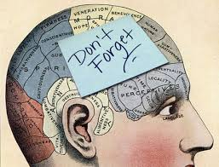
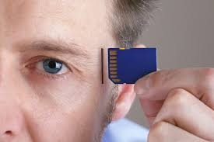
Chapter 6: Memory
WHY STUDY Memory?

Slide 4
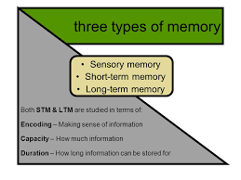

Chapter 6.1: Memory
What are the three processes of memory and the different models of how memory works?

Slide 5
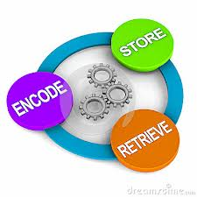
Memory and Its Processes
Memory: an active system that receives information from the senses, organizes and alters it as it stores it away, and then retrieves the information from storage.
There are many “models” of memory, but they all deal with the same three processes:
Processes of Memory:
      Encoding - the set of mental operations that people perform on sensory information to convert that information into a form that is usable in the brain’s storage systems.
      Storage - holding onto information for some period of time.
      Retrieval - getting information that is in storage into a form that can be used.

Slide 6
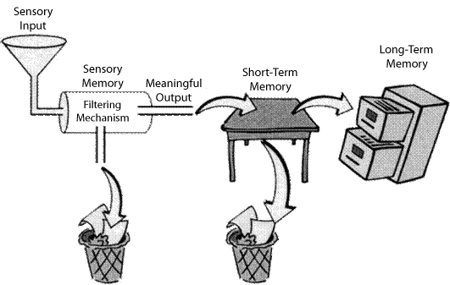
Models of Memory: Information Processing Model
Information-processing model - model of memory that assumes the processing of information for memory storage is similar to the way a computer processes memory in a series of three stages.
  This model focuses on the way that information is processed or “handled” through the three different stages of memory.
  Information Processing assumes that how long a memory is remembered and/or retained depends on the stage of memory in which it is stored
  Often known as the “Computer” or “Flash Drive” theory of memory.

Slide 7
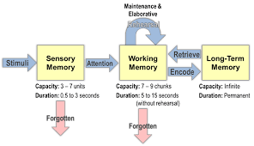
Models of Memory: Information Processing Model

Slide 8
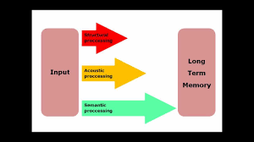
Models of Memory: Levels of Processing Model
Levels-of-processing model - model of memory that assumes information that is more “deeply processed,” or processed according to its meaning rather than just the sound or physical characteristics of the word or words, will be remembered more efficiently and for a longer period of time.
  This model suggests that how long a memory will be retained depends of the depth (i/e the effort made to understand the meaning) to which the memory was processed
  Example: Asking someone to recall a word that was flashed across a screen vs asking someone how to use the same word in a sentence

Slide 9
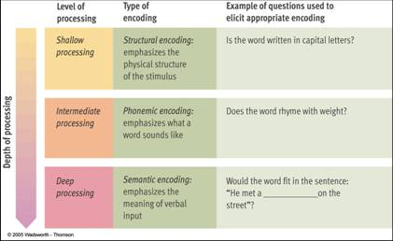
Memory Models: Levels of Processing Model

Slide 10
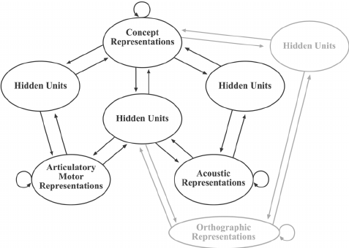
Models of Memory: Parallel Distributed Processing (PDP) Model
Parallel distributed processing (PDP) model - a model of memory in which memory processes are proposed to take place at the same time over a large network of neural connections
  Supporters of this model base their viewpoint on the way neural processing actually takes place in the brain.
  In this model, instead of processing information in a simple series of steps, it suggests that the brain performs several processes all at the same time, spreading the information across an entire neural network.
  The PDP model is the model used from constructing artificial intelligence

Slide 11
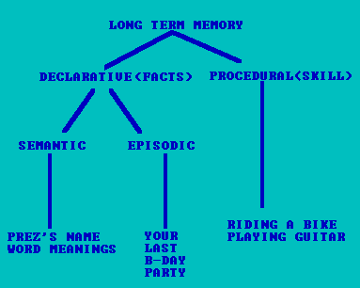
Memory Models: Parallel Distributed Processing Model

Slide 12
Brain Games: Memory Episode Questions
1. How does the episode explain how memory works?
2. Why do we have a memory?
3. Describe one of the “Brain Games” used to test or explain memory.
4. How does forgetting work? Why do we forget things?

Slide 13

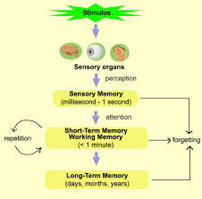
Chapter 6.2: Sensory Memory
How does sensory memory work?

Slide 14
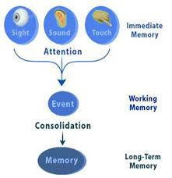
Sensory Memory
Sensory memory - the very first stage of memory, the point at which information enters the nervous system through the sensory systems.
Information is encoded into sensory memory as neural messages are traveling through the system.
There are two types of sensory memory that have been studied extensively: Iconic (Visual) and Echoic (Hearing)

Slide 15
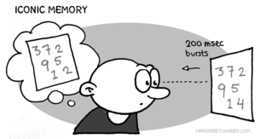
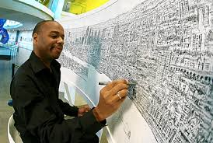
Iconic Sensory Memory
Iconic memory - visual sensory memory, lasting only a fraction of a second.
    Capacity – everything that can be seen at one time.
    Duration - information that has just entered iconic memory will be pushed out very quickly by new information, a process called masking.
    Eidetic imagery - the rare ability to access a visual memory for 30 seconds or more. (Sometimes called a photographic memory)
    Function – Helps the visual system to view its surroundings as continuous and stable and allows time for the brain stem to decide if information is important enough to be brought into consciousness.

Slide 16
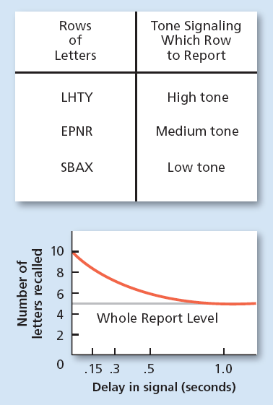
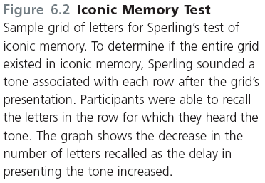

Slide 17
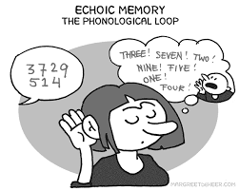

Echoic Sensory Memory
  Echoic memory - the brief memory of something a person has just heard.
    Capacity - limited to what can be heard at any one moment and is smaller than the capacity of iconic memory
    Duration – lasts longer that iconic — about 2 to 4 seconds
    Function --- Allows people to remember words and convert them into meaning and hold onto auditory information long enough for lower brain centers to decide if the information is important enough to become conscious

Slide 18
Do Now: Memory Processing
1) What are the 3 Processes of Memory? Provide a brief definition/example of each
2) Fill in the following chart to complete the components of the “Information Processing Model of Memory”
_____________ Memory
Encoding:
Storage( How long?):
Retrieval:
_____________ Memory
Encoding:
Storage( How long?):
Retrieval:
_____________ Memory
Encoding:
Storage( How long?):
Retrieval:

Slide 19
Video Questions: 10 Things You Didn’t Know About Human Memory
While the video outlines this Top 10 list, create a list in your notebook with a brief summary of each fact. Circle the one that surprised you the most

Slide 20
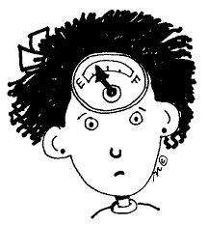
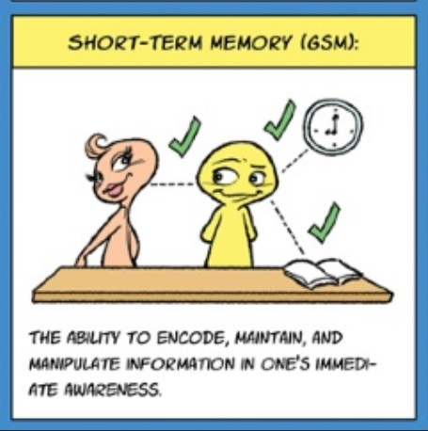
Chapter 6.3: Short Term and Working Memory
What is short term memory, and how does it differ from working memory?

Slide 21
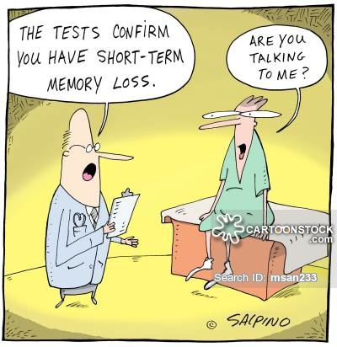
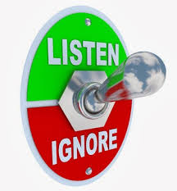
Short Term Memory
Short-term memory (STM) (working memory) - the memory system in which information is held for brief periods of time while being used.
Working Memory: An active system that processes the information in short term memory.
  Selective attention – the ability to focus on only one stimulus from among all sensory input.
  Example: A mother of a new baby can sleep through a passing train but immediately awakens at the sound of her baby crying (even if the train is much louder)
  Divided attention: When focus is divided or split between multiple tasks. Negatively affects memory.
  Example: Listening to music while trying to memorize lines for a play
It is easier to form memories around things we have selective attention focus on

Slide 22
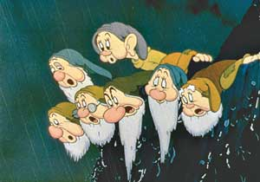

Short Term Memory
Digit-span test – memory test in which a series of numbers is read to subjects in the experiment who are then asked to recall the numbers in order.
  Conclusions are that the capacity of STM is about seven items or pieces of information, plus or minus two items, or from five to nine bits of information.
      “magical number” = 7
Chunking – bits of information are combined into meaningful units, or chunks, so that more information can be held in
Short term memory lasts from about 12-30 seconds without rehearsal
Maintenance Rehearsal: Practice of saying some information to be remembered over and over in one’s head in order to maintain it in short term memory.

Slide 23
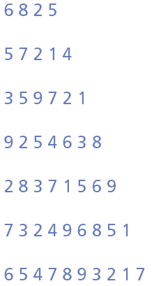
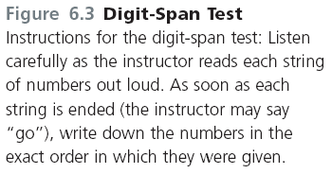
Example: Digit Span Test

Slide 24
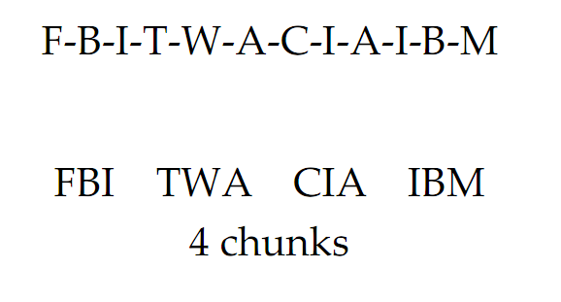
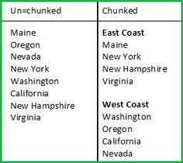
Example: Chunking

Slide 25
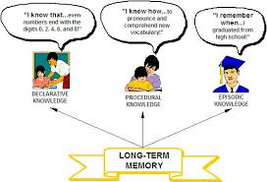
Chapter 6.4: Long Term Memory
How is long-term memory different from other types of memory?

Slide 26
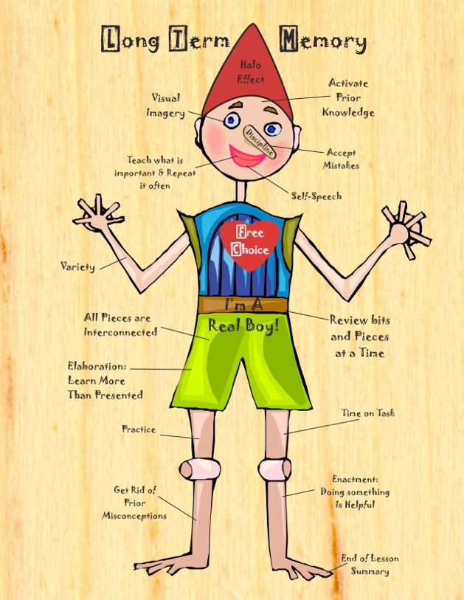
Long Term Memory
Long-term memory (LTM) - the system of memory into which all the information is placed to be kept more or less permanently.
LTM seems to be unlimited and forms permanent physical changes in the brain.
While LTM memories are always available, they are not always accessible (retrieval!).
LTM includes not only “Visual” memories, but sounds, smells and tastes and also combinations of these memories
  LTM is like your brain’s filing cabinet. You store things in it that you may or may not need and retrieve from it “When needed”
Elaborative Rehearsal: a method of transferring information from STM into LTM by making that information meaningful in some way

Slide 27
In Class Experiment:
Sensory Memory LTM and STM Lab
1. You will be completing the following lab in pairs/groups of 2. Select one person to be the “experimenter” and another to be the subject or “experimentee”
2. The experimentee will be blindfolded throughout the experiment and must be blindfolded before the teacher can hand out the components needed for each group.
3. The experiment does deal with food, so be sure to question your experimentee if they have any significant allergies from either tasting or touching certain foods.
4. Please keep the master sheet face down on the desk until you are told to begin

Slide 28
Once Blindfolded:
1. Experimenters must come to the front of class and take 2-4 foods as listed for their partner to try. You must also grab a card from the desk.
2. If your card is RED=Your partner is allowed to touch AND taste the objects in the experiment. If your card is BLACK=Your partner is only allowed to touch each item
3. Read the master handout CAREFULLY and be sure to strictly follow the instructions

Slide 29
Lab Reflection Questions
Once your lab is complete you and your partner may work together to complete the reflection questions in your notebooks:
1. 1. Blindfolded partner, how many associations did you make with the item and the new word that it was called?
2. Give some examples of associations that you made so that you could remember and recall the “new” item.
3. Was it harder for you to make associations if you were only allowed to touch the items compared to someone who was allowed to touch and taste the items/Was it harder for you to make associations if you were allowed to touch and taste the items? Explain your answer.
4. What is the model of memory that requires you to make deeper associations or understanding to move memories of from STM to LTM,
5. What is the method of transferring information from STM into LTM by making information meaningful in some way?
6. Does making more associations to remember apply to STM or LTM or both? Explain your answer.

Slide 30
Homework
Finish Lab Reflection Questions
Chapter 6-5 Notes Types of Long Term Information (Quiz next class)
ACE Vocab 6-3- 6-5
Memory Map due Friday (B) or Monday (A)

Slide 31
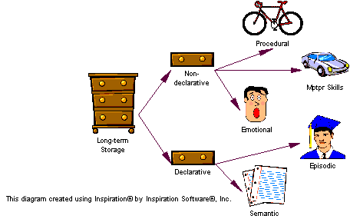
Chapter 6.5: Types of Long-Term Information
What are the various types of Long-term memory, and how is information stored in long-term memory organized?

Slide 32


Types of Long-Term Information
Long term information can be sorted into 2 categories:
  Procedural Memory (Non-declarative): Involving series of steps or procedures
  Declarative Memory: Facts that can be stated outright

Slide 33

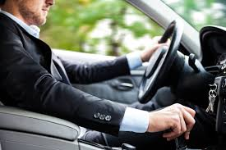
Procedural (Nondeclarative) LTM
Procedural (Nondeclarative) Memory: A type of long term memory including memory for skills, procedures, habits and conditioned responses. These memories are not conscious, but are implied to exist because they affect conscious behavior.
  Procedural memories also include emotionally associated memories
  Example: Tying your shoes, Riding a Bike, Driving a car are all procedural memories
Anterograde Amnesia: Loss of memory from the point of injury or trauma forward, or the inability to form new long-term message.
  Famous case study H.M suffered from anterograde amnesia
Implicit Memory: Memory that is not easily brought into conscious awareness. Memory that is IMPLIED (i.e. tying shoes , fear of dogs, etc….)

Slide 34
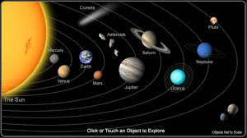
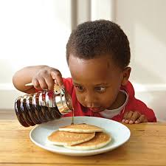
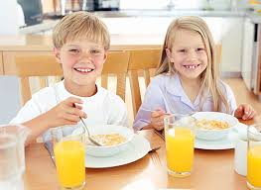
Declarative LTM
Declarative Memory: Type of long term memory containing information that is conscious and known. These are the facts and information that we learn, rather than the skills we learn
  Example: Information that you learn such as, how many planets are in the solar system, addition, grammar rules.
  Example: Things that have happened personally such as what you ate for breakfast, something you saw on your way to school

Slide 35

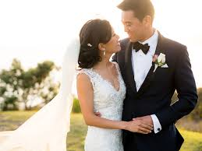
Types of Declarative LTM
1. Semantic Memory: Type of declarative memory containing general knowledge such as knowledge of language and information learned in formal education
  Example: Word meanings, math skills, names for objects, “Trivia” or “Game Show” knowledge
2. Episodic Memory: Type of declarative memory containing personal information not readily available to others such as daily information and events
  Example: Recent things in your life (what you ate for breakfast or saw on your way to school), Meaningful events in your life (first date, first day of school, wedding day)
  These memories are not always completely accurate
Semantic and Episodic Memories are both forms of Explicit Memory: Memory that is consciously known, such as declarative memory

Slide 36
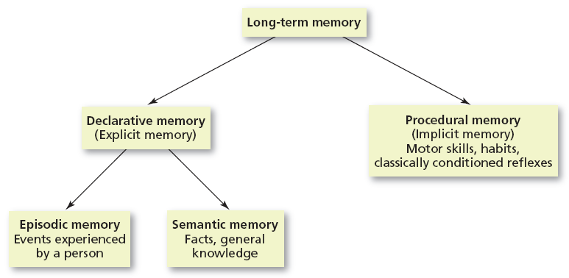
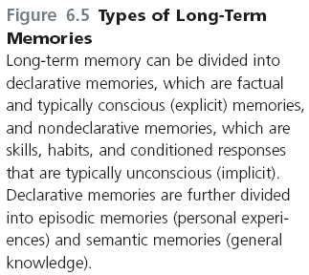

Slide 37
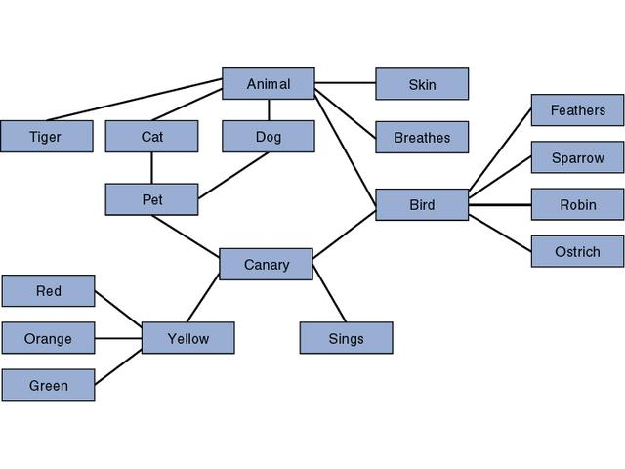
Organization of Long Term Memory
LTM needs to be well organized in order for memory retrieval to be so fast.
Research (Collins & Loftus 1975) suggests that LTM is organized according to related meanings and concepts.
This models is known as The Semantic Network Model: Model of memory organization that assumes information is storied in the brain in a connected fashion, with concepts that are related stored physically closer to each other than concepts that are not highly related

Slide 38
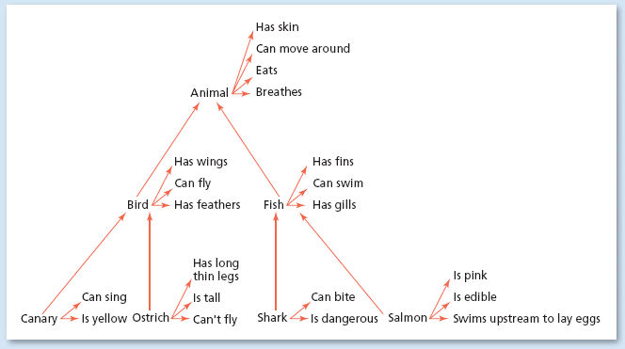
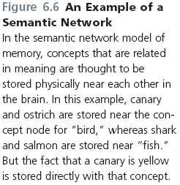
An Example of a Semantic Network

Slide 39
Do Now: Provide an Example of each type of memory
Long Term Memories
Procedural
Declarative
Example of a Procedural Memory
Example of an Episodic Memory
Example of a Semantic Memory

Slide 40
Ted Talk Question: Feats of Memory Anyone Can Do
1. What are some of the feats of memory performed at the United States memory championship?
2. Joshua Foer explains that humans have throughout history used technology to “externalize” their memories. What does this mean? Why is it important?
3. What is “Elaborative encoding”? How does it work?
4. Describe the Baker/baker paradox and how it relates to memory.
5. Are “Great Memories” genetic or are they learned? Explain….
6. How can you use the information and tricks from this TED talk in your real life? Do you believe his arguments about memory? Why or why not…explain.

Slide 41


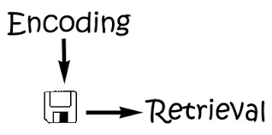
Chapter 6.6: Retrieval of Long-Term Memories
What kinds of cues help people remember?

Slide 42


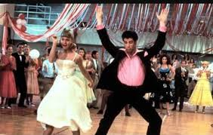
Retrieval Cues
A retrieval cue is a stimulus for remembering
  The more cues stored with a piece of information the easier the retrieval of that information will be
  Some memories are easily remembered, while others are much harder to bring up. For example, if you draw a blank on a test, it may be a result of the wording on the test not being the same as the wording you used while studying
  Example: A song you hear reminds you of a specific moment (First Dance, a date, Senior Prom). The song acts as a retrieval cue for the event

Slide 43

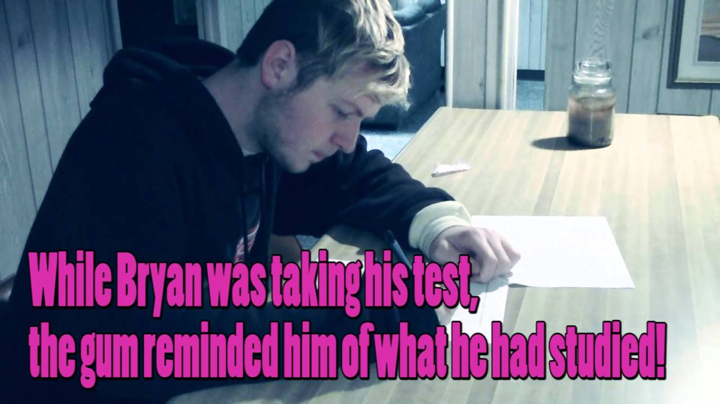
Encoding Specificity and State Dependent Learning
Encoding specificity - the tendency for memory of information to be improved if related information (such as surroundings or physiological state) available when the memory is first formed is also available when the memory is being retrieved.
  Example: Take a test in a classroom different from the one where the material was learned and normally your performance will be slightly worse.
State Dependent Learning: Memories formed in a specific psychological or physiological state will be easier to remember while in a similar state
  Example: When you are fighting with someone it is easier to remember all the bad things that person has done rather than the good things
  Example: Listening to happy music while studying psychology can put you in a good mood everytime you study for psychology.

Slide 44
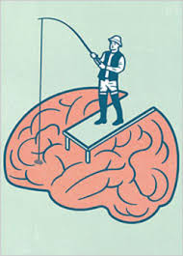


Chapter 6.7: Recall (Hmm…Let Me Think)
How do the retrieval processes of recall and recognition differ, and how reliable are our memories of events?

Slide 45
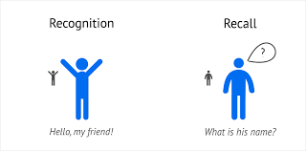

Recall vs Recognition
Recall: Type of memory retrieval in which the information to be retrieved must be “pulled” from memory with very few external cues.
  Example: Filling in the blanks on an application form, taking an essay test
Recognition: The ability to match a piece of information or a stimulus to a stored image or fact
  Example: Completing a word search or fill in the blank puzzle, taking a multiple choice test

Slide 46
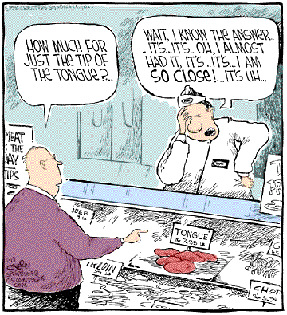
Issues with Recall
Retrieval Failure: Known as the “Tip of your Tongue” phenomenon. When you can recall names or letters associated with the word/concept but not the word/concept itself
  Best way to overcome TOT phenomena is to “forget about it” and allow the word to surface naturally or through retrieval cues
Serial Position Effect: Tendency of information at the beginning and end of a body of information be remembered more accurately than information in the middle of the body of information
  Primacy Effect: Tendency to remember things at the beginning of a body of information better than the information that follows
  Recency Effect: Tendency to remember things at the end of a body of information better than the information at the beginning of it.

Slide 47
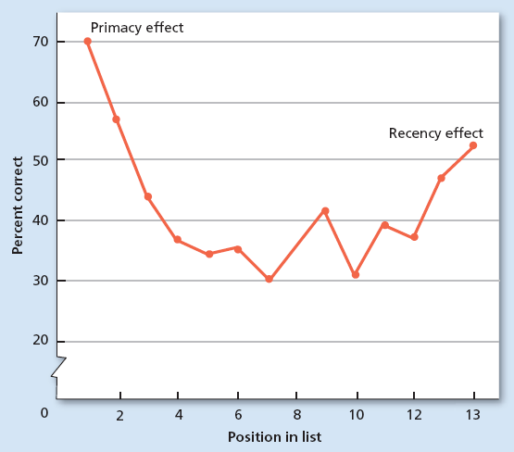
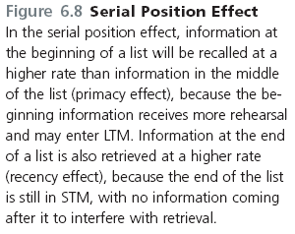
Serial Position Effect

Slide 48
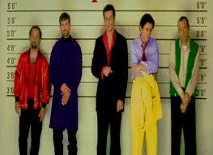
Issues with Recognition
Recognition is generally easier and more accurate than recall, however it is not without issues
False Positives: Error of recognition in which people think that they recognize some stimulus that is not actually in negative.
  Can be especially dangerous and damaging when dealing with criminal justice (lineups, eyewitness statements)

Slide 49
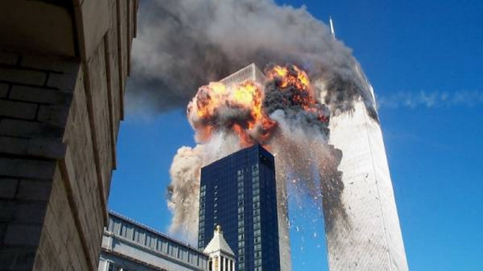
Automatic Encoding and Flashbulb Memories
While some memories need extensive maintenance and rehearsal (Think: Studying for your AP Psychology test), other LTM seem to enter permanent storage with little to no effort at all. This is known as Automatic Encoding.
Flashbulb Memories: Type of automatic encoding that occurs because of an unexpected event has strong emotional associations for the person remembering it.
  Example: People can remember exactly where they were during traumatic national events (9/11, JFK Assassination) or even major emotional events (wedding, first date, embarrassing event)
  These memories are generally more vivid because they are enhanced by emotions and hormones

Slide 50
Practicing Recall and Recognition: Celebrity Yearbook Photos
To practice the terms Recall and Recognition I am going to show you a series of celebrity yearbook photos. The first will be an exercise in Recall and the second will be in Recognition.
Let’s see which is easier.

Slide 51
The Cuppy Cake Song: FRQ Practice
To help practice your understanding of the memory terms we’ve learned so far, we’re going to listen to an awesome song and then practice applying terms to your own attempt to remember the lyrics of the song.
Listen to the words (DO NOT write them down) and when the song is over try to write as many lyrics as you can remember in the box.

Slide 52
Homework
Finish Cuppycake song worksheet/FRQ practice
Read and take notes on 6.8 (Constructive Processing of Memories) and 6.9 (Reliability of Memory Retrieval)
  Quiz Tuesday !!
Memory maps due Friday (B Day) or Monday (A Day)
Vocab cards 6.6-6.9 (Ch 5 & 6 due February 7th)
Unit Test/Notebook Check February 7th (B Day) and February 6th (A)

Slide 53


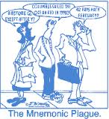
Chapter 6.8: Constructive Processing of Memories
How are long-term memories formed, and what kinds of problems do people experience as a result?

Slide 54

How LTM’s Are Formed
While people often describe their memories as an “instant replay” of an event, more often, our memories are a blend of knowledge and inference.
Constructive Processing: Referring to the retrieval of memories in which those memories are altered, revised or influenced by newer information
  This view describes memories as being “built” from the pieces stored away in our LTM.
  Each time a memory is retrieved, it may be altered or revised in some way to include new information or details that were there at encoding but left out at retrieval.
Hindsight Bias: The Tendency to falsely believe, through revision of older memories to include newer information, that one could have correctly predicted the outcome of an event

Slide 55

Memory Retrieval Problems: The Misinformation Effect
Misinformation Effect: The tendency of misleading information presented after an event to alter the memories of the event itself.
  This problem is the reason that police investigators try to keep eye witnesses to crimes or accidents from talking with each other.

Slide 56

Chapter 6.9: Reliability of Memory Retrieval
What is false memory syndrome?

Slide 57

False Memory Syndrome
If memory is edited and changed when people are in a state of waking consciousness, how much more might memory be changed when in an altered state of consciousness?
False memory syndrome - the creation of inaccurate or false memories through the suggestion of others, often while the person is under hypnosis.
  Evidence suggests that false memories cannot be created for just any kind of memory.
  The memories must at least be plausible

Slide 58
Do Now: Tip of the Tongue Phenomenon
Fables, proverbs, and old sayings are usually expressed in simple words. Can you cut through the verbiage below and write the familiar maxims in third usual simple form, or is it on the tip of your tongue?
1. One red, spherical fruit each twenty-four hours prevents visits from the physician.
  Ex: An apple a day keeps the doctor away
  Refrain from shedding tears regarding the overturning of a liquid dairy product.
  Each fleccy-white, rain bearing formation in the sky possesses an edge of shiny metal.
  Individuals who reside in fragile and transparent structures should never use igneous rocks as projectiles
  The route to a male’s pulmonary muscle is by way of his digestive system
  At the point in time that the feline is absent, the small rodents will engage in sports and diversions.
  Refrain from enumerating your fouls in advance of the time that they emerge from their eggs.

Slide 59
Ted Talks Video Questions: How Reliable is Your Memory?
1. Describe the story Loftus tells about Steve Titus and describe how it relates to the term “Reconstructive Memory”.
2. How many people in the US does Loftus suggest have been convicted based on “false” or “fake” memories?
3. How is our memory like a “Wikipedia Page”?
4. Describe Loftus’s famous memory study involving a car crash.
5. How can providing someone with false or misinformation actually permanently impact their memory?
6. Describe how some types of psychotherapy actually led people to have and create false memories.
7. How do false memories impact people’s lives and behaviors?
8. How can this information be useful and important today? Are there instances where the media, law enforcement, politicians or even schools and communities use “false memories” or reconstructive memory tactics? What can we do moving forward to limit the impact of false memories?

Slide 60
Eyewitness Bank Robbery Experiment
We are going to test the reliability of the eyewitness statement. To do this you are going to watch a bank robbery in action. As if you were an actual witness you are not going to write anything down, just try your hardest to REMEMBER what you saw. When it’s over you’re going to answer some questions about the robbery in your notebook.

Slide 61
Witness Questions
1. How many robbers were there?
2. Describe the robbers in as much detail as possible:
3. Describe the male manager in as much detail as possible:
Hair:
Clothes:
Other:
4. Describe the woman they took hostage in as much detail as possible:
Hair:
Clothes:
Other:
5. Describe the getaway car in as much detail as possible
6. How long did the whole episode take?

Slide 62


Chapter 6.10: Forgetting
Why do we forget?

Slide 63


Ebbinghaus and the Forgetting Curve
Hermann Ebbinghaus was one of the first researchers to study forgetting in 1913
He used a list of “nonsense syllables” (GEX, WOL, CHA) and memorized the list, waiting for a specific period of time and then tried to retrieve the list, making a graph of the results each time.
Curve of Forgetting: a graph showing a distinct pattern in which forgetting is very fast within the first hour after learning a list and then tapers off gradually.
  The graph shows that forgetting happens quickly (within the first hour after learning) and tapers off gradually
  Meaningful material is forgotten more slowly and less completely than the standard curve.

Slide 64



Slide 65

Distributed Practice
Ebbinghaus also discovered that “cramming” information was not an effective strategy for remembereing.
Distributed Practice: Spacing the study of material to be remembered by including breaks between study periods
  Example: Studying psychology for 30 minutes to an hour and taking several breaks over several hours in preparation for a test.
Massed Practice: The attempt to study a body of material all at once
  Example: Studying psychology for 3 hours right before the test

Slide 66

Encoding Failure
One of the common reasons people forget things, is that they never were properly encoded in the first place.
Encoding Failure: Failure to process information into memory.
  Example: Your mom says something as you are walking out of the door, you heard her but you weren’t paying attention to what she said. In this case the content never gets past sensory memory.

Slide 67


Encoding Failure: Which is the correct penny?

Slide 68

Forgetting: Memory Trace Decay Theory
Memory Trace: Physical change in the brain that occurs when a memory is formed.
  Decay: Loss of memory due to the passage of time, during which the memory trace is not used
    Decay is used to explain forgetting in sensory and short term memory
  Disuse: Another name for decay, assuming that memories that are not used will eventually decay and disappear. “Use it or lose it”
    Disuse is used to explain forgetting in LTM

Slide 69


Forgetting: Interference Theory
Another explanation of forgetting LTM is that memories not always be accessible to attempted retrieval because other information interferes with it. There are 2 different types of interference in LTM.
Proactive Interference: Memory retrieval problem that occurs when older information prevents or interferes with the retrieval of newer information.
  Example: When you switch from a sport you’ve been playing for years to a newer sport (soccer to field hockey) and have trouble picking up new skills or breaking old habits.
Retroactive Interference: Memory retrieval problem that occurs when newer information prevents or interferes with the retrieval of older information
  Example: Switching back from field hockey to soccer and having trouble recalling old soccer skills in favor of newly acquired field hockey skills.

Slide 70
Trade & Grade: Cuppycake FRQ Practice
As we prepare for your exam over chapters 5&6 we are going to review the “Cuppycake song” activity answers from last class. Your job this time will be to review the content of the responses by your classmates and evaluate them appropriately. Remember: You are graded on how you grade them, so don’t be nice just because someone is your friend.
Follow the instructions on the sheet provided and look for both a definition AND an application of each concept. Also be sure the term is applied correctly. Also take note of any errors in content, grammar or style

Slide 71
Homework
Take notes 6.11 and 6.12 (No quiz but will be graded and terms will be on unit test next week)
Vocab 6.10-6.12
Study for exam, work on Study Guide (February 6th (A)February 7th (B))

Slide 72
Documentary: Reconstructive Memory and Eyewitnesses Video Questions

