Slide 1



Saint Louis Public School District 2014- 2015 Transformation Plan
Kelvin R. Adams, Ph.D., Superintendent
Jesse Dixon, Office of Academic Services
Leon Fisher, Chief Financial Officer
March 13, 2014

Slide 2
Message
During the past five years, St. Louis Public Schools (SLPS) has laid a foundation for continuous improvement that has led it out of unaccreditation and must be built upon to maintain accreditation under MSIP 5. Now that the foundation has been set, the SY13-14 SLPS Transformation Plan focuses on change at the classroom level.
Furthermore, the fiscal year 2015 budget addresses the District’s responsibility as a Provisionally Accredited District to continue to build financial strength while also operating with a balanced budget.
“Building our Future: One Community, One School, One Child at a Time”

Slide 3
From Compliance to Accreditation
State and Federal Requirements
Title Funding (District Improvement Plan and LEA Plan)
DESE MSIP5 (District Improvement Plan for Accreditation)
Bringing Focus and Results to our Work
How should central office functions change as a result of MSIP 5 and the Accreditation Challenge? Should human and financial resources be allocated differently?
How will schools be supported and held accountable for the actions that will most impact student achievement?
Is there a reasonable number of high leverage, well-connected objectives established for educators?
COMPLIANCE

Slide 4

Provisional Status: “MSIP 4” versus “MSIP 5”
Math 3-5
Communication Arts 3-5
Math 6-8
Communication Arts 6-8
Algebra I
English EOC
Advanced Courses
Career Education Courses
College Placement
Career Education Placement
Graduation Rate
Attendance Rate
ACT Scores
Subgroup Achievement
“Old” Grade book
7 out of 14 standards
“New” Grade book
34.5 out of 140 points

Slide 5
Focusing on Rigorous Instruction
MAP English-Language Arts Performance (All Grades)
Achievement has been flat…
2010
2011
2012
2013
Transition from MSIP 4 to MSIP 5

Slide 6
Engaging Stakeholders
Teacher Feedback
What do you perceive as the biggest barriers to delivering consistently rigorous and engaging instruction?
What supports do you need to be successful?
Principal Feedback
How should the district prioritize its support and accountability to improve the quality of instruction?
How can we implement a plan that will be meaningful and not just feel like “compliance” or “another thing to do”?
Central Office Feedback
Why have previous reform efforts like this fallen short?
Parent and Community Feedback – (3/27 and 3/29)

Slide 7
Organizing Themes
Focus on improving the quality of instruction district-wide
Emphasis on standards-based lesson planning, rigor, and student engagement
Build the capacity of school leadership teams to be data-driven teacher developers
School-based leadership teams as the focus for significant professional development and coaching
Differentiate central office support based on school capacity and student needs and hold both accountable
“Tiered” approach for intensity of professional development, fidelity of implementation, and extra academic and non-academic interventions
Reflect on lessons learned locally and nationally

Slide 8
We know what’s possible in SLPS. . .
Grade 3 Math
Grade 4 Math
Grade 5 Math
Grade 3 ELA
Grade 4 ELA
Grade 5 ELA

Slide 9
We know what’s possible in SLPS. . .
Grade 6 Math
Grade 7 Math
Grade 8 Math
Grade 6 ELA
Grade 7 ELA
Grade 8 ELA

Slide 10
The Challenges. . .
Lesson Plans are not consistently rigorous nor are they consistently followed
Data team and professional learning community meetings are not consistently resulting in teachers changing practice to meet students’ learning needs
There is not a consistent definition of what high-quality rigorous and engaging instruction looks like
School leaders are not consistently giving growth-producing feedback to teachers to help them improve
District leaders are not consistently providing effective support to school leadership teams for improving instruction
Educators have not successfully and consistently engaged families as partners in their students’ learning

Slide 11
Transformation Plan Strategies
Objective 1: Rigorous standards and monitoring student progress
a. Common reading and math instruction blocks (Elementary)
b. Extra supports for at risk 6th-10th graders (Secondary)
Objective 2: Using data to improve instruction and decision-making
c. District and school data teams use common inquiry cycle/protocol
d. Accountability systems to ensure data team decisions are implemented and monitored for impact
Objective 3: Expand capacity to develop, deliver, and supervise instruction
e. Identify a consistent understanding of what effective instruction looks like with a focus on rigor and engagement
f. Provide consistent and constructive feedback through coaching/evaluation
Objective 4: Shared vision of SLPS embraced by community and stakeholders
g. Welcoming environment for parents and community
h. Community understanding of district vision and strategies
Objective 5: Ensure all SLPS preschool children are prepared for Kindergarten
g. Aligned curriculum specific to MO Early Learning standards
h. Job-embedded professional development and coaching to all PreK teachers

Slide 12
Vision for the Plan
LEADER
TEACHER
Observing, modeling, and providing growth-producing feedback
Delivering rigorous and engaging instruction
Support and
Accountability
Support and
Accountability
Facilitate
Data Teams and building
teacher
capacity
Classroom
Using data to improve instruction
Central Office
Building
Creating the Conditions for these Practices to be Implemented Consistently and Effectively across all Schools

Slide 13
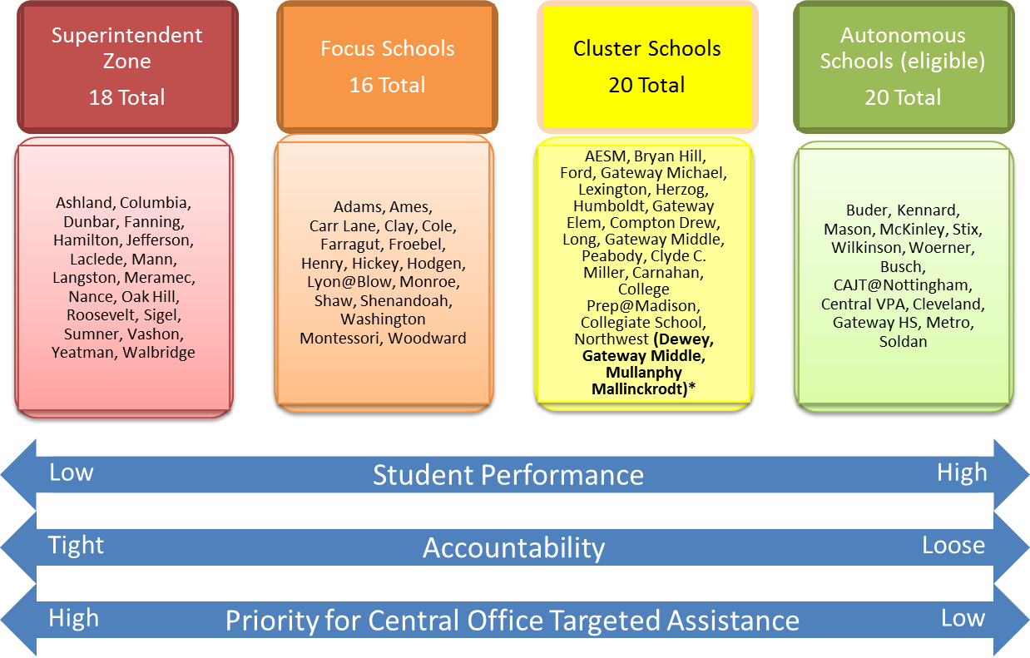
Tiered Approach to Implementation
* Academically qualified to be Autonomous

Slide 14
Differentiating Support/Accountability
Enrollment (2013-14) | % FRPL (2012-13) | ELA MPI (2012-13) | Math MPI (2012-13) | Support | Accountability for SLPS Transformation Plan
5,290 | 83% | 344 | 353 | Low ($0 extra funding) | Varied Based on Autonomous School Plan
7,826 | 92% | 290 | 278 | Medium ($0 extra funding) | Moderate High expectations for evidence of Plan Goals/ Objectives accomplished Varied strategies, timeline
5,496 | 96% | 282 | 269 | High ($0 extra funding) | High High expectations for evidence of. Goals/ Objectives accomplished Moderate fidelity to strategies Varied timeline
6,276 | 97% | 247 | 228 | Very High (Extra funds required) | Very High High expectations for evidence of Plan Goals/Objectives accomplished Tight fidelity to strategies Rapid timeline
Autonomous Schools (eligible)
14 Total
Cluster Schools
19 Total
Focus Schools
16 Total
Superintendent Zone
18 Total

Slide 15
Superintendent’s Zone Structure
Intensive Instructional Coaching and Support
Senior Central Office Administrators assigned to Cadre 1 Schools
Full-time Instructional Specialists coaching in Cadre III Schools
Professional development, observations, and feedback to teachers
Focusing on Rigor and Engagement
Extensive use of Professional Learning Communities to improve practice and increase teacher efficacy
Remove Obstacles to Instructional Leadership
Expedite matters related to HR, Operations, etc.
Greater Accountability and Oversight
Bi-Weekly 1-on-1 data-driven meetings with Superintendent
Bi-Weekly network meetings by Cadre
Monthly tracking of teacher growth (feedback and support)
Access to In-School High-Dosage Tutoring Program
Over 1,700 students being served by full-time tutors (ELA and/or Math)
Contract with School Turnaround Operators for school management if insufficient progress in 2014-15 (RFP posted)
Notes:
Dig up data on how the last cohort fared?

Slide 16
Superintendent’s Zone “At Risk” Support
Longer School Day for Instructional Planning
Currently: limited time for teacher planning/professional development
Additional Student Support Services
Social workers, counselors, nurses
Currently: .2 and .3 allocations for high-need schools
Targeted Reading and Math Specialists
Additional Family Community Specialists
Ramp up to 1 full-time in each of the schools
High Dosage Full-Time In-School Tutoring (Math/ELA)
Ramp up the model to reach all Basic/Below Basic students all year in both subjects

Slide 17
Funding the Plan
Professional development and central office staffing are budget neutral
Reallocate existing professional development funds
Realign existing central office human resources
Cluster Support model since 2012
Office of Family and Community Engagement
Extra funding required for Superintendent’s Zone “at risk” populations

Slide 18
New in FY 2015
KIPP Partnership
Carver Elementary Re-opening
Extension of Collegiate School of Bioscience and Medicine

Slide 19
SAB Commitments
Desirable Staffing Standard
Ensures optimal pupil to teacher staffing ratios in core classes
Magnet Transportation
Promotes school choice through the provision of transportation for students
Small Schools
Smaller campuses in communities

Slide 20

Funding the Plan

Slide 21
Funding the Plan: Our Current Status
The District is operating with a balanced budget for the fourth consecutive year and has expanded its fund surplus

Slide 22
Funding the Plan: Challenges
Teacher compensation (competitive)
Increasing annual required pension contributions
District has reached the voter approved tax rate ceiling
$3.75 per $100 of assessed valuation
DESE has been unable to fully fund the state aid formula
Currently funded at 93%
Each percentage increase in formula funding generates $1M

Slide 23
Funding the Plan: Challenges Teacher/Administrator Compensation
Teacher Compensation
SLPS ranks 8th out of the ten comparison school districts for its average teacher compensation.
Administrator Compensation
In 2012-13, the compensation of SLPS administrators ranked 9th out of the ten comparison school districts.
Source: DESE 2012-13

Slide 24
Funding the Plan: Challenges Annual Required Contributions (ARC) - Pension

Slide 25
Funding the Plan: Challenges Tax Rate
Tax Rate
The SLPS operating tax rate of $3.7860 (FY 2013) ranks 9th out of the ten largest Missouri school districts
The average tax rate for the comparison districts is $4.3744
We are at the voter approved tax rate limit as of FY 2014 ($3.75 per $100 of assessed valuation)
Limits additional property tax revenue
Source: DESE 2012-13
Property taxes are 60% of general operating revenues

Slide 26
Funding the Plan: Challenges GOB Revenue
94% funding projected

Slide 27
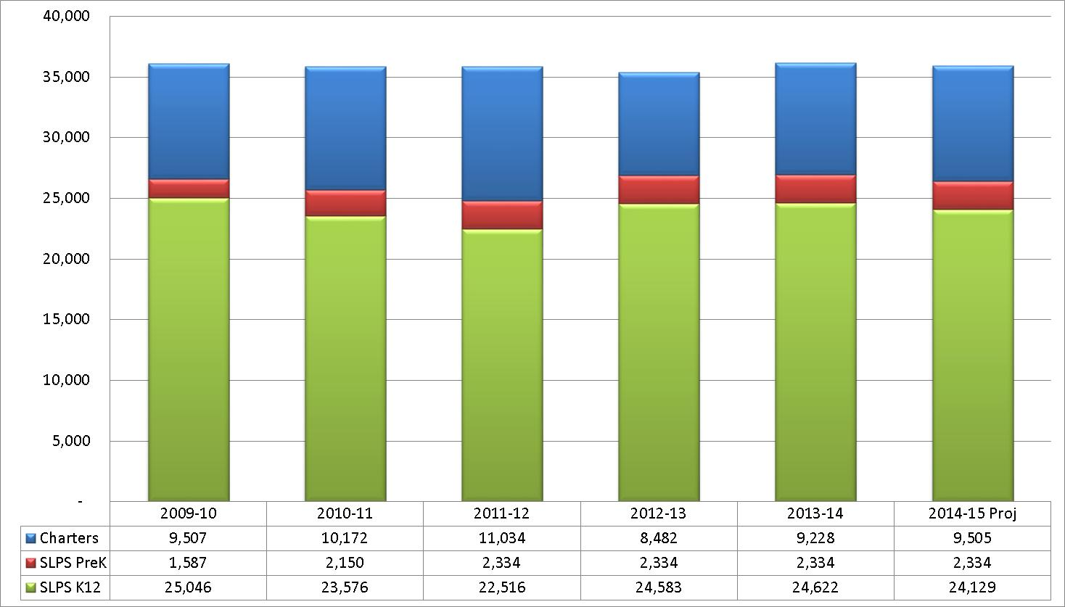
Funding the Plan: Challenges
Enrollment Drives Everything

Slide 28
Funding the Plan: Challenges Proposed Responses to Challenges
Desegregation Expansion Programs
Transportation Bell Time Changes
Identify Workforce & Non-Workforce Efficiencies

Slide 29
Funding the Plan: Challenges FY 2015 GOB Proposed Increases
Salaries & Benefits Increases $0.8
Pension Contribution
New Federal Healthcare Guidelines
Contract Increases $1.0
SAP Enhancements
SPED Occupational & Physical Therapy
Rate Increases (i.e., Insurance, Building Services)
Magnet School Transportation $2.6
Funded by Desegregation in FY 2014
Professional Development $0.3

Slide 30
Funding the Plan: Challenges FY 2015 GOB Proposed Reductions
Revenues ($1.2)
Formula Funds-State Aid
Transportation
Transportation Bell Times ($1.7)
Workforce & Non-Workforce Efficiencies ($4.2)

Slide 31
Funding the Plan: Challenges FY 2015 GOB Proposed Utilization of Fund Balance
St. Louis Plan $1.2
Funded by Desegregation in FY 2014

Slide 32
Funding the Plan: Challenges Preliminary FY 2015 General Operating Budget
FY 2014 FY 2015 Projected Preliminary Variance
Starting Fund Balance $ 19.7M $ 19.7M -
Revenues $286.2M $285.0M ($1.2M)
Payroll Expenditures 210.4M 211.2M 0.8M
Non-Payroll Expenditures 75.8M 75.0M (0.8M) Expenditures $286.2M $286.2M -
Annual Surplus/(Deficit) - (1.2M) ($1.2M)
Ending Fund Balance $ 19.7M $ 18.5M ($1.2M)

Slide 33
Funding the Plan: Challenges Expansion Programs Budget
FY2014 FY2015 Projected Pending
Unspent Funds $ 21.7M
Revenues -
Payroll Expenditures 7.6M
Non-Payroll Expenditures 2.8M
Expenditures $ 10.4M
Remaining Funds $ 11.3M*
*The remaining Desegregation Expansion Funds are returned to the Desegregation Capital Fund at the end of FY2014. A balance of $19M is currently in the Capital Fund for a total expected balance of $29.8M.

Slide 34
Next Steps
Solicit Family and Community Feedback on the SLPS Transformation Plan
Finalize Professional Development Plan aligned to the SLPS Transformation Plan
Feedback from principals and teachers
RFP for Professional Development partners
Formalize Accountability structures to ensure effective implementation and rapid results

Slide 35
Next Steps
September-March
Develop Plan
March 13
Board Presentation
March 23-29
Public Forums
June
SAB Approval
April
Preliminary FY 2015 Budget to SAB

Slide 36
Public Forums
Thursday, March 27, 2014
Vashon High School
6-8 p.m.
Saturday, March 29, 2014
Central VPA High School
10 a.m.-Noon

