Slide 1
Social Anxiety Disorder
Widespread but Treatable

Slide 2
Patient

Slide 3
What
Symptoms mostly physical
Work setting, classroom trouble
Misinterprets
Notes:
Aggravation, desire to leave setting

Slide 4
Who
Stress and Environment
May have underdeveloped social
Possibly genetic
Notes:
Don't engage, can't develop
17 mil, 75% childhood or teen

Slide 5
Attitude Towards
Many misconceptions surrounding
Can lead to patient dismissing
Notes:
People surrounding may see as shyness
Patient may adopt this belief

Slide 6
Medical Expert

Slide 7
Risk Factors of SAD
Negative experiences
Family / Genetics
Younger age
Depression
Having an appearance that draws attention
Notes:
Risk factors that may increase...

Slide 8
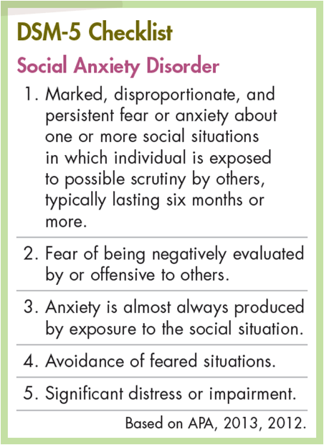
Diagnosis
Physical Exam
Discussion of symptoms
List of Situations
DSM-5 Criteria
Notes:
Physical for what could cause symptoms
Discussion what could cause and where
Situations to see what makes them anxious

Slide 9
Treatment
Depends of effect of disorder
Psychotherapy
Prescribed Medication:
SSRI SNRI
Paxil Effexor XR
Zoloft other prescribed antidepressants
Notes:
Learn how to recognize neg thoughts and change them, build confidence, helps face bad situations
Selective serotonin reuptake inhibitors, paroxetine, sertaline, norepinephrine reuptake inhibitor, venlafaxine

Slide 10
Significance and Support
Help patients engage
Reduce stressful situations
Help reduce future gen struggles
Encourage to help others
Careers:
Psychiatrist
Counseling Psychologist
Nurse
Family Counselor

Slide 11
Further Info/Support
Try to prepare for certain situations
Meditation/ Relaxing Exercise
Realistic Goals
Learn stress management techniques
Reach out to Friends/ Family
Join a support group!

Slide 12
Family and Loved Ones

Slide 13
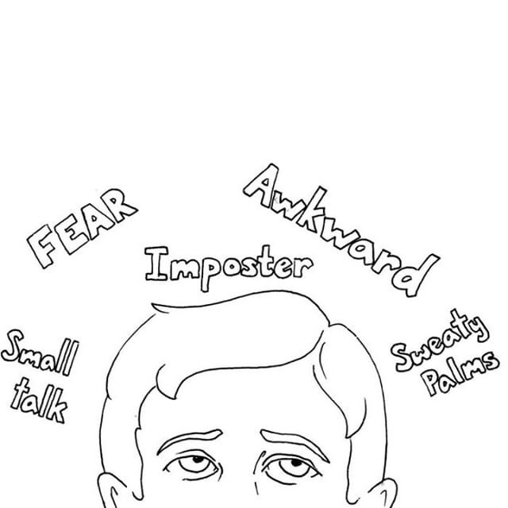
Signs
Avoiding common social situations
Physical Symptoms
Emotional Symptoms
Behavioral Symptoms

Slide 14
Negative Stereotypes
Low self-esteem
Trouble being assertive
Hypersensitivity to criticism
Poor social skills
Low academic and employment achievement
Substance abuse

Slide 15
3 Local Resources/Services
Cognitive behavioral therapy/psychotherapy
Support groups
Medication

Slide 16
How to be more understanding
Encourage prioritization of issues
Encourage keeping a journal/diary
Understand their emotions
Realize how they may be feeling at a given moment

