Slide 1
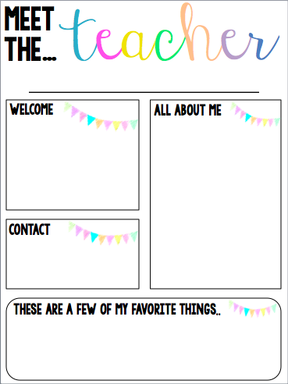
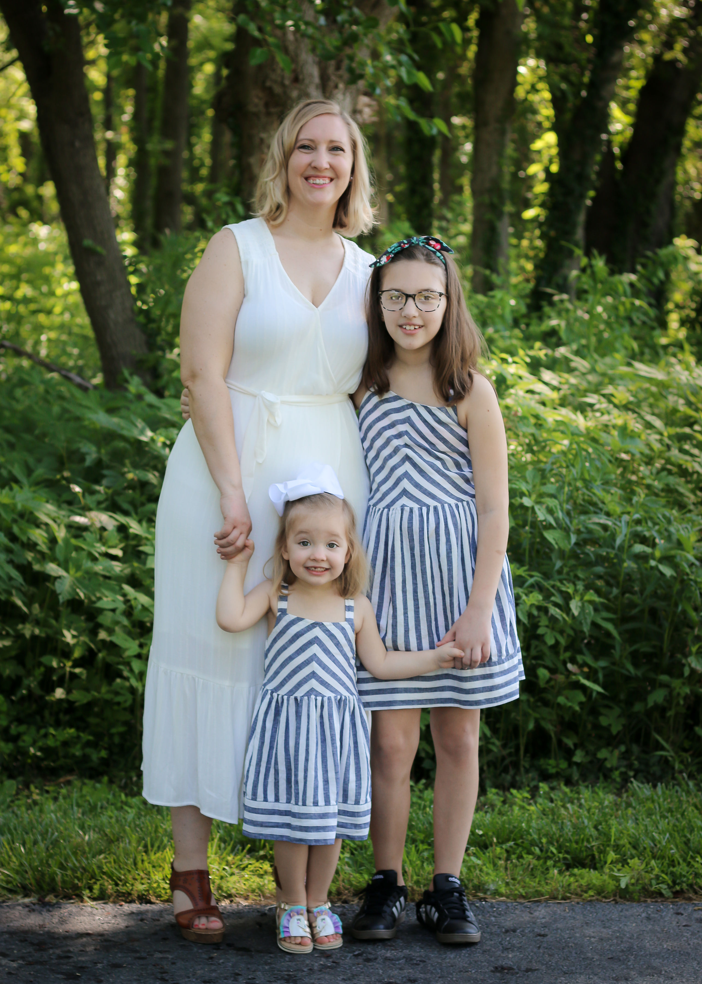
Miss Vernier (Miss V.)
Visit my Ford school webpage to find links to our TEAMS virtual classroom and CLassDojo
https://www.slps.org/domain/12419
This fall will be my 2nd year at Ford but my 12th year as a teacher. I have an 11 year old and 2 year old daughter who both love to be outside and do crafts.
I look forward to getting to know your family!
Email: Sarah.vernier@slps.org
Phone: 314-282-5420
Kansas Jayhawks, Starbucks, Chocolate, Spicy Foods, and My Daughters (of course)

