Slide 1
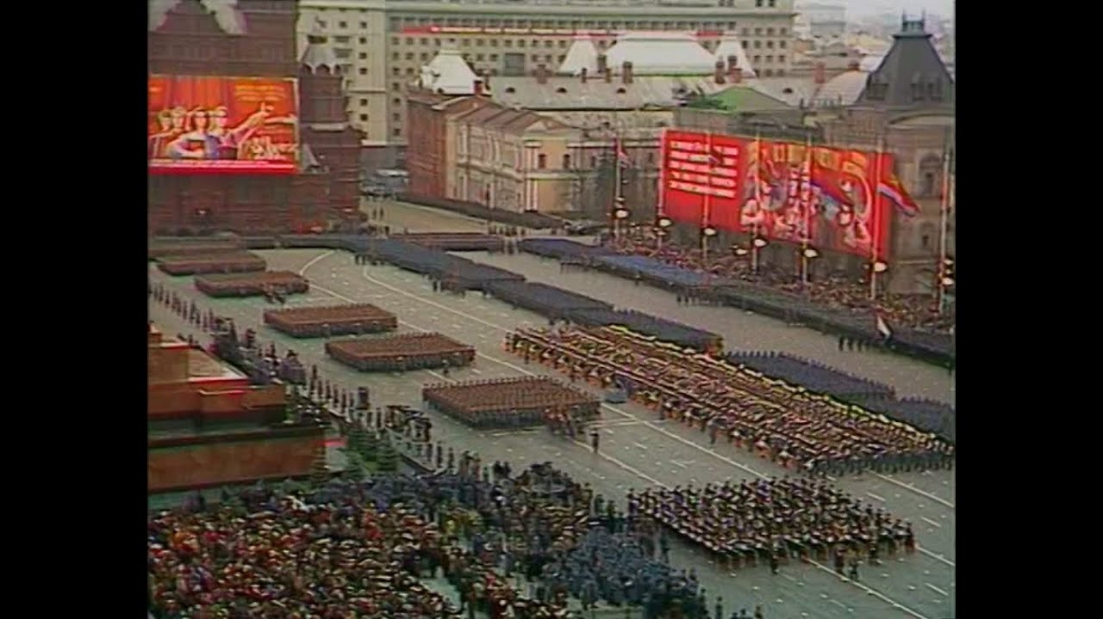
Do Now
What do you think makes a country great?

Slide 2
Northern Eurasia

Slide 3
Before Russia was Russia
Many peoples settled in the area
Greeks and Persians traded along the Black Sea
Sold to “clans” living in the forests
100 BCE
China beings trade along the Caspian Sea
300s CE
Roman Christians settle between the seas
500 CE
Slavs settled in Russian forests and in plains in Ukraine

Slide 5
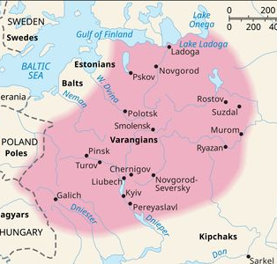
Then the Vikings Came
800s CE
Vikings move in
Marry Slavs
Called themselves “Rus”
Built a Kingdom
Named it Kievan Rus
Now Kiev, Ukraine
Got Rich
Friends with Byzantines
Converted to Eastern Orthodox Christianity

Slide 6
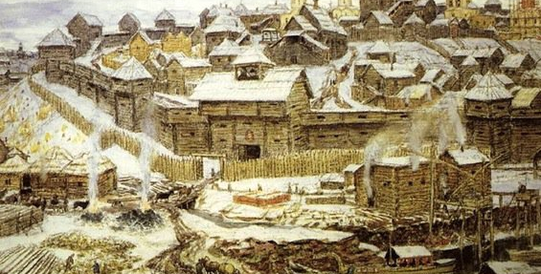
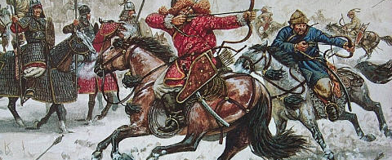
The Mongols and Moscow’s Power
In the 1200s, the Mongols invaded and controlled Russia for over 200 years.
Moscow grew in power; collected taxes for Mongols
Eventually, Ivan III (Ivan the Great) kicked out the Mongols

Slide 7
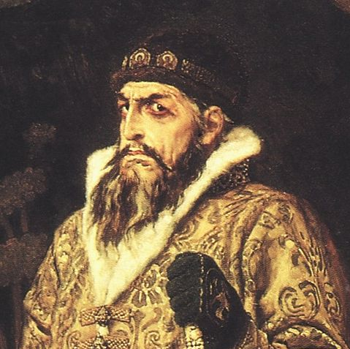
Ivan the Terrible: Russia’s First Tsar
In 1547, Ivan IV crowned himself the first Tsar (Emperor) of Russia.
Ivan expanded Russia’s territory but ruled with fear and violence.
After Ivan’s death, Russia entered a period of chaos known as the Time of Troubles.

Slide 8
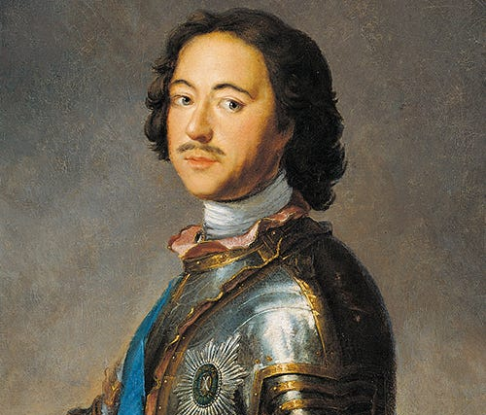
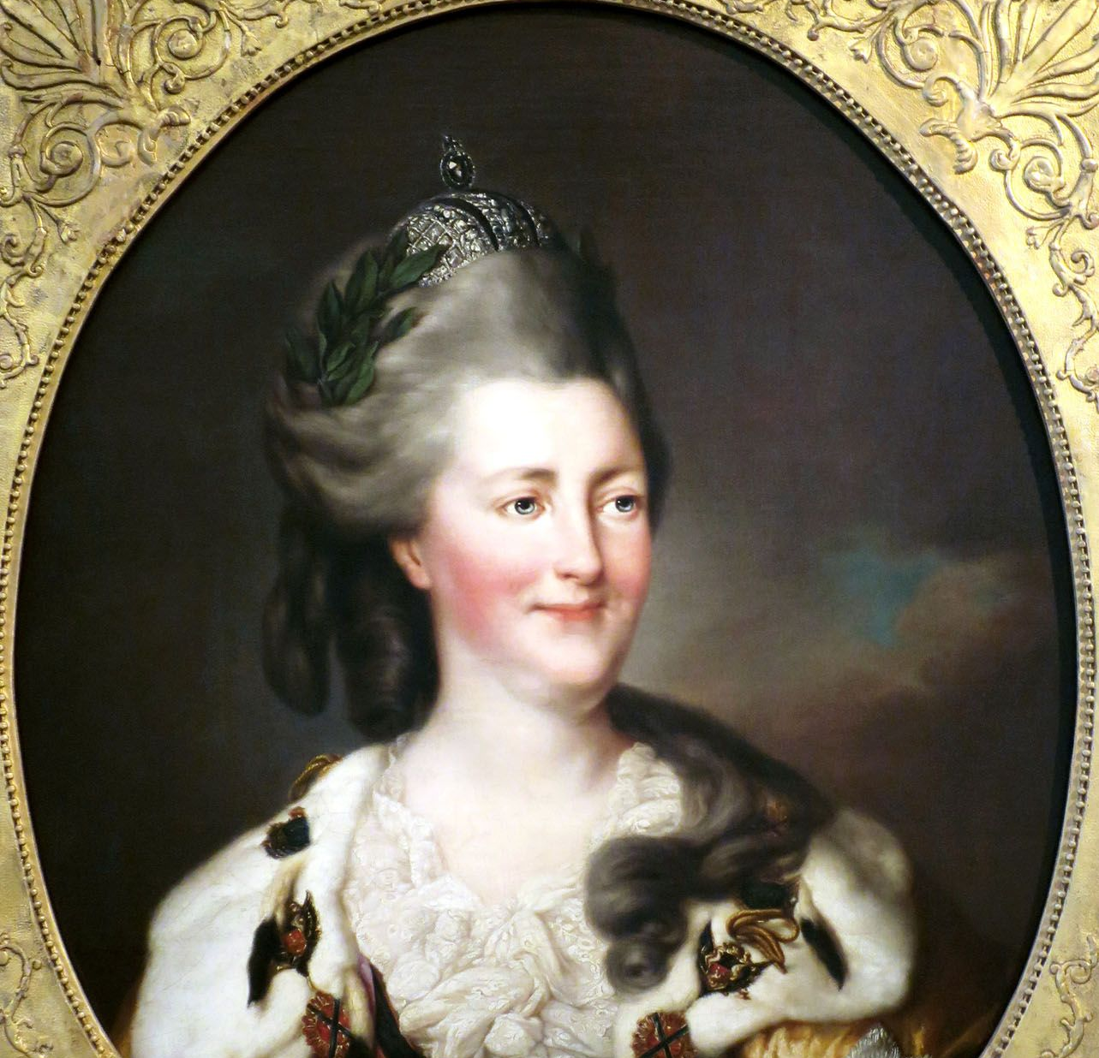
Modernizing Russia: Peter and Catherine
Peter the Great (late 1600s) modernized Russia, building the city of St. Petersburg as a “window to the West.”
Catherine the Great continued expanding the empire and brought European ideas to Russia.
Both leaders made Russia stronger but also kept the people under tight control.

Slide 9
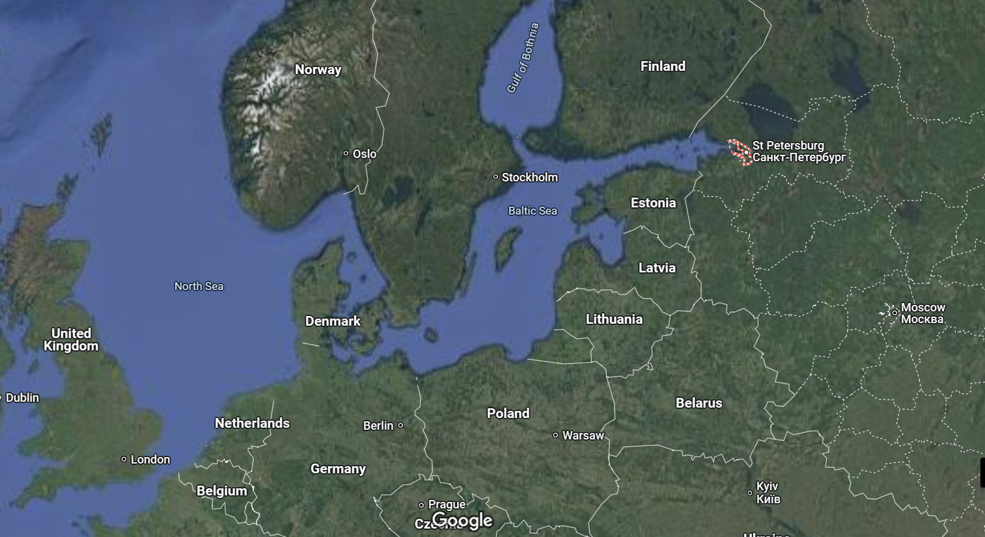

Slide 10
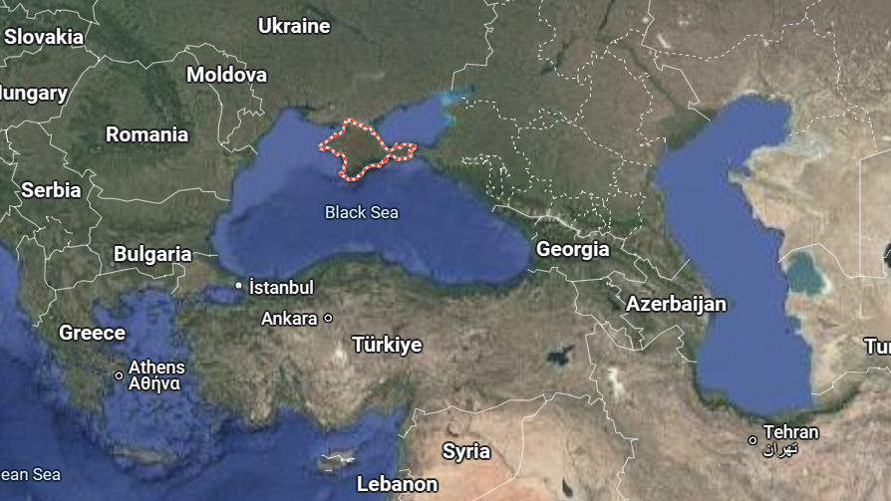

Slide 11
The Charge of the Light Brigade: Bravery or Bad Leadership?
What Happened?
In 1854, during the Crimean War, British soldiers received a confusing order to charge into battle.
The soldiers knew it was dangerous—they were surrounded by Russian cannons—but they followed orders anyway.
Over 600 soldiers rode into battle. Many were killed, but their bravery was remembered in a famous poem by Alfred, Lord Tennyson.

Slide 12
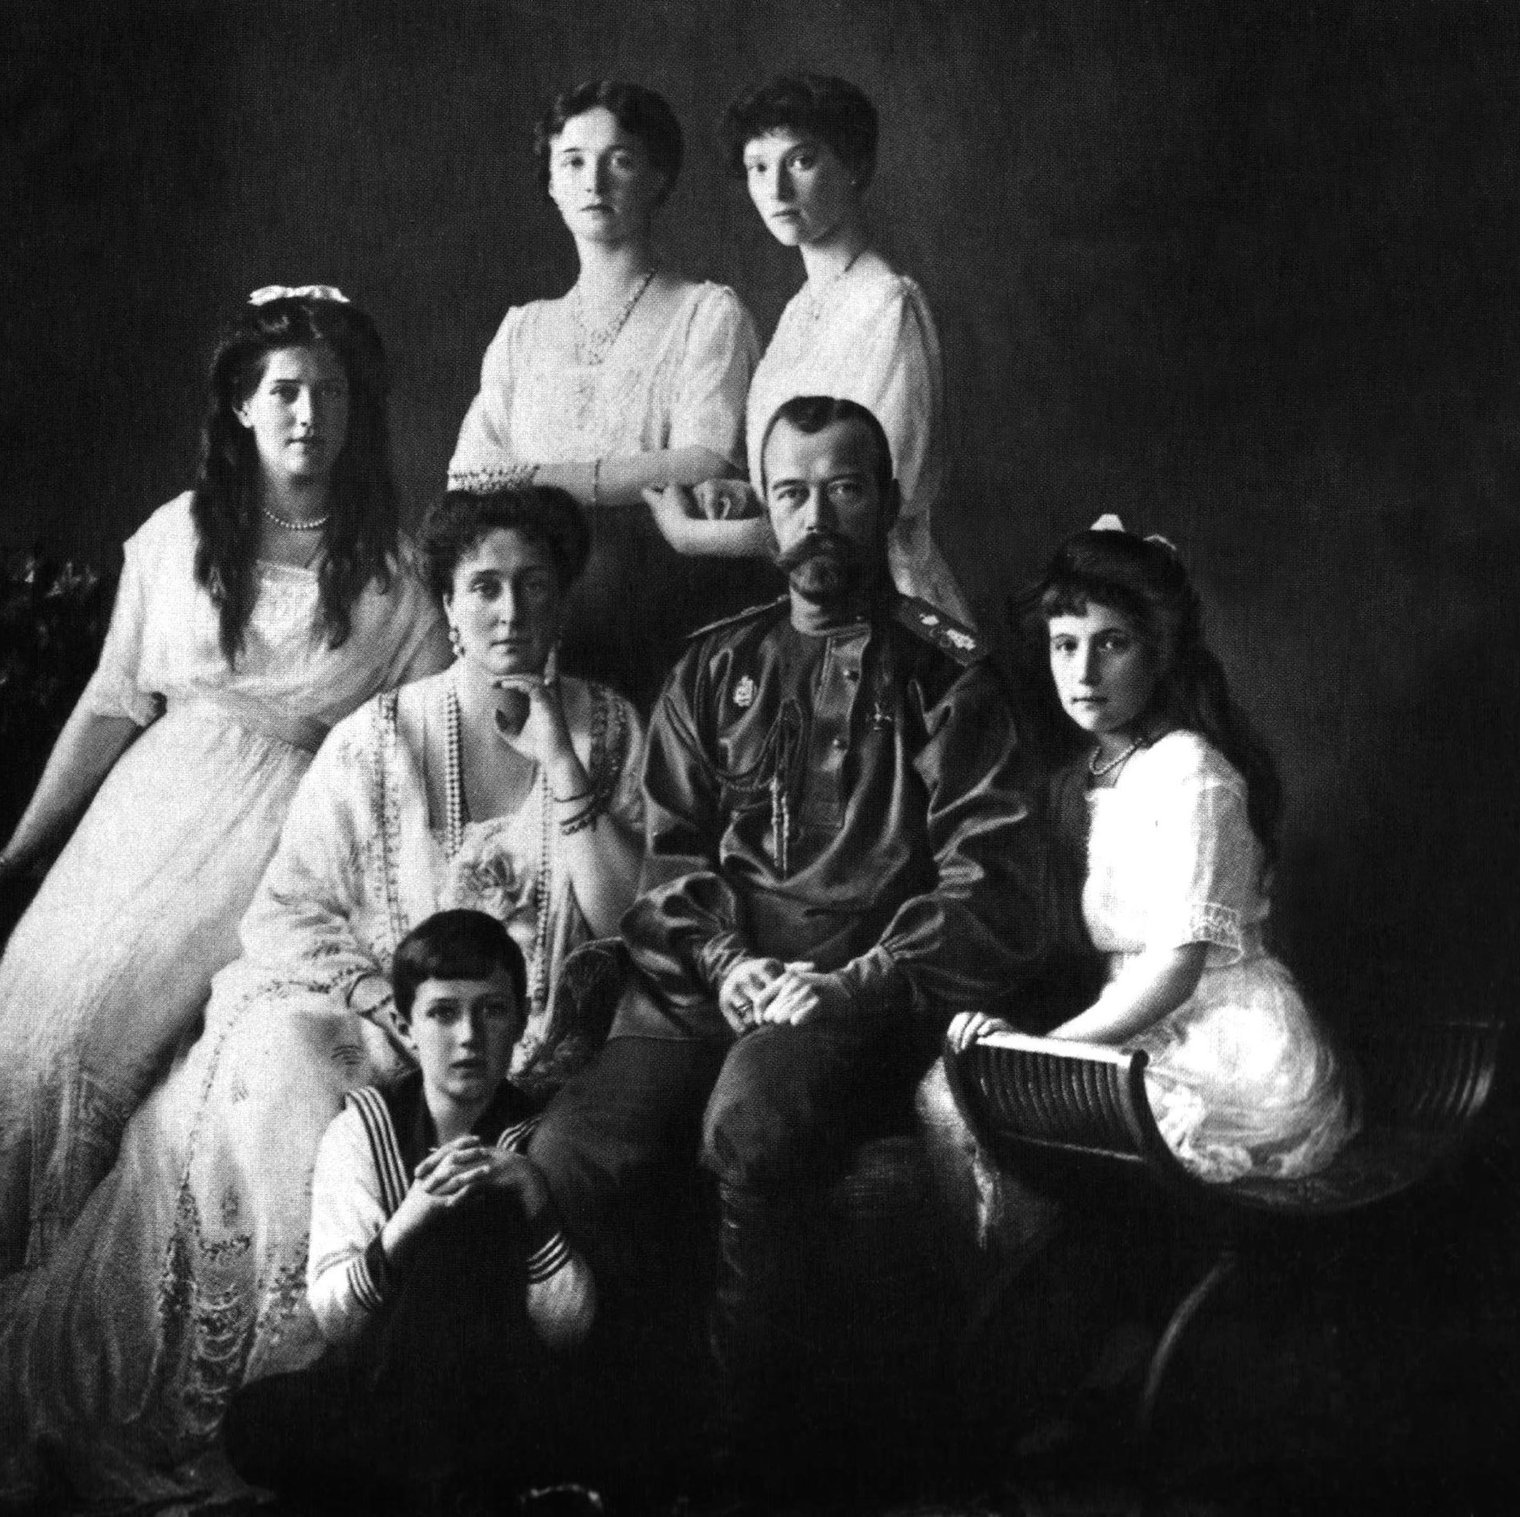
The Last Tsars: The Romanov Family
The Romanov dynasty ruled Russia for over 300 years, but life was hard for most people.
Tsar Nicholas II struggled to lead during wars and revolutions.
In 1917, the Russian people overthrew the Tsar during the Russian (Bolshevik) Revolution.

Slide 13
Bolshevik Revolution
Poor Living Conditions: Most Russians were poor, hungry, and struggled with food shortages and high prices.
Weak Leadership: Tsar Nicholas II ignored public struggles and made poor decisions in WWI, leading to military defeats and lost trust.
Unfair Society: While nobles lived in luxury, workers endured low wages and harsh factory conditions.
Influence of New Ideas: Communist ideas promising equality gained popularity. Leaders like Lenin aimed to empower workers and peasants.

Slide 14
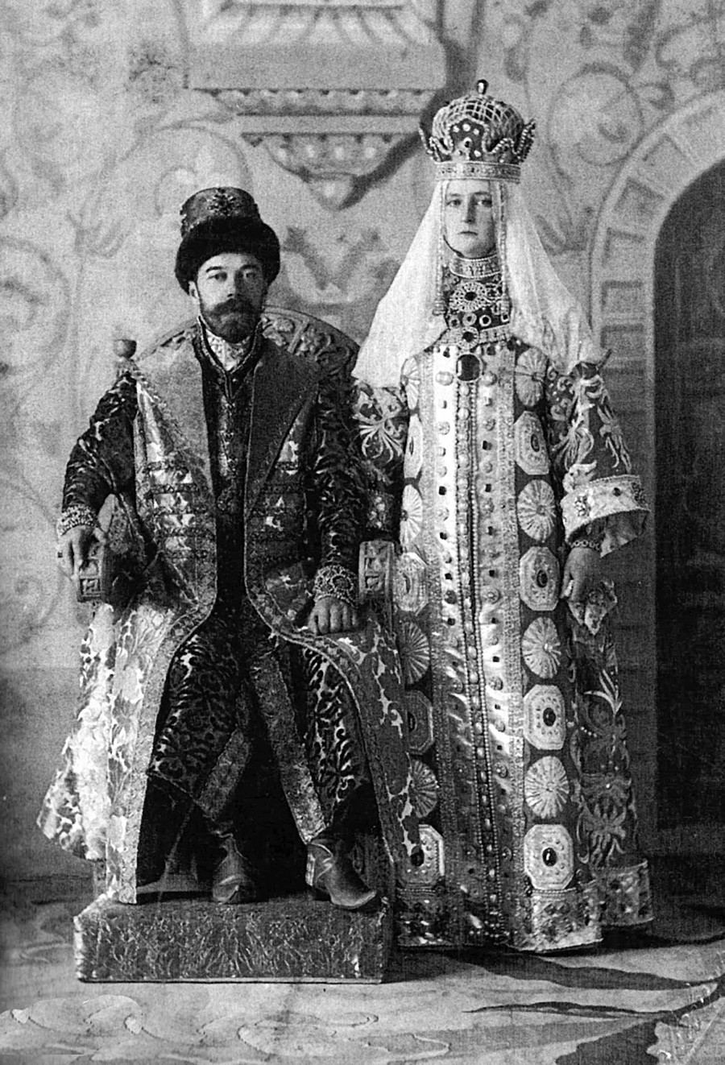
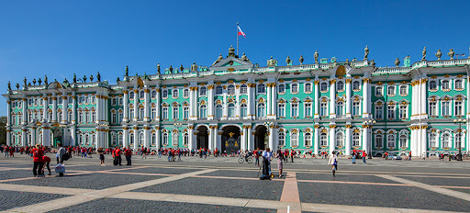
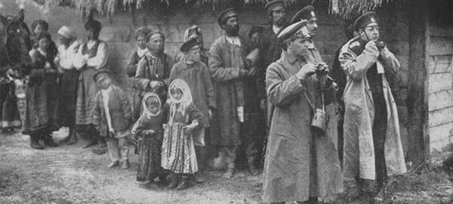

Slide 15
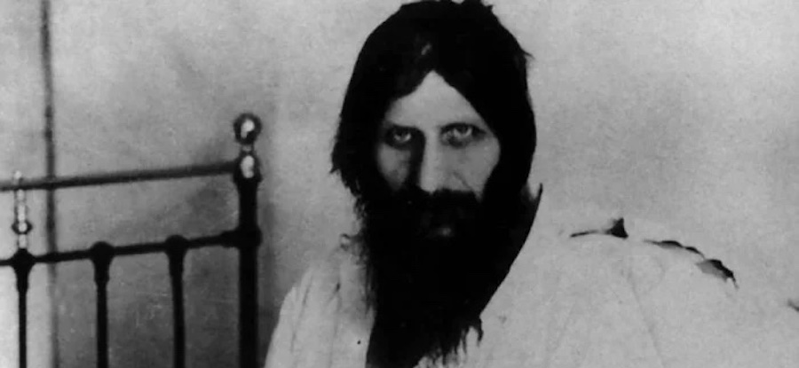
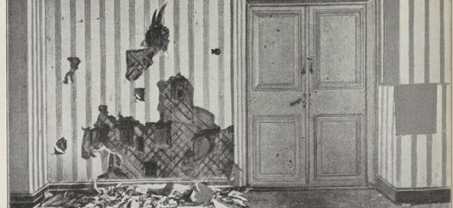
Rasputin and the Romanov Mystery
Rasputin, a mysterious monk, gained power by influencing the Tsar’s family. Many thought he had magical powers.
After the revolution, the royal family was assassinated in 1918.
A rumor spread that Anastasia, the Tsar’s daughter, survived.
People searched for her for years, but her remains were later found.

Slide 16
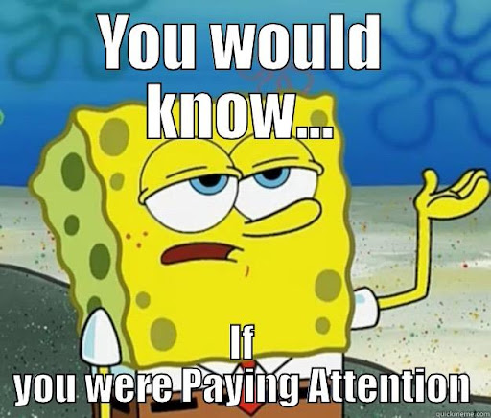
Exit Ticket
What was one reason the Russian people overthrew the Tsar?
Who was Rasputin, and why did people fear him?

Slide 17
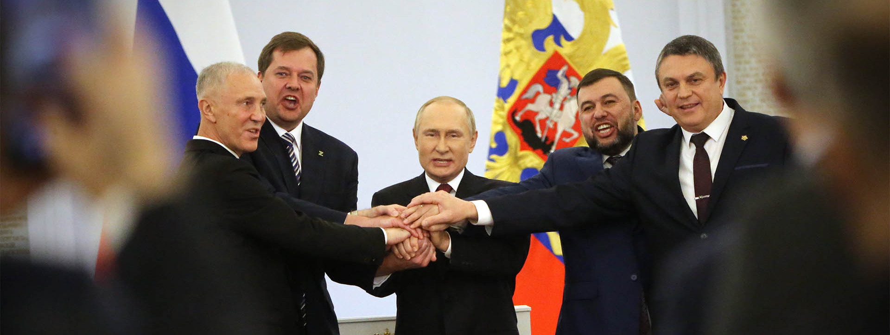
Do Now
What happens when one person or group has all the power? Is that good or bad? Why?

Slide 18
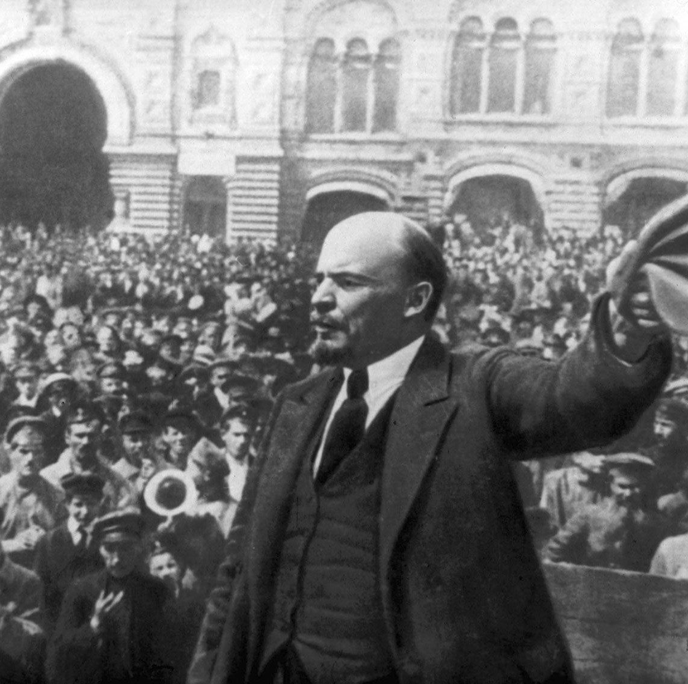
Bolshevik Revolution
1917: Russian Revolution → Vladimir Lenin and the Bolsheviks seize power.
1922: Union of Soviet Socialist Republics (USSR) established.
Communism: Government controls economy, media, and political power.

Slide 19
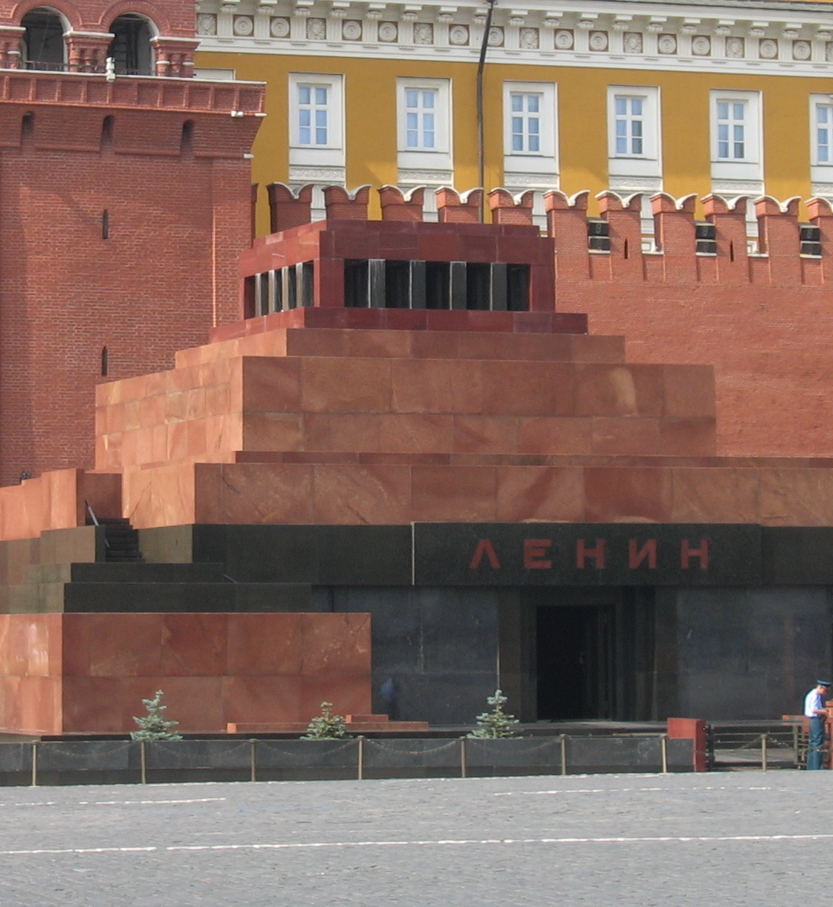
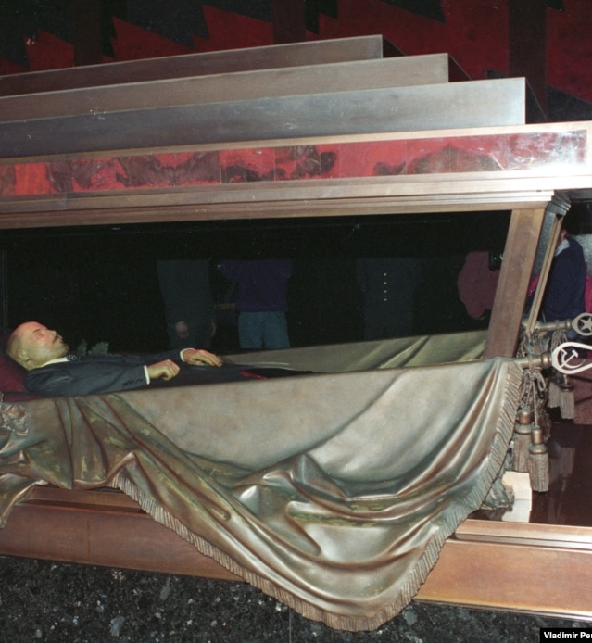

Slide 20
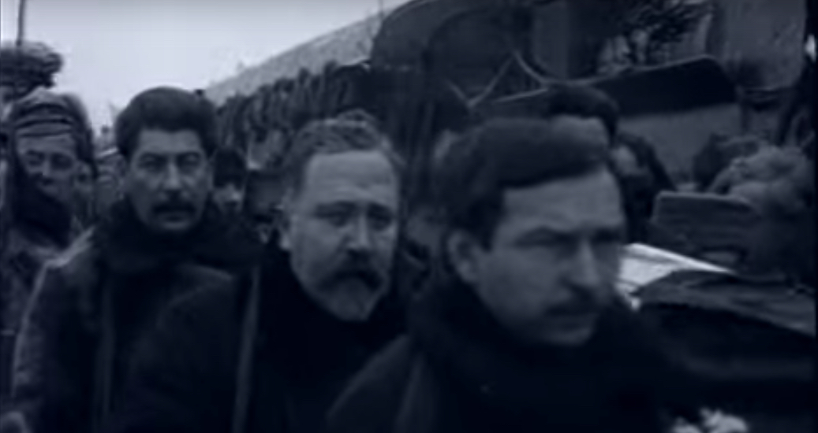

Slide 21
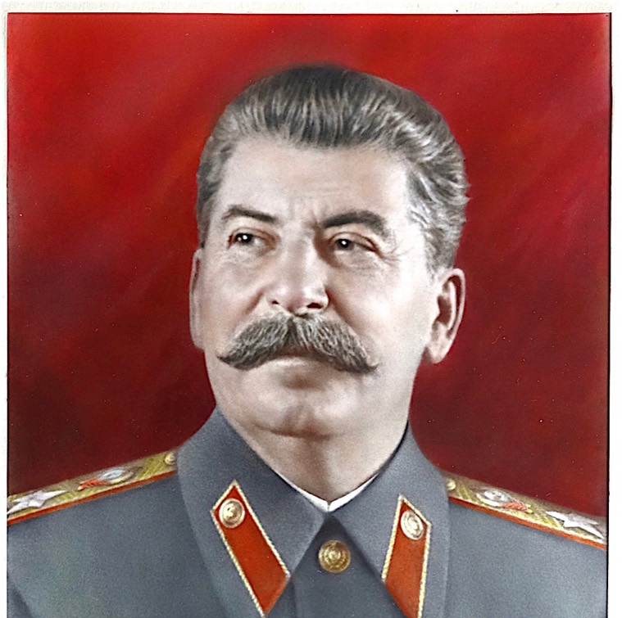
Stalin’s Rise
Rapid industrialization, forced collectivization → famines and suffering.
Great Purge: Political opponents eliminated.
USSR becomes a superpower after WWII.

Slide 22
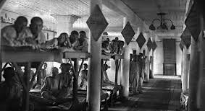
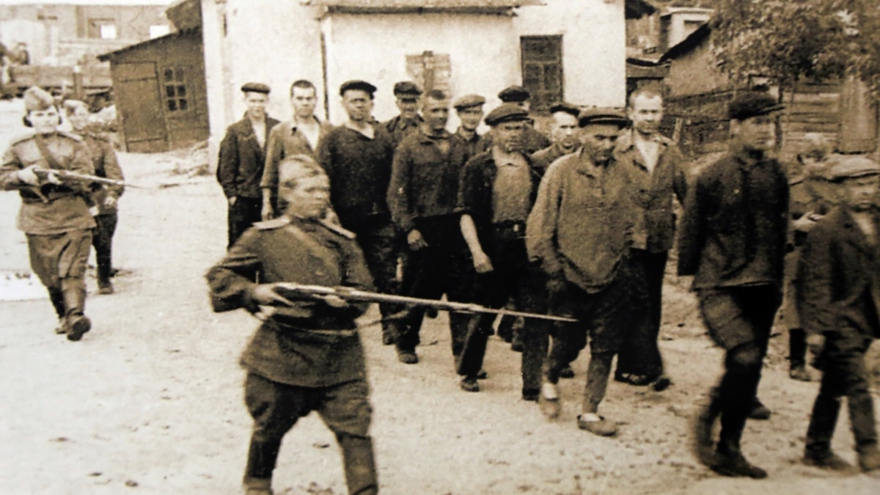
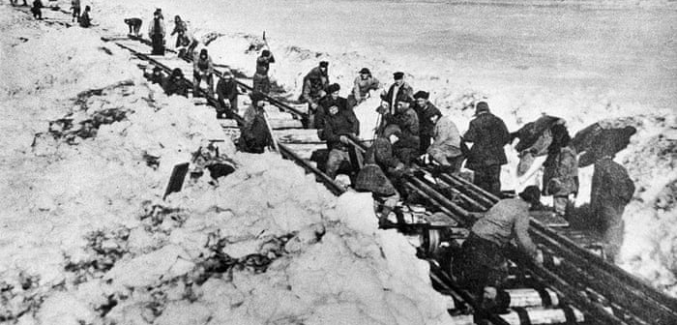
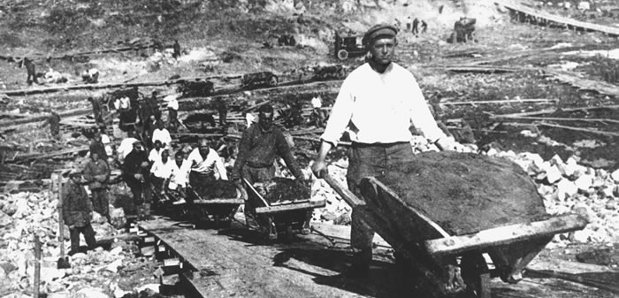

Slide 23
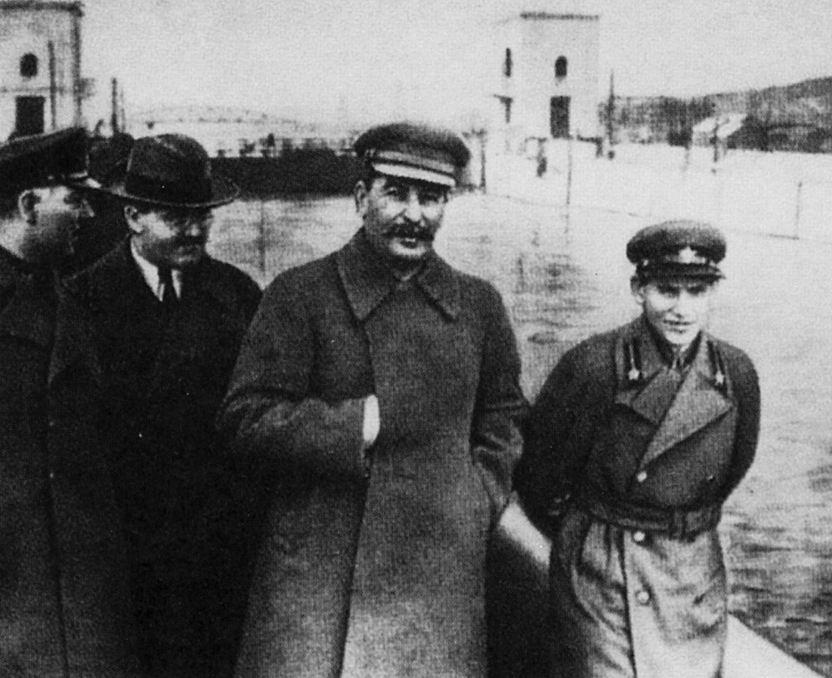
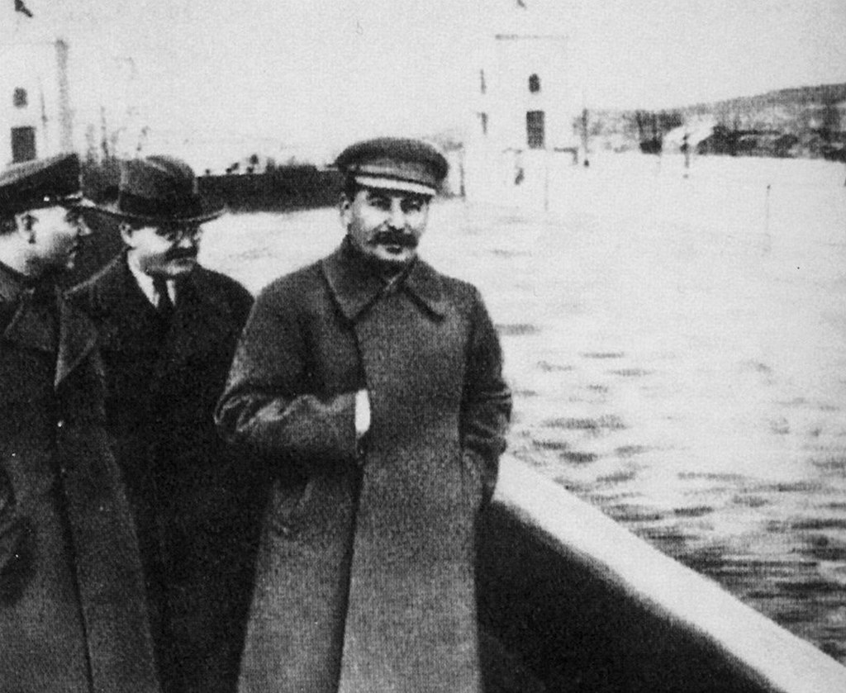

Slide 24
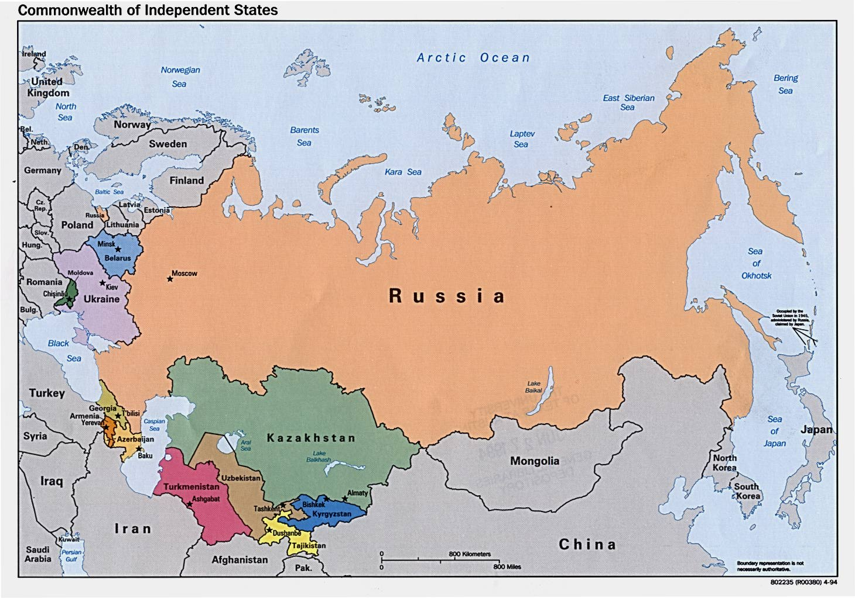

Slide 25
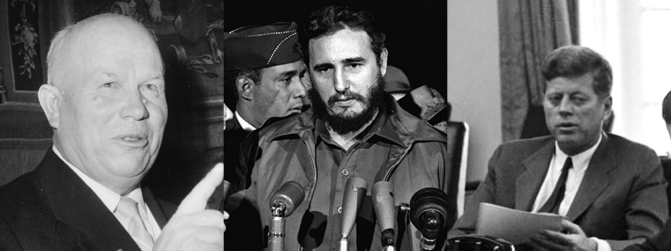
The Cold War (1945-1991)
Tension with the U.S. and NATO.
Arms race, space race, and proxy wars (e.g., Korea, Vietnam, Afghanistan).

Slide 27
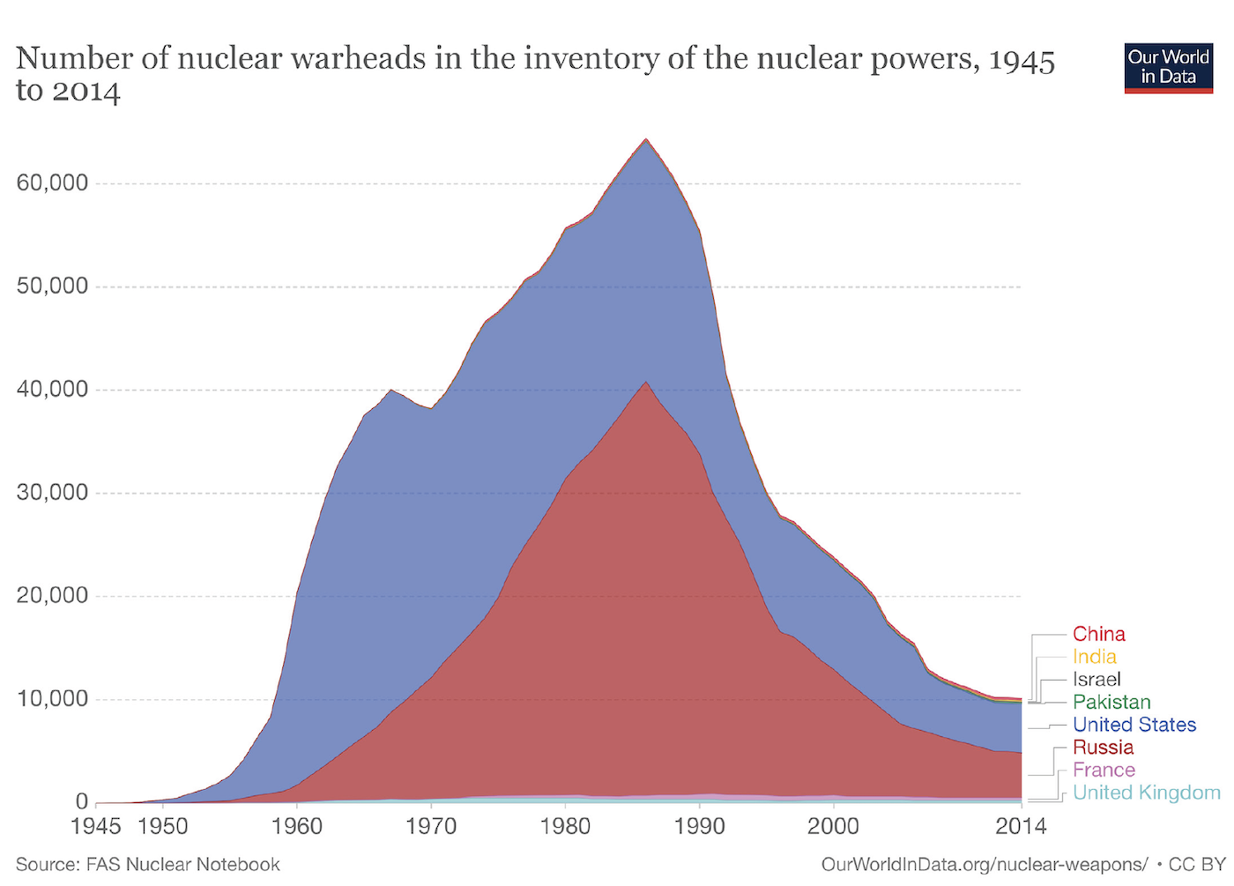

Slide 28
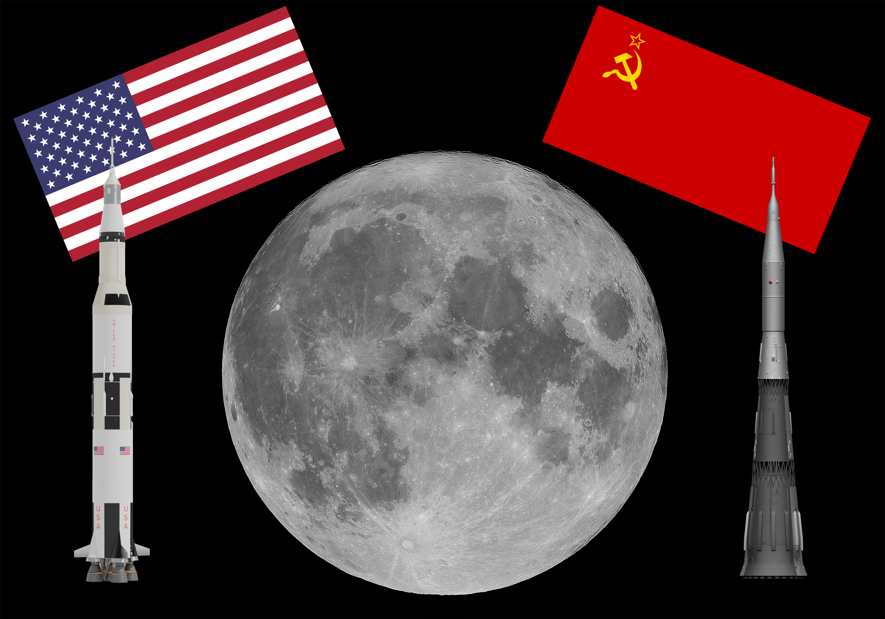

Slide 29
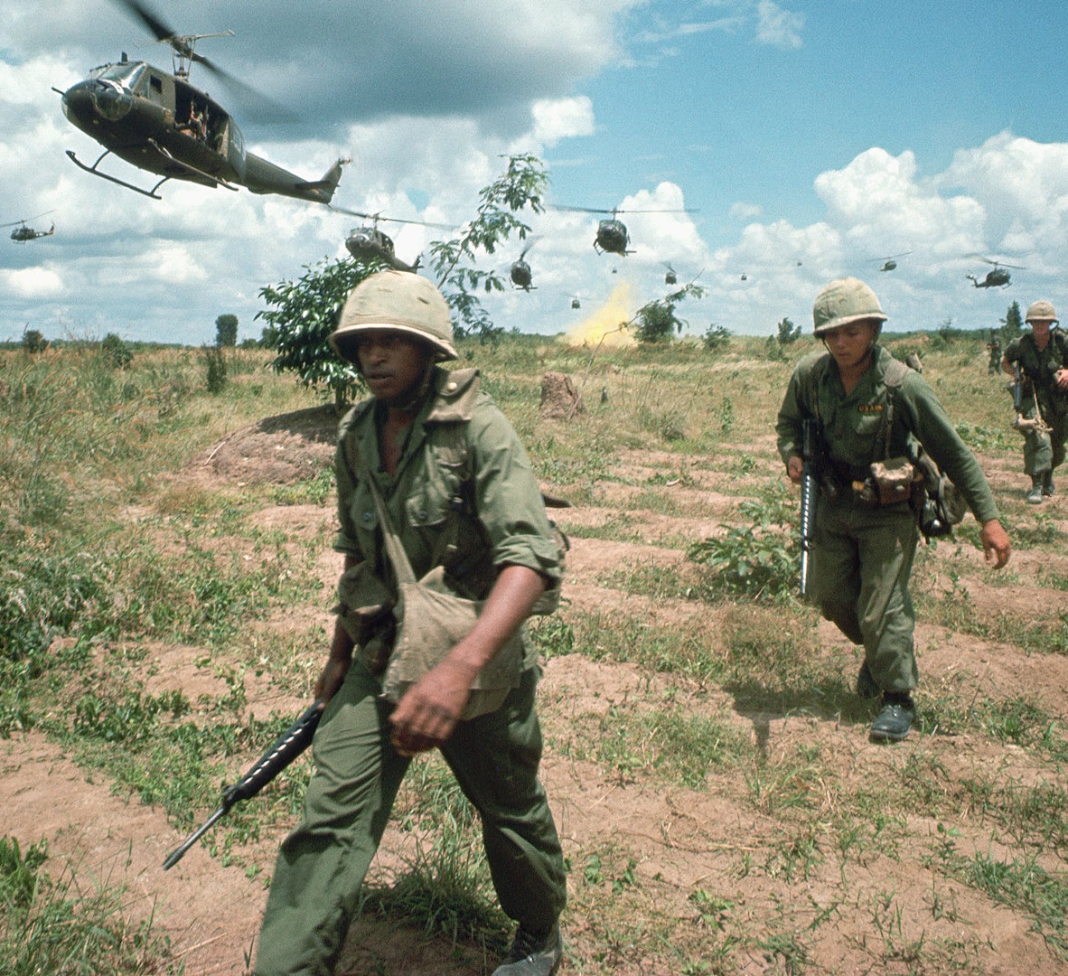
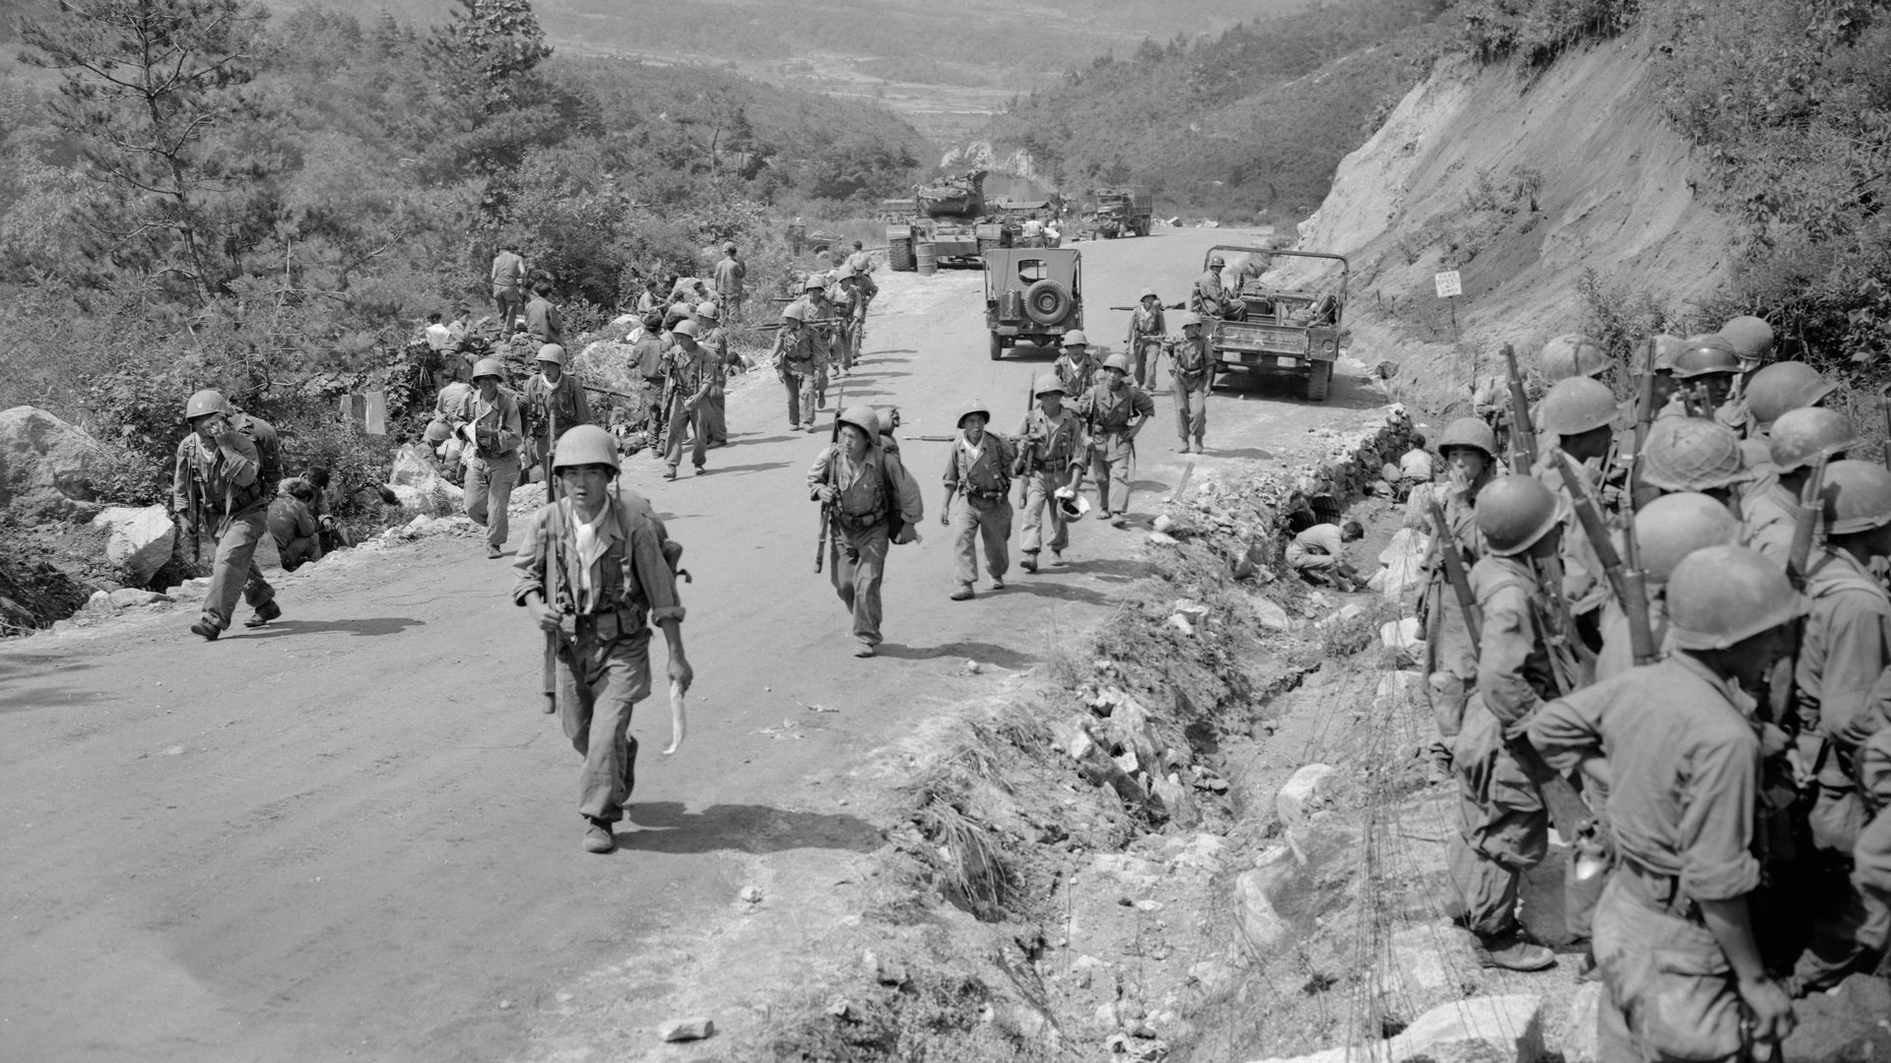
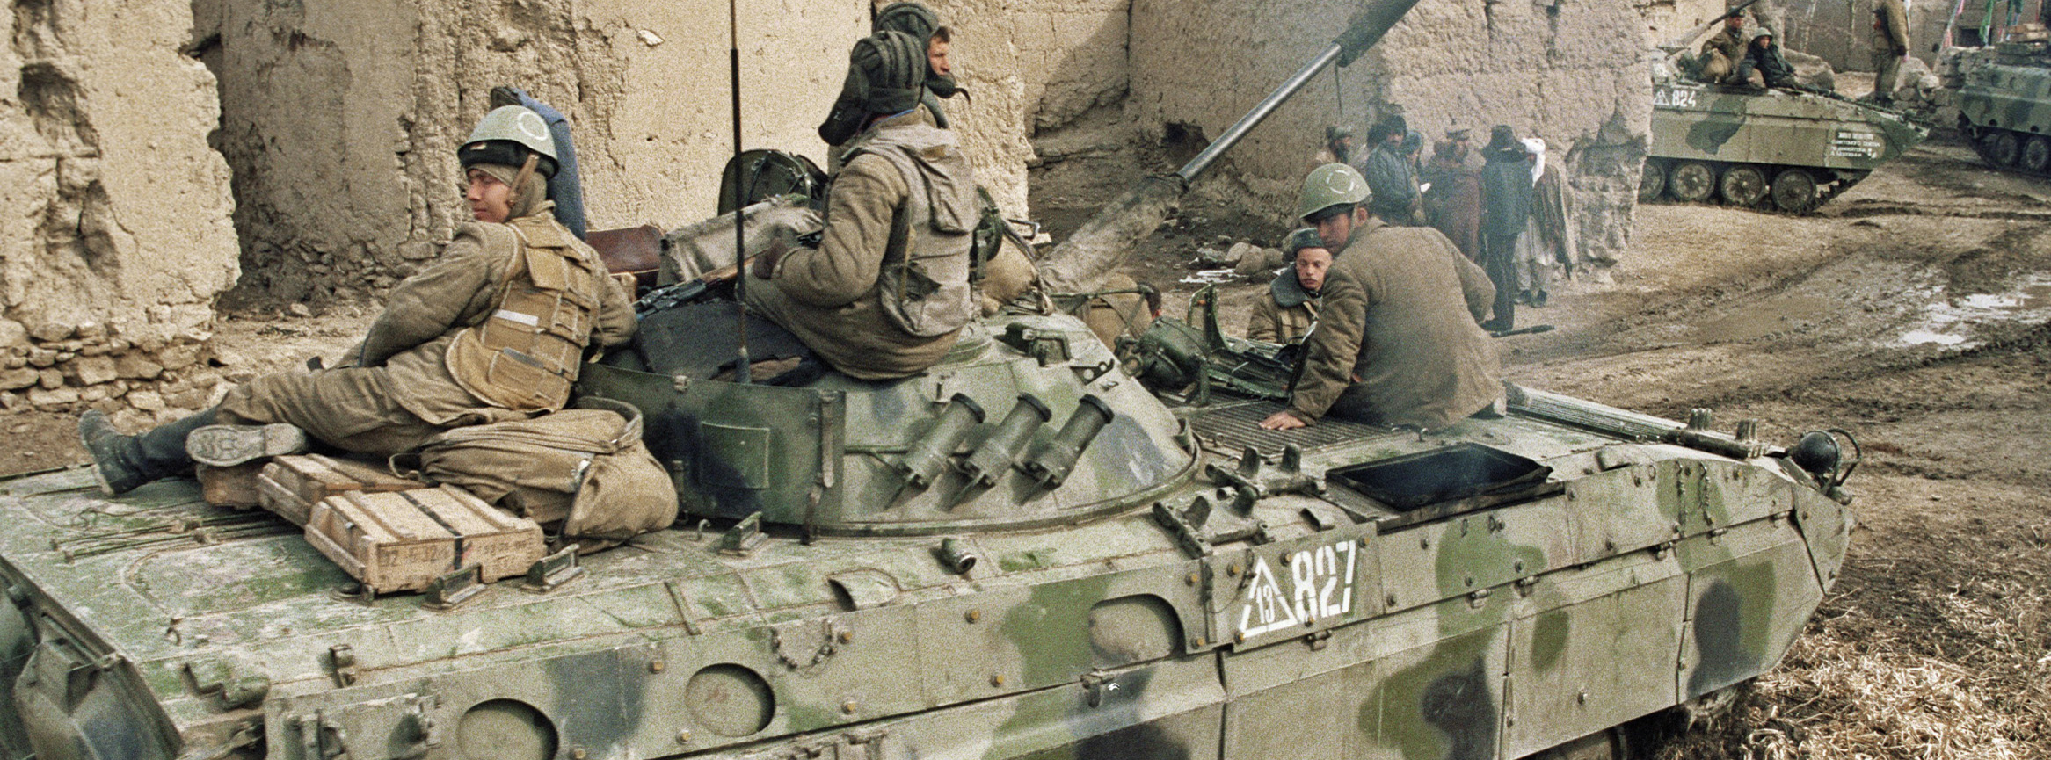

Slide 30
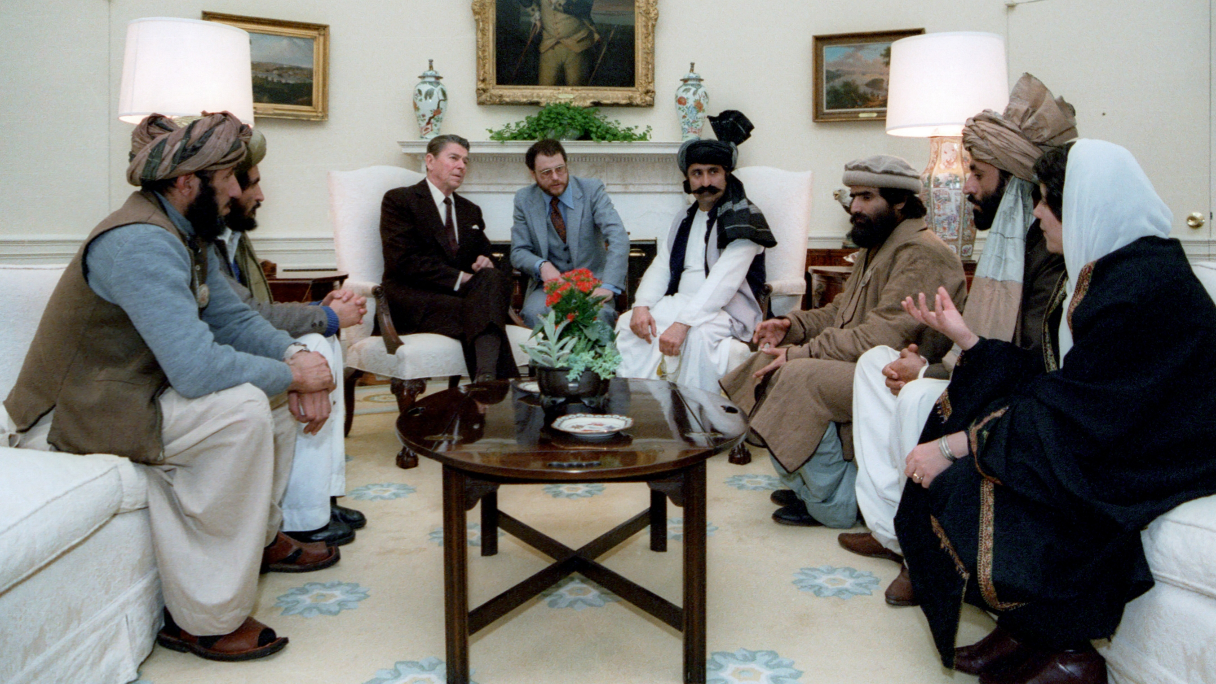

Slide 31
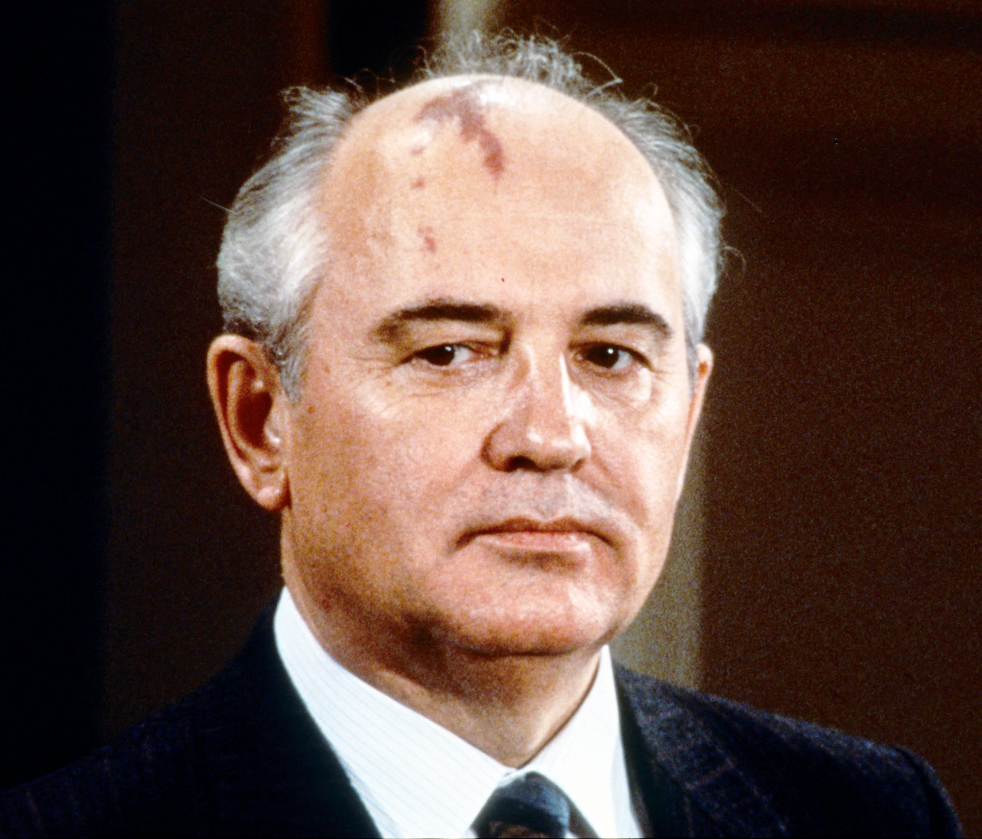
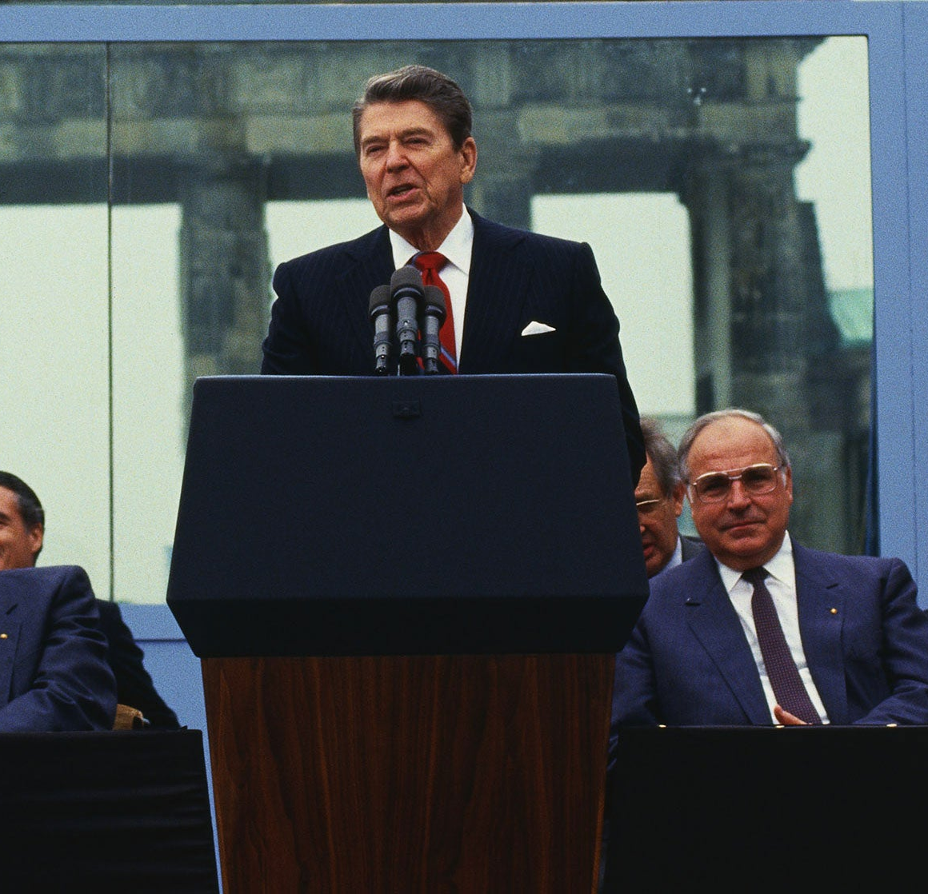
The Fall of the Soviet Union
Economic problems and public dissatisfaction.
1985: Mikhail Gorbachev introduces reforms (Glasnost and Perestroika).
Glasnost – Open government, more information
Perestroika – Restructuring the economy and government
1991: USSR dissolves → 15 independent republics.

Slide 32
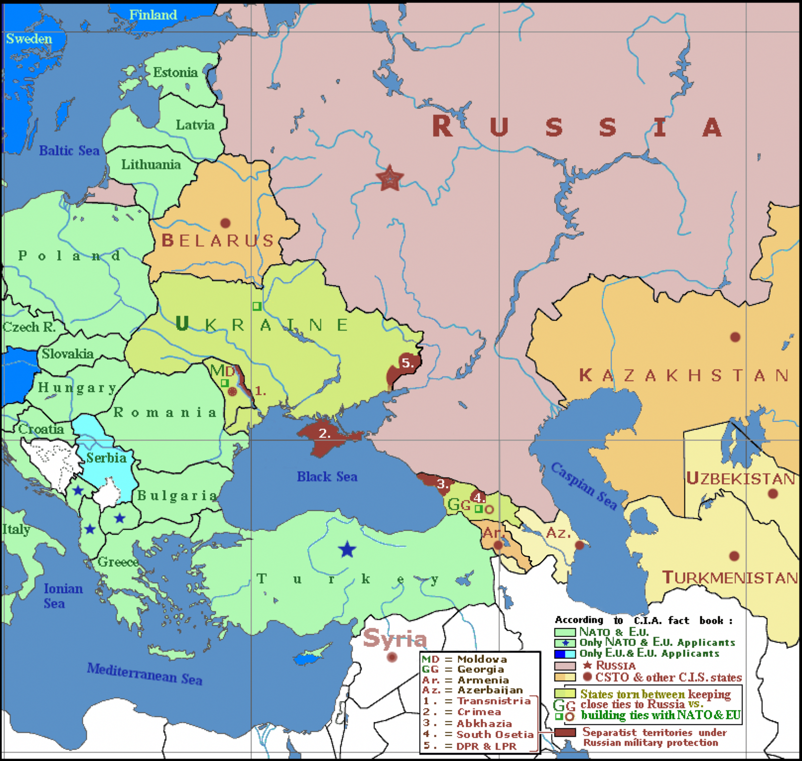

Slide 33
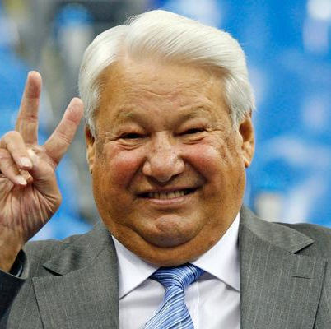
Russia After the USSR
1991–1999: Economic crisis and instability.
Boris Yeltsin: First Russian president; struggled with reforms.
Rise of wealthy oligarchs, growing inequality.

Slide 34
Hyperinflation
Milk (U.S. Dollar)
Milk (Russian Ruble)
Today
$3.75 (₽343.12)
With hyperinflation (2,520%)
Today
₽301 ($3.29)
With hyperinflation (2,520%)

Slide 35
Hyperinflation
Milk (U.S. Dollar)
Milk (Russian Ruble)
Today
$3.75 (₽343.12)
With hyperinflation (2,520%)
$94.50 (₽8646.67)
Today
₽301 ($3.29)
With hyperinflation (2,520%)
₽7585.20 ($82.90)

Slide 36
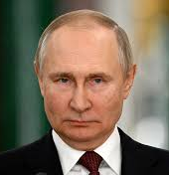
Putin’s Rise and Crimea’s Annexation
2000: Vladimir Putin becomes president → promises strength and stability.
Focus on centralized power, controlling media, and boosting economy.
2014: Russia annexes Crimea from Ukraine, citing historical ties and protecting Russian-speaking population.
Global response: Sanctions, diplomatic fallout.

Slide 37
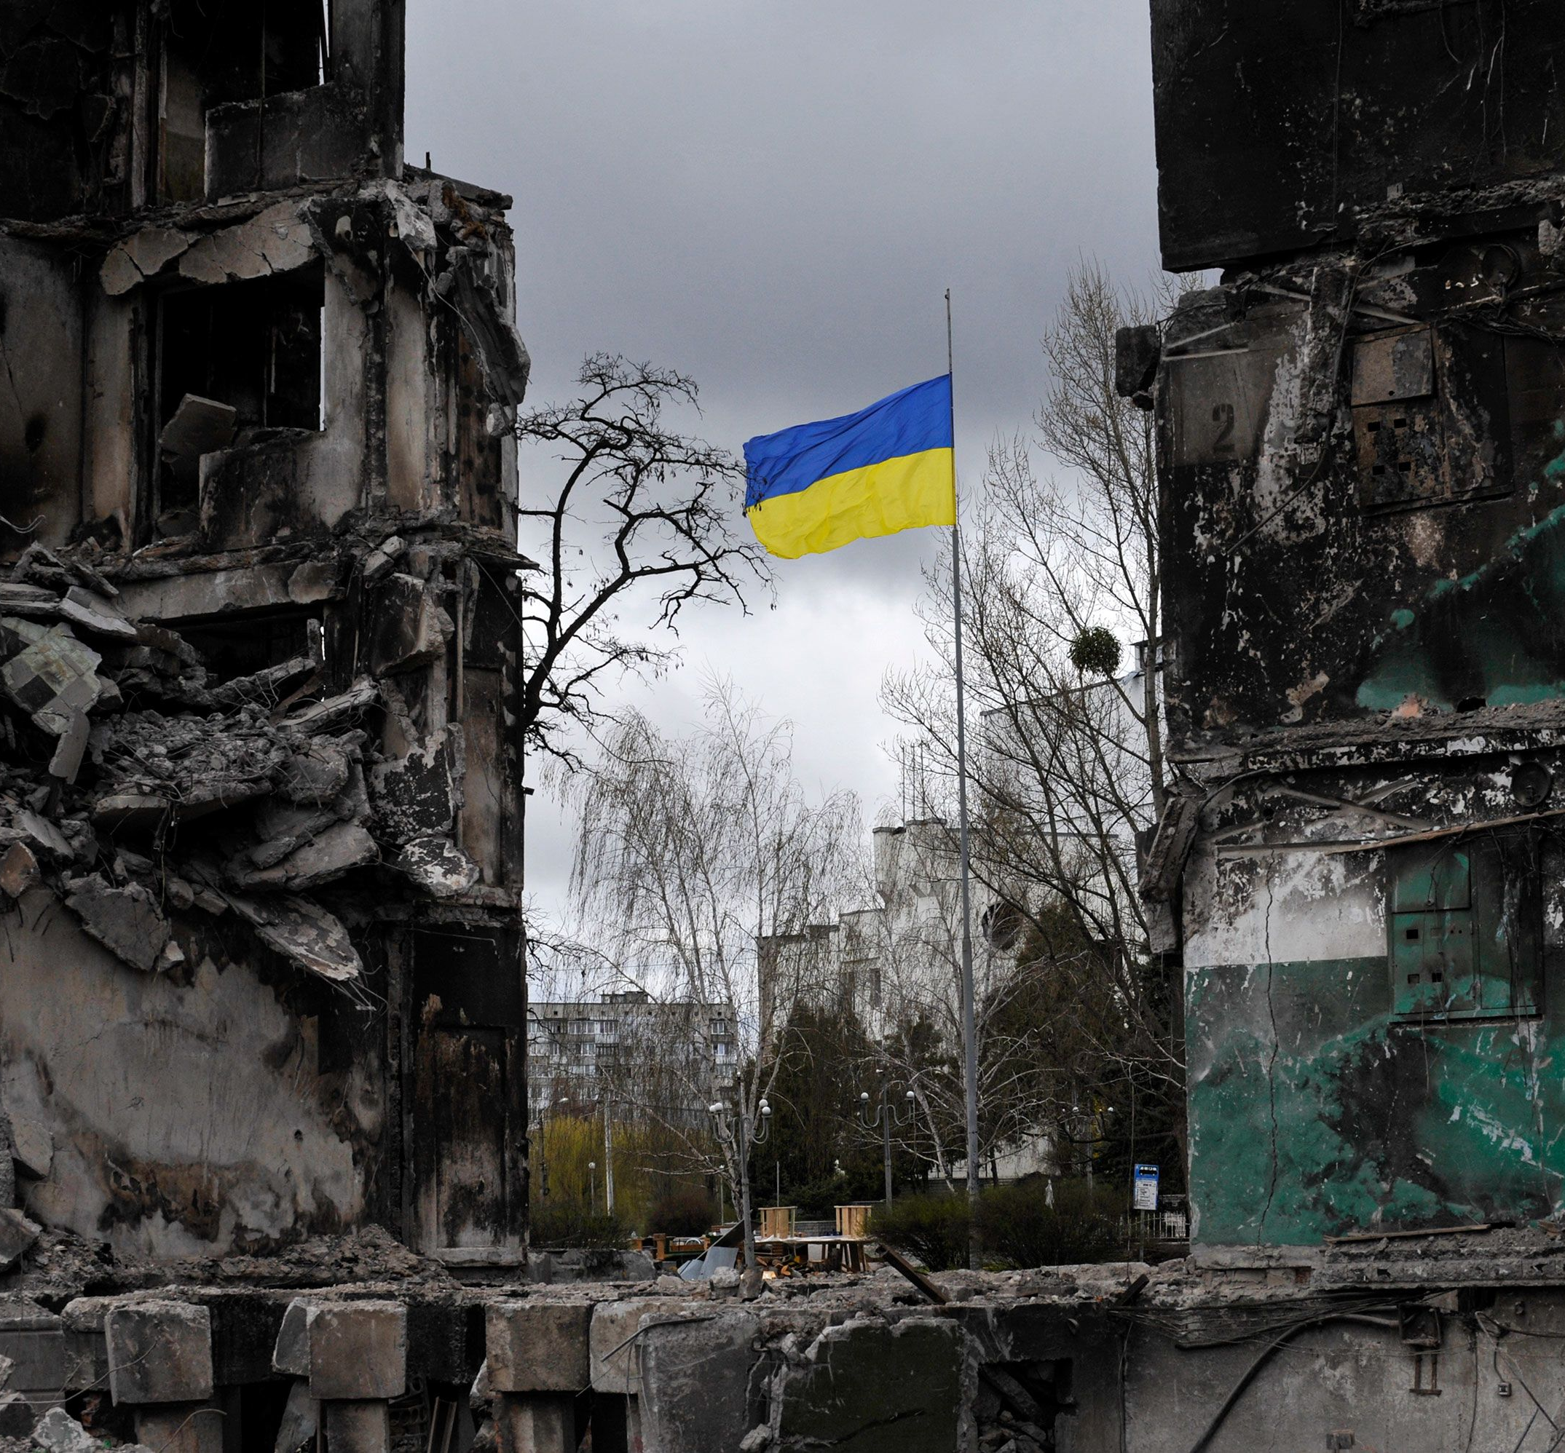
The War in Ukraine
February 2022: Russia invades Ukraine.
War continues; heavy casualties and destruction.
International response: Sanctions and military aid to Ukraine.

Slide 38
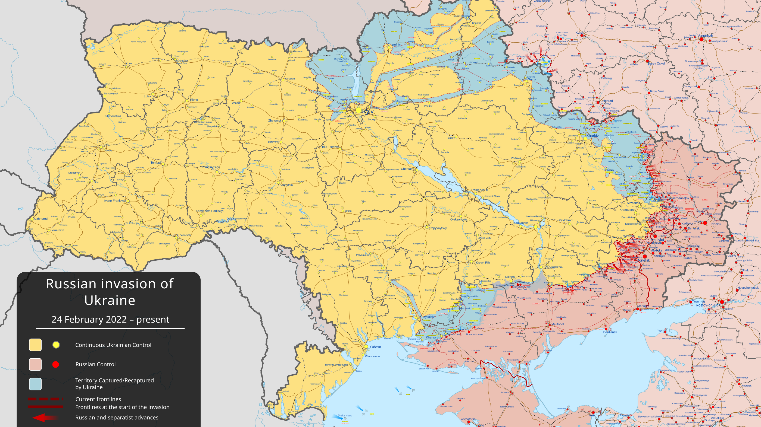

Slide 39
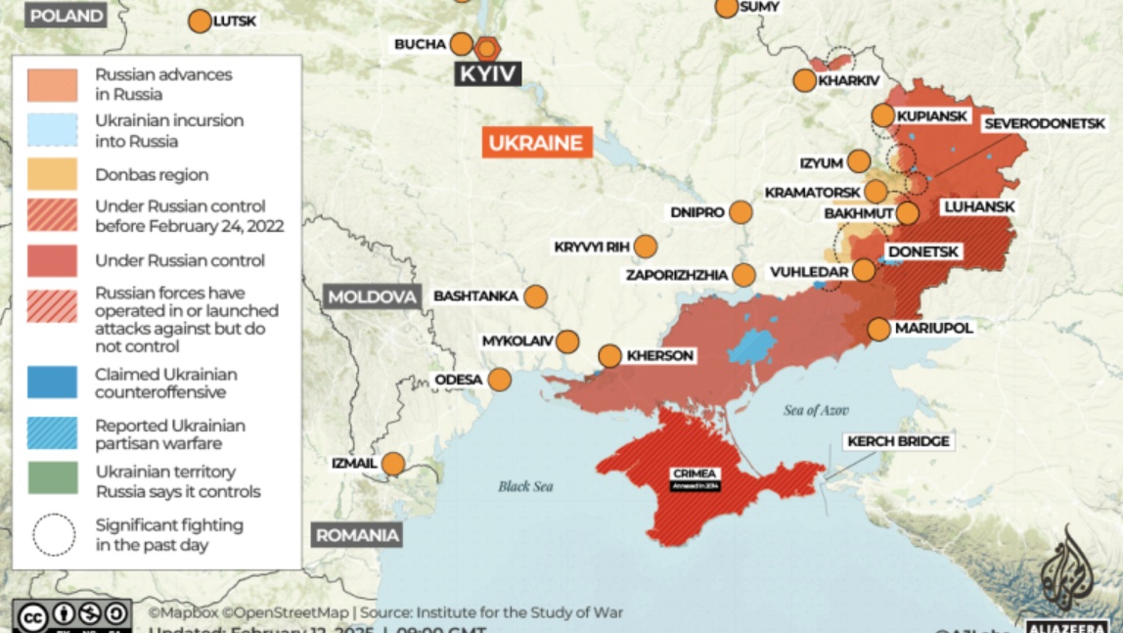

Slide 40
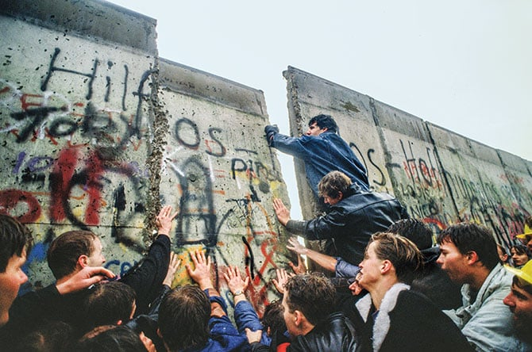
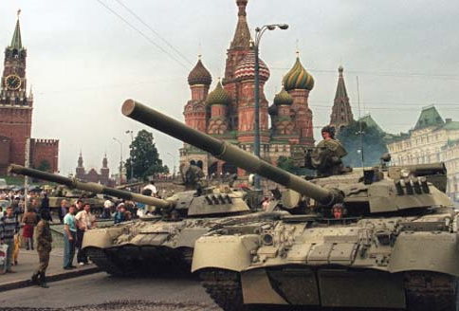
Exit Ticket
What was one major event that led to the fall of the Soviet Union?

