Slide 1
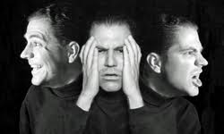
Dissociative Identity Disorder
(Multiple Personality Disorder)
Tynira Johnson & Lena Ray

Slide 2
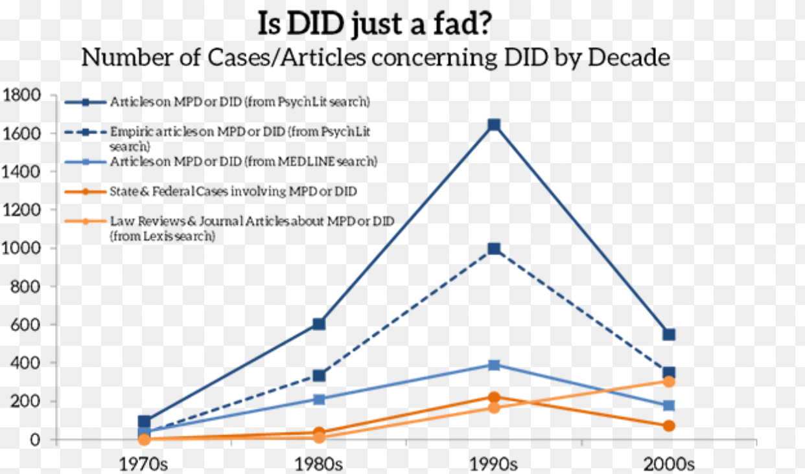
What is DID?
How Common?

Slide 3
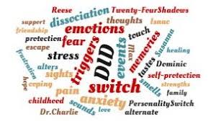
What can trigger this disorder?
Severe trauma during early childhood (usually extreme, repetitive physical, sexual, or emotional abuse).

Slide 4
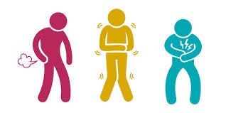
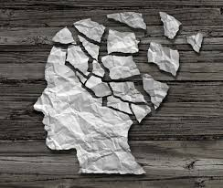
Symptoms
Memory less (amnesia)
Sense of detachment from self & emotions
Blurred sense of identity
Inability to cope with emotions/ professional stress
More problems such as depression
Anxiety
Suicidal thoughts/ behavior

Slide 5
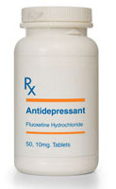
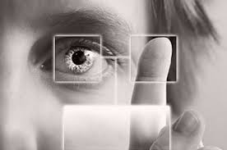
Treatments
Psychotherapies Medications EMDR
Cognitive behavioral therapy & Dialectical behavioral therapy
Eye movement desensitization and reprocessing
Antidepressants

Slide 6
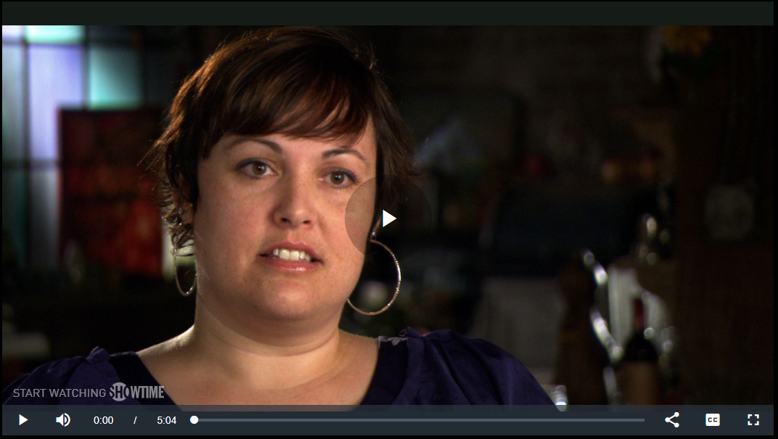
Personal Stories
https://www.sho.com/video/10742/leah-peterson-living-with-did

Slide 7
Sources
https://psychcentral.com/lib/types-of-mental-health-professionals/
https://my.clevelandclinic.org/health/diseases/9792-dissociative-identity-disorder-multiple-personality-disorder
https://www.mayoclinic.org/diseases-conditions/dissociative-disorders/symptoms-causes/syc-20355215
http://www.mentalhealthamerica.net/types-mental-health-professionals
https://www.psychiatry.org/patients-families/dissociative-disorders/what-are-dissociative-disorders
https://www.betterhealth.vic.gov.au/health/conditionsandtreatments/dissociation-and-dissociative-disorders

