Slide 1
Post Traumatic Stress Disorder
Circumcision
By Isaiah and Locke

Slide 2
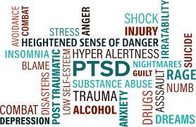
PTSD Overview
PTSD is caused by the seeing or experiencing of a shocking, scary, or dangerous event.
In a traumatic event, a person feels fear which triggers split second changes in the body to defend itself.
People who suffer from PTSD feel these symptoms after the trauma when they are no longer in danger.

Slide 3
PTSD Symptoms
Avoidance
Avoiding thoughts or feelings related to the traumatic event
Staying away from things that are reminders of the traumatic experience
Re-Experiencing
Flashbacks
Bad dreams
Frightening thoughts
Cognition
Negative thoughts about oneself or the world
Loss of interest in enjoyable activities
Trouble remembering features of the traumatic event
Feelings of guilt or blame
Arousal
Being easily startled
Feeling tense or “on edge”
Having difficulty sleeping
Having angry outbursts

Slide 4
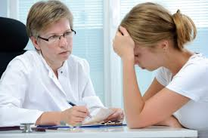
PTSD Diagnosis
To be diagnosed you must:
- Have at least one re-experiencing symptom.
- At least one avoidance symptom.
- At least two arousal symptoms.
- At least two cognition or mood symptoms.
You must be diagnosed by a psychiatrist or a psychologist

Slide 5
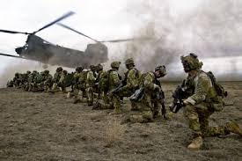
PTSD Causes (Risk Factors)
Risk factors for PTSD include
Living through dangerous or traumatic events ( especially with little or support afterwards)
Extra stress after the event, like the loss of a loved one, house, job, etc.
Being hurt
Seeing another person be hurt or killed
Experiencing extreme helplessness or fear

Slide 6
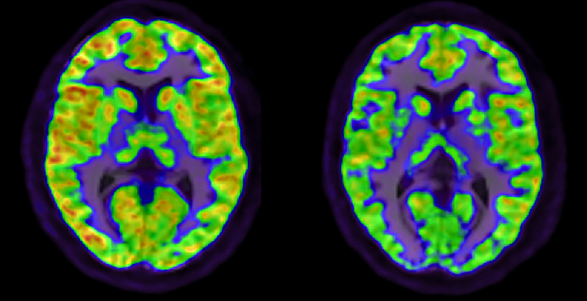
PTSD Treatments
PTSD affects everyone differently and therefore treatment varies from case to case and the same thing will not work everytime. Medication and therapy are the most common forms of PTSD treatment.
Person with PTSD before treatment
Person with PTSD after treatment

Slide 7
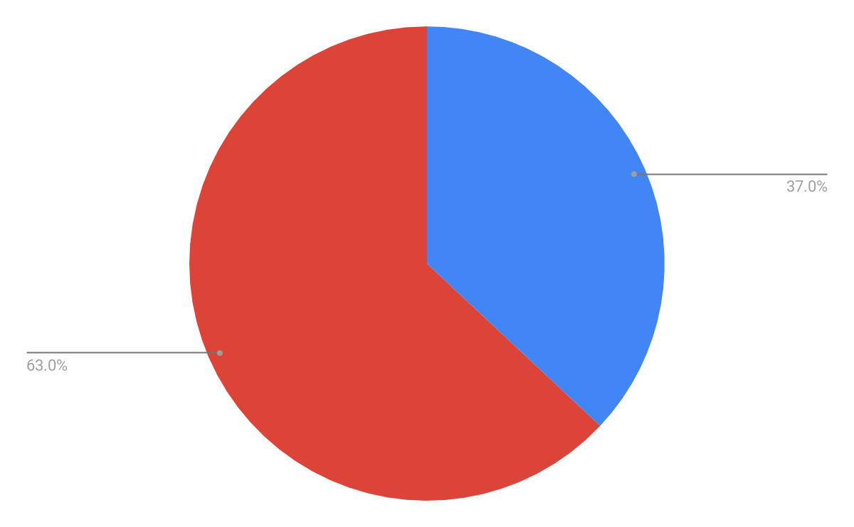
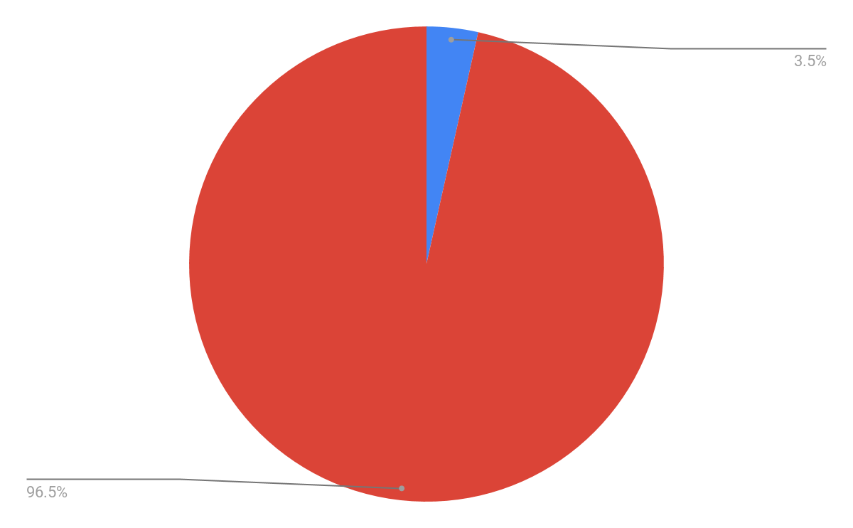
PTSD Statistics
These statistics apply to the United States only.
About 8 million Americans suffer from PTSD.
PTSD
Severe Symptoms
Minor/Moderate Symptoms
No PTSD
37% with severe symptoms
3.5 percent of adult population

Slide 8
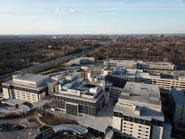
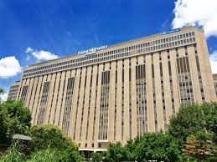
PTSD Resources
These are all in the St. Louis area.
Saint Louis Counseling - multiple locations
Mercy Hospital St. Louis - behavioral health center
Barnes Jewish Hospital - behavioral health center

Slide 9
Citations
Sources used in addition to provided websites
ptsdalliance.org
https://medicalxpress.com/news/2017-07-ptsd-potential-path-treatment.html

Slide 10
KAHOOT TIME
Were you paying attention?

