Slide 1
Major Depressive Disorder
Kayla Willis & Caleb Hines

Slide 2
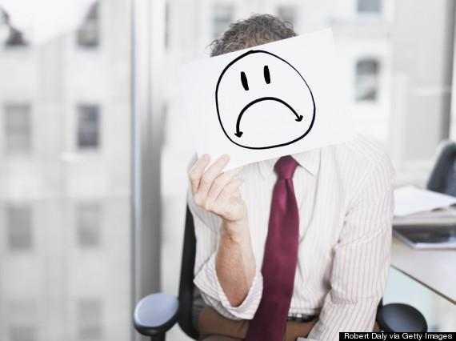
Symptoms & Causes
Potential Causes:
Trauma (Emotional/ Physical)
Genetics
Frontal lobe dysfunction
Life circumstances
Other medical conditions
Substance abuse
Hormones
Common Symptoms:
Low energy
Low concentration
Social Withdrawal
Sadness
Over or under eating
Over sleeping or lack of sleep
Guilt
Anxiety
Irritability
Physical Pain
Suicidal thoughts

Slide 3
Statistics
16 million adults (7%) had 1+ major depressive episode (2016)
Between ages 18-25 had the was the highest(10.9%) among adults who had a major depressive episode
37% of adults with an episode didn’t get treatment
44% did receive treatment and medicine
3.1 million (~13%) 12-17 year olds had a major depressive episode.
60% did not receive treatment

Slide 4
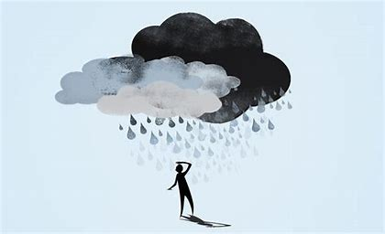
Reasons for not Seeking Help
Stigma: Gender roles and judgement
Lack of public acceptance and support- “Good thing to just deal with it”
It will just go away, or conversely, a natural part of growing up to become depressed
Fear of starting antidepressants and taking the pills forever

Slide 5
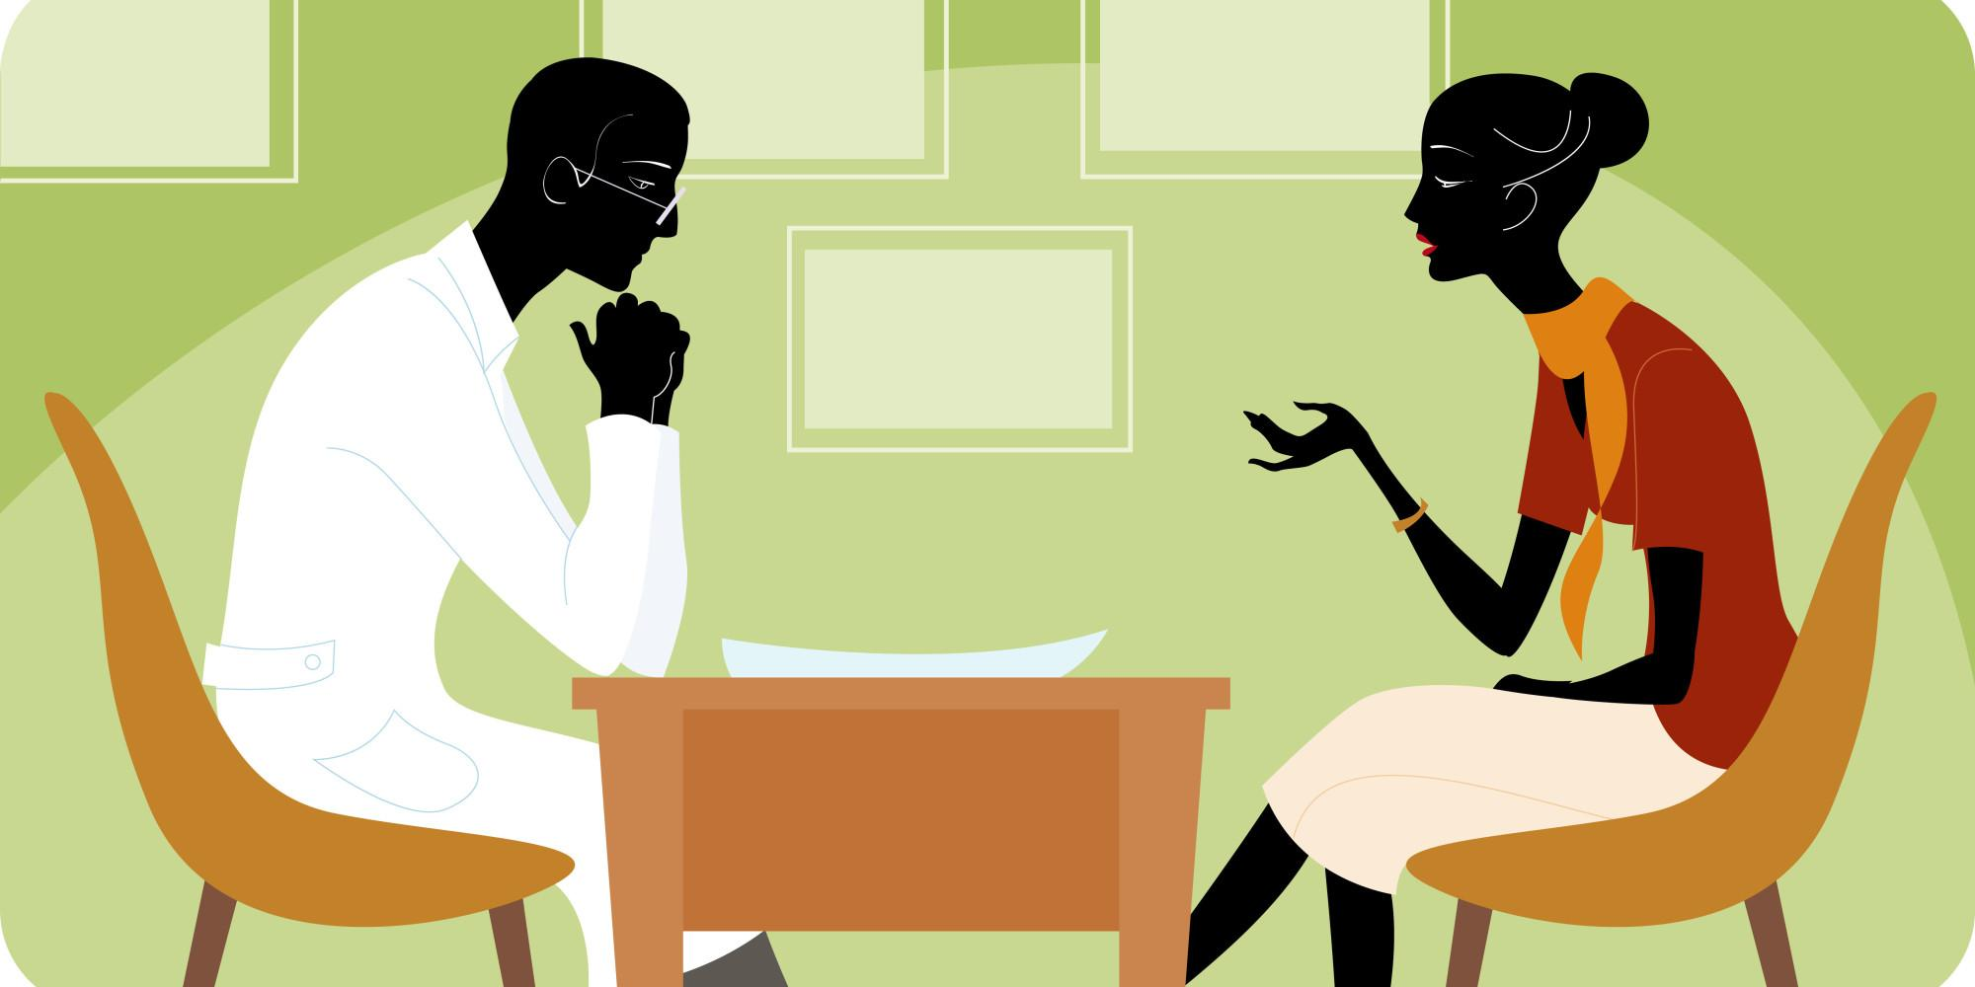
Risk Factors & Diagnosis
Risk Factors
Personal and or family history
Major life changes, Trauma, or Stress
Certain illnesses and medication
Drug and alcohol abuse
Diagnosis Includes a period longer than two weeks where said patient has experienced symptoms mentioned before

Slide 6
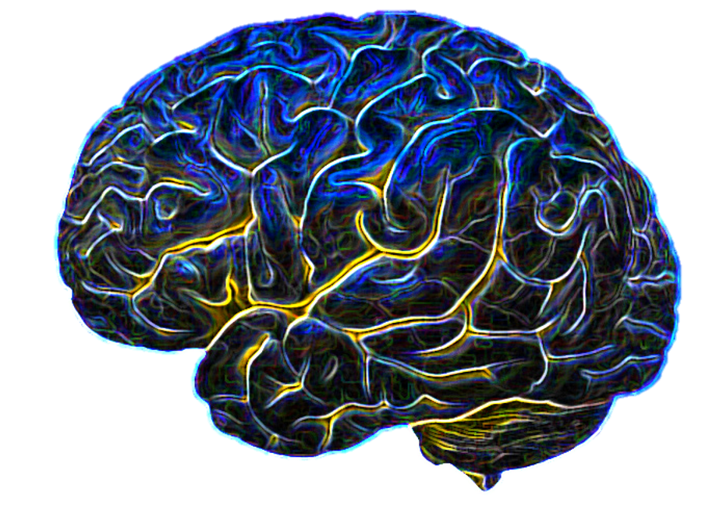
Treatments
Holistic Methods:
Faith healing
Meditation
Exercise
Healthy diet
Psychotherapy
Self Help Groups
General Methods
Medicine (antidepressants)
Brain Stimulation (ECT)
Light Therapy

Slide 7
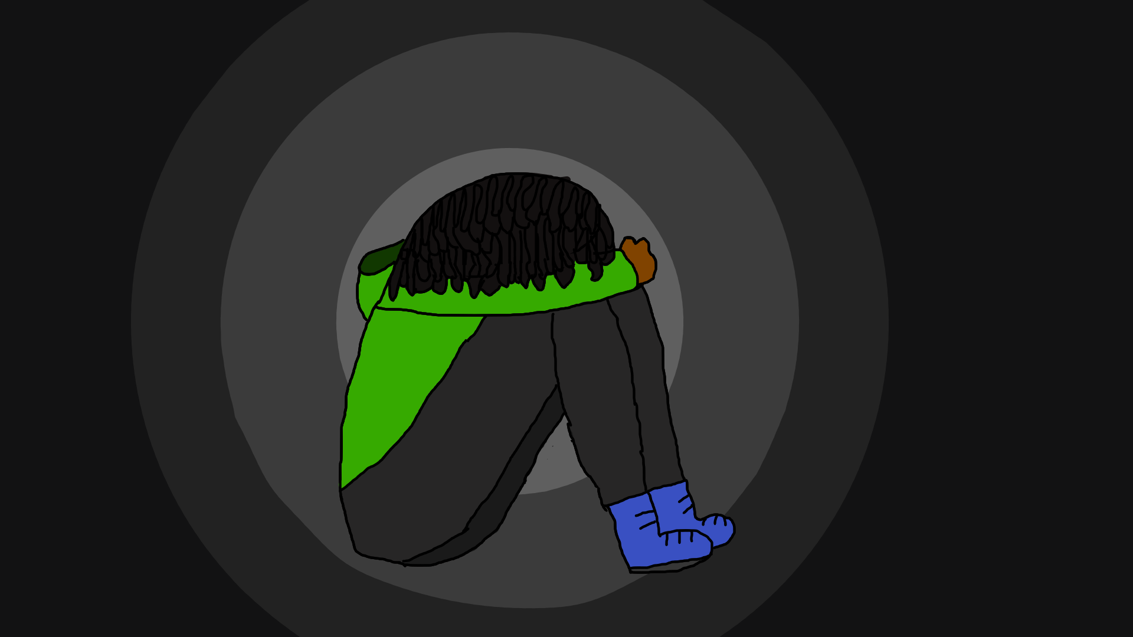
Importance of Treatment

Slide 8
Careers
Many groups of specialized mental health counselors
Specialized social workers

Slide 9
Resources: Online & Local
Provident Inc- Yalem Location 2650 Olive Street, Saint Louis, MO 63103
Saint Louis Behavioral Medicine Institute 1129 Macklind Avenue, Saint Louis, MO 63110
Care STL Health formerly Myrtle H Davis Health Centers, Inc. 5471 Dr Martin Luther King Drive, Saint Louis, MO 63112
1-800-273-8255 - National Suicide Prevention Lifeline
https://www.accreditedschoolsonline.org/resources/student-mental-health-resources/
https://www.affordablecollegesonline.org/college-resource-center/college-student-depression/

Slide 10
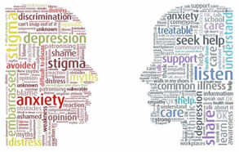
Negative Stereotypes
“Real men don’t get depressed”- A negative stereotype strongly impacting men, which ties into reason for not
receiving treatment
“Depression is a sign of weakness”
“It’s not a real illness”
“All in the patient’s head”

Slide 11
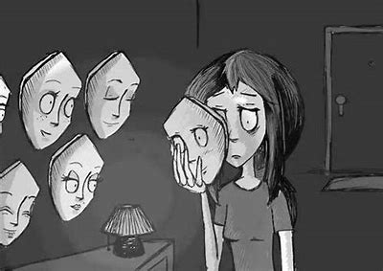
Important Information
Depression can lead to medical issues beyond sadness, such as obesity, anxiety, diabetes, heart disease,
Alzheimer’s, and cancer.
Masked depression- Patients do not
report any typical feelings of sadness, but show completely different symptoms- ties into not seeking out treatment

Slide 12
Sources
https://www.mayoclinic.org/diseases-conditions/depression/symptoms-causes/syc-20356007?p=1
https://mastersinpsychologyguide.com/articles/8-best-careers-help-people-mental-illness
https://www.huffpost.com/entry/depression-myths_n_5715453
https://www.webmd.com/depression/default.htm
https://psychcentral.com/lib/an-overview-of-electroconvulsive-therapy-ect/
https://www.healthline.com/health/depression/light-therapy#method

