Slide 1
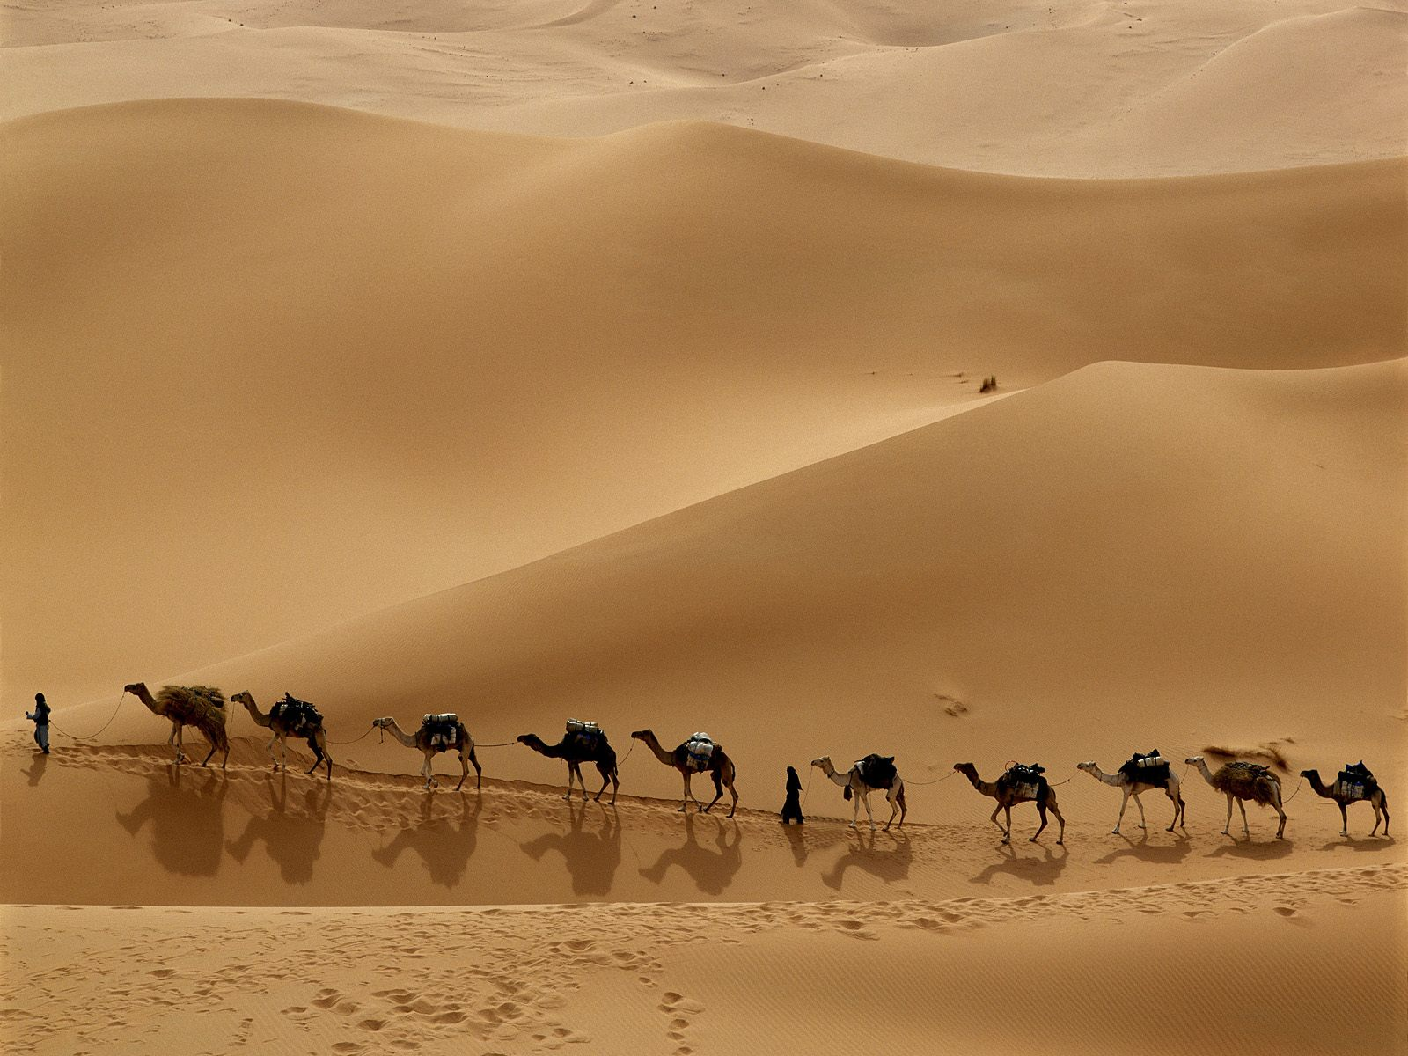
NETWORKS OF EXCHANGE

Slide 2
SILK ROAD
& TRADE

Slide 3
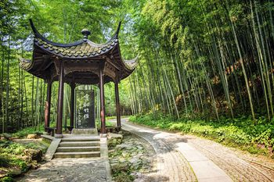
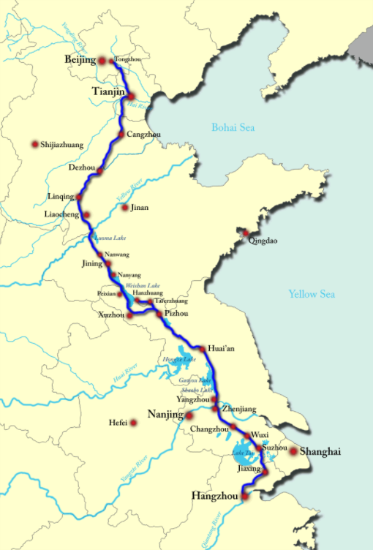
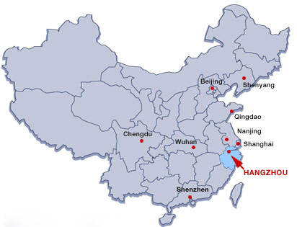
SILK ROAD & GROWTH OF CITIES
Silk Road refers to a network of East-West trade routes connecting the goods of China to the rest of the world. Named after silk, China went to great lengths to protect travel and trade on it.
*Items of international importance like Silk was made in China and shipped to Hangzhou and then all over the world.
*Great Wall was set up to protect trade.
*Other world cities like Timbuktu in Africa and Malacca in SE Asia played an important trade role.
China exported wealthy goods like tea, salt, sugar, porcelain, & spices. Imported cotton, ivory, silver, etc.

Slide 4
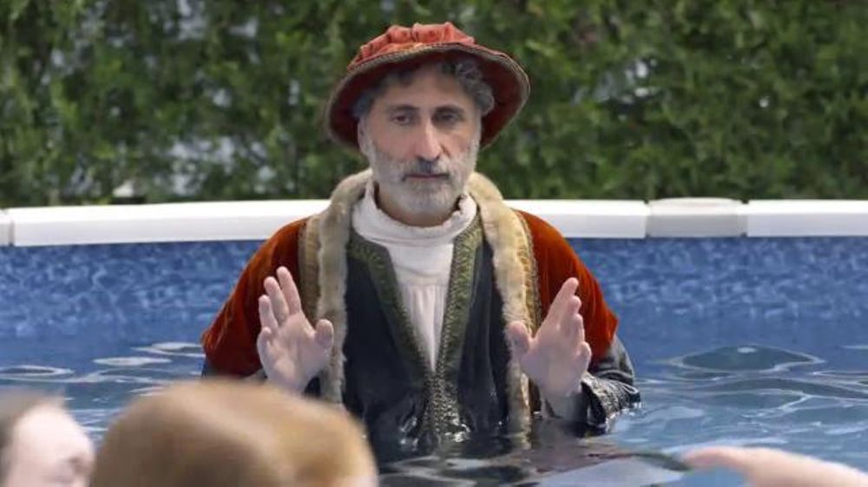
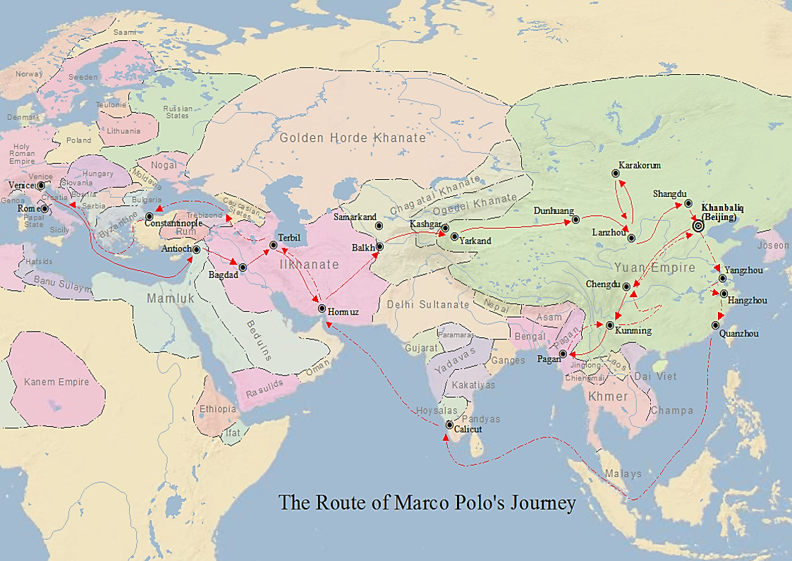
Marco polo
1st explorer to chronicle his travels to China in great detail, provided clarity to others & encouraged trade (he traveled over 15,000 miles in 24 years).
*Brought knowledge of spices, ginger, powdered milk, yaks, & paper money to E.
*Knew Kublai Khan and was given his gold tablet to ensure safe travel.
*He thought rhinos were unicorns, believed in sorcery and evil spirits.

Slide 10
THE MONGOLS

Slide 11
EARLY MONGOLS
Early Mongols were nomads, heavily influenced by Chinese emperors and Tatars (traveling barbarians that brutalized Russia & Ukraine regions).
*It’s sort of a mystery as to how they gained military edge, but its though warmer conditions led to more horses thus increased military strength (invented stirrups which assisted their riders).

Slide 12
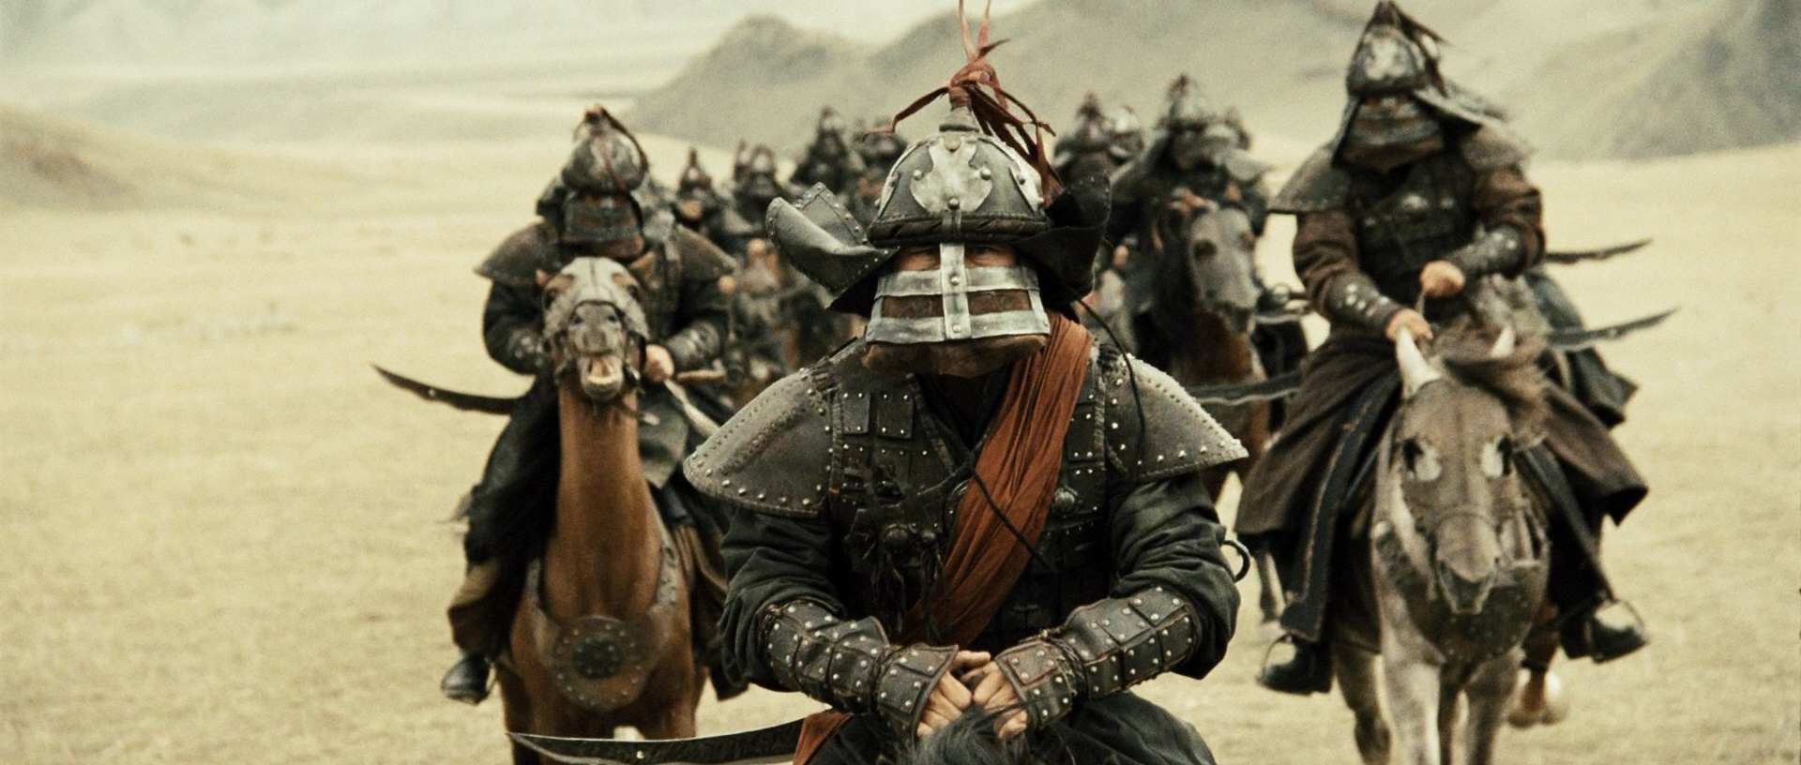
Mongol fighting tactics
In general, Mongols would arrive at an enemy village & tell people either to surrender or that everyone would be slaughtered (no survivors). Cities that fought were entirely put to death! Reputation spread and cities began to surrender.
Mongols never had supply lines, never outnumbered enemies. As skilled horse men they just attacked faster & more effectively than any other soldiers in history.
*Mongol armies killed 40M people, about 10% of the world at that time, today that’s 700M.
*Cities that surrendered were treated pretty well, if they paid tax, they kept independence & freedom.
*If your nation broke treaty, would destroy entire civilization which includes innocent towns next door to the people who broke it.
*Once had molten silver poured into enemies eyes & ears, others had backs broken/trampled to death. Soldiers in groups of 10, 100, 1000, and 10,000.
*Genghis Khan will go down in history as greatest killer in the history of the world.

Slide 13
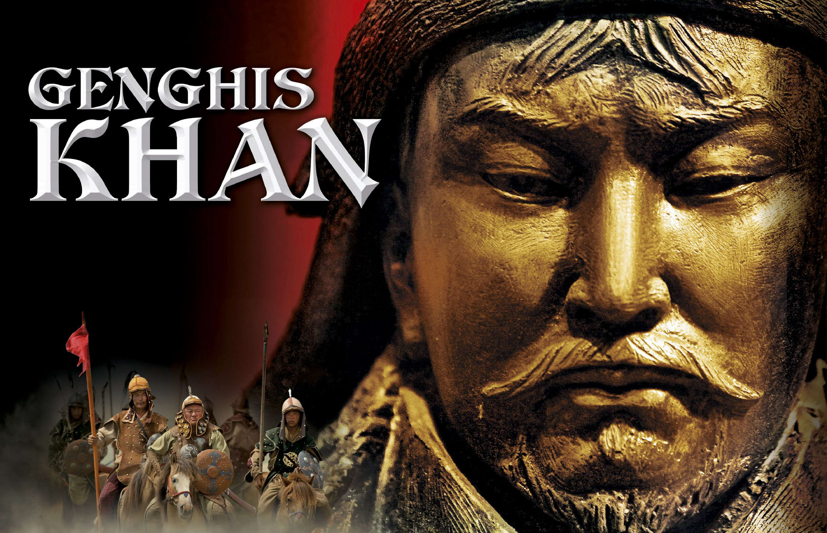
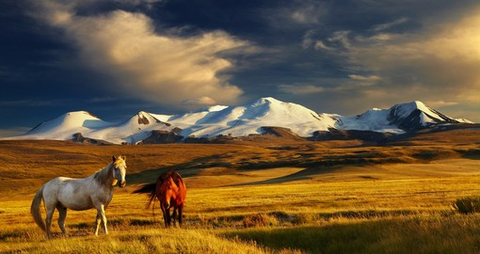
In 1206, Genghis Khan comes to power & creates the largest land based empire in the history of the world. GK would slaughter rivals and establish new cities focused on trade. At it’s peak, Mongol Empire controlled 12 million square miles (about size of Africa).
*GK had a rough childhood, his father was poisoned and he killed his half-brother in a hunting dispute, as a teenager, he and his wife were kidnapped & forced into slavery (once he escapes he begins creating his army out of revenge).
*Before 1206, GK was one of the regional tribal leaders fighting for area supremacy. His rise to power was fueled by hatred of other leaders who also were legendary sickos (one was known for boiling people to death).
*GK had lots of offspring, he had 1000s of partners, estimated 1/200 people in world are related to GK.

Slide 14
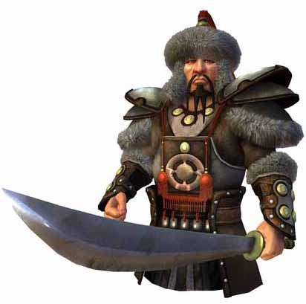
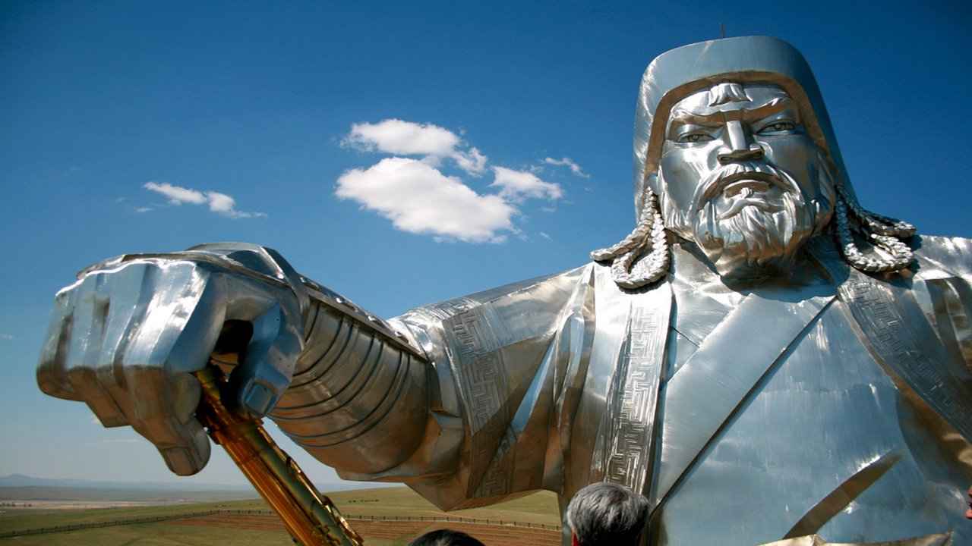
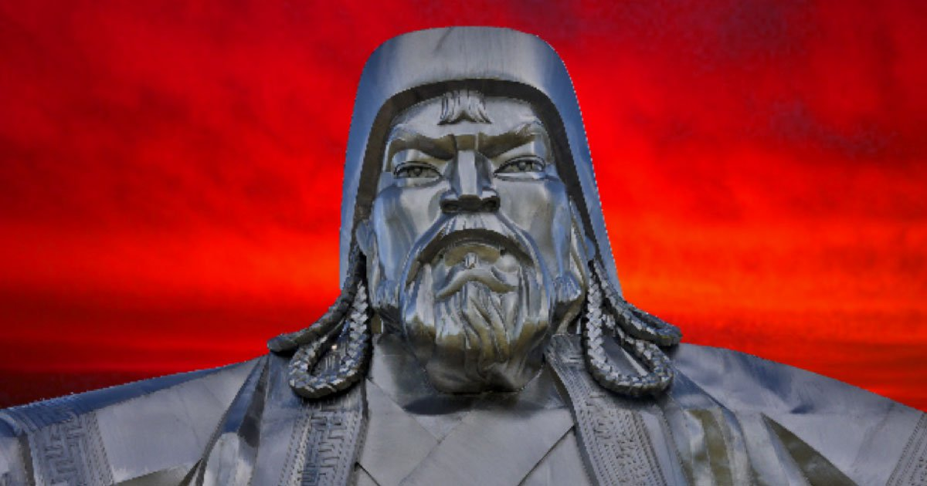
*Legend of Khan
According to legend, GK was born with a blood clot in his fist. At age 9, rival people (Tartars) poisoned his family & GK spent his life abandoned by his clan & living in extreme poverty.
To revenge Tartars, he killed every male taller than a cart axle.
“Man’s greatest good fortune is to chase & defeat his enemy, seize his total possessions, leave his married wife weeping & wailing, & ride off with his horse.”

Slide 15
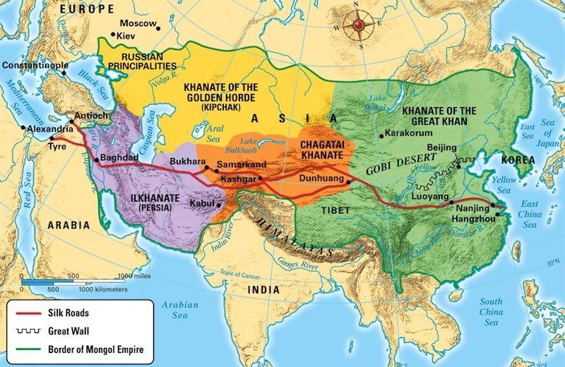

Slide 16
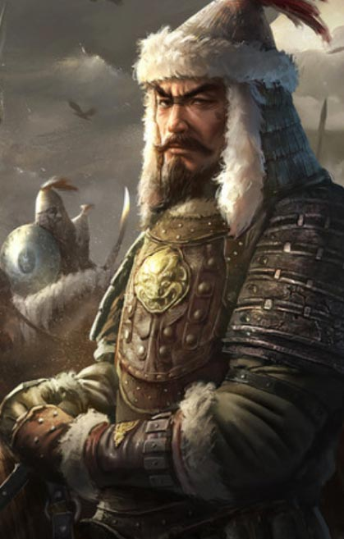
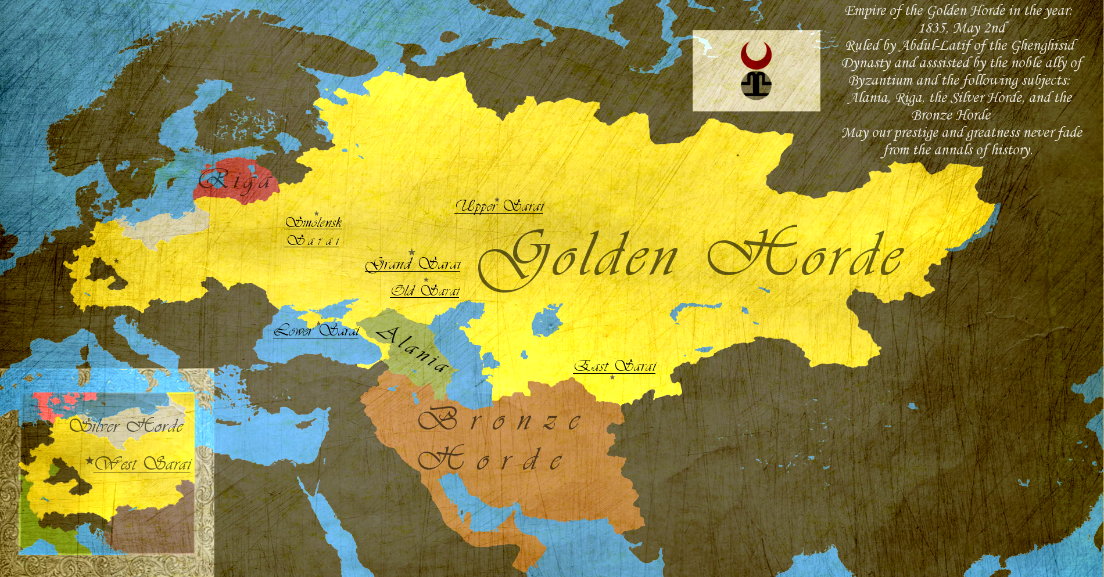
Ogedei & BAtU khan
In basic terms, conquering & dominance continued through son and grandsons (and attacks made by their Golden Horde). Armies move into Europe.

Slide 17
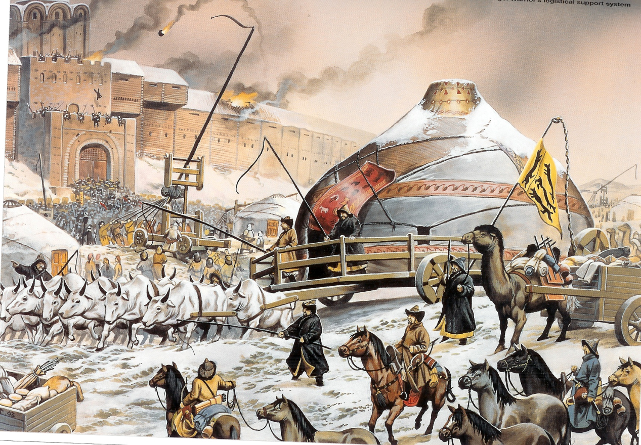
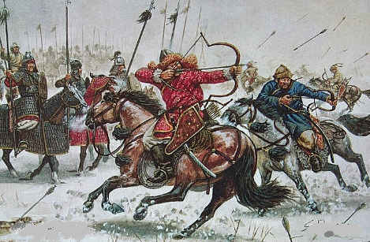
Fall of Kiev (Russia)
“No eye remained to weep.”
“When we passed thru the land, we found lying in the field countless heads and bones of the dead.”
Bantu Khan demolished the Russians in Kiev.
*Bantu was impressed with the splendor of Kiev so he offered terms for its surrender. Instead the Russians killed the envoys requesting their surrender. Mongol attacks included catapult launches and killings of people hiding in churches. Out of 50,000 citizens Russian, only 2000 lived.

Slide 18
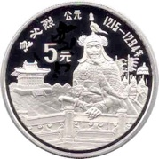
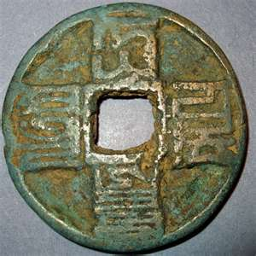
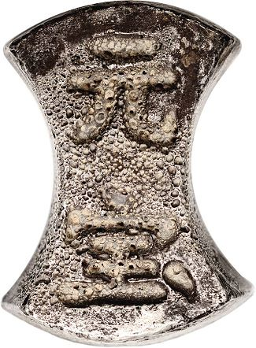
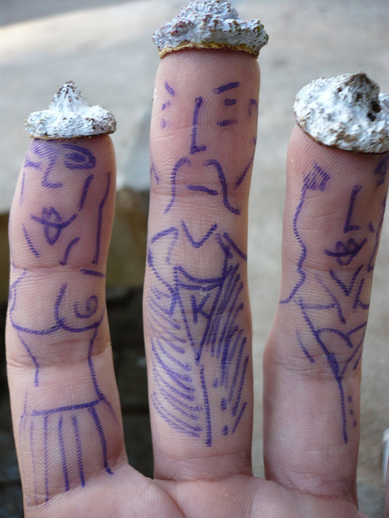
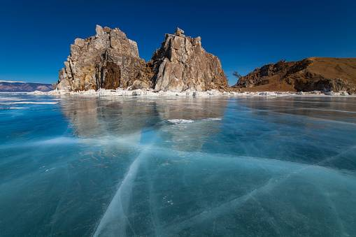
KUBLAI KHAN
GK’s sons fought for control of divided kingdom, but Kublai Khan controls most lands including China.
China paid a tribute (tax) of 200K taels of silver & 200K bolts of silk to Kublai.
The Golden Horde won a battle by chasing enemy onto a frozen lake which broke upon their weight.

Slide 19
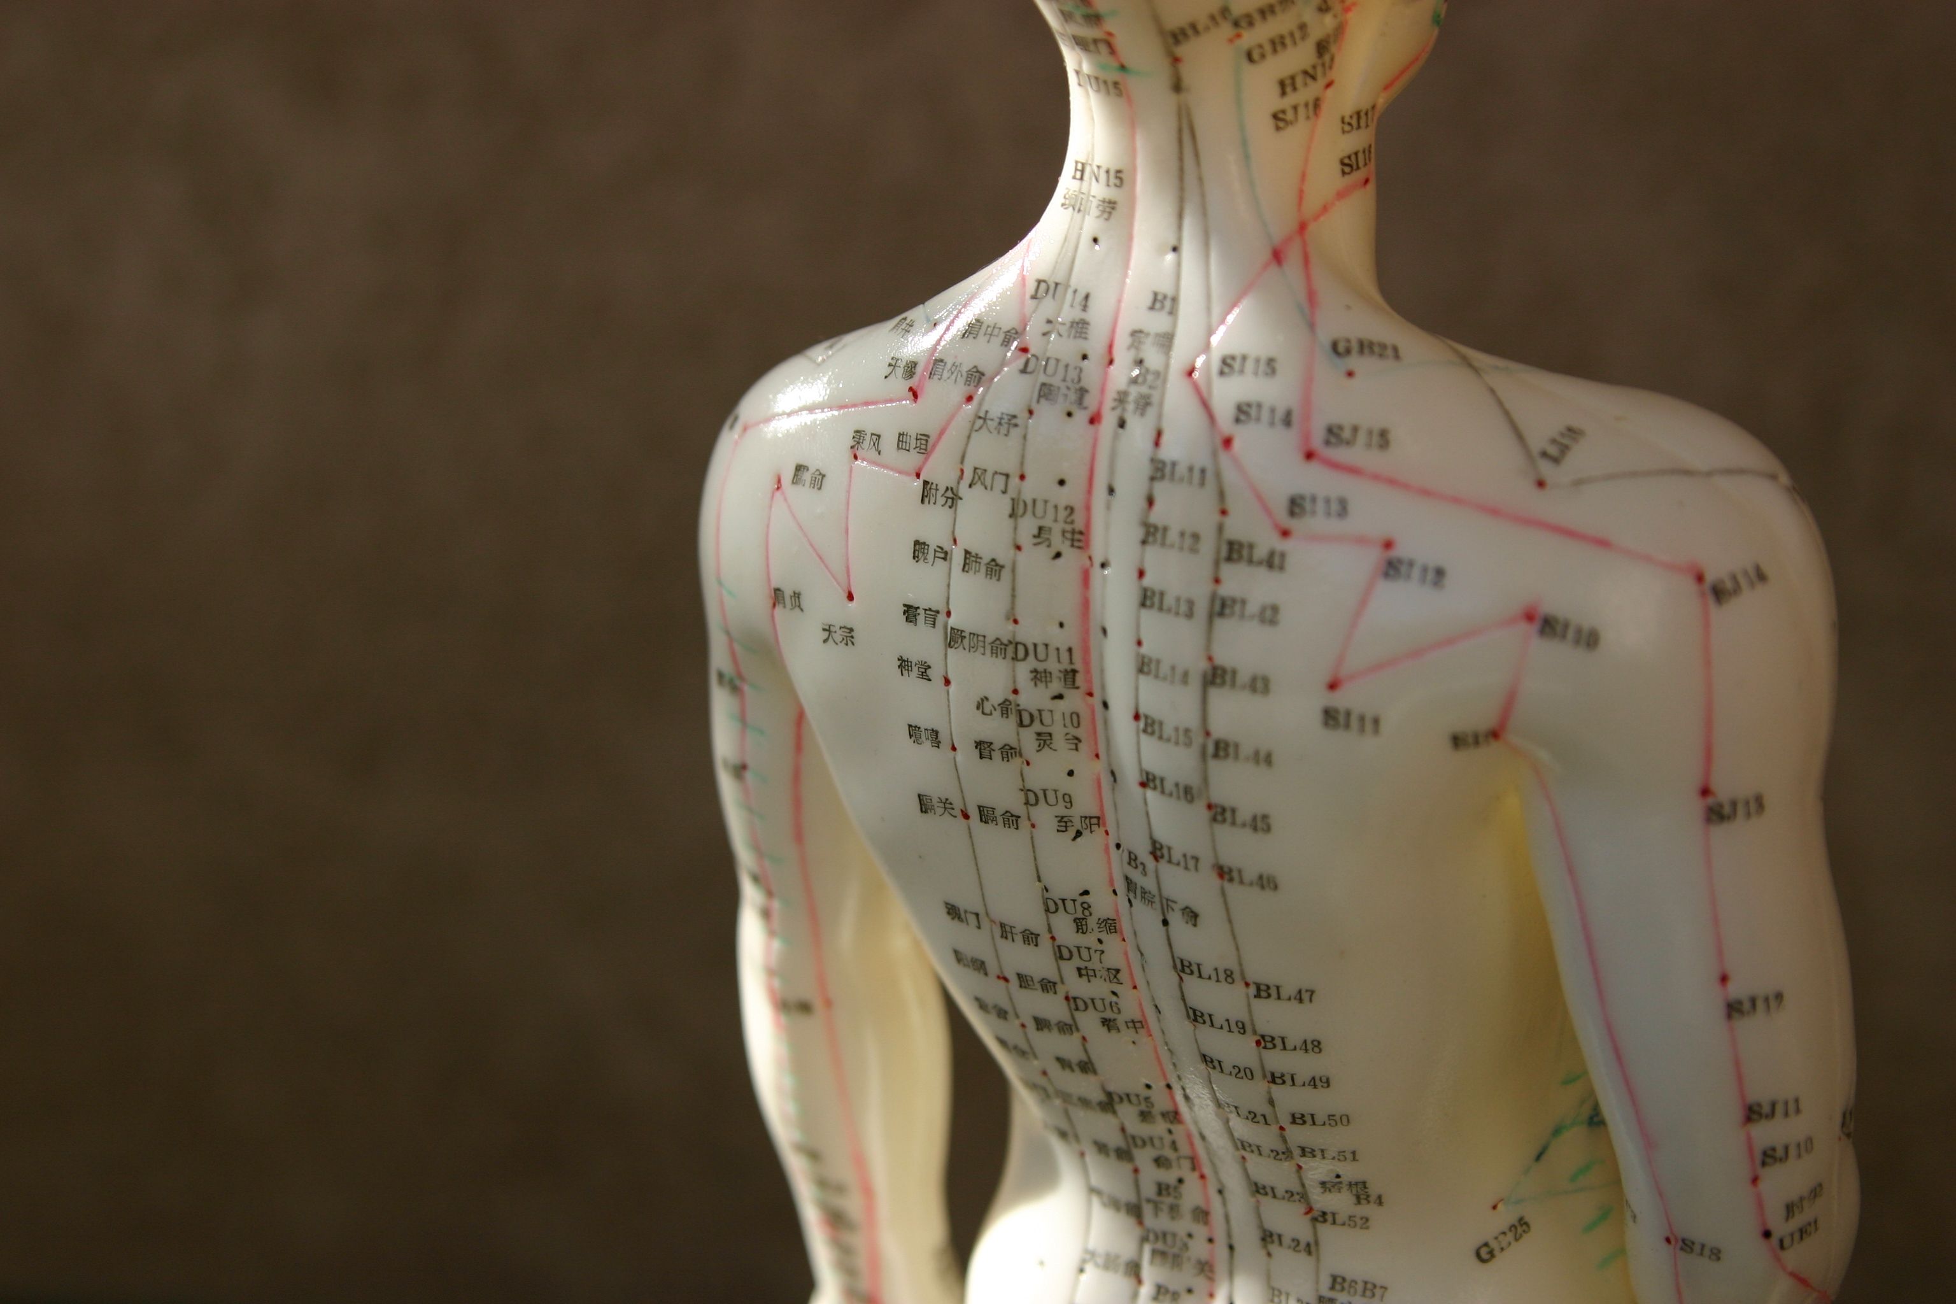
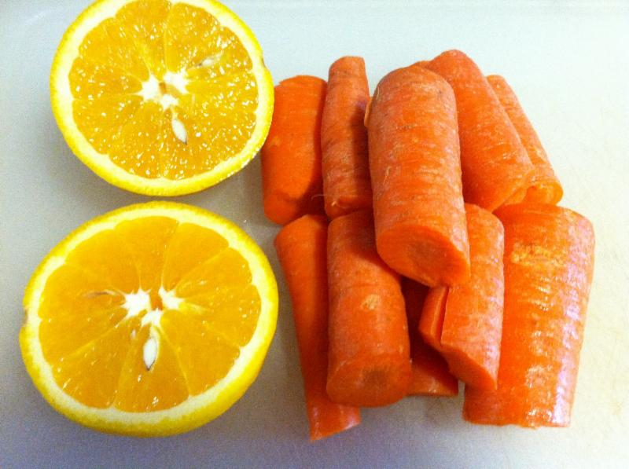
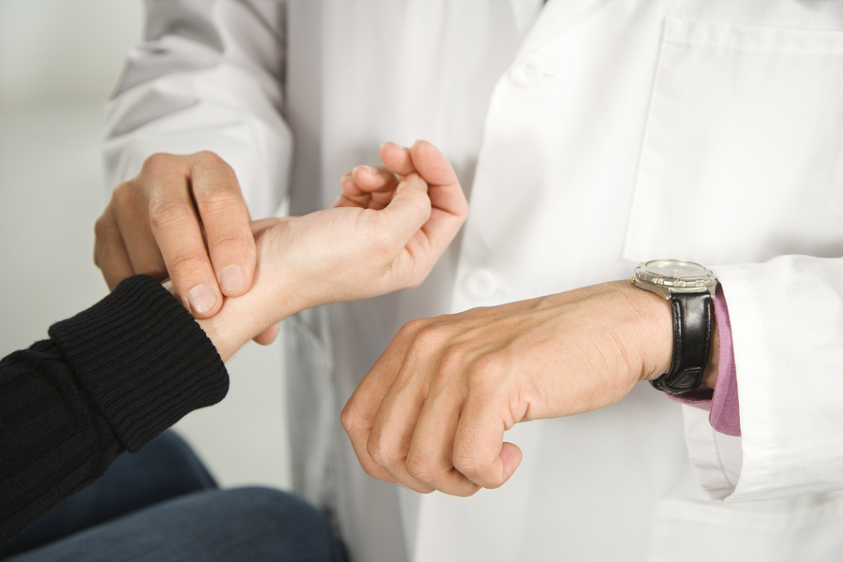
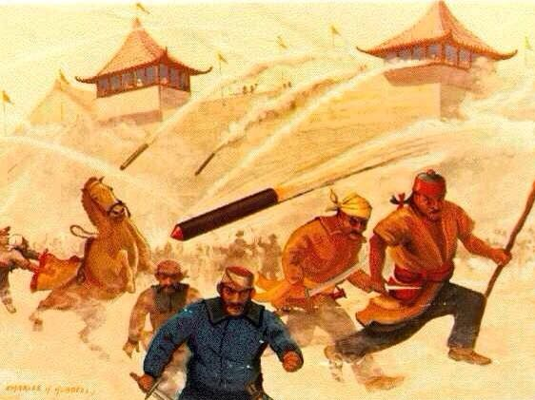
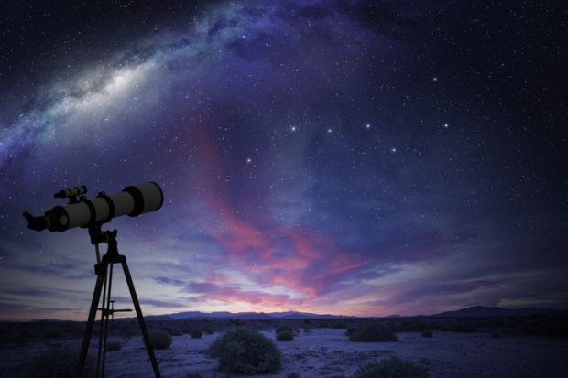
Ideas traveled with the Mongols so medical ideas like acupuncture and taking a pulse traveled to. So did new food items like lemons & carrots, as did astronomy, gunpowder, better furnaces & paintings.
CULTURAL EXCHANGE
*Wars always change the world. For example, after World War II the foods USA ate changed dramatically. Part of the reason Asian foods are so popular today has a lot to do with Vietnam War and bringing that cuisine home.
*During this time, Chinese actors appeared in Middle East as Persian wrestlers appeared in China, a jester from Eastern Europe entertained Mongols.

Slide 20
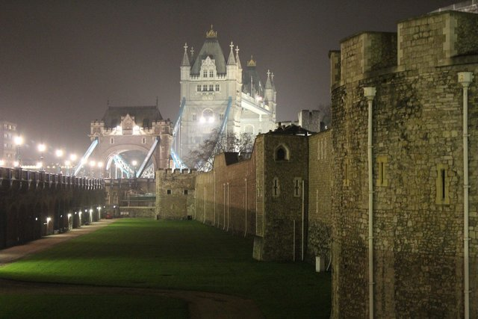
EUROPE

Slide 21
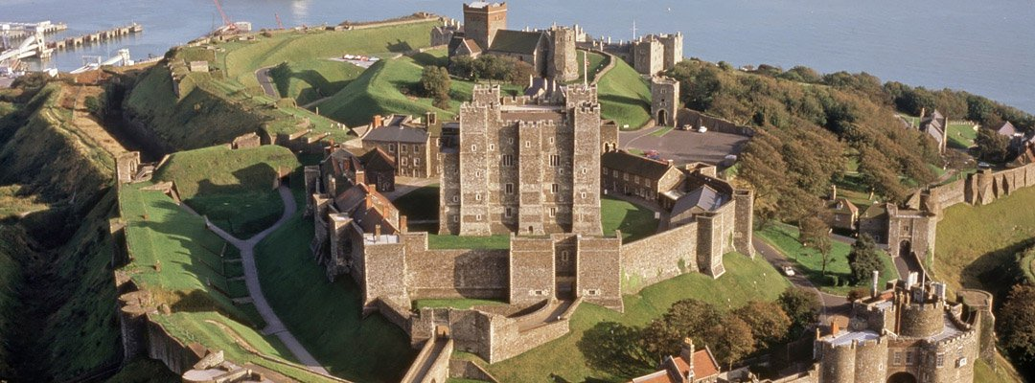
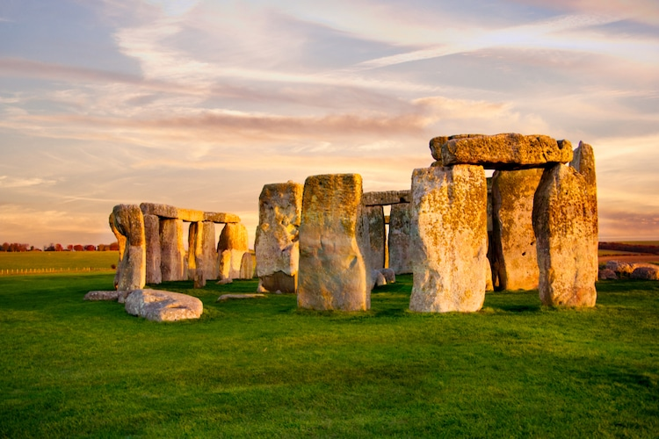
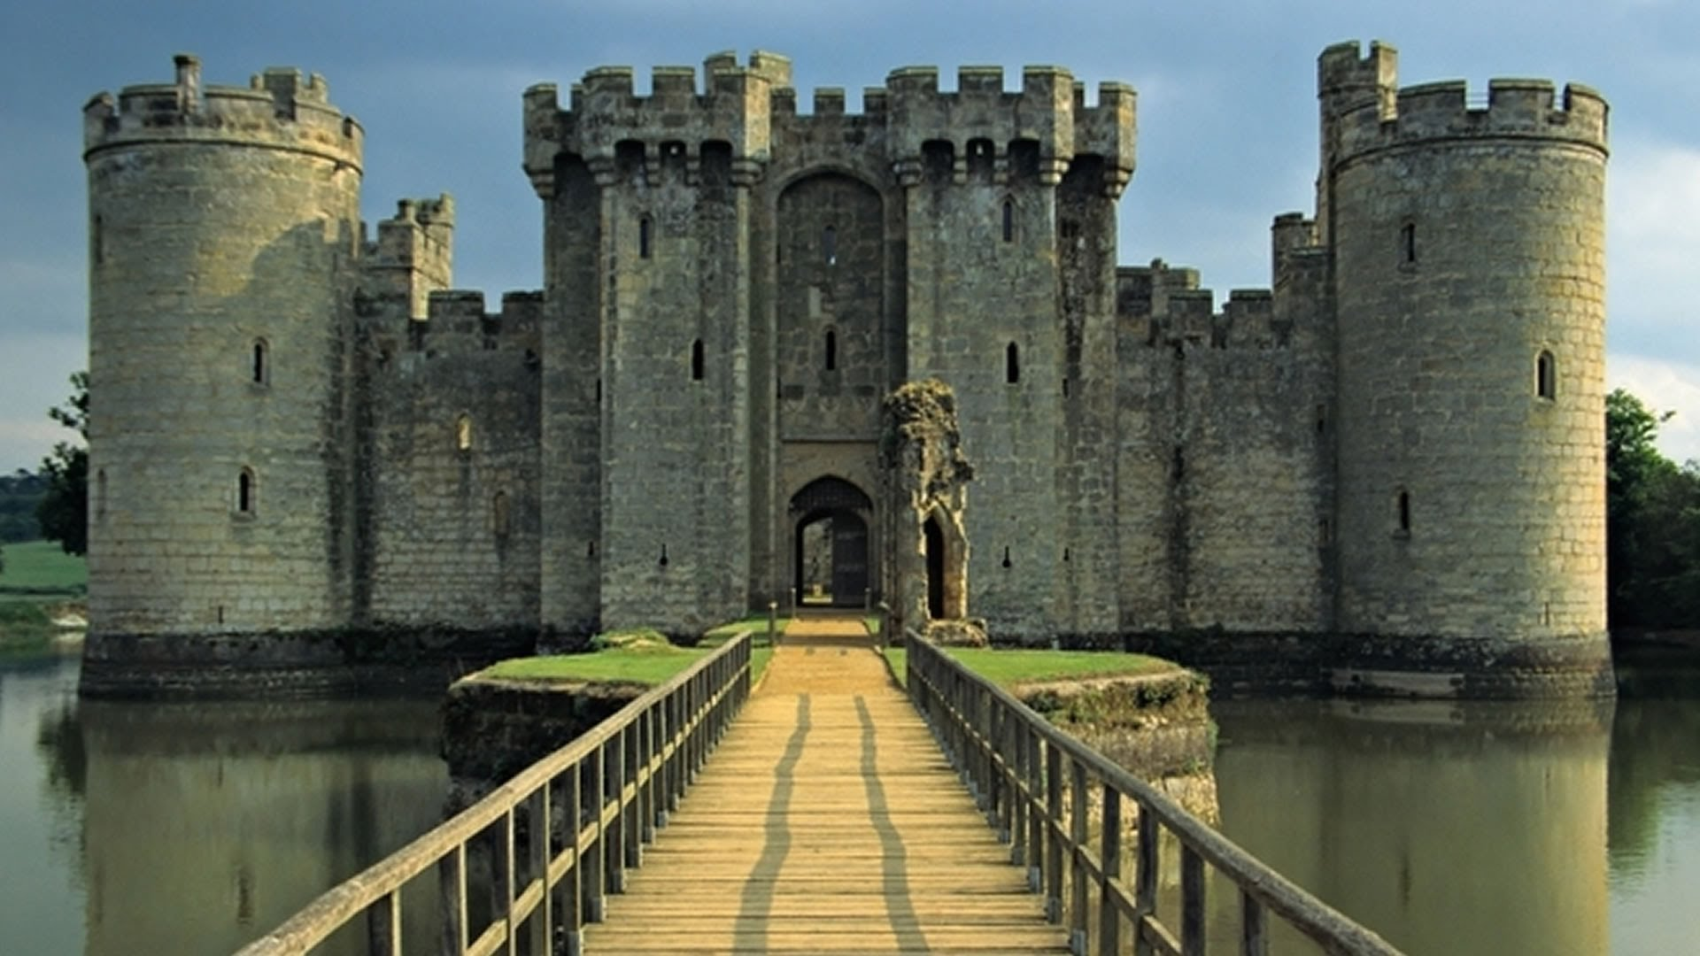
england
Island region was made up of small villages depleted by Viking raids until the people unified in the “Land of Angles” (named after Anglos peoples).
Early 1000’s, England molds Vikings & Anglo-Saxons into one people. In 1066, William the Conqueror of the Normans (located in France) took over & claimed all England as his property. Modern England begins in 1066.
In 1215, people were tired by absolute rulers/high taxes/etc so they demanded their rights in a document called the Magna Carta.

Slide 22
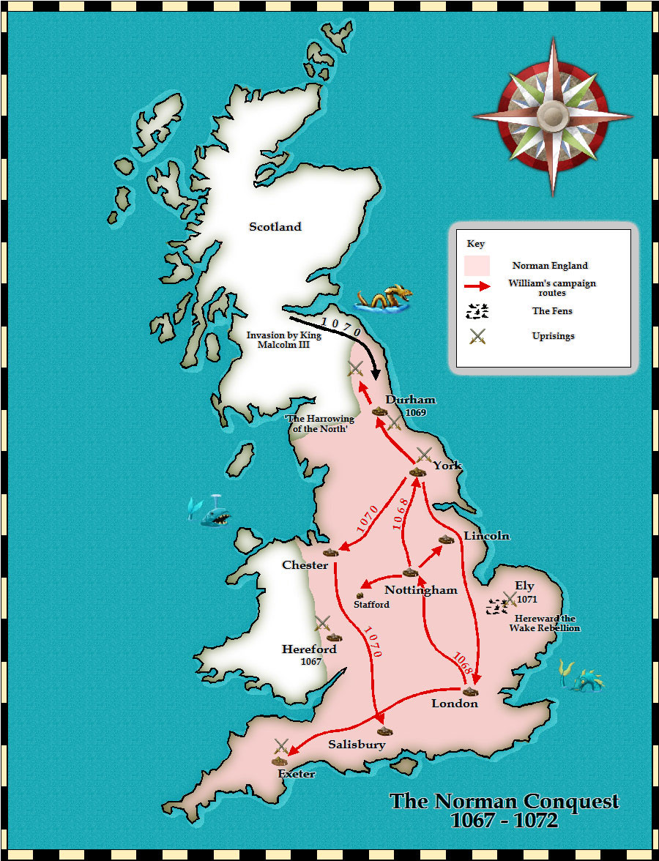
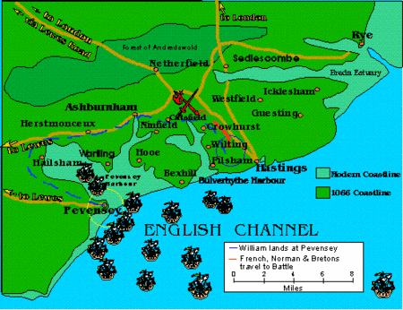
NORMAN CONQUEST
William the Conqueror won at the Battle of Hastings & was crowned king on Xmas of 1066. WTC put 200 Lords in charge of lands and modern day England is officially a nation.
x

Slide 23
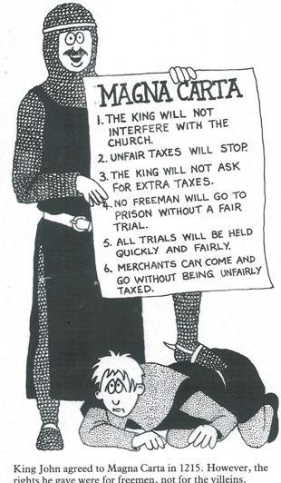
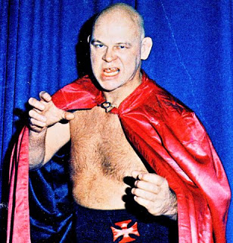
MAGNA CARTA
“The Great Charter,” limited the king’s power by some barons. It’s considered as the greatest Constitutional document in history (the first!).
*England eventually creates a Parliament as knights, bishops, lords meet together.
*Royalty will be called House of Lords, others called House of Commons.

Slide 24
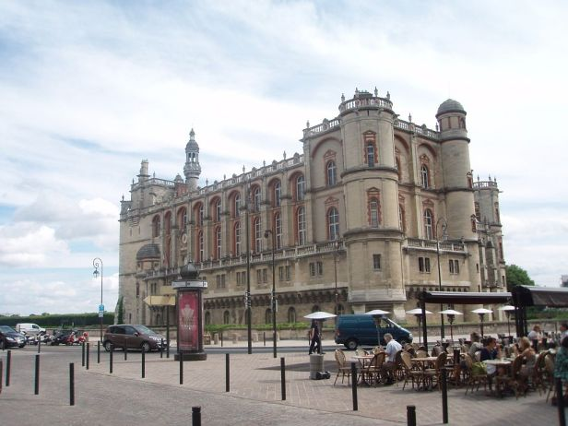
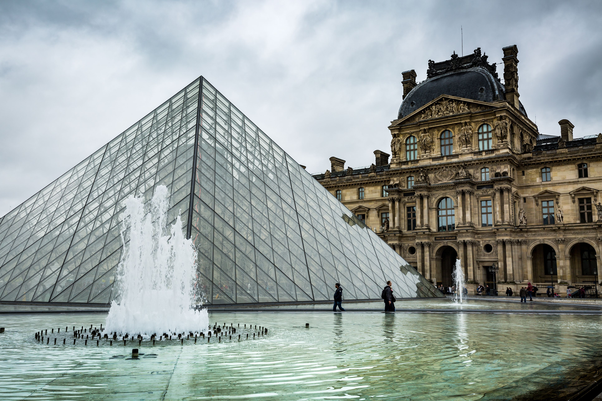
france
Feudal system governed the area of France (about 47 different territories existed around the year 1000). Hugh Capet (ruled area around Paris) arises to power & creates Capetian Dynasty (938-1328), unites France. France arranges its society into 3 classes called Estates:
1st Estate: Church 2nd Estate: Lords & Nobles 3rd Estate: Everybody Else

Slide 25
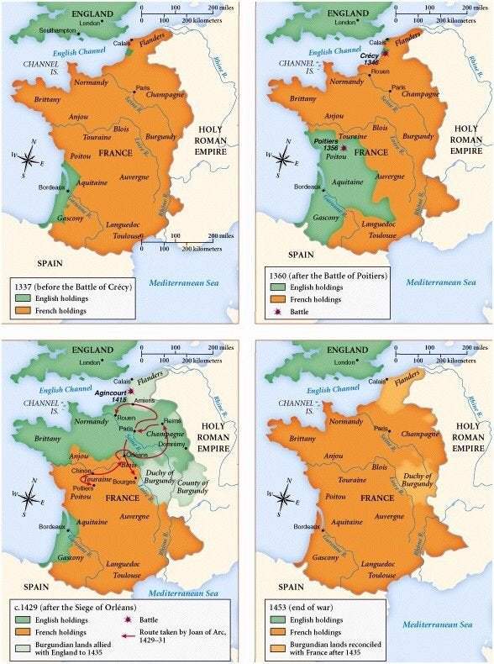
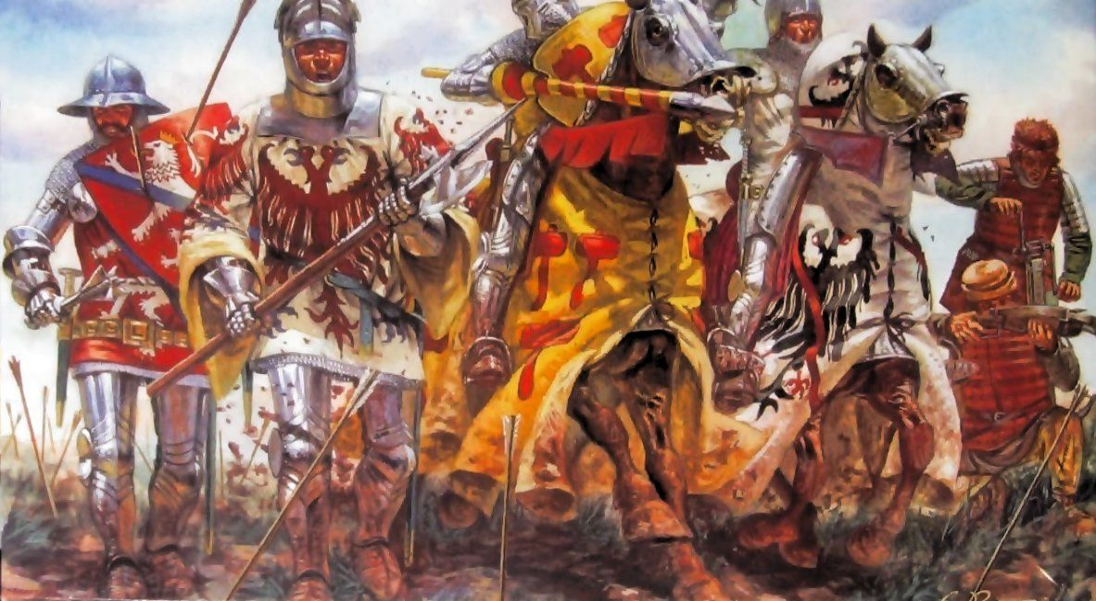
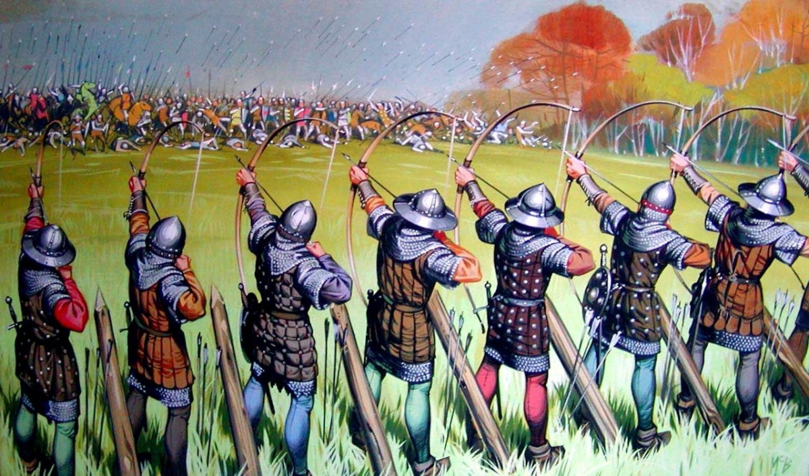
HUNDRED YEARS WAR
England & France are bitter enemies and stuck in a on-and-off war lasting 116 years. Fighting was mostly about royal family rivalries & desire to takeover other’s lands.
*As you can see on the map, most of fighting was done in France and England was about to take over completely until Joan of Arc became military commander in 1429.
*Though France “won” since they were not conquered at the end, both nations lost a lot. France lost half its population, England 25%.

Slide 26
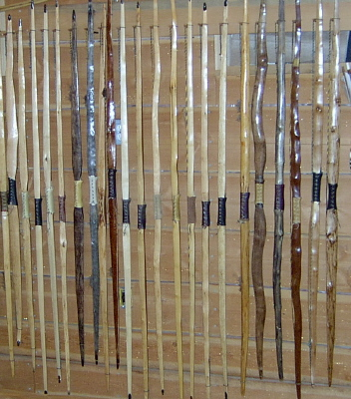
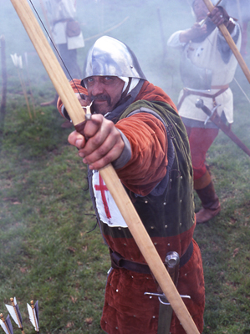
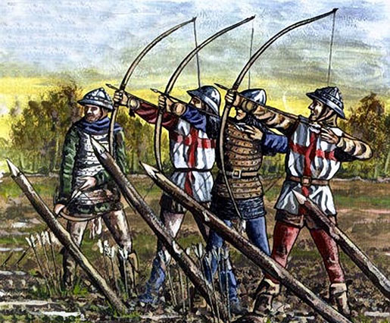
Longbow
“Machine Gun of the Middle Ages,” arrows pierced thru armor with ease, & were absolutely deadly under 100 feet.
The Longbow was as tall as the man, & this new style of warfare made the heavily armored foot soldier a thing of history (English perfected their use).

Slide 27
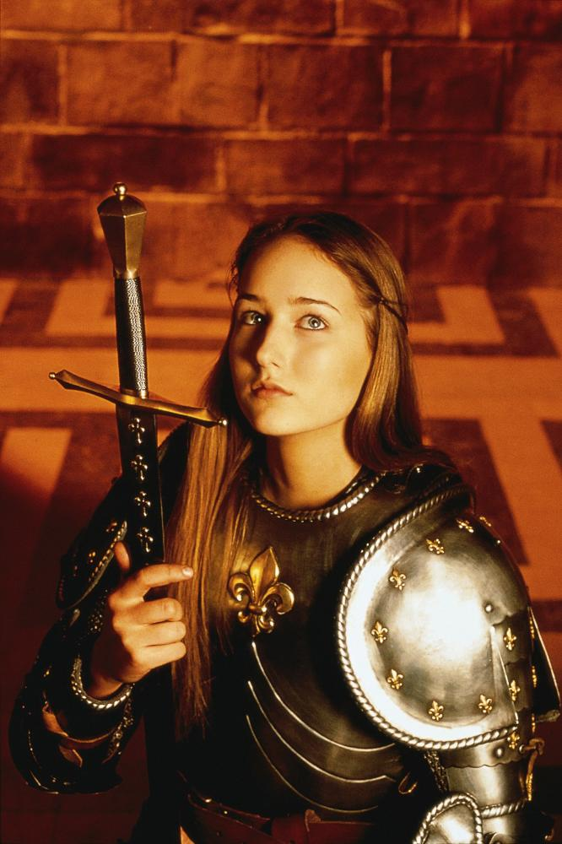
Joan of arc
During 100 Years War, most of the fighting was done in France & a lot of towns were destroyed. JOA was a courier & felt God spoke to her and turned the war into a religious war. People followed her and victories began for France (she was just 17).
*Her famous battle victory took place at Orleans, a lot of it had to do with she led an aggressive assault which was way different than the defensive battles the French were used to fighting.
*The “voices” are complex, they weren’t just inner thoughts. JOA claimed angels, saints, others spoke to her aloud so she could hear them.
*JOA early on disguised herself as a man to be used in the war effort, then was later tried for heresy and burned at the stake (for cross-dressing). It’s important to note, it was the British who killed her not her French people. A crowd of 10,000 people came to see her burn (some say heart didn’t burn).

Slide 28
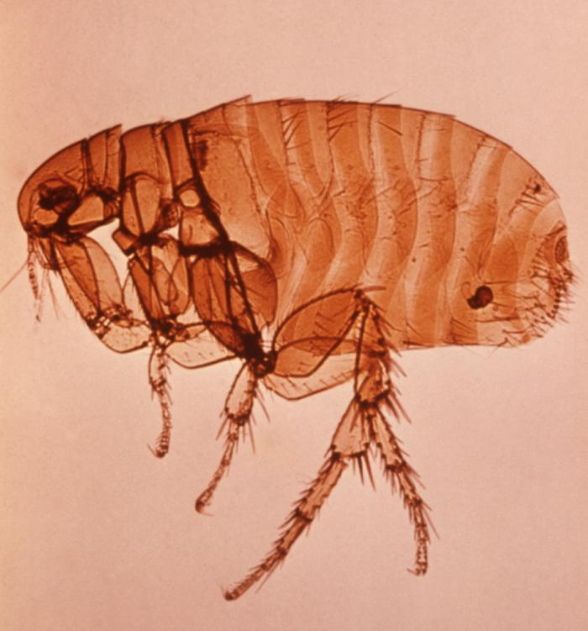
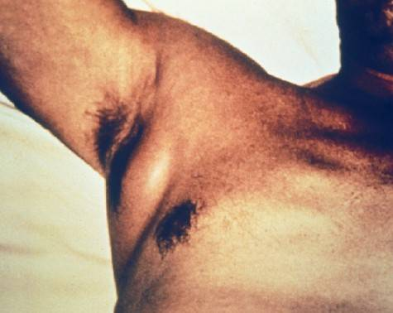
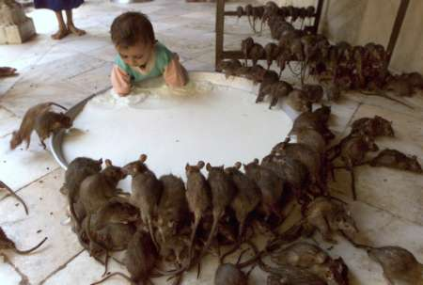
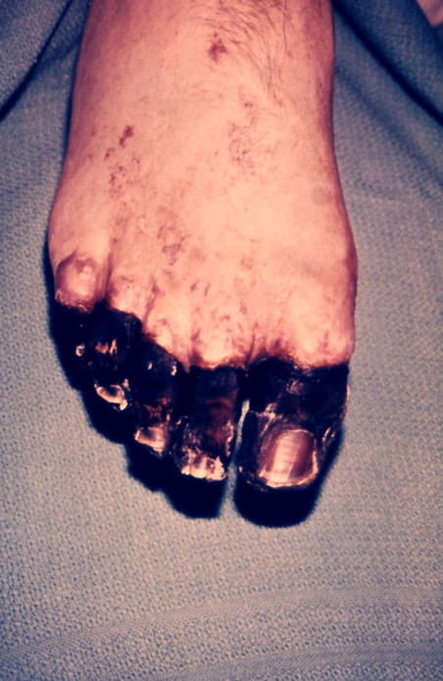
BUBONIC PLAGUE
Plague began in Asia, then in 1347 a bunch of sailors showed up in Italy covered in purplish/black spots. Technically, its caused by infected fleas on rats, but no one knew that (within 4 years, hit all corners of Europe).

Slide 29
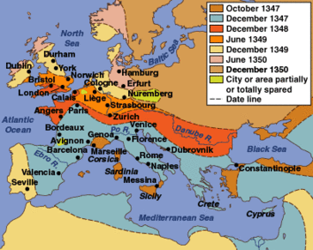
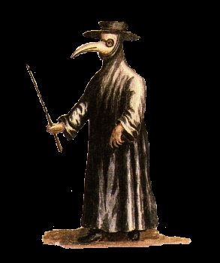
BLACK DEATH
50M die worldwide (1/3rd of Europe is wiped out).
Cities collapsed, serfs ran away, prices rose, Church credibility decreased, & often Jews were blamed.

Slide 30
LAND BASED EMPIRES

Slide 31
Seljuk Turks
Seljuk Turks conquered the ancient Persian empire & lived in present day Iraq. Modern day Turkey gets its name from them & they were the main rival of the Europeans during the Crusades. Majority were Muslim, they were a pasturing people using camels.

Slide 32
Seljuk Culture
These are nomad Tatars that created a power and expansive Muslim empire after migrating to the Middle East. Seljuks are the reason the world sees Islam as a conquering religion (even expanded into Asia until Mongols). Ottoman Empire will rise from them.
*Photos are of the Great Mosque of Eshafan in Iran. It is a single shelled dome that survived centuries without ever being damaged. Some consider this to be the oldest and most beautiful of all the mosques in history.

Slide 33
OTTOMAN EMPIRE
*Historical Middle Eastern Empires:
*Assyrian Empire (900-600BC)
→Persian Empire (500-300BC)
Umayyad Caliphate (660-750)
→Seljuk Turks (1000s-1300s)
→ Ottoman Empire (1300s-1900s).
Longest lasting Middle Eastern empire made from Turks who saw selves as warriors for Islam. Military success based on gunpowder, first nation to use an effective cannon. Ruled thru local leaders called Sultans.

Slide 34
MEHMED THE CONQUEROR
“Give Me Constantinople,” he dragged 70 ships over land to avoid city’s harbor chains & fired massive cannons (one launched 1200 pound boulders) as he conquered the city (at just 21 years of age). Renamed it Istanbul.
*The major challenger to the Ottomans at this time was the Timurid Empire led by Timur the Lame. During one battle, Timur was injured from an arrow thru his leg and kept fighting, his soldiers burned Baghdad to the ground.

Slide 35
SULEYMAN THE MAGNIFICENT
The Lawgiver was the longest reigning Ottoman Emperor. He conquered Christians & his fleets dominates the seas (a poet & a goldsmith). He married a harem girl. He promised protection to every Muslim city if they were ever attacked.
*During transitions of power, it was common for the new sultans to strangle their brothers & keep sons in prison.
*He created a law book for both criminal & civil cases. Had an elite war machine of 30,000 janissaries.
*He created a fair tax system, built schools, supported the arts, led during “Golden Age.”
*Known for his failed siege in Europe in Vienna, Austria when weather did forces in.

Slide 36
SAFAVID EMPIRE
Led by Shi’ite Muslims under a Shah (One shah killed a population of 30,000 Sunni Muslims).
Final battle between two sides took place at Battle of Chaldiran (Ottomans beating Safavids). Site is the border of Iran & Iraq today.
Shah Abbas becomes great leader & builds capitol at Esfahan thought to be one of most beautiful places.
*Carpets played a major role in the Safavid Empire & still remain important to modern Persians (Iranians).

Slide 37
MUGHAL EMPIRE
In 1398, Timor the Lame destroyed the city of Delhi, which is rebuilt & gains significance.
Akbar led for almost 50 years, equipping armies w/ artillery & cannons, but unified 100M people thru tolerance & diplomacy.
Many different tongues were spoken (Arabic, Persian, Hindt), is now Urdu in Pakistan.
Architecture is mostly Hindu themed, much of it made from nearby red sandstone.
*Akbar had a library w/ 24,000 books, but never learned to read.

Slide 38
20,000 workers labored 22 years to build the famous tomb, made from white marble brought from 250 miles away (blends Hindu & Muslim styles). It has 1000s of carved flowers & stones inside.
TAJ MAHAL

Slide 39
KHMER EMPIRE
Southeast Asian Empire (currently Vietnam, Cambodia, etc) that build homes along the Mekong River. People had fish, rice, sugarcane, banana leaves, lived in homes made of woven bamboo.

Slide 40
Mekong River is 7th largest river in the world, important during Khmer Empire & to Americans during Vietnam War.

Slide 41
Built in the 1100’s, Angkor Wat is the world’s largest religious structure. It’s for Hindu and honors the god Vishnu and covers nearly an entire square mile. It features “ogive” shapes.
ANGKOR WAT

Slide 42
HINDU
World’s 3rd largest religion, practiced in India & SE India. Though there are technically 30M gods/goddesses, the Trinity of Brahma, Vishnu, & Shiva are the highest. These gods make up one Supreme Being. When a Hindu dies their atman is reborn into another body. Next life depends on how you lived in this life (karma).

Slide 43
HINDU QUESTIONS
Reincarnation? Yes, soul does not die, it comes back in another body until soul is eventually liberated and free.
So Many Gods? Technically its Henotheistic, there are many gods (attributes) all residing inside of one god.
Karma? It’s a divine system of judgment, something bad happens to us its not punishment—it’s a life correction.
Dot on the forehead? It’s a religious symbol called the bindi made of red powder, it represents spiritual sight.
Yoga? Historically speaking Yoga was the religious preparation of getting ready to pray.
Worship cows? No, but the cow is gentle animal who gives more than she takes, Hindus honor all creatures.

Slide 44
CHINESE MING DYNASTY

Slide 45
MING DYNASTY: After Mongol rule and plague declined, China begins to flourish again with a return to traditional Chinese society and removing all foreign influences (lasts 1368-1644).

Slide 46
MING EXPLORATION
China undertook the largest & most impressive maritime expeditions the world had ever seen. One voyage had more than 300 ships & 27,000 people including all occupations (massive floating city).
Zheng He was sent to “bring order back into the world” but really was sent to establish China’s greatness worldwide.
*Trips visited India, Middle East, East Africa…all over the world. As great as these trips were, they ended abruptly and without a clear explanation.

Slide 48
During this time, great wall of china takes current form, paper currency was switched to coins, blue & white porcelain becomes an expensive worldwide fad.
MING CULTURE

