Slide 1
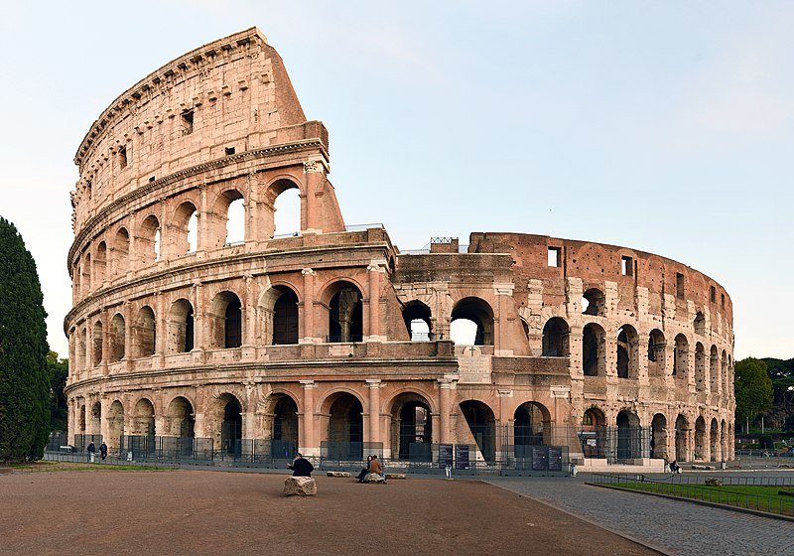
Ancient Rome
All Roads Led Here

Slide 2
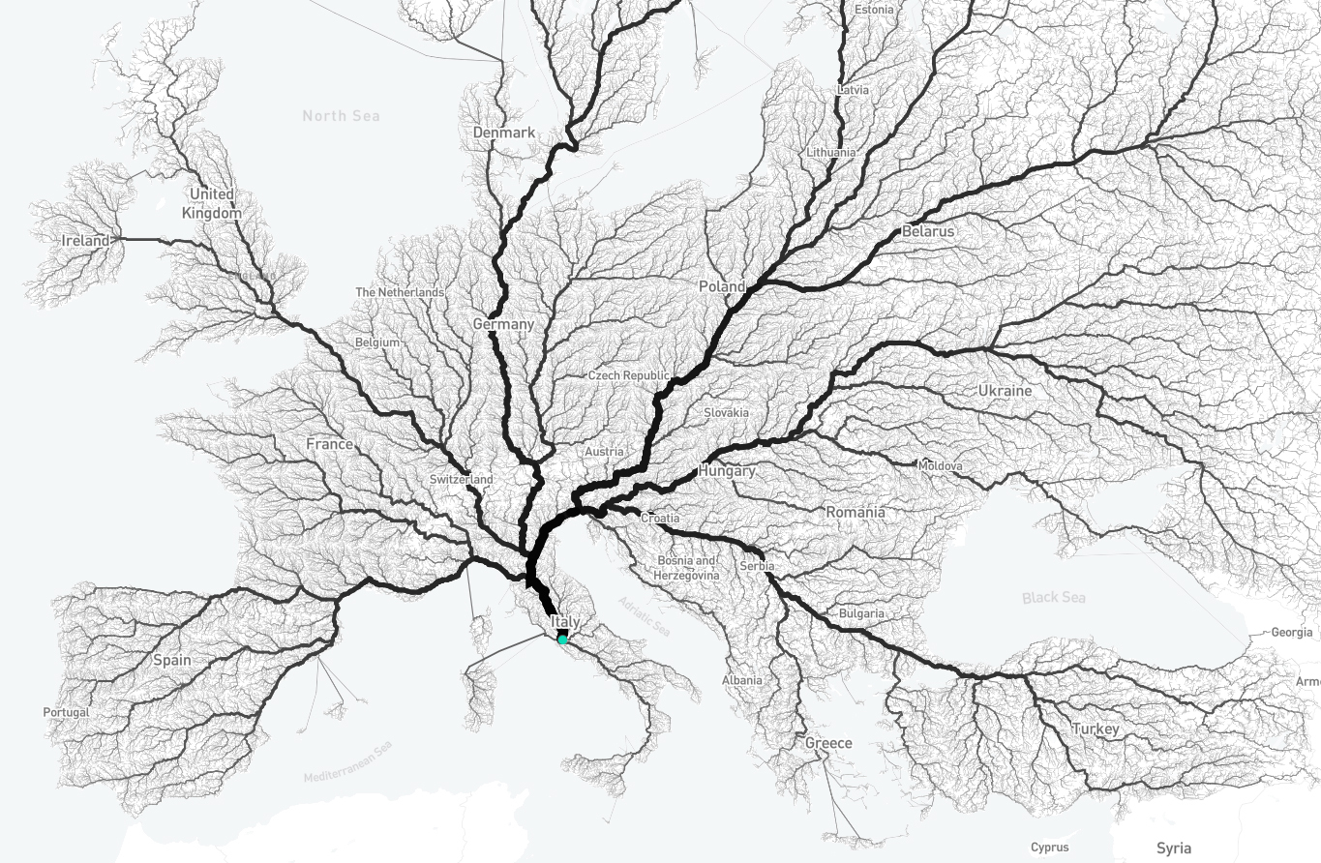
Notes:
486,713 different routes to Rome!

Slide 3
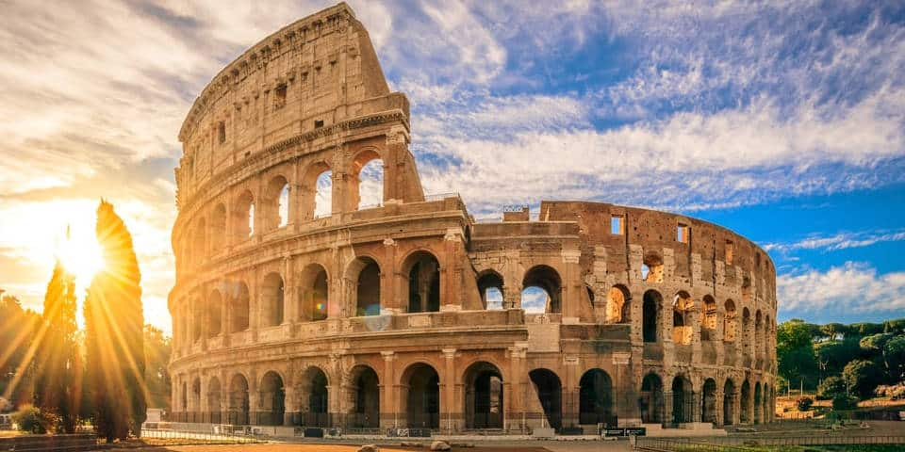
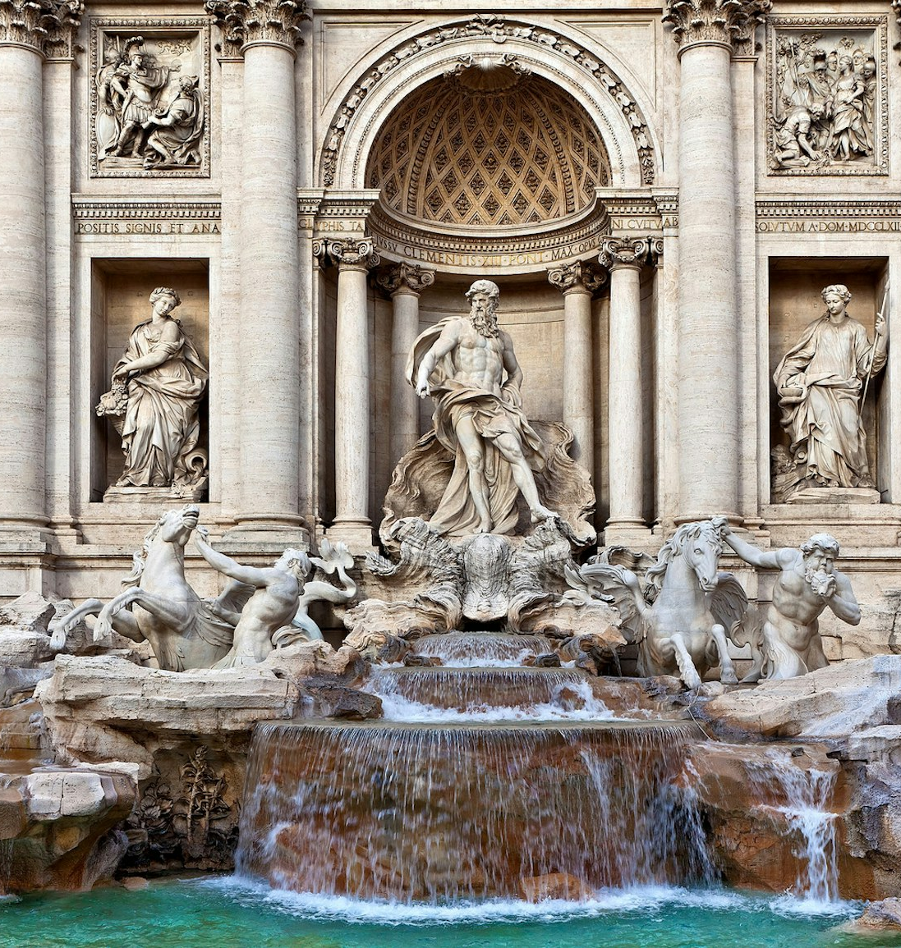
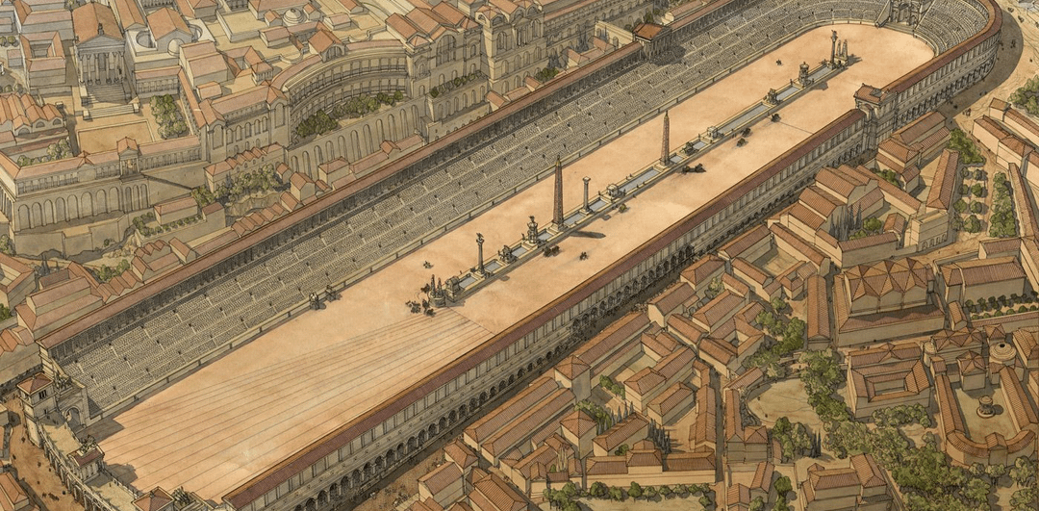

Slide 4
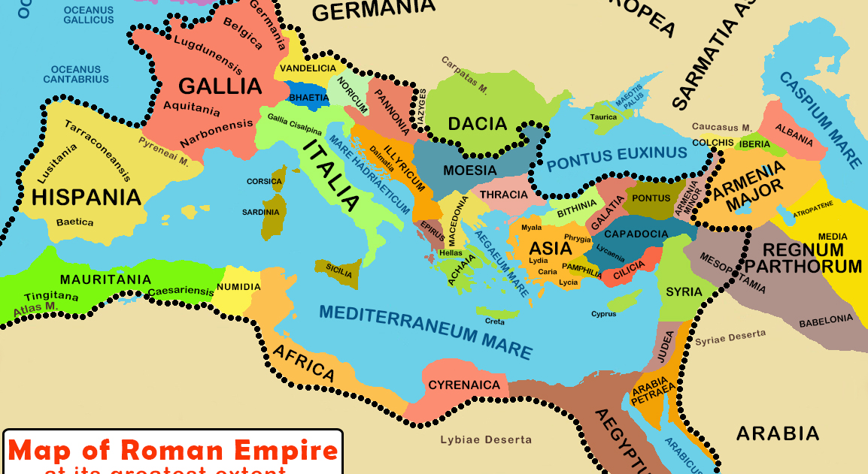

Slide 5
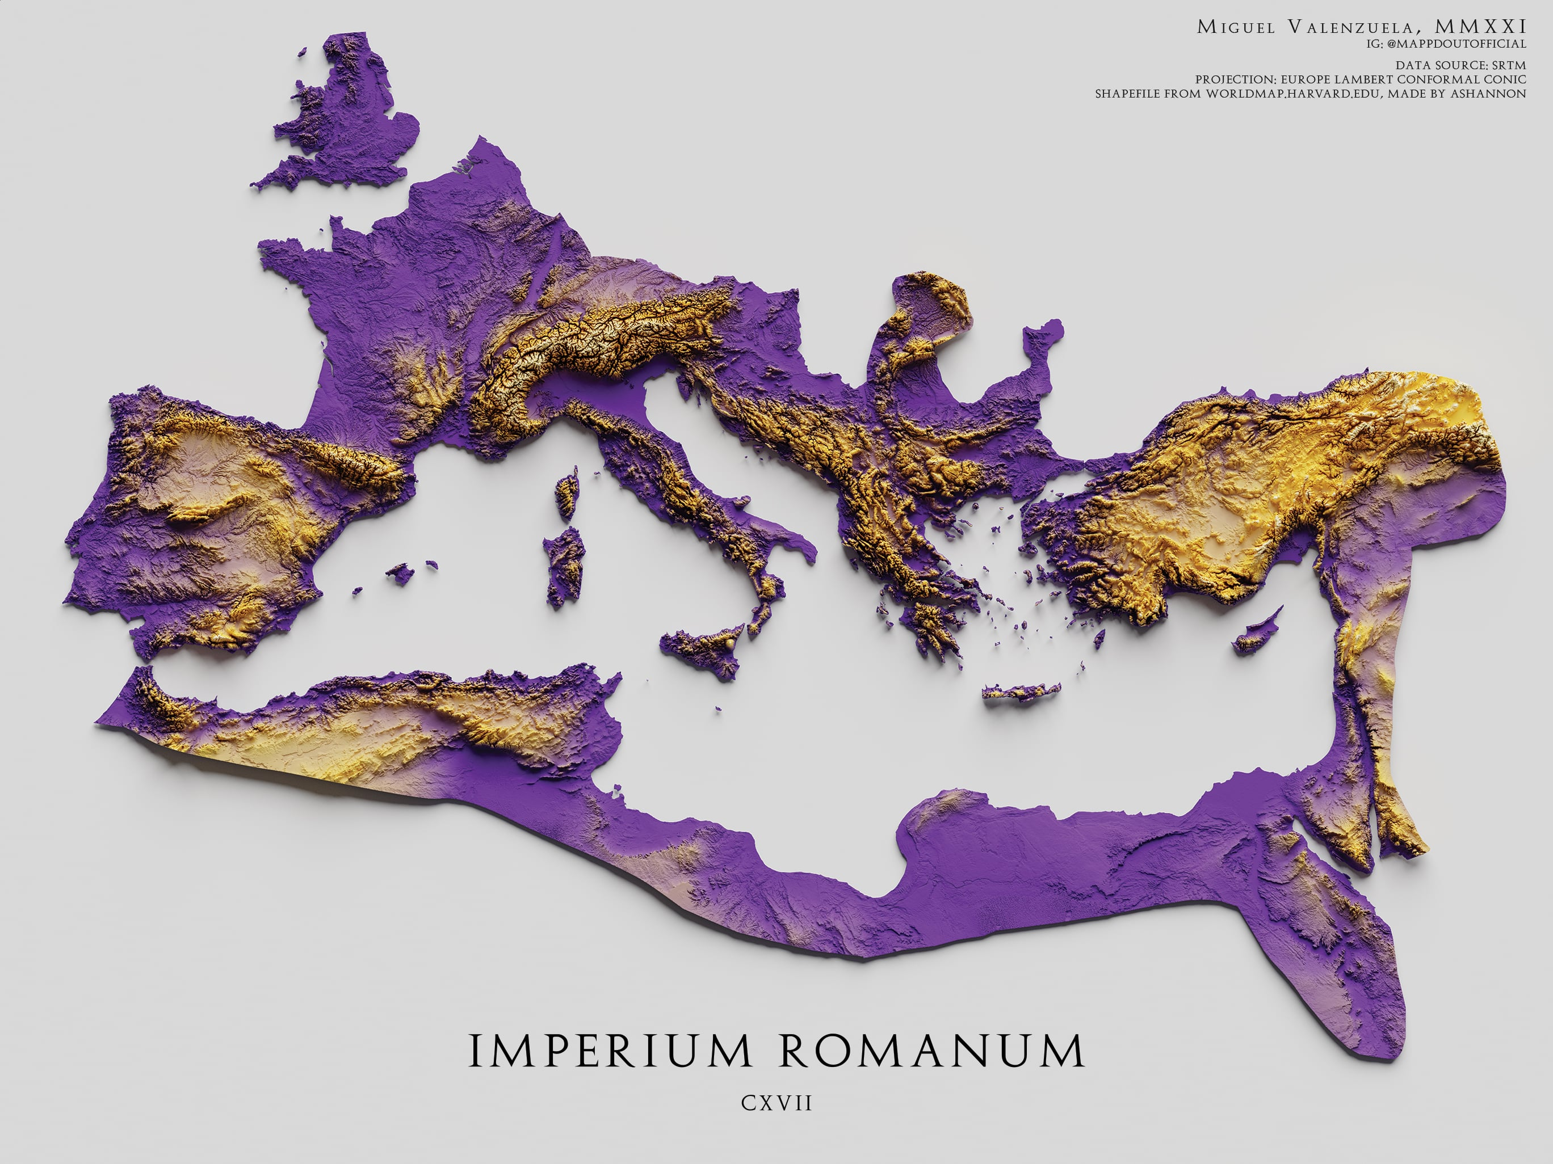

Slide 7
Italian Geography
Alpine Mountains
Perfect for defense
Perfect for raising livestock
Mediterranean Sea
Perfect for defense
Perfect for fishing
River Systems
Perfect for trade
Perfect for farming

Slide 8
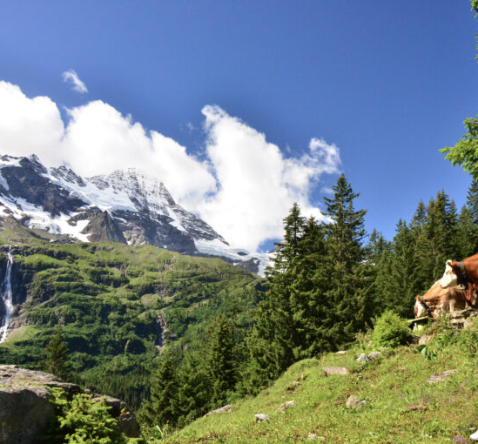
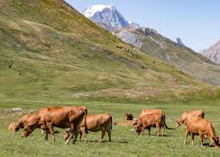
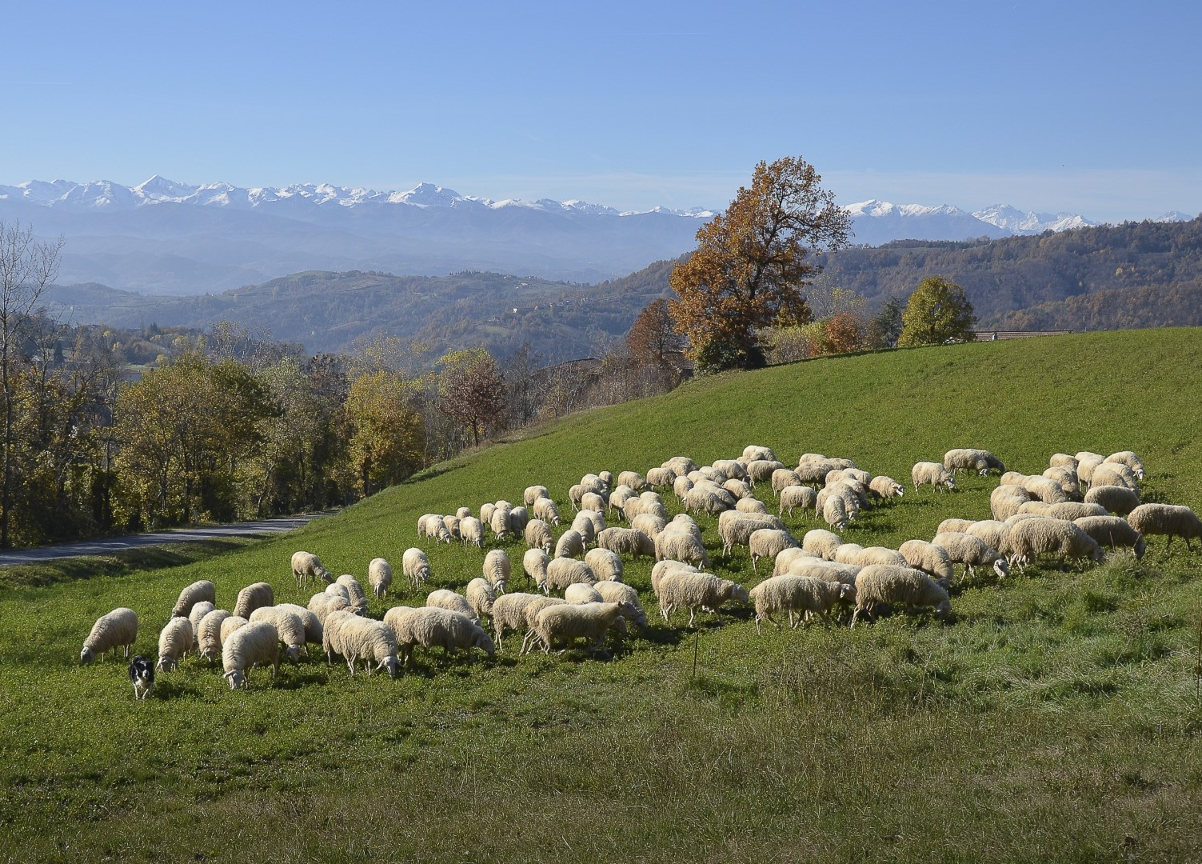

Slide 9
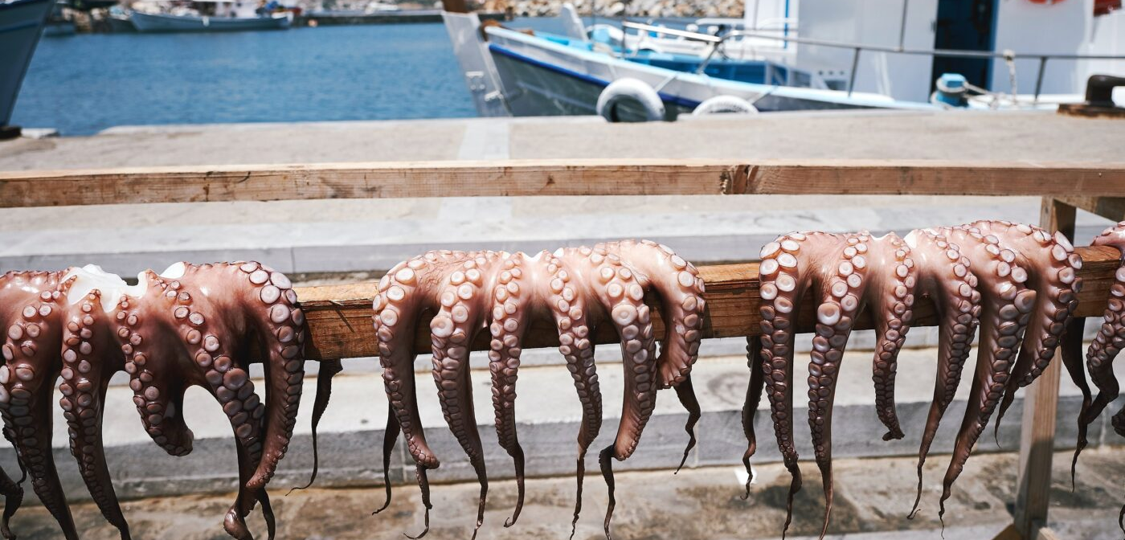
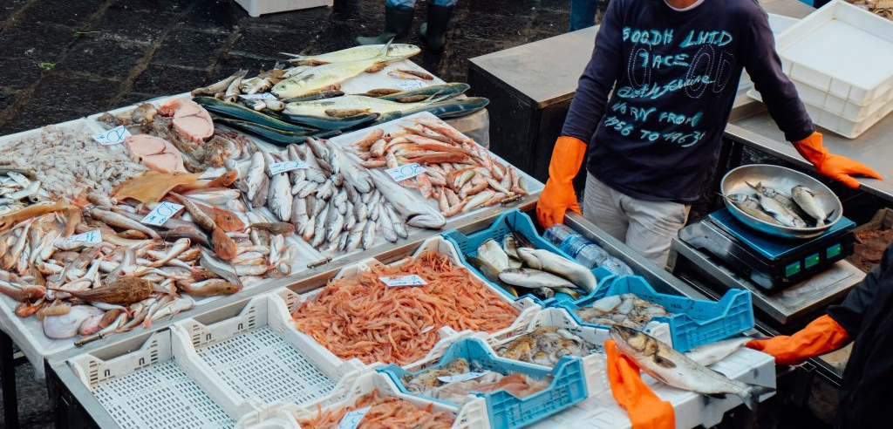

Slide 10
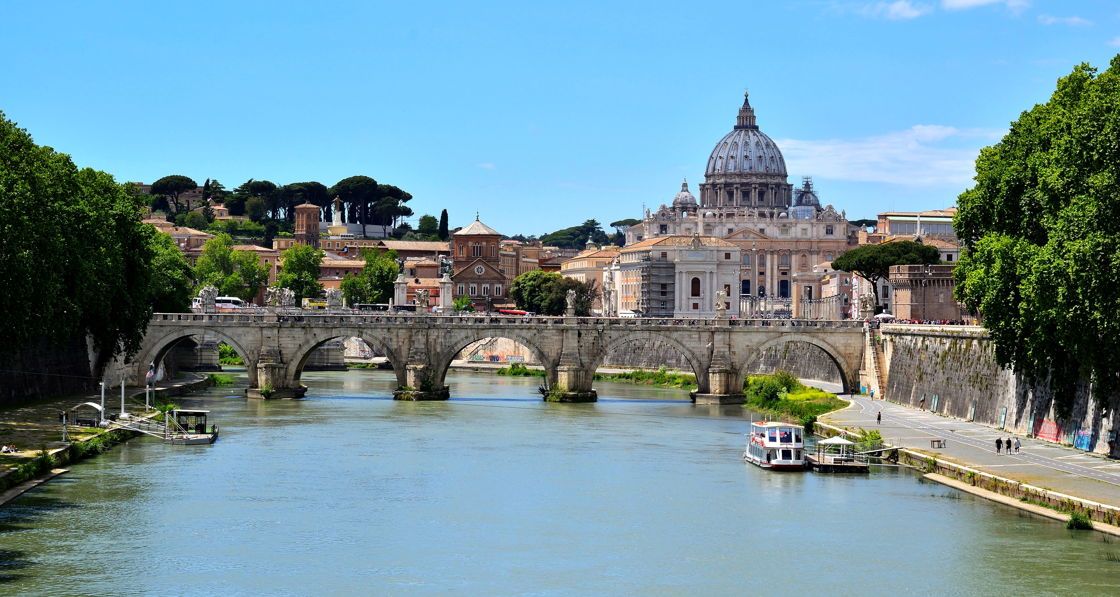
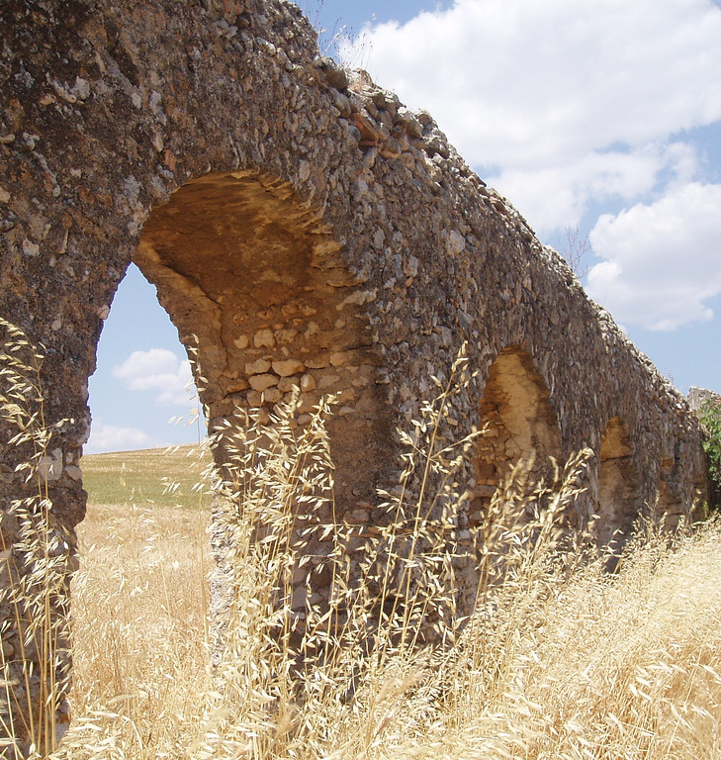
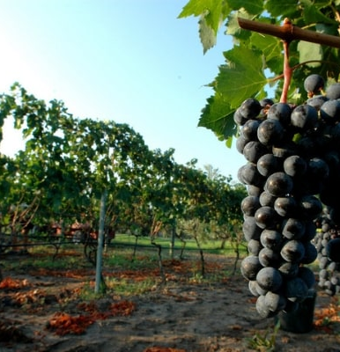
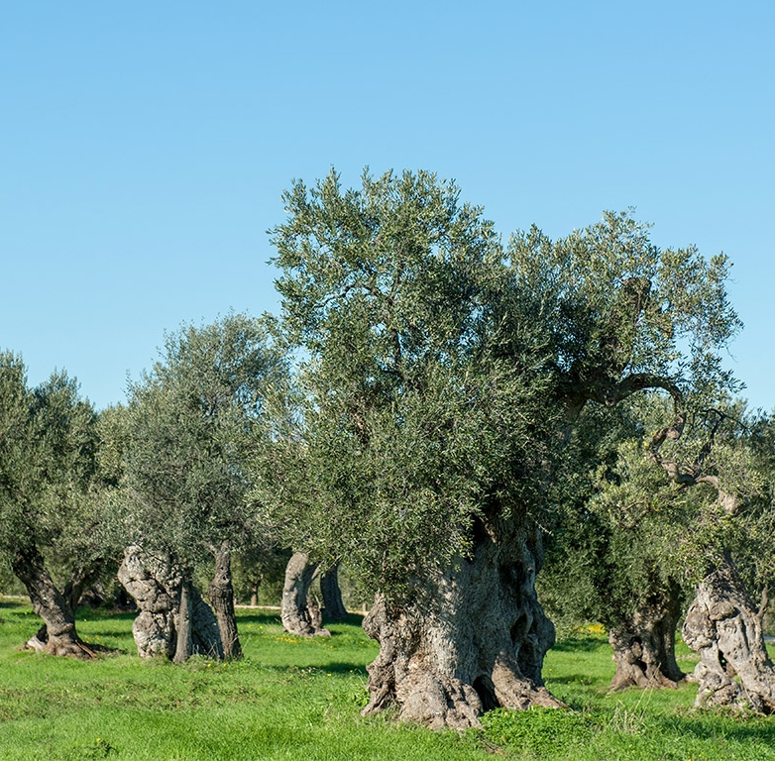
Notes:
Why would Rome’s location be an advantage for its growth and power? Go to Google Earth.

Slide 11
Romulus and Remus
Twin brothers
Mom was a princess
Dad was Mars, God of War
Uncle was a king
Uncle got jealous about Romulus and Remus
Dumped the kids in the river
Saved and raised by a she-wolf and a shepard
The boys went on their own to start a new city
Got into a fight
Romulus killed Remus
Named the city Rome
This didn’t happen

Slide 12
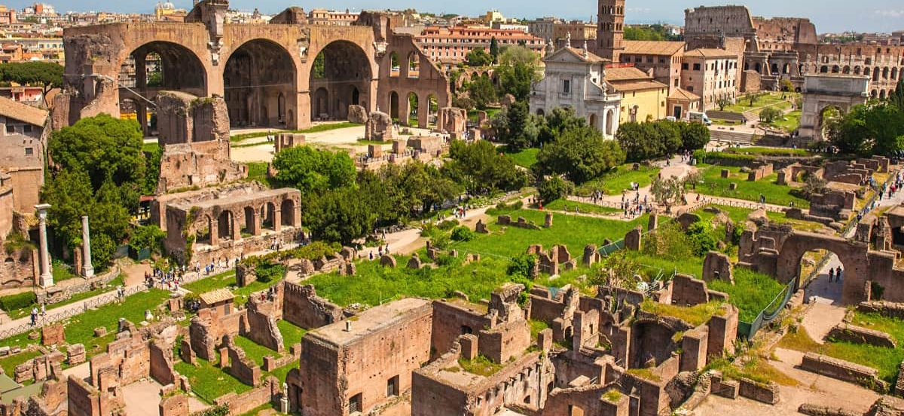
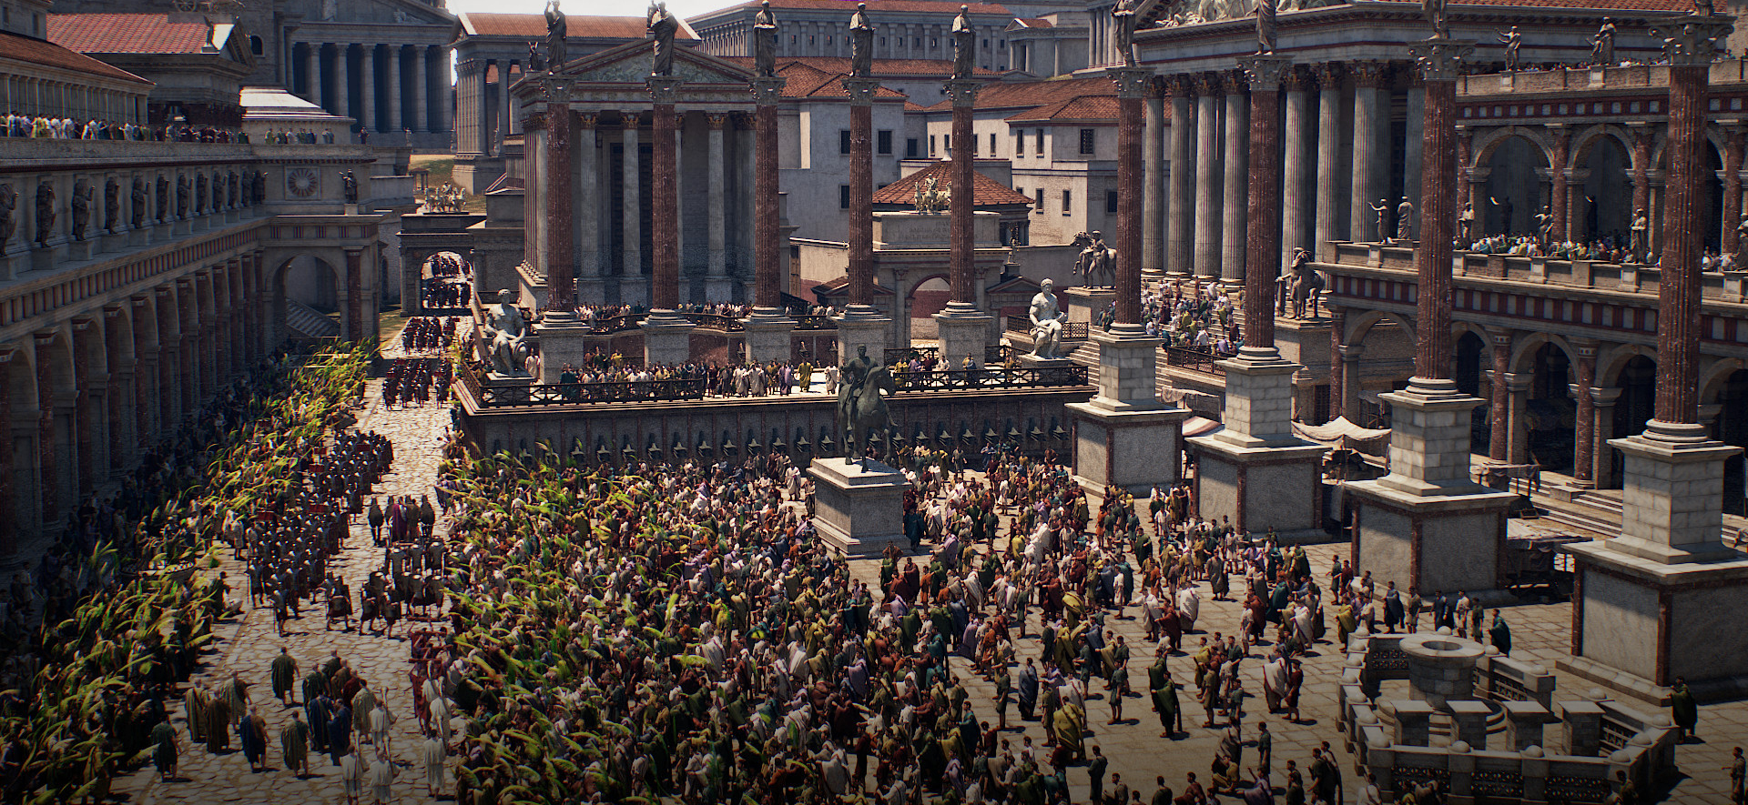
Roman Forum
Forum
Open area of a city with government, temples, and markets

Slide 13
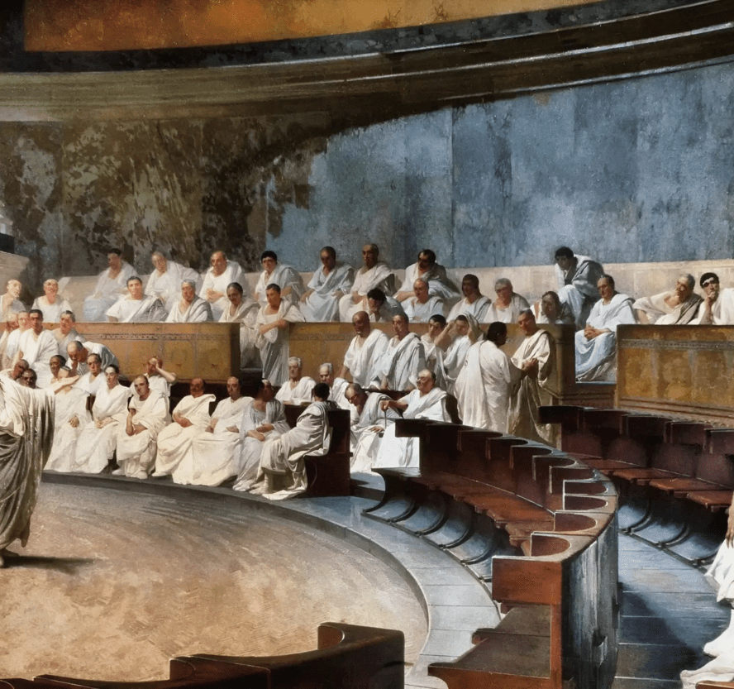
Roman Republic
Rome = City-State
Started as monarchy
Kings = Chief of army, head priest, makes all the decisions
Old aristocrats (rich guys)
Created the Senate, advised the king
509 BCE
Aristocrats kick out the king and take over
Republic
Res publica = Public Business
All FREE adult males could participate

Slide 14
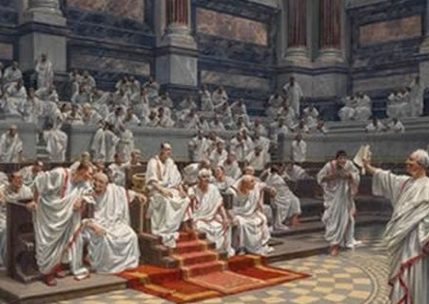
Do Now
Is it better for everyone to vote, or is it better to vote for people to decide for us? Give your reasoning.

Slide 16
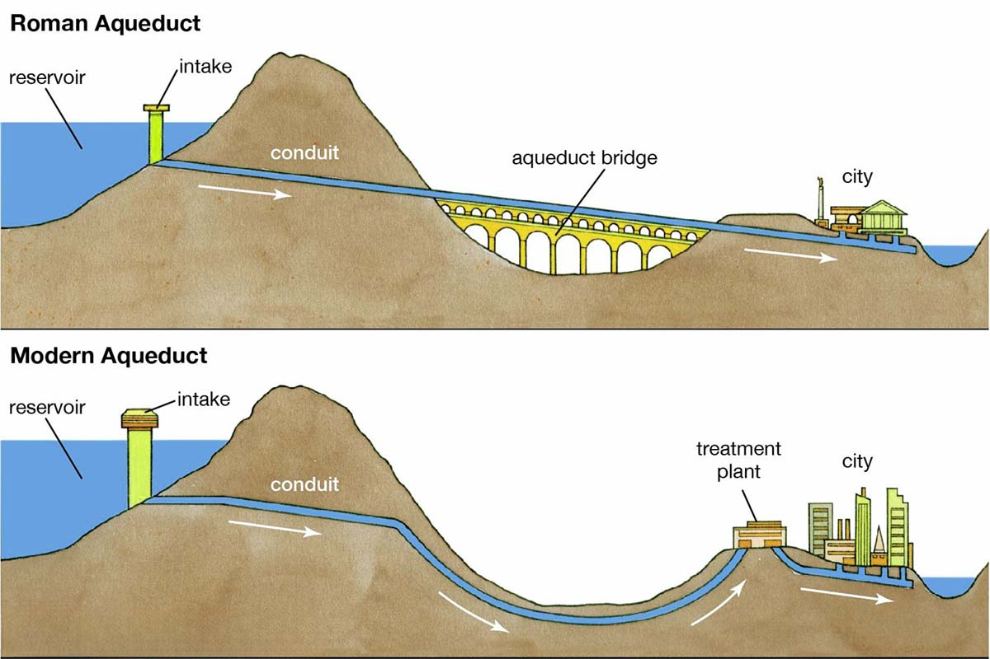
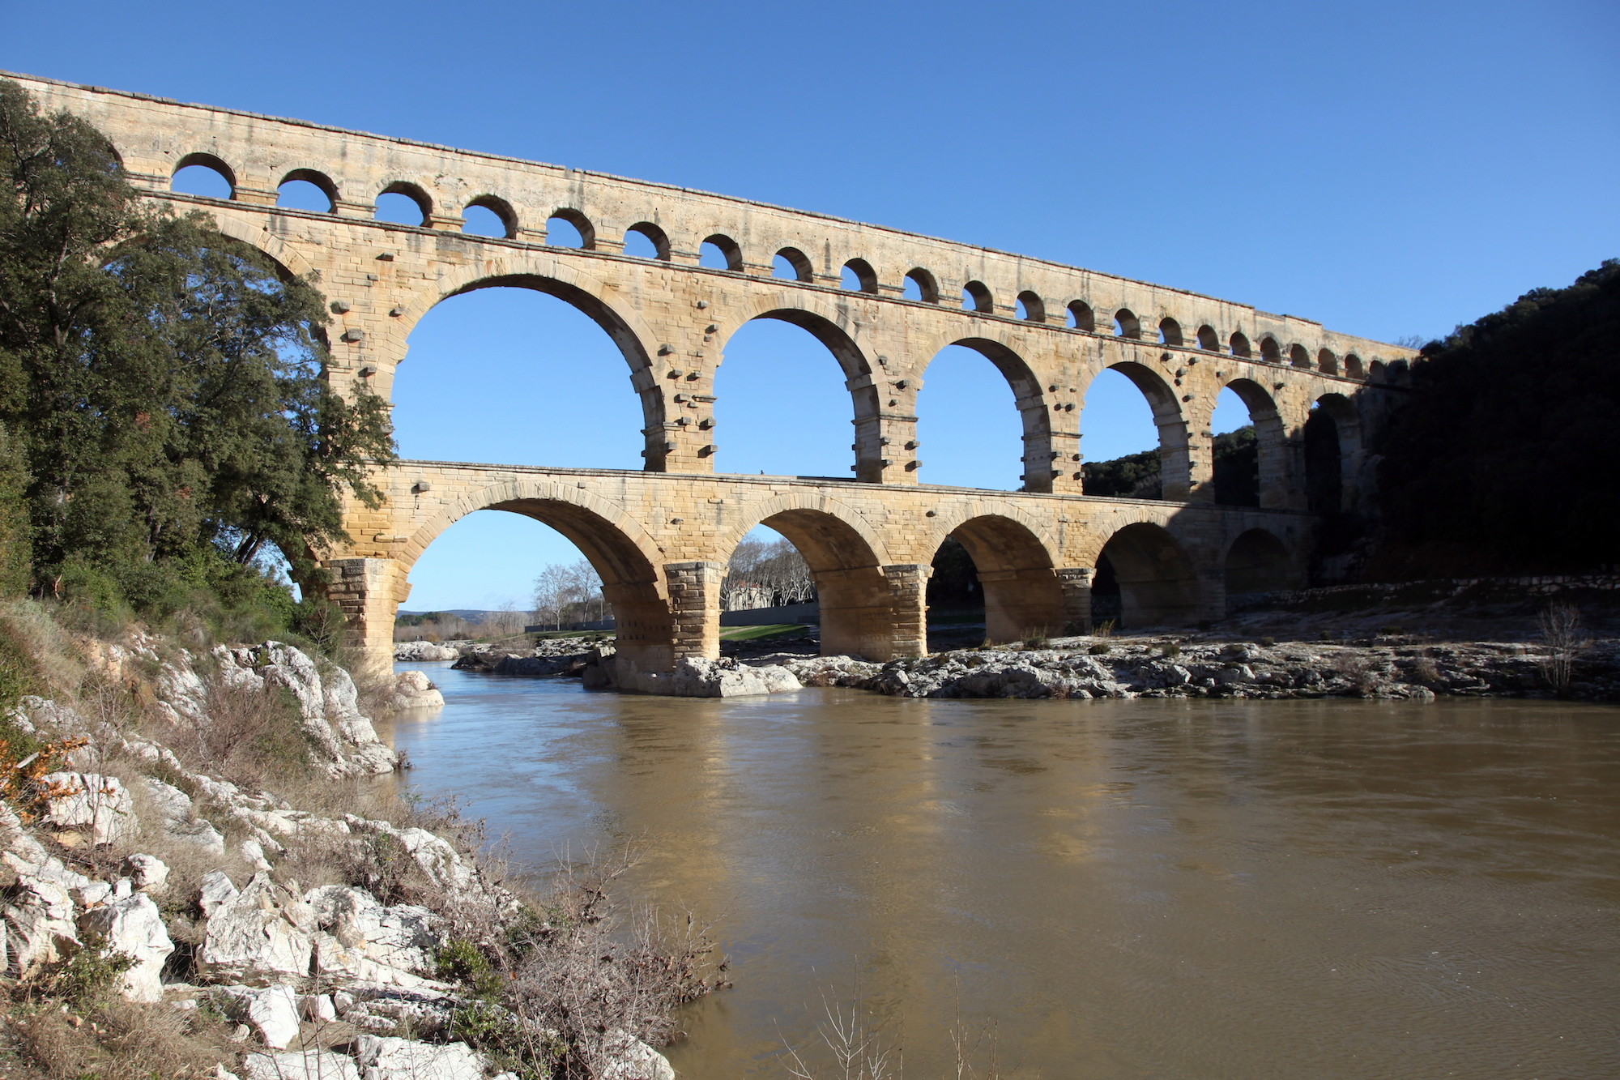

Slide 17
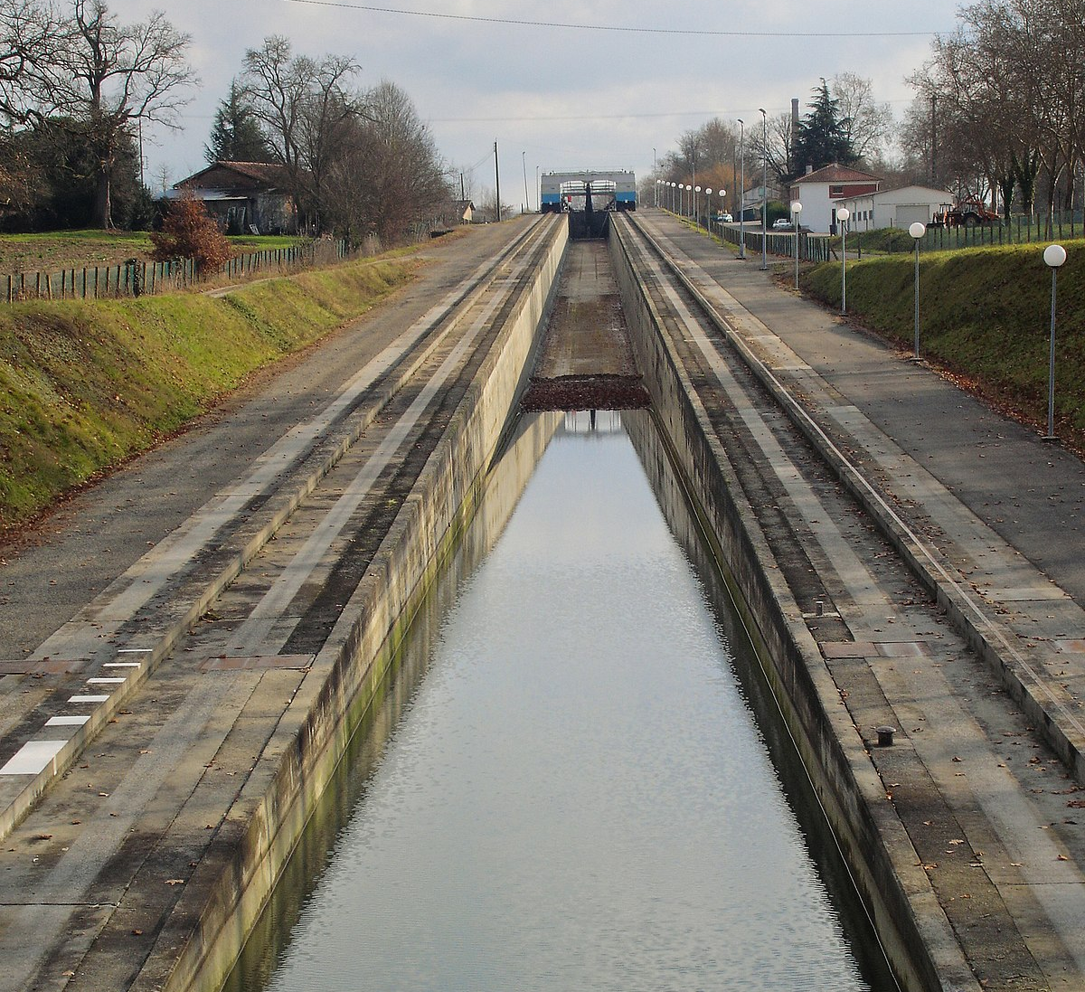
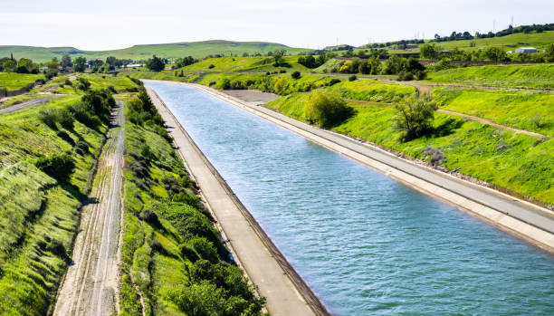
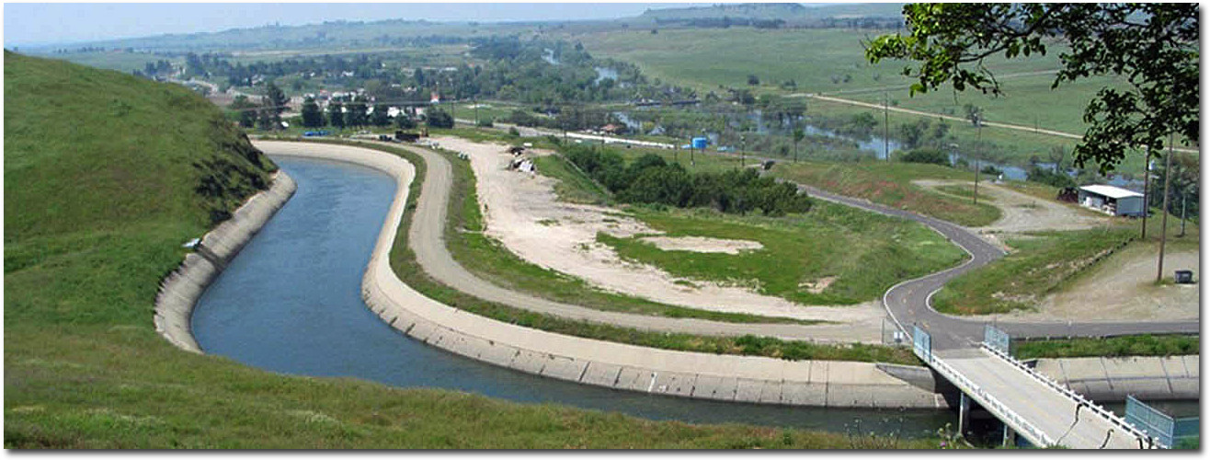

Slide 18
Roman Government
Constitution
A system of rules to organize a government
Assemblies
Made laws
Elected magistrates
Senate
Wealthy and important
Passed laws, ran foreign policy, controlled money
Magistrates
Enforced laws, judged cases
Consuls were the top two magistrates

Slide 19
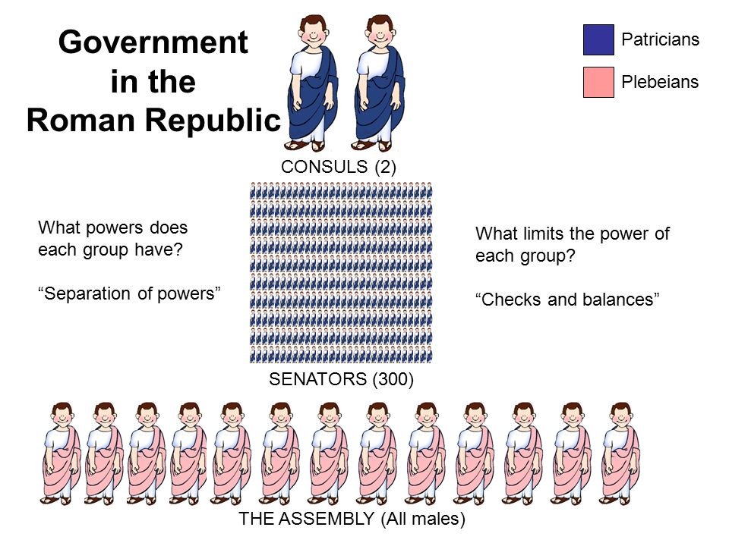
Separation of Powers
Power was shared among different branches
Consuls had veto power
Veto = “I forbid” or to vote against
Term time
1 year

Slide 20
Checks and Balances
Tripartite Government
Government with three parts
Each branch had its own set of powers
One branch could “check” or stop another branch
Senate was the most powerful
But no one could be all powerful

Slide 21
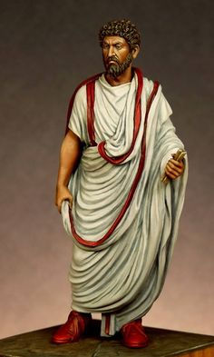
Roman Citizens
Only free, adult men could be citizens
Birthright Citizenship = both parents are citizens
Naturalized = made a citizen later in life
TOGA PARTY!!!
Only Roman citizens wore togas
Some togas had colors for government
Role of a Citizen
Vote, pay taxes, serve in the military

Slide 23
Roman Laws
Twelve Tables
First 12 laws in Rome
Laws covering trial, property, lawsuits, etc.
Example: Paternal Power (Don’t Write This)
Table IV. Paternal Power
1. A notably deformed child shall be killed immediately.
2a. To a father ...shall be given over a son the power of life and death.
2b. If a father thrice surrenders a son for sale the son shall be free from the father.
3. To repudiate his wife her husband shall order her... to have her own property for herself, shall take the keys, shall expel her.
4. A child born within ten months of the father's death shall enter into the inheritance ...
Notes:
Turn and talk: what does this law tell you about the ancient Romans and their way of life?

Slide 24
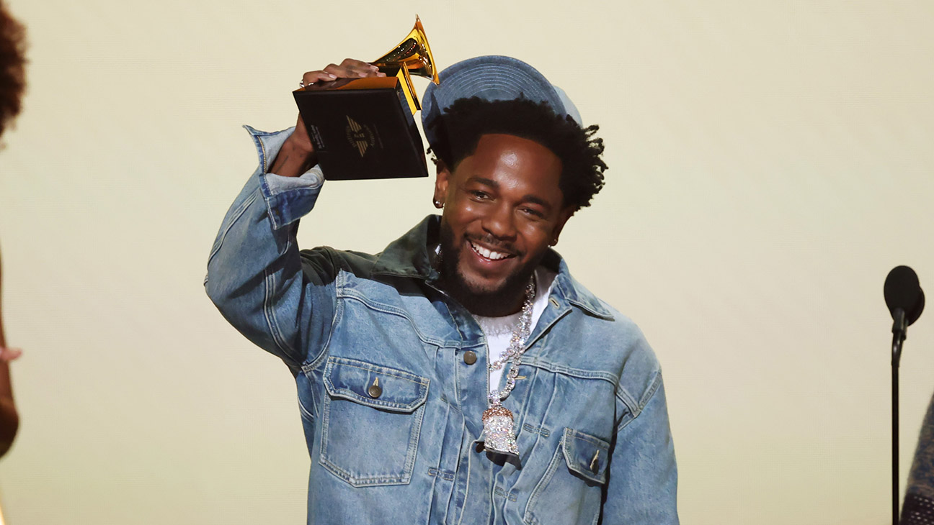
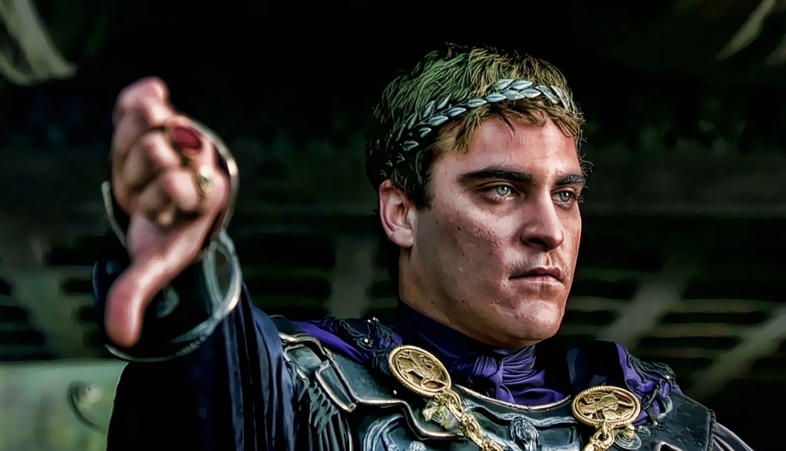
Exit Ticket
Write down what you think this law means:
If anyone sings or composes an incantation that can cause dishonor or disgrace to another ... he shall suffer a capital penalty.
Then write down what would happen to Kendrick Lamar for singing “Not Like Us” in ancient Rome and why.

Slide 25
Roman Society (Men)
Patriarchal
Men ruled
Ancestry was traced only through men
Paterfamilias
“Head of the Household”
Father had absolute power over everyone in the home

Slide 26
Roman Society (Women)
More free than Greek women
Owned property
Make a will
Divorce her husband
Social life
Parties
Went to the theater
Rich wives
Could NOT vote
But they could influence their husbands or sons

Slide 27
You Do Together
T-Chart
Roman Society Modern Society
Write down some differences for both men and women in ancient Rome and today

Slide 29
Roman Religion
Greek gods with different names
Zeus = Jupiter
Ares = Mars
Aphrodite = Venus
Religion was important in society
Government tried to keep the gods happy
Gov’t talked to priests
Other religions were allowed… sort of
Jewish people were left alone
Christians were killed

Slide 30
You Do Alone
Write a paragraph about why religion was important and its role in ancient Rome.
You can use your notes and read pg. 294
Do not copy it
Use your own words

Slide 31
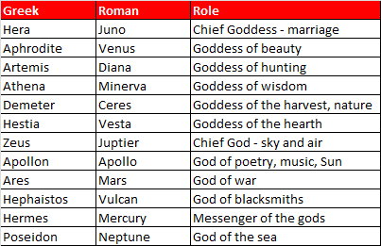

Slide 32
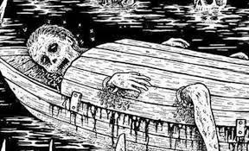
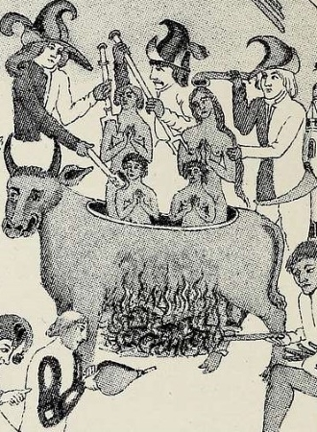
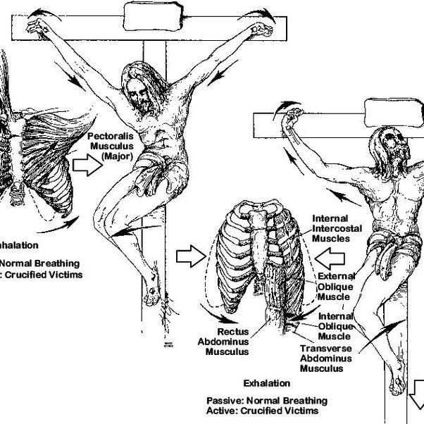
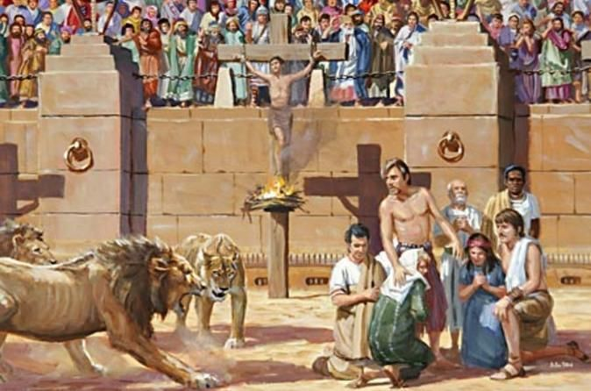

Slide 33
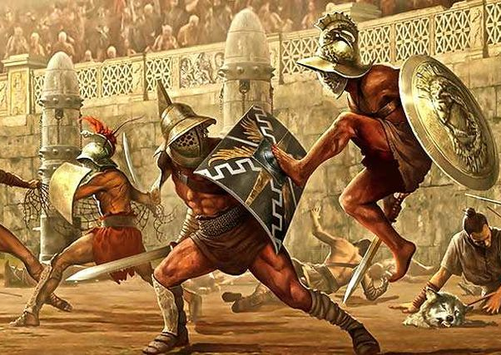
Exit Ticket
What does ‘patriarchal’ mean, and how did it affect Roman families?

Slide 34
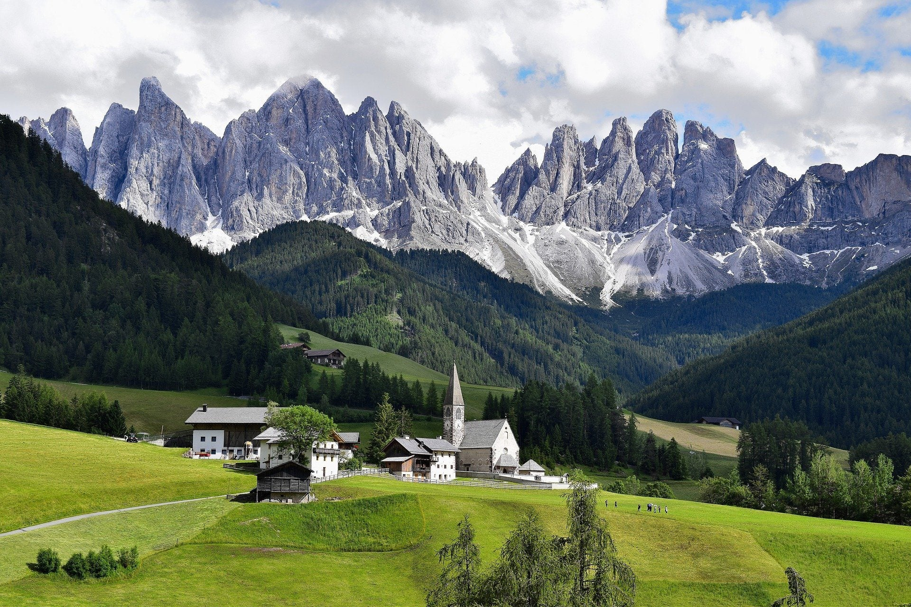
Do Now
If you were trying to get through mountains, which animal would you ride? Make sure to say why.

Slide 35
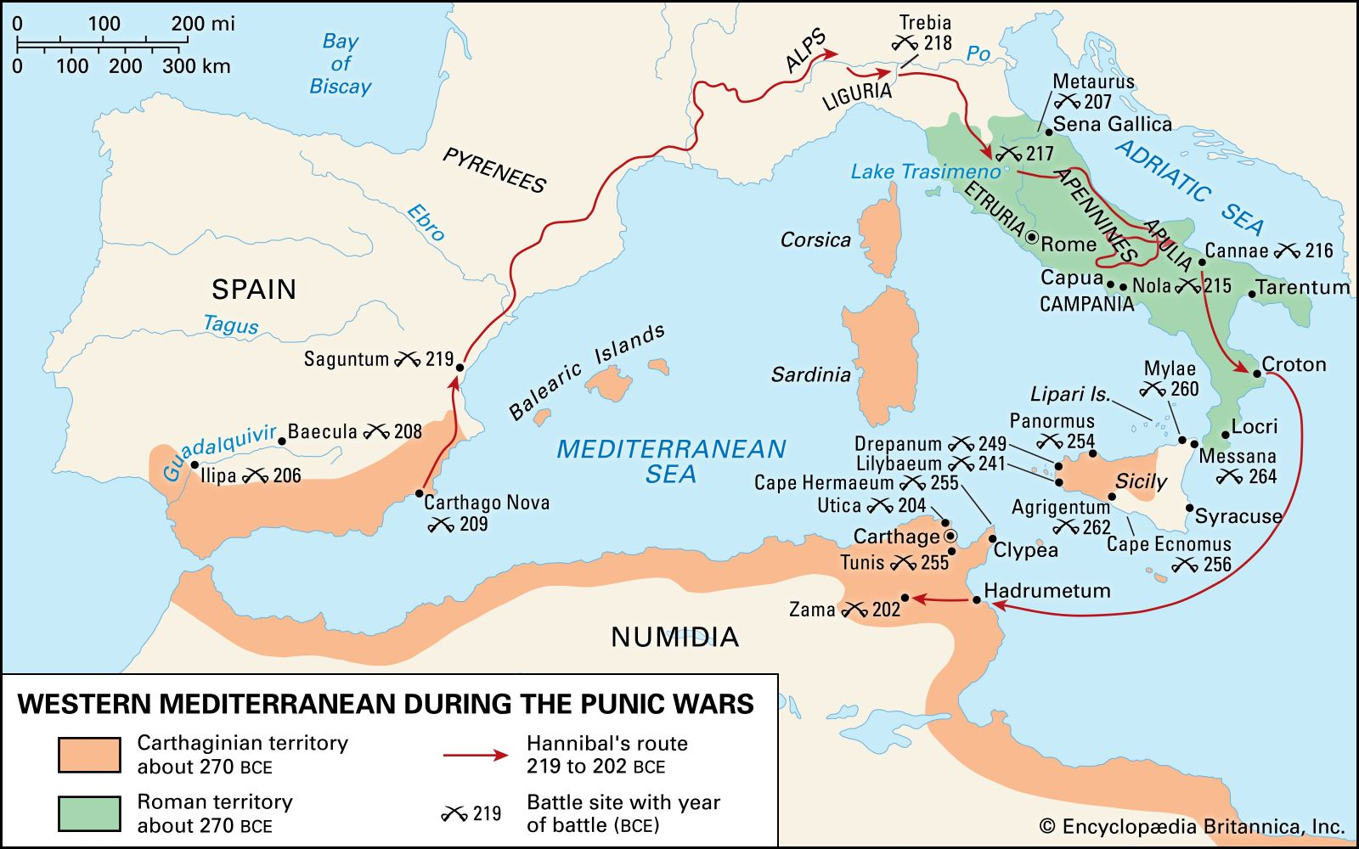
Punic Wars
Rome expanded and wanted the western Mediterranean
Carthage controlled this area
Let’s have a war!
Three of them!!!

Slide 36
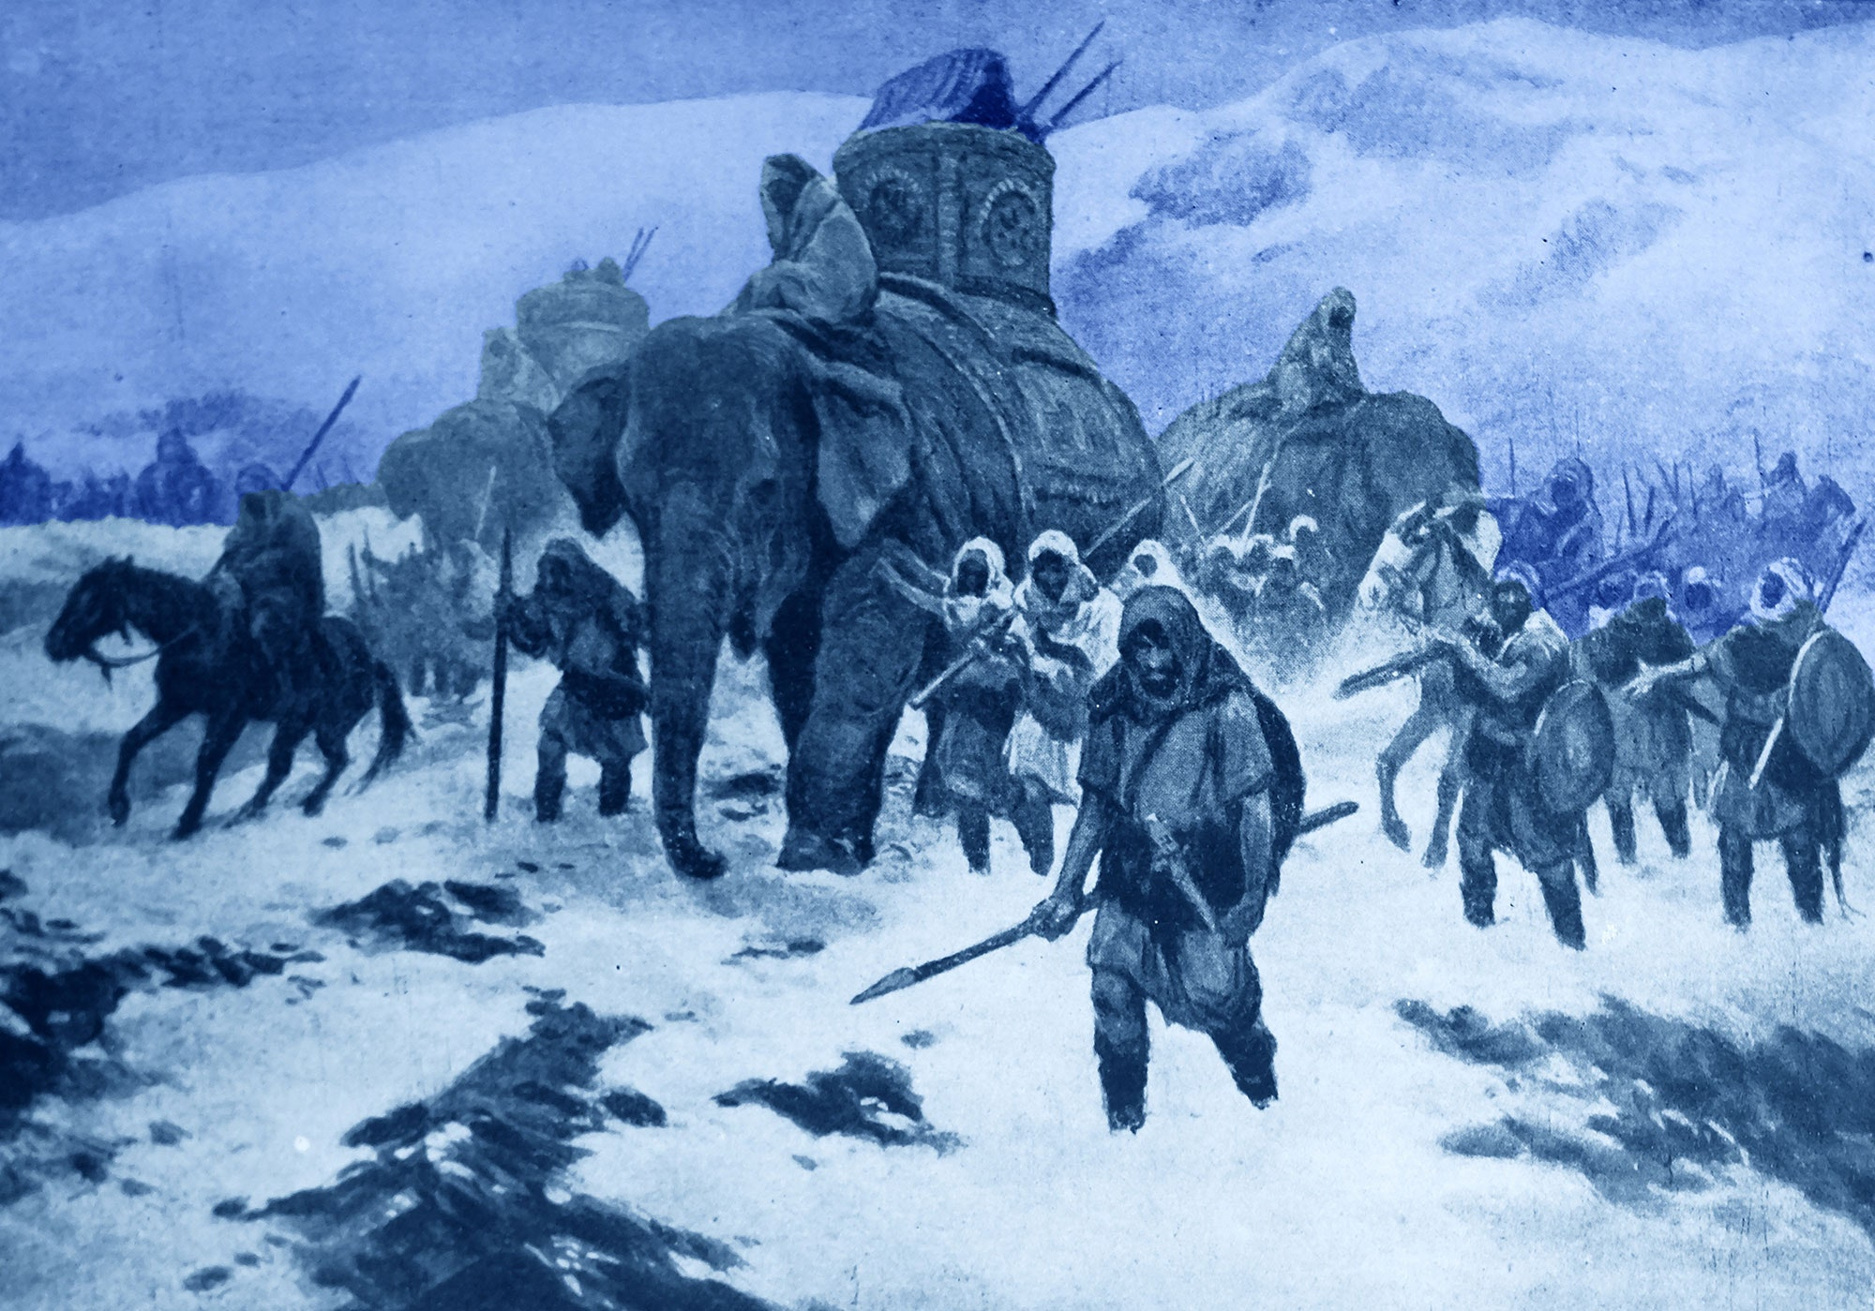
Hannibal’s March
Hannibal
General from Carthage
Could not get to Rome from the sea
Had to cross the mountains
40,000 soldiers and 40 war elephants

Slide 37
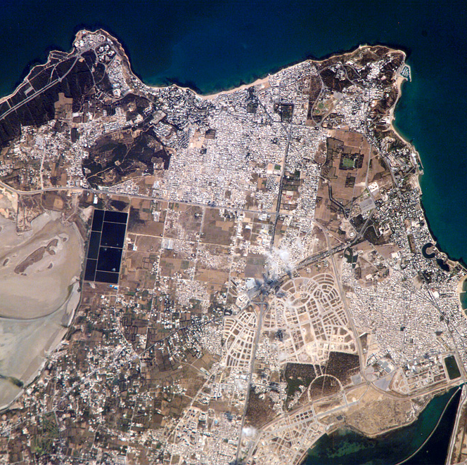
The End of Carthage
Hannibal did well at the start
Took a few towns
Expected the Romans to give up
Rome fought back
General Scipio sailed to Carthage
Hannibal had to go back and was defeated
“Salt the Earth”
Rome wanted Carthage gone
Romans burned the city
Salted the ground so nothing could grow

Slide 38
The Beginning of the End
New lands, new wealth
Mo’ money, mo’ problems
The rich got richer, broke laws, and used violence to win elections
The poor got poorer
And angrier
Slaves were bought and plebians were forced out of work
(Don’t write this): What do you think happened in plebian homes?
Talk to your shoulder partner and come up with some ideas
Notes:
Distribution of wealth YouTube video

Slide 39
Then the Riots Started
The plebians grew angry
The government tried giving free grain
That didn’t work well
Candidates appealed to the poor
But those guys were bums too
Tiberius and Gaius Gracchus tried to give land to the poor
They were killed by their opponents
They army allowed the poor to join
They had a job, but nothing when they got out

Slide 40
The Fall of the Republic
The army became very powerful
Poor soldiers were loyal to the army, not the government
A civil war broke out
Sulla became the dictator
Then came Julius Caesar
He won another civil war and became dictator
He was assassinated by his friends
Octavian was Caesar’s heir
He became emperor and changed his name to Augustus

Slide 41
Exit Ticket
Go through your notes and your reasoning and write a paragraph explaining the fall of the Roman Republic.
Tell me
Why Rome getting too big was a problem
How the mistreatment of the poor led to riots
Why letting the poor join the army led to issues for the government

