Slide 1
MODERN TIMES

Slide 2
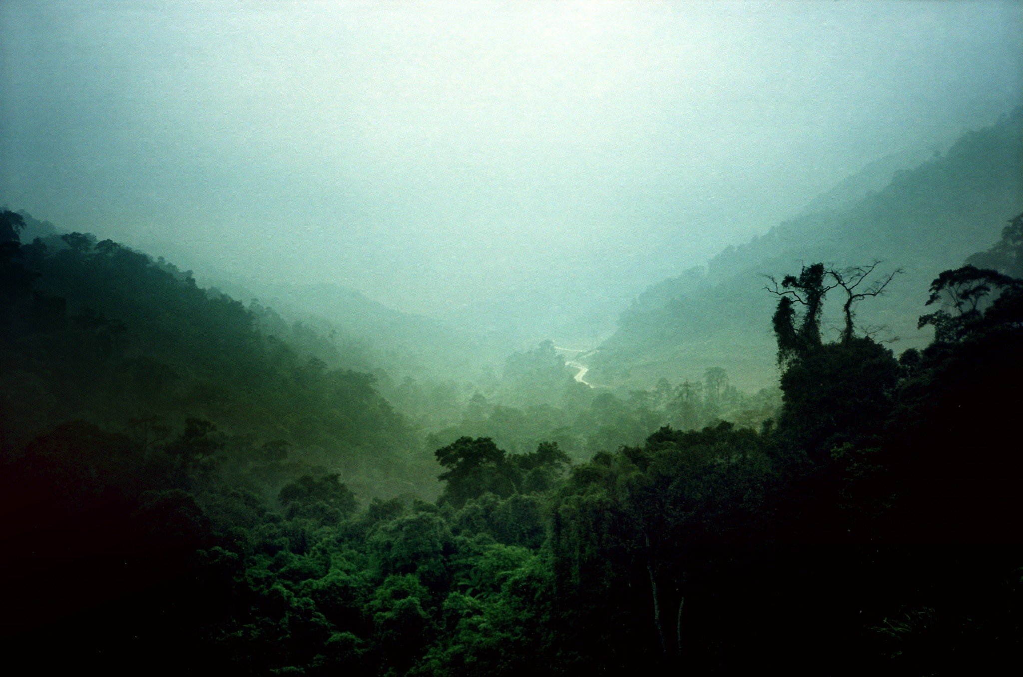
VIETNAM WAR

Slide 3
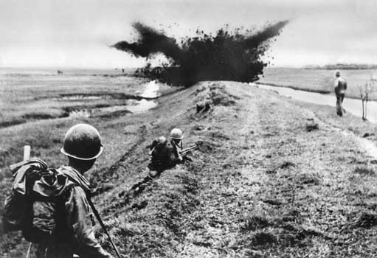
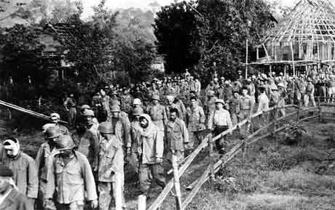
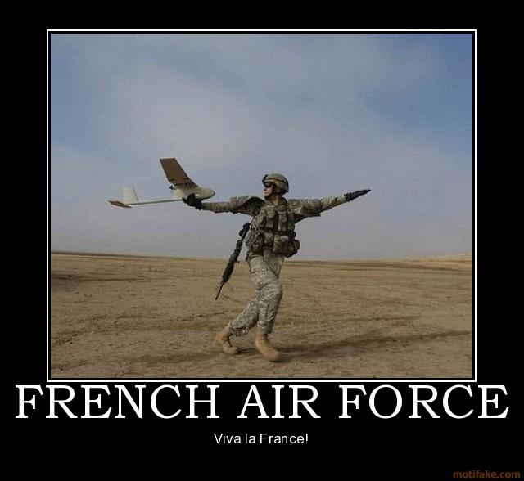
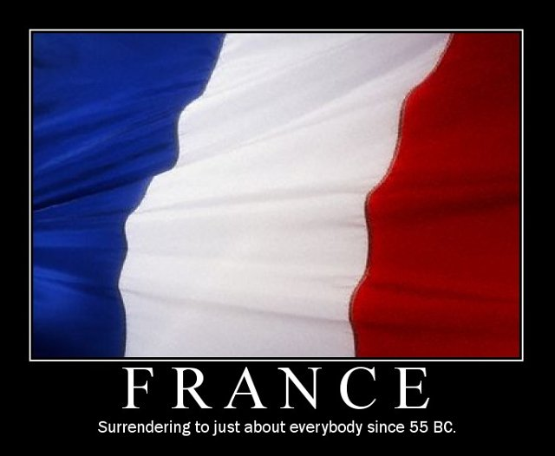
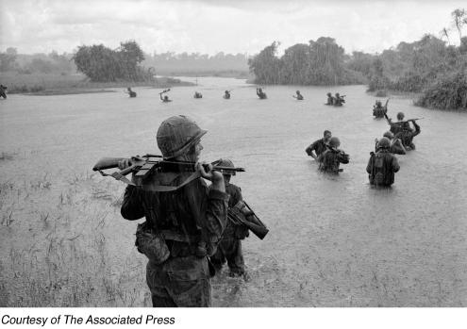
INDOCHINA WAR
After WWII, France tries to regain colony in Vietnam. USA helps supply weapons and money to France (as France loses). Result of war is North Vietnam becomes communist under Ho Chi Minh, South Vietnam is “free.”
*Here’s the deal: After WWII USA wanted France to join us in NATO & make the world safe for democracy
*But, even though it would benefit France to join, they bribed USA by stating “we join NATO if you give us weapons to win in Indochina.” We take the bait.
*At one point, France asks Eisenhower for atomic weapons—Ike correctly says “no way Jose.”

Slide 4
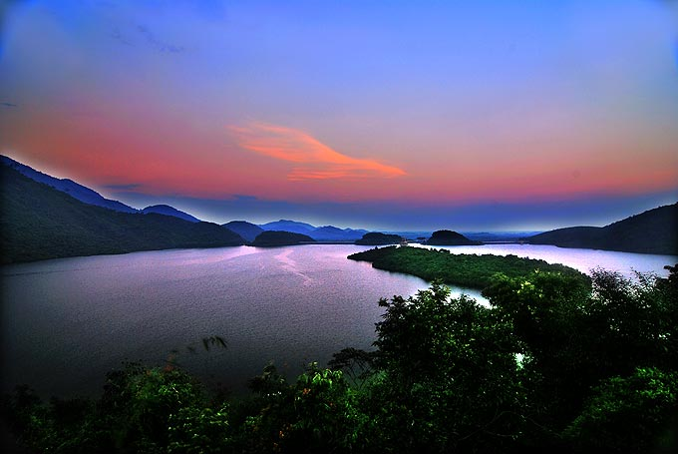
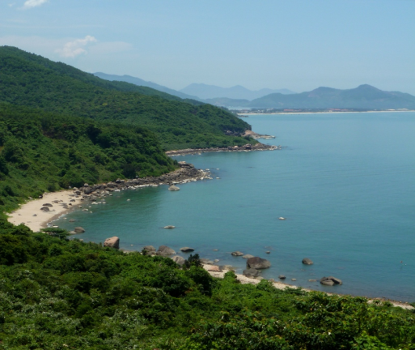
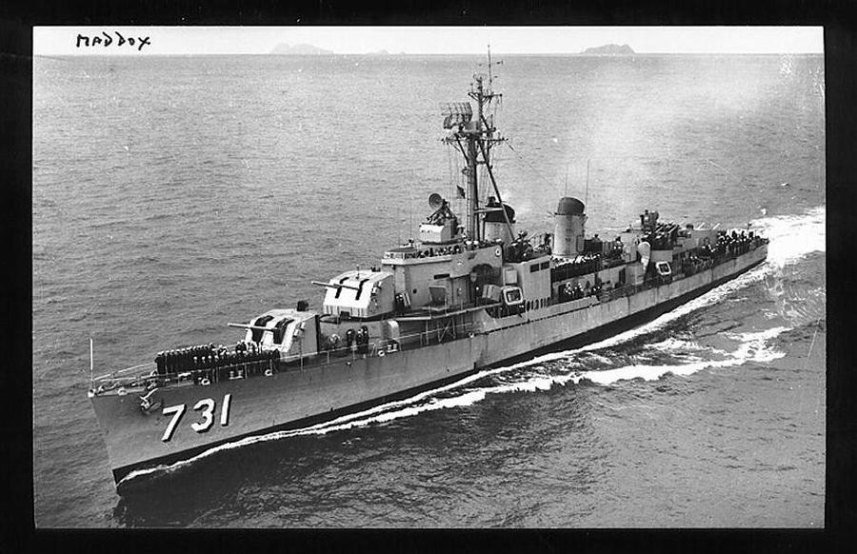
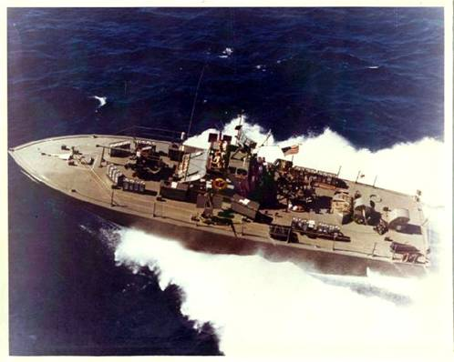
USS MADDOX
August 1964, USS Maddox was 11 miles off Vietnam coast when shooting occurred. President Johnson will use this “attack” as a reason to go to war against communist NV.
*This is one of the most controversial events in US history. On 8/2, USA used warning shots telling NV to back off. But on 8/4, US launched a full scale attack vs. objects on their radar. *Most historians believe this attack was against “air” or “ghosts.” Nonetheless it leads to war.

Slide 5
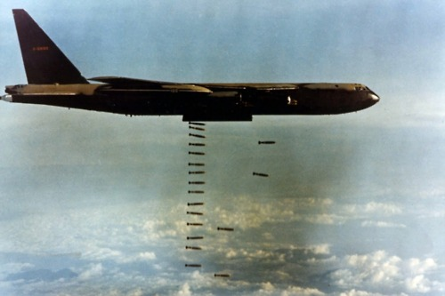
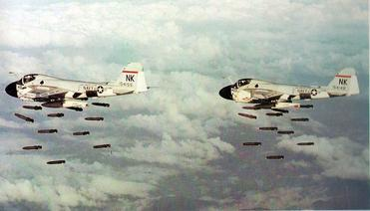
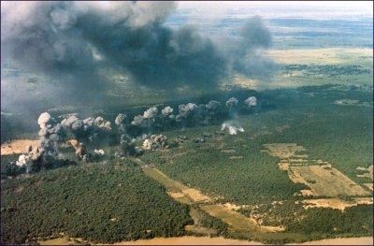
OPERATION ROLLING THUNDER
Plans call for massive USA bombing in an attempt to persuade NV to not invade SV
*USA hoped to avoid bringing ground troops into NV.
*Original plan called for direct hits to top military targets. LBJ & Sec. of Defense McNamara feared reprisal by USSR & China could lead to world war. So instead, we did “tit for tat” bombing, sort of like “you hit us we hit you.” Ultimately, not very affective.

Slide 6
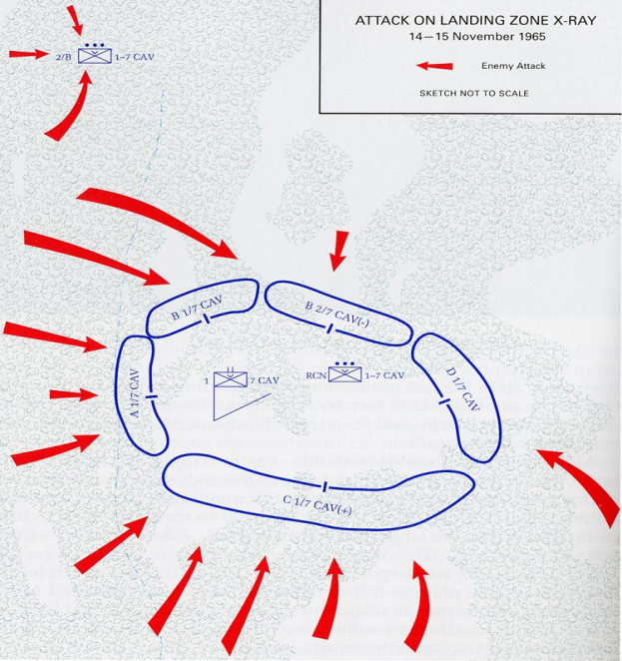
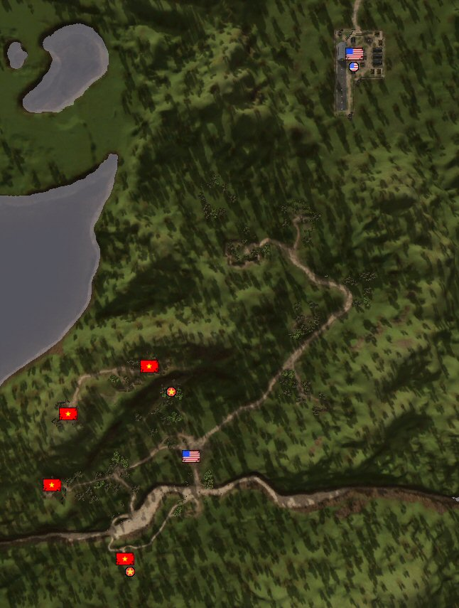
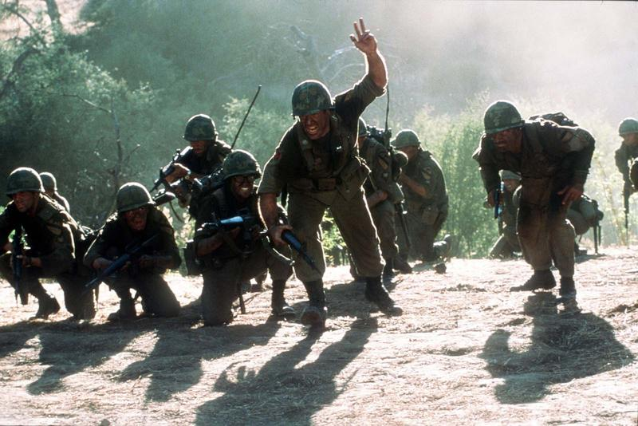
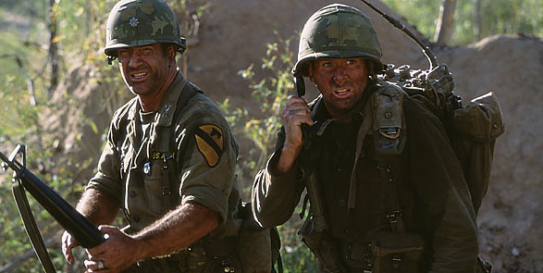
BATTLE OF IA DRANG VALLEY
In a “search & destroy” mission led by Lt. Col. Hal Moore, 450 Americans got surrounded “Custer style” by 3000 NV. After taking OFFENSIVE measures, the NV left their 2000 dead & moved out.

Slide 7
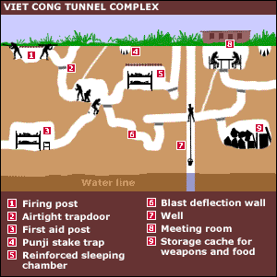
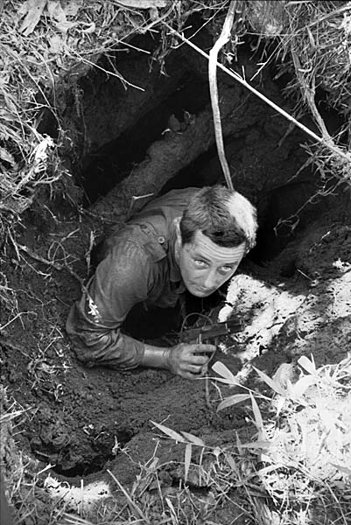
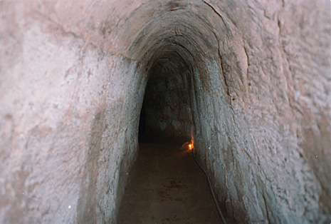
TUNNEL SYSTEM

Slide 8
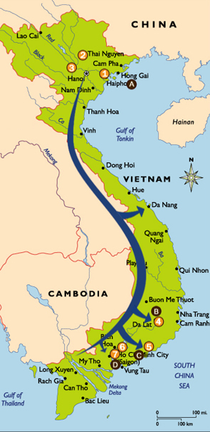
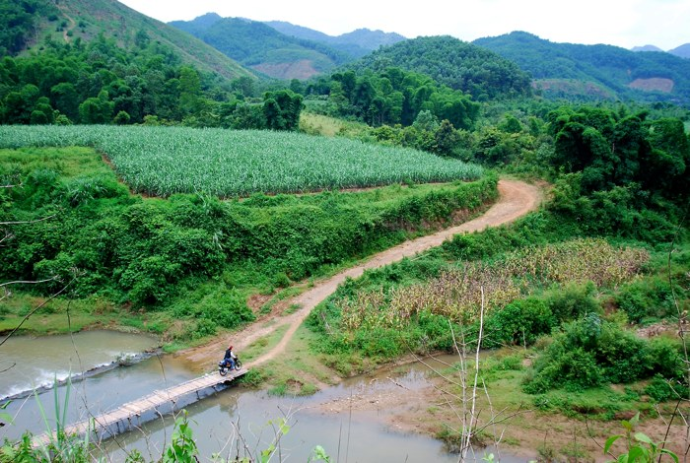
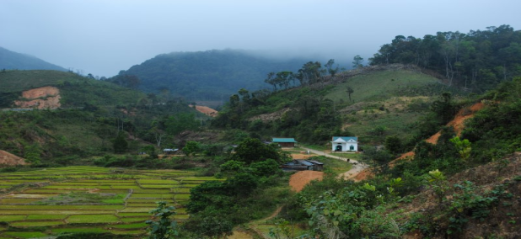
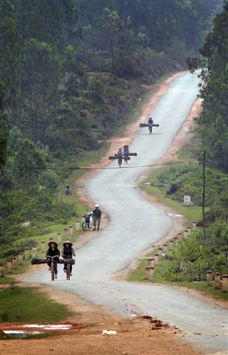
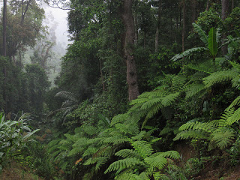
HO CHI MINH TRAIL
NV attacked by using secret travel routes thru dirt roads, muddy trails & underground tunnels (crossed the border into Cambodia & Laos).

Slide 9
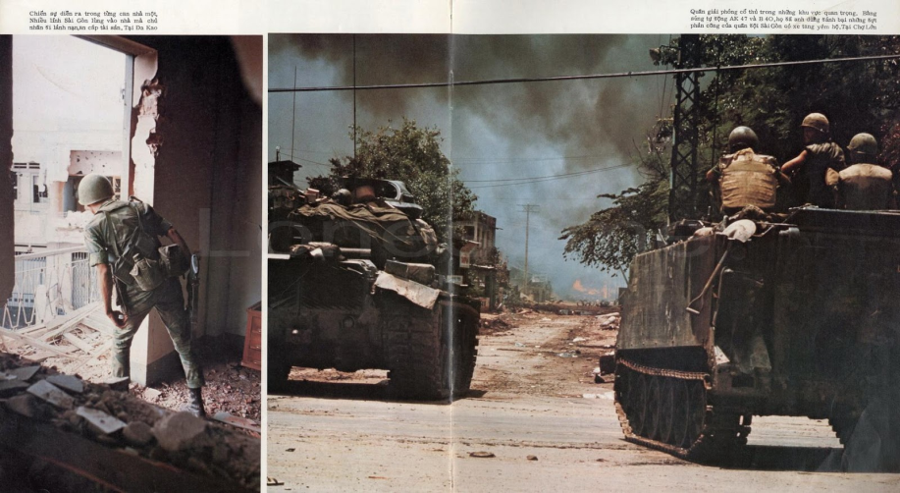
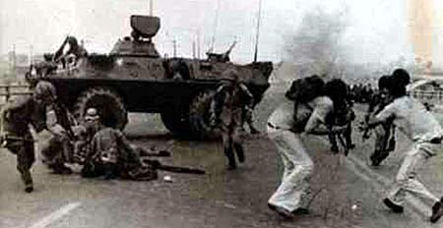
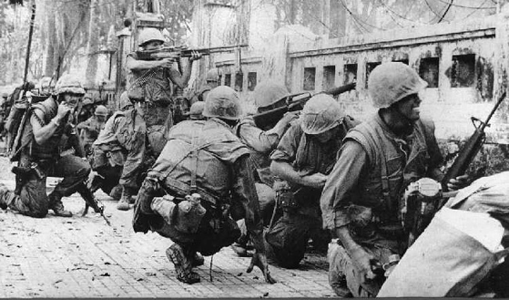
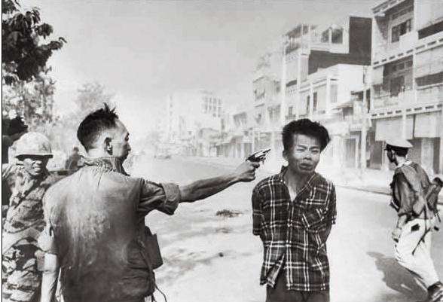
TET OFFENSIVE
During Vietnamese holiday of Tet, NV launched massive invasion on surprised soldiers hitting bases, cities, Saigon & even the USA embassy. Battle becomes turning point of the war for many in USA begin to think we are not winning.
*Westmoreland will actually tell USA that Tet proves we are winning for it was NV’s last ditch try to win.

Slide 10
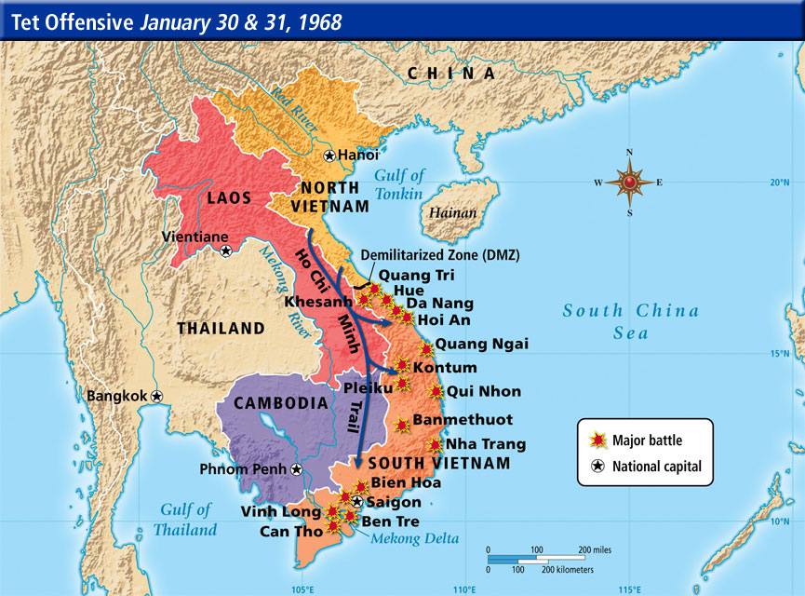

Slide 11
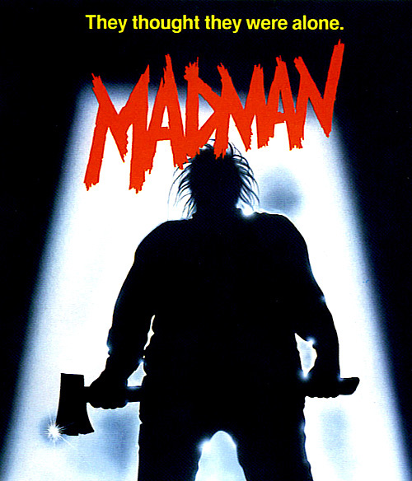
MADMAN THEORY
Calling for “peace with honor,” President Nixon tried to privately scare NV into submission. He wanted to push NV passed their “breaking point” by bombing so much NV would consider him a madman.
*Nixon made sure commies knew the madman was loose, that his finger was beside the button & that he would do anything to halt their advance.

Slide 12
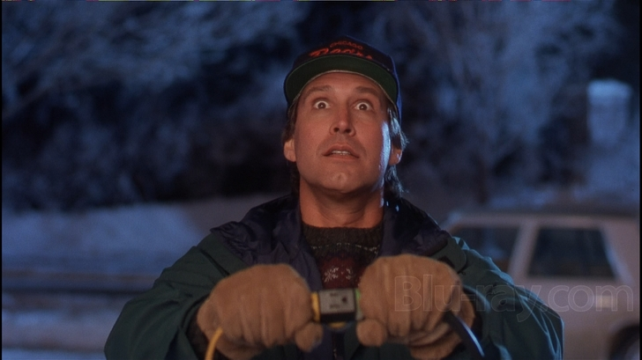
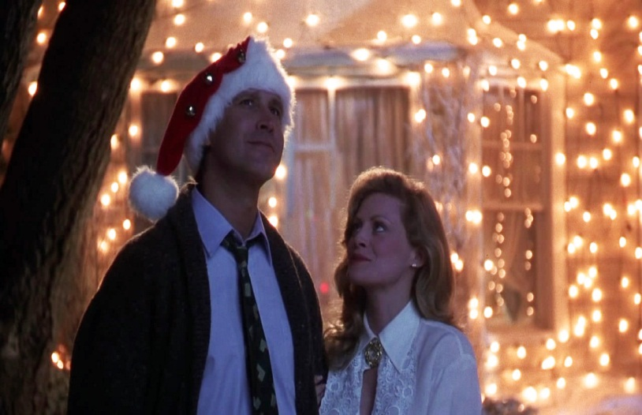
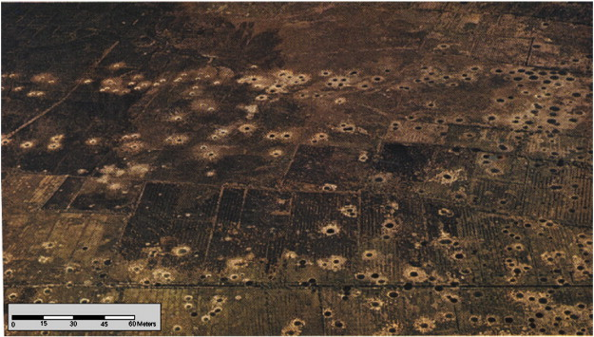
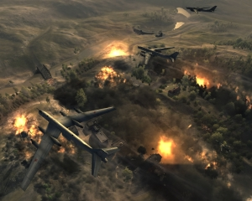
CHRISTMAS BOMBINGS
Angry at the slow peace talks, Nixon orders 36K tons of bombs dropped in just 12 days (more than total of all bombs dropped 1969-71).
CEASE FIRE: January 27,1973.
*Fighting stops, USA promises to return in NV crosses over the border and enters SV.

Slide 13
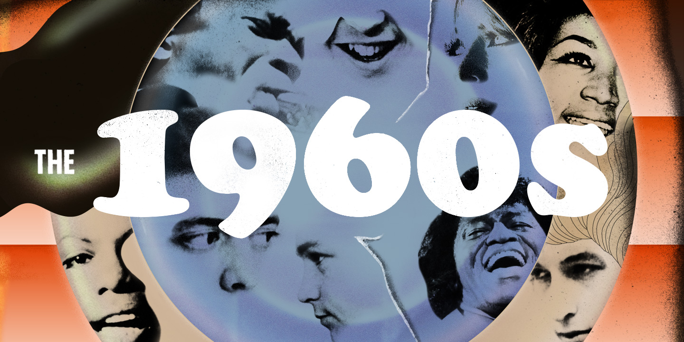

Slide 14
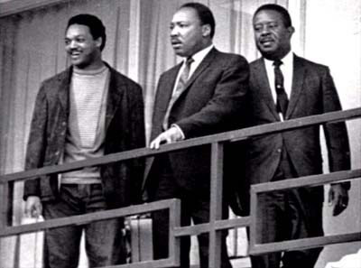
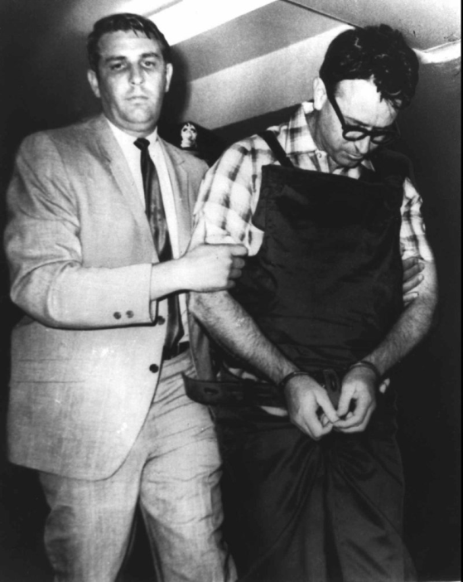
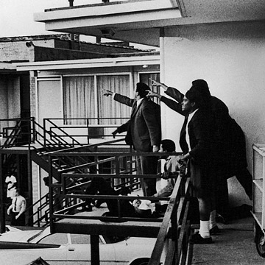
MLK JR. ASSASSINATION
Assassin James Earl Ray shot King while he was standing on a hotel balcony in Memphis (was in town to help AA sanitation workers receive fair wages).
*King’s last speech “I’ve Been to the Mountaintop” sort of prophesized own death, “I may not get there with you…but mine eyes have the seen the glory of the coming of the Lord.”
*Conspiracy theorists think Ray is innocent (ballistic tests came back inconclusive & some eyewitnesses say shots came from behind shrubs). But he was in Memphis during death, had prints on weapon, & arrested in England w/ a false Canadian ID trying to go to Angola.

Slide 15
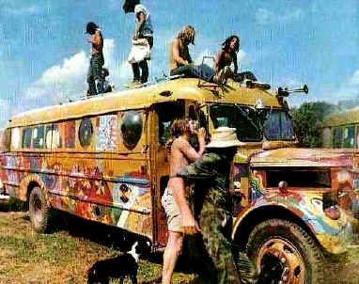
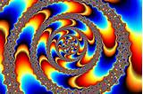
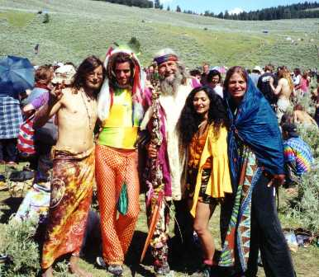
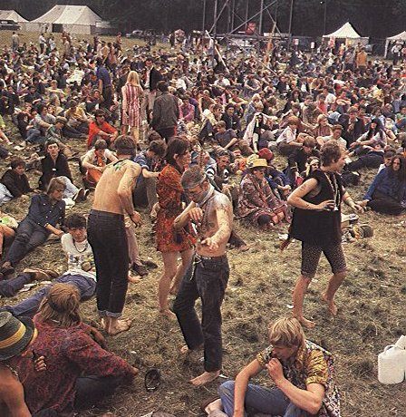
HIPPIES
Counterculture Movement rejected traditional morals & encouraged pre-marital sex, drugs, psychedelic music & birth control (many formed their own traveling communities & embraced new age religions)
*Psychedelic refers to contrasting art, music & drugs that when combined create a distorted view of reality.
*Haight-Ashbury in California becomes an unofficial hippy capitol as police gave up busting people for drug use as 100K converge on it calling 1967 the Summer of Love.
*Hippy hero Timothy Leary encouraged hippies to “turn on, tune in, drop out” which became a motto to many.

Slide 16
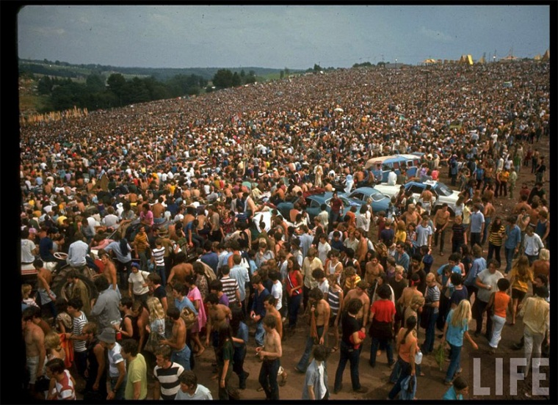
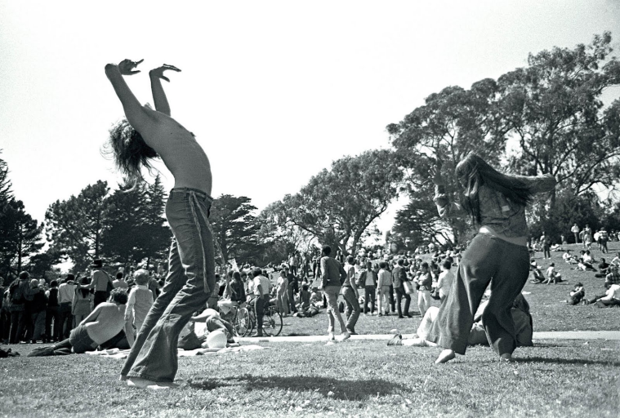
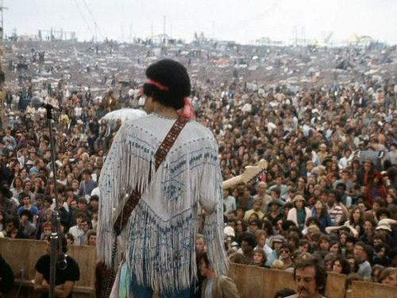
WOODSTOCK
400K hippies gathered for 3 Days of Peace & Music in NY. Many drug-induced concert goers listened to Jefferson Airplane, Janis Joplin, Grateful Dead, CCR, Jimi Hendrix w/ a total of 32 bands--on just 600 acres
*Bathrooms , food vendors, & security were messy, event planners only anticipated for a max of 100K people.
*JH’s now famous version of the Star Spangled Banner was actually performed initially as a protest & at end of concert.
*Traffic was heinous as concert goers abandoned cars on highway & walked to venue, bands took helicopters in.
*Beatles turned down invites. The Doors canceled last min.
*So much for peace as 3 people died: 1 to burst appendix, 1 heroin overdose & 1 patron was run over by a tractor.

Slide 17
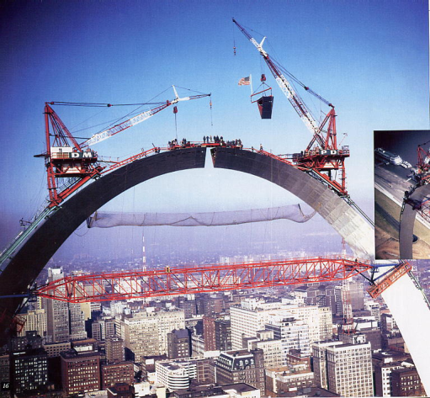
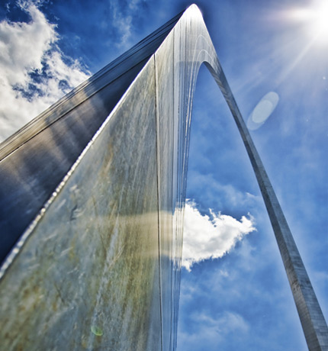
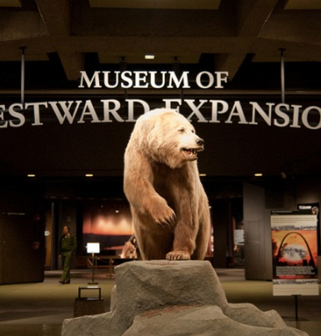
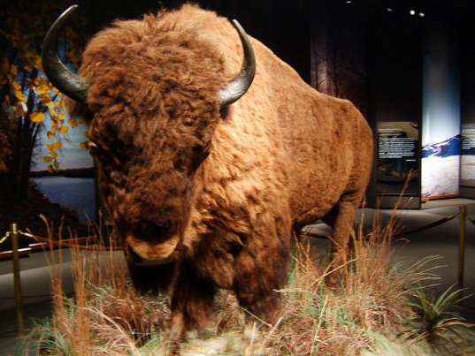
GATEWAY ARCH
*Under arch is Museum of Westward Expansion—cool buffalo eh?
Tallest manmade monument in USA (630 feet tall) is made by MS River in St. Louis as a symbol of westward expansion.

Slide 18
LUNAR LANDING
July 20, 1969: Apollo 11 lands on moon as Neil Armstrong & Buzz Aldrin take “one small step for man, one giant leap for mankind.” The Eagle Had Landed.
*Crew took home 49 pounds of Lunar surface material.
*Buzz Aldrin accidently broke circuit breaker that lights the ignition—could have stranded them on moon (crew successfully used a felt tip pen to operate the switch instead).
*Buzz Aldrin (Catholic) took communion on the moon (kept quiet not to offend Atheists).
*Some skeptics doubt we landed on moon. Technically, we’ve had 6 manned landings & numerous unmanned landings. Any doubts? Get a telescope & see the American Flag.

Slide 19
WATERGATE & THE 1970s

Slide 20
WATERGATE BREAK-IN
Democratic National Headquarters was burglarized during the 1972 election, & 2 Washington Post reporters (Bob Woodward & Carl Bernstein) traced the break-in back to members of President Nixon’s re-election team (called plumbers).
*Though dull to the modern viewer, an epic 1970’s movie titled All the President’s Men which detailed the news reporters investigation—for history peeps it’s a worthwhile view.

Slide 21
COVER UP
Nixon orders CIA & FBI to NOT investigate & tells USA that he personally discover all “unethical activities.” He then fires chief aides & told plumbers to clean up the mess.

Slide 22
SECRET TAPES & RESIGNATION
As people asked, “What did Nixon know?” it became known that Nixon had the White House bugged. When Nixon only released certain parts of the tapes, USA knew Nixon was behind the break-in.
NIXON RESIGNS.
*Nixon is then pardoned by the following President Gerald Ford.

Slide 23
FALL OF SAIGON
With Nixon gone, NV invades & USA refuses to keep promise to “respond in full force.” Commies take SV & unify under a communist Vietnam. USA helped many escape in daring helicopter rescue.

Slide 24
JONESTOWN
Official Leo Ryan visited a cult that had left California choosing to live in Guyana, SA. Upon leaving, his plane was attacked. Fearing arrest, cult leader Jim Jones made 900 followers (276 kids) commit suicide by drinking cyanide-laced kook-aid.

Slide 25
THREE MILE ISLAND
??????????
Nuclear reactor in PA malfunctioned as its cooling system failed. Reactor core hits 5000 degrees & USA citizens fear nuclear explosion (had to release radiation).

Slide 26
IRAN HOSTAGE CRISIS
Pro-USA leader of Iran is ousted by radical leader Ayatollah Khomeini who takes over US embassy & kidnaps 52 hostages over a period of 444 days (President Carter ☹).
*Carter orders a rescue operation but helicopters get caught up in a dust storm, hit each other & burn to the ground.
*Event is exclamation point of failed Presidency as nightly newscasts tally the days as “America: Held Hostage.”

Slide 28
RONALD REAGAN
With Carter’s approval rating at 21%, US chose Hollywood star/CA governor Ronald Reagan. Same day of election, Iran releases hostages.
Movie star Ronald Reagan begins passing massive tax cuts which creates $30T of goods & 20M jobs created, Critics claim Reaganomics is responsible for large wage gap.

Slide 29
BUSINESS LEADERS
*Graph below is a little old, McDonald’s is now worth about $60B, Walmart’s $250B value is about equal to the value of Egypt.
Ray Kroc: McDonald’s owner alters world by leading the fast food explosion.
Sam Walton: Shortcut department stores to lower prices (2M Walmart employees).
Bill Gates: Microsoft founder takes over computer software empire, worth $100B.

Slide 30
ATARI
Pioneer of arcade & video games Pong & Combat were early hits, Paper Boy & Pac-Man gain fame.
*Over 500 games were made for the original Atari 2600 (shown above).
*There were competitors like intellivision but never caught on.
*Game bubble crashed in 1983 w/ staggering losses (burial of E.T.).

Slide 31
MICHAEL JACKSON
King of Pop breaks records in music industry.
*Thriller sold 20M albums & stays #1 for 37 weeks.
*Thriller had 7 Top Ten songs on the album.
*Bad had five #1 hits in a row (Katy Perry tied this).
*MJ had 28 Top Ten hits, trails only Beatles, Elvis & Madonna (she has 37 Top Ten songs as of 2014).
*Success explains why controversial pedophile charges doesn’t affect overall image…yet?

Slide 32
CHALLENGER
74 seconds after liftoff, shuttle carrying seven (including school teacher Christa McAuliffe), exploded while US watched on national TV.
*The launch took place in colder than normal conditions, resulted in a faulty O Ring, a $20 part.
*Since McAuliffe had won a nation wide contest to be selected, millions of school children watched event live

Slide 33
EXXON VALDEZ
Massive oil tanker went over a reef & took out 1000 miles of Alaskan coast line (11M gallons of crude oil). Fishing industry wrecked, spent $2B clean up.
*For sake of notes, its now 1989 and in the George H.W. Bush Presidency, though short 4 years, a lot of important things take place in this brief period.
*Would have been good advice to tell ship Captain Joseph Hazelwood to not drink & drive an oil tanker (yeah, not kidding).

Slide 34
TIANANMEN SQUARE
*Tank Man, as history refers to him comes to symbolize the world’s fight against communism. To this day no one knows his real name.
*TS is massive & located in center of Beijing, its over 100 acres & play a major role in 2008 Olympics.
Chinese students protest Communist regime, tanks are rolled in to evacuate crowd by killing at least 2000 civilians.

Slide 35
FALL OF BERLIN WALL
Mr. Gorbechev Tear Down This Wall…came as Soviet leader agrees to tear down wall. Event begins in the middle of the night & leads to a 5M person party.

Slide 36
PERSIAN GULF WAR

Slide 37
SADDAM HUSSEIN
Iraq leader accuses Kuwait of thieving oil & launches invasion. George H.W. Bush unleashes Desert Shield, a defensive measure with a timetable to withdraw.
*Iraq had just fought a costly war vs. Iran who was perceived as USA’s enemy. So when Hussein invaded Kuwait, he most likely thought US would look other way.
*The bigger issue was Saudi Arabia, what if Hussein got possession of their oil fields? 40% of world’s oil in his hands

Slide 38
DESERT STORM
USA General Norman Schwarzkopf leads a world coalition of 34 nations that removed all Iraqi military from Kuwait in just 100 hours as 60K scared Iraqi troops surrendered.
*Key to success was the massive air raids that hit for around 40 days prior to ground forces
*Main defense was to launch scud missiles at Israel—hoping to start Arab vs. Israel war.

Slide 39
UN RESOLUTION 687
Saddam Hussein stays in power after agreeing to cease fire promise of withdrawing troops & destroying all chemical weapons & long range ICBM missiles.
*During withdraw, SH used oil fields as a biological weapon by having them burned in order to supply air cover. Highways littered with vehicles.
*To many, Persian Gulf War is seen as perhaps the most masterfully architected war in USA history.
*Long term issue becomes the policing of Iraq’s weapons which will ultimately lead to the 2003 Iraq War.

Slide 40
SOVIET UNION COLLAPSE
Hardline communist leaders try a coup to overthrow reforms made by Mikhail Gorbechev. Boris Yeltsin intervenes by rallying people to a peaceful revolution.
COLD WAR (1945-1991) IS OVER: USA WINS!

Slide 42
RODNEY KING
*Rioters started over 7000 fires & cost over $1B in property damage. Officers were later tried & found guilty in federal courts.
AA motorist high on speed is arrested & beaten by LAPD (caught on video). After a NOT GUILTY verdict of police brutality, riots erupted in Los Angeles causing 58 deaths & 5300 arrests.
*Most famous riot incident involves truck driver Reginald Denny being dragged out of truck & beaten to near death w/ a brick.

Slide 43
CLINTON’S POLICIES
Clinton works with Congress to balance National Budget, creates a 5 day Waiting Period to buy a handgun, allows homosexuals to serve in military under Don’t Ask, Don’t Tell, but does get impeached for actions taken with White House intern Monica Lewinsky.
*Clinton had more scandals of any President in history at that time (less than Trump now) and many of them may involve sex & some critics even cry murder. Yet, he will be considered an above average President despite all the controversies. His wife Hillary Clinton plays active role in admin.

Slide 44
FLOODS OF ‘93
*Pics Lt to Rt: Arch in St. Louis, train depot at Historic St. Charles Highway into Jefferson City.
Heavy rains increased river height. 1000 levees failed as cities such as Jefferson City, Winfield, St. Charles, Alton (IL) & 100s of others went under. 17,000 square miles underwater, $20B lost, 8M acres of farmland completely covered.

Slide 45
ST. LOUIS 1993

Slide 46
OKLAHOMA CITY BOMBING
Believing he was Luke Skywalker waging a war against an evil empire, Timothy McVeigh used a Ryder moving truck to blow up the 9 story federal building in Oklahoma City, Oklahoma: 169 dead including most of the kids in daycare.
*Blast destroyed 324 buildings & shattered glass in over 250 others: worst terror attack in history (until 9/11).

Slide 47
TRIAL OF THE CENTURY
*Aside from LAPD proven racism, the big issue was a bloody glove that was worn by murderer but didn’t fit OJ’s hand (after he gained weight).
NFL legend OJ Simpson is arrested on felony charges of killing his ex-wife. After a long ride in a white Bronco, he surrenders & hires high profile lawyer Johnny Cochran. He’s found innocent as mistakes by the LAPD leave Reasonable Doubt.

Slide 48
COLUMBINE
*This is 1st time a HS attack goes national.
*Sadly, there have been many others since 4/20, 1999 (boys were honoring Hitler’s Birthday).
2 students went on a spree murder rampage at a Colorado HS targeting minorities & Christians. They killed 13 before committing suicide (this is the first of many public spree killings in USA).

Slide 50
9/11
Using box cutters, 19 terrorists took over 4 planes in flight. 2 planes hit World Trade Center, 1 plane crashed into Pentagon, & 1 plane was headed for White House until passengers thwarted the attack forcing a crash in PA (death count exceeds 2800).

Slide 51
*OBL was an Afghan freedom fighter vs. USSR who turned vs. US when Saudi Arabia asked US for help during Desert Storm. To him, attack was jihad—Holy War.
War is declared w/ the goal of killing 9/11 mastermind Osama Bin Laden, destroy terrorist groups like Al Queda, fight nations that allow terrorist groups, & to defend the home front of USA.
*Bush tied together nations that allowed terrorism & named them the Axis of Evil (include Iran, Iraq & North Korea). Map is on the left.

Slide 52
USA invades Afghanistan to remove the Taliban gov’t which arose to power in the vacuum following the departure of USSR, & to destroy Al Queda.
*Though also called the War in Afghanistan, OEF actually encompasses attacks in many locations: Philippines, Horn of Africa, Pankisi Gorge, Trans Sahara Africa, Caribbean & South America.

Slide 53
IRAQ WAR
Claiming Iraq housed weapons of mass destruction (WMDs),US invaded (this time by sea). After initial success, US met difficulty in the 2nd phase of war against the insurgency (those who rose up to fight occupying forces).

Slide 54
SADDAM HUSSEIN
After USA takes Baghdad, Saddam Hussein is hunted until caught hiding in a hole. He is executed by Iraqi people. War is a USA victory, but plans for democracy in Iraq are messy as USA has no exit strategy.
*SH had multiple palaces, tons of wealth & even killed his own citizens to keep power (gassed an ethnic group, Kurds). So where he is captured (in a hole) is bitter irony.
*Problem with building democracy (that differs from Japan) is that the people of Iraq are militarily divided & would be willing to simply kill each other to take power (Japan didn’t have this issue). So leaving the country void of chaos is hard.
*Also, though Secretary of Defense Colin Powell (who is very respected by both political parties) claimed Iraq had WMDs and could even strike our Eastern Seaboard…no WMDs were found. This is why some people claim “Bush is a liar.”
*Technically, combat troops leave in 2011, but soldiers remain.

