Slide 2
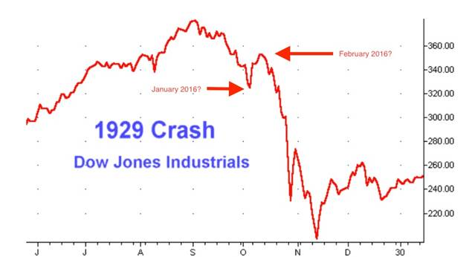
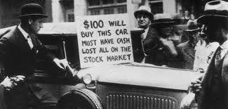
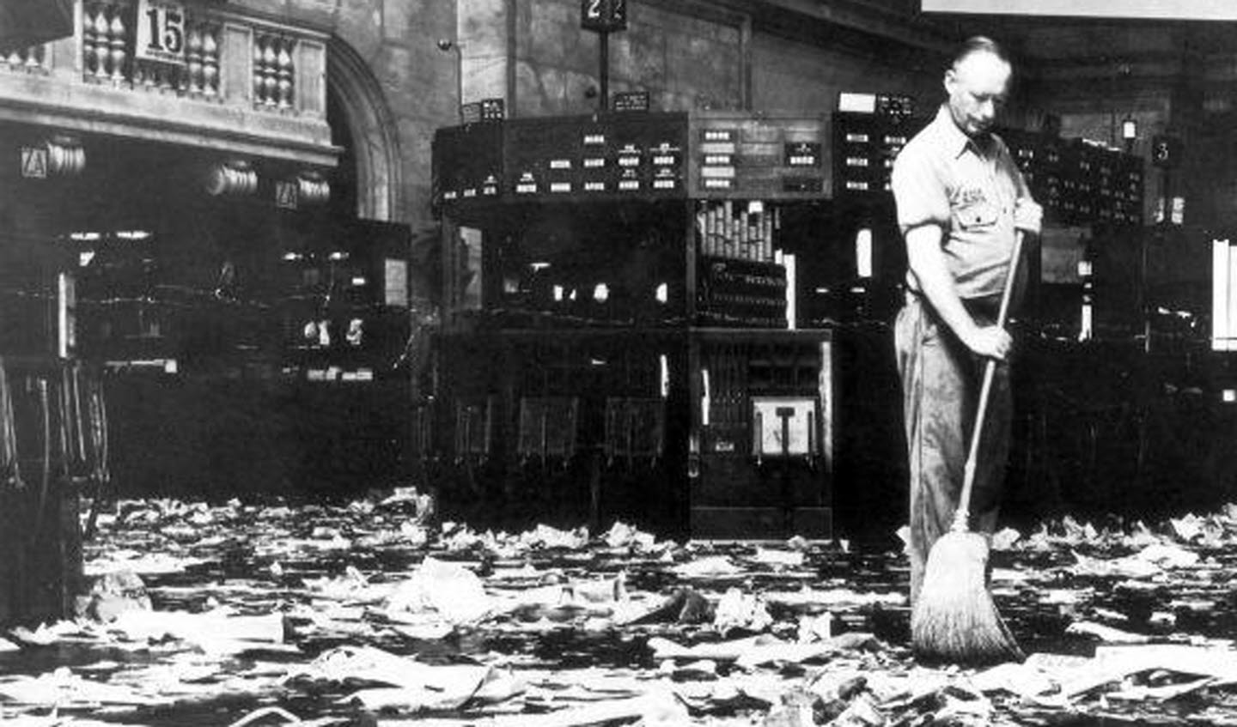
BLACK THURSDAY
BLACK THURSDAY (OCT 24, 1929): Prices dropped sharply as trading went way up. Billionaire JP Morgan & some bankers halted the panic by pouring $30M into the market.

Slide 3
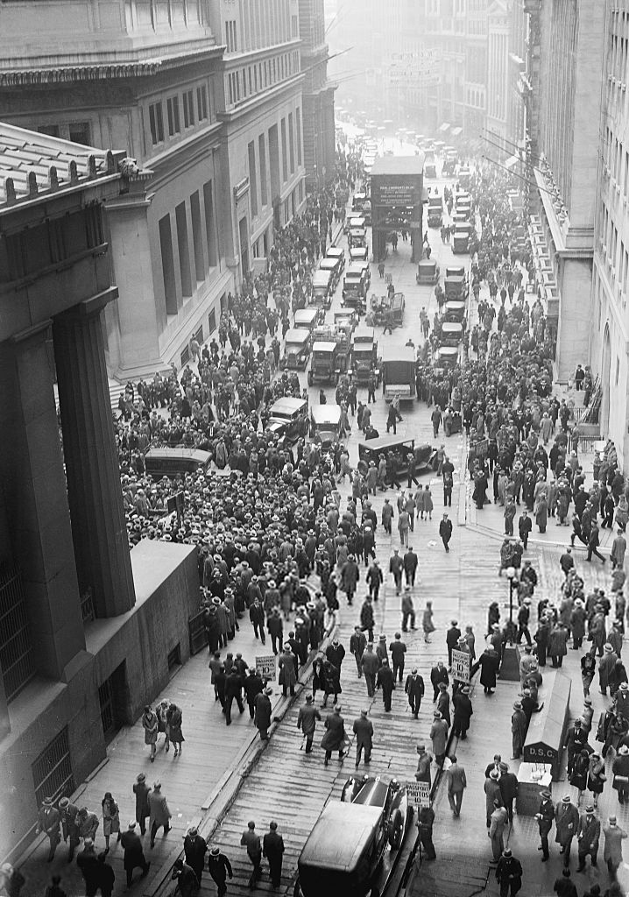
Wall Street drops to record lows as $14B is lost in one day, stock market continues to drop losing $30B by the end of the week!
*GM ($73 a share down to $8), US Steel ($262 to $22), Montgomery Ward ($138 to $4). This four year drop continues until 89% of the money is gone.
*The $30B loss in 1929 equals about $500B today.

Slide 4
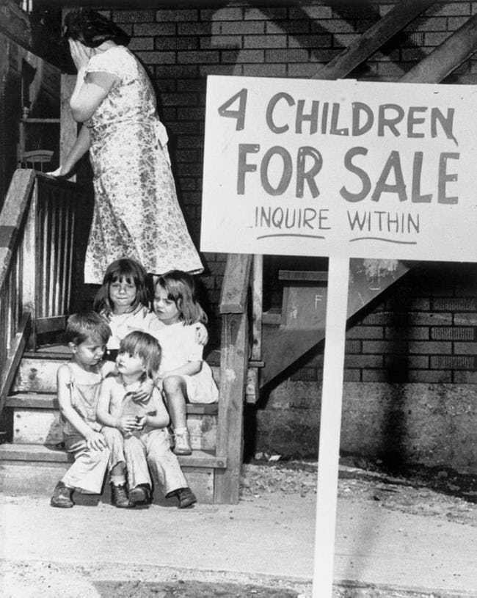
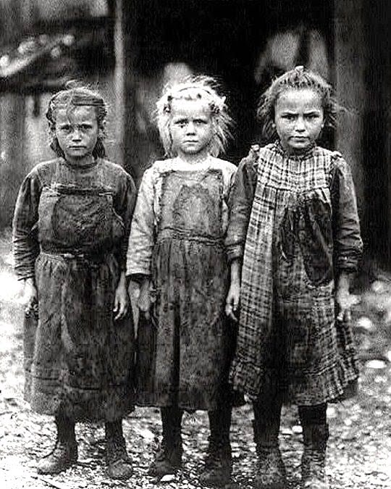
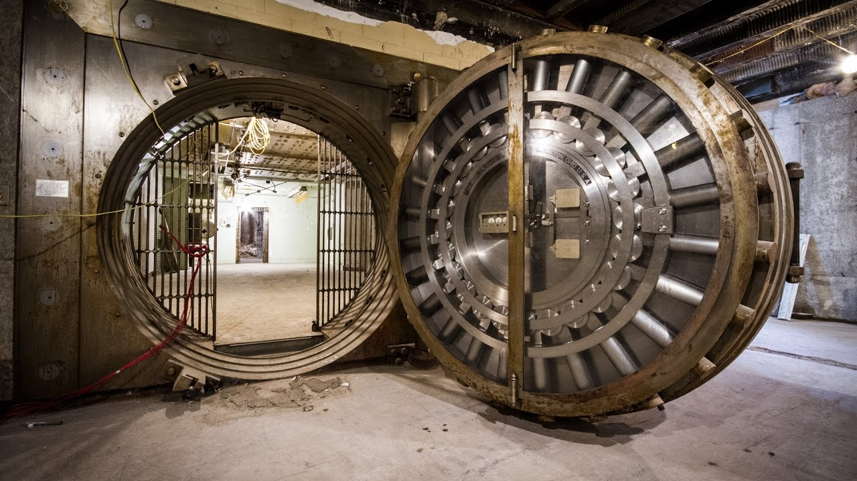
Economic collapse
30,000 businesses fail per year, 40% of banks closed, family income drops 33% nationally, 400,000 farms are lost. 50% of children were unnourished. Unemployment went from 5% to 25% (Chicago hits 50%, Cleveland 80%). AA workers were the last hired & the first fired.

Slide 5
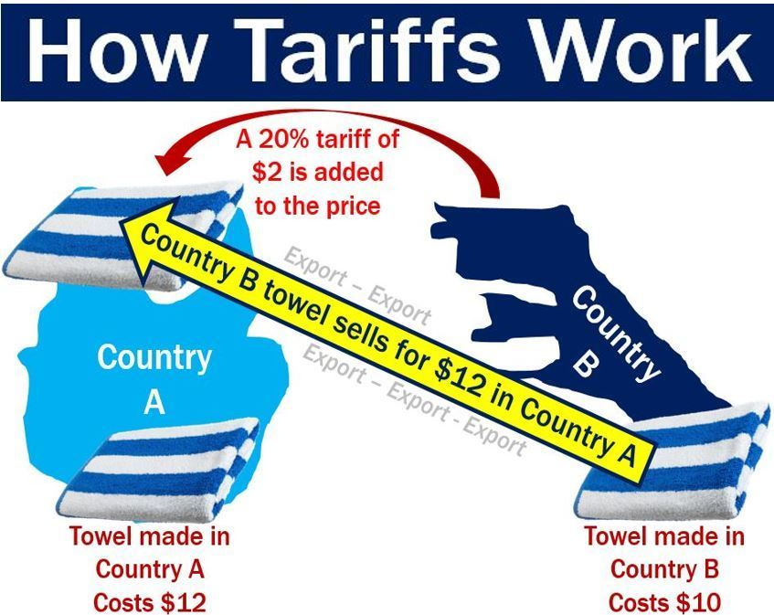
Smoot-Hawley act
USA Raised tariffs on 20,000 goods to record levels, in response Europe raised tariffs on items leaving USA. This led to a 61% decrease in American exports which further crushed our economy (the idea was supposed to help farmers but did not).
*Hundred of economists told politicians not to do this but were ignored.
*Though it was the combination of the Stock Market Crash and debt that caused the Great Depression, others point to this act as furthering the depression (these people say that had this not been signed GD would have ended.

Slide 6
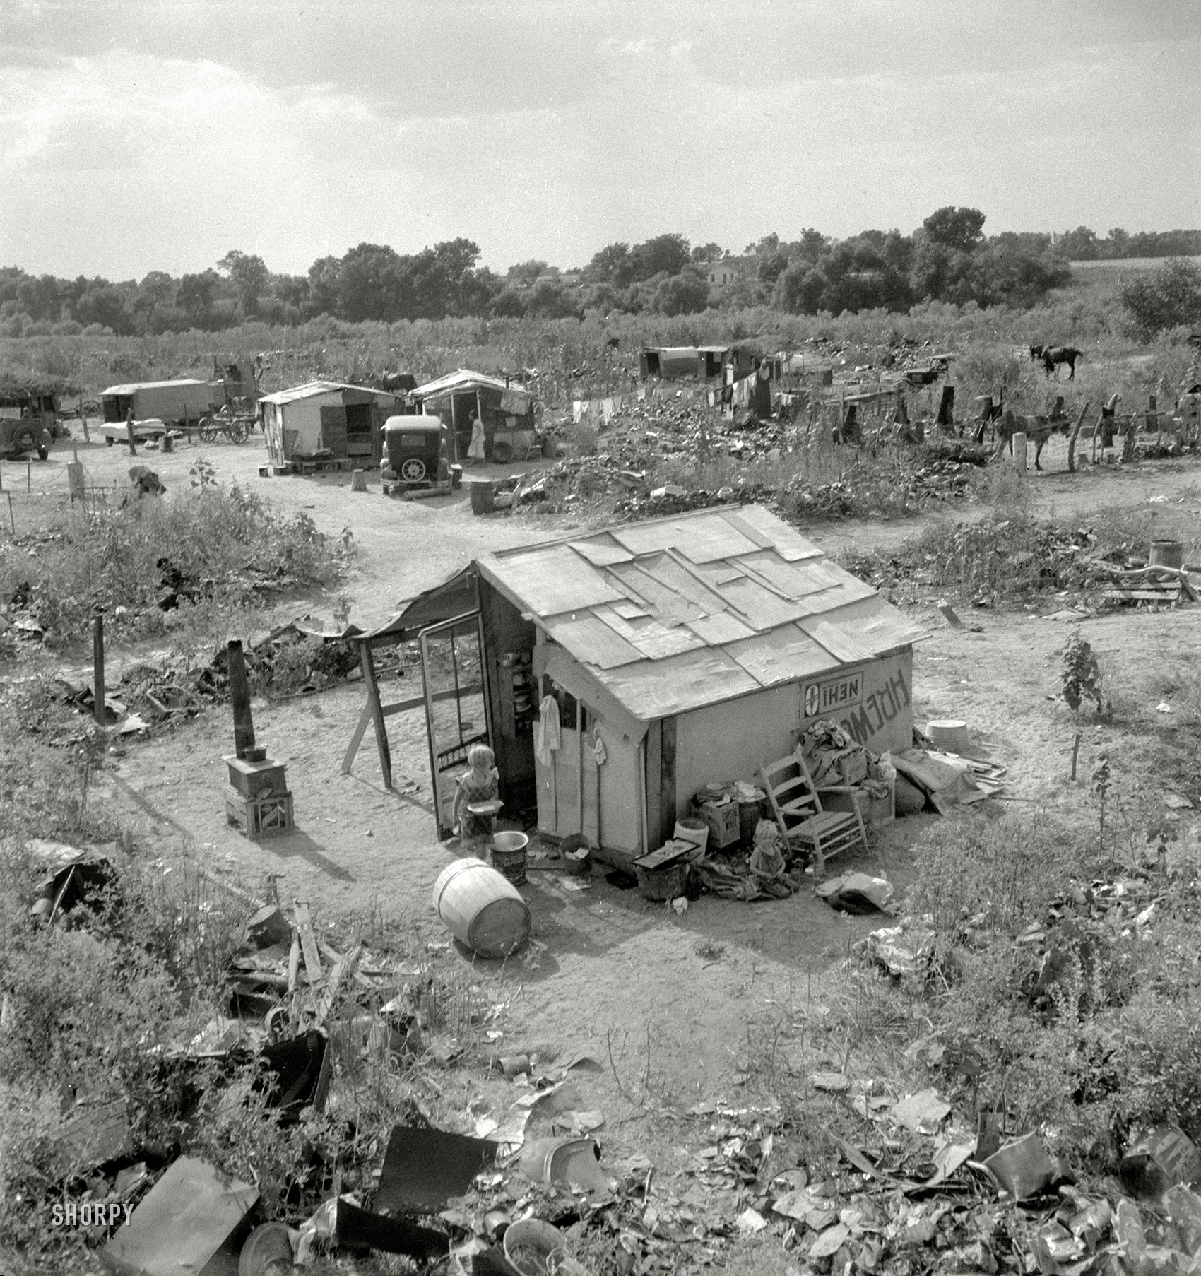
hoovervilles
By 1932, 2M homeless people roamed the nation living in shantytowns made of cardboard, scrap metal, tents, etc. Hoboes ate rats, sifted thru trash, & hitchhiked across USA on railroad lines (Hoover flags, Hoover blankets, bum blockade headed West).

Slide 7
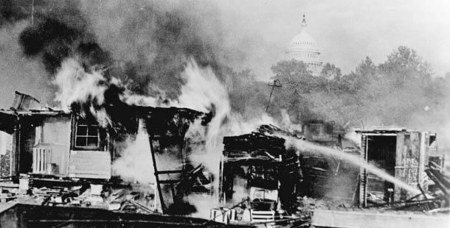
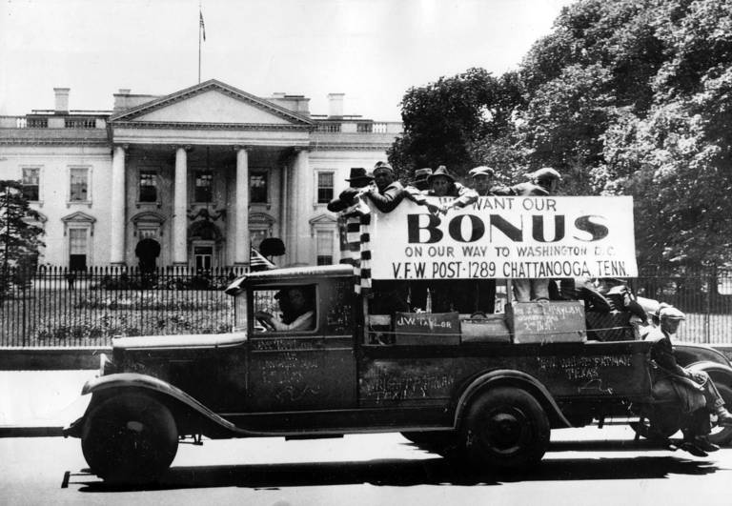
Bonus army
WWI veterans marched on Washington DC demanding an early payment of their future bonus (need the money now). Instead of meeting with the soldiers, President orders current military to use tanks, bayonets, vomit gas, & fire to remove vets out of town.

Slide 8
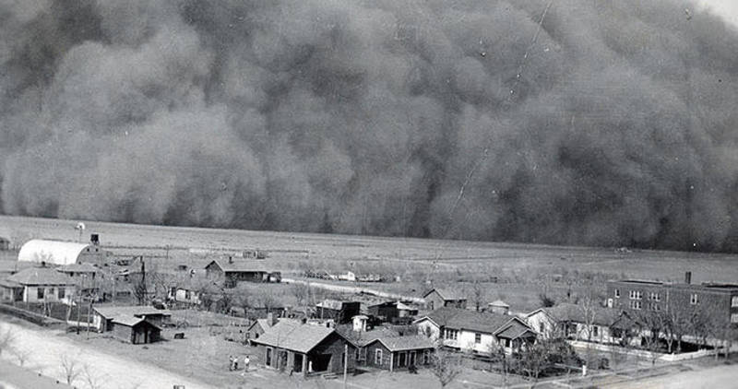
Dust bowl
Howling winds carried massive black blizzards measuring 1000 feet high across the Midwest. People claim you could not see 5 feet in front of you.
*Oklahoma, Kansas, Nebraska are hit hard as snow piles of dust cover farms. Livestock die as their food perishes, dust pneumonia kills 100s

Slide 9
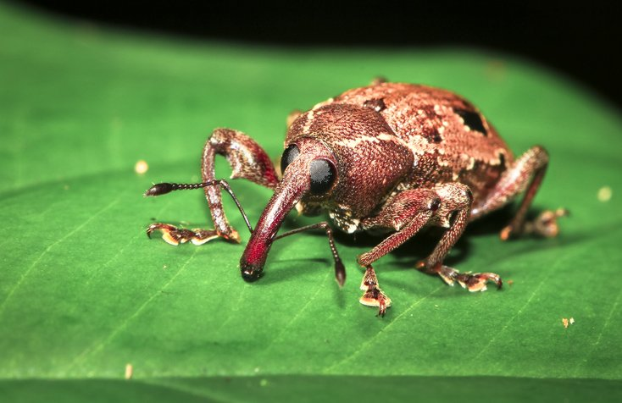
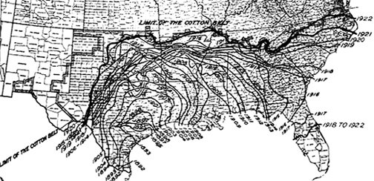
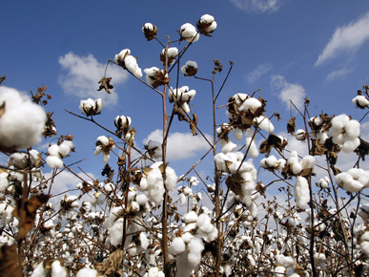
BOLL WEEVIL
Cotton eating beetle made its way into Deep South traveling about 80 miles a year, decimating cotton crop to the tune of $13B over 20 years.
*Insect is native to Mexico, 1000s of farmers were forced to sell their farms and move.
*The Great Migration is usually seen as WWII job search, but also people leaving south.
*University of Arkansas at Monticello mascot.

Slide 10
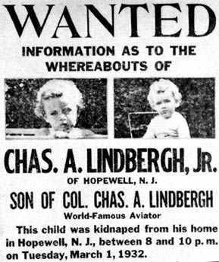
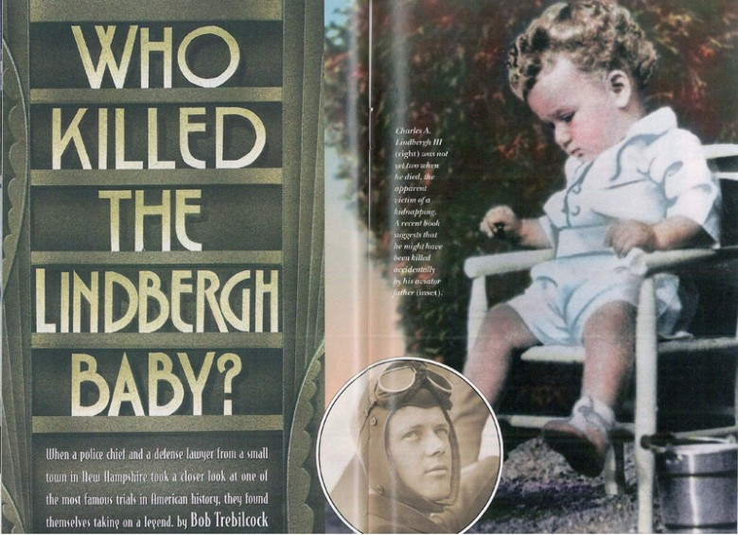
LINDBERGH BABY KIDNAPPING
Hero’s baby was kidnapped for a $50K ransom. After paid, corpse was found in a forest 5 miles away.
*Charles Jr. was abducted from a crib while sleeping on the 2nd floor of his house (found a ladder and two sets of footprints heading off into the snow).
*Ransom was given in a custom made wooden box & gold certificates instead of cash…hoped to catch the criminal at a future date.
*Richard Hauptmann was arrested & given death penalty.
*Here’s the Letter…
Dear Sir! Have 50.000$ redy 25 000$ in 20$ bills 15000$ in 10$ bills and 10000$ in 5$ bills After 2–4 days we will inform you were to deliver the mony. We warn you for making anyding public or for notify the Police The child is in gut care. Indication for all letters are Singnature [Symbol to right] and 3 hohls.^{[13]}

Slide 11
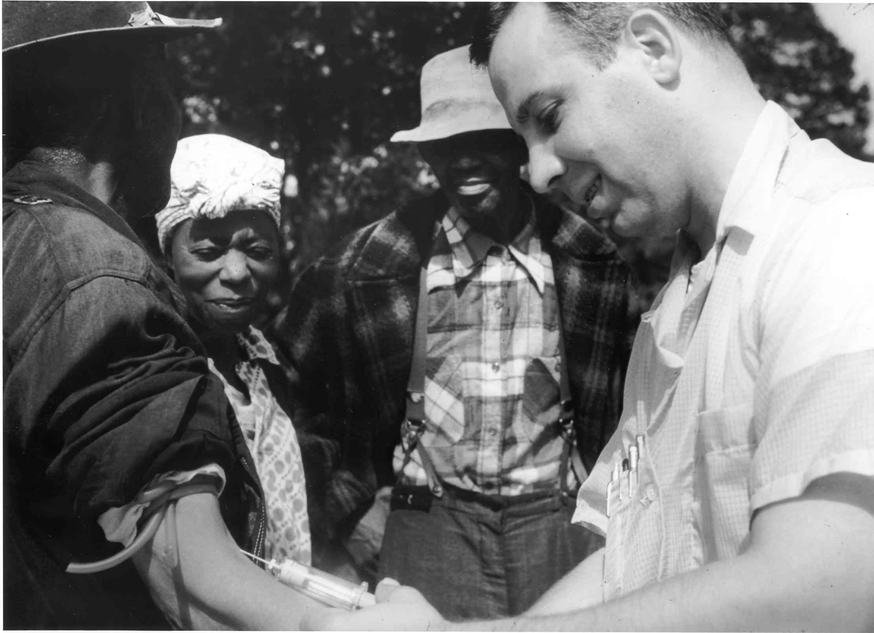
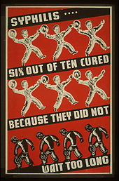
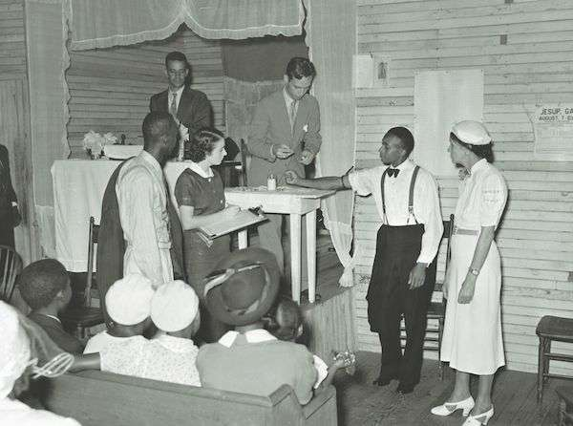
TUSKEGEE SYPHILIS STUDY
400 AA men were told they were receiving free health care while government instead studied the affects that the STD syphilis had on their bodies while they were dying.
*Men were told they would receive free health care, meal, free burial insurance for their participation in a “study.”
*Men were never told they had the disease as the lie continued for over 40 years.
*When penicillin was discovered and proved to be a great treatment for the disease, it was never provided to the men.
*Syphilis didn’t have to be deadly, there were treatments.

Slide 12
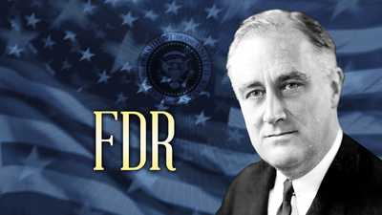
Franklin d. Roosevelt
FDR wins landslide election & promises big changes in how government is run.
*FDR has a navy background & is from a wealthy family, cousin to Teddy Roosevelt, he lost as Vice President in 1920 election, then when struck with polio & had his legs paralyzed. He was the governor of NY, had wheelchair.
*Polio is a disease that destroys muscles in the body, usually in the legs first. It is spread through food , water, or infected people through saliva. When cure was found the world was changed.

Slide 13
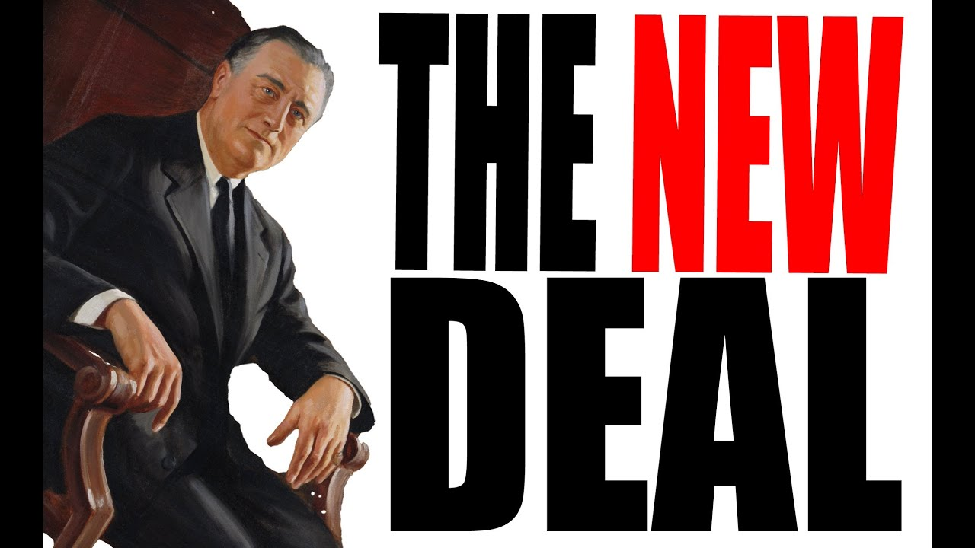
CCC: FORESTS *Created work in forests, national parks, wildlife, bee keeping, etc.
AAA: FARMS *Paid farmers to NOT plant crops so prices would go back up.
TVA: ELECTRICITY FROM DAMS *Dammed up rivers in the Southeast in financially poor regions.
PWA: PUBLIC WORKS *$3.3B to build streets, bridges, highways, airports, schools, etc.
FHA: HOUSING *Regulated interest rates & lengthened the years to pay of loans.
FDIC: BANKS *Insured people’s money in banks in case of “bank runs.”

Slide 15
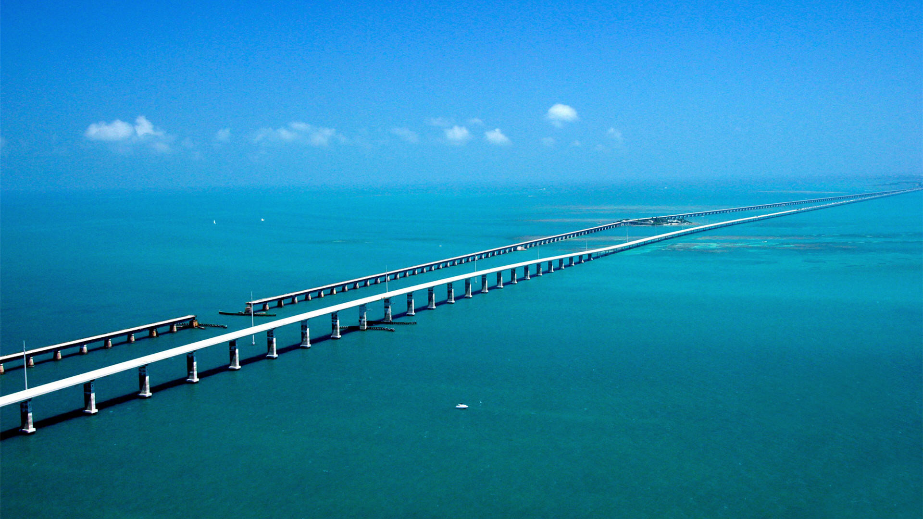
OVERSEAS HIGHWAY
127 mile highway thru the Florida Keys including The Seven Mile Bridge.

Slide 16
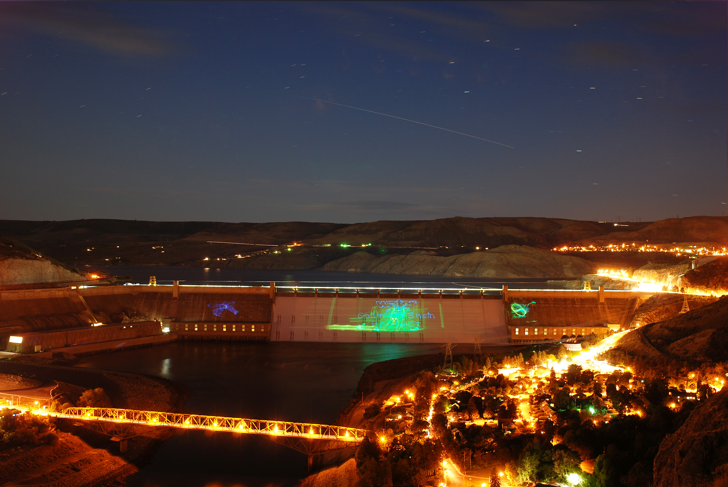
GRAND COULEE DAM
Largest USA electric power producing dam in USA, has a cool glass elevator.

Slide 17
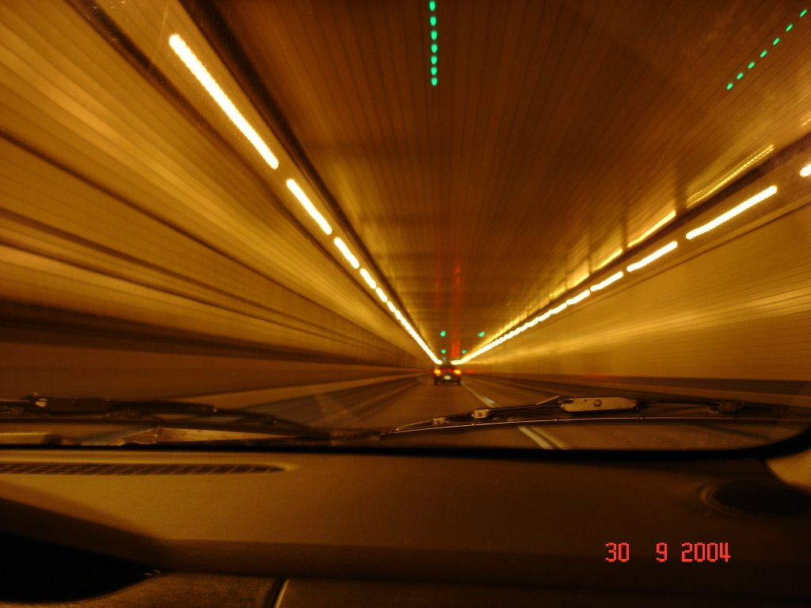
LINCOLN TUNNEL
Connected NY and NJ with a 1.5 mile tunnel under the Hudson River.

Slide 18
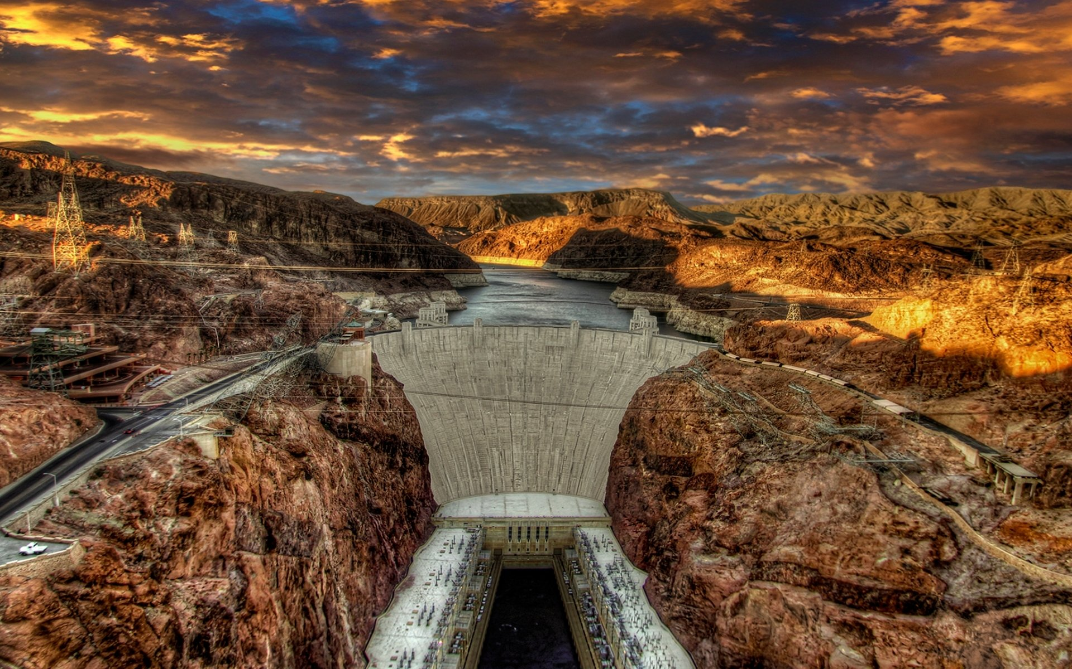
HOOVER DAM
Built on the Colorado River on the border of Nevada & Arizona, it makes power & creates Lake Mead..

Slide 19
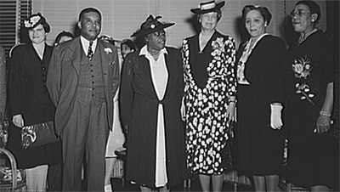
Eleanor Roosevelt & the black cabinet
Most active First Lady in history, fought for civil rights, women’s rights, met with her Black Cabinet regularly, and personally answered millions of letters herself.
*Mary McLeod Bethune was known as the “First Lady of the Struggle,” she battled for Civil Rights & even started her own college. Eleanor called MMB her “closest friend in her age group.”
*The photo on the right is Eleanor, flying with the Tuskegee Airmen during World War II.

Slide 20
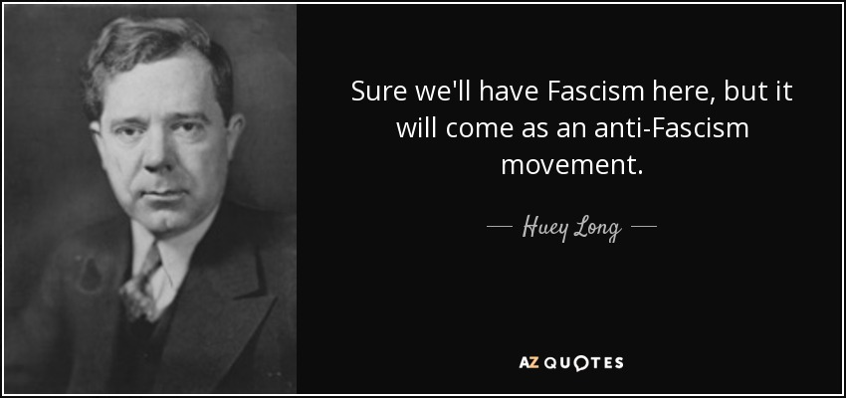
When new deal wasn’t lowering unemployment, some had other ideas…
Governor of Louisiana had a plan to take wealth away from rich and redistribute it to the poor, he had total control of the government. His actions were similar to a fascist dictator.
*The Huey Long era was very interesting. On paper, what he said looked very good:
Expansion of health care, charity hospitals, & a “share the wealth” program.
*But the “Kingfish” also wanted democracy to end & favored the confiscation of property in the same manner Hitler told possessions.
*Would eventually be assassinated when a doctor shot him in the torso. The assassin received 60 shots from Long’s bodyguards.

Slide 21
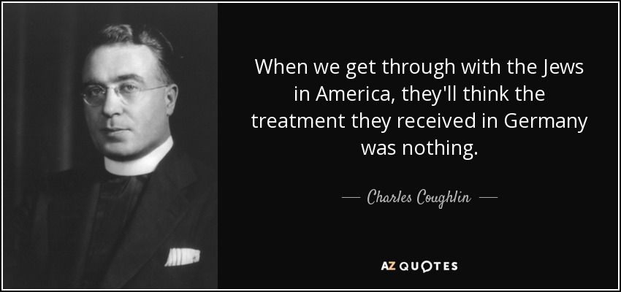
Though market crash caused depression, others put blame elsewhere…
Racist priest had a radio show with a massive audience of 30M weekly listeners, he told people that Depressions was a result of tolerating Jews in America.
FATHER CHARLES COUGHLIN
*Anti-Semite is the term for those prejudiced against Jews, and this belief was common in 1930s, not just in Germany but in USA too
*Some believed conspiracy theory that Jews controlled the world-wide banking industry and the Jews purposefully crashed markets
*Church finally silenced Coughlin, ordered him to stop broadcasts.

Slide 22
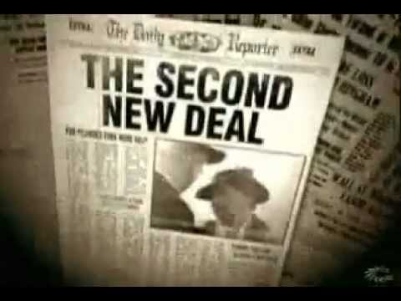
WPA: LIBRARIES & ART *$11B program funded buildings, roads, libraries, bridges, art, concerts, and luxury buildings/resorts (employed 2M people).
FLSA: FAIR WAGES *Wages & Hours Bill that created a 40 hour work week, created overtime pay, stopped child labor, and made a minimum wage (initially 40 cents an hour).
SOCIAL SECURITY: RETIREMENT *System that assists older citizens by collecting money from younger and paying for their retirement.
SEC: WALL STREET *Regulation of the stock market.

Slide 23
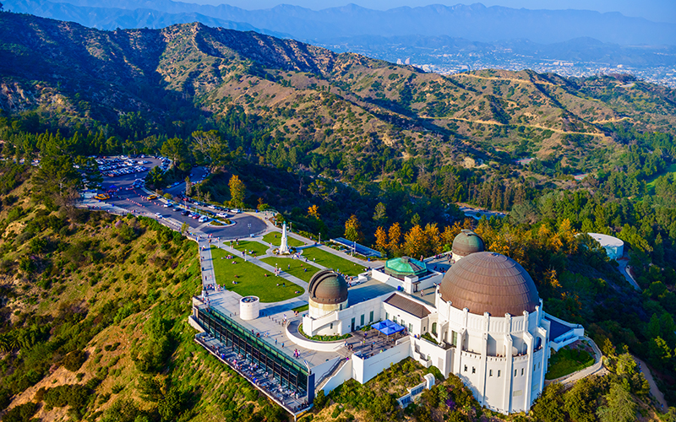
GRIFFITH OBSERVATORY IN LOS ANGELES

Slide 24
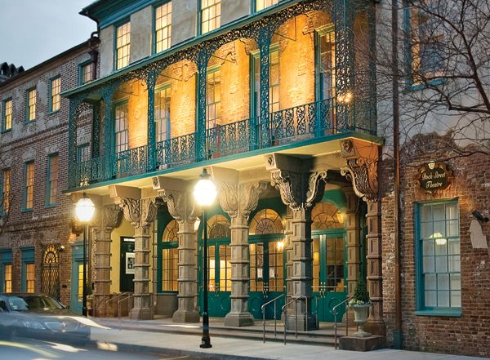
DOCK STREET THEATER
IN CHARLESTON

Slide 25
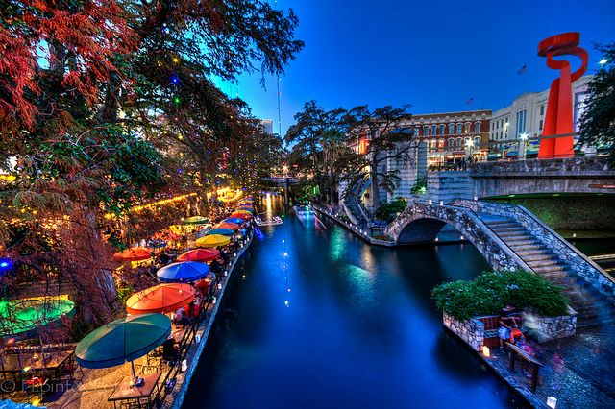
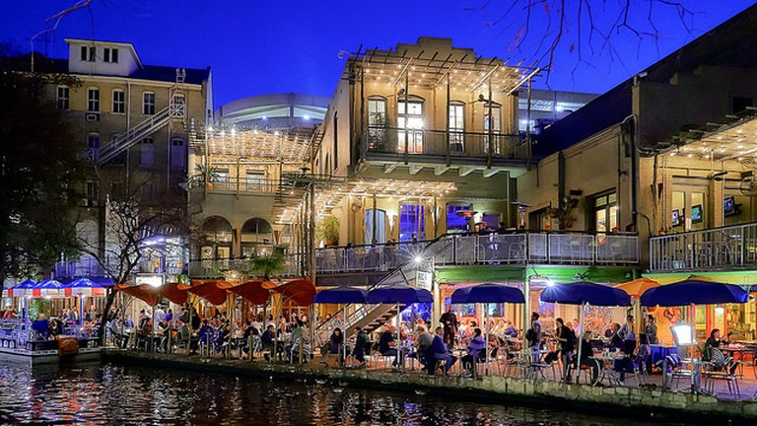
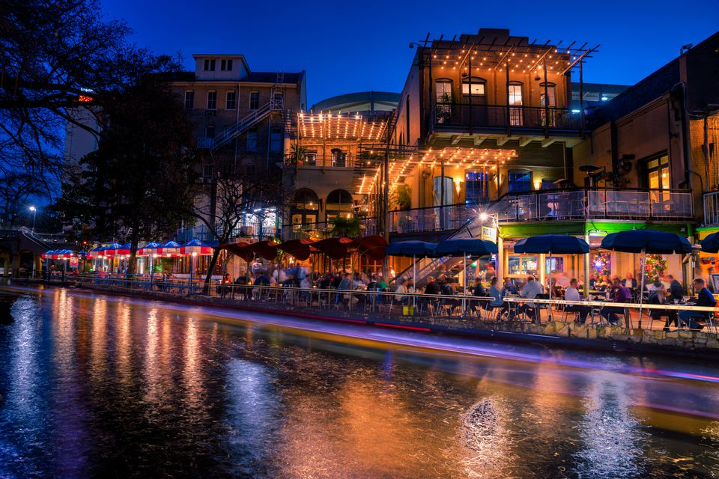
SAN ANTONIO RIVERWALK
*15 MILE RIVER IS ORGANIZED TO STOP FLOODING, IT NOW HOSTS HUNDREDS OF STORES/RESTAURANTS/ SHOPPING PLACES. 5 MILES IS DOWNTOWN & RIVER EVEN RUNS THRU A 5 STAR HOTEL.

Slide 26
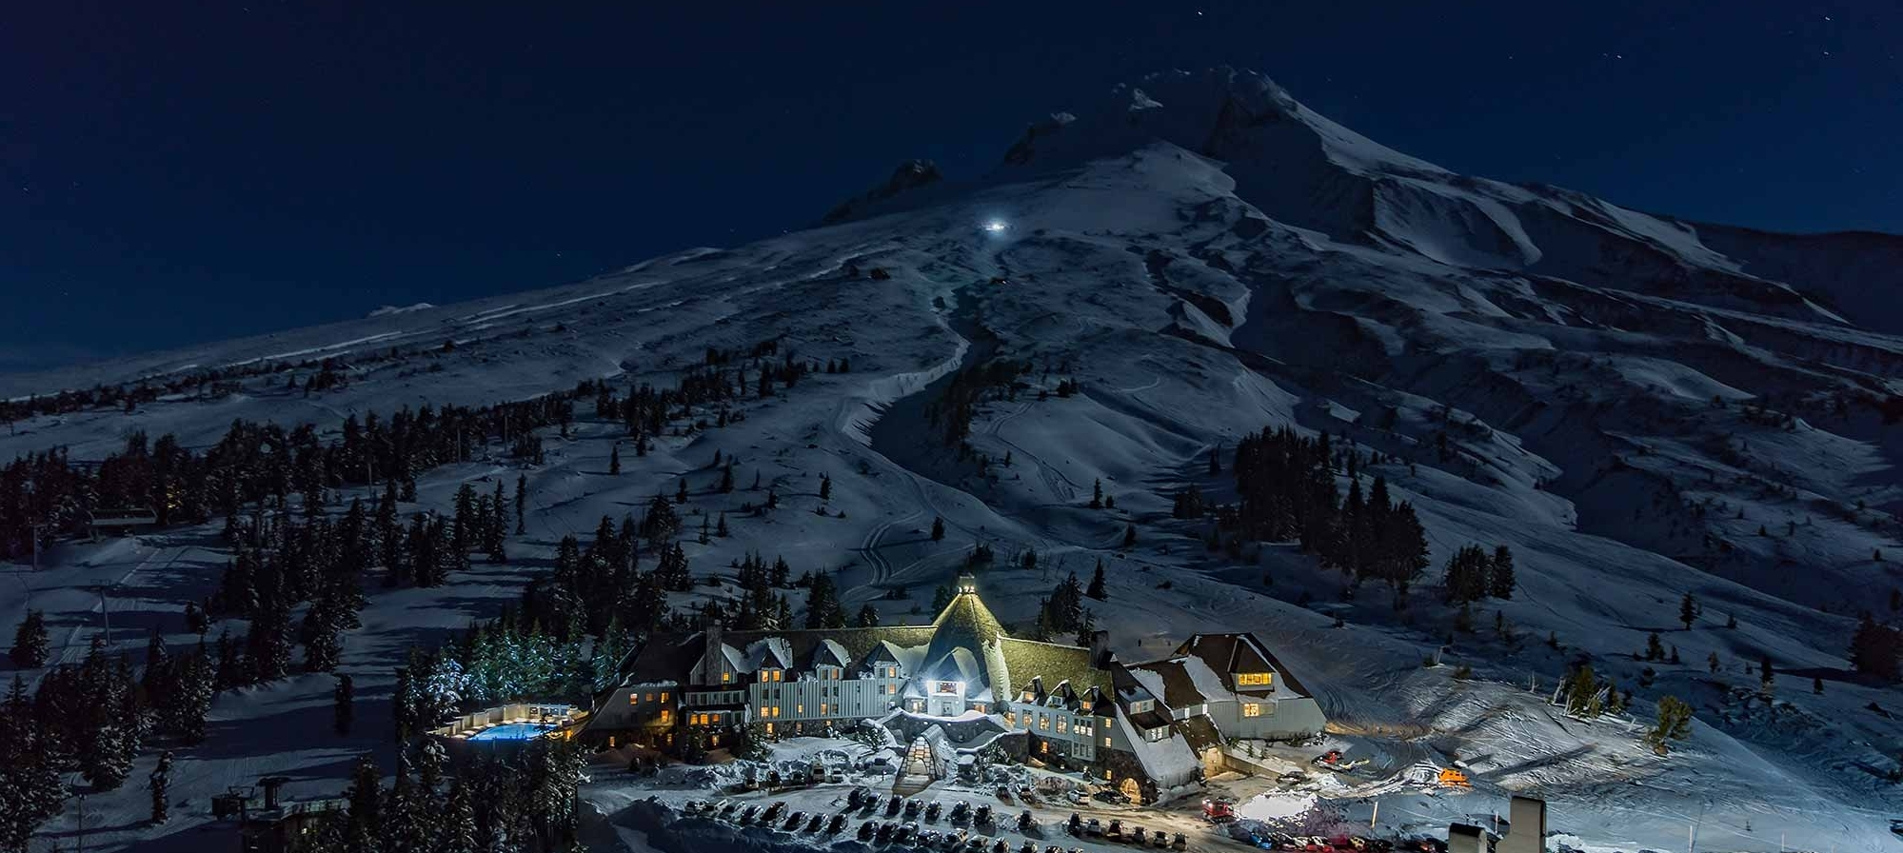
TIMBERLINE LODGE
*WPA project created in Oregon, remains publicly owned & operated. Snow remains on Mount Hood all year so its open for skiing all 12 months of the year. The Shining horror movie was filmed here.

Slide 27
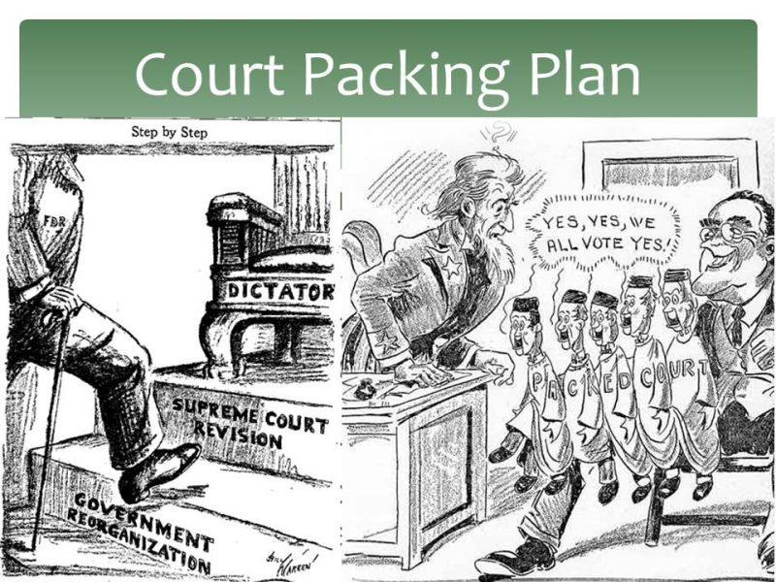
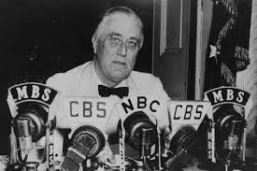
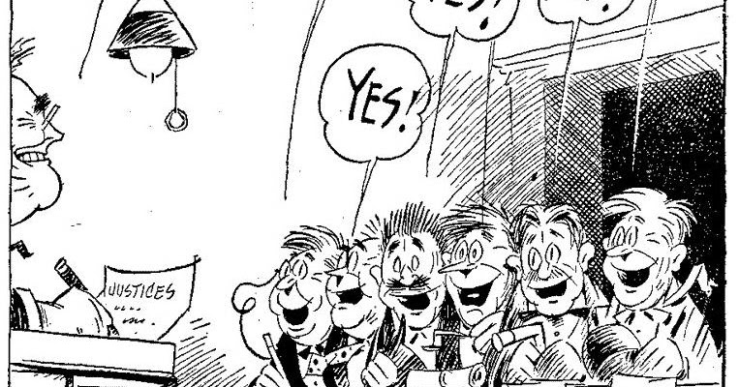
Tired of having programs declared illegal by the supreme court, fdr tried to increase the number of supreme court justices from 9 to 15 by adding 6 more. This is seen historically as an abuse of power.
*The issue is a mathematical one. For example, if President makes a bill and Supreme Court declares it to be unconstitutional on a 7-2 vote, if President adds 6 more YES”S, then the Supreme Court passes the bill on an 8-7 vote. It is very underhanded and was seen by many as FDR becoming an essential dictator. Having said that, it is not illegal, the Constitution never explicitly says how many justices we are supposed to have.

Slide 28
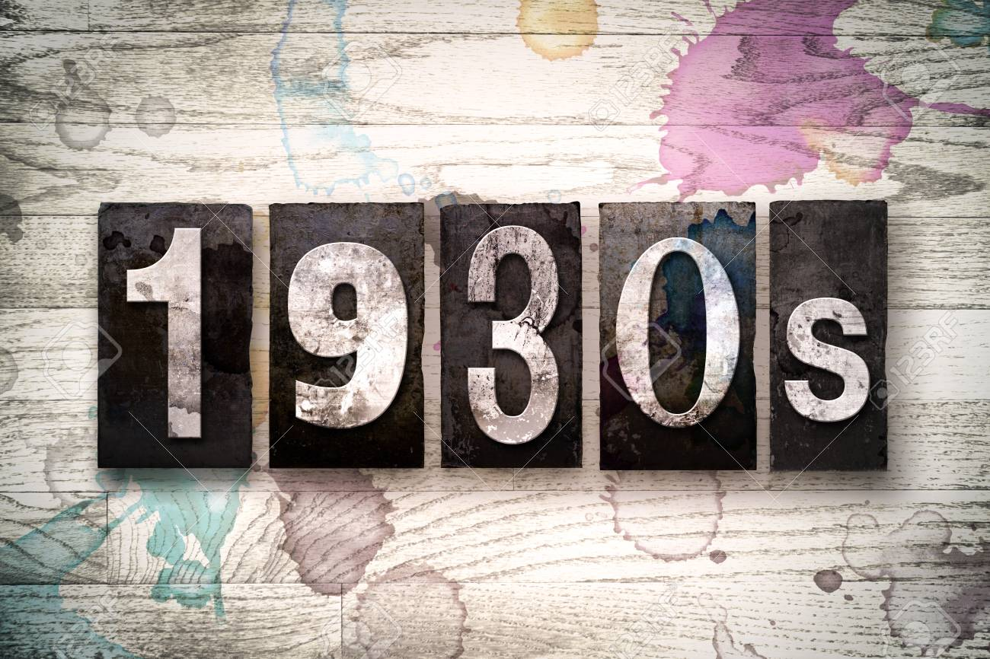
MORE EVENTS OF THE

Slide 29
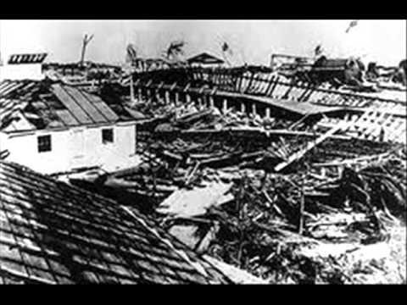
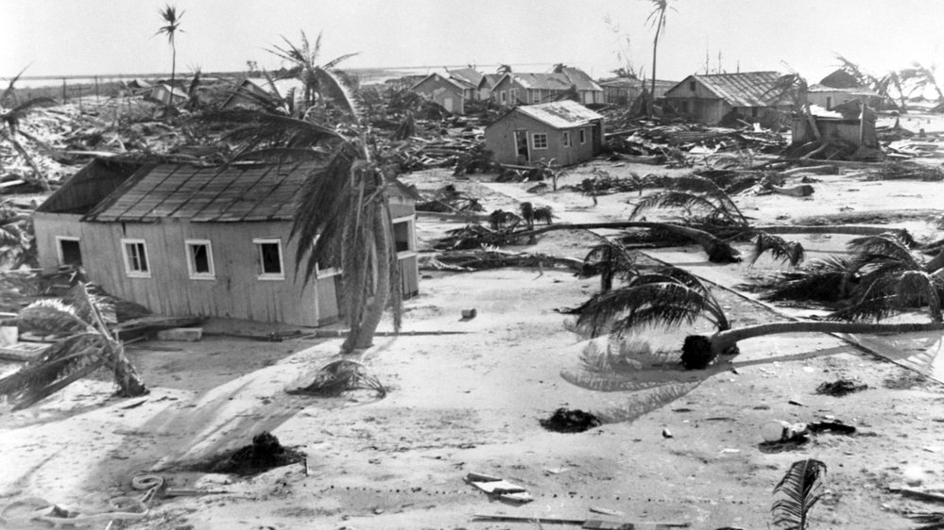
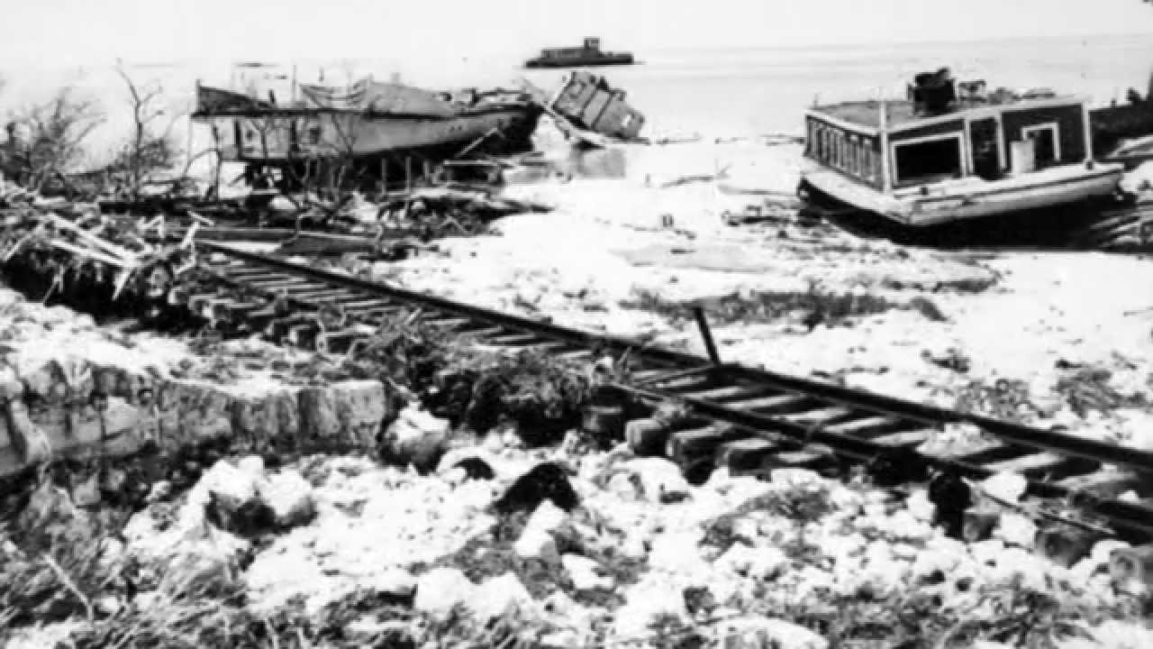
LABOR DAY HURRICANE OF 1935
Most devastating hurricane in USA history. Class 5 hits Florida Keys & heads up Florida coast, wind speeds hit 185 mph.
*For comparison, this is greater than Katrina, the storm that wrecked N.O. & Dorian in the Bahamas.
*At one point it picked up a 10 car train & tossed it.
*Just under 500 died.

Slide 30
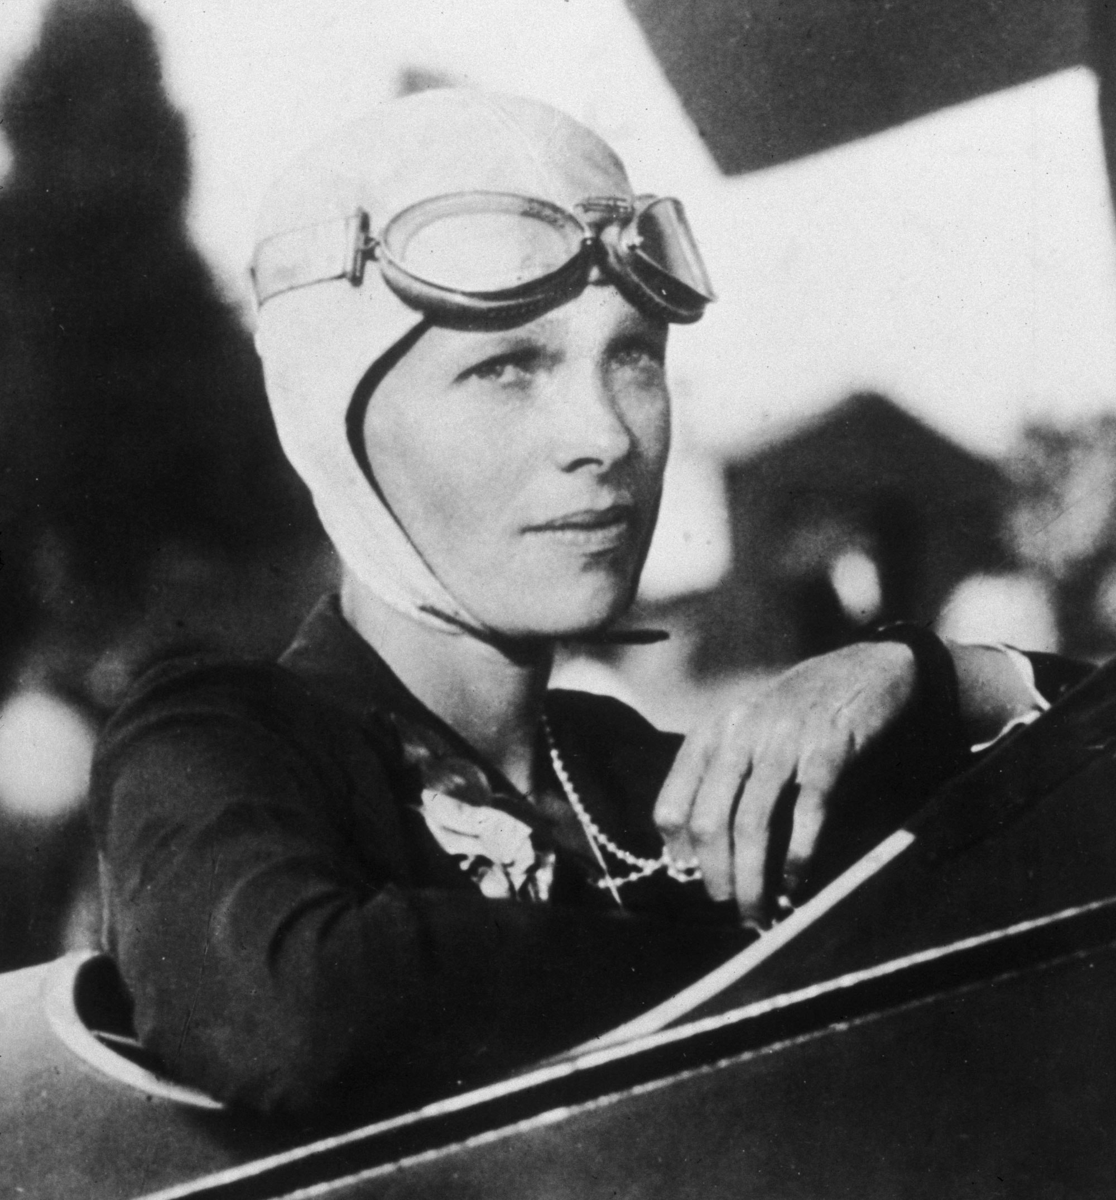
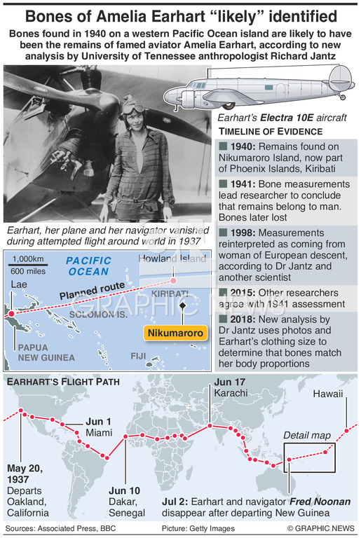
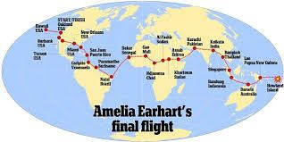
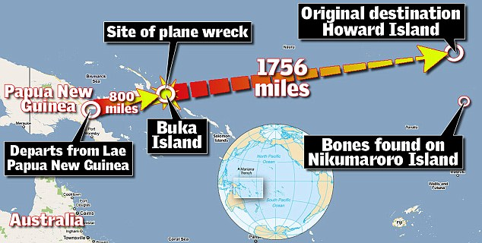
AMELIA EARHART
Amazing record setting pilot (1st to fly over the Atlantic Ocean twice) crashes in the Pacific.
*She had planned to fly the entire world during the crash, there remains a lot of mystery of where she ended up and how.
*She was very successful, actually had her own clothing line.

Slide 31
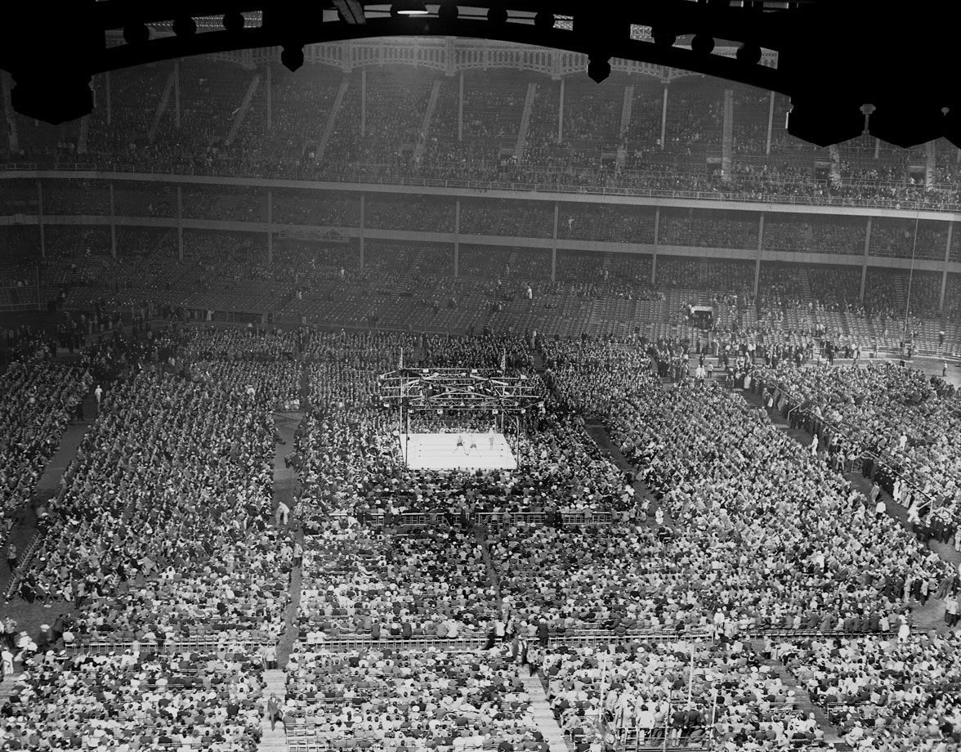
Joe louis
Brown Bomber wins boxing title but loses to Nazi Max Schmeling in worldwide fight. Louis wins rematch at Yankee Stadium & establishes himself as 1st AA sports icon in American history.

Slide 32
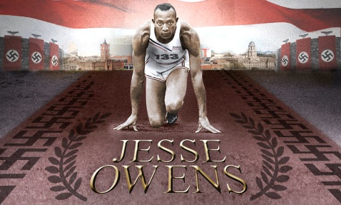
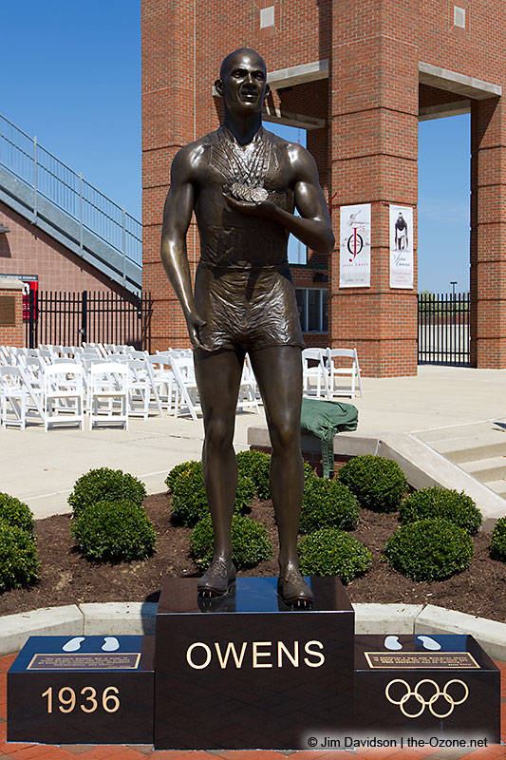
In spite of Hitler bragging about Aryan greatness, AA Jesse Owns wins 4 gold medals racing in the 1936 Olympics in Germany.

Slide 33
Radio broadcast by HG Wells that detailed an alien invasion of New York causes widespread panic (describes poison gas, heat ray weapons).
*The station “interrupted the program for a special announcement” and then provided details of the crash site & aliens emerging from the wreckage. They easily killed 7000 soldiers & according to history caused a nationwide panic.
*A remake 11 years later in Ecuador, citizens had heart attacks, burned own crops to cut food supply.

Slide 34
Ny skyscrapers
*Of the Top 10 tallest buildings in the world, 9 of them were located in New York. Pictured here: Rockefeller Center, Chrysler Building, & the Empire State Building.

Slide 35
GOLDEN GATE BRIDGE

Slide 36
HORROR MOVIES
*Going Clockwise: Invisible Man, Dr. Jekyll & Mr. Hyde, Dracula, Freaks, The Mummy, Frankenstein, King Kong, Werewolf in London.

Slide 37
Walt disney
Missouri native makes Mickey Mouse famous & creates billion dollar industry called cartoon characters. 1st character Lucky the Rabbit is stolen but hits jackpot with the movie Snow White.

