Slide 1
Promotion
2.5 GPA
95% Attendance
0 Referrals
0 “F”’s
“B” in Naval Science
NSI and PC Recommendation

Slide 2
Promotion
Quarter 1st 2nd 3rd 4th
Freshman SA SN PO3 PO2
Sophomore PO1 CPO
Junior SCPO MCPO/O
Senior ----------- make up ----------

Slide 3
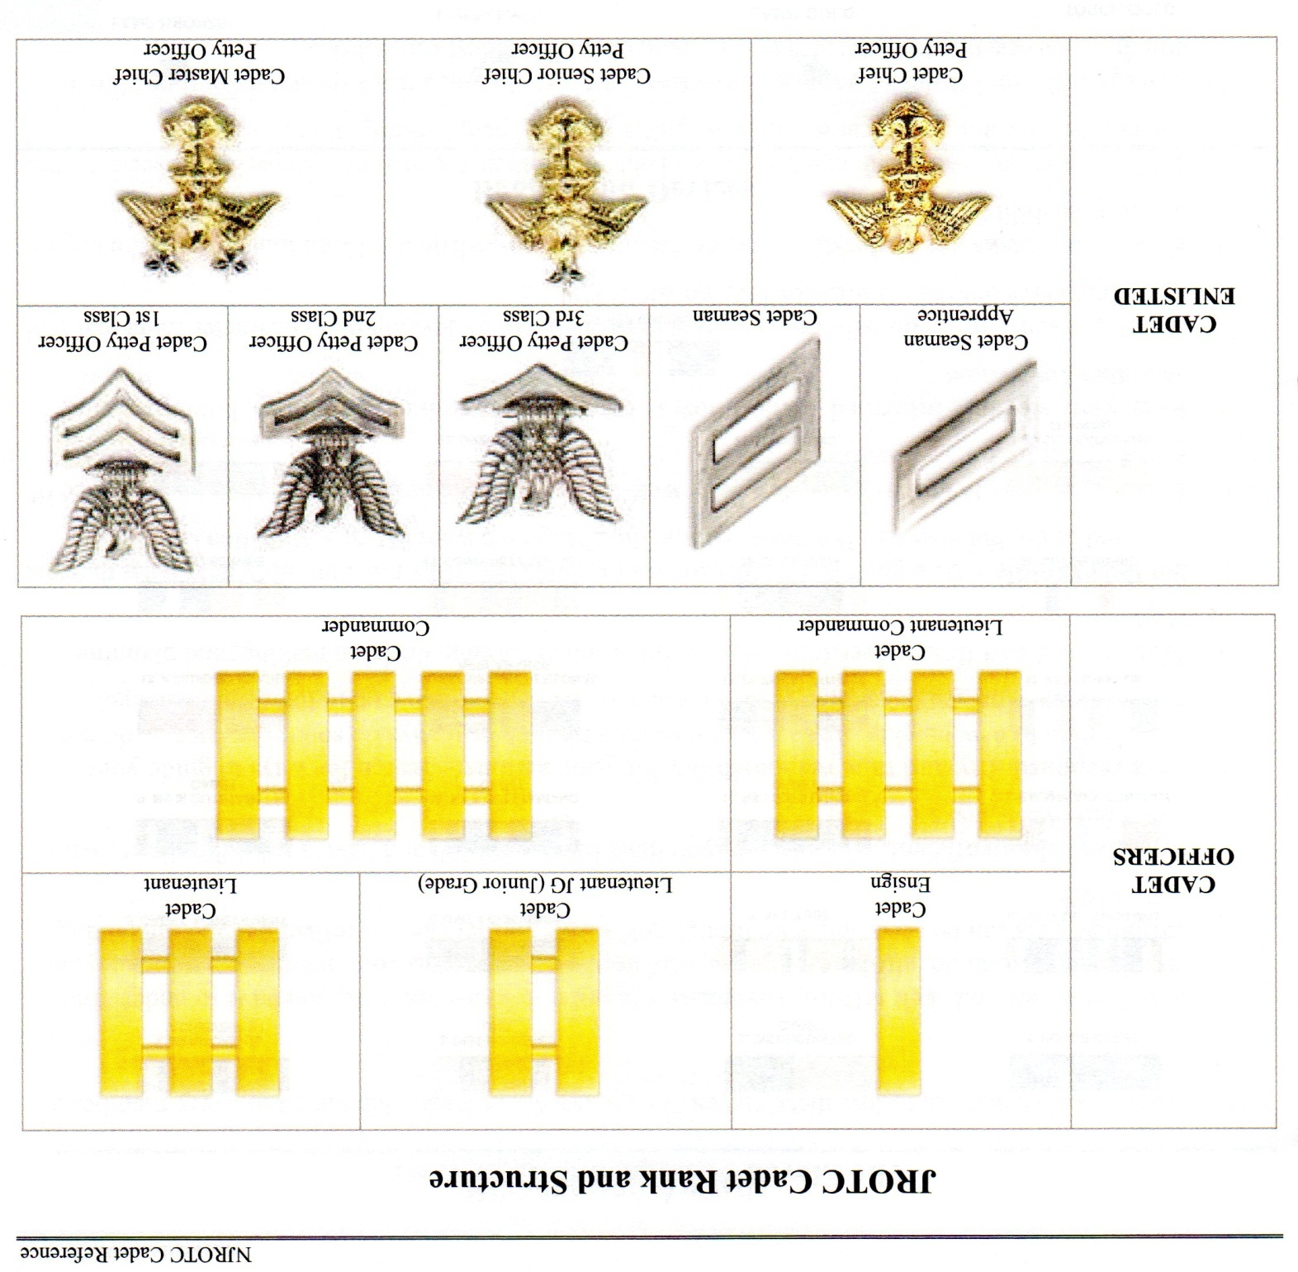

Slide 4
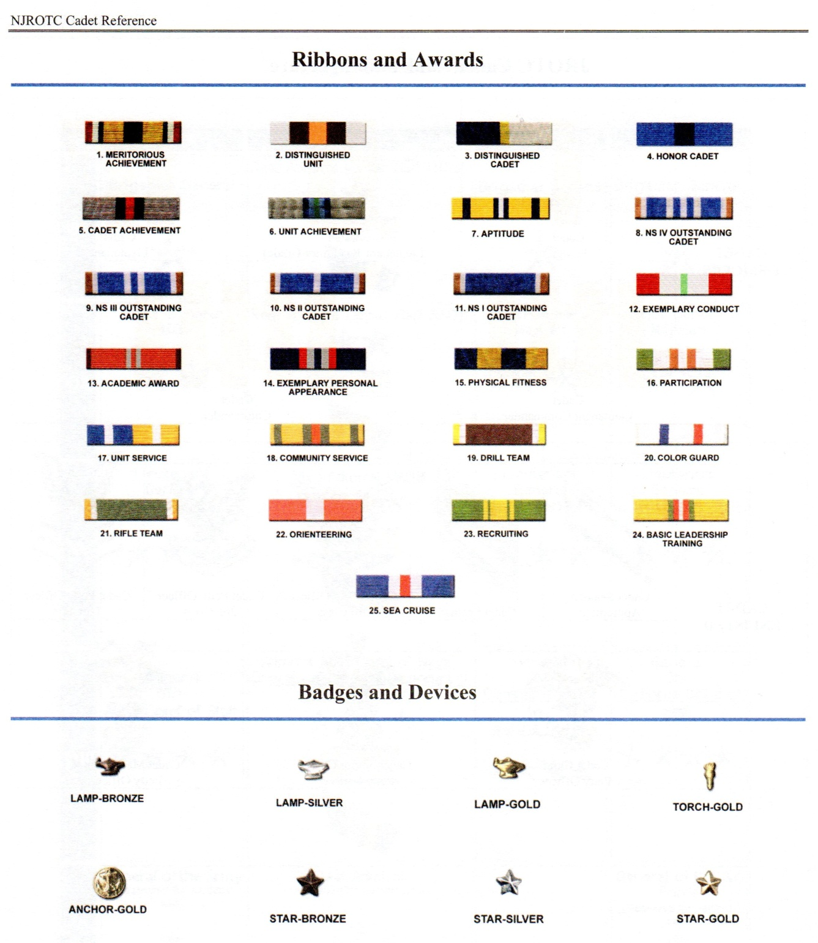

Slide 5
Male Hair

Slide 6
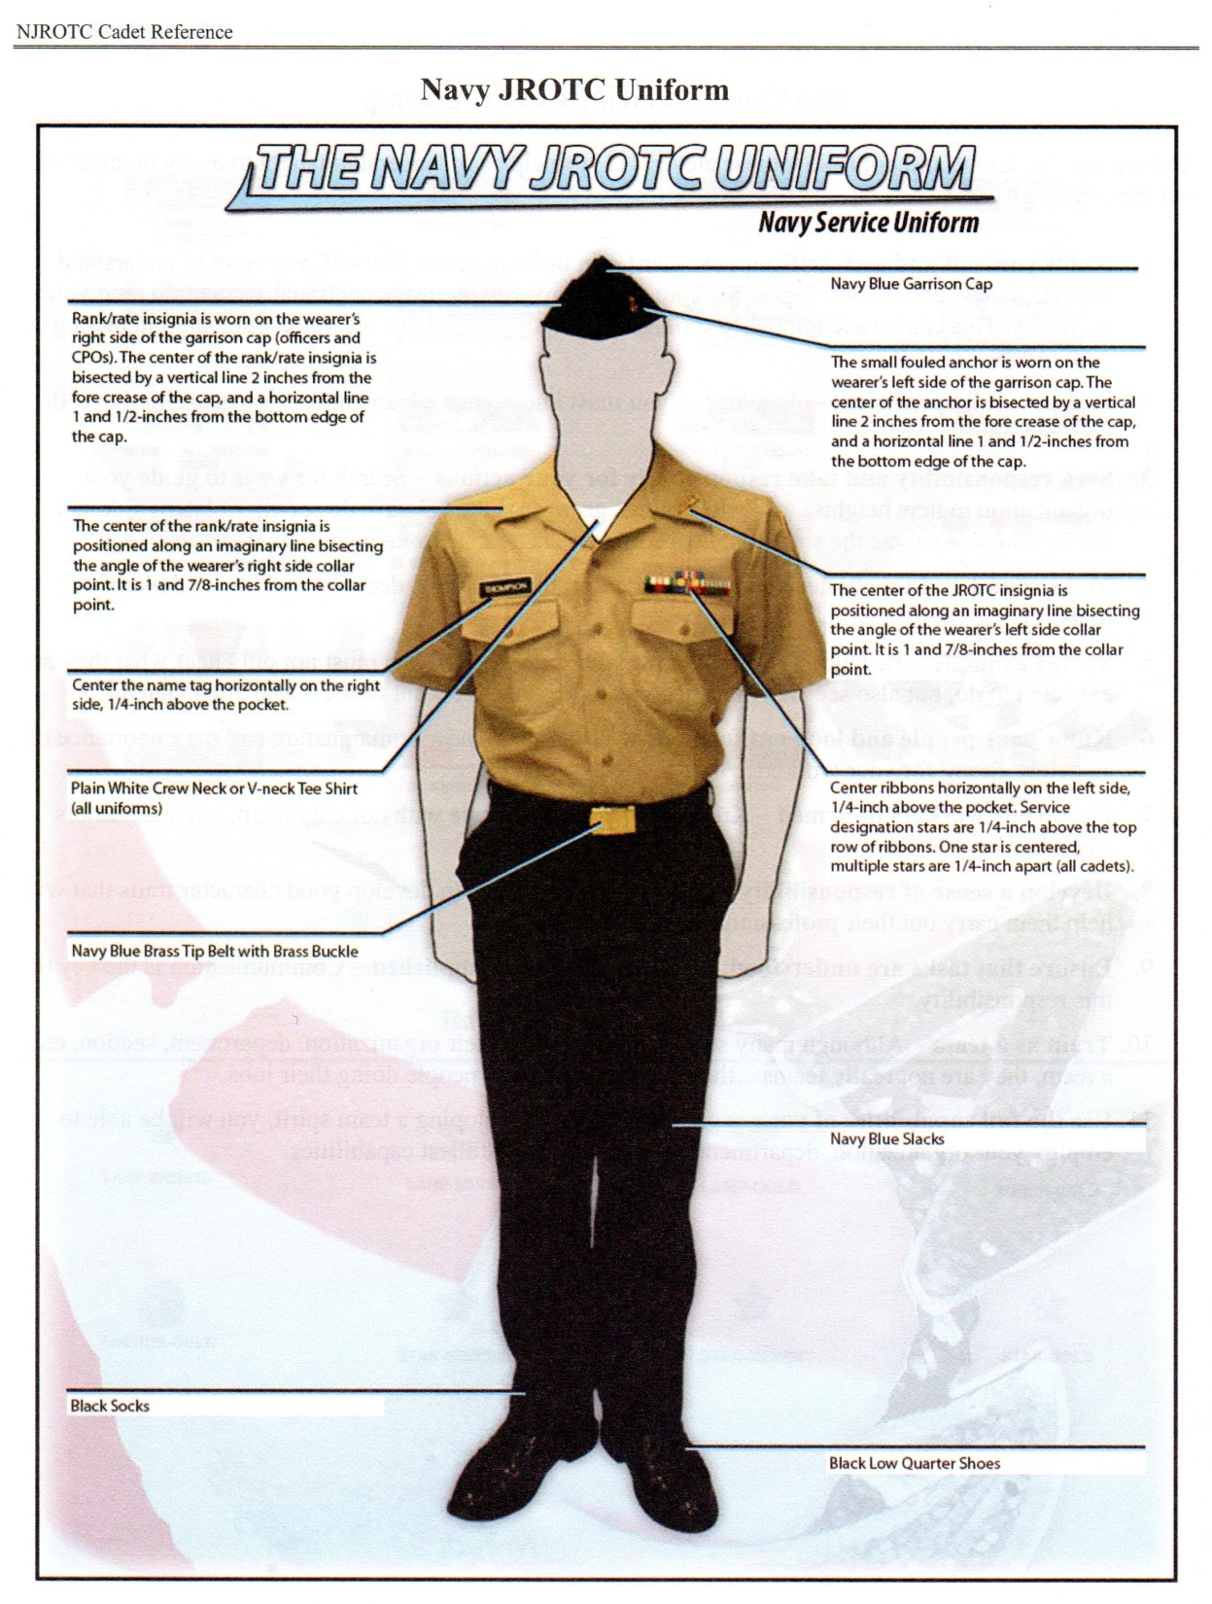
Uniform
-Black Garrison cover
-Cover anchor
-Khaki blouse
-White T-shirt
-NJROTC bar
-Name tag
-Black belt (Male Only)
-Brass buckle (Male Only)
-Black trouser
-Black socks
-Black shoes

Slide 7
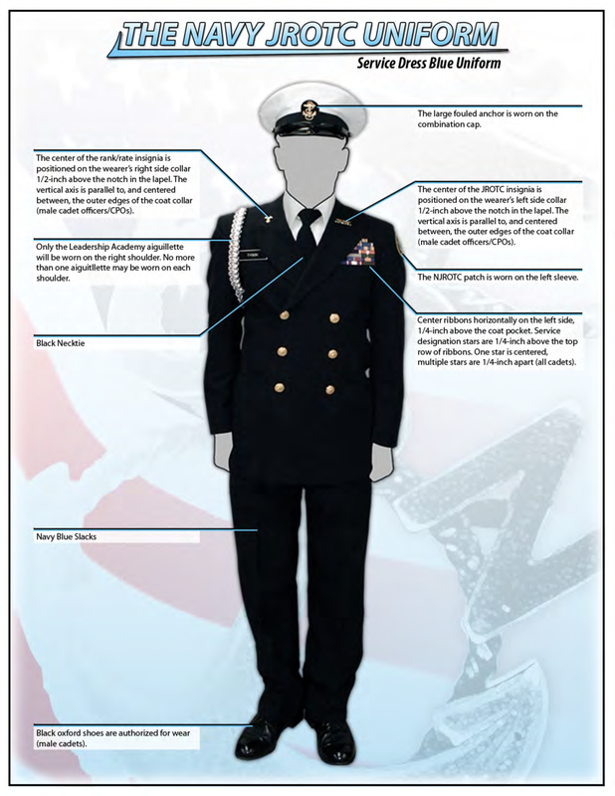

Slide 8
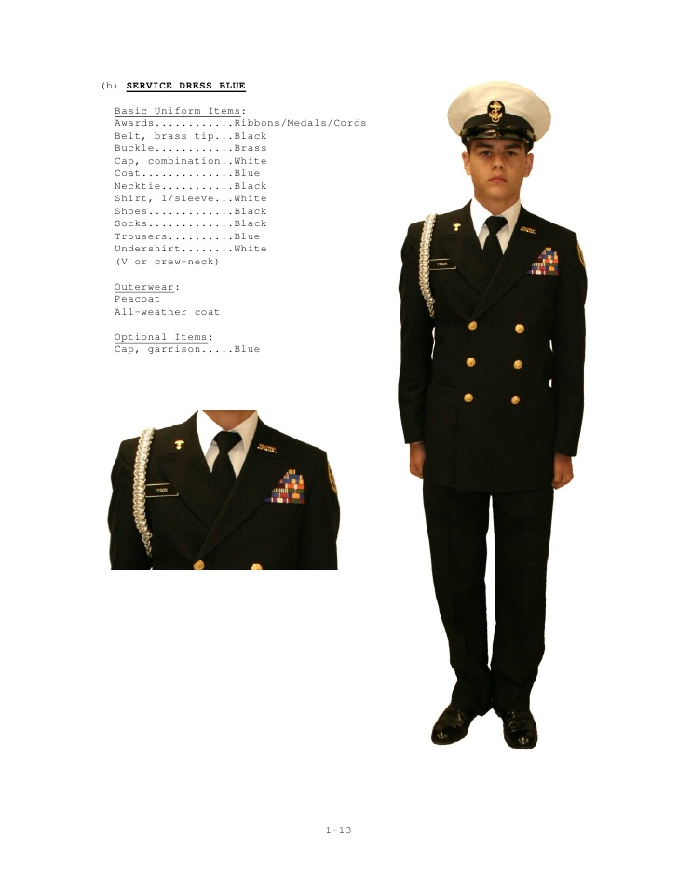

Slide 9
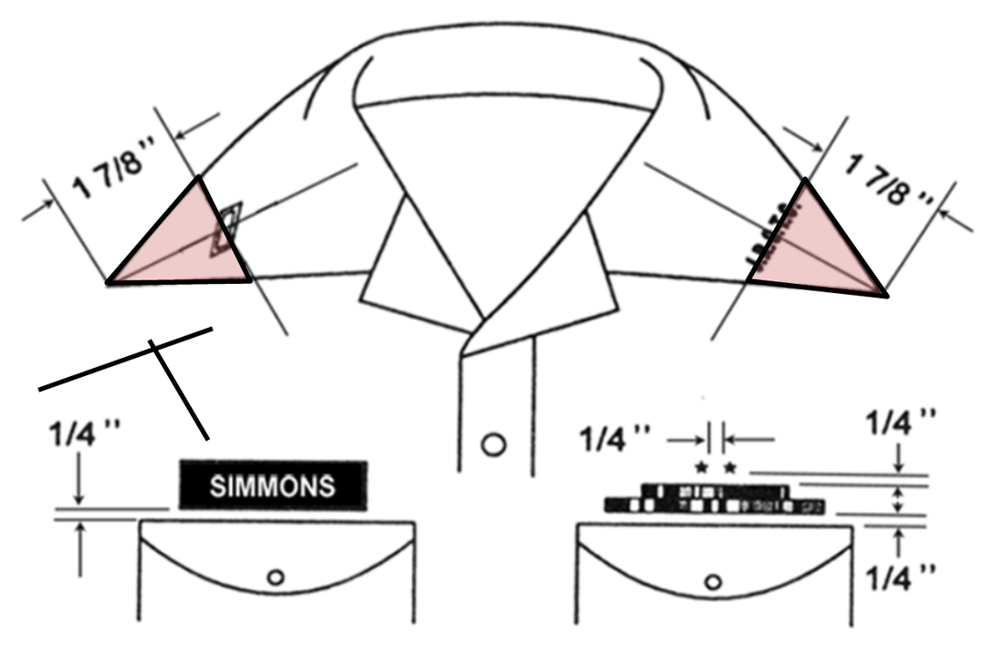

Slide 10
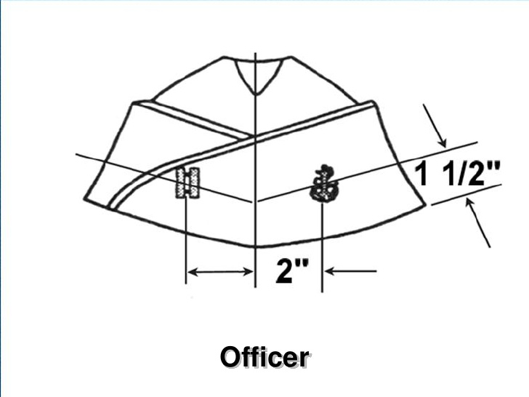

Slide 11
