Slide 1
Postpartum Depression(PPD)
Terrell Cobb, Breauna Martin, Cayla Shorter

Slide 2
Postpartum depression
Postpartum depression suffered by a mother following childbirth, typically arising from the combination of hormonal changes,psychological adjustment to motherhood and fatigue.

Slide 3
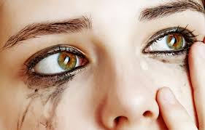
Symptoms
g
Symptoms

Slide 4
Negative stereotypes
Negative stereotypes

Slide 5
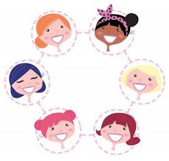
story
fsf

Slide 6
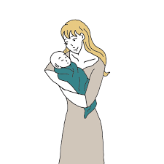
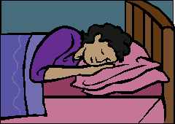
fwsds dvd
f

Slide 7
fv
s

Slide 8
Resources to reach out to
Resources to reach out to
Your doctor
Your child pediatrician
Call the toll-free 24-hour hotline of the National Suicide Prevention Lifeline at 1-800-273-TALK (1-800-273-8255); TTY: 1-800-799-4TTY (4889).
gd

Slide 9
You’re at risk for postpartum depression if you:
-lack support from family
-have family that suffered from PPD
-have an unplanned or unwanted pregnancy
-are pregnant under the age of 20

Slide 10
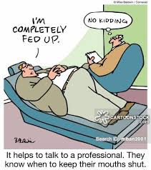
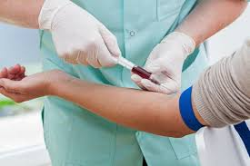
Diagnostics & Treatments

Slide 11
Baby Blues vs PPD
Sleep Deprivation
Makes you emotional
Bonding w/ Baby
Doesn’t happen immediately
The Changes in Your Life
Makes you feel overwhelmed
You Cry Tears
Of sadness
Your Mind is
Foggy & Unclear
You Worry
About unimportant things
After a Few Weeks
You start to feel better
Sleep Deprivation
Makes you angry
Bonding w/ Baby
Doesn’t happen at all
The Changes in Your Life
Makes you feel worthless
You Cry Tears
Of frustration
Your Mind is
Full of bad thoughts
You Worry
If you are fit to be a mother
After a Few Weeks
You start to feel worse

Slide 12
Importance of identifying & treating PPD
It may worsen and become postpartum psychosis & hospitalization may become necessary.
Electroconvulsive therapy may be used to treat severe depression, such as this one, with hallucinations, delusions, & overwhelming suicidal thoughts
Psychiatrists, Therapists, Counselors & Psychologist are jobs that are available in helping and researching Postpartum Depression & Psychosis

Slide 13
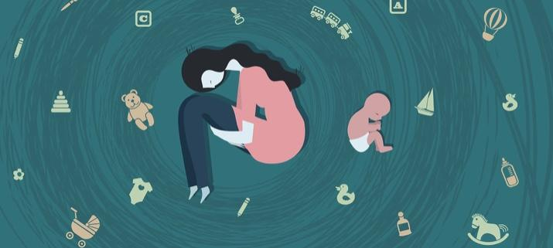
Patient Aspect

Slide 14
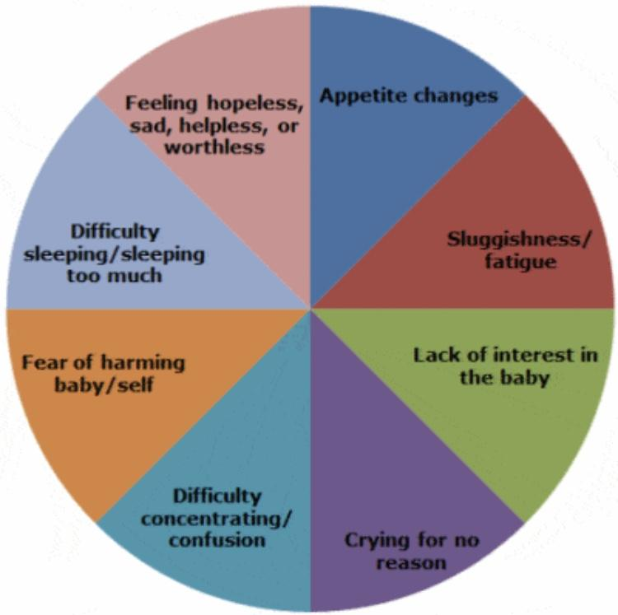
better understanding the importance of acknowledging postpartum depression
patients often experience
mood swings, difficulty bonding with the baby, insomnia or sleeping too much, recurring thought of death/ suicide severe anxiety, intense irritability

Slide 15
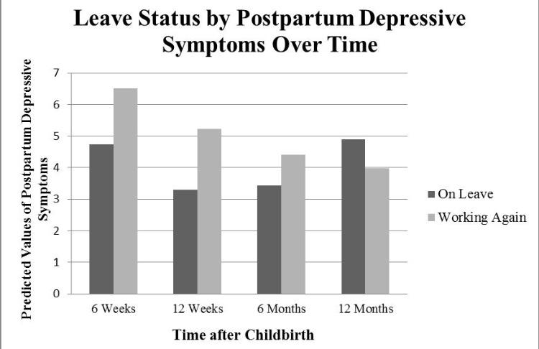
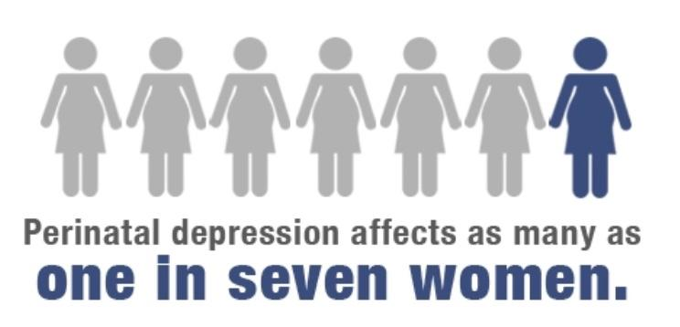
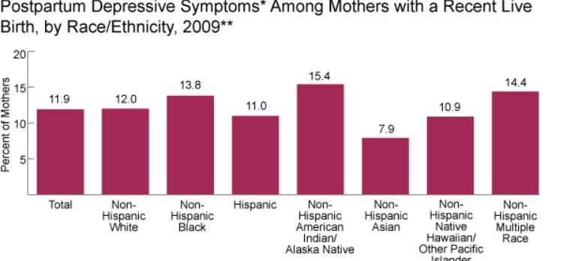
the stats
to mention:
stigma
not educated about the disorder
teaching during the prenatal stage

