Slide 1
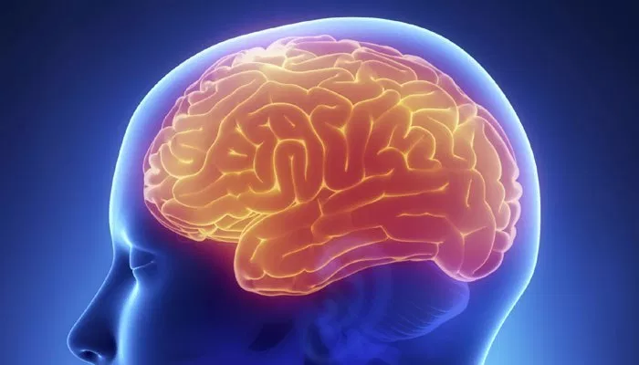
Obsessive Compulsive Disorder

Slide 2
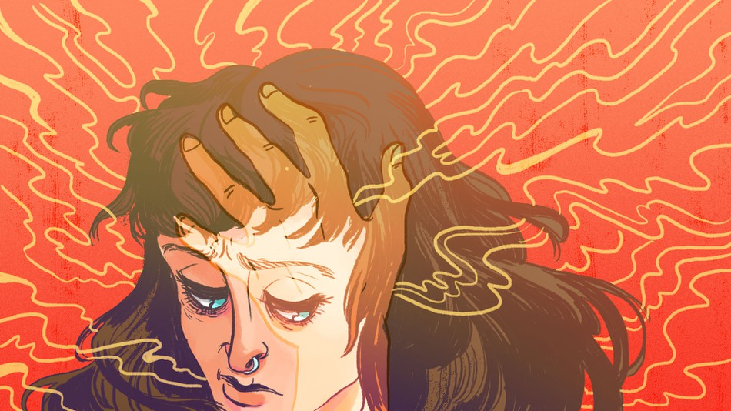
Symptoms
Obsessions
the need to have things in order
obsessive apprehension towards bacteria
intrusive thoughts, including aggressive and/or harmful thoughts towards oneself or others

Slide 3
Symptoms
Compulsions
meticulously organizing and arranging things especially based on symmetry
excessive cleaning and/or handwashing
checking repeatedly on things
compulsive counting (objects, fingers)

Slide 4
Possible Causes
Environmental factors
can be due childhood traumas (specifically due to abuse)
In rare cases OCD can be brought on by a strep infection
Genetic factors
There are differences in the frontal cortex and subcortical structures of the brains of people with OCD
There is a higher risk of developing OCD if a first degree relative has it

Slide 5
Statistics
around 2.2 million Americans suffer from OCD
about 30 percent of OCD sufferers first experience signs during childhood.
the average non-treatment rate is 57%

Slide 6
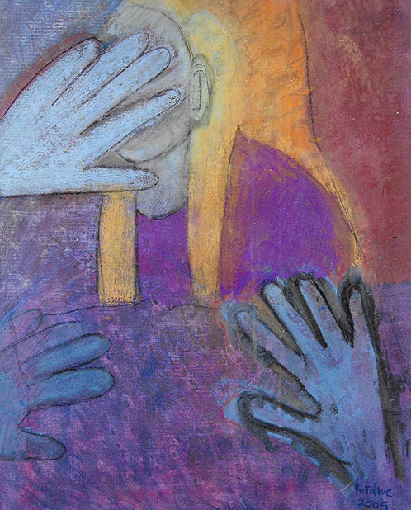
Reasons people don’t seek help
Lack of knowledge, people might not even realize they have a problem
Shame
Lack of access (availability, financial)

Slide 7
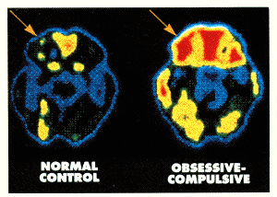
Risk Factors
Age
Conditions
Pregnancy
Genetics
Brain structure and functioning
Environment

Slide 8
Diagnosis
Symptoms and medical history
Do the symptoms consume at least an hour a day and/or result in emotional distress?
Are the symptoms disruptive in your everyday life?
General physical with blood tests

Slide 9
Treatment
Medication - Selective Serotonin Reuptake Inhibitor (SSRI)
Psychotherapy - Cognitive Behavior Therapy (CBT) and Exposure and Response Therapy (ERT)

Slide 10
Importance of Identifying and Treating OCD
Obsessions and compulsions cause a lot of distress and significantly interfere with a person’s work, social, and personal life.

Slide 11
Careers and Organizations to Help with Mental Health Issues
Careers:
Mental Health Counselor
Clinical Psychologist
Mental Health Psychiatrist
Organizations:
NIMH - National Institute of Mental Health
MHA - Mental Health America
NAMI - National Alliance on Mental Illness

Slide 12
Signs of OCD
Impulsive behavior
Social isolation
Agitation
Nonsensical doubts
Ritualistic behavior
Nightmares
Persistent repetition of words or actions

Slide 13
Negative stereotypes about OCD
Excessive neatness is not an indicator of OCD, in fact, many people with OCD are hoarders.

Slide 14
Resources for OCD
National Alliance on Mental Illness
International OCD Foundation
Peace of Mind Foundation

Slide 15
What can we do to help?
Educate yourself
Encourage your loved one to seek help
Stop enabling OCD in your house or relationship
Be non-judgemental and patient to the best of your ability

Slide 16
https://www.youtube.com/watch?v=ufqFO5B1vQY

Slide 17
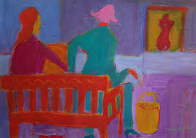
Questions?

Slide 18
References
Mental Health and Behavior on the MedlinePlus® by the National Library of Medicine at http://www.nlm.nih.gov/ medlineplus/mentalhealthandbehavior.html
HCA Healthcare at https://hcahealthcare.com/hl/?/19904/Risk-Factors-for-Obsessive-Compulsive-Disorder--OCD-~Diagnosis
National Alliance on Mental Illness at http://www.nami.org/Hometemplate.cfm
Mental Health Services Locator at http://mentalhealth.samhsa.gov/databases
TeensHealth™ from Nemours Foundation at http://kidshealth.org/teen/your_mind
American Psychiatric Association at https://www.psychiatry.org/patients-families/ocd/patient-story
Brain and Behavior Research Foundation at https://www.bbrfoundation.org/faq/frequently-asked-questions-about-ocd
Learn How to Become at https://www.bbrfoundation.org/faq/frequently-asked-questions-about-ocd
Mental Health America at http://www.mentalhealthamerica.net/conditions/ocd
National Institute of Mental Health, Mental Health Topics at http://www.nimh.nih.gov/health/topics/index.shtml
OCD Facts and Statistics at https://theoakstreatment.com/blog/ocd-facts-and-statistics/
Resources & Information for Better Mental Health http://davidsusman.com/2015/06/11/8-reasons-why-people-dont-get-mental-health-treatment/

