Slide 1
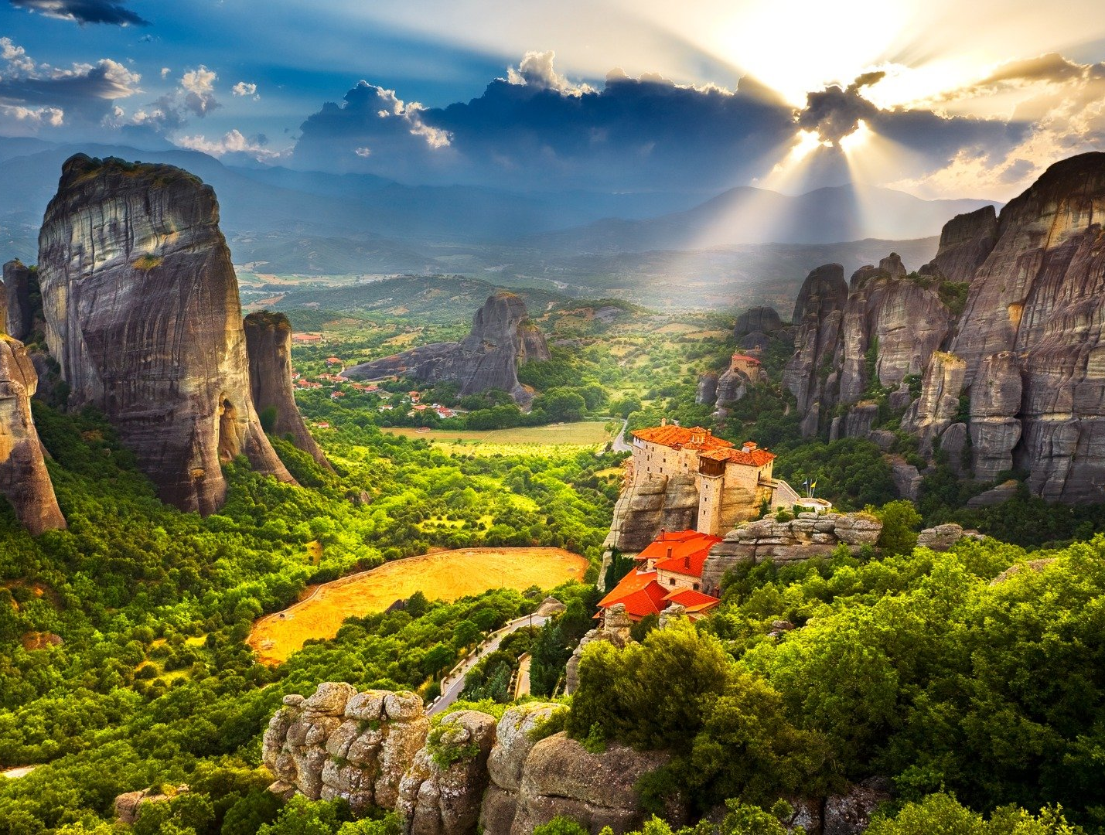
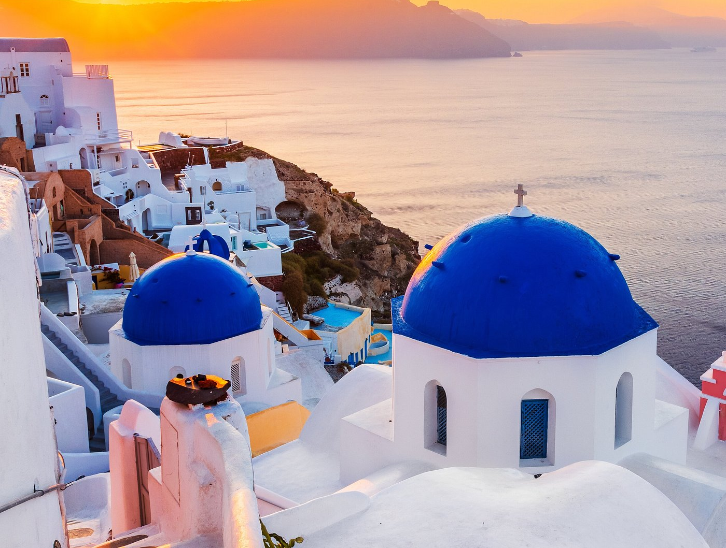
Do Now
Write down one observation of the landscapes and how they may affect daily life.

Slide 2
Agenda
Do Now
Song of the Day: Funny How Time Slips Away – Dr. John
I Do
PowerPoint notes and Google Earth feature
We Do
Read pp. 221-23 (geography), 225-26 (City-States)
You Do Together
Small groups: Look at maps of Greece and ID features
You Do Alone
1-2 Sentences: How did mountains and seas impact Greek life?
Exit Ticket
Write one way geography affects your own daily life

Slide 3
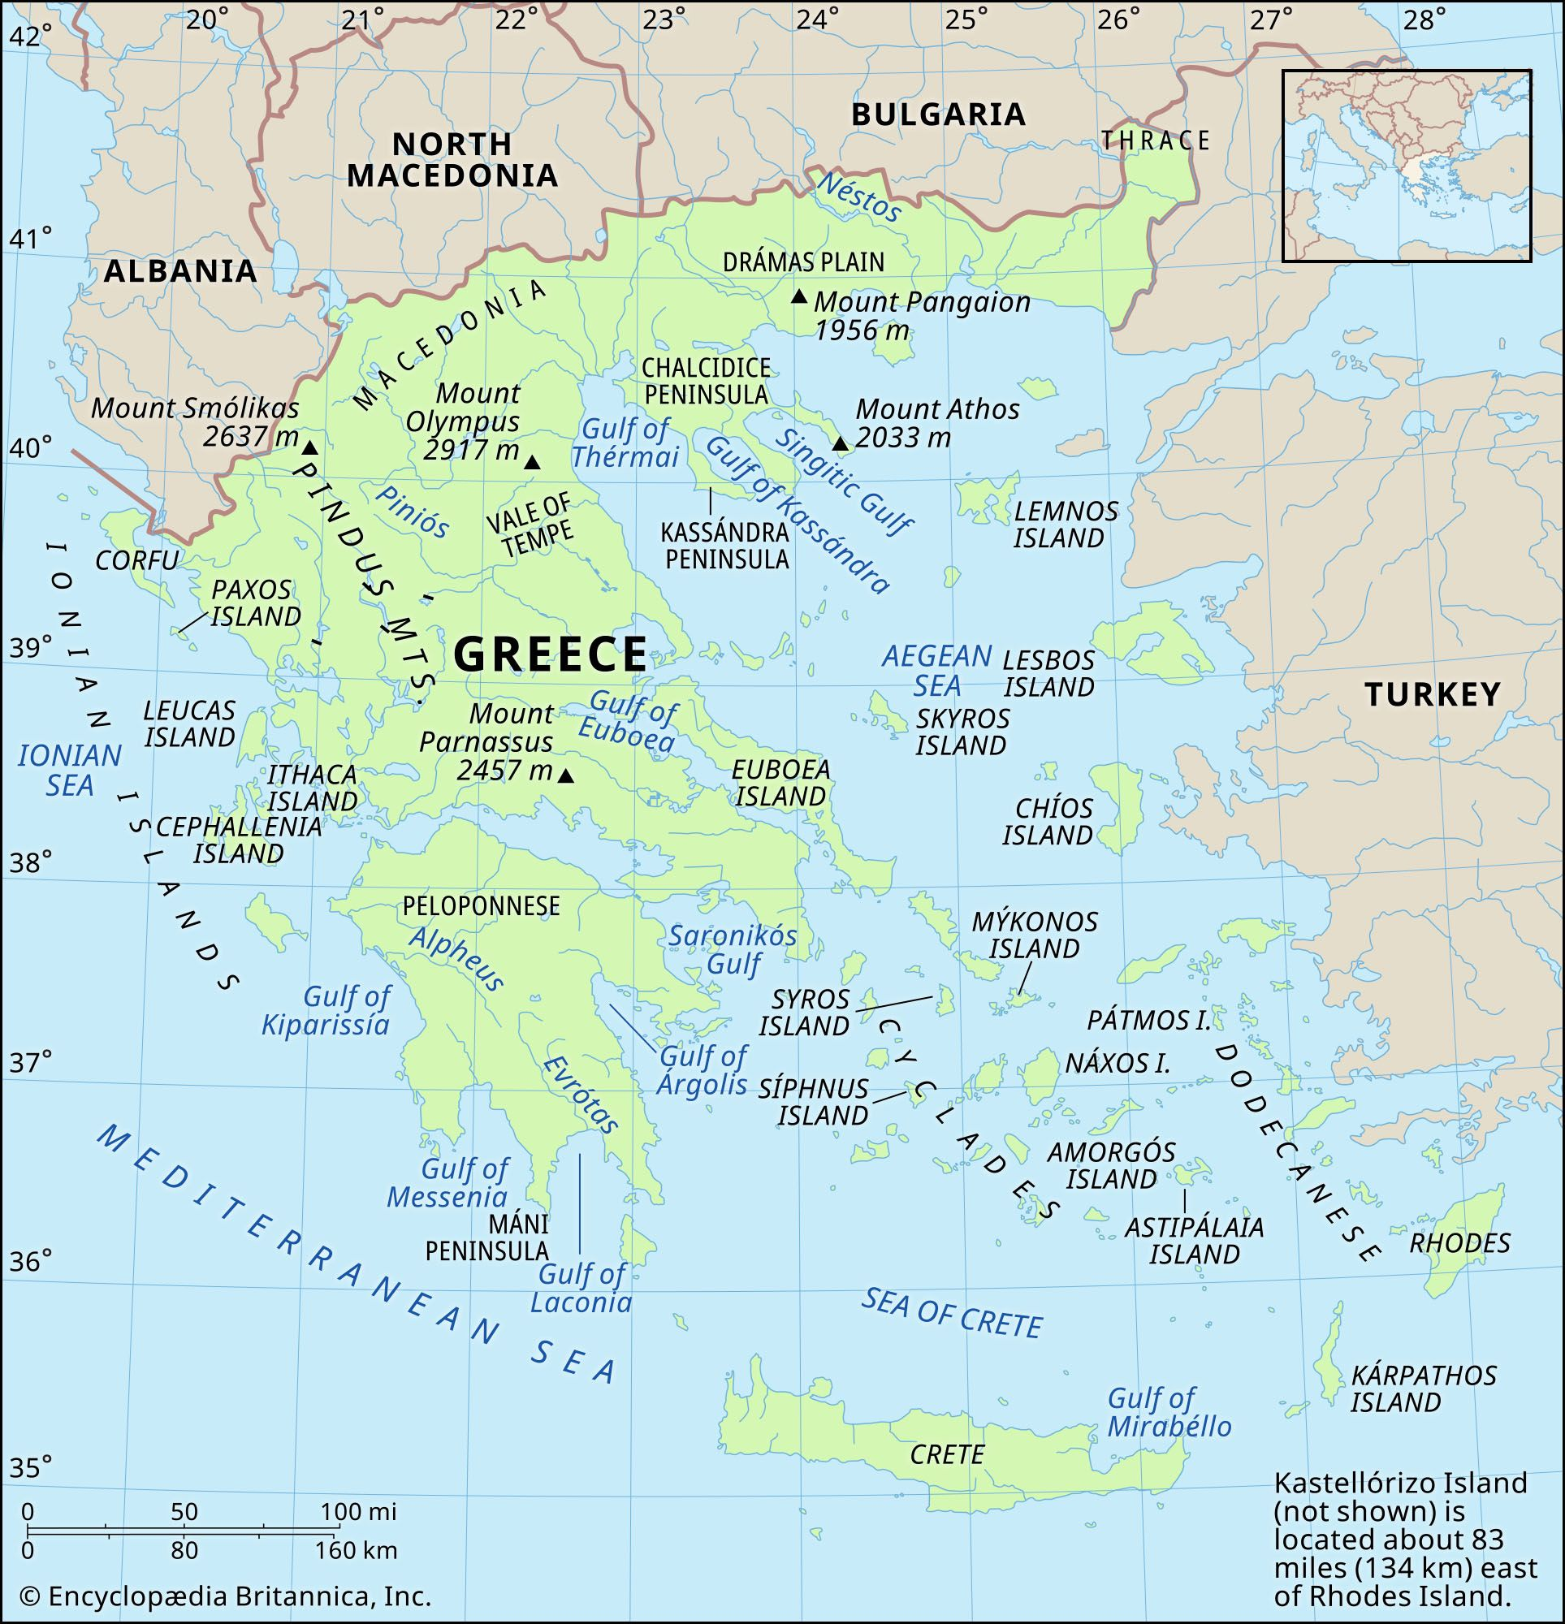
Notes:
Go to Google Earth after this

Slide 4
Greek Geography
Peninsula: Land mass with water on three sides
Valley: land between mountains
Lots of water (three seas: Mediterranean, Ionian, and Aegean)
Lots of mountains
Hot, dry summers
Mild, wet winters
Shallow root crops: no good
Grains
Deep root crops: very good
Olive trees and grapes

Slide 5
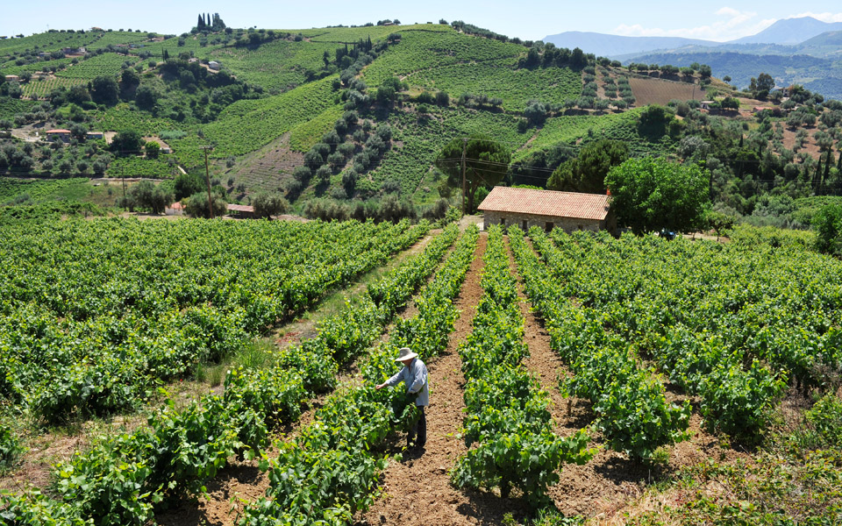
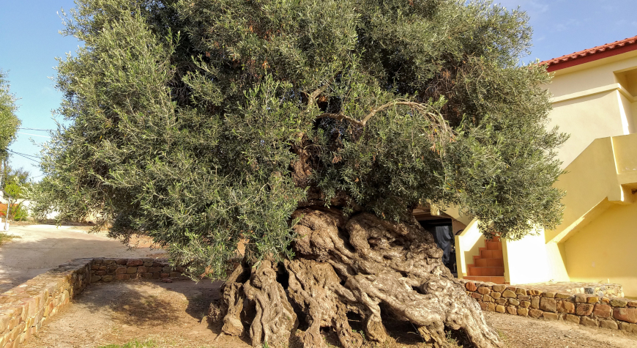
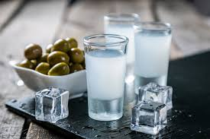
Notes:
Olive tree: Crete, 3-5000 years old; still produces olives

Slide 6
Early Greeks (pp. 221-23)
Minoans
Highly advanced, writing systems, stone palaces with running water
Mycenaeans
Towns governed by monarchies (kings), made bronze weapons, traded for copper and ivory, and stole gold
Killed off by the Dorians
The Dark Age
1100-750 BCE
People lost the ability to read and write
Many moved to Anatolia (Ionia)

Slide 7
City-States (pp. 225-26)
Polis = City-State
City-State = Big city with government and small villages around it
Or = The city and the suburbs
Citizens of the city-state would make their own laws
Two level to a city-state
Acropolis = “High City”: temples and government offices
Lowlands: homes, shops, and farms
Politics = the art and practice of government
Aristocracy = hereditary (by birth) class of rulers
“rule by the best people”

Slide 8
You Do Together
Look at a map of Greece and find the following features and their names:
Two mountains
One mountain range
Two islands
Three seas

Slide 9
You Do Alone
Write 1-2 sentences about how mountains and seas impacted Greek life.

Slide 10
Exit Ticket
What is one way geography affects your daily life.

Slide 11
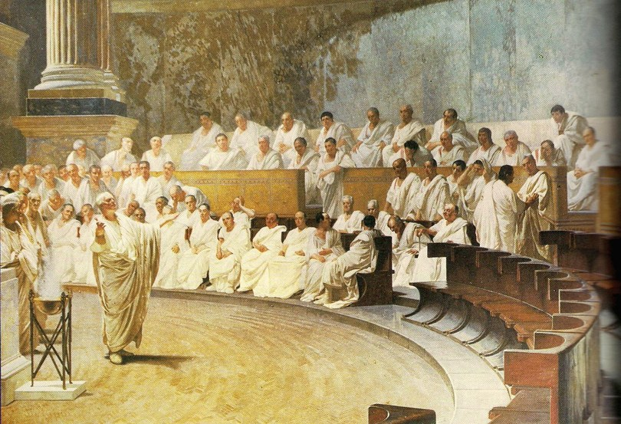
Do Now
Write one rule that you would make or change in this school.

Slide 12
Agenda
Do Now
Song of the Day: Take Back the Power – The Interrupters
I Do
PowerPoint on Athens and Sparta
We Do
Read pp. 227-231; 234-35
Discuss Athenian Democracy vs Spartan Oligarchy
You Do Together
T-Chart on Democracy vs Oligarchy
You Do Alone
Write one reason you would live in Athens or Sparta
Exit Ticket
Write one strength and one weakness for Democracy and Oligarchy

Slide 13
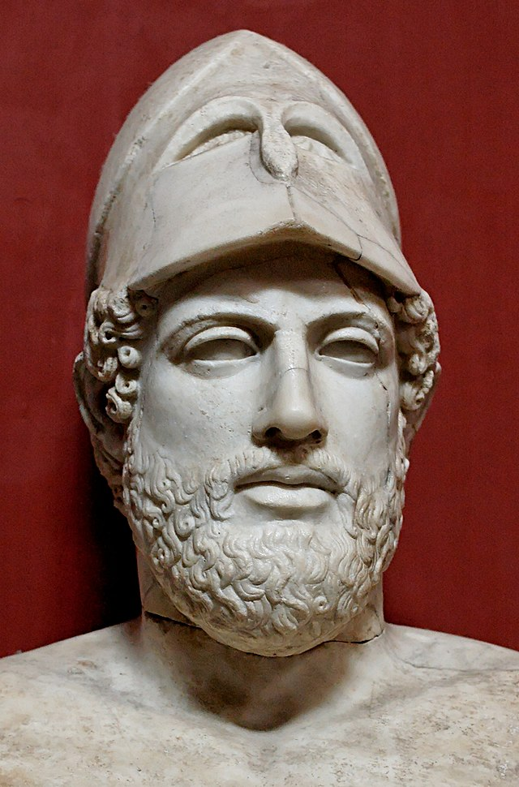
Athenian Democracy
Democracy = Rule of the People
Started with Solon (ended debt slavery)
Continued with Cleisthenes (allowed more people to vote)
Big ideas from Pericles
Paying people for jury duty and other civic service
Allowing the poor a voice
Citizenship or membership of a community (today, of a country)

Slide 14
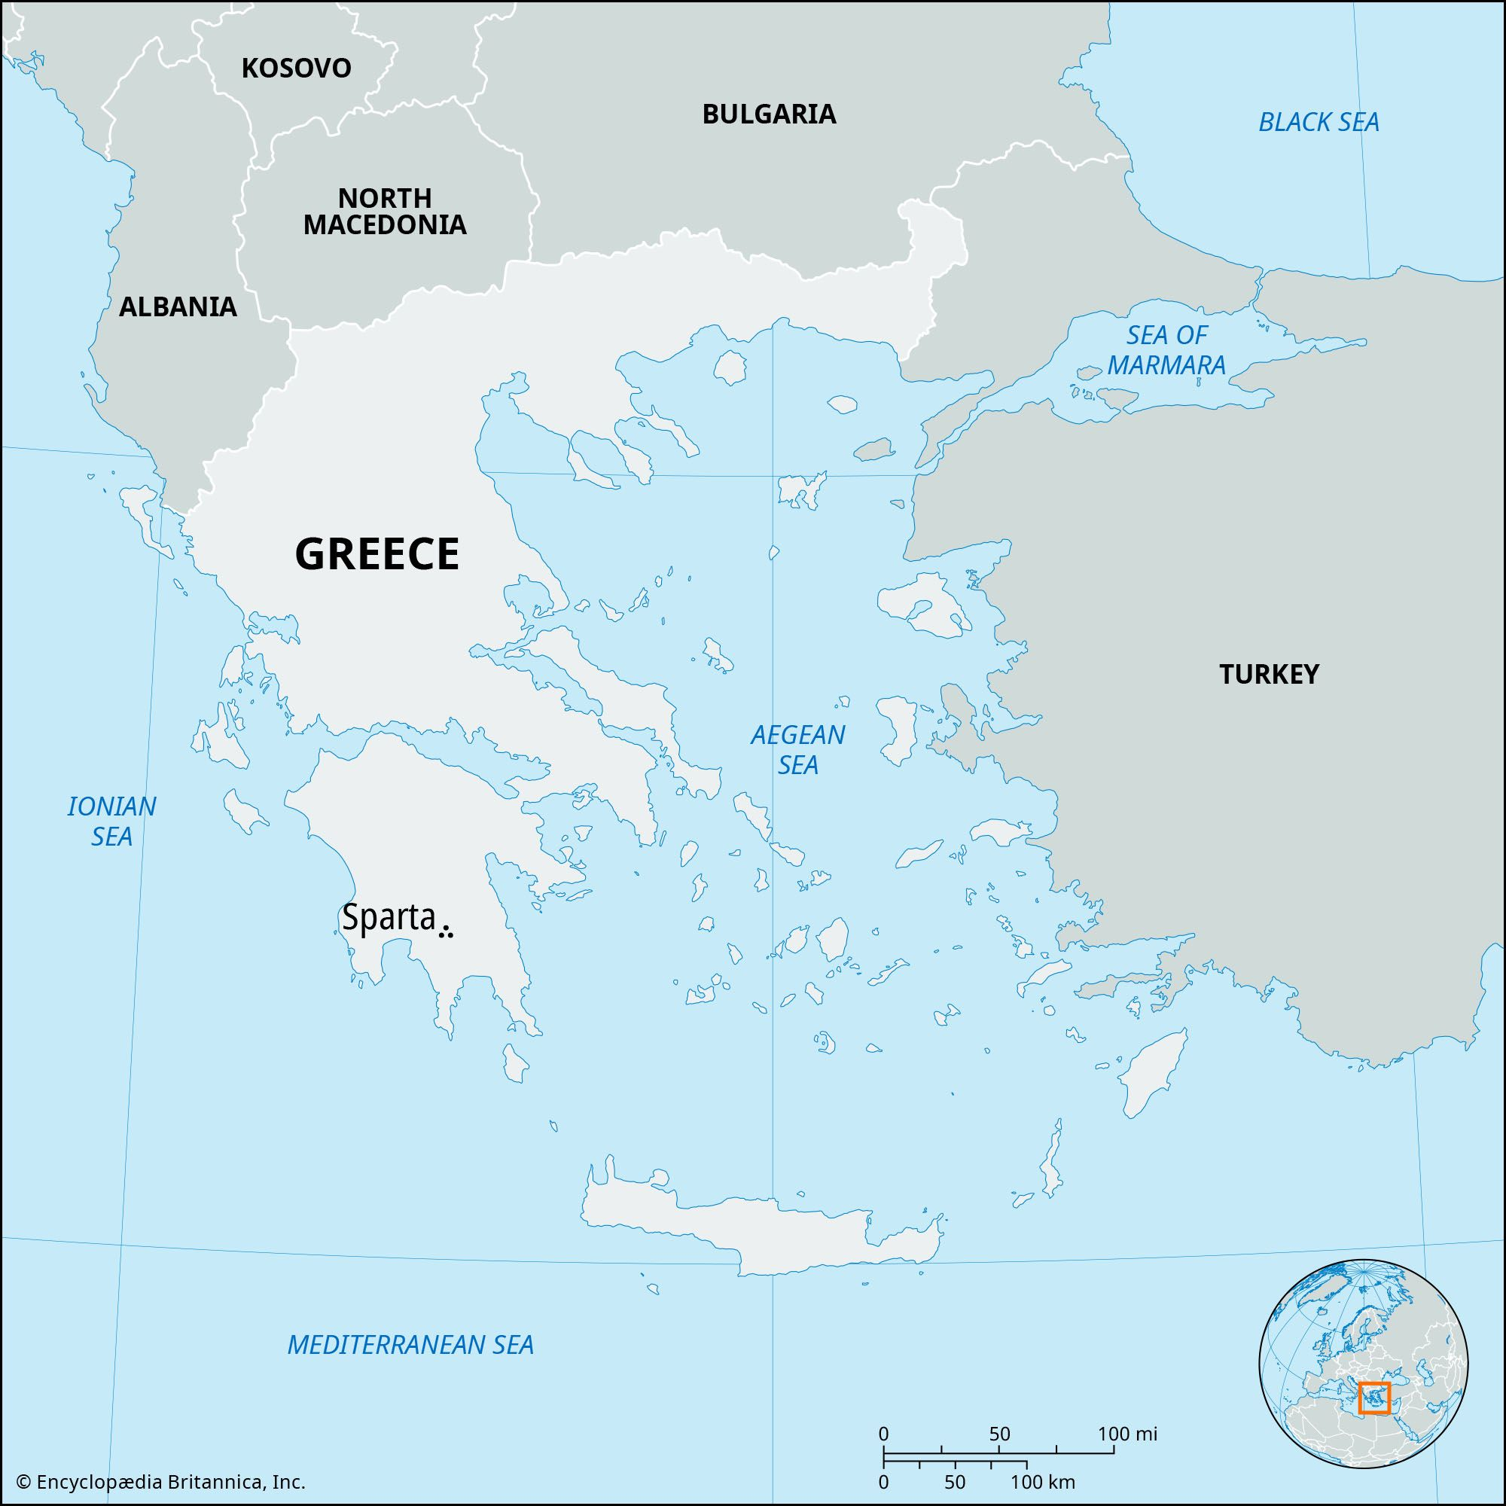
Sparta
War Hawks
From youth, Spartan boys were trained for combat
Strict and Harsh
No real need for art, philosophy, or individual freedom
Everything was done with the army in mind
Notes:
Harsh Physical Training: Spartan boys began rigorous military training at a young age, often starting around age 7. This included:
Lack of Comfort: They slept on hard beds, wore minimal clothing, and were given limited food.
Endurance Tests: They were encouraged to steal food to survive, teaching them resourcefulness and cunning.
Constant Discipline: They faced harsh punishments for disobedience, including beatings.
Limited Individual Freedom:
Focus on the State: The needs of the Spartan state always came before individual desires.
Controlled Lives: Spartans had very little personal freedom. Men spent most of their lives in the barracks, while women were expected to produce strong sons for the army.
Surveillance and Control: The Spartan government closely monitored the lives of its citizens to ensure obedience and conformity.

Slide 15
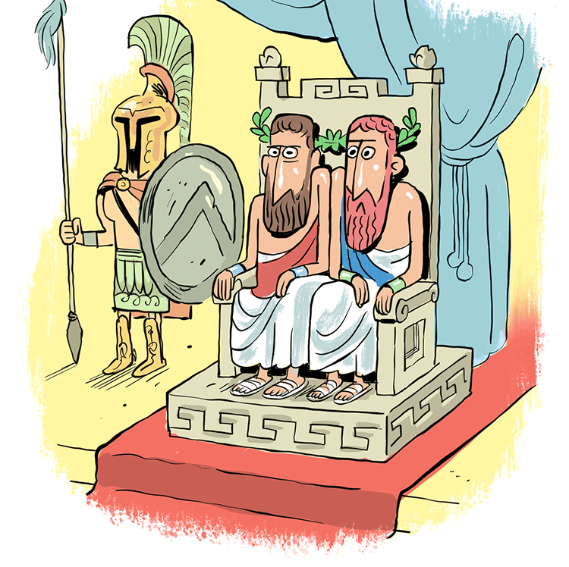
Spartan Oligarchy
Oligarchy = political power is held by a small group of people
Draco was one of the oligarchs
Draconian = laws that are unnecessarily harsh or severe

Slide 16
We Do
Let’s read!
Pp. 229-231; 234-235 (The Spartan State)

Slide 17
You Do Together
Go over the things we have discussed and read
Make a “T-Chart”
One one side, everything you have learned about Democracy
On the other, everything you have learned about Oligarchy
Take 10 minutes and we will discuss

Slide 18
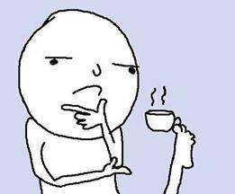
You Do Alone
Where would you rather live: Athens or Sparta, and why?
Write down your answer and we will discuss in a few minutes.

Slide 19
Exit Ticket
Write one strength and one weakness for Democracy and Oligarchy
Psst… this means you should have four things ☺

Slide 20
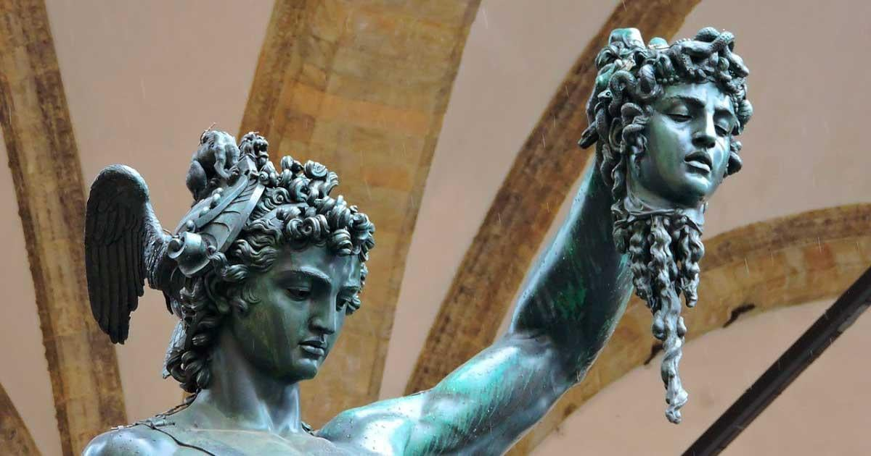
Do Now
What is a myth or hero story that you know about? It can be a book, movie, tv show, manga…

Slide 21
Greek Mythology
Greek mythology is a collection of stories about gods, goddesses, and heroes that explain the world and teach lessons.
The Greeks believed these myths helped them understand nature, human behavior, and morality.
Key themes in Greek mythology include bravery, loyalty, love, and the consequences of pride or anger.
Myths were shared through storytelling, theater, and art, and they continue to influence modern literature and movies.

Slide 22
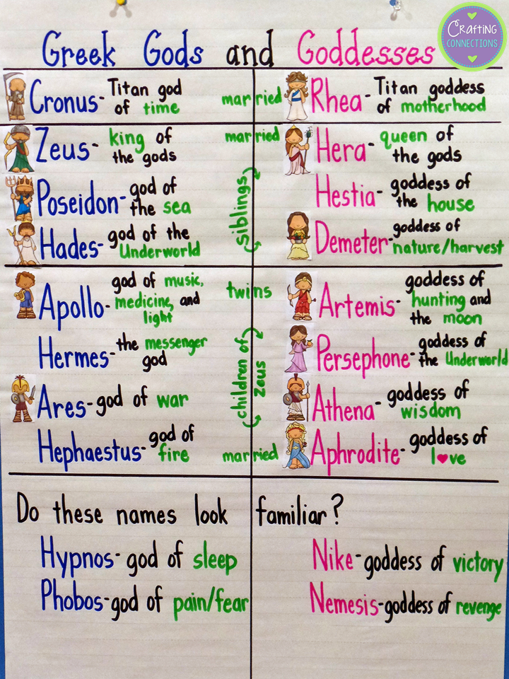

Slide 23
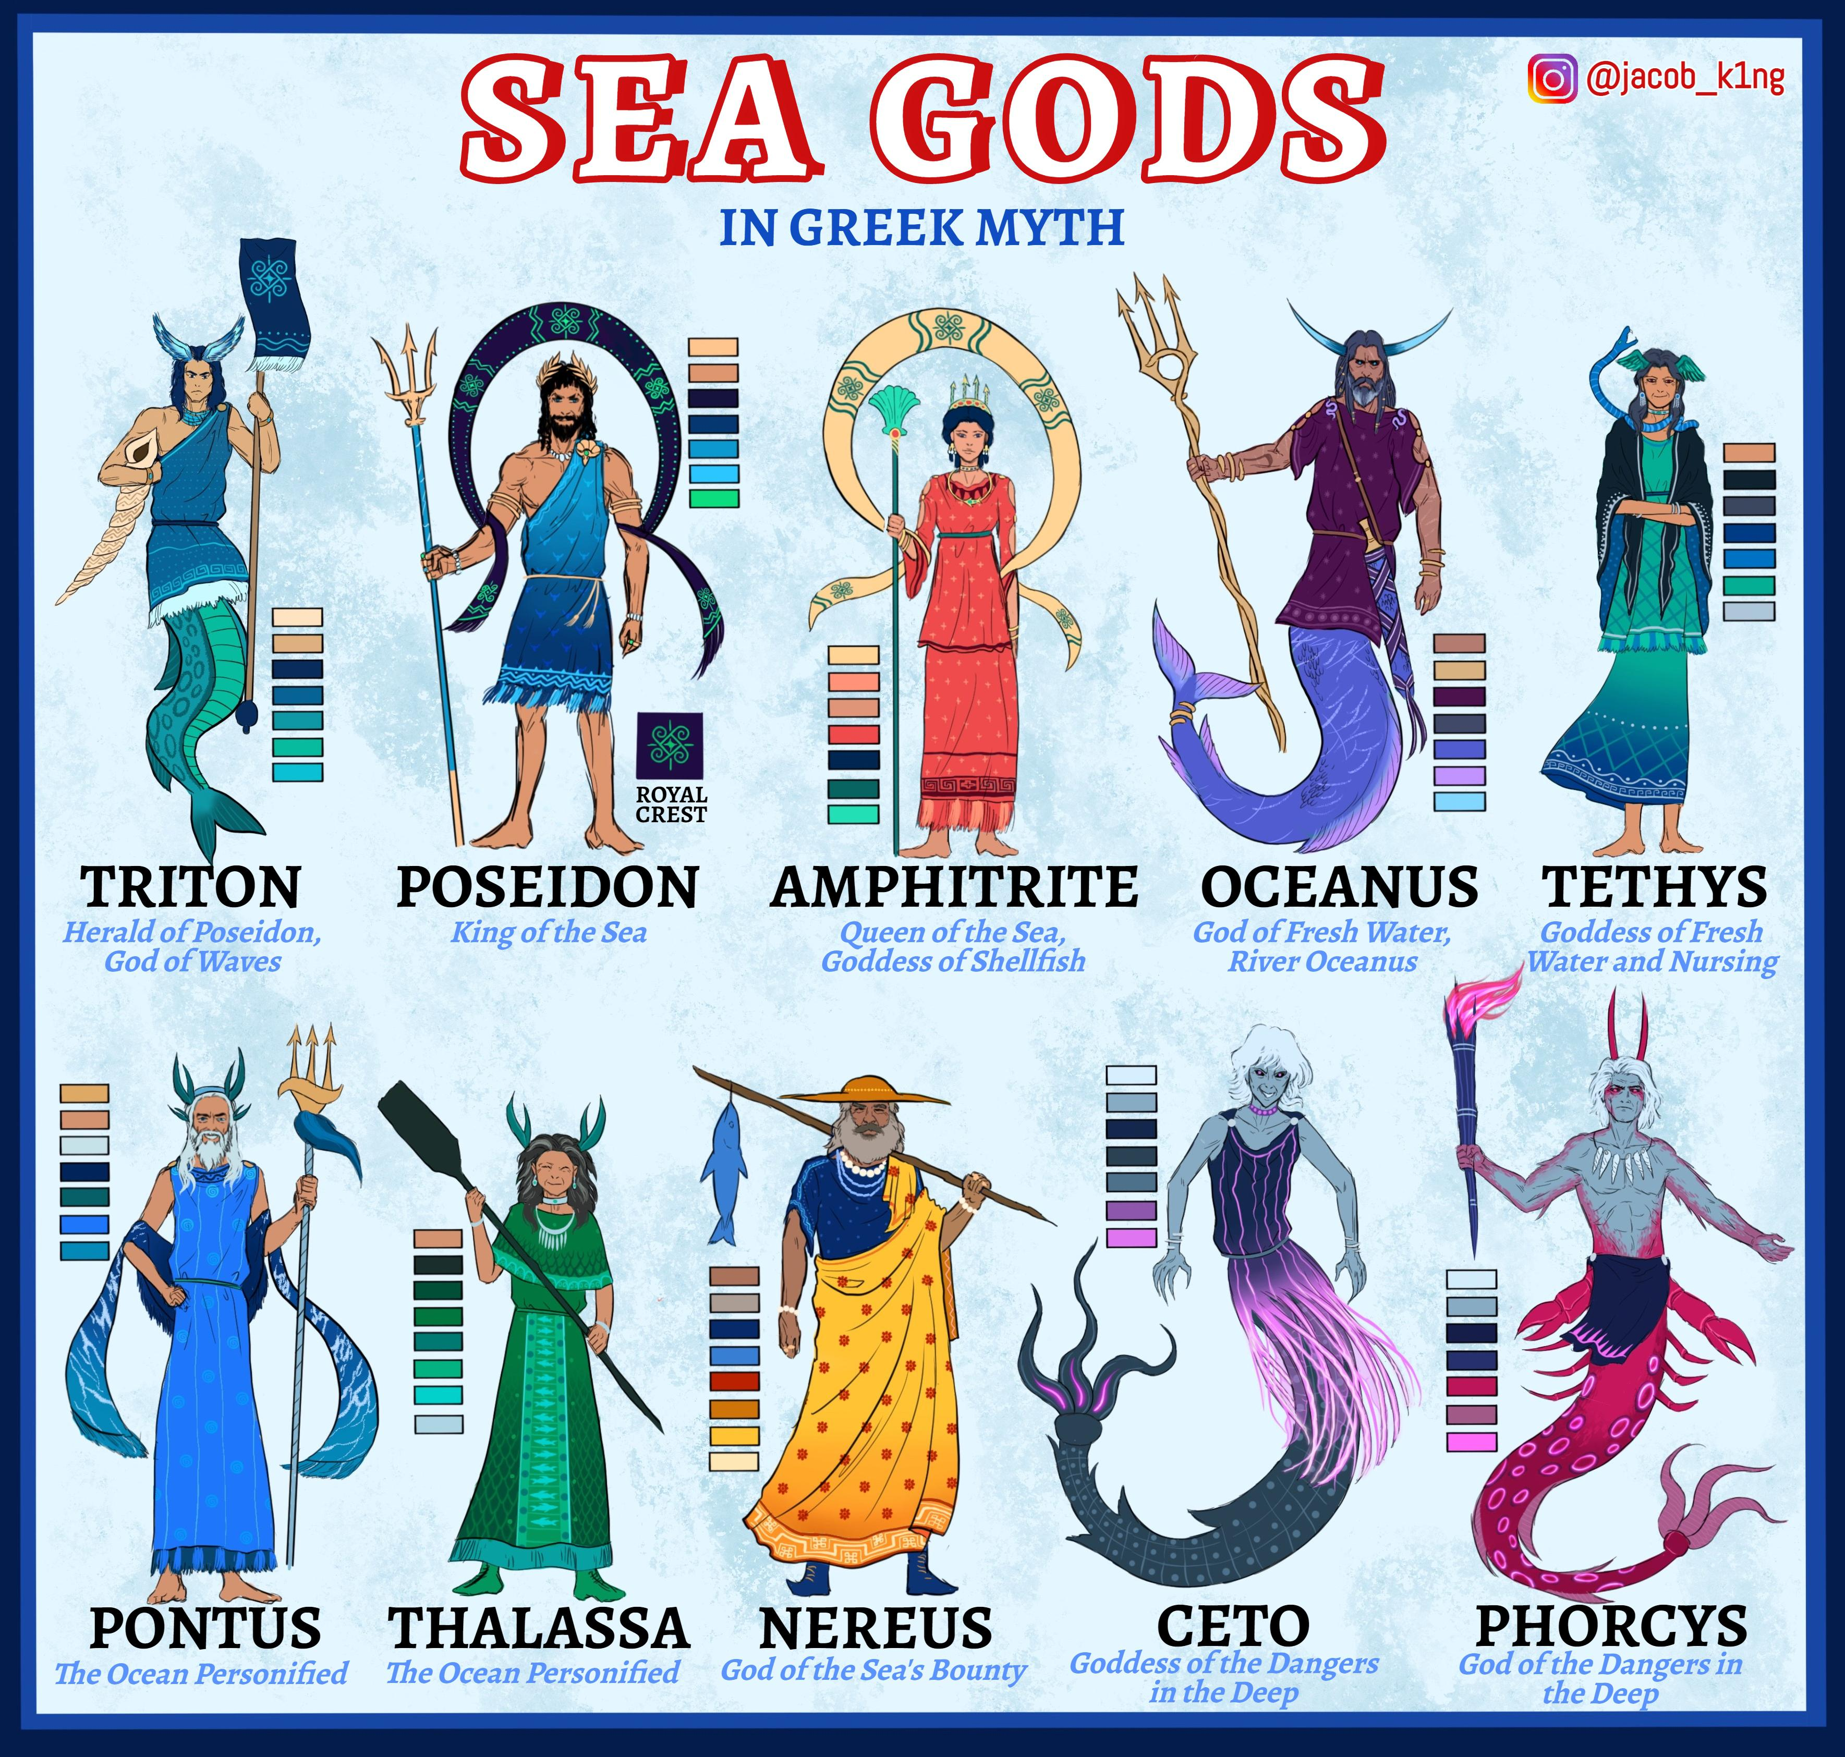

Slide 24
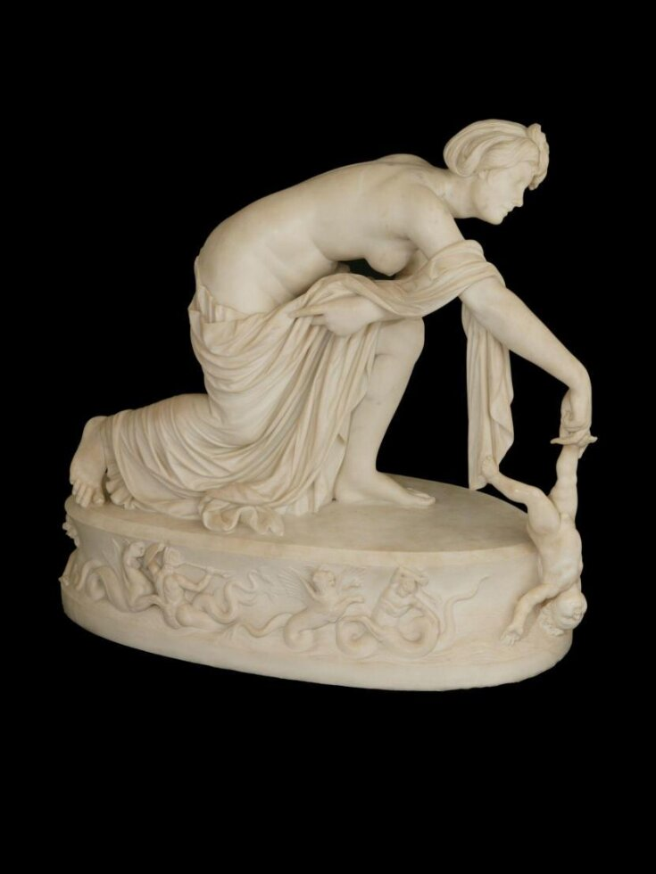
Key Figures in Greek Mythology
Zeus: King of the gods, ruler of the sky, and wielder of lightning.
Athena: Goddess of wisdom, war strategy, and craftsmanship.
Poseidon: God of the sea, earthquakes, and horses.
Hercules: A hero known for his incredible strength and completing 12 dangerous labors.
Achilles: A powerful warrior whose story is central to the Trojan War and the Iliad.
Known for his strength, courage, and a fatal weakness—his heel.

Slide 25
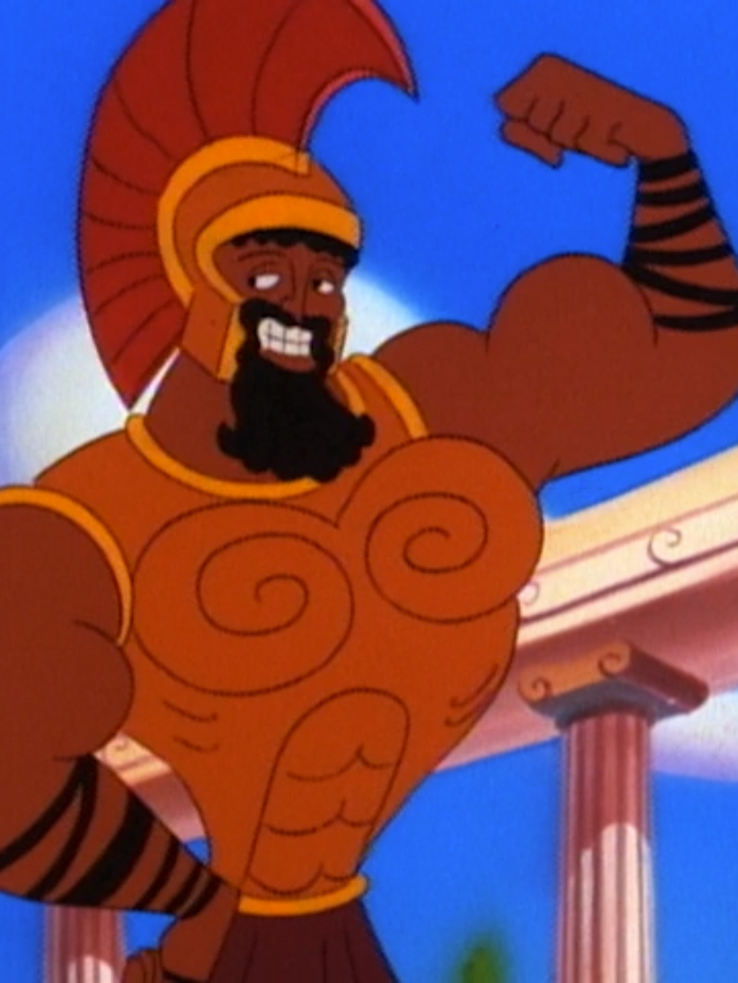
Introducing Achilles and the Trojan War
The Trojan War was a legendary conflict between the Greeks and Trojans, sparked by the kidnapping of Helen of Troy.
Achilles, the greatest Greek warrior, fought bravely but had a tragic fate.
His mother dipped him in the River Styx to make him invincible, but his heel remained vulnerable.
Themes in Achilles’ story: loyalty, anger, pride, and the consequences of decisions.

Slide 26
Do Now
Make a list of your daily responsibilities at school and at home.

Slide 27
My Daily Responsibilities
School/Work
Home
Lesson planning
Grading
Classroom management
Safety and security
Mandated reporter
Before/After school duties
Coaching (wanna play?)
Getting the kids up
Making sure lunches are ready
Take the dog out
Laundry (if needed)
Make dinner
Prep for work
Prep kids for school

Slide 28
Family Life in Ancient Greece
Athens
Sparta
Men were in charge
Poorer women were allowed to work in the market
Richer women were expected to stay at home
Poorer and richer men were expected to work
Men were in charge
Women could work but most managed the home
Women could have an education
Women could sell property
Women were trained in sports
Men worked

Slide 29
Children’s Lives
Greeks
Spartans
Boys went to school to learn reading, writing, and how to be good citizens.
Girls learned at home from their moms how to cook and take care of a house.
Spartan boys were trained to be strong soldiers from a very young age. They had to be tough and learn to survive.
They didn't have much time for games. It was all about training and being the best warrior they could be.

Slide 30
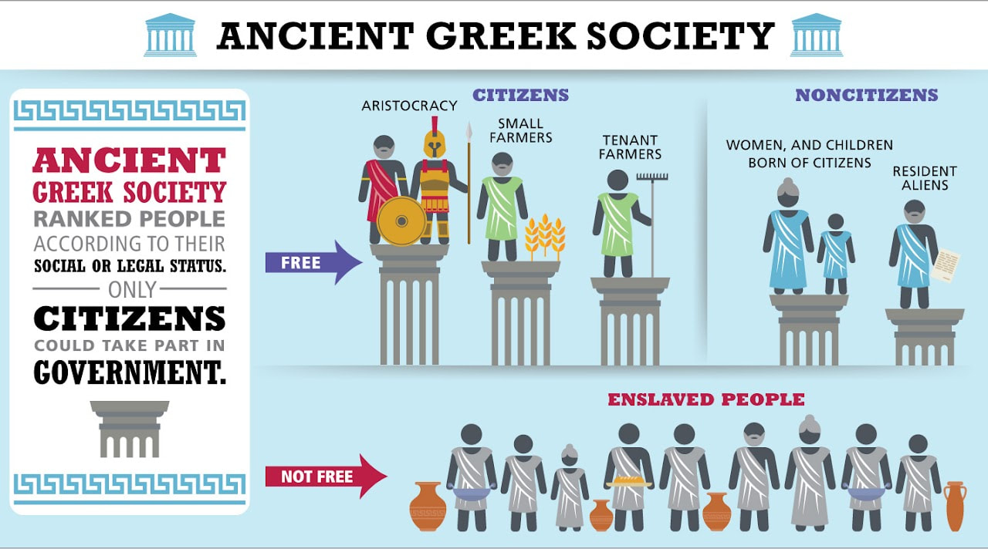

Slide 31
Economy
Athens
Sparta
Relied on trade and colonization to get what they needed
Conquered whoever had what they needed

Slide 32
We Do
Let’s Read!
Pp. 239-243

Slide 33
You Do Together
Create a model family and discuss roles (Greek or Spartan)
Think about all we have discussed and read
You and your group will then tell us about your “daily life”
Take about 10 minutes and then we will discuss

Slide 34
You Do Alone/Exit Ticket
Write a paragraph about how your life compares to an ancient Greek/Spartan child

Slide 35
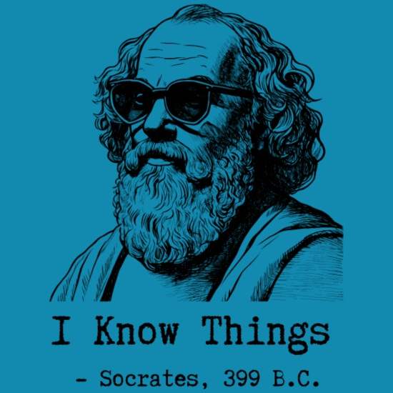
Do Now
What makes a “good” question?
Why do we ask questions?

Slide 36
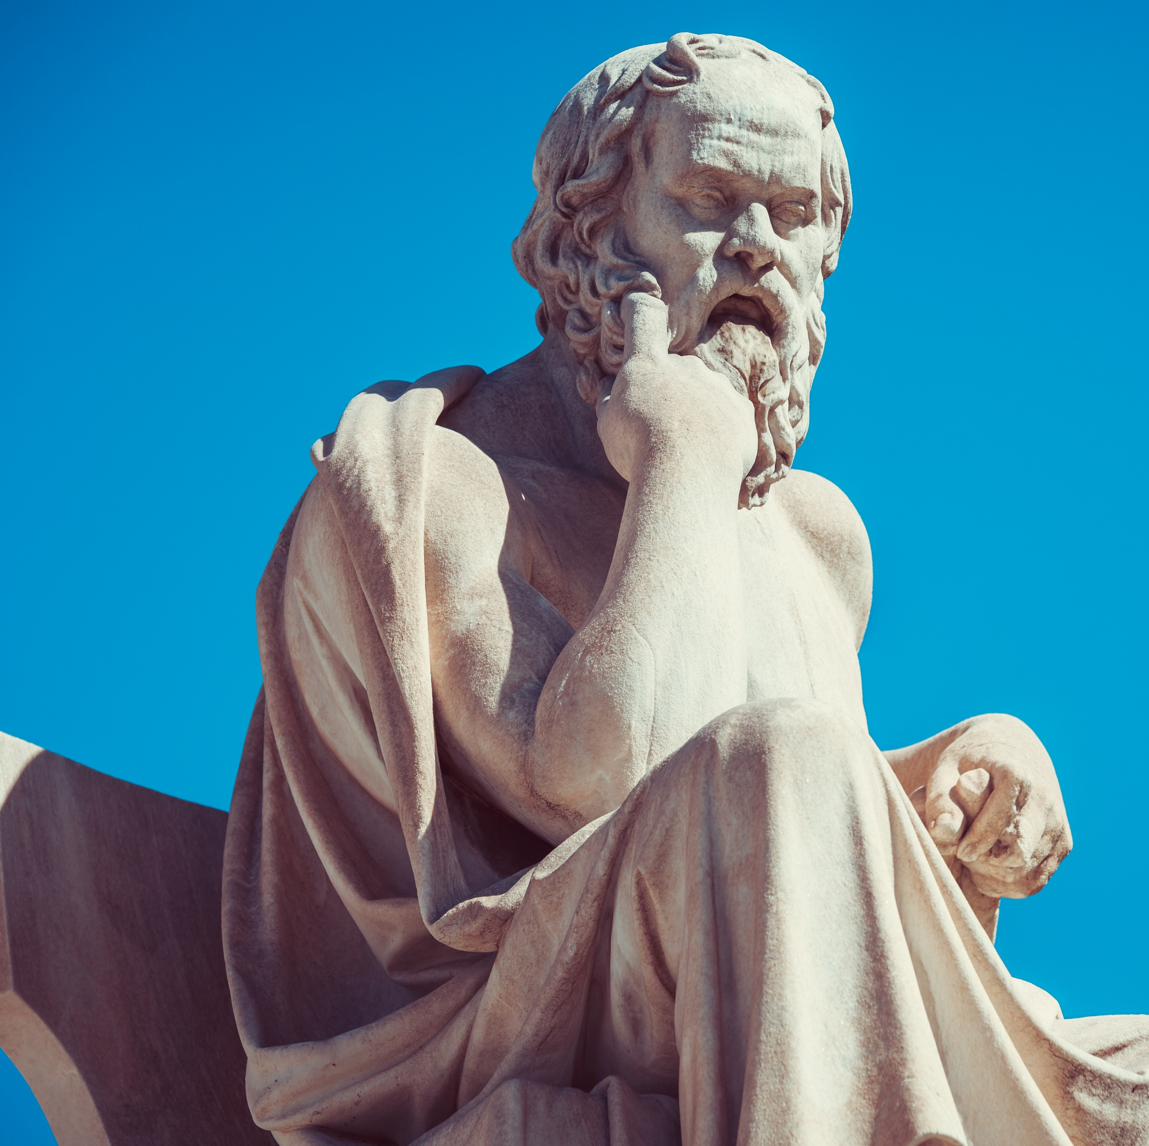
Who was Socrates?
Socrates was a famous teacher and philosopher in Ancient Greece.
Instead of giving answers, Socrates asked questions to help people think deeply and find their own answers.
This method is called the “Socratic Method” and is still used today in schools, debates, and even courts.
Notes:
Today, we’ll practice thinking like Socrates by asking questions instead of jumping to answers.

Slide 37
Socratic Method
The Socratic Method is about:
Asking open-ended questions (not just “yes” or “no” questions).
Listening carefully to what others say.
Responding with more questions to explore their ideas
Examples of Socratic Questions:
Why do you think that?
Can you explain your reasoning?
What evidence supports your idea?
What if we looked at it differently?

Slide 38
Practice Round
I am Socrates, and I have a question for you:
Your best friend stole a candy bar. They feel bad and tell you about it. What should you do?

Slide 39
You Are Socrates
Get in groups (3-4)
Everyone gets a chance to be Socrates
Choose one of these dilemmas and discuss:
Your friend is being bullied. Should you tell a teacher or stay silent?
Your team lost a game, and a teammate wants to blame the referee. What should you say?
You promised to help your sibling with homework, but your favorite TV show is on. What should you do?

Slide 40
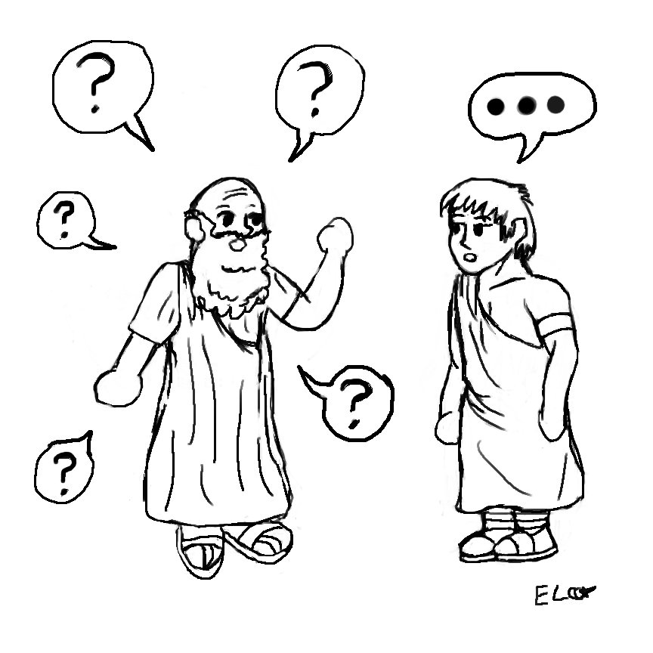
Class Discussion
Socrates said, “If you want to be wrong then follow the masses.”
What does this mean?
Let’s discuss

