Slide 1
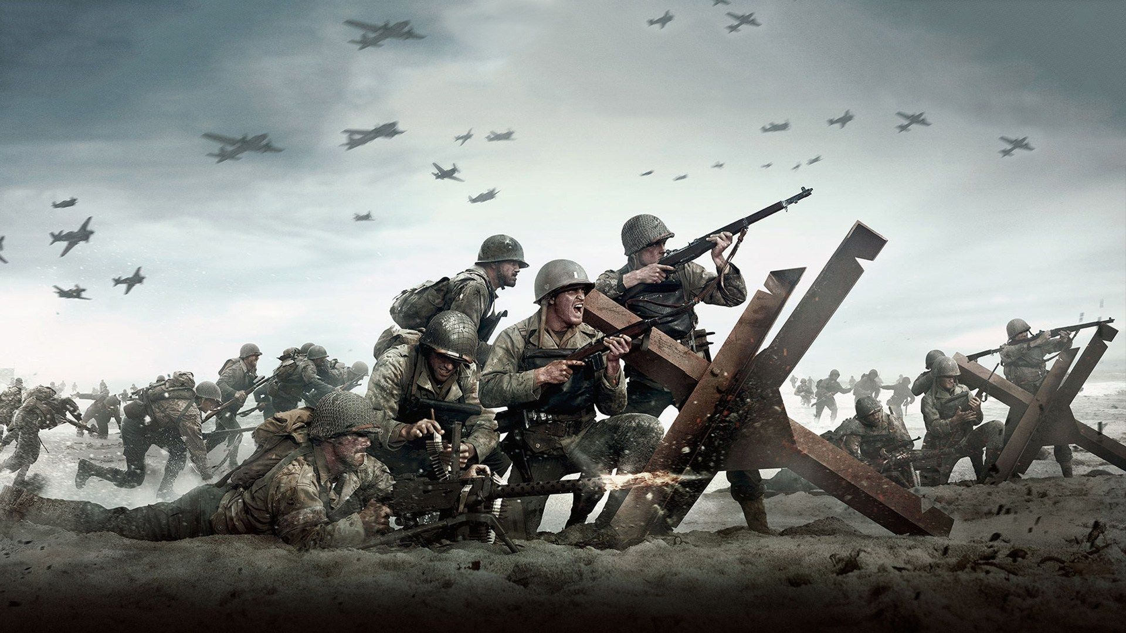
WORLD WAR II

Slide 2
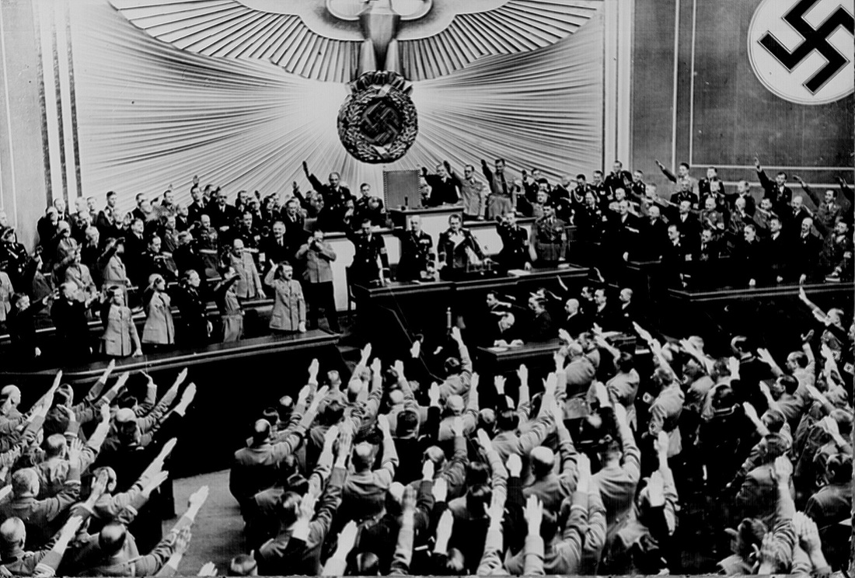
WORLD IN CRISIS

Slide 3
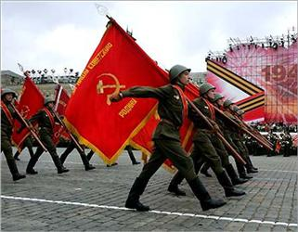
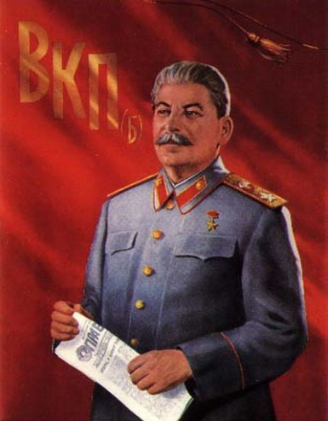
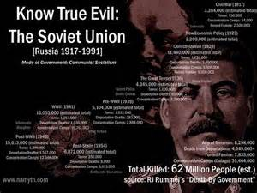
SOVIET UNION
Soviet Union transfers communist power from Vladimir Lenin to (believe it or not) an even worse murderer named Joseph Stalin. Stalin will be responsible for 20M deaths.
*In shifting USSR from agriculture to industry, 20M died thru force, prisons, & famine. Great Purge executed everyone who stood in his way.

Slide 4
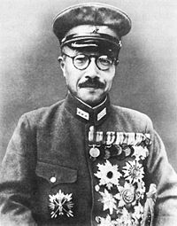
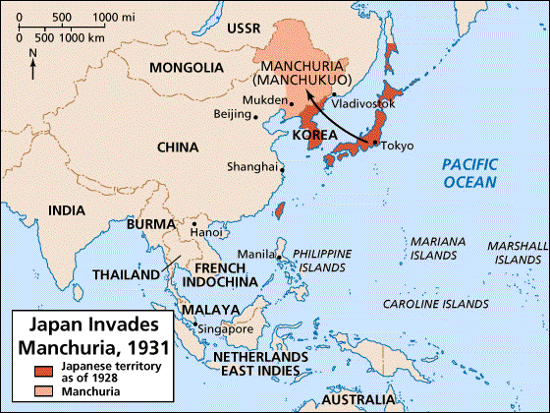
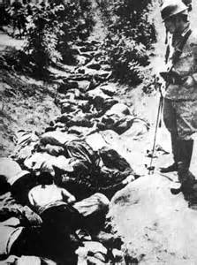
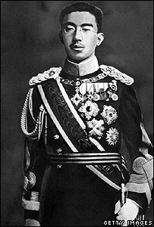
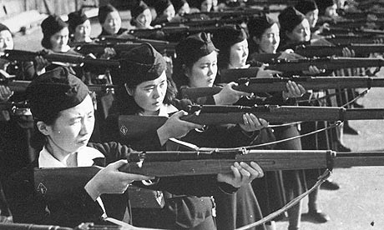
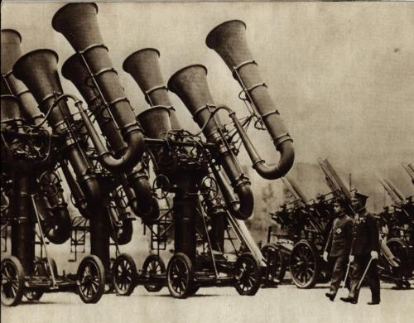
JAPAN
Military takes over leadership as Hideki Tojo gives Emperor Hirohito orders, Japan continues to build military and conquer Nanking, China.
*Japan butchers thousands in a holocaust called the Rape of Nanking, & plans to take over 5000 miles of oceanic space in the Pacific.

Slide 5
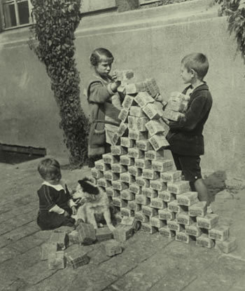
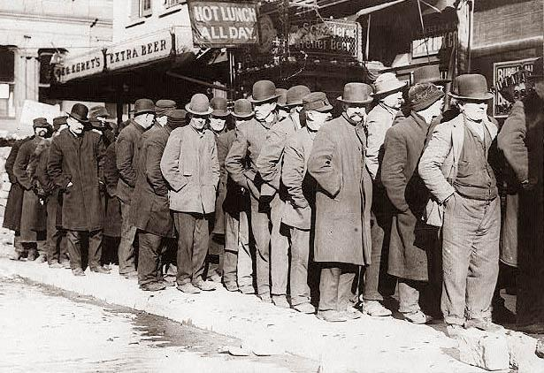
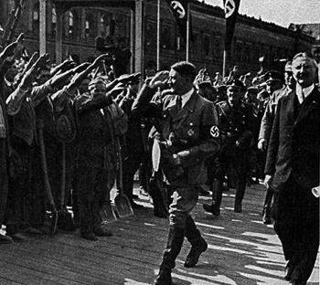
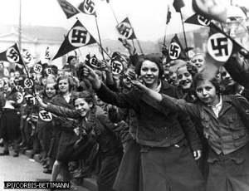
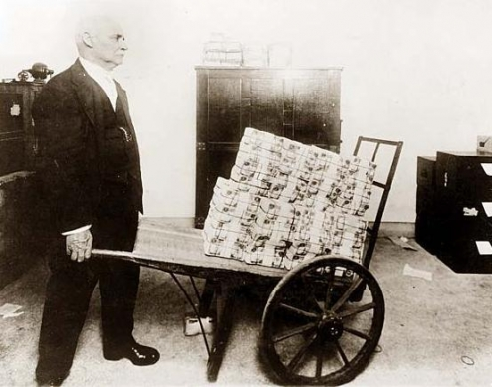
GERMANY
Broke German government continues to collapse as Nazi (National Socialist Party) rises in power.
*Pictured here are the masses of people saluting a young Hitler while men wait in food kitchens for meals. Inflation of money was so bad that cash carried essentially zero value.
*A loaf of bread cost 160 Marks in 1918, by 1922 the cost had risen to 200 Billion Marks—no joke.

Slide 6
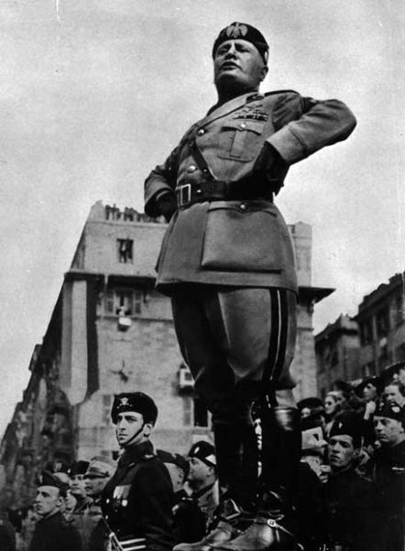
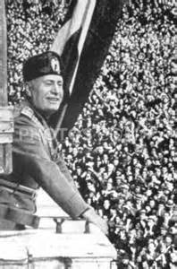
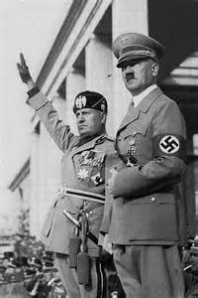
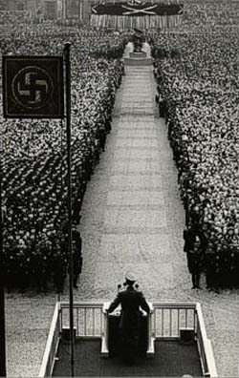
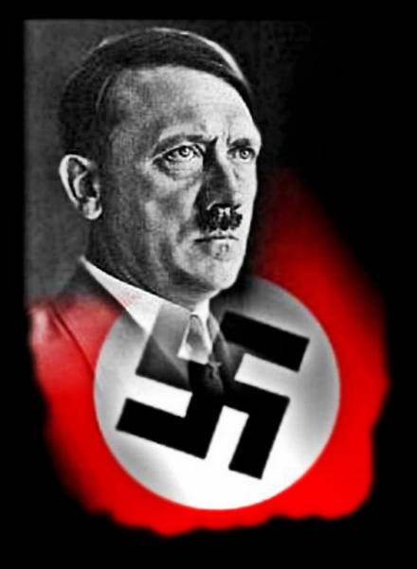
BENITO MUSSOLINI & ADOLF HITLER
Italy: Benito Mussolini founded Fascist political movement after WWI & gained power when his Blackshirts marched on Rome in a coup.
Germany: Adolf Hitler gains fame after a failed takeover & is appointed to the #2 position in power. He takes over after a natural death & promises
a Third Reich, a great empire in honor of Holy Roman Empire.
*Hitler’s plan was clearly written out in his book Mein Kampf.

Slide 7
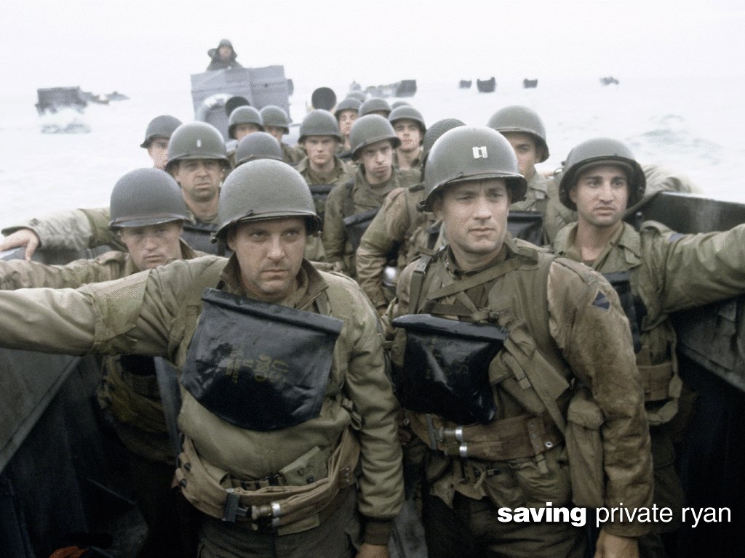
WORLD WAR II

Slide 8
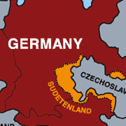
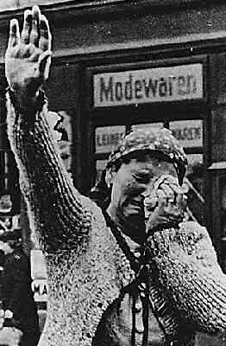
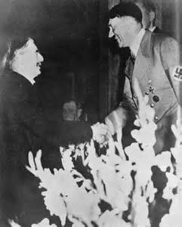
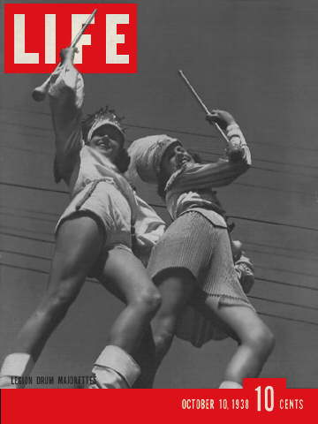
HITLER INTO SUDETENLAND
Italy starts WWII by attacking Ethiopia.
Begging for living space, Hitler makes the case that Germany should take control of the Sudetenland (western part of Czechoslovakia).
Instead of fighting, European leaders say OK.
*This YES comes from GB and France, it is called the Munich Pact, and backfires as Hitler takes over all of Czechoslovakia. Europe acts stunned that Hitler would so blatantly lie to them.
*Life magazine celebrated the takeover by showing pics of German parades & emphasizing world approval.

Slide 9
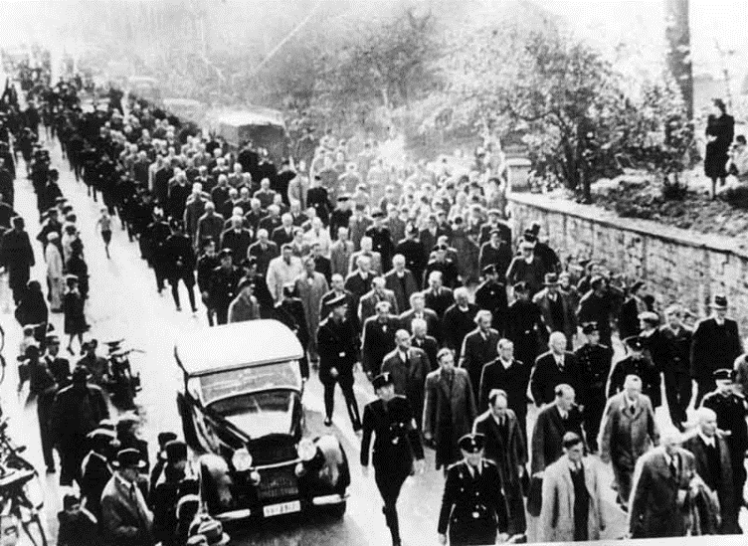
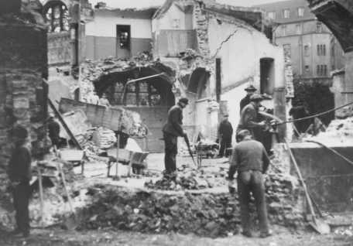
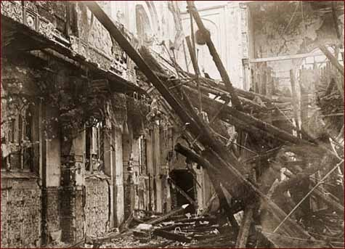
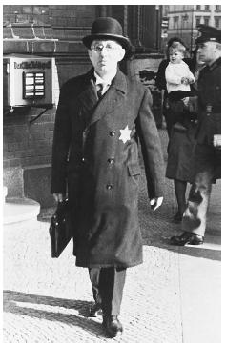
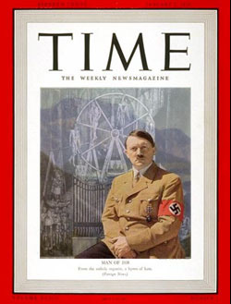
KRISTALLNACHT
Hitler’s plan to create Aryan nation of “pure blood” begins on Kristallnacht (Night of the Broken Glass) as Jews were no longer considered people.
*Synagogues were burned, homes ransacked, Jewish businesses were destroyed & thousands were rounded up into concentration camps.
*3 years earlier, Germany had passed the Nuremberg Laws, which ordered Jews to wear yellow stars, forbade marriage, stripped their citizenship, etc.
*2 months after Kristallnacht, Time magazine picked Hitler to be its 1938 man of the year…yup the world loved him.

Slide 10
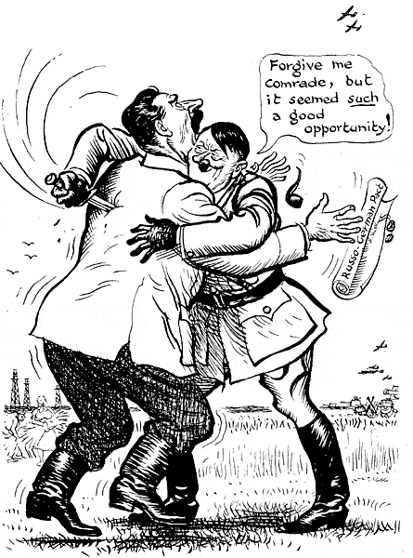
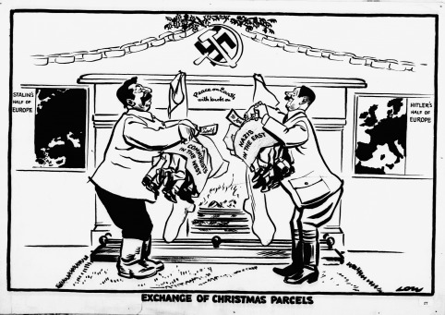
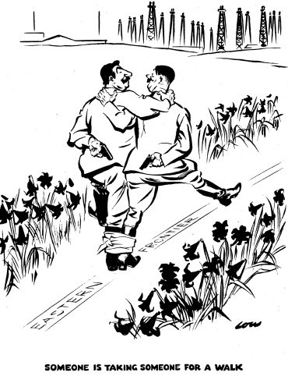
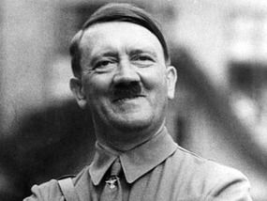
NONAGGRESSION PACT
Despite that the Soviet Union & Germany are bitter enemies & politically polar opposite, the 2 nations agree to NOT fight.
*This contract was supposed to last 10 years but both nations planned their double cross.

Slide 11
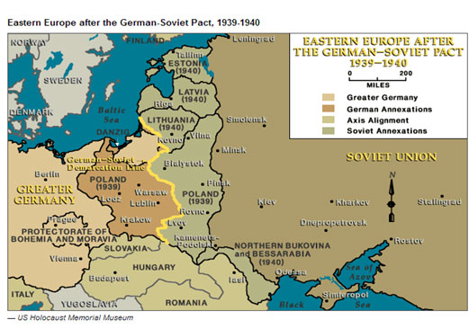
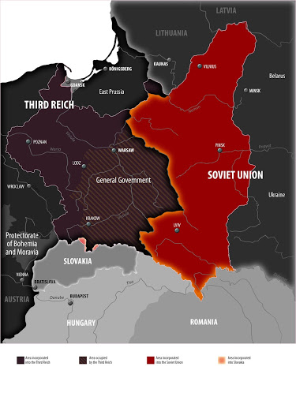
GERMAN & RUSSIAN OFFENSIVES
Hitler and Stalin unleash their forces on all the nations standing between them crushing all, including the nation of Poland.

Slide 12
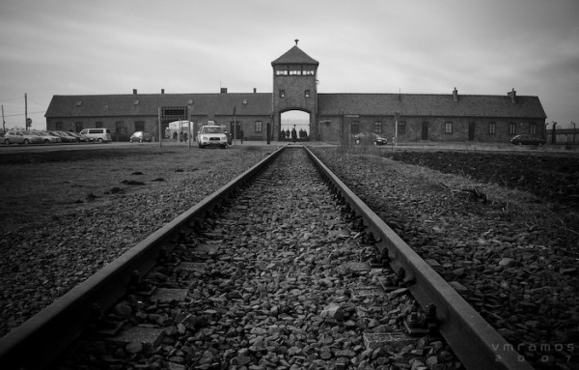
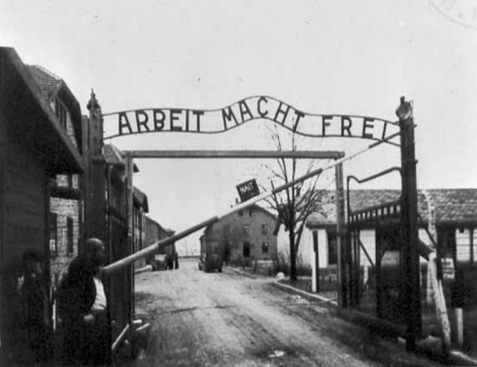
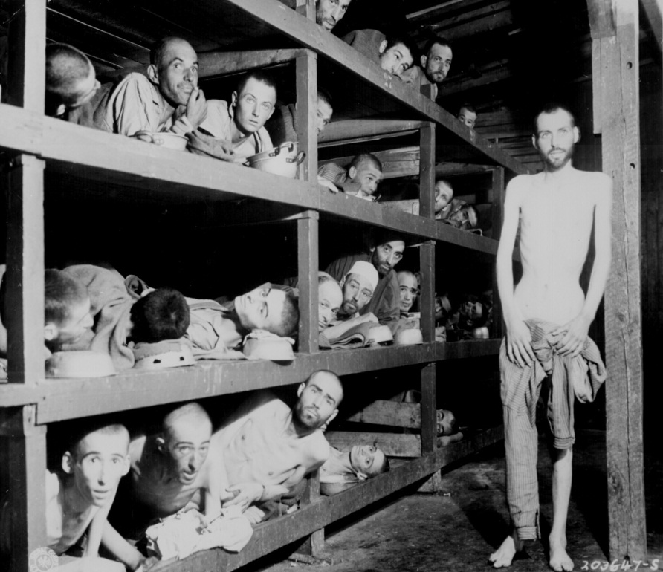
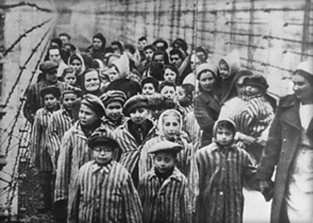
HOLOCAUST
Germans were willing to “purify” their Aryan Race thru the extermination by ordering captive Jews to the “showers” and gassing them to death with poison gas.
By the end of war, Germans had used their 40,000 death facilities to kill 2/3rd of the European-Jewish population. Aushwitz camp ends the lives of 4M.
Total Jews Killed: 6,000,000.

Slide 13
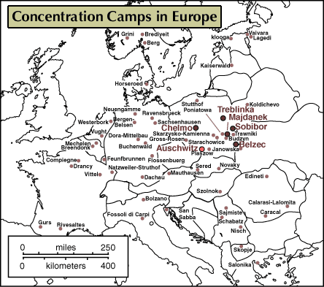
DEATH TOTALS:
Jews: 6M
Soviet POWs: 2M
Ethnic Poles: 2M
Romanians: 1M
Disabled: 150K
Also: Freemasons, Jehovah’s Witness, Homosexuals, etc.
TOTAL: 11M
*A lot of Christians were killed for faith but its easier to count by ethnicity.

Slide 14
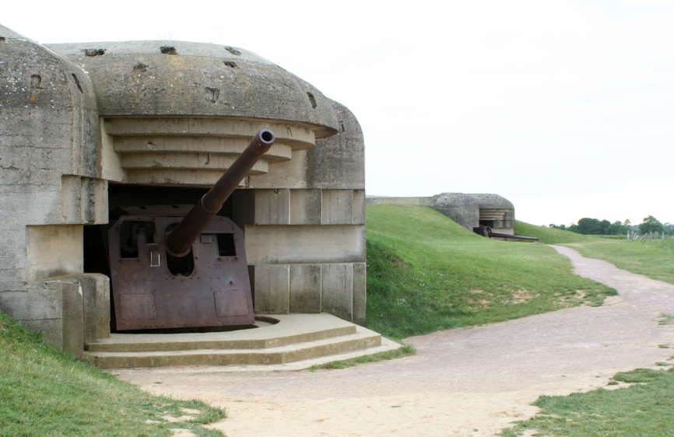
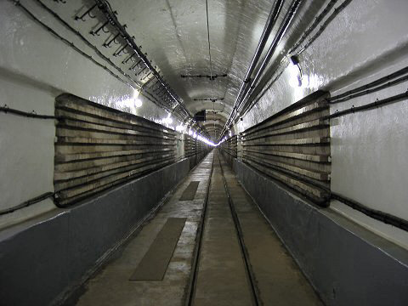
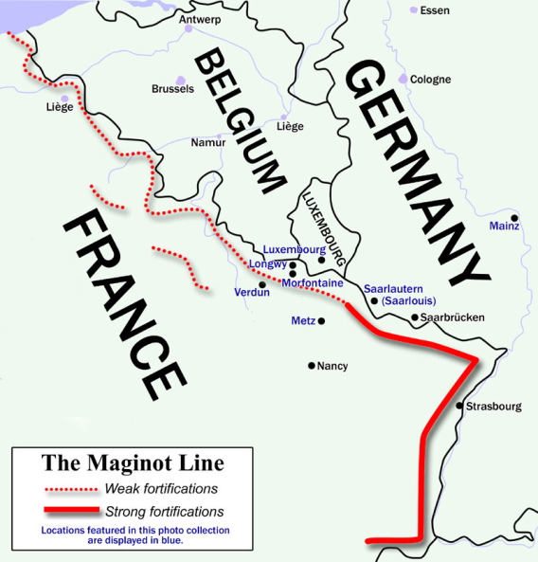
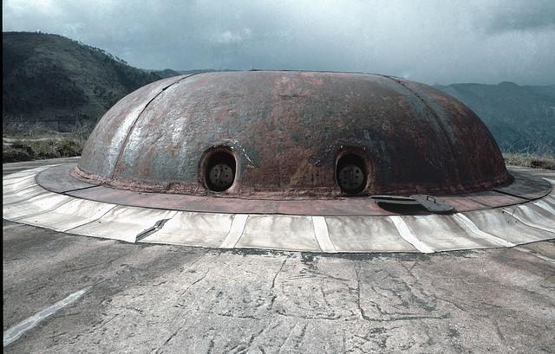
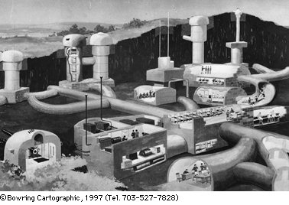
MAGINOT LINE
France & Britain waited, hidden behind a defensive wall called the Maginot Line.
*Thought to be the greatest defensive fortification in history (like a Great Wall of China). It was filled with machine guns, cannons, obstacles, & even a railway system. But it could not fire UP.

Slide 15
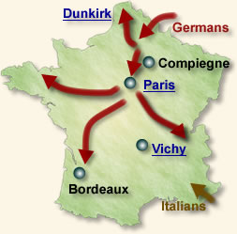
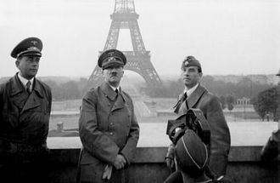
INVASION OF FRANCE
For the 2nd time in 30 years, Germany goes thru Belgium to attack France (used airplanes to blast apart the Maginot Line)
Germany’s lightning war (Blitzkrieg) smashes France into submission.
*Fall of France was June 22, 1940 ( leaders sign surrender in same railway car that was used to sign the Treaty of Versailles).
*1000s of French soldiers escape to Britain in an event called the Dunkirk Rescue.

Slide 16
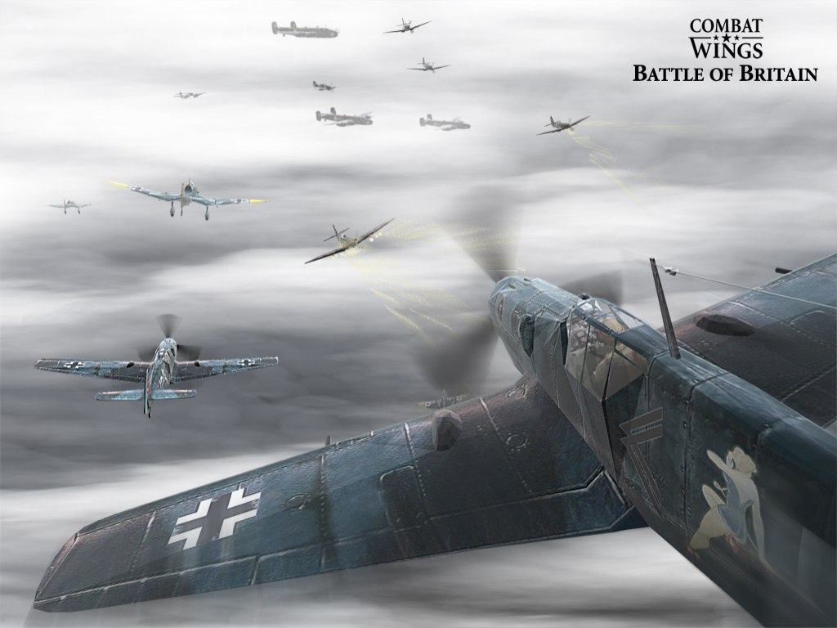
BATTLE OF BRITAIN
Germany attacks Britain by air (called a Blitz). GB leader Winston Churchill keeps people strong while promising “never to surrender!” GB will eventually win.
USA supports GB by providing supplies, weapons & destroyers (President FDR).

Slide 17
INVASION OF RUSSIA
Hitler turns on Russia & invades using 2500 aircraft, 3000 tanks, 600,000 motorized vehicles, 625,000 horses & 3M soldiers to smash the Red Army
*Russia answers w/ Scorched Earth Policy (like they did against Napoleon 130 years earlier). Russia defends major cities of Leningrad, Moscow & Stalingrad to the death (freezes around 190K GE troops at Stalingrad).

Slide 19
UNDECLARED WAR IN ATLANTIC
Despite neutrality, USA & Germany were blowing each other up in the Atlantic Ocean. Submarines sunk USA ships including the Rueben James.
*Notice on map the area Germany called their blockade zone.
*Left is a model of the Rueben James.
*Right is the Kearney after hit by a torpedo.

Slide 20
PEARL HARBOR
On Sun morning, December 7, 1941, Admiral Yamamoto sent 183 planes to attack the unknowing USA fleet sitting still on Battleship Row. Japan blew up 200 planes, damaged 8 battleships, & killed 2471 Americans (1100 of the men died aboard the USS Arizona).
*Franklyn D. Roosevelt stated that this dastardly attack will live in infamy as USA declares war.

Slide 21
USS ARIZONA

Slide 22
PHILIPPINES
Japan (part of the Axis Powers w/ Italy & GE) attack Philippines just 10 hours after Pearl Harbor. Bomb USA bases & land near Manila. After USA soldiers surrender, severe brutality occurs during the Bataan Death March (no food or water as 16,000 soldiers die on trek).

Slide 24
RAPE OF NANKING
While in China, Japan committed one of the worst atrocities in history.
*Slaughtered 250K people thru vicious acts including burying alive, death by fire, bizarre body acts, feedings to dogs, multiple stabbings & tons of decapitations (goal was to save bullets) in China’s capitol city.
*WARNING, pics of massacre equal the worst ever seen so be careful on internet.

Slide 25
USA FIGHTS BACK

Slide 26
AMERICAN PREPAREDNESS
USA had only the 19th largest army in the world at the start of the war (ranked between Portugal & Bulgaria). By the end, 15,145,000 Americans would see action (including 1M African-Americans, 350K Hispanic & 200K women). Factories produced: 250,000 planes, 100,000 armored cars, 75,000 tanks, millions of tons of bombs & shells & twice as many weapons as the entire Axis Army combined (spent $321 Billion in just 4 years).

Slide 27
NAVY BATTLES
USA strikes Germany in the Battle of the Atlantic hitting their ships & subs.
USA hits Japan with a Raid on Tokyo in order to send a message.
*Doolittle Raid is the attack on Tokyo in which 16 heavy bombers take off from an aircraft carrier after being stripped down to nothing (literally had broomsticks as guns).
*Pilots hit Tokyo then crash land in China hoping the correct Chinese would assist.

Slide 28
BATTLE OF THE CORAL SEA
USA stops Japan’s march forward by meeting them in air battle in the Coral Sea. *Though Japan wins the battle, their empire presses no further (1st battle in history in which the two sides could not visually see each other during the conflict).

Slide 29
BATTLE OF MIDWAY
Turning point of the Pacific Theater as USA wins by sinking 4 Japanese aircraft carriers.
USA makes plan for victory: island hopping.

Slide 30
BATTLE OF NORTH AFRICA
Dwight D. Eisenhower (USA) & Allies traps “Desert Fox” Erwin Rommel’s (Germany) forces in Tunisia, 250,000 Axis soldiers surrender.
*Allied Forces included: USA, Britain, Australia, New Zealand, Canada, South Africa, Free France, Tunisia, Czechoslovakia, Greece, Poland, Morocco & Algeria.

Slide 31
INVASION OF SICILY
Allied forces fight awesome 6 week land battle after a daring sea invasion to make Italy surrender.
*Once Benito Mussolini is captured, his own Italian people arrest him and hang him upside down for crimes against humanity.
*History will call General George S. Patton as the greatest tank commander in history. He plays a major role in most of the USA battles on the European front.

Slide 32
D-DAY
June 6, 1944: 5300 ships & 176,000 troops targeted French beaches of Normandy. Within 3 weeks, Allies had 1M troops ashore pushing GE back.
*German panzer divisions waited mistakenly at Calais as they fell for our espionage. It also helped that Hitler fell asleep & was not awoken to give order to change fighting location.

Slide 34
ISLAND HOPPING
*Guadalcanal: 1st USA offensive. 20K marines land on a “shoestring” of supplies to fight Japanese troops in a malaria infested jungle.
*Tarawa Island: On only 8 square miles, 5K Japanese fought to death (having only 17 survivors). Censors allowed to show corpses for 1st time.
*Great Marianas Turkey Shoot: Major air battle with Japanese Zero vs. USA’s Hellcat. USA loses 29 planes, Japan loses 243 planes & 17 subss
*Saipan: After USA win, 4000 J soldiers kill selves w/ banzai leaps of cliffs.
*Leyte Gulf: General MacArthur fulfills promise to return to Philippines by invading the mainland & recapturing the cities of Manila & Corregidor.

Slide 36
IWO JIMA & OKINAWA
Iwo Jima: fiercest fighting in the Pacific took place on this 8 square mile island known as Sulfur Island. It was USA’s 1st attack on one of Japan’s home islands.
Okinawa: Japanese soldiers continue to defensive hiding tactics while killing 26,000 Americans on these 2 isles.

Slide 37
KAMIKAZE
Suicide attempts by Japanese pilots in an attempt to turn the tide of the war.
*Japan was losing the dogfights vs. USA, so instead of training new ones to fight, Japan taught them how to fly as living bombs.
*Kamikaze was actually an effective weapon (50 ships sunk & another 300 damaged).
*Pilots were given complete burial ceremonies prior to their take off.

Slide 38
TUSKEGEE AIRMEN
AA squad of pilots trained in Alabama, some say they were the only squad to never lose a bomber during escort.
*1st Lady E. Roosevelt took a practice flight.
*Featured in movies Red Tails & Night of the Museum: Smithsonian.

Slide 39
JAPANESE INTERNMENT
Fearing a potential Japanese invasion, FDR gives Executive Order 9066 that allows for the legal incarceration of people based on race (120K Japanese-Americans are placed into camps).
*Sign on the store was placed by J-A hoping to avoid relocation & stay open for business.
*Despite “No Person Shall Be Deprived of life, liberty or property without due process of the Law,” Supreme Court ruled Executive Order 9066 to be legal.

Slide 40
BATTLE OF STALINGRAD
Russians fight Axis Army in frozen conditions. The 280K troops Hitler used to attack Soviet Union either die or are captured (Germany is under siege from both sides).

Slide 41
BATTLE OF THE BULGE
Germans try one more last ditch effort to win with an all out assault. USA forces pinch off their forces in Europe’s most brutal fighting.

Slide 42
V-E DAY
May 8, 1945: GE signs unconditional surrender as war in Europe ends.
*Sadly, FDR has passed already so it’s Harry S. Truman (from Missouri) who gets to celebrate.
*Seeing Allies coming, Hitler orders people into subways for “protection,” then begins gassing own people.
*Hitler cowardly commits suicide prior to the takeover of Berlin (along w/ his mistress Eva Braun).
*Russians beat USA to Berlin and order the civilian population to be raped, estimates are about 90,000.
*Though Allied mood is festive, Patton refuses to celebrate w/ Russians & tells them they’re next (after Japan).

Slide 43
HIROSHIMA & NAGASAKI
USA spent $2B on the Manhattan Project: a plan to create an atomic weapon. After a practice drop at Alamogordo (NM), Truman warned Japan to surrender or face “prompt & utter destruction.”
After no response, Truman ordered Little Boy to be dropped on Hiroshima (100K dead) and Fat Man to be dropped 3 days later (70K dead).

Slide 44
HIROSHIMA

Slide 45
V-J DAY
Sept 2, 1945: Japan signs unconditional surrender as war in Pacific ends.
*Though USA didn’t have any more atomic bombs made, the threat of dropping dozens more scared Japan.
*Thankfully, the original plan of dropping atomic bomb on beach prior to invasion didn’t come to pass.
*AFTER Hiroshima is when Russia officially declares war against Japan, thanks for nothing.
*The Kamikaze plans of the Japanese was far more successful than USA led us all to believe.
*Surrender was signed aboard the USS Missouri (USA will allow Hirohito to remain in charge of Japan).
*USA leaves General Douglas MacArthur over in Japan as he re-organizes government into a democracy.
*Though world brings German war criminals to justice, Japan’s atrocities get swept under the table.
*In 1972, a Japanese soldier emerges from a cave to attack some vacationers—he hadn’t heard war was over.

Slide 46
DEATH TOTALS
292,000 Americans 11,000,000 in Holocaust
2,000,000 Japanese 18,000,000 Russians
4,000,000 Germans 10,000,000 Chinese (best estimate)
6,000,000 Polish 60,000,000 TOTAL
*Soldiers from 6o different nations fought in World War II.

