Slide 1
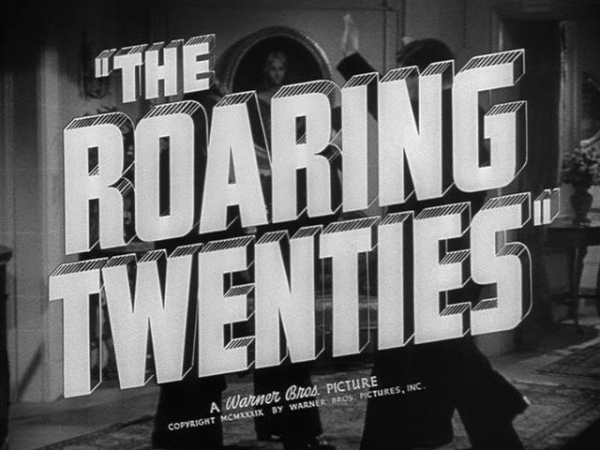

Slide 2
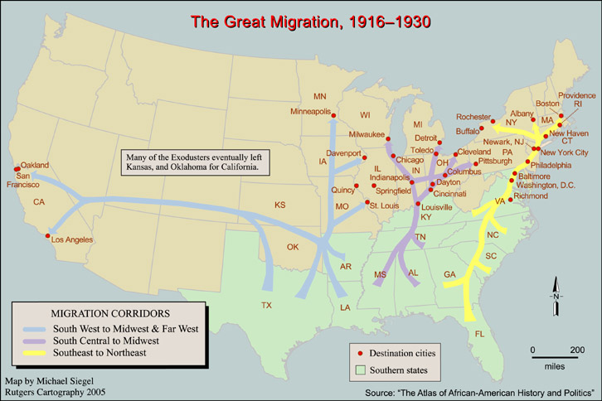
African-Americans moved from the rural South to big cities after WWI.
Chicago example: AA population grew from 44,000 to 234,000.
Marcus Garvey tried Back to Africa movement but failed to poor supplies.

Slide 3
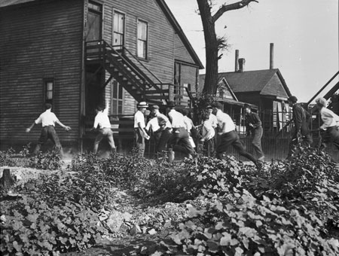
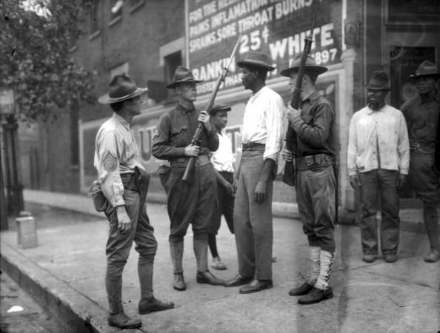
CHICAGO RIOTS
AA teen is killed on a beach (whites hit him in head while swimming with a rock). Arson, murder & theft occurred by mainly Irish whites who attacked the Black Belt on the south side (38 killed). Incident sparked beginnings of Red Summer.
*AA and Irish had moved to the same area of Chicago & searched for the same jobs. When a drought hit Southern IL, broke farmers were added to the mix. **Part of the issue is that the White Police did not arrest the man who threw the rock & killed the teen

Slide 4
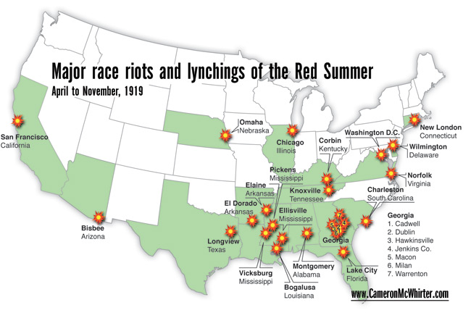
RED SUMMER

Slide 5
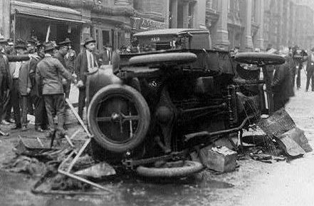
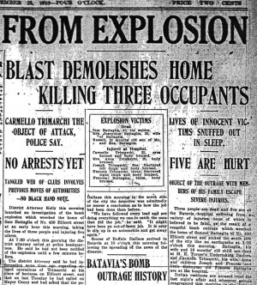
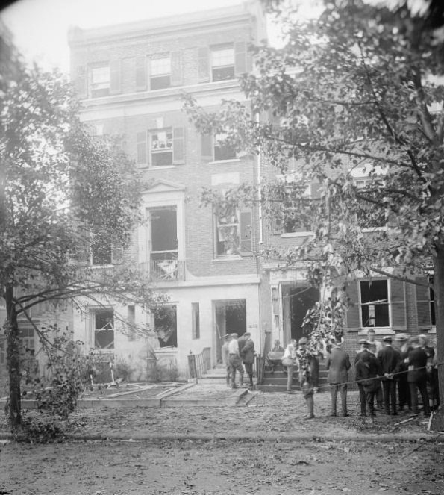
ANARCHIST BOMBINGS OF 1919
In April, 36 booby-trapped bombs were sent via mail to VIP officials.
On June 2nd, 8 bombs blew up within 90 minutes in 8 large cities.
*Bombs were sent to Attorney General, John D. Rockefeller , Gov of MS, Mayor of Seattle, former GA Senator, FBI, etc (packaged them in Dept Store boxes as novelty items).
*The June 2nd bombs were about 25 lbs. each & once again targeted Attorney General.
*History doesn’t make a huge mention of these attacks, & for some reason focuses more attention on the illegal actions of the government to catch these anarchist/communists.

Slide 6
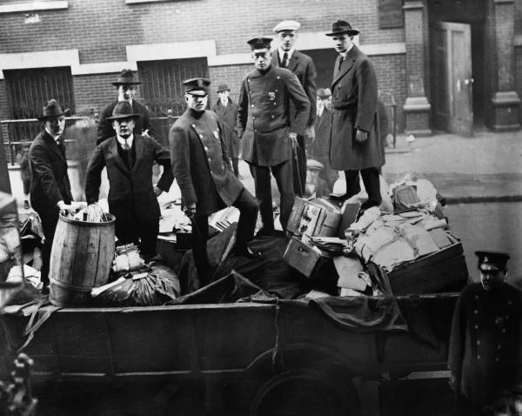
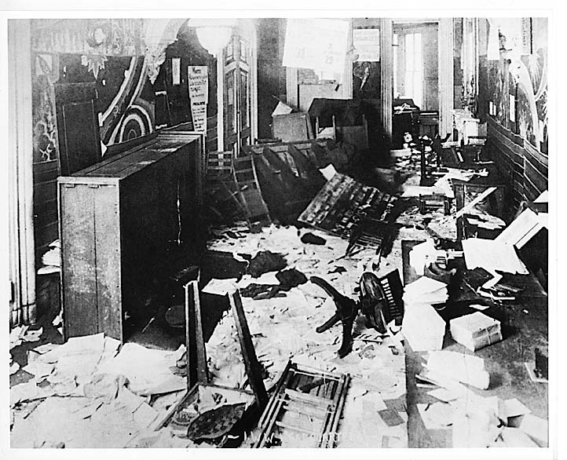
RED SCARE
President Wilson has pushed for Sedition Acts in order to deport political foreigners, then led to massive arrests following bombings. A. Mitchell Palmer (the Attorney General) had 4000 arrested in 33 cities & 249 sent away (illegal searches, no warrants, few civil liberties to the accused).

Slide 7
SOCIAL
ISSUES

Slide 8
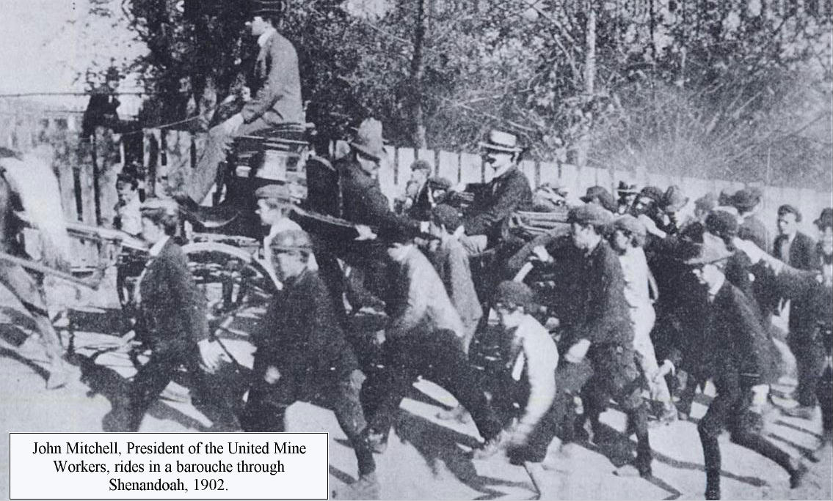
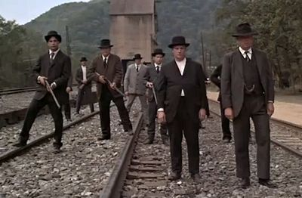
LABOR STRIKES
Popular opinion turned against unions after WWI as a United Mine Workers Strike in Belleville (IL) sets off a chain of strikes across USA.
In one case, Wilson orders 400K coal strikers to choose work or prison.
*There were 3000 strikes in USA in the year 1919 alone, trend continued throughout 1920s.
*Owners used Welfare Capitalism: give great benefits to non-union workers.
*Pic above is from the movie Matewan, details 1920 strike/battle in WV.

Slide 9
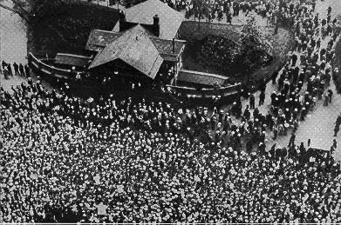
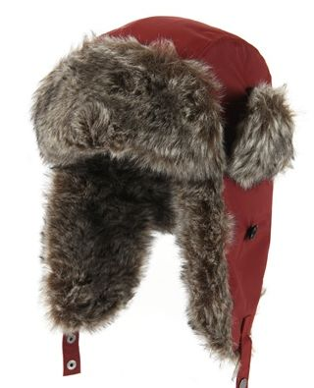
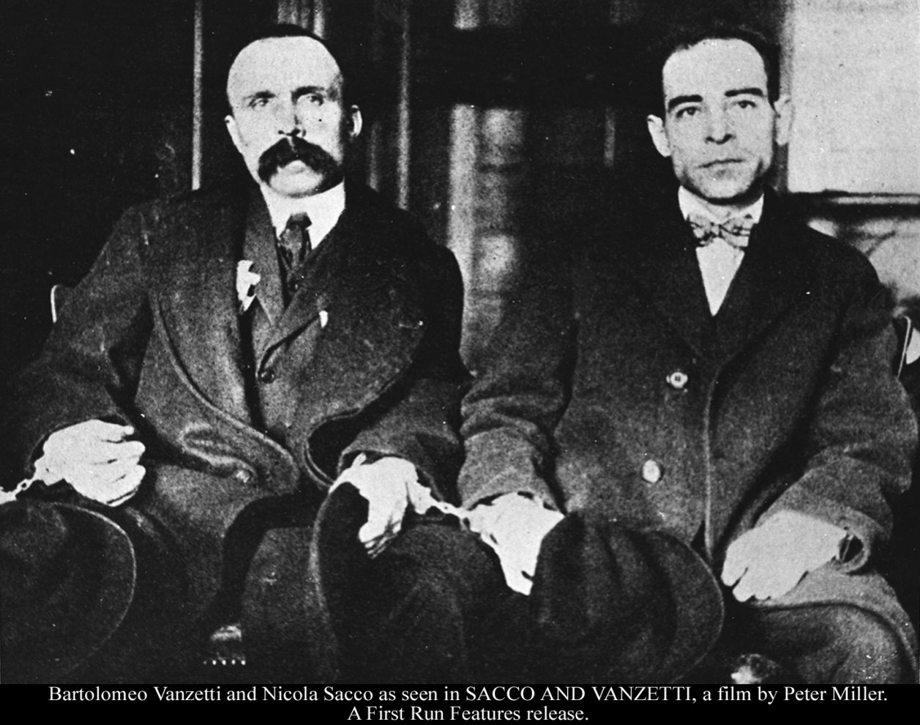
SACCO & VANZETTI
Italian anarchists were accused of murder during an armed robbery. Evidence included bullets, a handle-bar mustache & a floppy-eared winter hat.
*Found guilty & ordered to the electric chair, the big issue is that they had no real chance to be declared innocent via media.
*Sacco’s last words:
“Long Live Anarchy!”

Slide 10
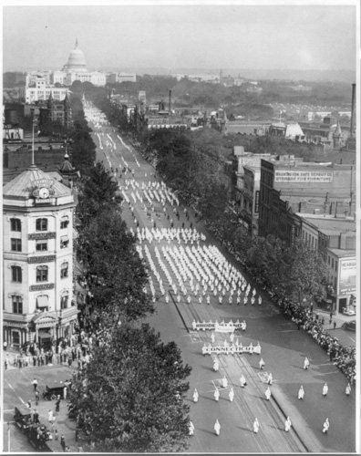
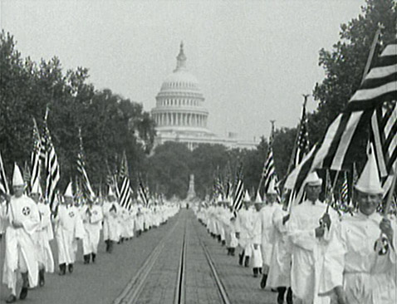
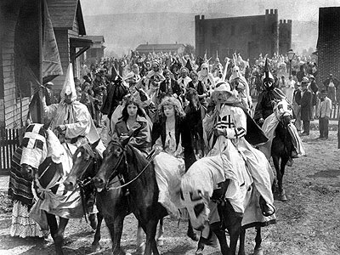
KLU KLUX KLAN
Following the movie Birth of a Nation, KKK re-emerges adding Mexicans, Asians, Chinese & Catholics to hate list.
Grand Dragon David Stephenson claims 4M members nationwide.
*Top are pics from their famous march on DC right is pic from movie. Which state had the highest number of KKK members? Indiana!

Slide 11
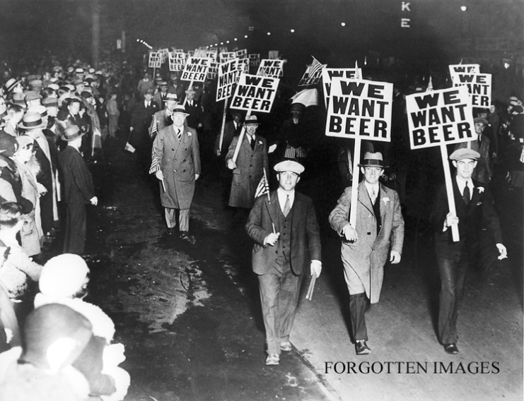
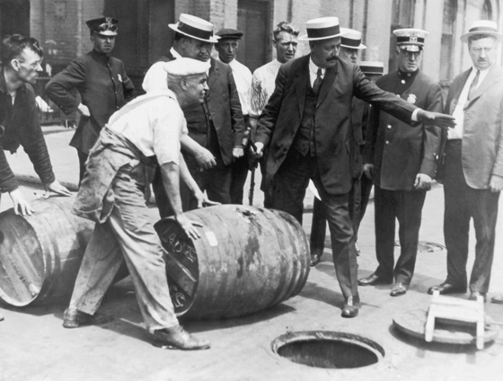
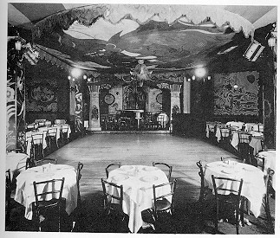
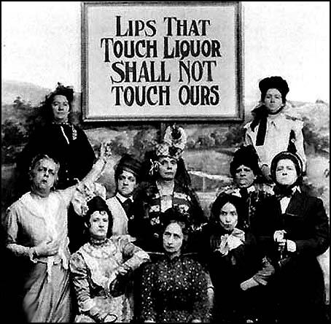
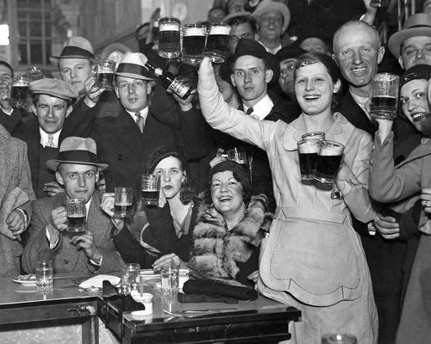
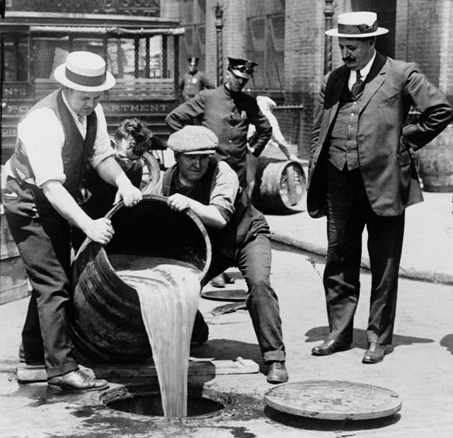
PROHIBITION
Led by the Anti-Saloon League & temperance movement, the 18th Amendment passes making the sale of booze illegal (1500 officers were told to police USA).
*Demand was met by mob, bootleggers, moonshiners, rum runners, etc. as black market is formed in USA.
*Chicago had 10K speakeasies, clubs that illegally sold booze.

Slide 13
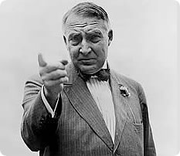
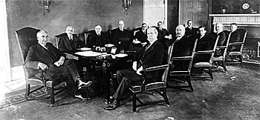
WARREN G. HARDING
Lovable OH Senator wanted to return USA to normalcy (USA tired of war, progressivism, etc.). Had quite a following of Hollywood stars, business tycoons (made up words like “bloviate” promised to end “wiggle & wobble”)
Though WGH had some great advisors, his Ohio Gang was extremely corrupt!
*1 went to prison for fraud, another sold $7M of supplies from a veterans hospital for personal profit, 2 committed suicide before trials even started.

Slide 14
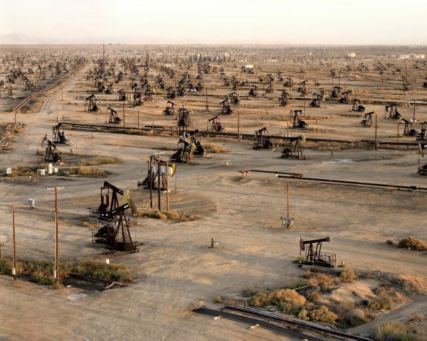
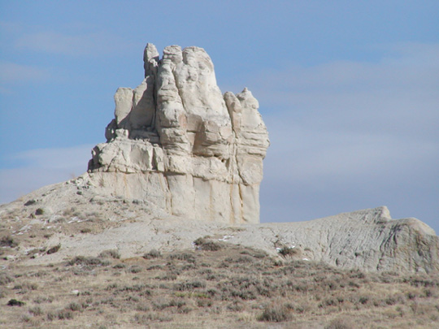
TEAPOT DOME SCANDAL
Under Executive Order, public oil fields were given to Harding’s friends (cabinet member Albert Fall received $100K kickback for the transfer).
*The “new owner” was convicted of jury tampering, another man for bribery, as Fall goes to prison (1st time in history). Later, Harding dies in office.

Slide 15
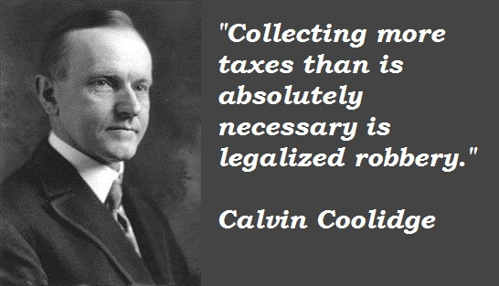
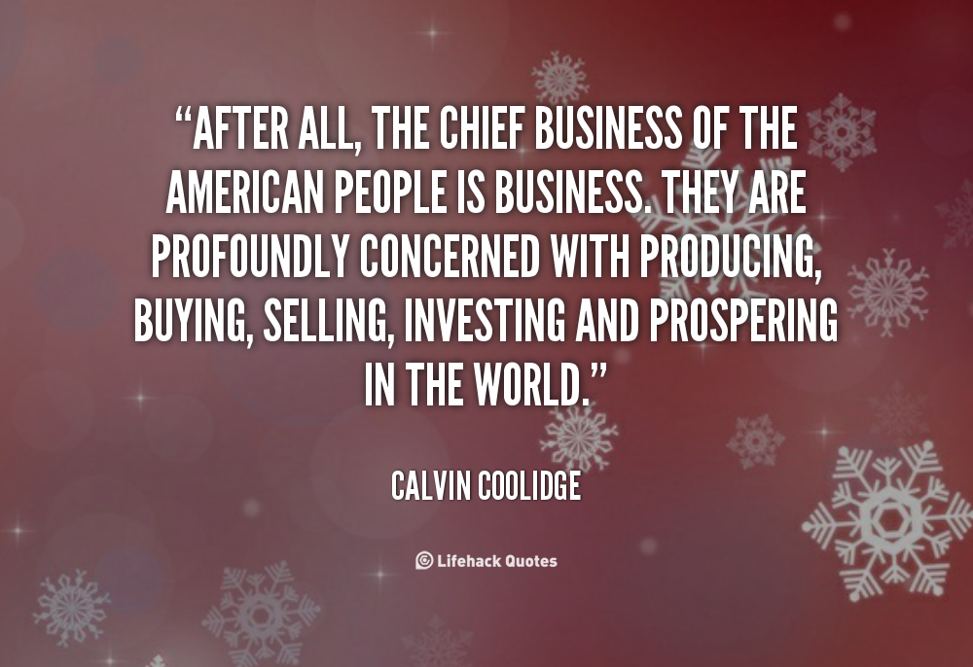
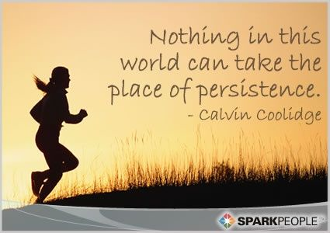
CALVIN COOLIDGE
Silent Cal (MA) became famous after ending a police strike, was a frugal GOV who lived in duplex rather than mansion.
He pushed laissez-faire economics & big business (balanced budget). He kept tariffs high, taxes low & immigrants out.
*A reporter won a meal w/ Coolidge & told him she had a bet she could make him say 3 words. After meal, he put down fork & said “you lose.”

Slide 16
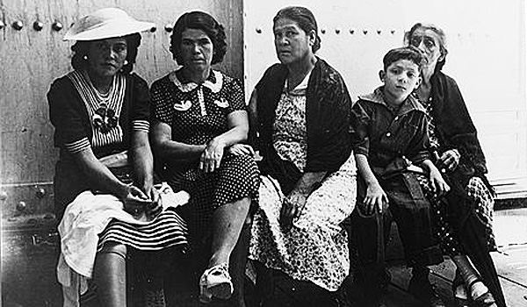
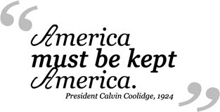
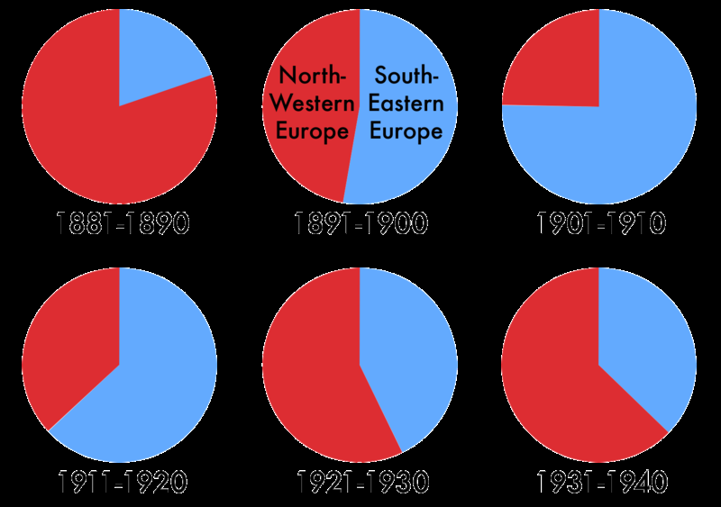
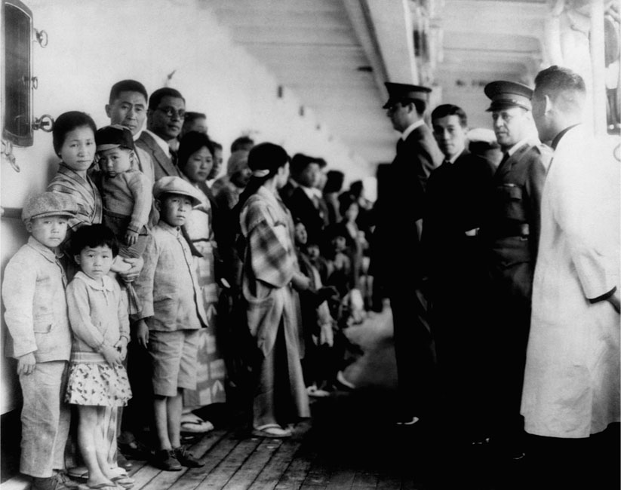
NATIONAL ORIGINS ACT OF 1924
To keep “ethnic status quo,” immigrants from nations other than NW Europe faced severe limitations (just 2% allowed by nation).

Slide 17
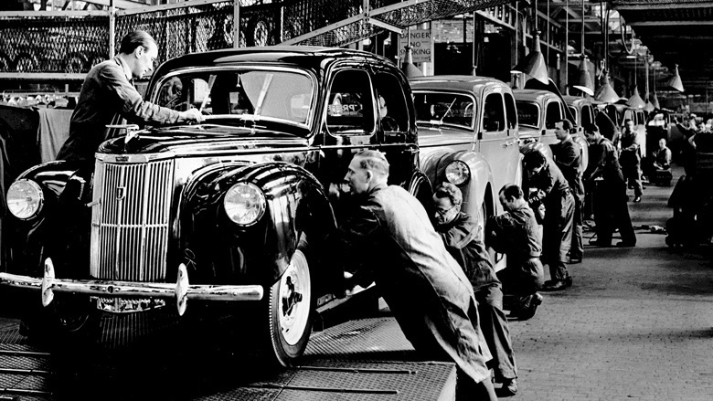
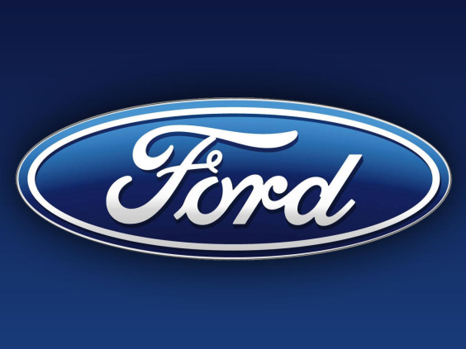
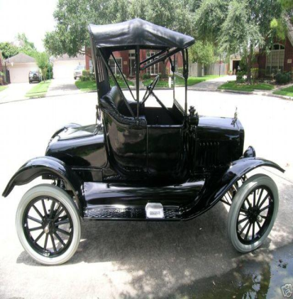
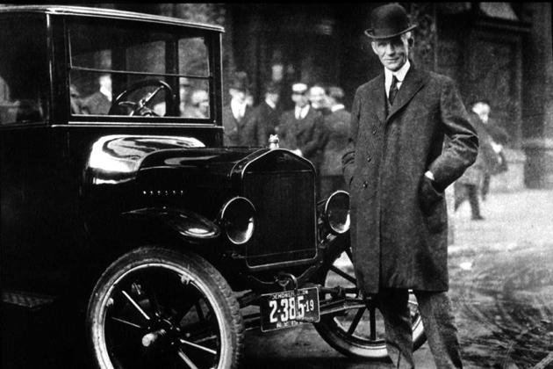
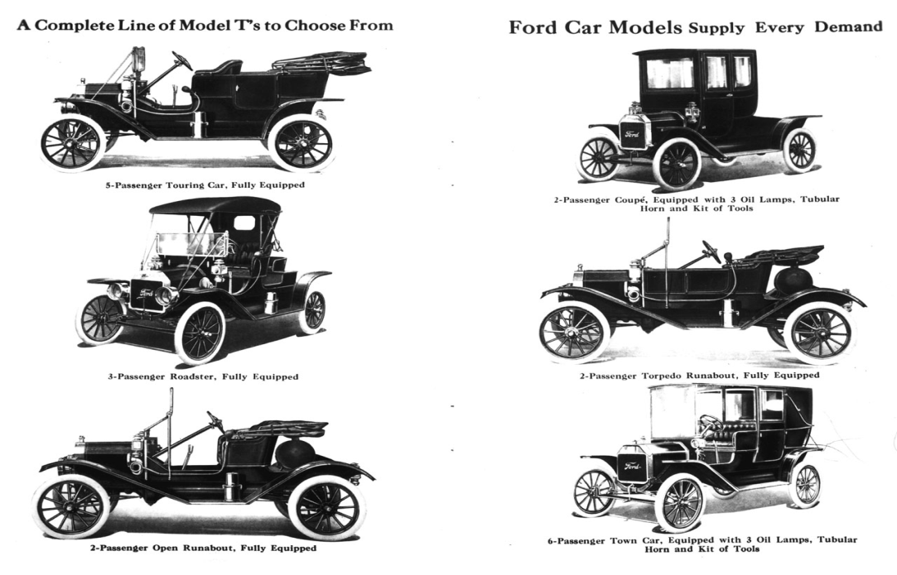
HENRY FORD
Created Assembly Line which cut car production from 14 hours down to 93 mins. By 1925 a Tin Lizzie rolled off the line every 10 seconds. The Model T price dropped from $950 to only $300 ($7000 today).
Ford sold 15M cars in 20 years & workers were paid well at $5 a day!

Slide 18
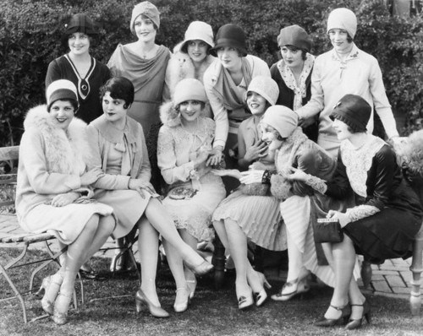
CULTURE

Slide 19
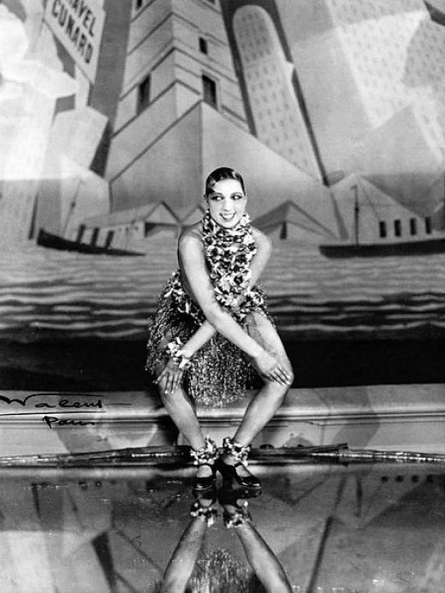
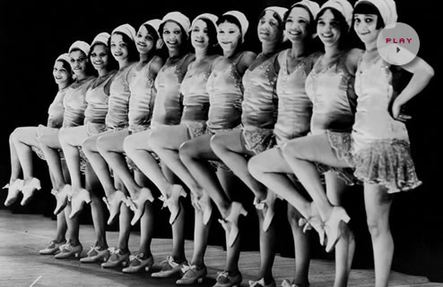
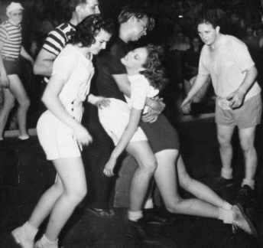
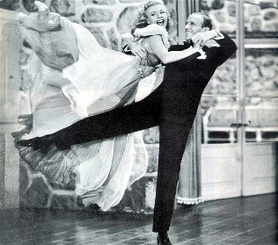
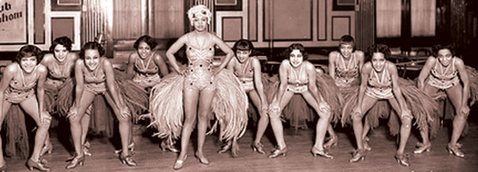
DANCE CRAZES
Charleston, tango, fox trot, waltz, cake walk & others (even had dance marathons).

Slide 20
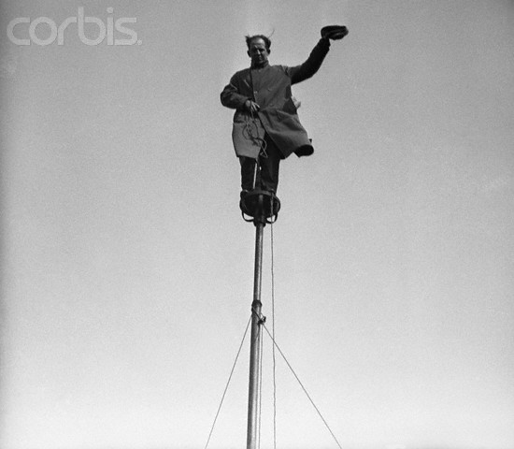
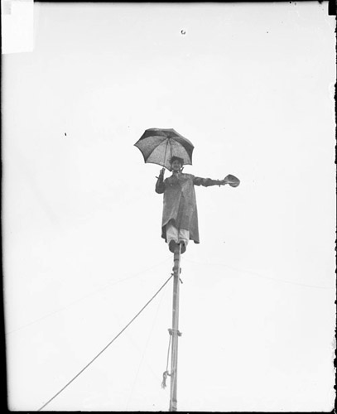
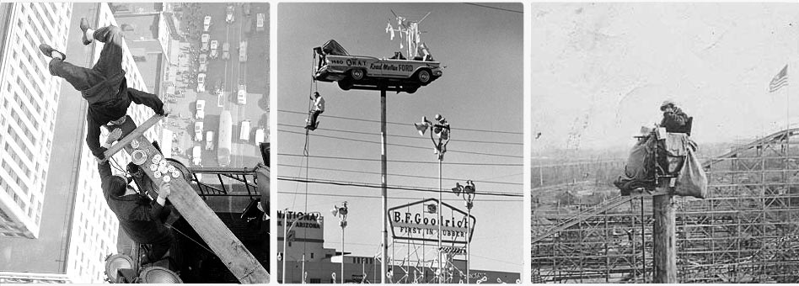
FLAGPOLE SITTING
Endurance test of sitting in the air on a pole
(Shipwreck Kelly actually earned a living income).

Slide 21
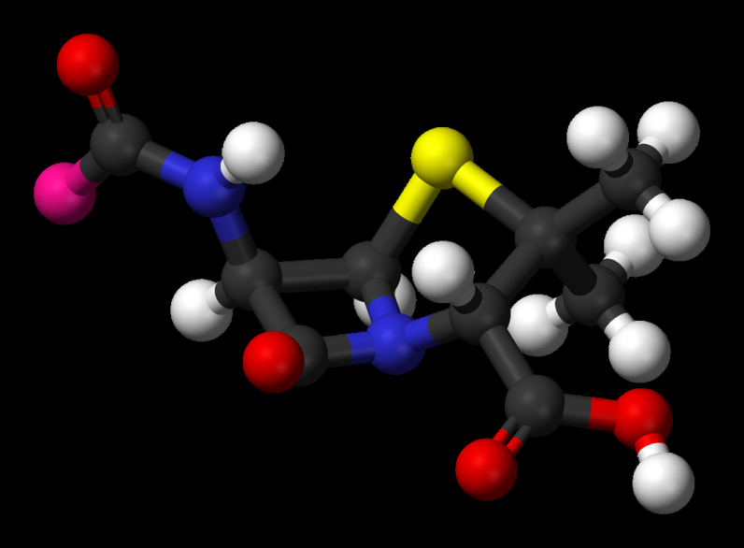
DISCOVERIES
Medicine: Penicillin, insulin & vitamins.
Archeology: King Tut’s Tomb.
*Egyptologists found Tut’s tomb & 1000s of artifacts including 21 pound solid gold death mask (1922).

Slide 22
FADS
Ragtime Music (famous by Scott Joplin), dance marathons, beauty contests, daredevil stunts.

Slide 23
FLAPPERS
Shebas short-bobbed hair, smoked, drank, doused perfume, attended jazz clubs & speakeasies, wore high heels, tons of makeup & mini-skirts.

Slide 24
GANGSTERS

Slide 25
JOHN DILLINGER
Public Enemy #1 robbed banks & stole about $300K (escaped prison twice).
*1st crime was for stealing chickens.
*Known for his turn style leap at banks.
*Dillinger was eventually killed outside the Biograph Theater in Chicago, set up by brothel house owner/girlfriend who was bribed by FBI to not deport her.
*Big Fan of the Chicago Cubs.
*Age was initially called “Dillinger Days.”

Slide 26
MACHINE GUN KELLY
Bootlegger/Kidnapper whose wife gave him his 1st Tommy Gun.
*His gang kidnapped an oil tycoon & got the $200K ransom.
*His trials were the 1st in USA that were filmed by cameras.
*Alcatraz re-nicknamed him Pop Gun Kelly because he was such a model prisoner.

Slide 27
BABY FACE NELSON
Youthful psychopath who robbed banks & killed innocent people.
*Most telling info about his character is that he was kicked out of the Dillinger Gang because he was too dangerous.
*Killed more FBI agents than any of the “Depression Era Gangsters”
*While escaping a MN bank, he sprayed crowd with tommy gun.
*In movie O Brother Where Art Thou, he is called the cow killer.

Slide 28
BONNIE & CLYDE
Robbers traveled thru Midwest robbing stores & outrunning the law (including MO).
*In prison, Clyde had an inmate cut off 2 of his toes in order to avoid work.
*1 of their shootouts took place in Joplin.
*They killed at least 13 during their span, sometimes kidnapping people along way.
*The police ambush put a minimum of 167 bullet holes in their tan 1934 Ford.
*Bonnie had written her own eulogy.

Slide 29
AL CAPONE
*Mob film genre is heavily inspired by Capone, pic from Scarface is to the rt.
*Al also made $$$ thru prostitution.
*After arrest, FDR uses Al’s bullet proof limo for his own personal use.
Scarface amassed $100M from bootlegging & murder (killed over 500 including the St. Valentine’s Day Massacre). He went to White Sox games, opened soup kitchens, enjoyed opera & provided free milk to children.
*He would eventually be found guilty of tax evasion, depicted in movie The Untouchables.

Slide 30
SPORTS
& HEROES

Slide 31
BABE RUTH
*1 time Ruth binged on hot dogs & soda getting sick, called “the bellyache heard round the world.”
Bambino earned $80K/year, was so popular Yankee Stadium was known as House That Ruth Built (career .690 SLG %).
*Ruth’s 60 HRs in 1 season & 714 for career were unthinkable records. He actually started career as a pitcher.

Slide 32
OSCAR CHARLESTON
Negro League icon who led league in HR’s 6 times.
*Other stars in later years would include Josh Gibson, Satchel Paige & the legend Jackie Robinson.
*Josh Gibson was nicknamed the black Babe Ruth, hit over 1000 HRs!

Slide 34
JACK DEMPSEY
Manasses Mauler was boxing icon who held title for 7 years.
*He was so famous, a 1923 fight was in front of 85,000 (another 20,000 couldn’t get in to see) & was live on the radio from his foe’s home in Argentina.
*When he lost to Gene Tunney in ’26, crowd was over 120,000 (rematch vs. Tunney was worth $1,000,000).

Slide 35
BOBBY JONES
*Jones never declared himself a pro, which means his payout for every tourney victory was $0.00, kept amateur status.
Golfer who retired at 28 after winning 13 titles.
*His best year was 1930: had 27 top tens & 13 victories in just 31 tournaments.
*Would later design Augusta National (shown to the right) sight of the Master’s.

Slide 36
CHARLES LINDBERGH
Lucky Lindy flew his Spirit of St. Louis plane on 1st transatlantic flight over the ocean (33 hours & 29 minutes). Tickertape parade weighed 1800 tons.
*Lindbergh was in pursuit of the Orteig Prize--$25K to the 1st pilot to fly the ocean.
*Plane almost crashed during takeoff due to the heavy weight of all the gasoline.
*3610 mile trip ended when 125,000 peeps in Paris stormed the plane to celebrate.

Slide 37
HARLEM
RENAISSANCE

Slide 38
ENTERTAINMENT
Major cultural movement of the 1920s in Harlem, NY used AA actors instead of black-faced minstrel shows.
*Clubs like the Cotton Club & the Apollo made the Harlem nightlife alive.
*Harlem Globetrotters created in 1920s.

Slide 39
LITERATURE
Amazing poets include:
Claude McKay
Langston Hughes
Countee Cullen
James Weldon Johnson
Zora Neale Hurston
*McKay’s If We Must Die is powerful & mentions the upcoming fight for the AA.
*JWJ’s Lift Every Voice and Sing is often referred to as the black national anthem.
*Hughes is officially the 1st AA person to earn a living solely from writing.
*Historians agree that the Civil Rights movement has roots in the Jazz Age.

Slide 40
JAZZ
Difficult to explain, uses upbeat improvised rhythms, began in New Orleans. Famed performers include: Louis Armstrong, Joe “King” Oliver & Duke Ellington.
*Nicknamed “Satchmo,” LA played trumpet & cornet. Like Ella Fitzgerald, he was considered a great “scat singer” (no words just notes).
*Some say it combines 1910s big band swing with ragtime, but even that is too vague. Key word is improvisation.

Slide 41
BLUES
*Style is a 3 stanza story in which the 1st two lines sort of repeat & the 3rd line answers the 1st two.
*Though Chicago becomes famous for the blues, many argue that official origination actually comes from St. Louis (think Hockey team).
Somewhat depressing genre w/ roots in the field hollers, has to be experienced. Perfected by “Jelly Roll” Bessie Smith & “Mother of Blues” Ma Rainey.

Slide 42
END OF THE JAZZ AGE

Slide 43
HOUSEHOLD TRENDS
Phonograph: Begin in 1905, making 100 million a year by 1921.
Refrigerator: Only 5000 in world in 1920, by 1931 making 1M a year.
Magazines: Readers Digest & Time boasted circulations of 2M each.
Radio: Before WWI few had even heard of it. By ‘29, 4M a year were made
NEWS FLASH: The amount of debt owed by Americans was off the chart!!!

Slide 44
TRI-STATE TORNADO
Deadliest tornado in history killed 695, left an unbelievable 219 mile track from SE MO crossing MS River into IL & ending up in Indiana (destroyed 9 schools during day). Last 3 ½ hours.

Slide 45
SCOPES MONKEY TRIAL
Lawyer Clarence Darrow defended John Scope’s rights to teach evolution. Aging politician William Jennings Bryan defends creation.
Creation wins: but theory takes a credibility hit when questions about Adam’s Rib, Cane’s wife, Eve’s temptation & age of universe come up.
*Odd, the whole case was a set up from the beginning. ACLU said they would defend anyone who would be willing to teach evolution, then asked Scopes to do it.
*Scopes said he didn’t really even remember teaching it, but did go over a chart with some monkeys on it. He actually encouraged students to testify against him.
*Darrow was almost held in contempt during the case.

