Slide 1
Digital Citizenship and Etiquette Lesson
Coach Armstrong
METRO HIGH 19-20’

Slide 2
Digital Citizenship
Some key terms you need to know…
Digital Footprint: Evidence of a person’s use of the Internet. This includes anything that can be linked to his or her existence, presence, or identity Watch this link for more info… http://www.youtube.com/watch?v=kHYkWtI7004
Digital Immigrant: A person who has not grown up with digital technology, such as computers, cell phones and the internet but have adopted to it later (believe it or not these things have not always existed!!)
Digital Native: A person who has grown up with digital technology. Many young adults would be classified as digital natives because they have not known a time without the Internet or cell phones.

Slide 3
What is Digital Citizenship?
Digital citizenship can be defined as the appropriate, responsible behavior with regard to technology use.
Try this link for a good explanation: http://www.youtube.com/watch?v=FdEXijFXfD8&feature=related
Digital Etiquette: electronic standard of conduct or procedure
Digital Communication: electronic exchange of information
Digital Literacy: process of teaching and learning about technology and the use of technology
Digital Commerce: electronic buying and selling of goods
Digital Law: electronic responsibility for actions and deeds
Digital Rights and Responsibilities: those freedoms extended to everyone in a digital world
Digital Security (self-protection): electronic precautions to guaranteed safety
http://www.digitalcitizenship.net/

Slide 4
What is Cyberbullying?
What are some steps that you can personally take in order to help yourself or others if cyberbullying occurs?

Slide 5
More on Cyberbullying
Bullying is defined as repeated and deliberate harrassment by one towards another. It can involved threats or indirect and subtle forms of aggression, including rumor spreading
Cyberbullying is the intentional and repeated harm inflicted through the use of computers, cell phones, and other electronic devices
When someone repeatedly makes fun of another person online or repeatedly picks on another person through email and/or text messages, or when someone posts something online about another person that the person doesn’t like

Slide 6
Even more to discuss…
Bullying and Cyber bullying have been growing exponentially ever since social media has boomed.
It is NEVER ok to bully someone.
Remember that words can hurt…be careful what you say and write to others.
There is a difference between joking around with friends and making fun of someone and trying to hurt their feelings.
You need to report bullying if you feel it is happening to you or a friend.

Slide 7
Real Life Examples …
https://www.youtube.com/watch?v=C5YFANVQpjs
Click on the link to watch.

Slide 8
Who can help you???
There are lots of people that you can go to if you or a friend are being bullied
Parents, grandparents, other family members
Teachers, Guidance Counselors
Administrators in our school
Friends or friends parents
ANY adult you feel comfortable talking to can help you out if you feel like you are being bullied

Slide 9
Who has experienced cyberbullying?
Statistics on cyberbullying
42% of kids say they have been bullied online
35% of kids have been threatened online
21% of kids have received mean or threatening emails or other messages
58% of kids admits someone has said mean or hurtful things to them online
53% of kids ADMIT to having said something mean or hurtful to ANOTHER person online!!!
THINK BEFORE YOU POST!!!

Slide 10
You can prevent Cyberbullying
Refuse to pass along cyber bullying messages
Tell friends to STOP cyber bullying
Block communication with anyone that cyber bullies
Report cyber bullying (or any bullying) to a trusted adult
Remember if you wouldn’t say it in person don’t say it online!
Speak up and Stop it!

Slide 11
Final thoughts on Bullying from Coach
Remember: Words can hurt, think before you say or write something to another person
It is not ok to pick on a person because you think they are different from you, or weird, or nerdy, or geeky…
We are all a little different in our own ways and no one person is better than another
There are lots of people that will help you out if you feel like you are being bullied
If you are being a bully STOP NOW
If you are being bullied GET HELP

Slide 12
Digital Footprint
Everyone should be monitoring their digital footprint…as you get older your footprint will get bigger
Things to keep in mind about your footprint
Don’t post anything you wouldn’t want your grandmother to see
Set all your social-networking accounts to private (including your wall)
Google yourself once or twice a month
If you find something you do not like, be proactive
Be cautious in posting or blogging about anything too controversial
Never Cyber Bully!!

Slide 13
How to create a positive footprint:
With the help of your teachers you can start to:
Create positive online reports using new technologies (for example Glogster’s and Prezi’s)
Publish your own original works on-line
Use the internet as a positive, educational resource
Know how to evaluate the validity of a website
Protect your on-line reputation by watching what you put on-line

Slide 14
Google yourself…
Go to www.google.com
This is the number one search engine right now on the internet
Type in your full name and see what comes up?
This is one way to see what is out there attached to your name
There may be people in the world that share your name so you may find things that aren’t about you but share your name

Slide 15
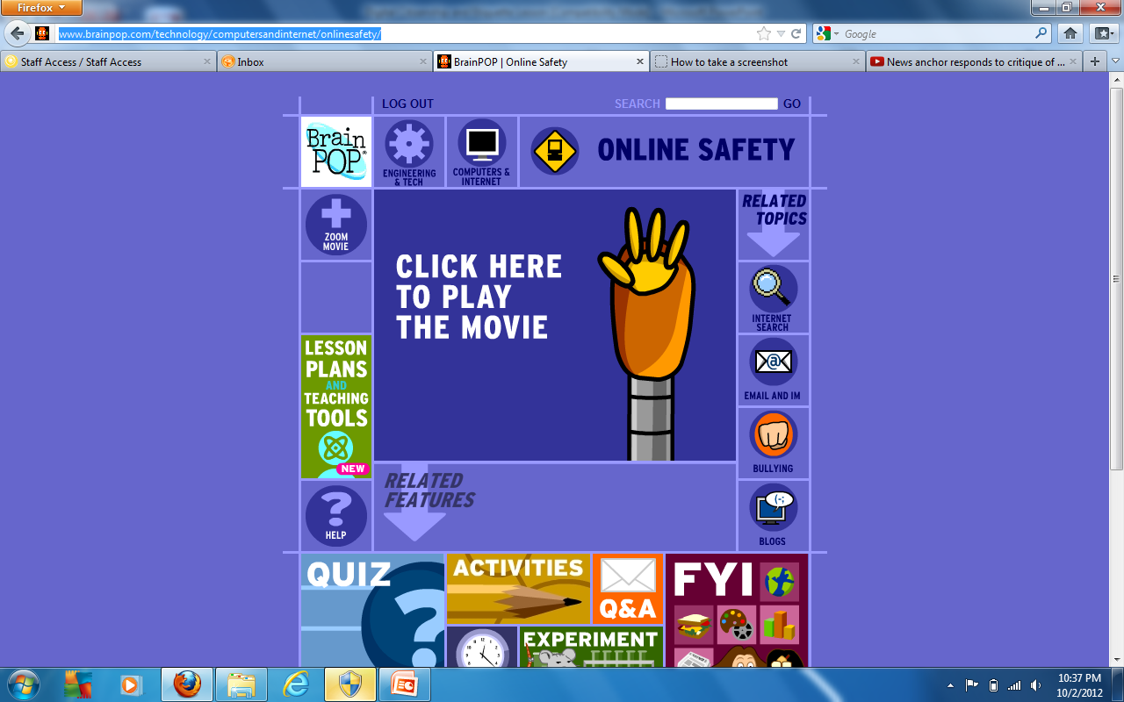
Online Privacy
Back to Brainpop…
Watch the Online Safety video clip
Click here… http://www.brainpop.com/technology/computersandinternet/onlinesafety/
Answer the question on your worksheet about online privacy

Slide 16
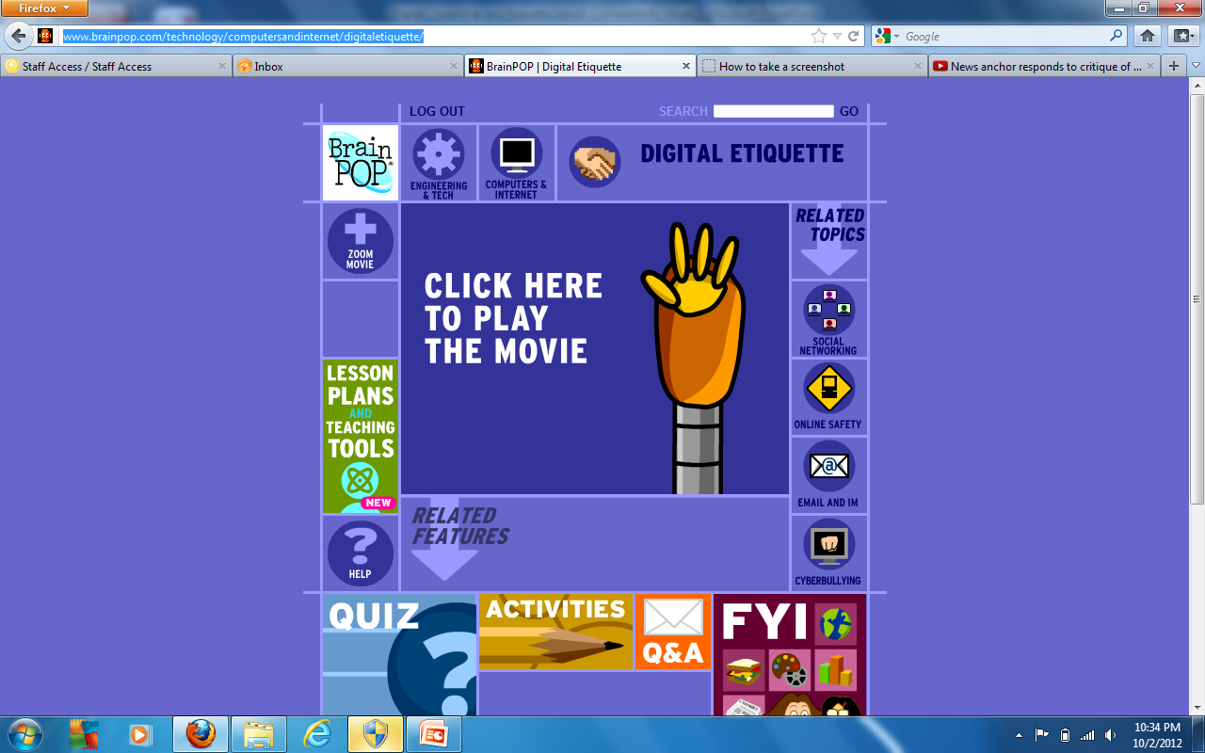
Digital Etiquette
Watch the Digital Etiquette brainpop clip and answer the first THREE questions on the worksheet under digital etiquette
Click here… http://www.brainpop.com/technology/computersandinternet/digitaletiquette/

Slide 17
Some rules of email and Internet Activity:
Keep emails short and to the point
Start emails with Dear, for example: Dear Miss Springborn
Always remember to include your name at the end of the email, for example I would use Miss Springborn
It’s a good idea to include your class period when emailing a teacher
Some abbreviations and emoticons are ok to use with friends and family only
BUT, not appropriate to use in more formal messages (like with teachers)

Slide 18
More rules:
Don’t use all capitols because it will seem like your yelling
Humor isn’t always obvious in writing
Always re-read your emails before hitting send
Check your tone, grammar, and spelling to make sure you really mean what you are saying
Make sure you have permission before posting anything about your friends on a blog

Slide 19
And most importantly…
Remember: The internet is not a private place, DON’T post things that you wouldn’t want your parents, teachers, principals, school admissions directors, future employers, to see
Now if you have time: Log into your Hamburg School email account and check it out.
Try sending an email to either a teacher (this year or last year), a friend, etc. to practice your new skills. Remember the rules above!!

Slide 20
10 Ways To Be a Better Friend:
It’s ok to be mad, it’s not ok to be mean
Don’t respond to bullying by bullying back
Be a hero Bystander, reach out to kids who are being bullied
Don’t put others down to build yourself up
Be accepting of others differences
Hang out with friends who make you feel good about yourself
Don’t just say “Sorry” Show you are sorry!
Take responsibility for your hurtful behavior by making amends
Know the difference between tattling and reporting (tattling gets someone in trouble, reporting keeps someone from getting hurt)
Report Bullying to a grown up you trush

